Slide 1
902001 4K ROV Main Camera Development
The deep sea visual images collected by MBARI’s Remotely Operated Vehicles (ROV’s) are often the most important returned science data.
  Species identification, abundance and behavior.
  Seafloor composition and properties.
  Documentation of operations such as coring.
Visual images from our ROV’s are also a vital component of science publications as well as MBARI’s and MBA’s public education and outreach programs – exceptional video imagery has been a core identity at MBARI since our founding!

Slide 2
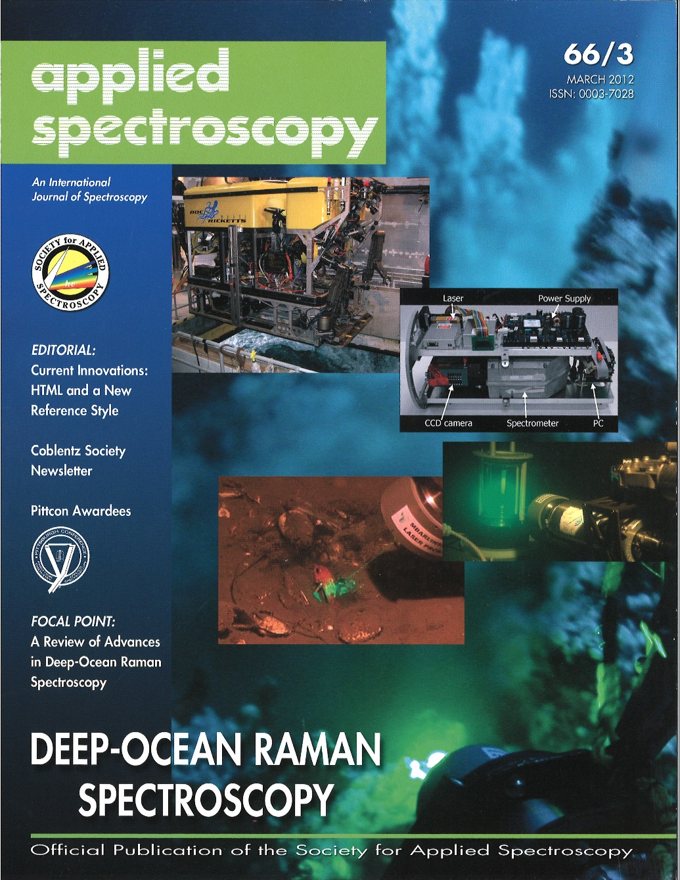
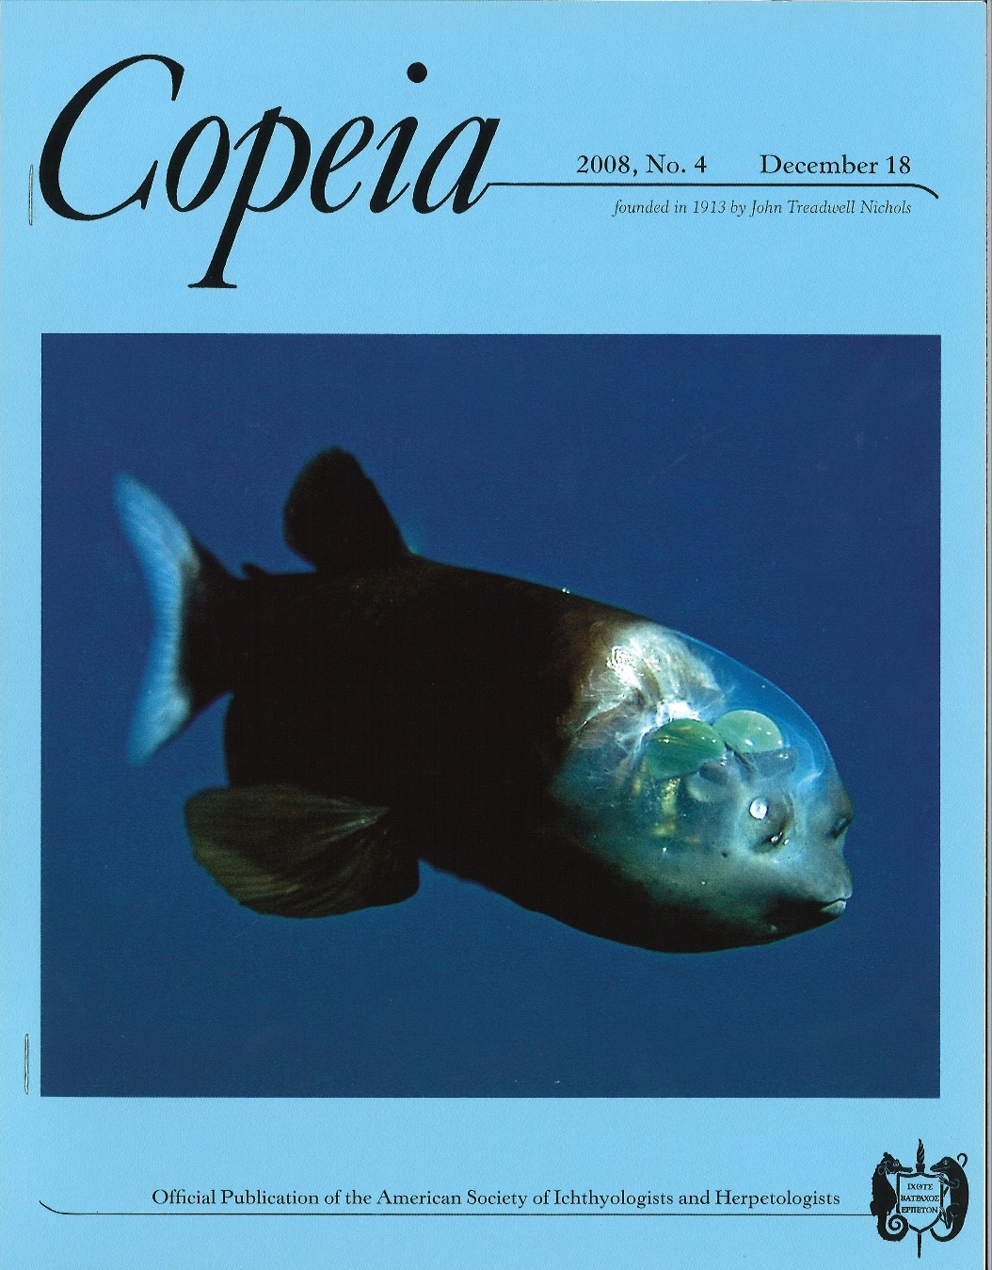

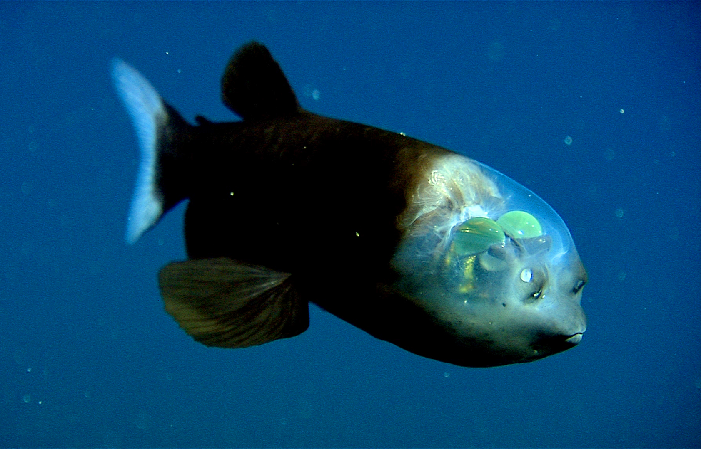
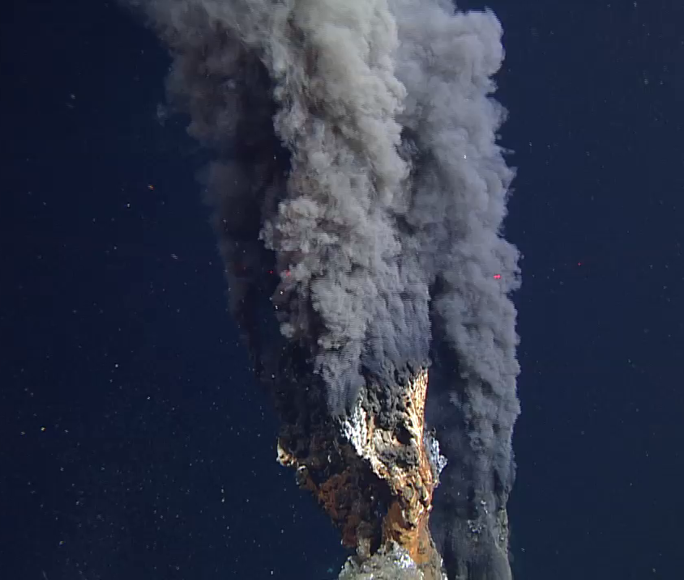

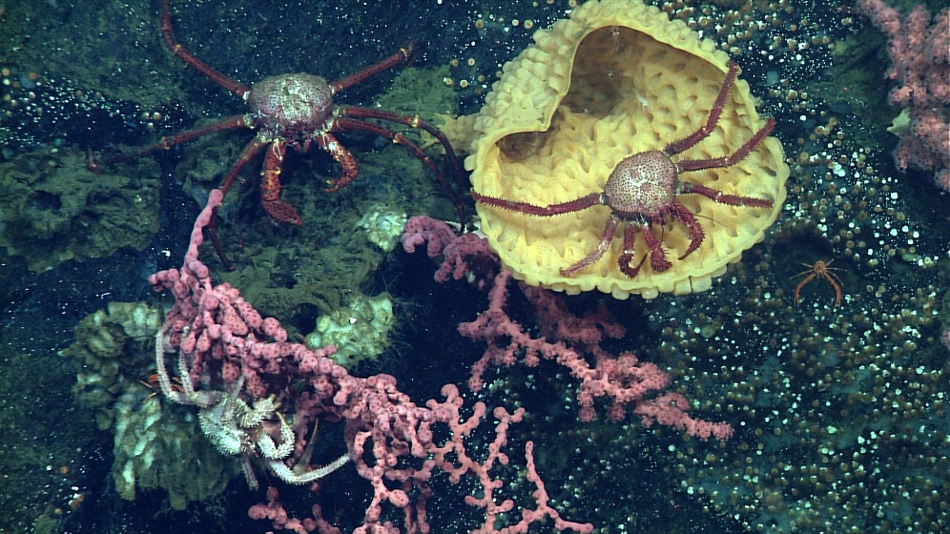
ROV video images are essential for MBARI’s Research Mission
902001 4K ROV Main Camera Development
Notes:
This is an example of one of the vent chimneys first discovered in the AUV mapping along the Alarcon rise.

Slide 3
902001 4K ROV Main Camera Development
As the world transitions from “High Definition” to “Ultra High Definition”, MBARI is well positioned to take the lead on collecting exceptional deep sea video.
  Our regular access to the deep sea.
  Our history of developing high quality camera systems.
  Our storage and processing capacity.
The project has received bids from four commercial vendors for a co-development effort.
A final decision on vendor selection or completing the entire project in-house is pending and completion is scheduled for Fall 2020.

