Slide 1


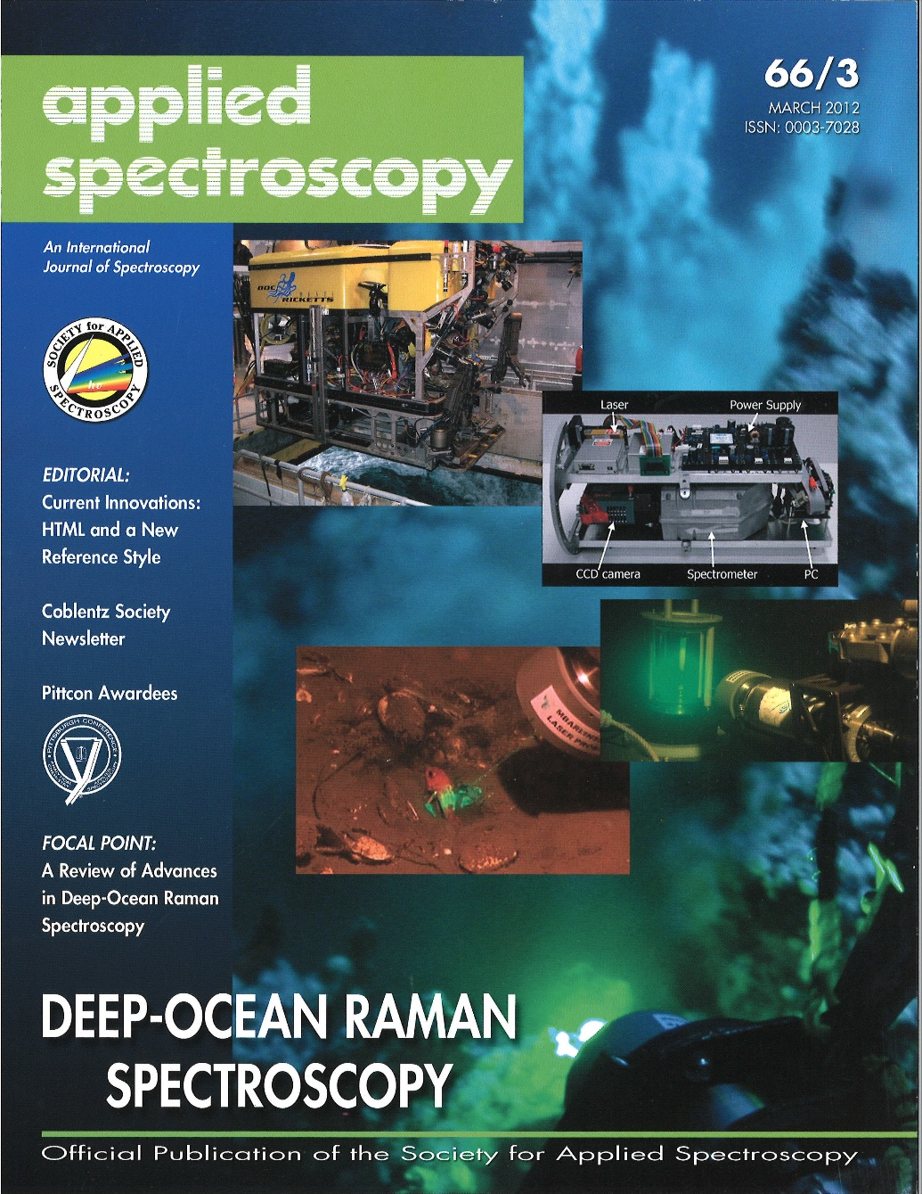

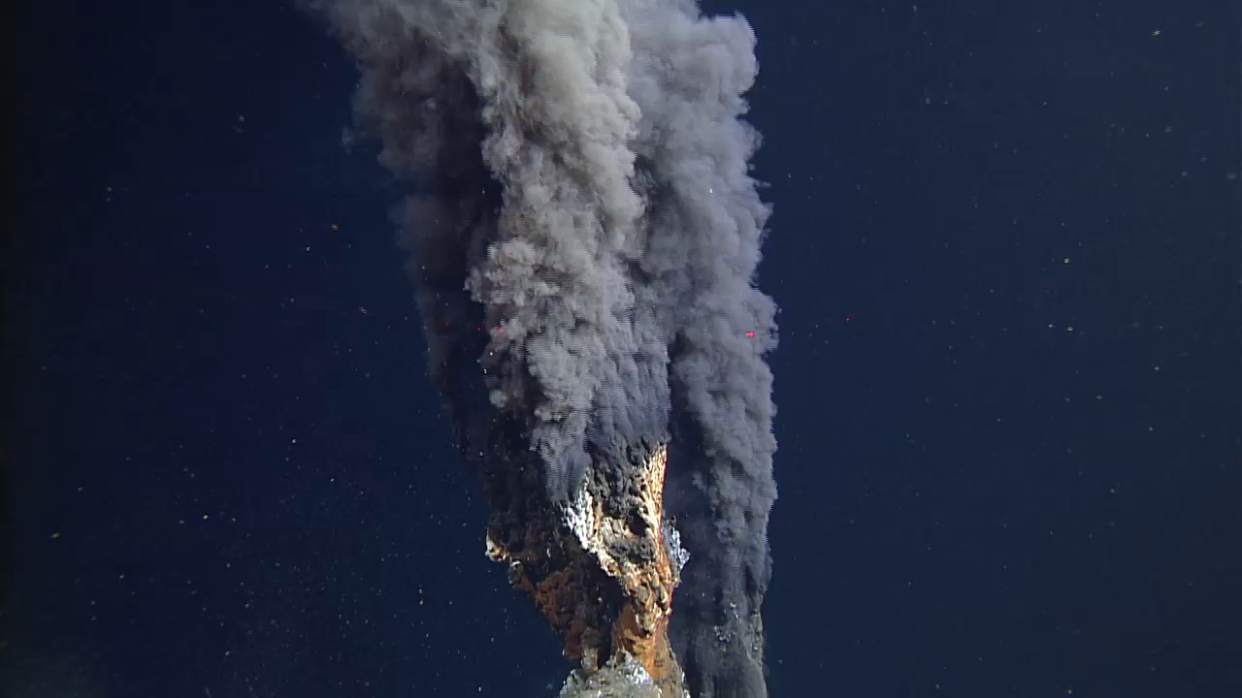
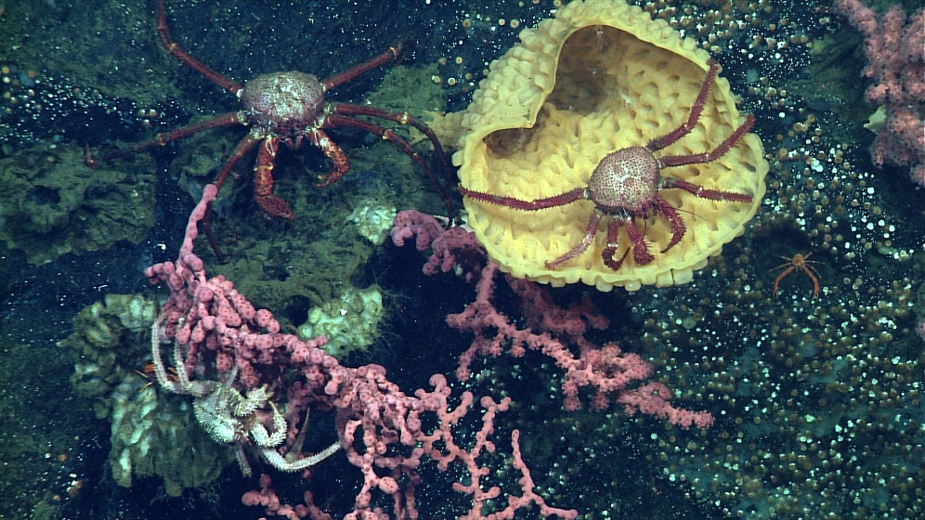
902001 4K ROV Main Camera Development
The deep sea visual images collected by MBARI’s Remotely Operated Vehicles (ROV’s) are often the most important returned science data.
  Species identification, abundance and behavior.
  Seafloor composition and properties.
  Documentation of operations such as coring.
  Illustrations for scientific publications and MBARI’s and MBA’s education and outreach programs.
Exceptional video imagery has been a core identity at MBARI since our founding,
Transitioning from “High Definition” to “Ultra High Definition”, MBARI is well positioned to assume a leadership position in adapting this technology to the deep sea.

Slide 2
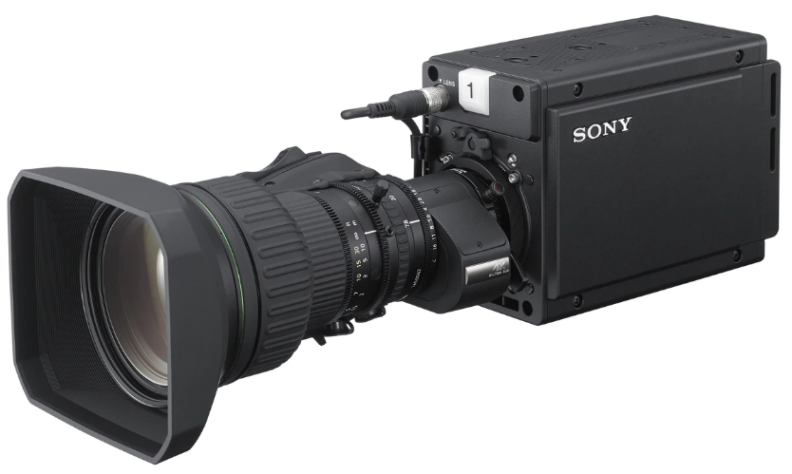
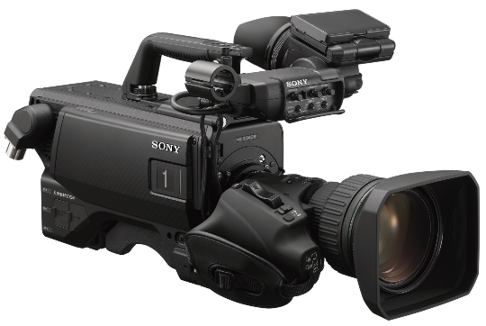
The Project is designed Around the Sony HDC-P50 Camera
No available commercial ROV camera product provides equivalent imaging performance.
Sony HDC-P50 Module and Canon CJ15ex4.3B 4K UHD Super Wide lens with 15x optical zoom.
  2/3” 3-Chip global shutter CMOS imager*.
  4096x2160 progressive scanning @ 60 frames/sec.
  ITU-R BT.2020 color gamut.
  High Dynamic Range (HDR) capable.
  Professional topside control box supports precision rate zoom and position focus servos.
  Single fiber telemetry for dual 12G-SDI video (24G!!) and all auxiliary channels supports most features including high frame rates.
  18-36Volt DC power supply input (18-30V with integrated sizing lasers).
  Internal monitoring for temperature, humidity, pressure and water alarm.
  Housing size approximately equivalent to current Insite Pacific Zeus Plus camera.
The HDC-P50 is derived from the Sony HDC-3500 and 4500 series field cameras.
  * The 2/3” 4k imager is key, allowing a large depth of field, super wide angle and large zoom in a compact lens.

Slide 3
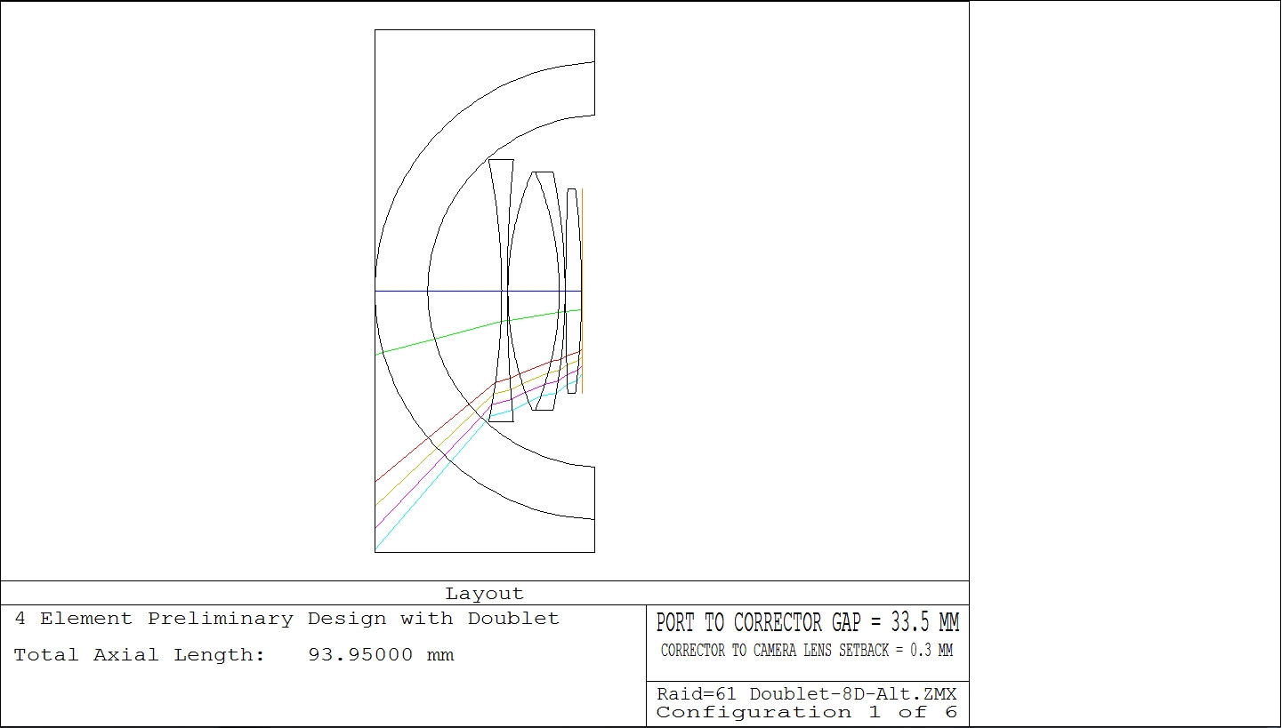
902001 4K ROV Main Camera Status
In 2020 MBARI entered into a collaborative agreement with Deep Sea Power and Light corporation to co-develop this state-of-the-art 4K ROV camera.
  MBARI develops the camera, telemetry and control systems.
  DSP&L develops the pressure housing and optical relay system.
  DSP&L licenses MBARI contribution and provides royalties for commercial sales.
The design of the system is 95% complete and the manufacturing of components is underway.
  Optical lenses and dome port have been received and are in test.
  The Telemetry system has been fully tested.
  The Mechanical design is complete and manufacturing drawings are in progress.
  The final electrical design is in progress.
Optical dome, relay lenses, and ray pattern

Slide 4
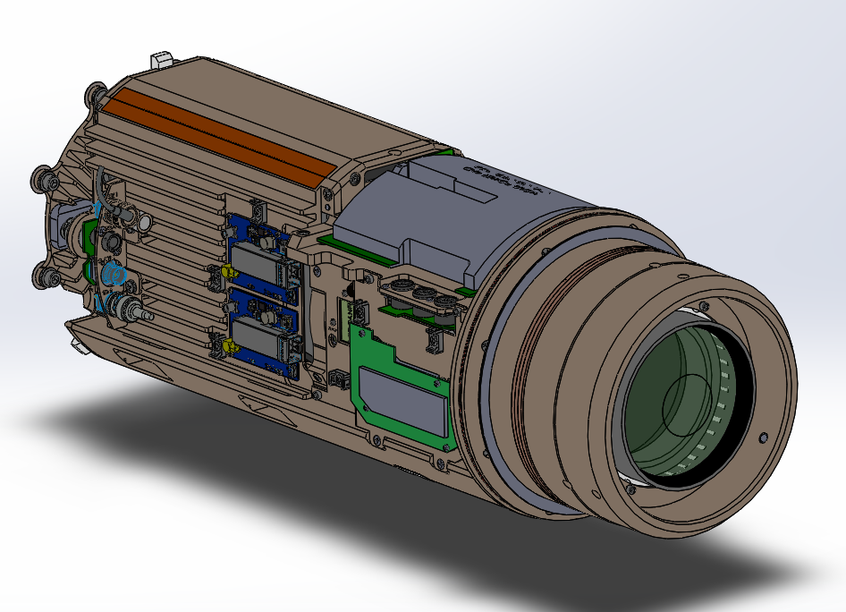
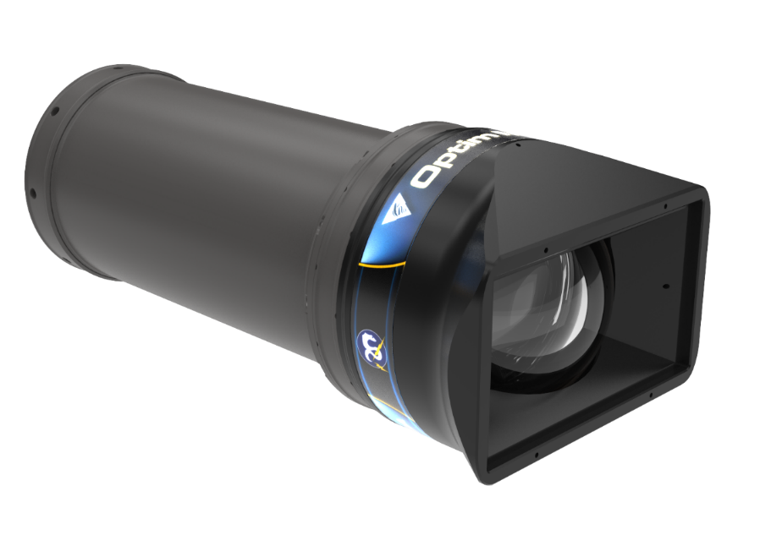
902001 4K ROV Main Camera Status
Internal mechanical and optical structure
Mechanical model complete
Thermal analysis complete
Manufacturing drawings underway
Housing design model is complete
FEA analysis complete
Shortened test article complete.
Over 1,700 pressure cycles on dome and seals.
  This project was originally planned for Fall 2020 completion. We are pushing hard to complete and install in the first half of 2021.

