Slide 1
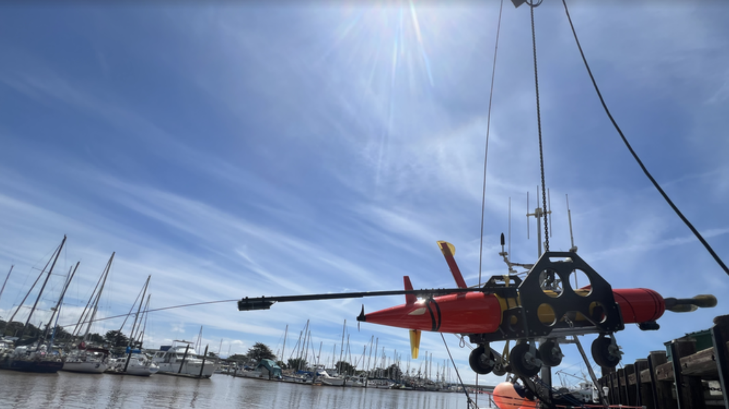
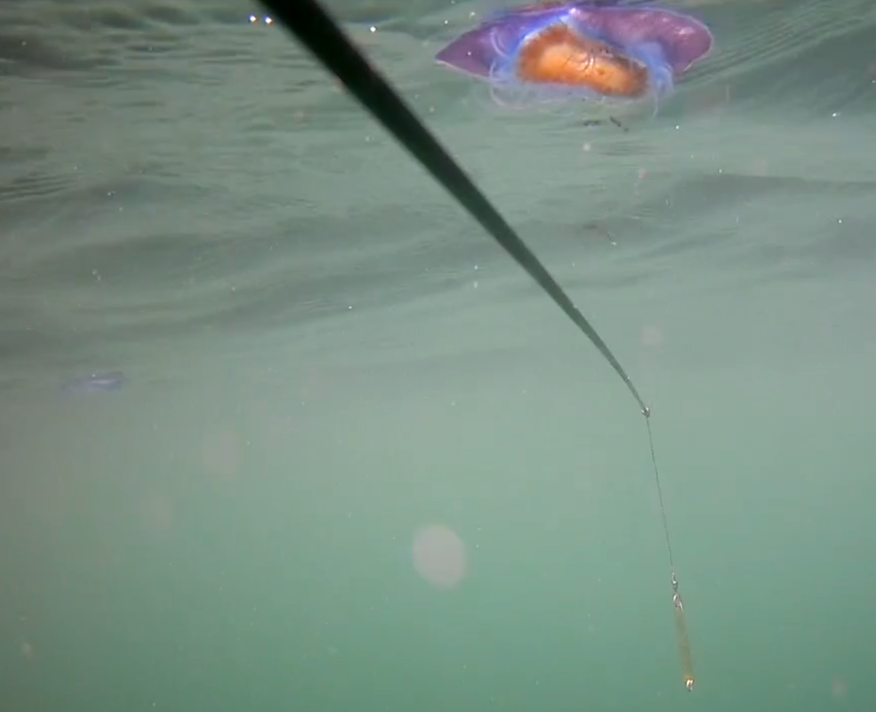
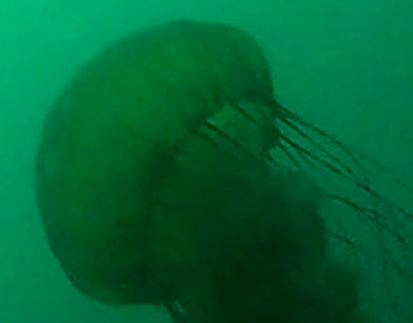
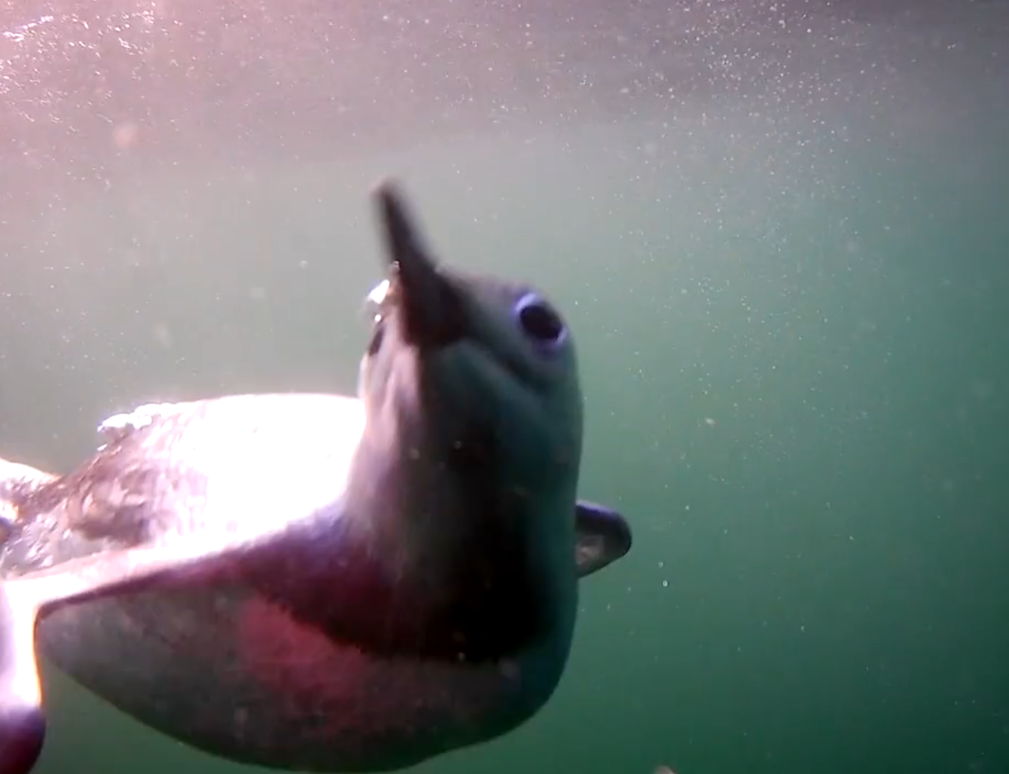
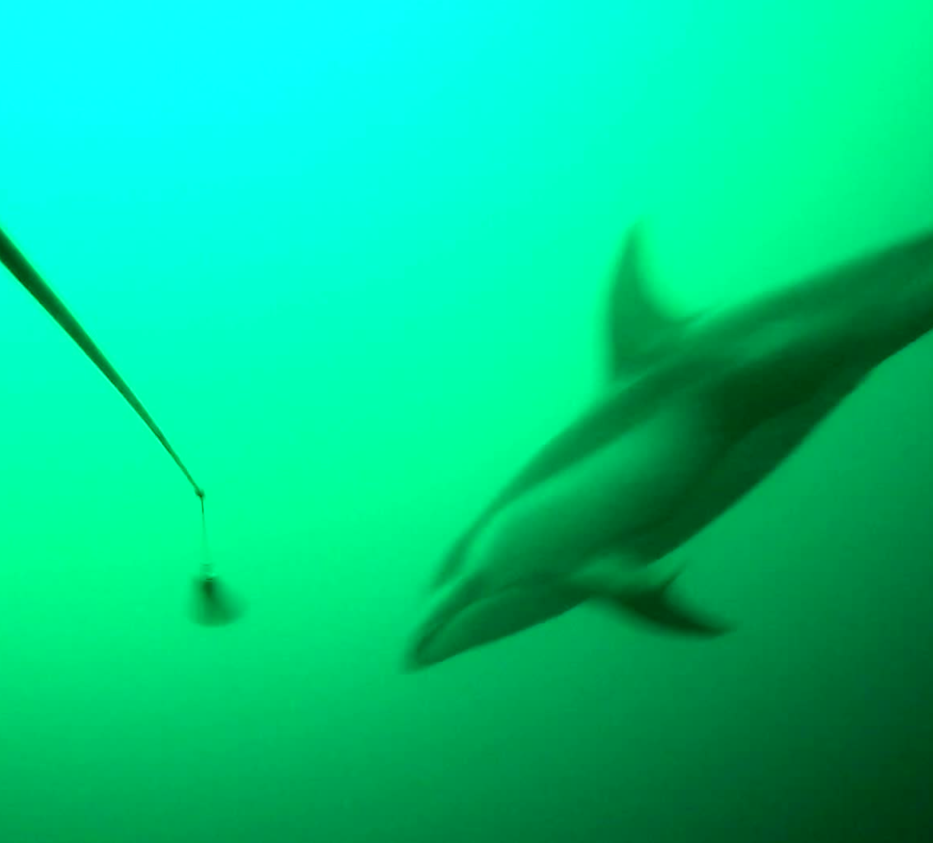
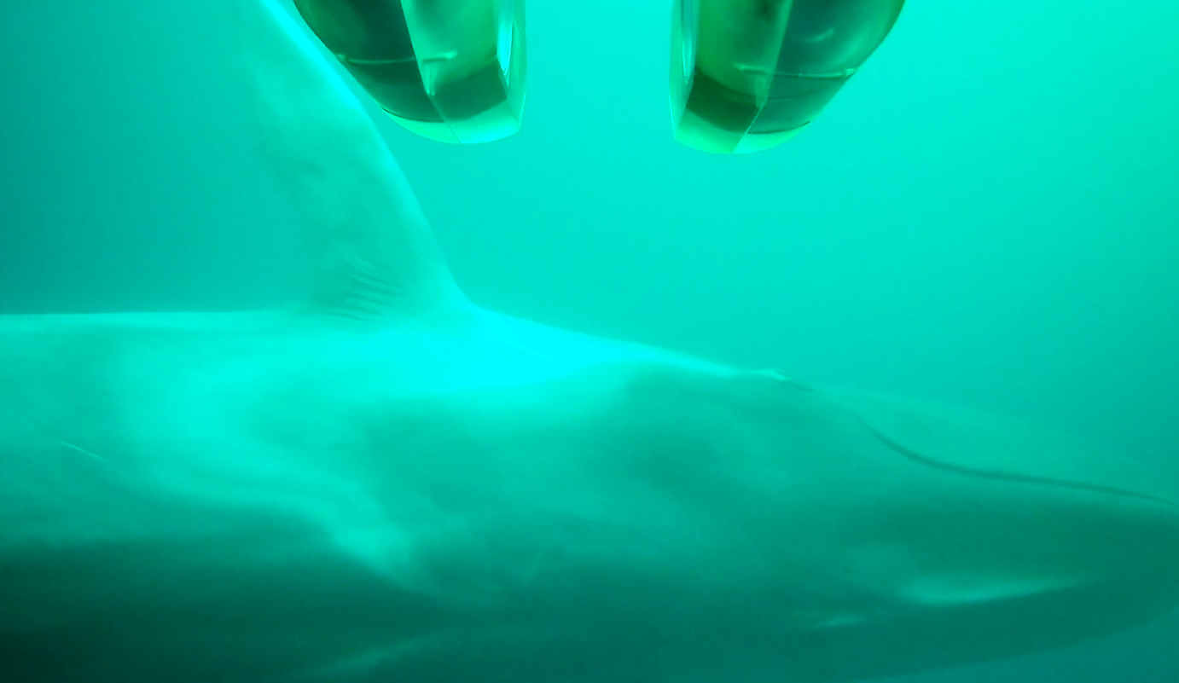
Piscivore
Video: 1920x1080p30
Camera: GoFishCam, 4W
Lighting, ambient
Raw Data Rate: 120 MB/s
0.5-1.0 m/s
1 cm to 10 m size range

Slide 2
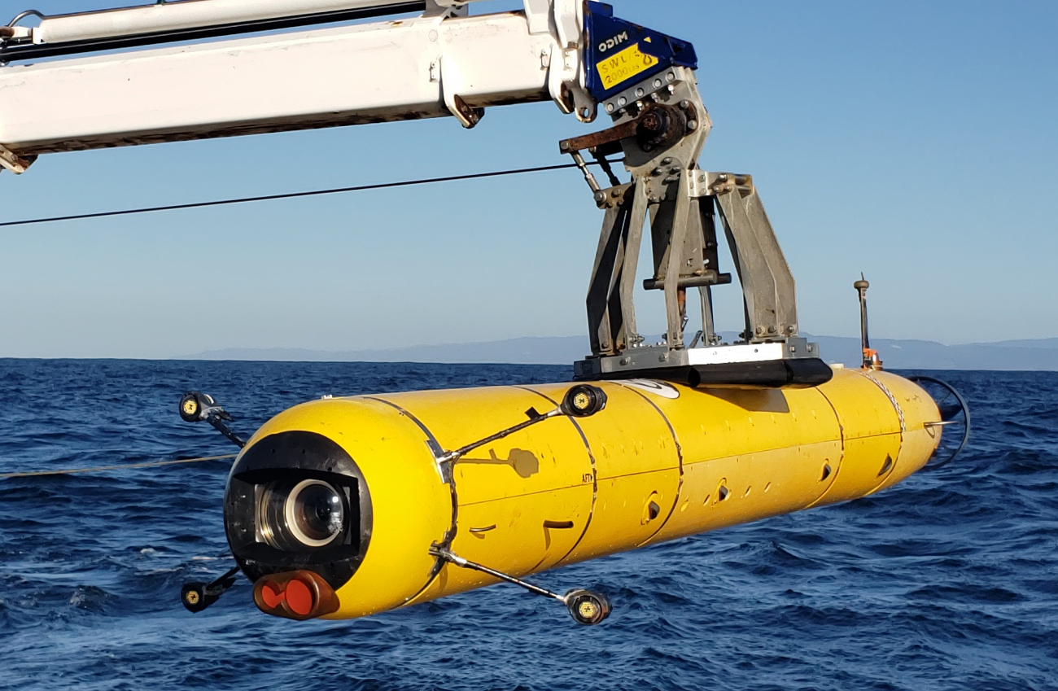
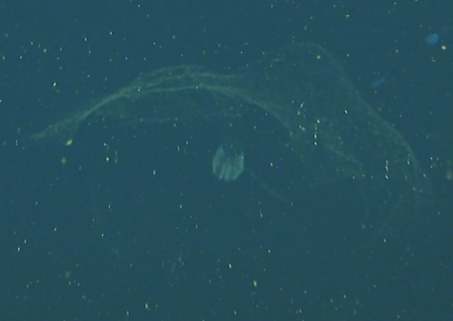
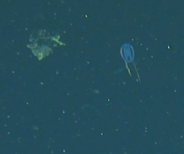
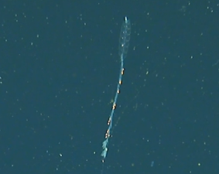
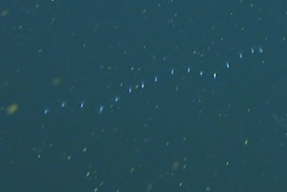
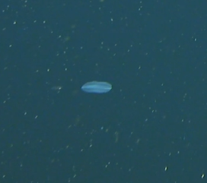
i2MAP
Video: 1920x1080p60
Lighting, 400 W LED
Raw Data Rate: 120 MB/s
0.8-1.5 m/s
1 cm to 1 m size range

Slide 3
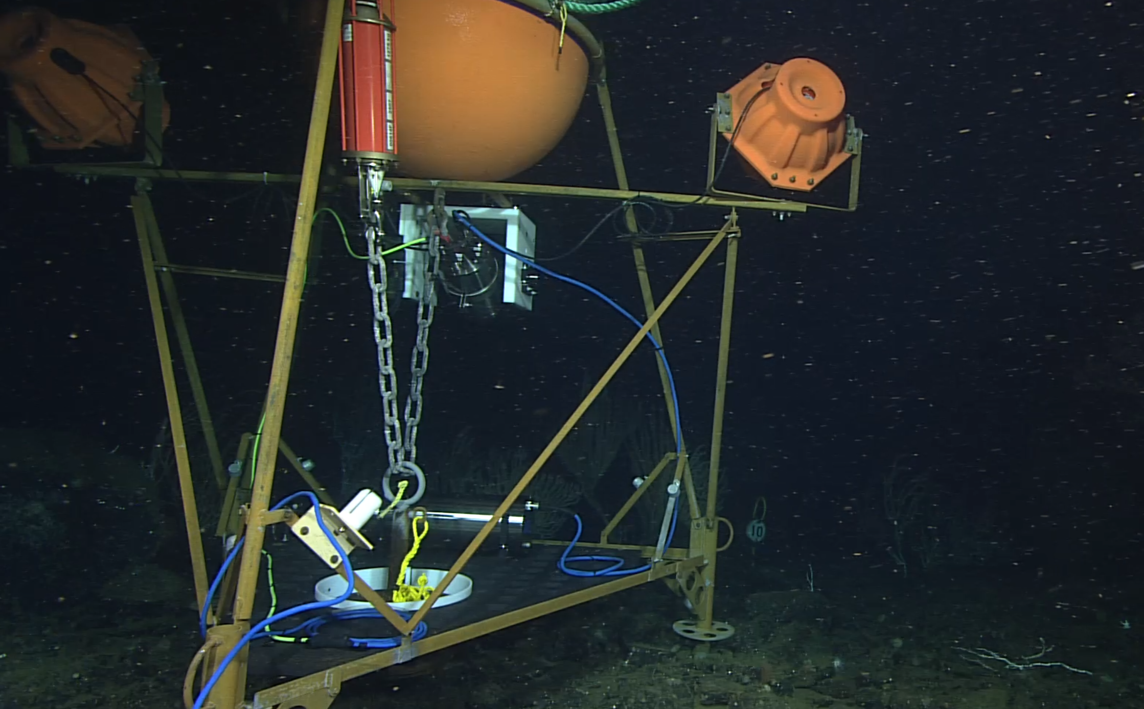
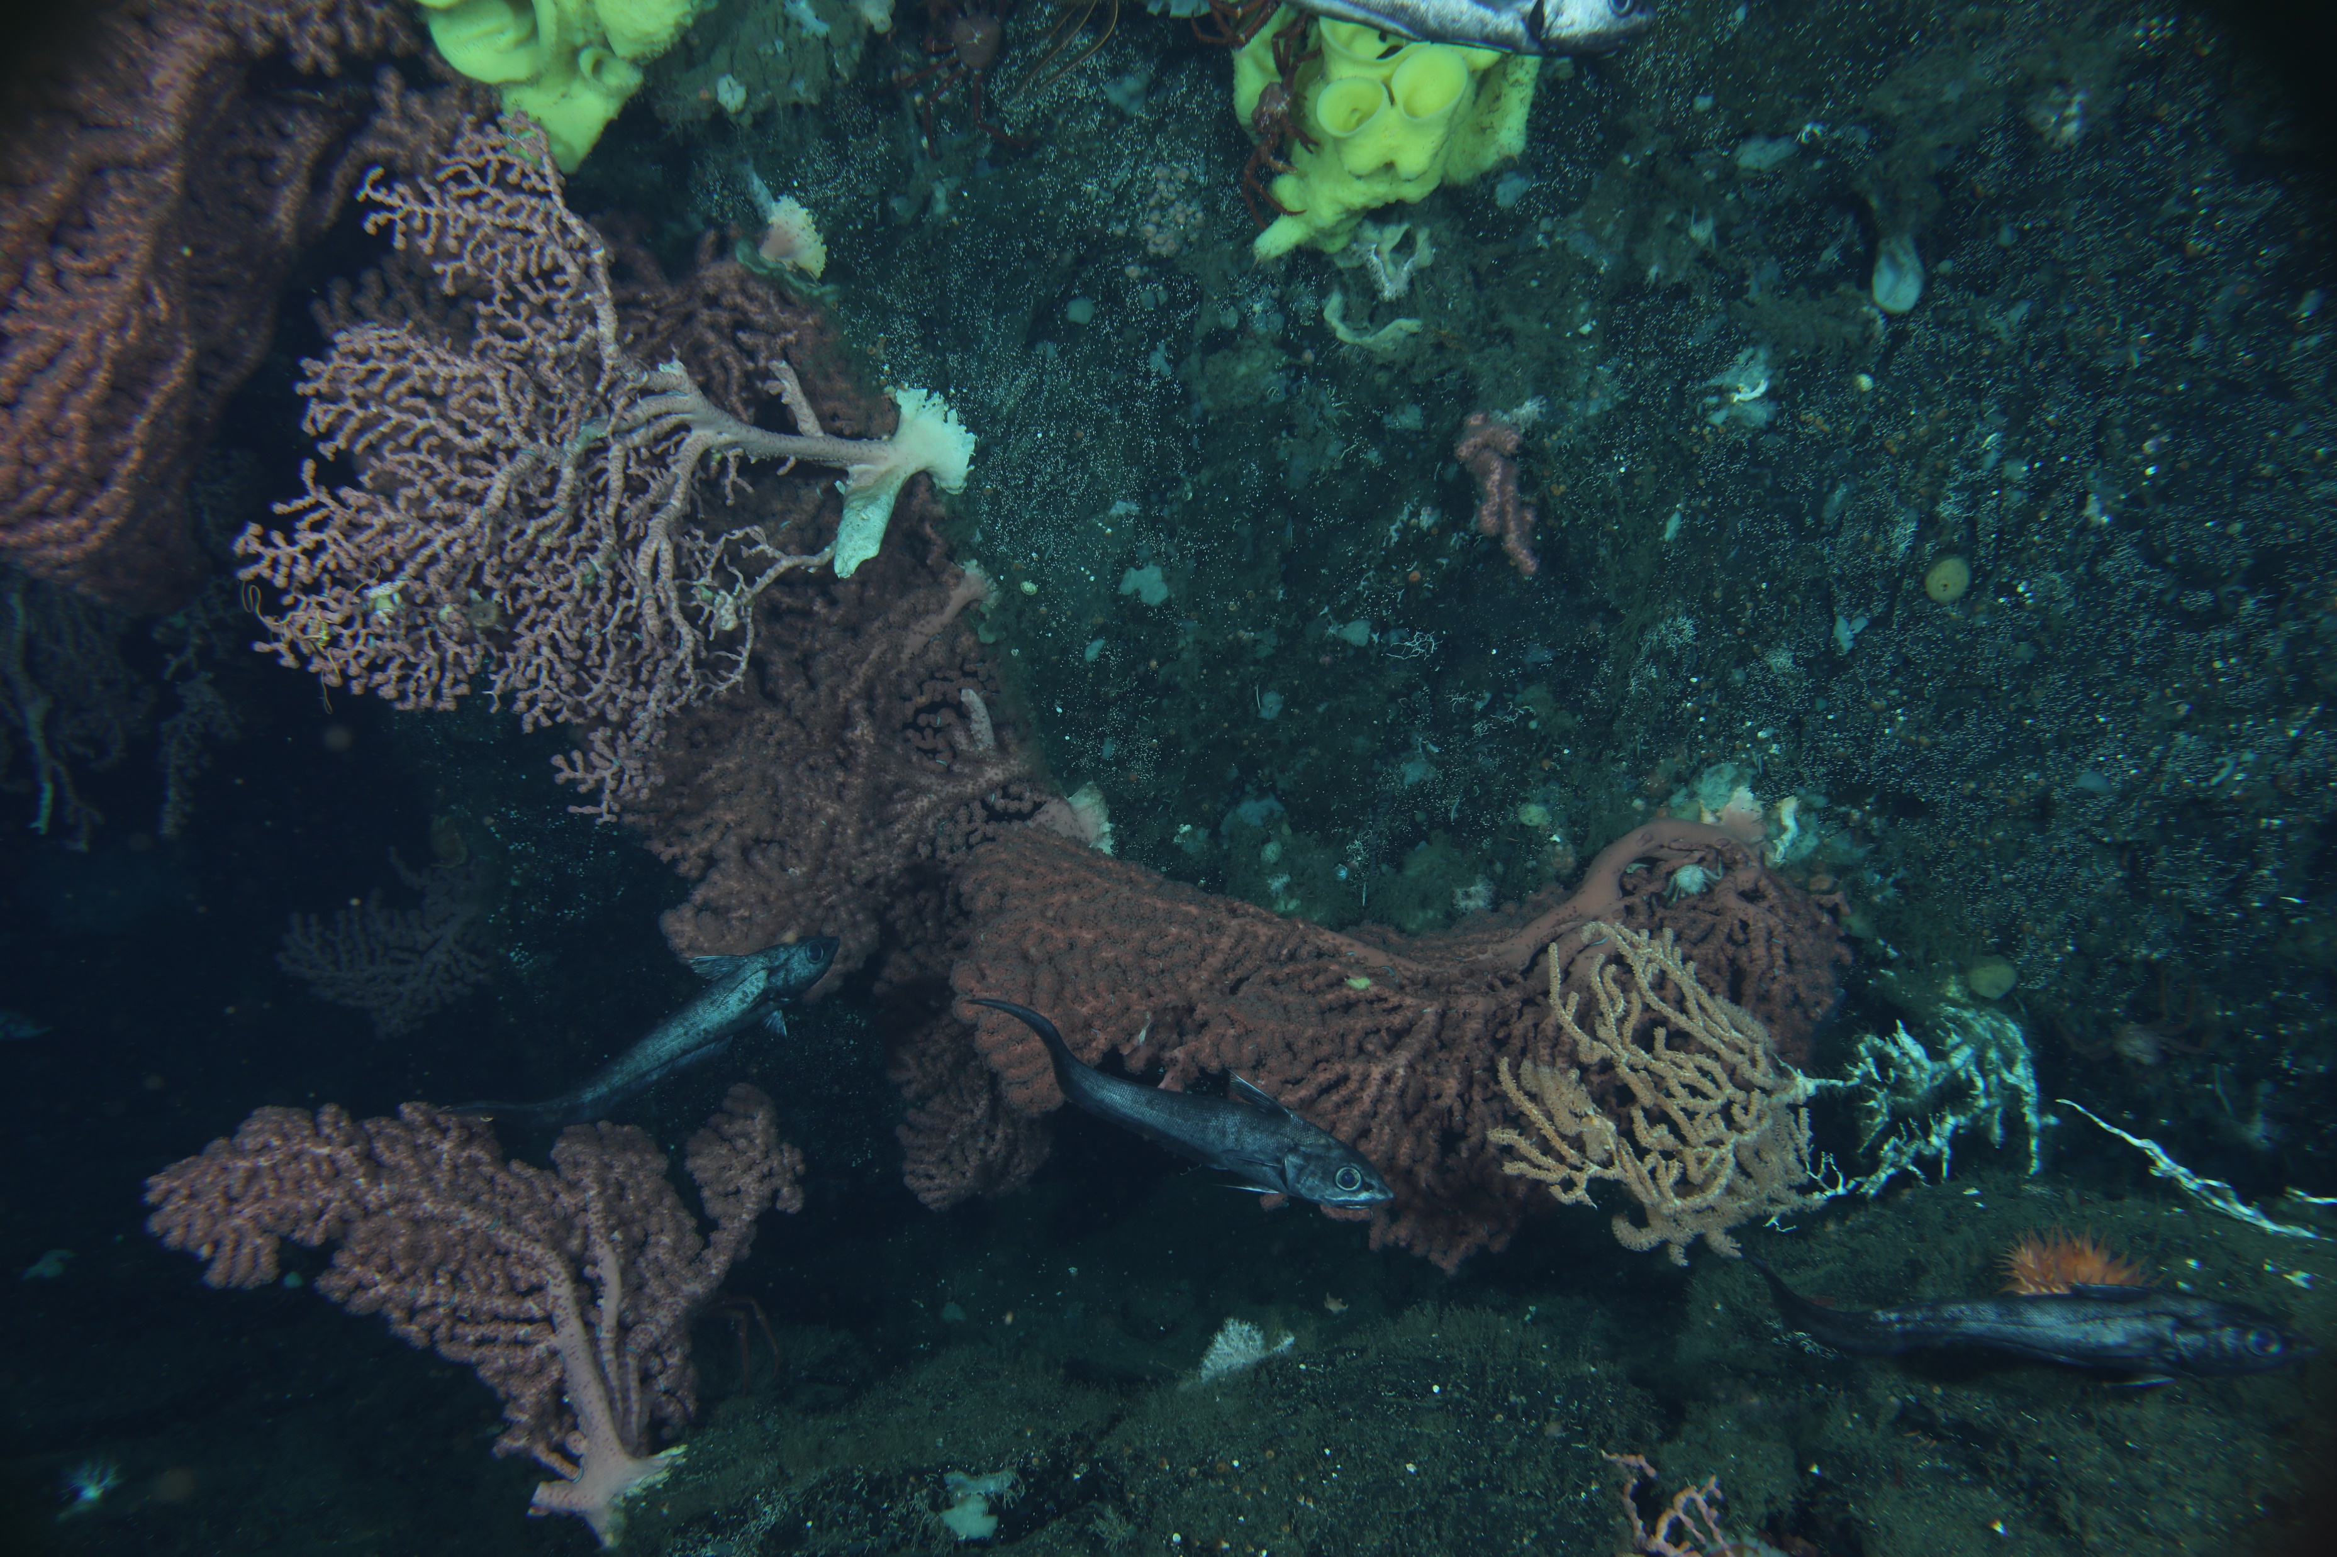
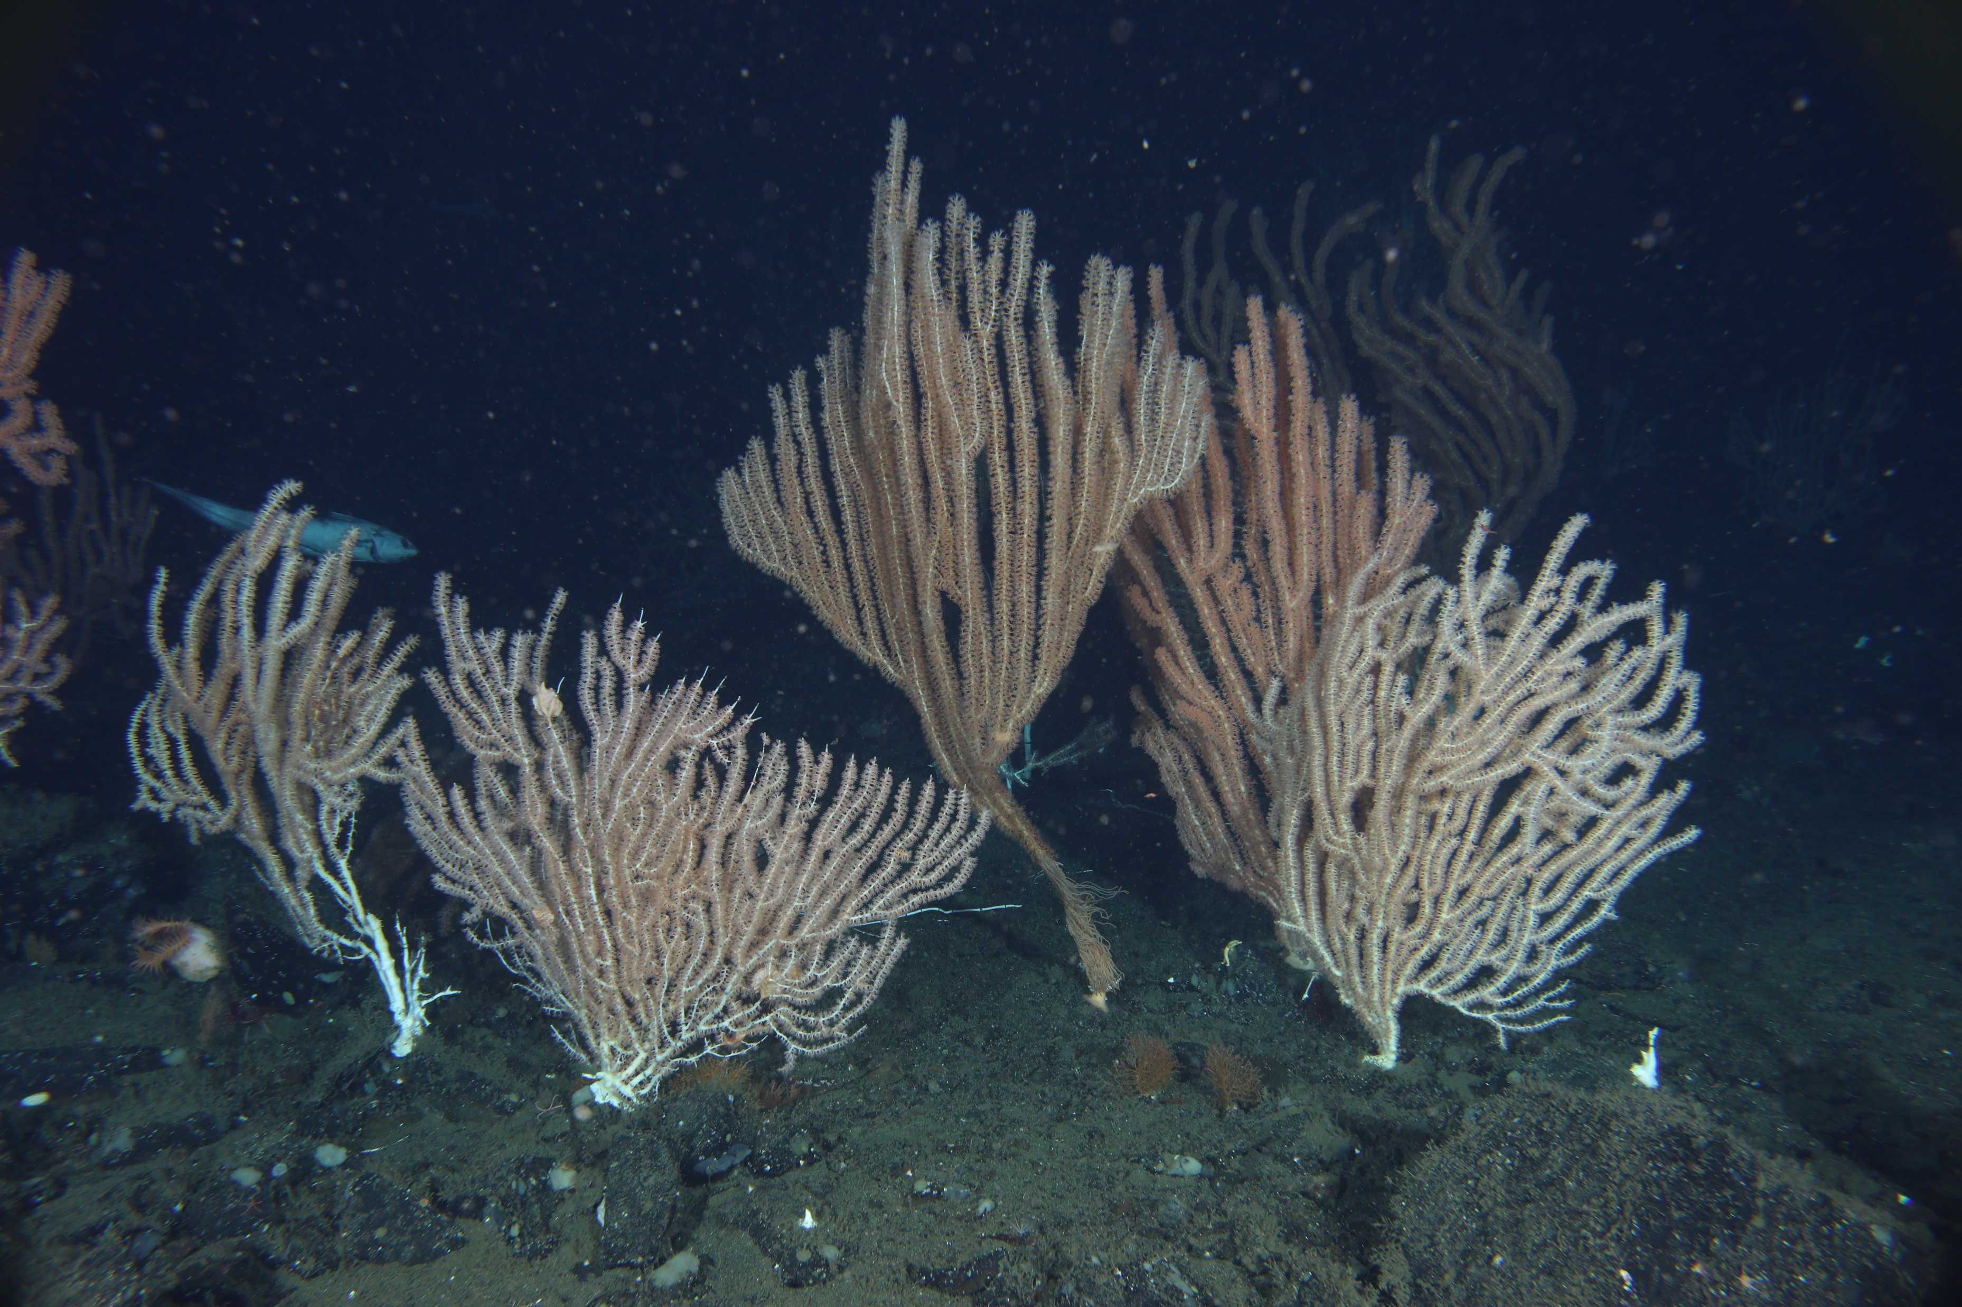
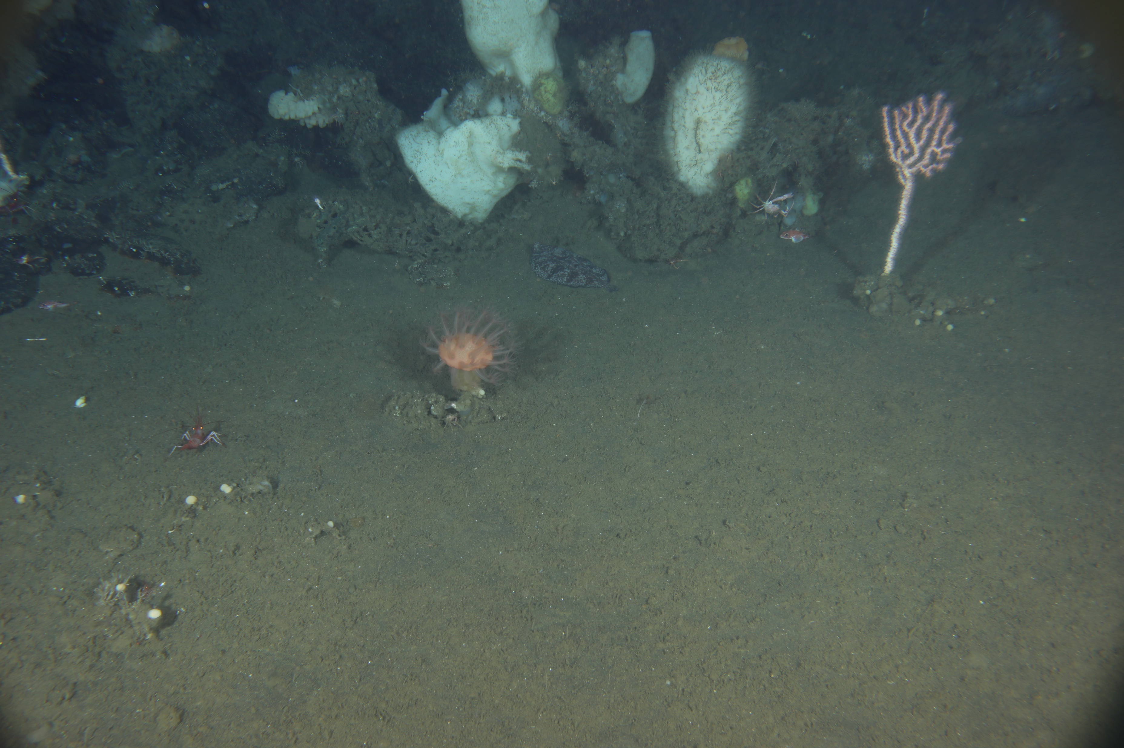
Mega Coral Cam (Time Lapse)
Images: 48 MP Stills, once per hour
Camera(s): Canon 5D MKIII
Lighting, Dual 10,000 lumen strobes 1W
Raw Data Rate: 0.01MB/s
Recorded Data Rate: 0.01 MB/s
0.0-0.1 m/s
1 cm to 3 m size range

Slide 4
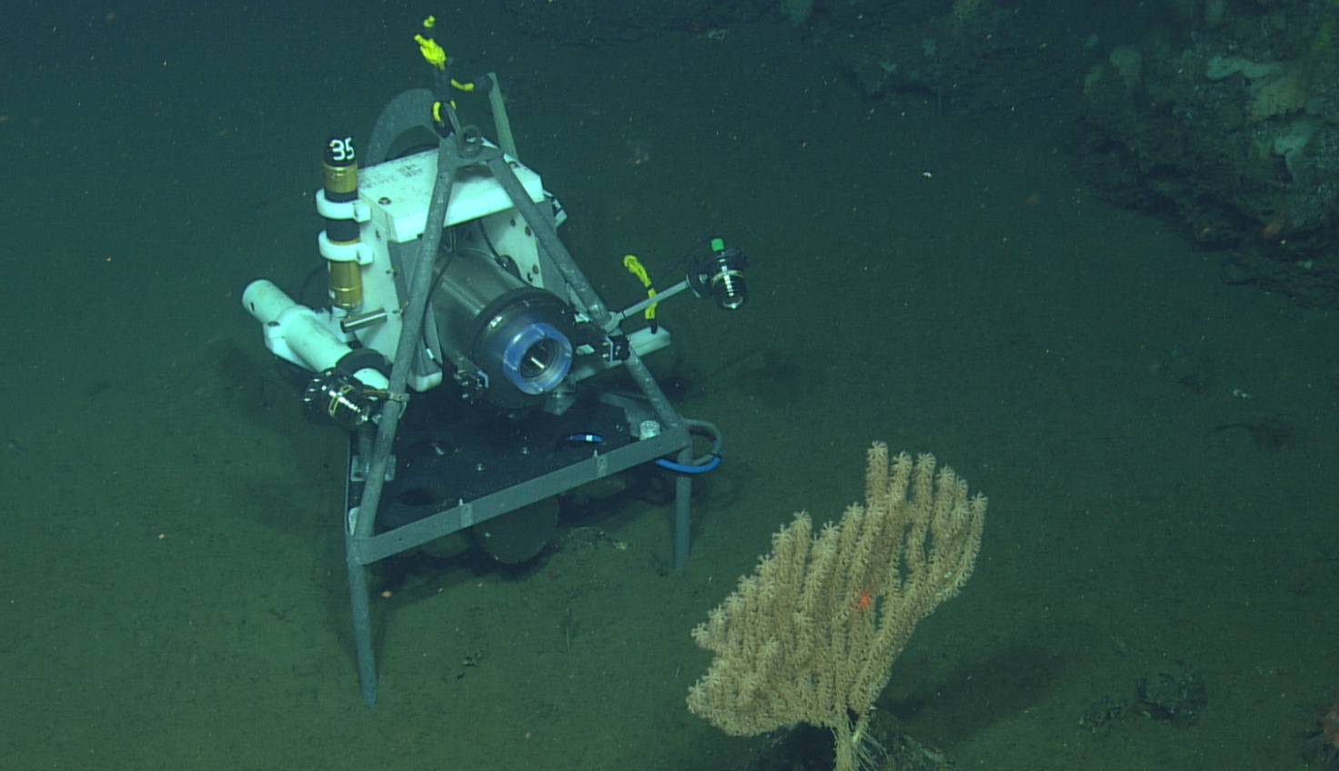
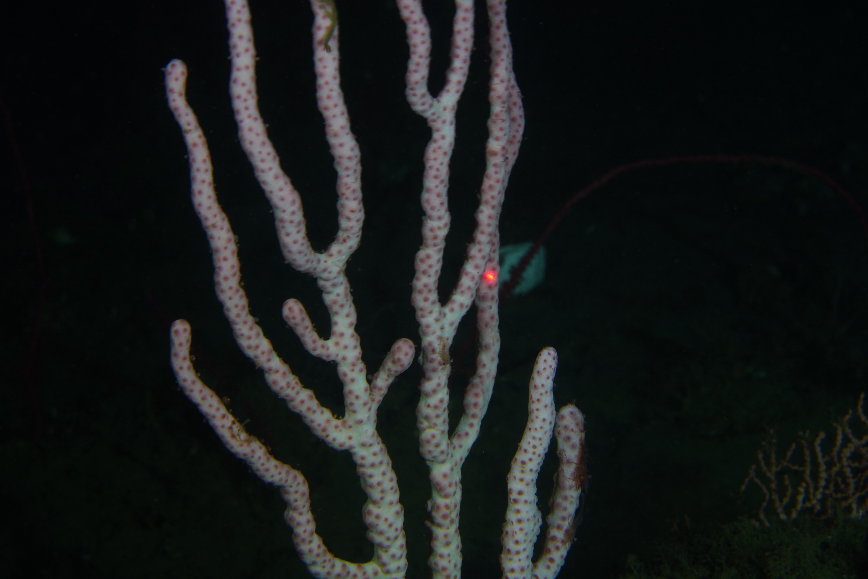
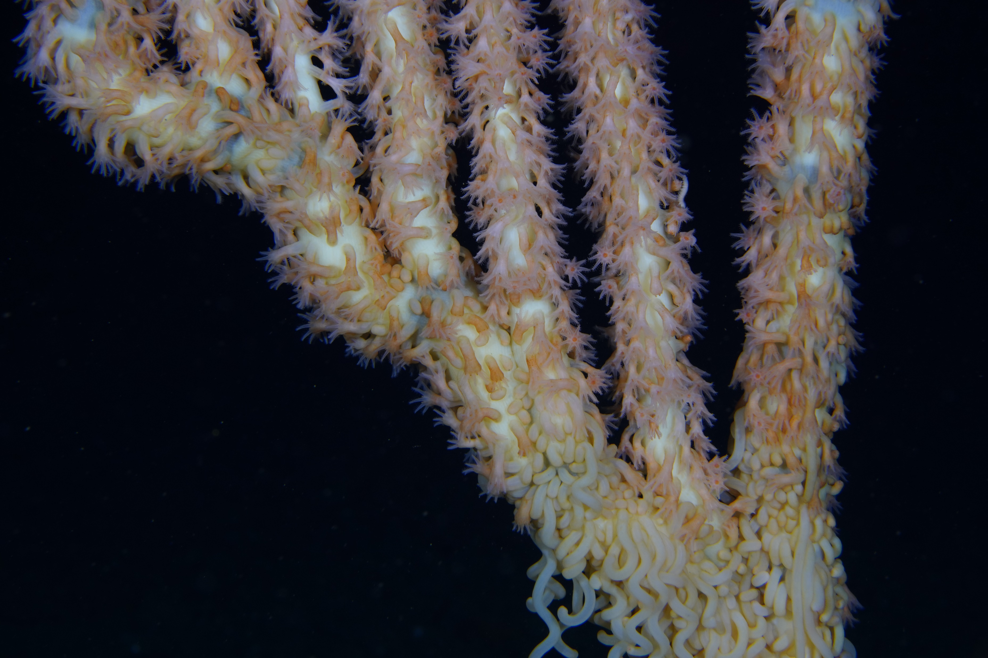
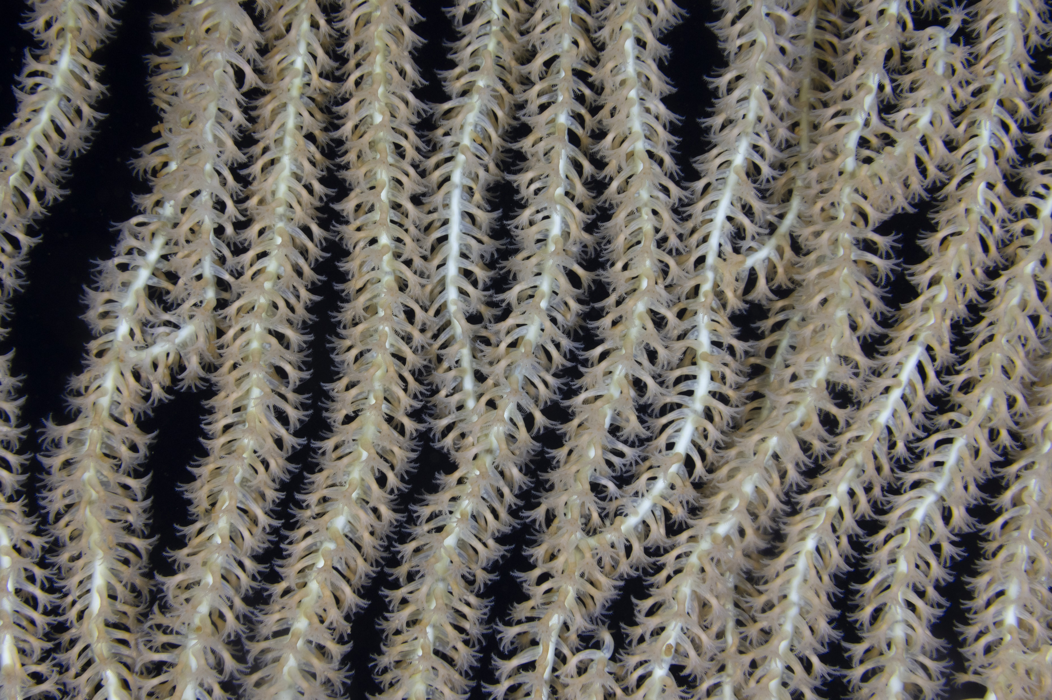
Macro Coral Cam (Time Lapse)
Images: 48 MP Stills, 4 images per hour
Camera(s): Canon 5D MKIII
Lighting, Dual 10,000 lumen LED strobes 1W
Raw Data Rate: 0.01MB/s
Recorded Data Rate: 0.01 MB/s
0.0-0.1 m/s
100 um to 50 cm to 3 m size range
40 um

Slide 5
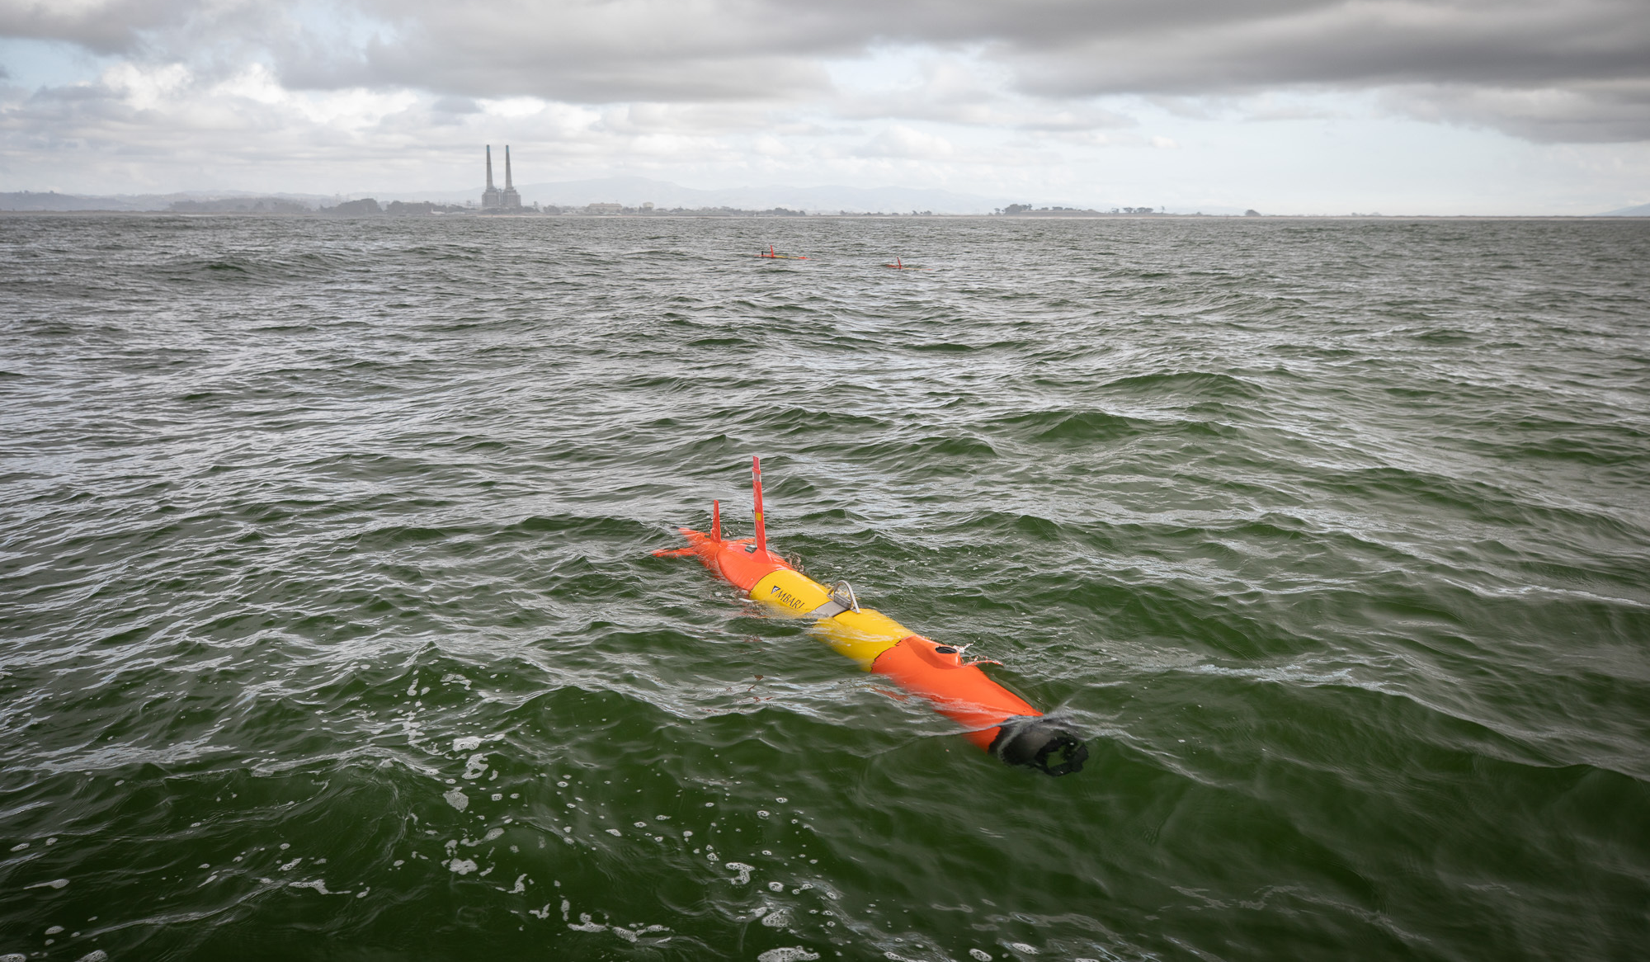
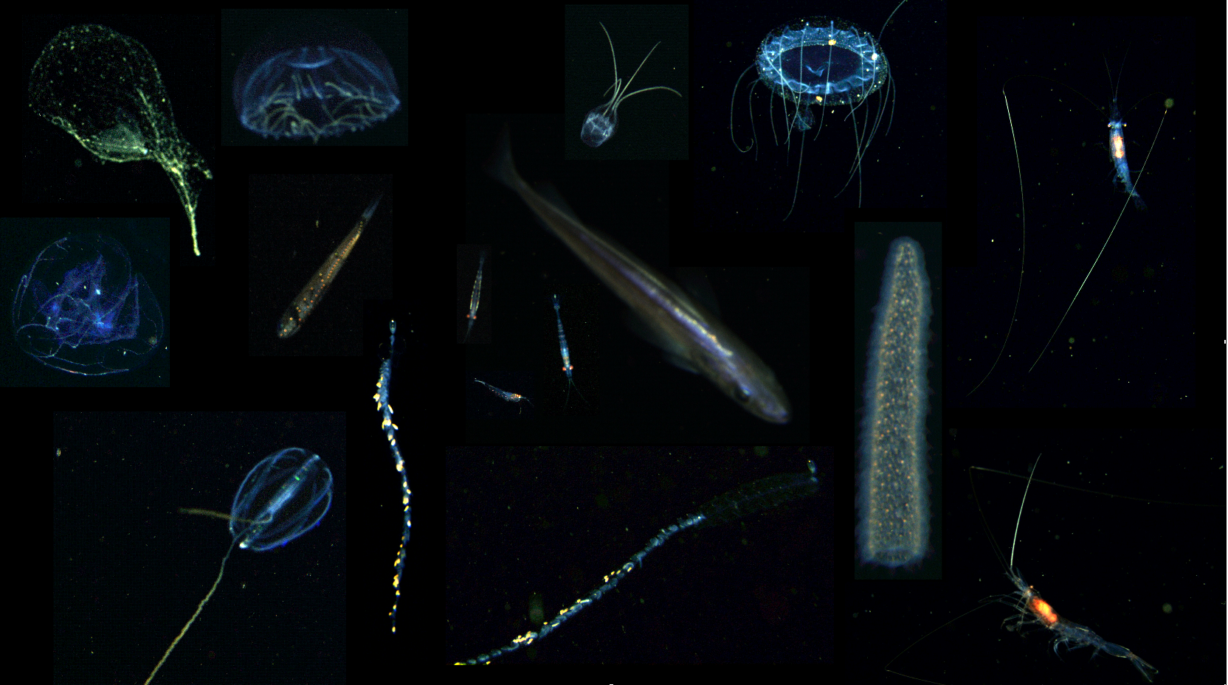
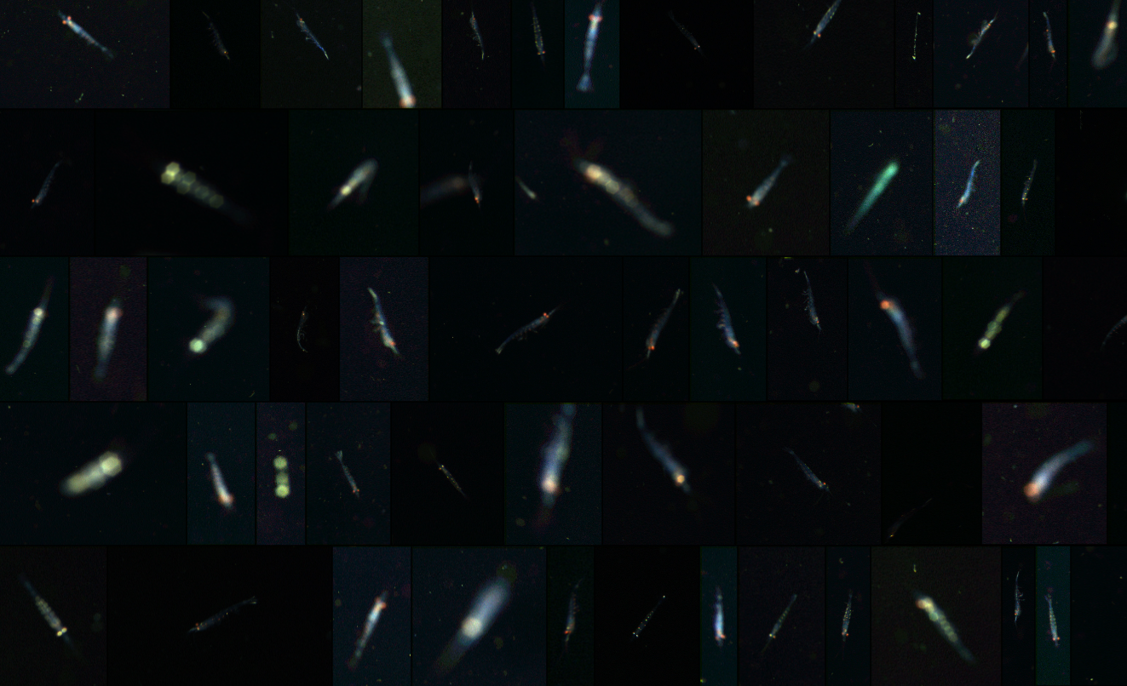
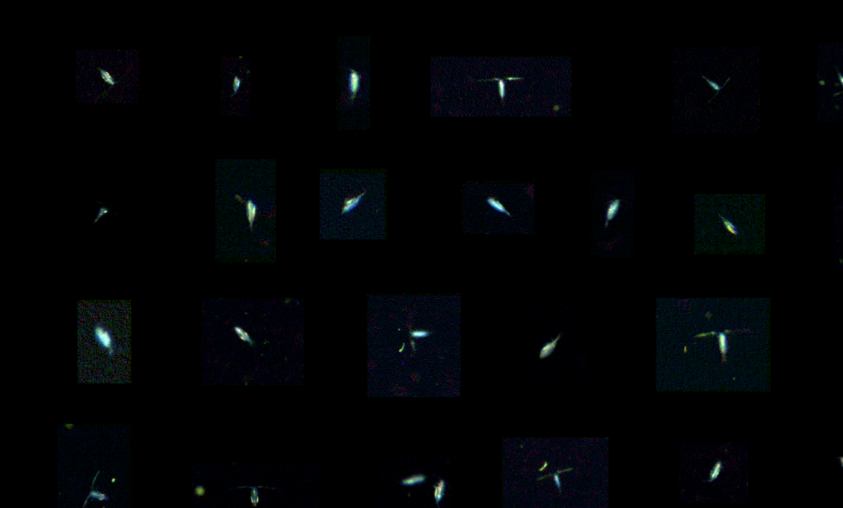
Chiton
Video: 140 MB stills up to 10 Hz
Camera(s): 7x FLIR IMX183 10W
Lighting, 300,000 lumen strobes 7W
Raw Data Rate: 1400 MB/s
Recorded Data Rate: 1.4 MB/s
0.5-1.0 m/s
1 mm to 20 cm size range
20 mm
10 mm
5 mm

Slide 6
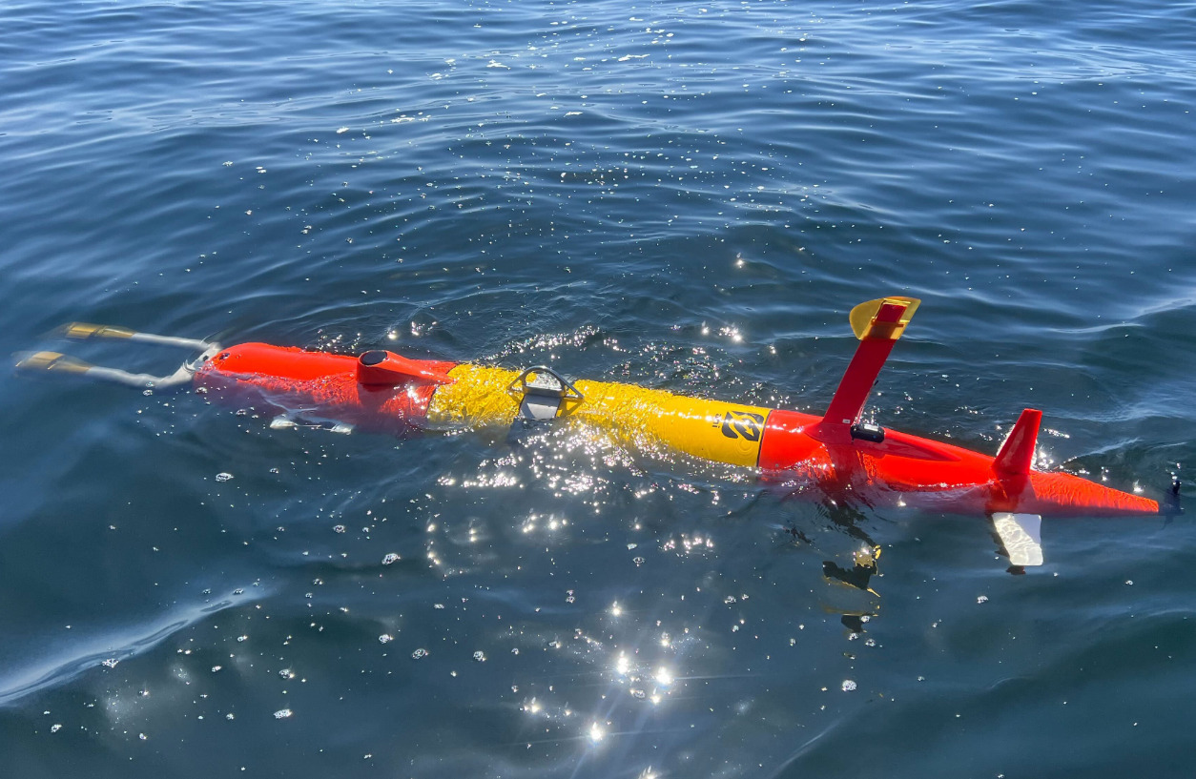
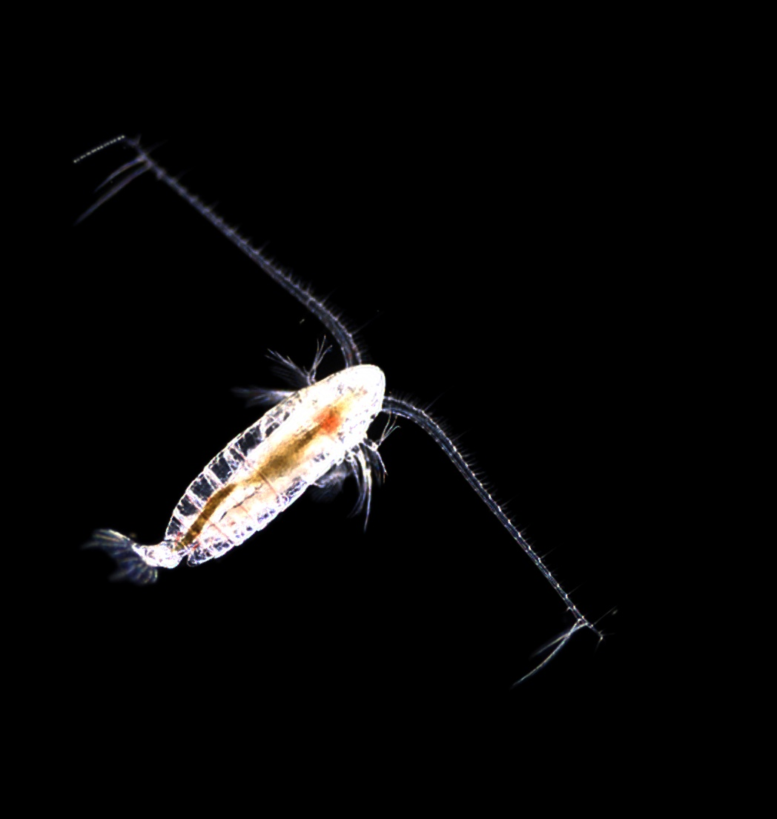
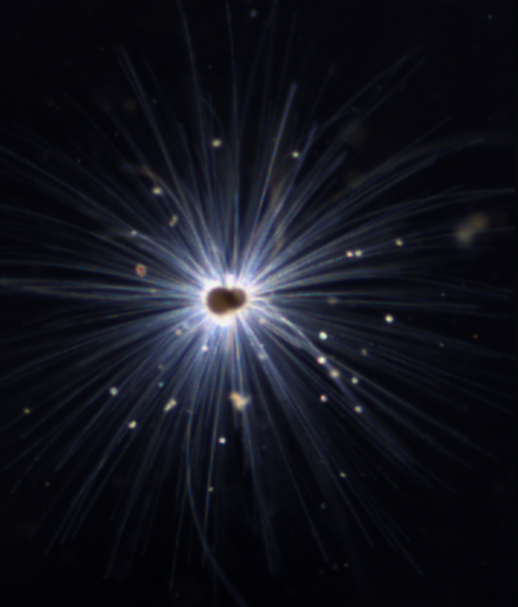
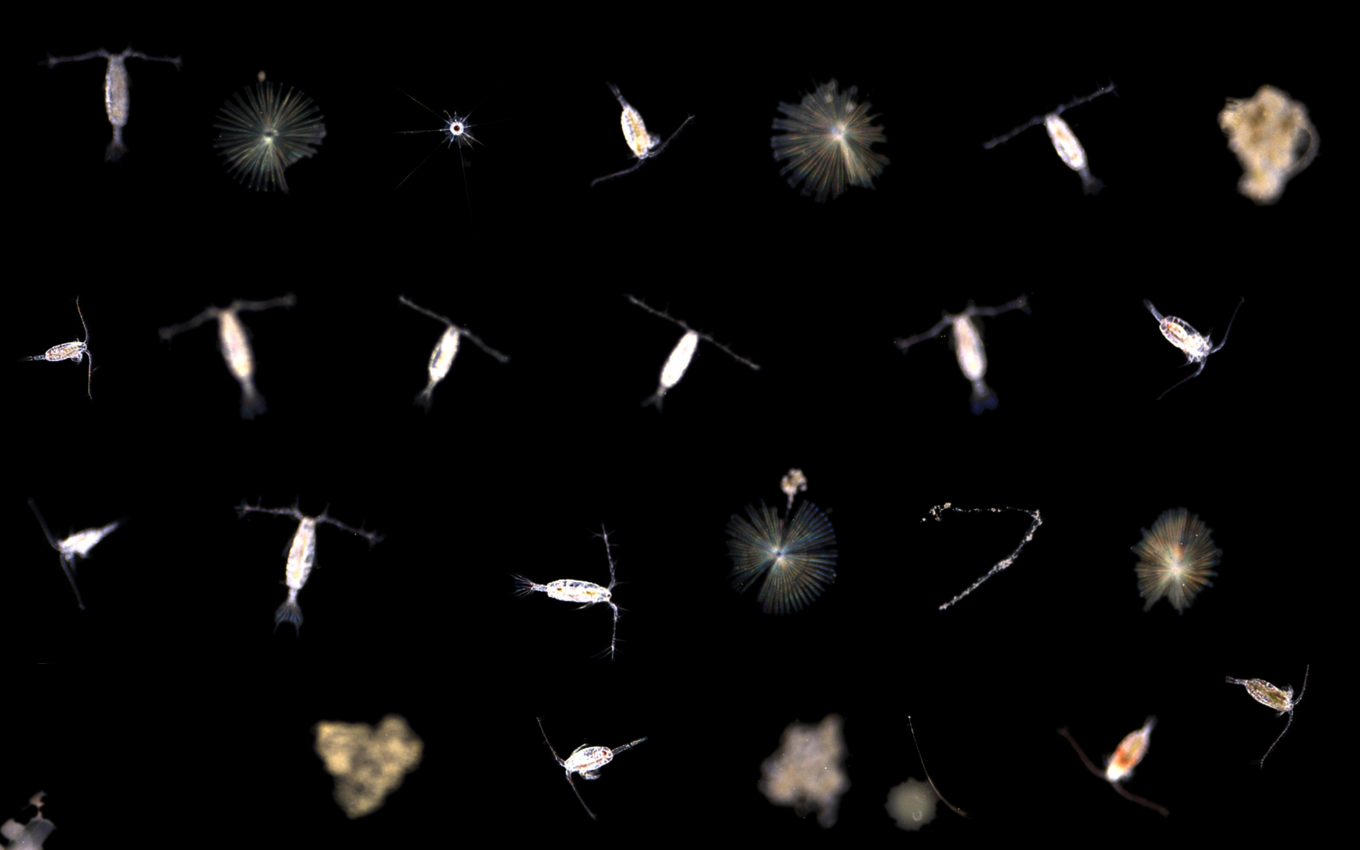
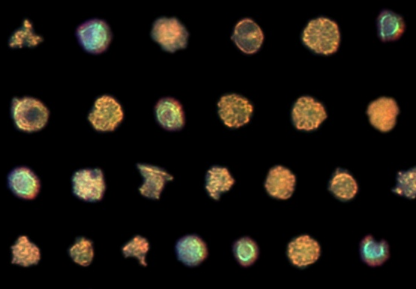
Planktivore
Video: Dual 5 MB stills up to 10 Hz
Camera(s): 2x FLIR IMX264 5W
Lighting, Dual 10,000 lumen strobes 1W
Raw Data Rate: 100 MB/s
Recorded Data Rate: 1 MB/s
0.5-1.0 m/s
20 um to 2 cm size range
7 mm
1 cm
2 mm
80 um
3 mm

