Slide 1
Camera System Design Using the Canon CJ15ex4.3 Lens

Slide 2
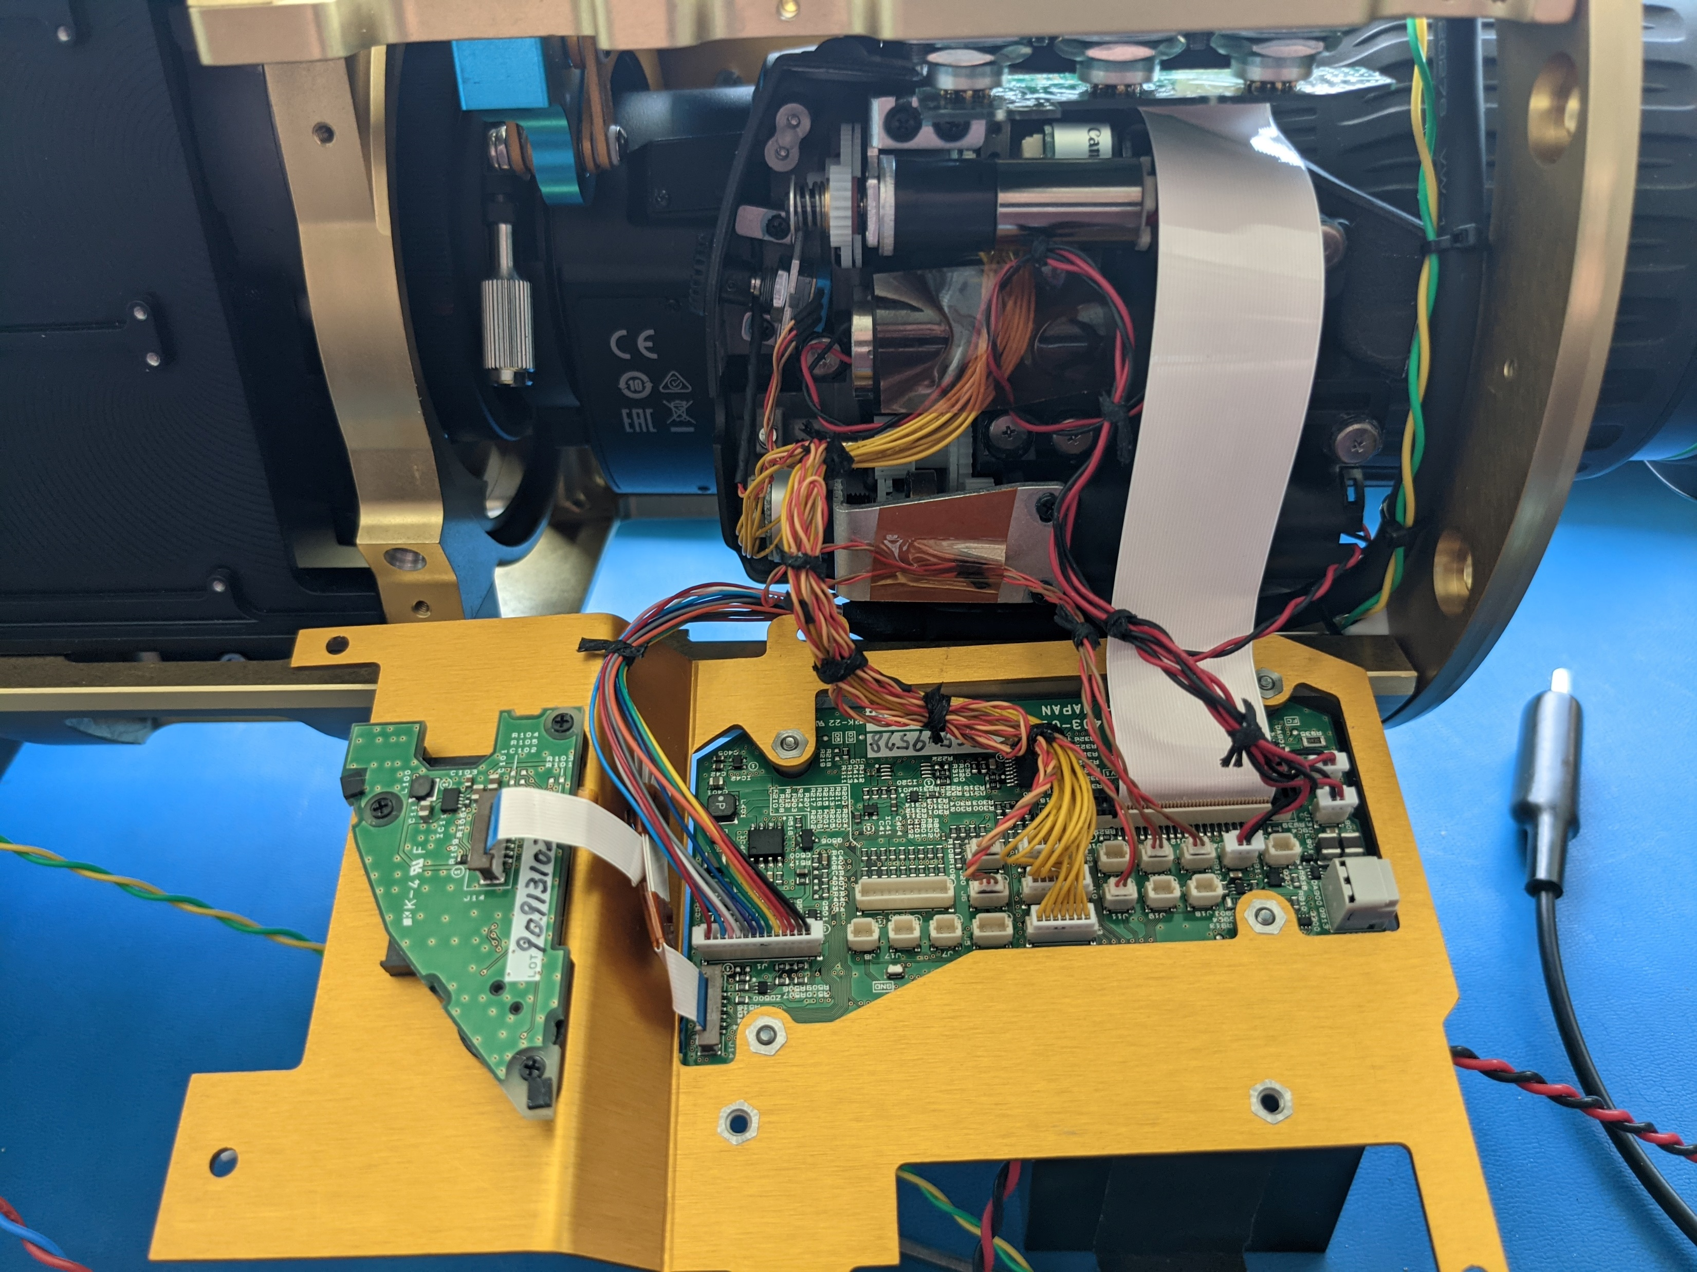
Modifications to stock Canon Lens to fit in underwater housing
2X extender actuator
Chassis side panel

Slide 3
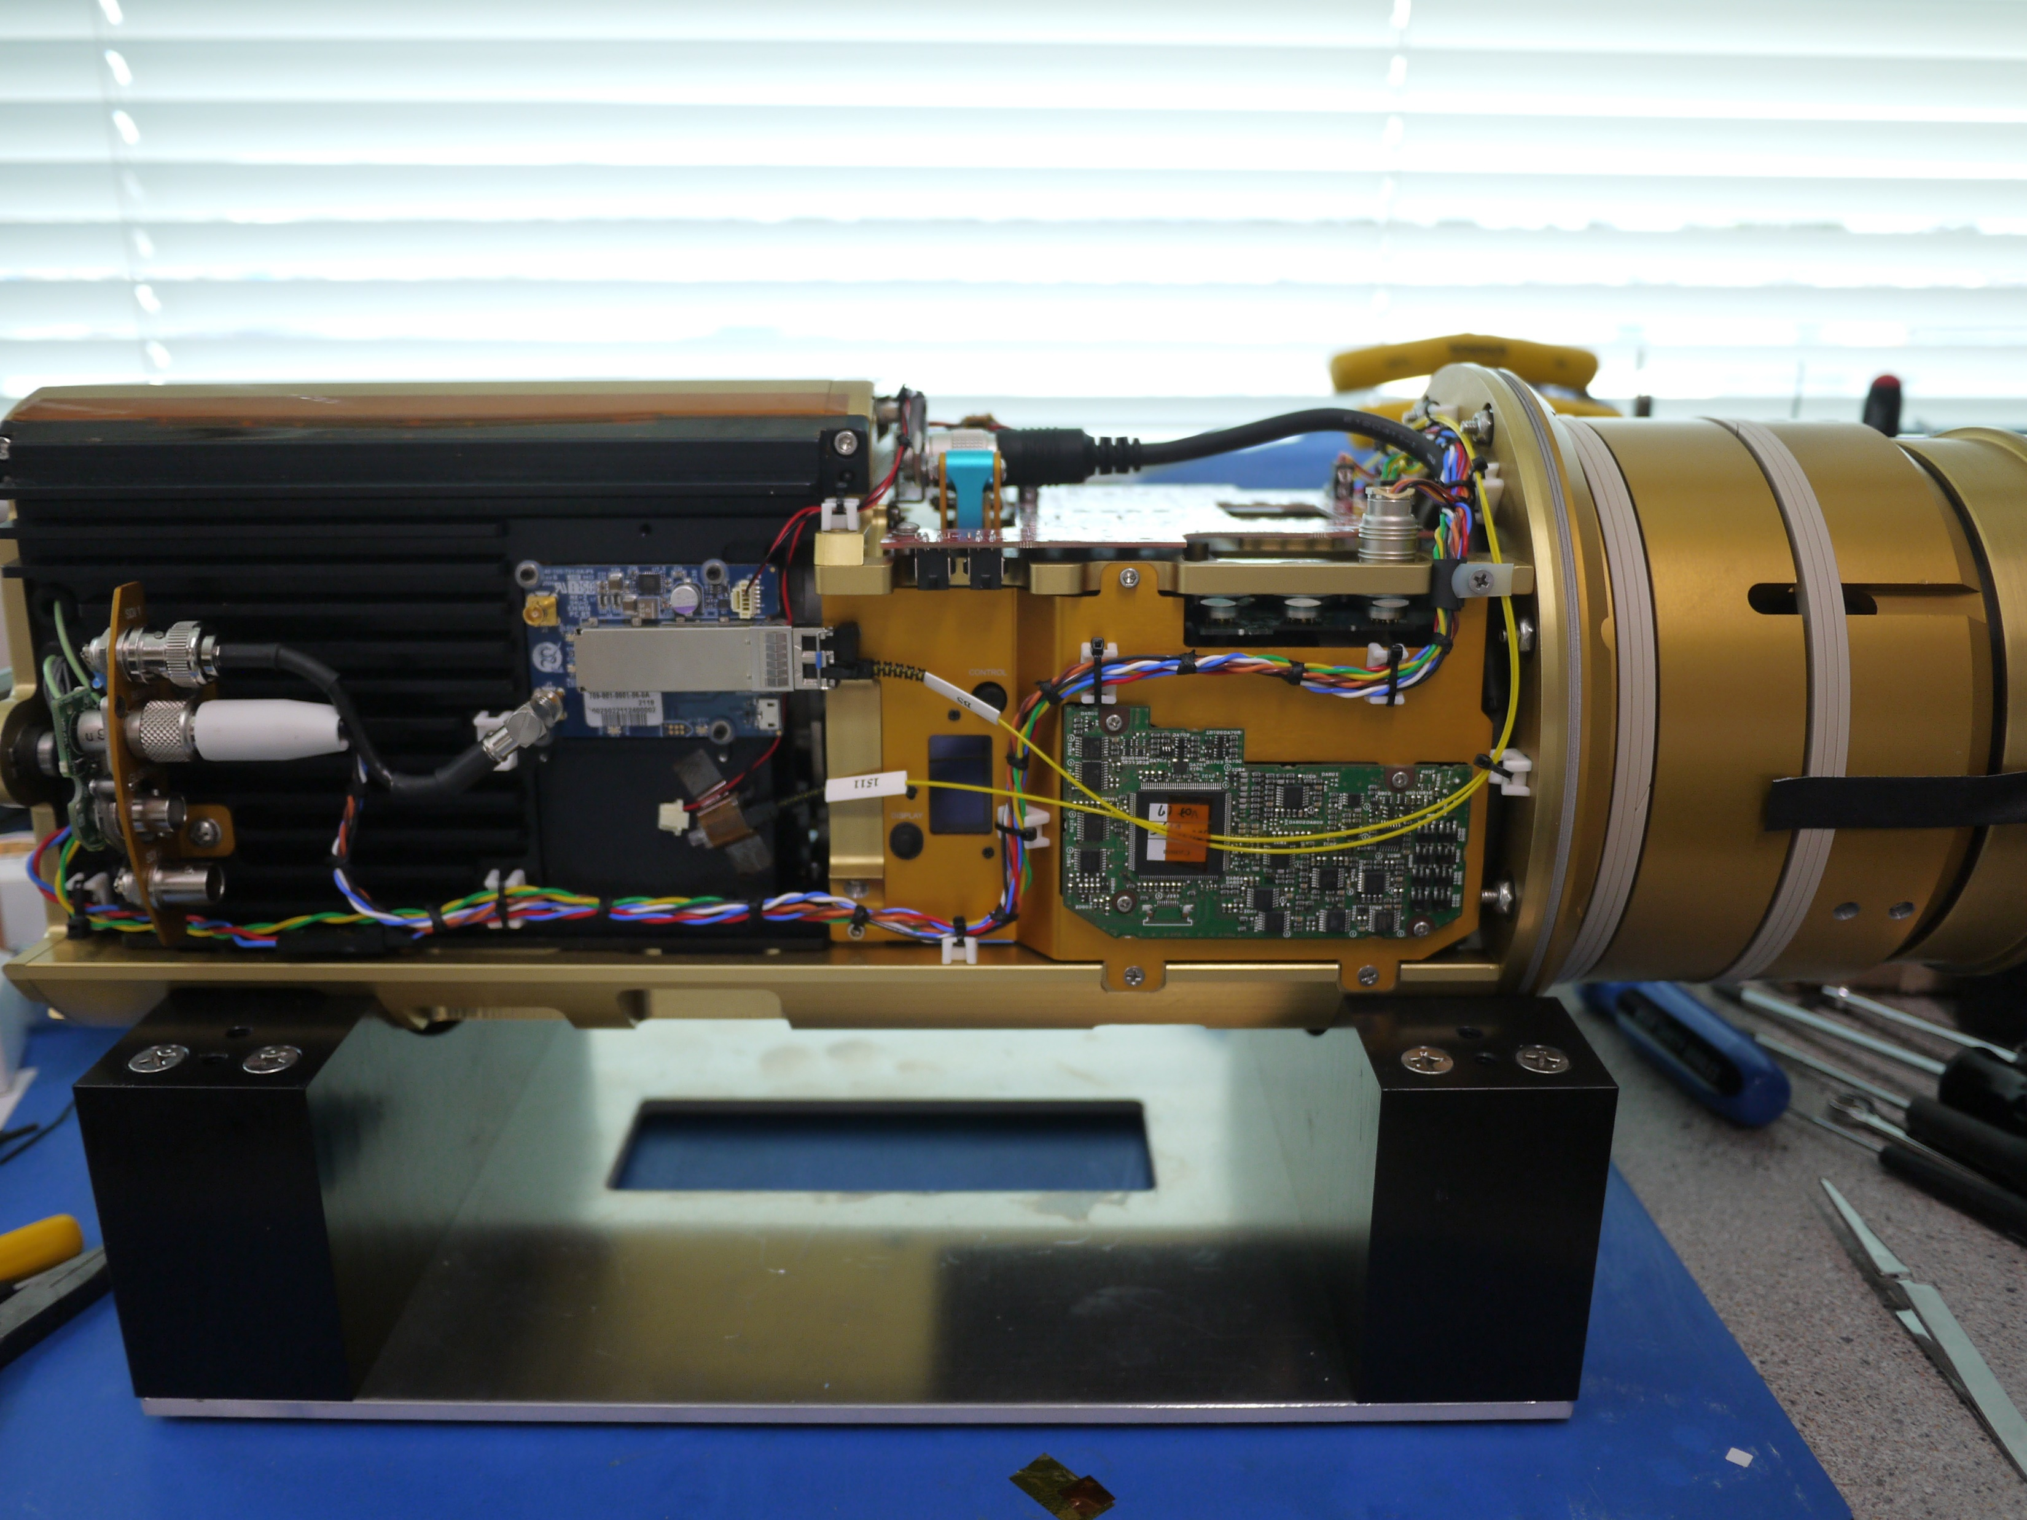
Canon lens user interface controls. Lens is tightly integrated into the camera system
Fully assembled chassis incorporating Canon CJ15 lens

Slide 4
Note vignetting in full wide angle
Final laser alignment of the optical path

Slide 5
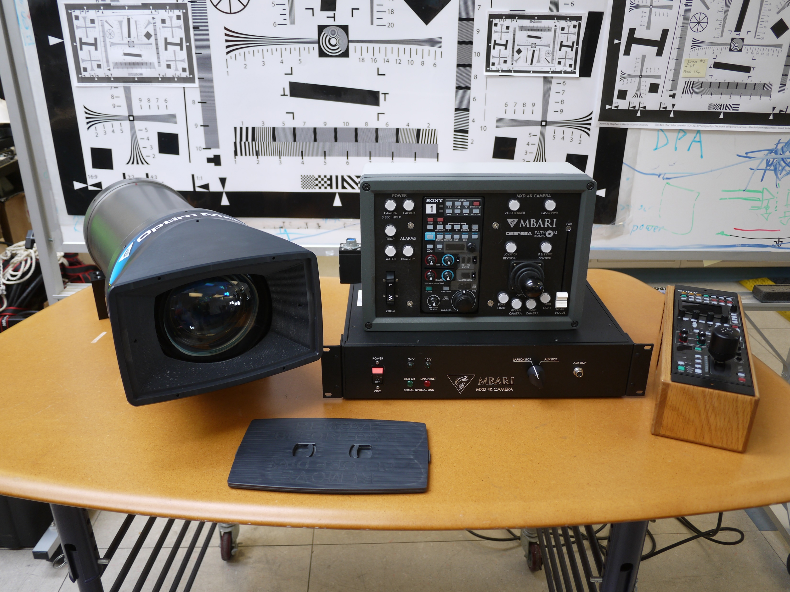
Full camera system

Slide 6
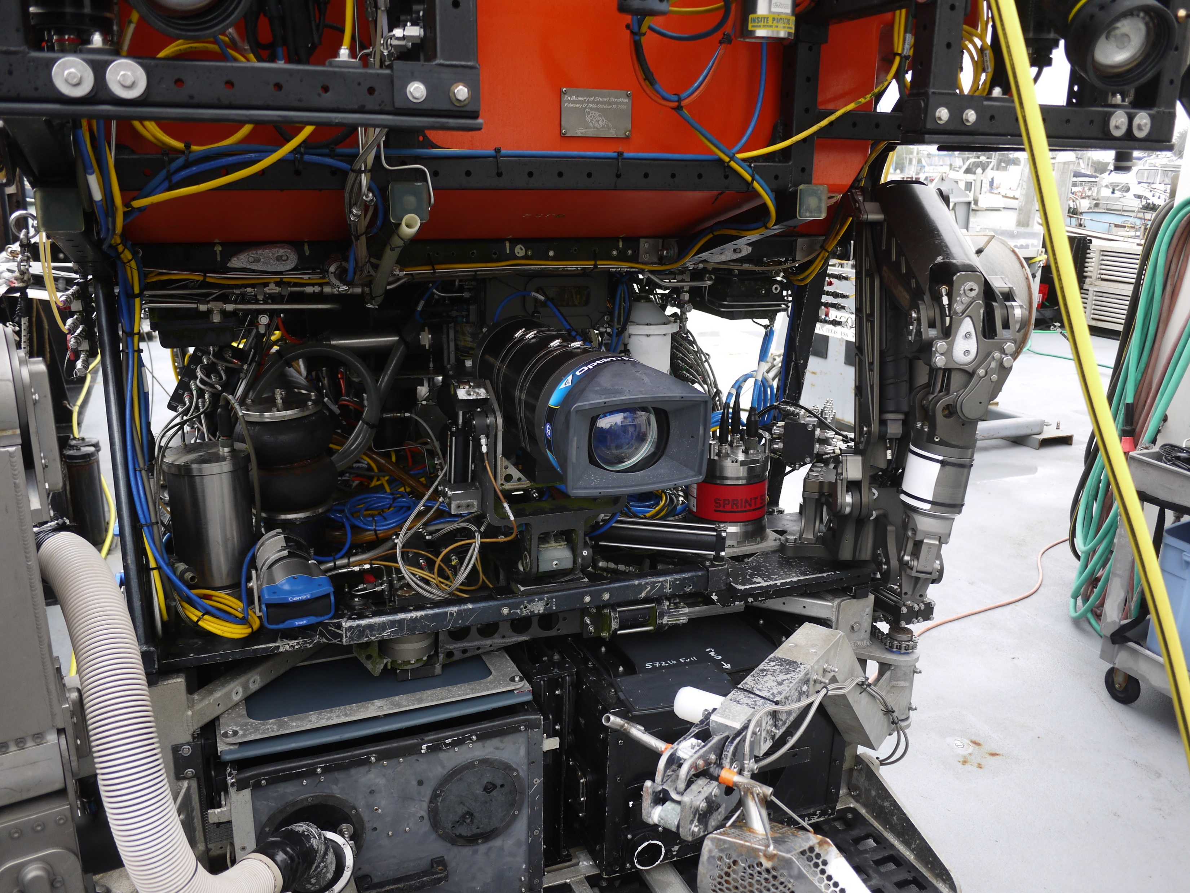
Camera installed on Remotely Operated Vehicle

Slide 7
Frame grab from underwater image at 1000 meters

