Slide 1
Miniature 4k Subsea Optics Feasibility Study
Paul Roberts
MBARI Abstract Presentation May 14 2025
Notes:
My Name is Paul Roberts and I’m an electrical engineer at MBARI, I’ve been here for just over 5 years.
Today I’ll give an overview of imaging systems in production and development at MBARI

Slide 2
Overview
Adding 4k optics to MBARI’s larger ROVs has enabled stunning video, and new science capabilities.
MBARI’s fleet carries numerous small cameras for a wide range of applications.
Aside from I2MAP (upgrading to 4k recording this year), these other vehicles can’t carry cameras the size of the MxD
A new optical design focused on space constrained application could enable access to 4k recording on the majority of MBARI’s fleet

Slide 3
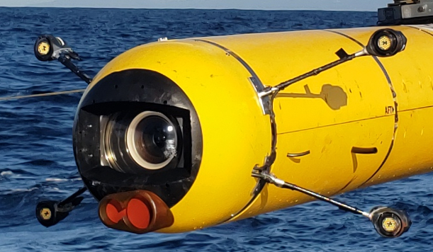
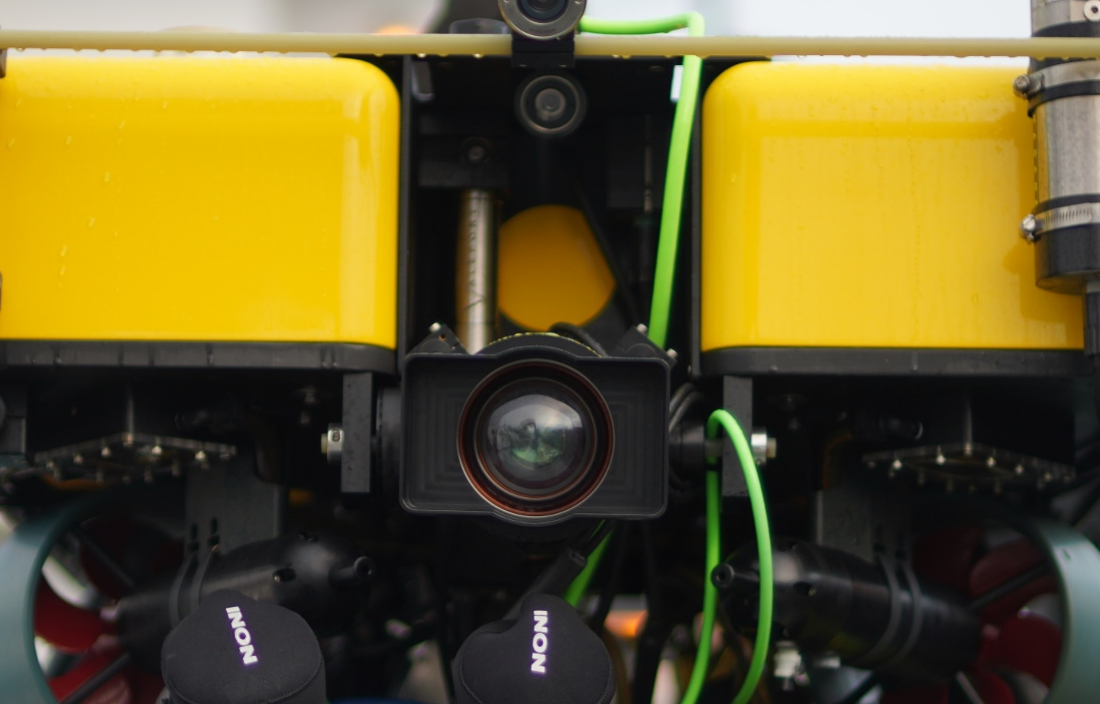
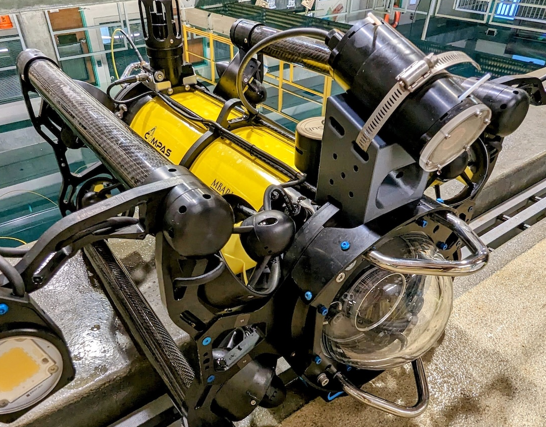
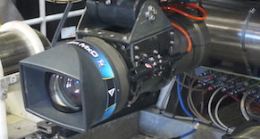
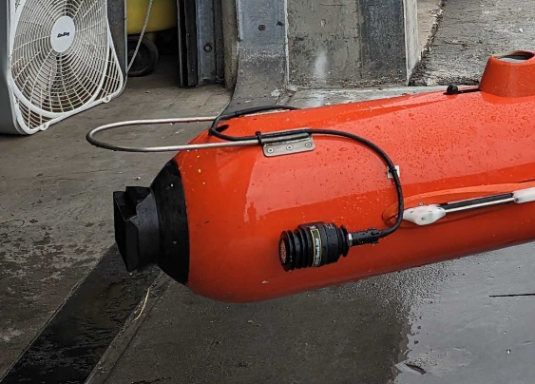
Current State of the Optics
Large platforms
(Ventana, Ricketts, Dorado)
Medium platforms
(MiniROV, LRAUV)
Small Platforms
(Mola, Blue ROV, Defender)
Large and Heavy (100 lbs)
Professional 4k video
Suitable for BBC, Nat Geo, etc
Sets the standard in the field
2 liter bottle sized
Mixture of HD and 4k recording
Limited optics and correction
Soda can size or smaller
Mixture of HD and 4k recording
Limited optics, no correction

Slide 4
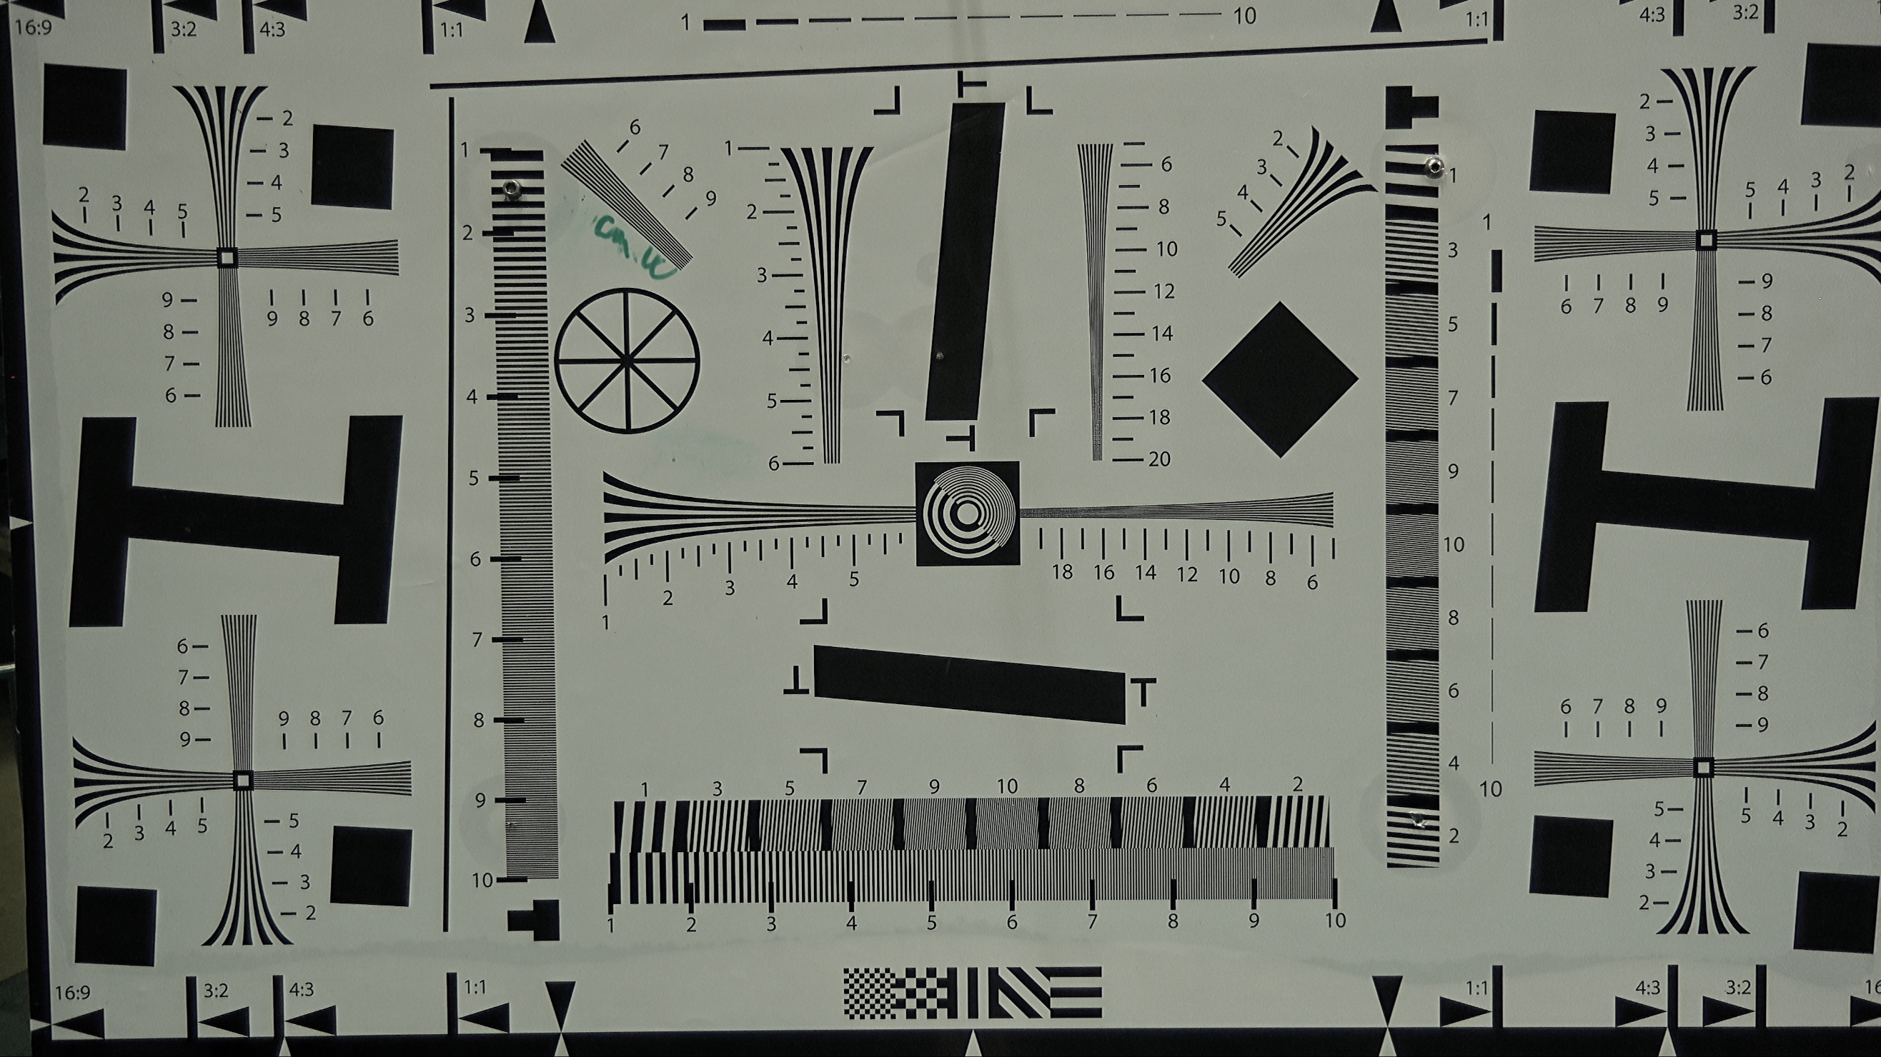
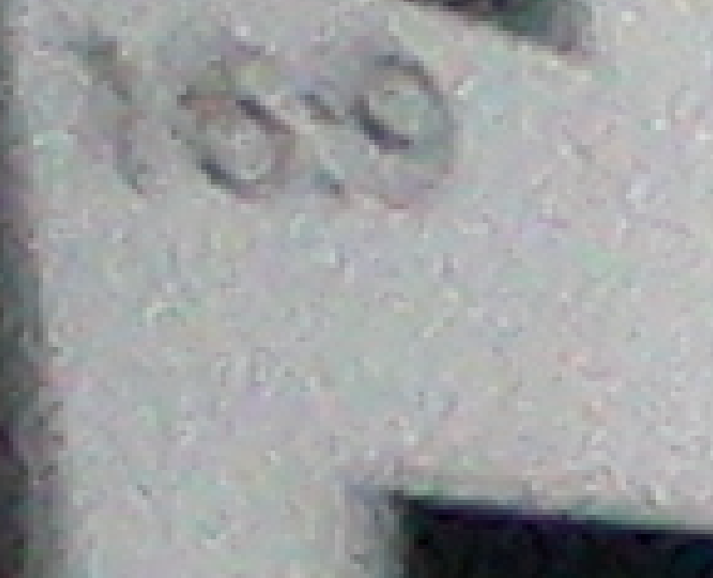

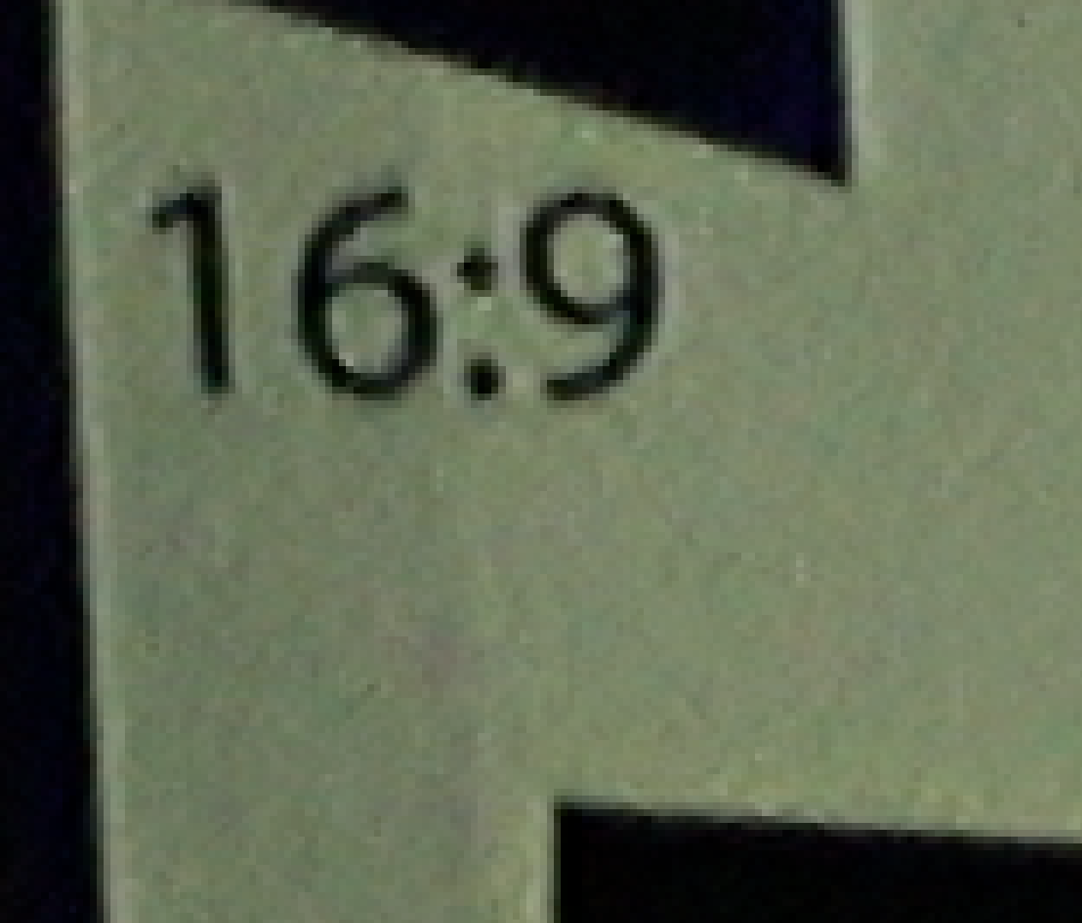

4k Optics Examples
Insite Pacific Mini-Zeus
Sony FCB-ER8300 Block Camera
Deep Sea Power and Light Apex
Sony FCB-ER8300 Block Camera

Slide 5
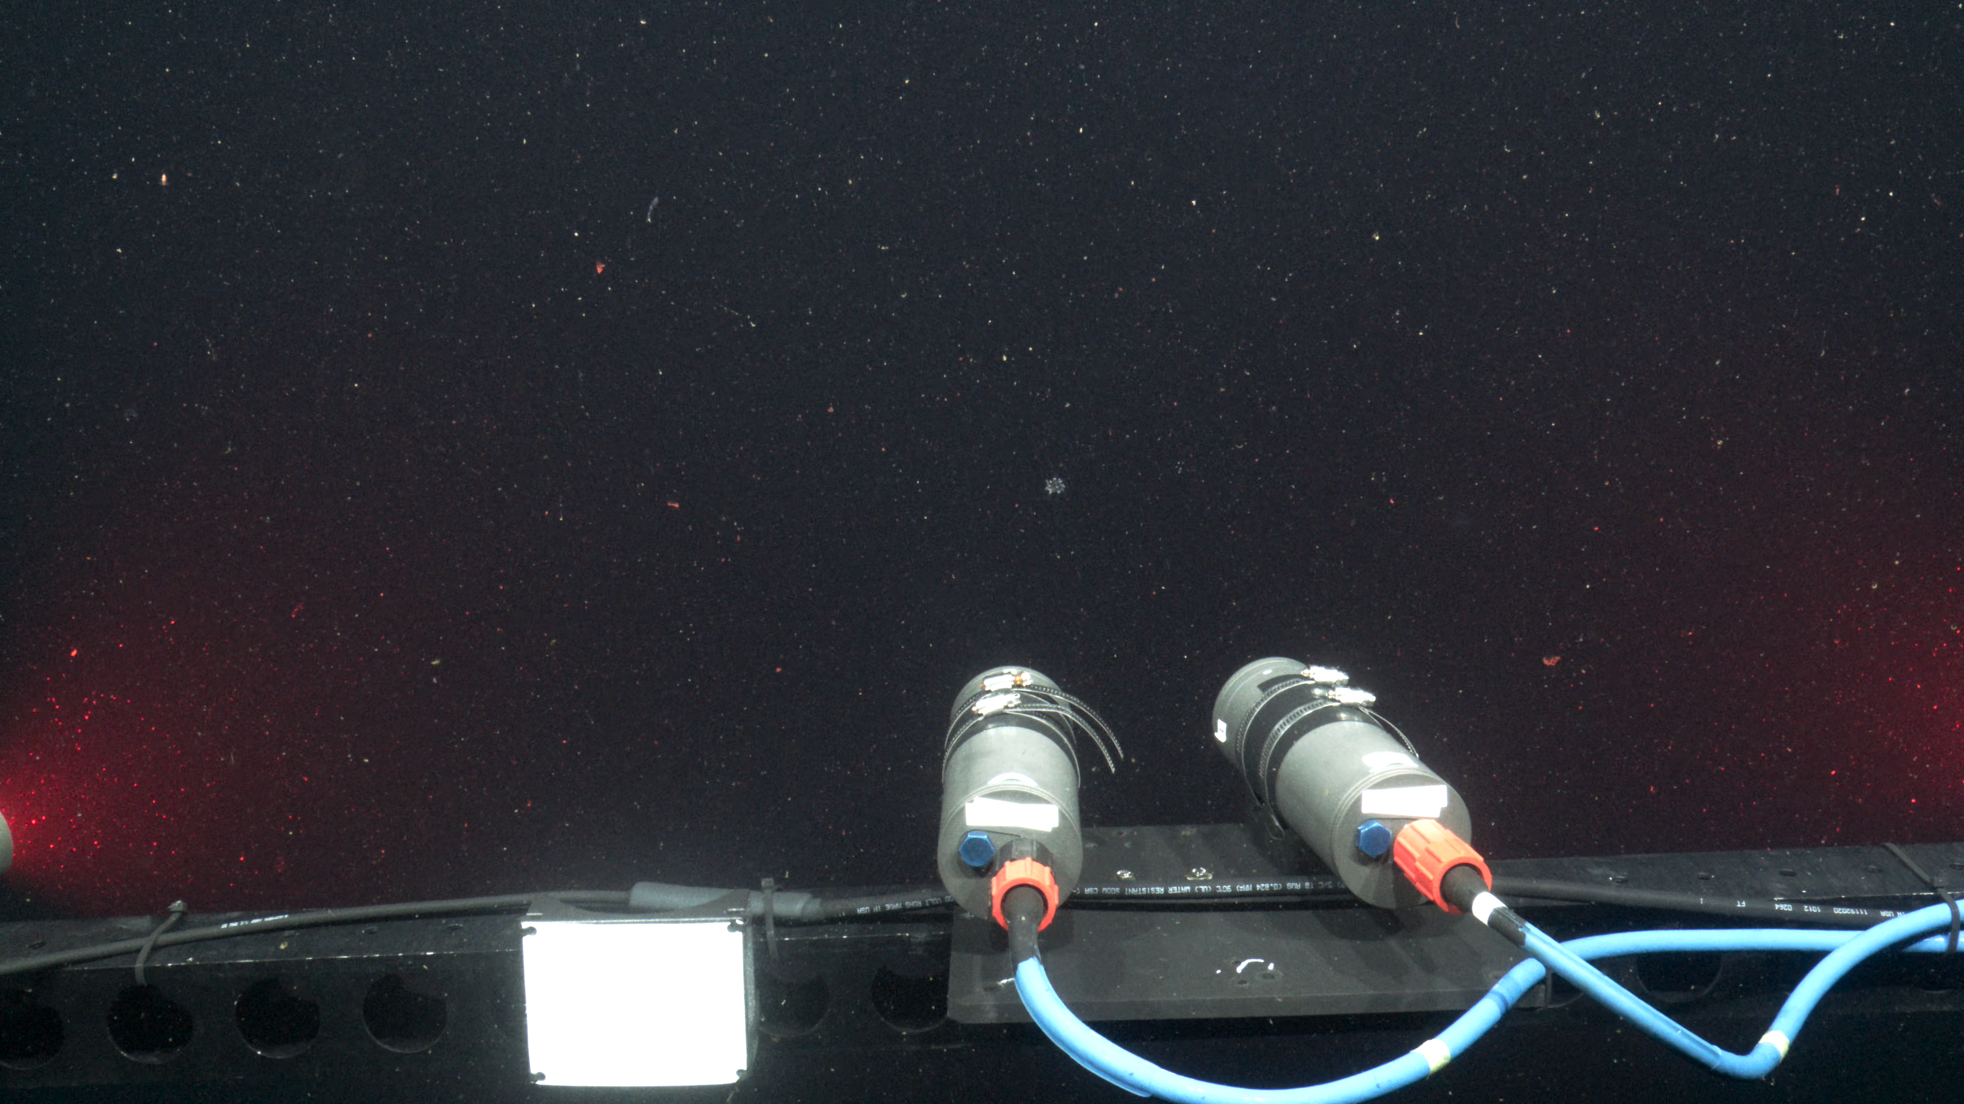
4k Optics Examples

Slide 6
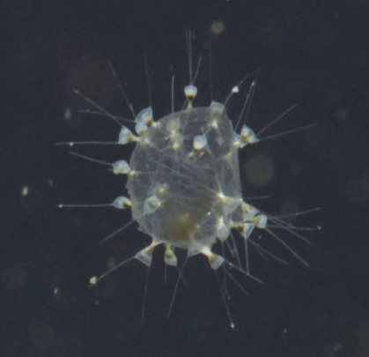
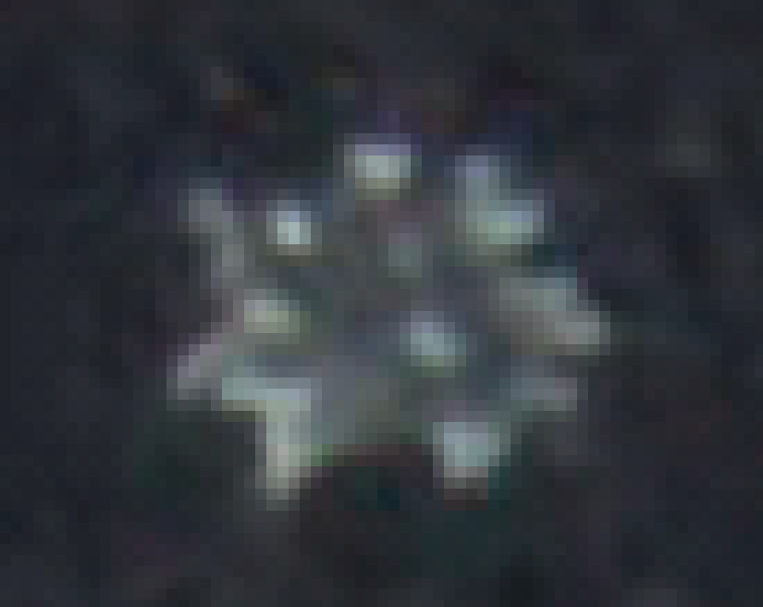

4k Optics Examples
4k zoom
HD wide
4k wide

Slide 7
Approach
Focus on the most common use case:
  wide-angle (~ 90 deg. Horizontal)
  small form factor (~soda can)
Partner with optical design firm (as before with MxD)
Design the optics for modern 4k sensors like Sony 2/3” (same as in MxD)
Design lens from scratch, rather than as a corrector for COTS lens

Slide 8
Hasn't this been done already?
Kind of
  Zeiss
  I2MAP
  SubC
  Deep Water Exploration

Slide 9
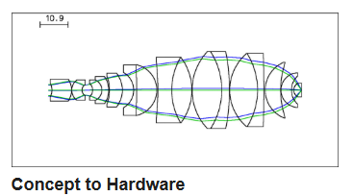
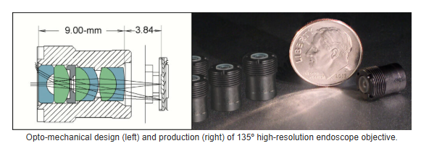
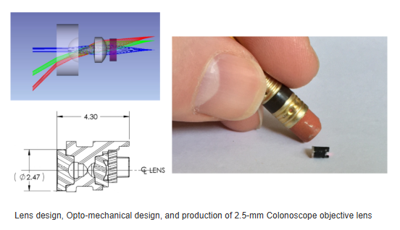
Gemini Optics
Specialize in small-volume concept to hardware custom optics
Capable of handling any and all aspects of the project
  DFM->prototypes->production
Experts in micro optics

Slide 10
Timeline and Budget (Phases 1-3)
Establish lens goals / requirements (this step involves first order optical parameters, optical performance, opto-mechanical factors, interfaces)
Feasibility / optical predesign (this first phase is estimated as an optical feasibility study only).
Review (intended to be a report on the feasibility study) may be a review meeting conducted virtually
Labor / Budget Estimate:
$28,700 for Gemini Optics to complete all three phases above
20 hours of Paul Roberts to attend virtual meetings, advise on design goals, and review materials

Slide 11
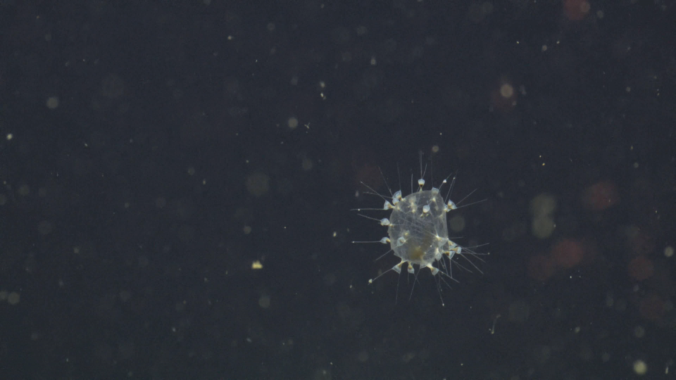

Slide 12
