Slide 1
902002 FathomNet
What’s the fundamental problem, question, or issue you are addressing?
MBARI has many platforms deployed in the ocean which will be collecting a huge volume of imagery moving forward.
This ever-increasing volume of data, which scientists want annotated by experts in the Video Lab, is creating a backlog that will be increasingly challenging to analyze without increasing staffing or reducing other tasks performed by the Video Lab.
Automating the detection and identification of marine taxa and other phenomena recorded in MBARI imagery will ease staffing constraints and improve timeliness of imagery analysis at MBARI.
Why is it important/why should anyone care?
Beyond MBARI’s immediate needs, we can apply these same technologies developed at MBARI to assist government, NGO’s, and other agencies with analysis of their un-curated data (e.g., NGS, NOAA, NMFS, TNC)?
These developments will allow scientists within and outside MBARI to better know/predict what’s in the ocean and where for effective and responsible stewardship.

Slide 2
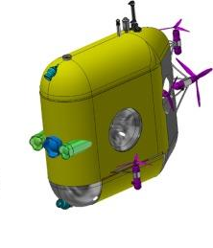
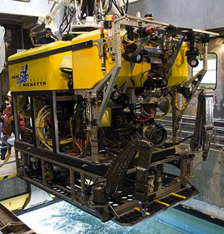
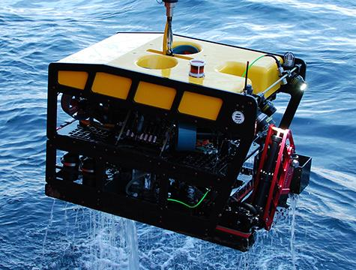
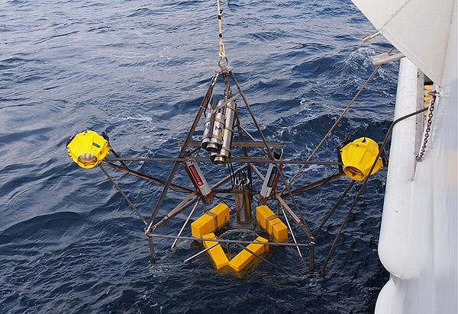
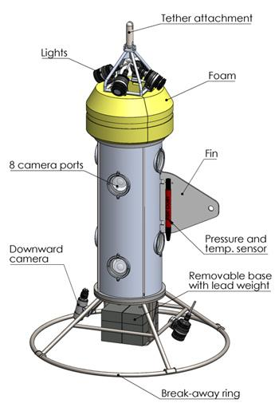
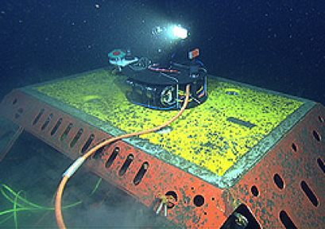
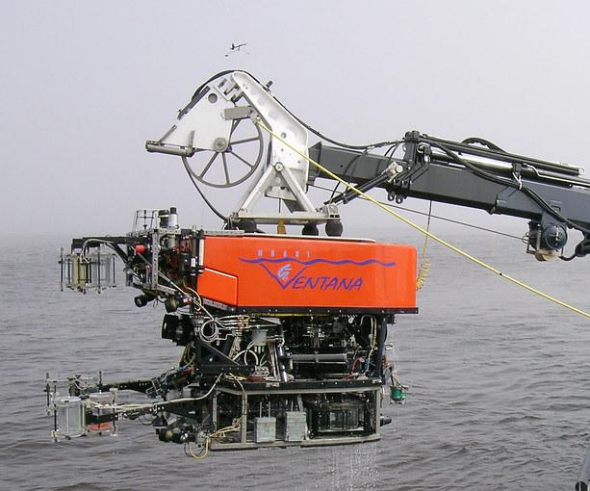
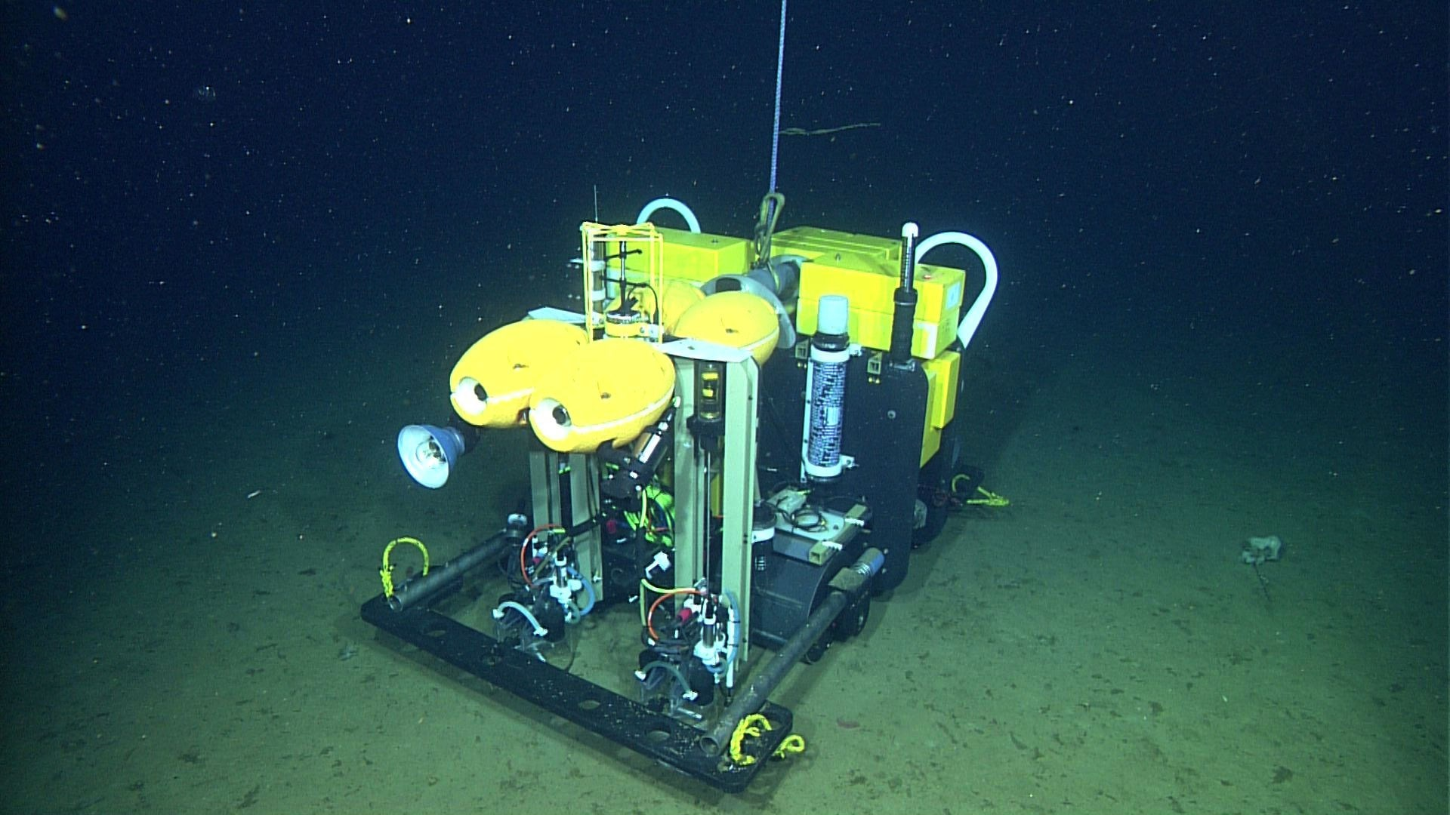
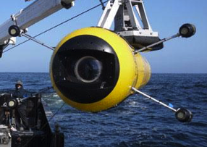
902002 FathomNet
MBARI 2020
Notes:
In 2020 MBARI will have many imaging systems in place

Slide 3
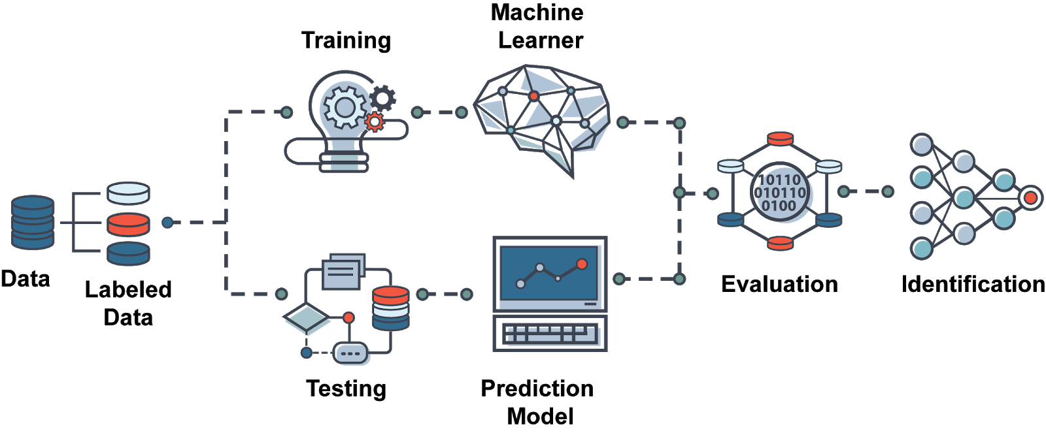
902002 FathomNet
The bottleneck that FathomNet will address
Notes:
A bottleneck that we’ve identified is the lack of annotated images and video with localization.

Slide 4
902002 FathomNet
What are we doing about it/what’s MBARI’s unique contribution?
FathomNet will utilize MBARI’s one-of-a-kind video library, VARS database, and video lab taxonomic expertise to develop machine learning training image sets that will be used to develop models for automating video and imagery analysis at MBARI.
This technology will be developed internally for use by MBARI staff and select partners. Eventually the project will be open-sourced and available outside MBARI to assist other researchers in the ocean science community.
MBARI can and should develop this technology because of our one-of-a-kind, expertly curated video archive. No other institute/agency is better positioned than MBARI to develop this deep-sea image training set.

Slide 5
902002 FathomNet
What are your project plans for next year (2020)?
Continue localizing (generating position accurate, labeled images) for use in training ML models using software developed for this purpose in 2019.
Take direction from science staff at MBARI to determine the most useful taxonomic groups to focus on.
Work closely with the VARS Annotation Assistance project (9002005) and a group of external partners to develop image detection models and integrate these models and workflows into the the VARS annotation pipeline.

Slide 6
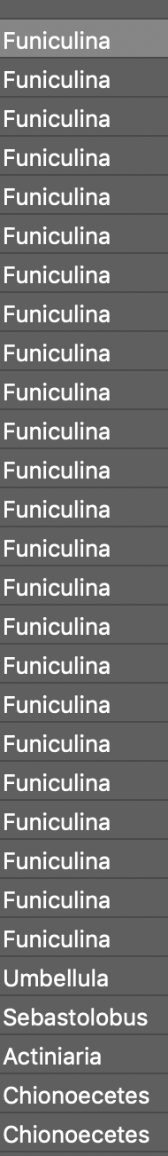
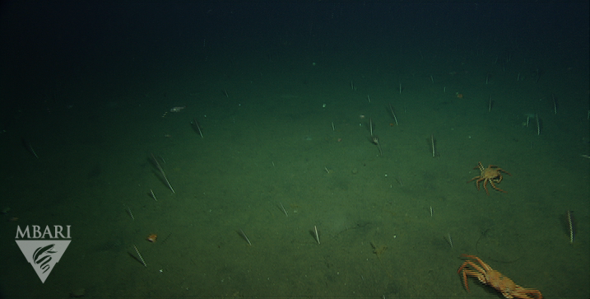
902002 FathomNet
VARS video annotations are currently like this….each image/video frame has a time stamp that relates objects seen with physical data collected by the ROV … but all we know is what was seen in the frame
Notes:
A bottleneck that we’ve identified is the lack of annotated images and video with localization.

Slide 7
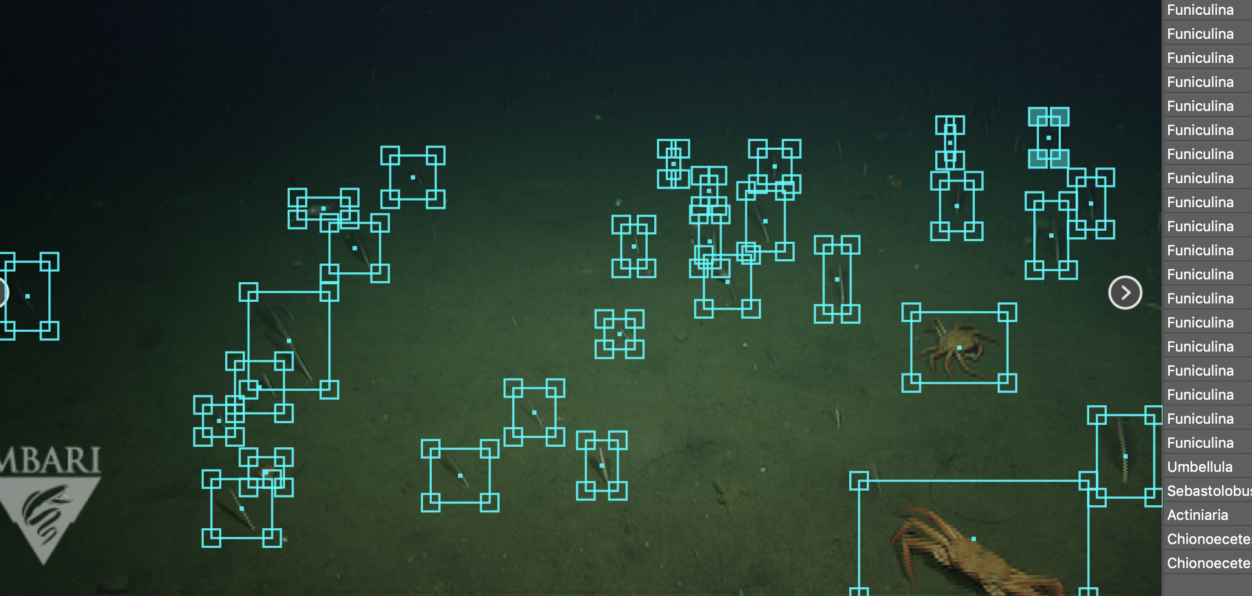
902002 FathomNet
Machine learning model development and training needs localized annotations. E.g., we need to know what the object is (class, concept) and where it is (localization, bounding boxes, segmentation)
Notes:
A bottleneck that we’ve identified is the lack of annotated images and video with localization.

Slide 8
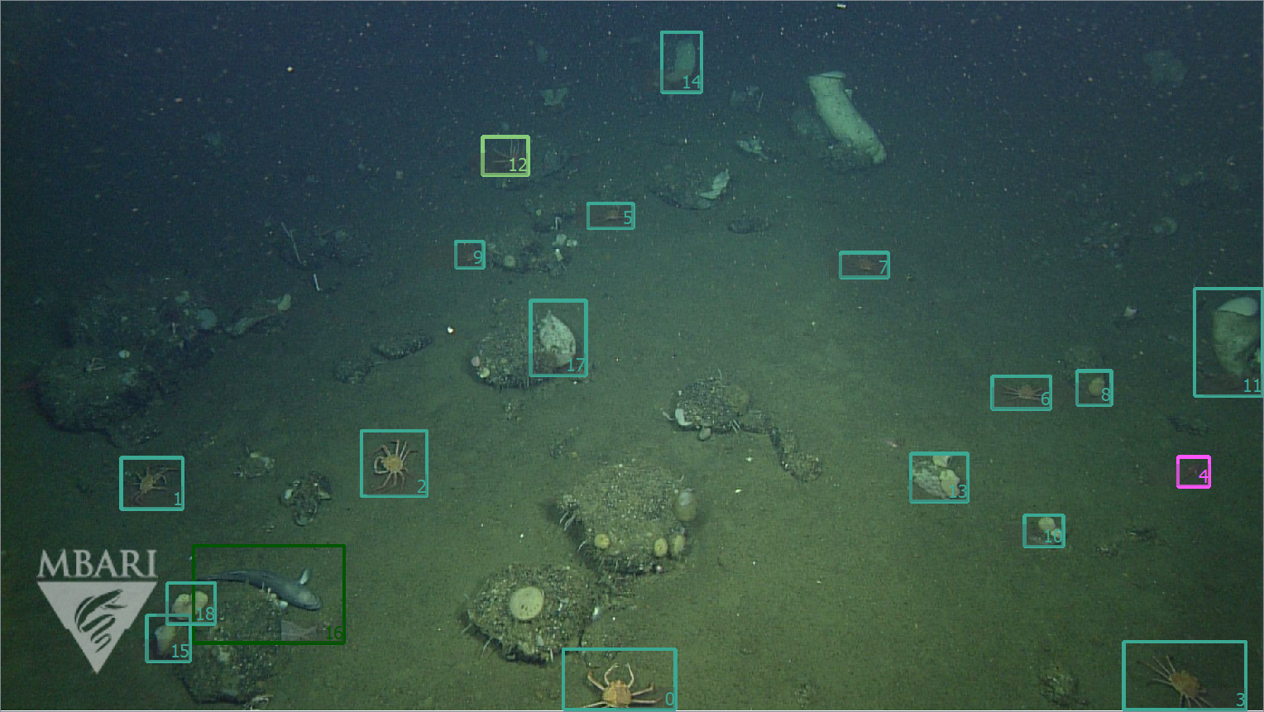
902002 FathomNet
Machine learning model development and training needs localized annotations. E.g., we need to know what the object is (class, concept) and where it is (localization, bounding boxes, segmentation)
Notes:
A bottleneck that we’ve identified is the lack of annotated images and video with localization.

Slide 9
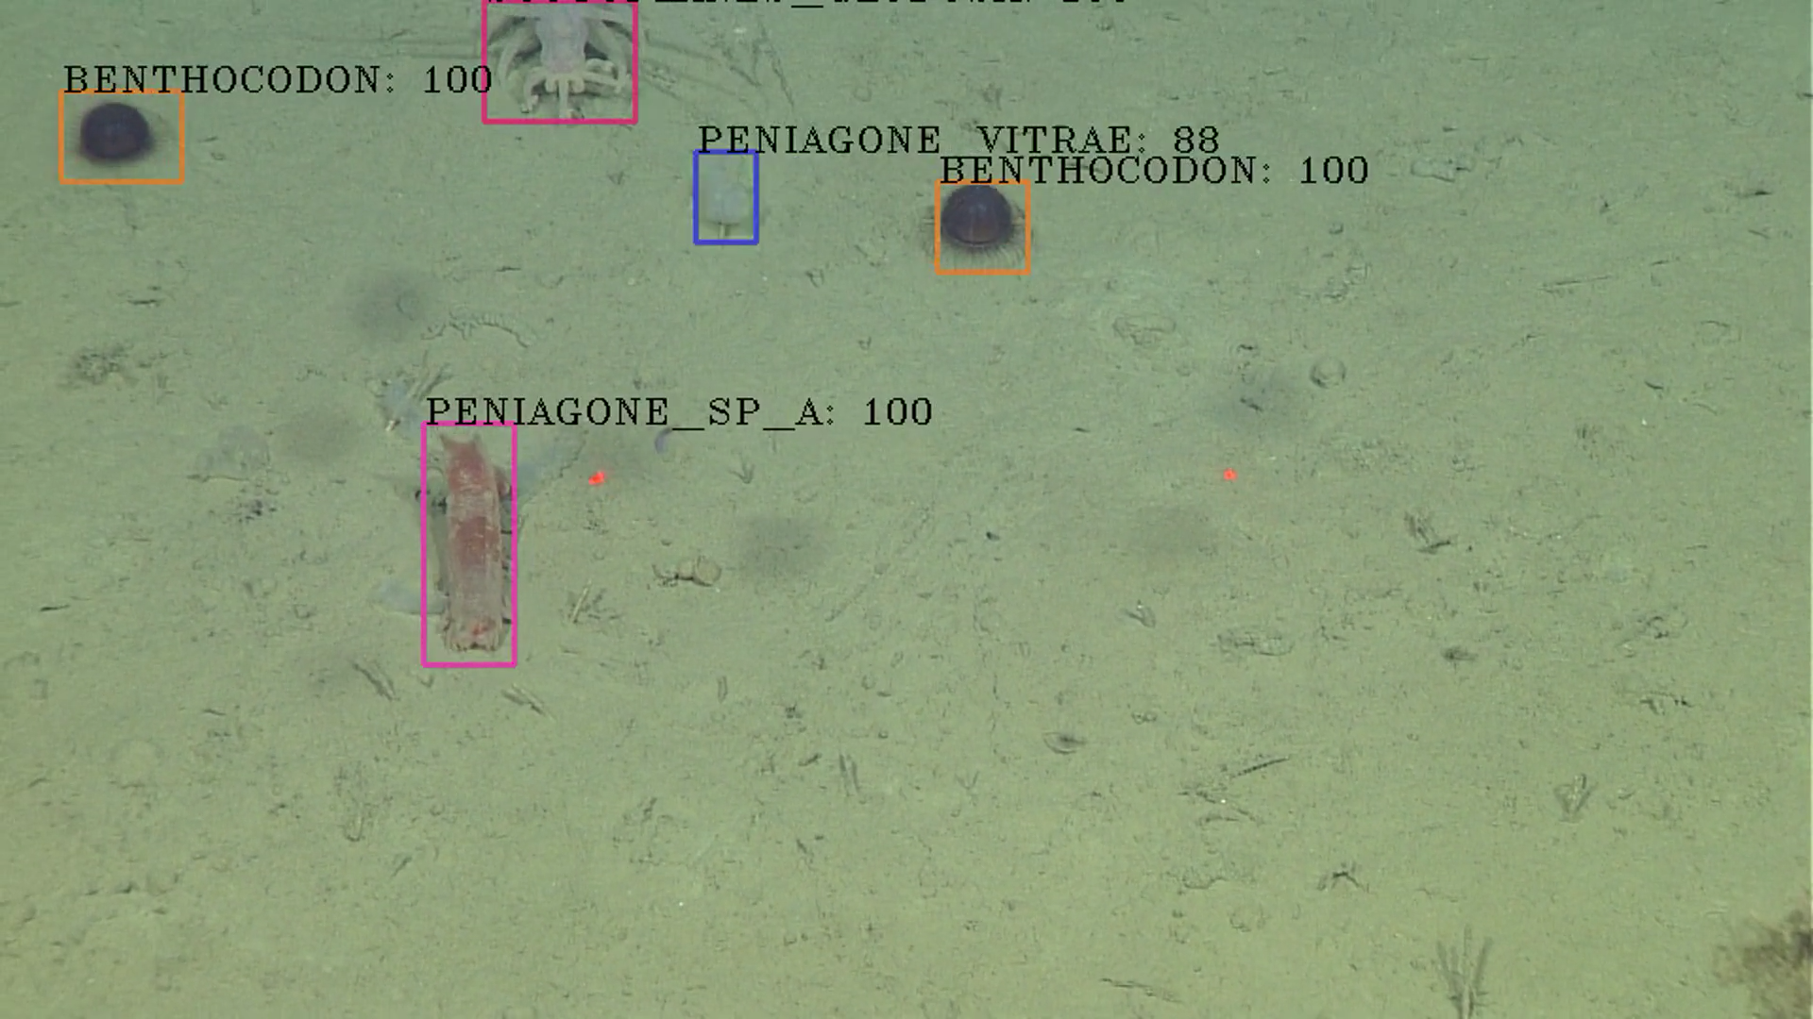
902002 FathomNet
Machine learning model development and training needs localized annotations. E.g., we need to know what the object is (class, concept) and where it is (localization, bounding boxes, segmentation)
Notes:
A bottleneck that we’ve identified is the lack of annotated images and video with localization.

