Slide 1
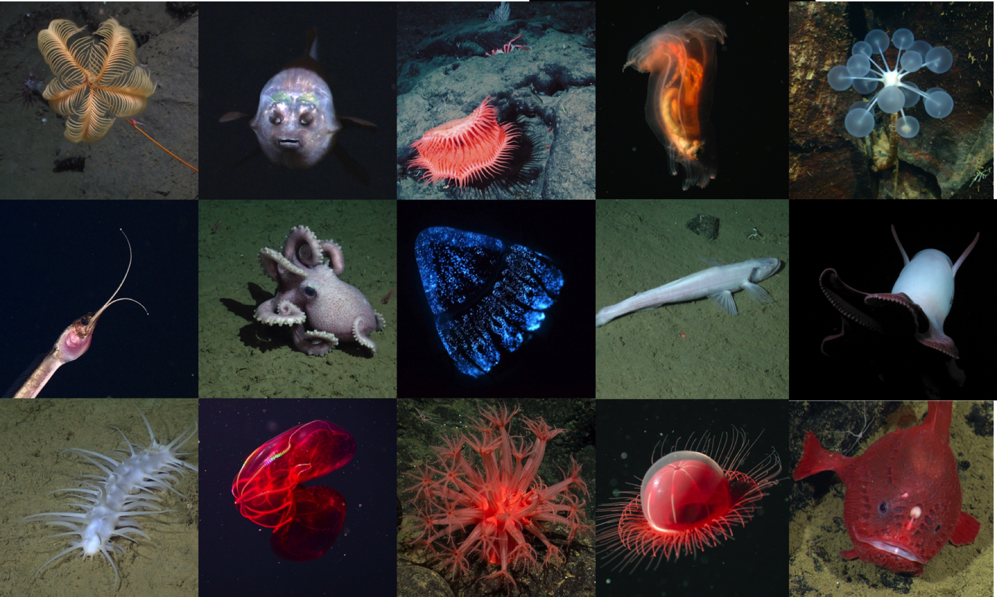
FathomNet
Developing an underwater image training set and algorithms for automated detection and classification using machine learning
Project Team: Lonny Lundsten (PM), Brian Schlining, Ken Smith, Jim Barry, Kakani Katija (PI)

Slide 2
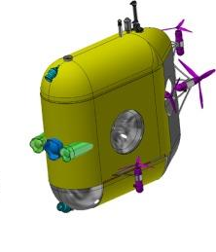
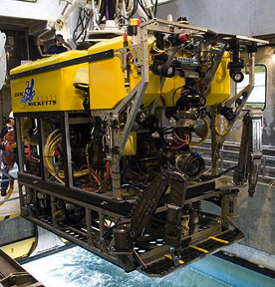
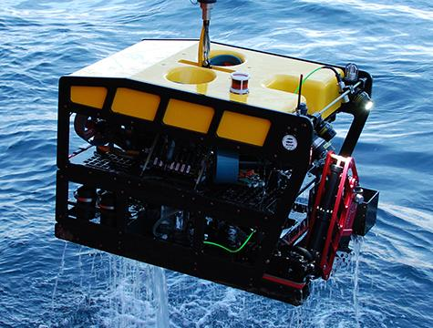
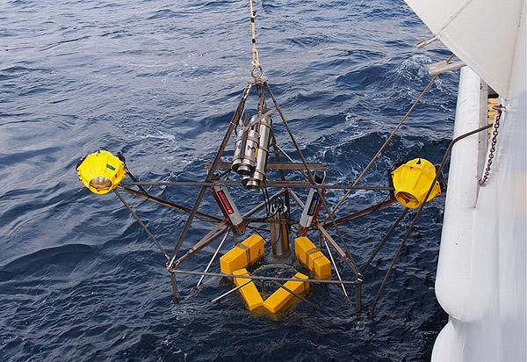
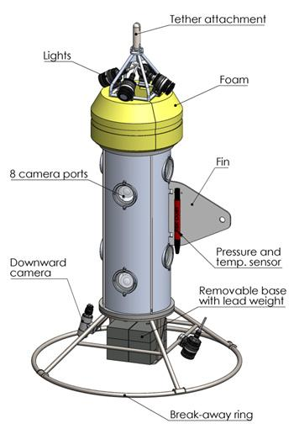
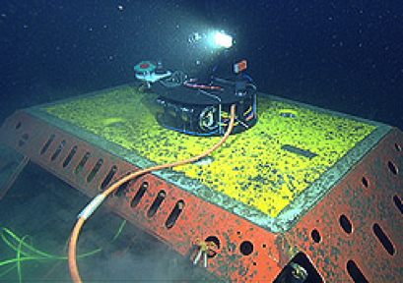
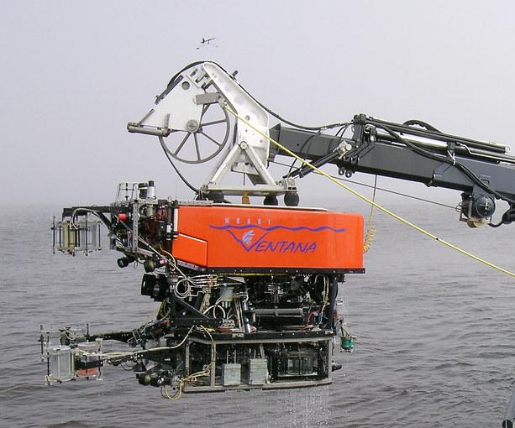
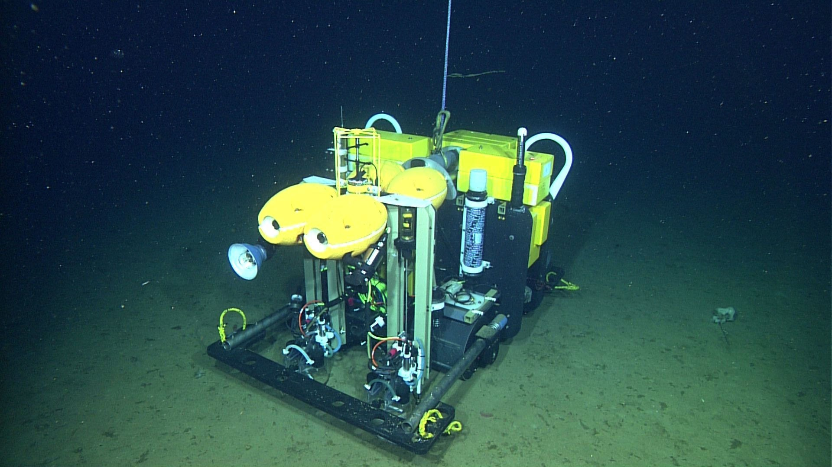
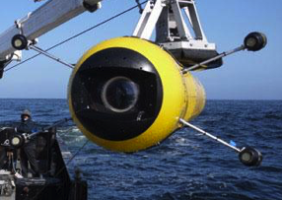
MBARI 2020
Notes:
In 2020 MBARI will have many imaging systems in place

Slide 3
Can we address this data challenge using machine learning?

Slide 4
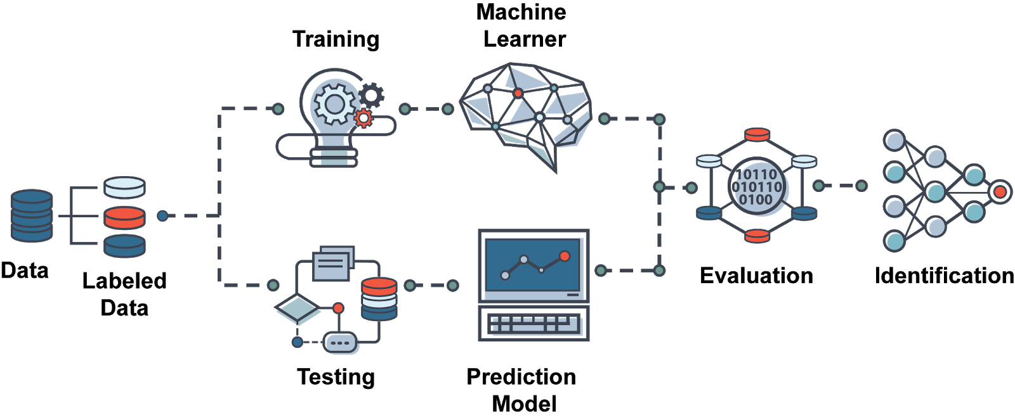
Yes, but we need localized images for model training
The bottleneck that FathomNet will address

Slide 5
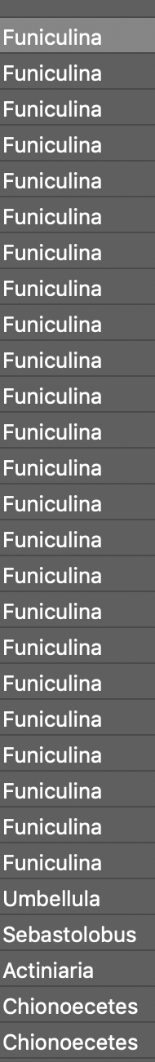
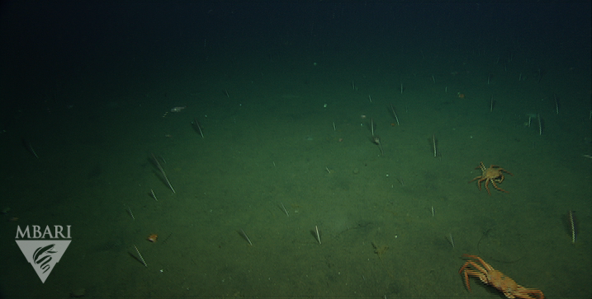
VARS annotations are like this….each image/video frame has a time stamp that relates objects seen with physical data collected by the ROV … but all we know is what was seen in the frame
Notes:
A bottleneck that we’ve identified is the lack of annotated images and video with localization.

Slide 6
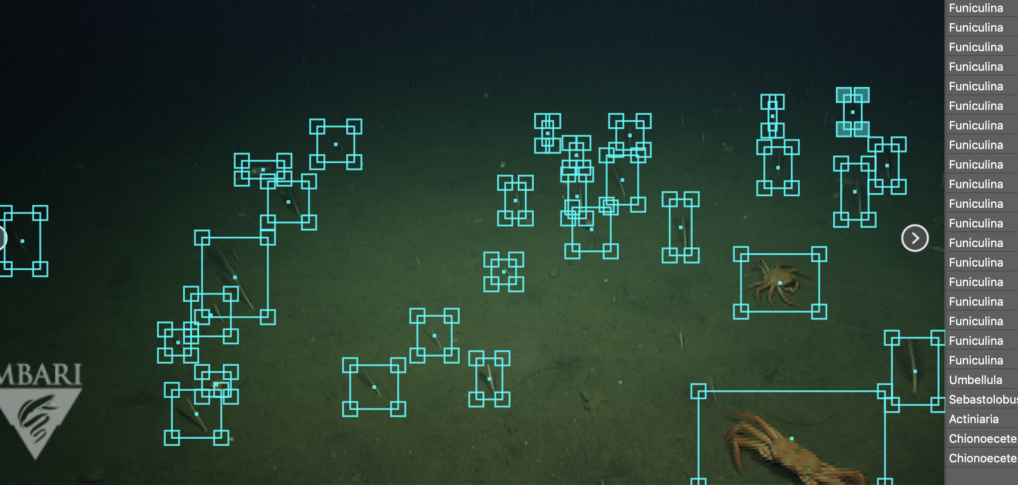
Machine learning model development and training needs localized annotations. E.g., we need to know what the object is (class, concept) and where it is (localization, bounding boxes, segmentation)
Notes:
A bottleneck that we’ve identified is the lack of annotated images and video with localization.

Slide 7
Can we use FathomNet to automate detection of targets in MBARI video data?
Can we use FathomNet to automate detection of targets in external partner video data?
Yes.

Slide 8
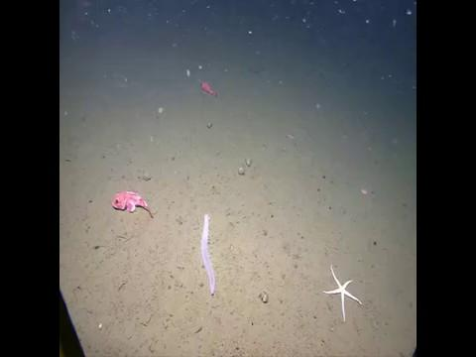
Benthic Animals
NOAA Okeanos Footage, identifying Sebastolobus
Notes:
Weakly supervised learning using GradCam++ to generate bounding box proposals

Slide 9
FathomNet potential
 | FathomNet (Current) | FathomNet (Future)
Images | 65,770 | ~1,000,000 (many more with digitized tape archive)
Annotations (without localization) |  | 6,500,000 +
Classes | 20 Morphotypes 194 Genera | ~40 Morphotypes 374 Genera 846 Species
Images with localizations | 3,000 images, 26,000 localizations | TBD

Slide 10
ML Models
ML Model
Zoo
FathomNet
The world
ML morph
The world
ML order
ML family
Proposed labels
ML genus
Framegrabs & Annotations
Verified labels
Video Lab or
Non-
Experts
FathomNet
Repo
VARS
Incomplete labels
Human-in-the-loop
Database
Notes:
Project workflow

Slide 11
Project Timeline
 | 2020 | 2021 | 2022
Milestone 1 | Develop FathomNet database architecture | Apply workflow with expert and non-expert validation on all VARS frame grabs (1M) | Pending video tape archive digitization:
Milestone 2 | Establish ML workflow for bounding box proposals | Evaluate quality of FathomNet data using gold standard video sets - midwater and benthic transects | Augment FathomNet further using remaining legacy annotations and digital video
Milestone 3 | Establish human-in-the-loop validation pipeline
Milestone 4 | Add additional classification algorithms

Slide 12
Resource Needs
Infrastructure
Image storage and backup (onsite in 2020)
Publicly accessible server (onsite in 2020; later years will leverage external partnerships)

Slide 13
Resource Needs
Internal Engineering
Localization data import into database
Localization editing/validating within VARS/web interface
Metadata storage or aggregation
  for quick search and lookup of images and localizations
  database, REST API, Elastic Search, ?

Slide 14
Resource Needs
Staff
Software Engineering = 600 hours
VL Technician = 2 people at 50% time or 1500 hours
Project Management = 100 hours

Slide 15
Data
Data types: framegrabs, metadata (e.g., uuids, localization, annotation, physical data)
Quantity: ~1 TB in 2020
Data management: share on Atlas/Titan with access for external collaborators
IP: None. FathomNet is open, using non-embargoed data

Slide 16
FathomNet Impact
Develop an underwater image training set and ML algorithms rivaling other image training sets in terrestrial applications.
Pushes the envelope for MBARI automated image/video classification.
Images/data/models can be used by data scientists to address diverse questions within ocean sciences.
Will continue to leverage our external partnerships. In future years disseminating the data via a publicly accessible platform will significantly impact a number of areas:
  Academic - WHOI, MIT Media Lab, UH, Stanford, etc.
  Non-profit - MBA, NGS, OET, The Nature Conservancy, Schmidt Ocean Inst.
  Government - MBNMS (and other marine sanctuaries), NOAA
  Industry

Slide 17
Thanks!

Slide 18
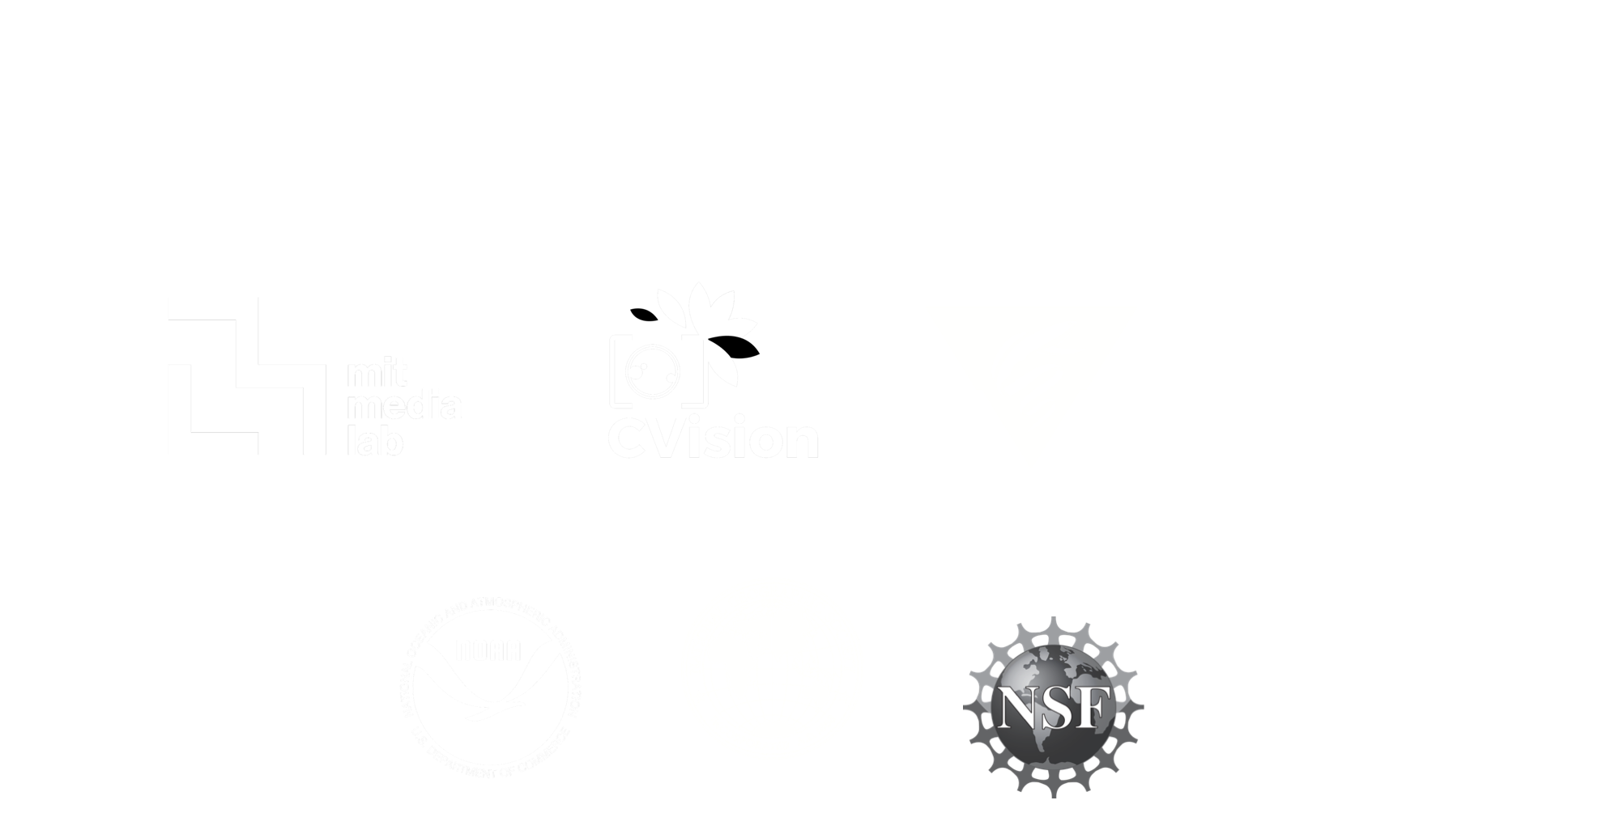

Slide 19
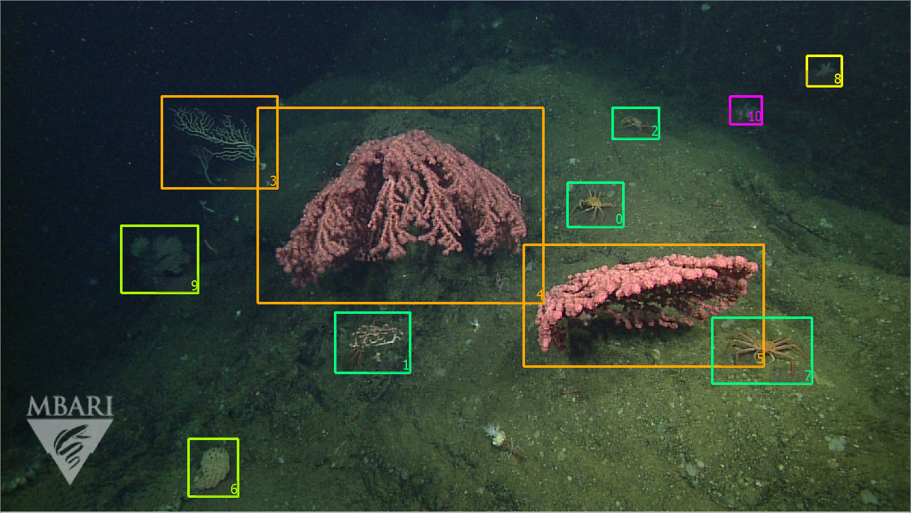
Notes:
Used FathomNet to compress classes to include morphotypes (examples), and will use few-shot learning model iterations to classify detections down to genus level pending FathomNet data state

Slide 20
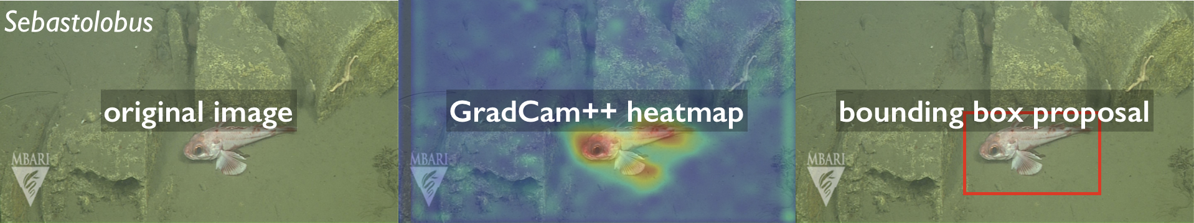
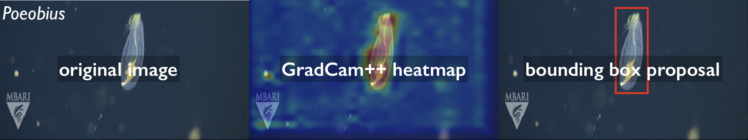
Benthic Animals
Midwater Animals
Notes:
Weakly supervised learning using GradCam++ to generate bounding box proposals

Slide 21
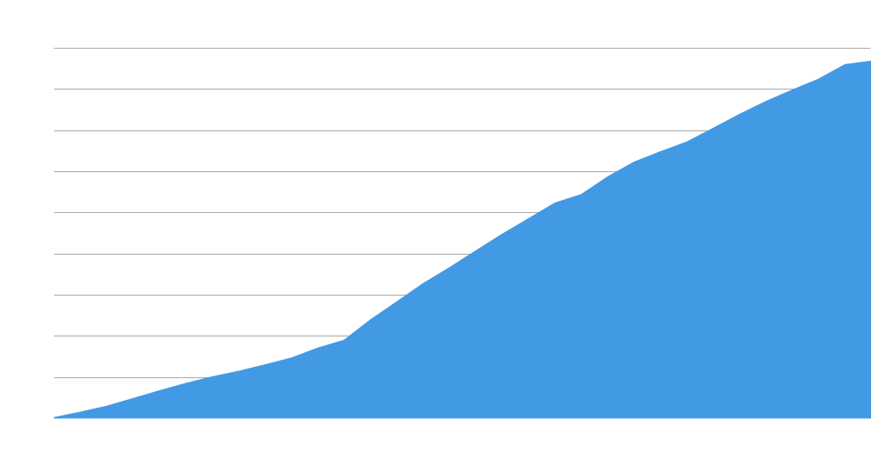
MBARI ROV video accumulation
Video (hours)
Year
Notes:
Image and video archive is growing == ROV video alone is ~26,000 hours, 6M+ annotations

Slide 22
Can we leverage existing, expertly curated data (MBARI VARS) to develop an image training set for machine learning called FathomNet?
Can we automate the detection of targets in MBARI video and other, uncurated data (e.g., NGS, NOAA)?

Slide 23
Can we use FathomNet to know/predict what’s in the ocean and where for effective and responsible stewardship?
We think MBARI can and should because of our one-of-a-kind, expertly curated video archive. If not MBARI, then who?

Slide 24
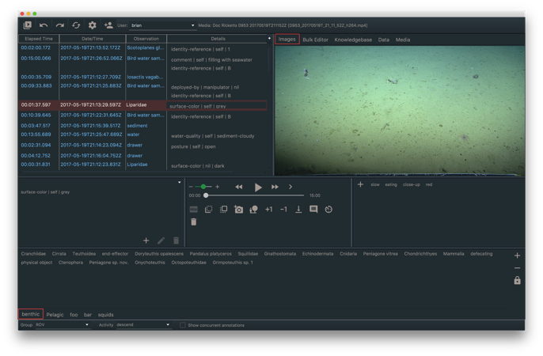
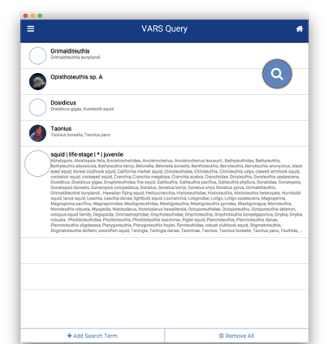
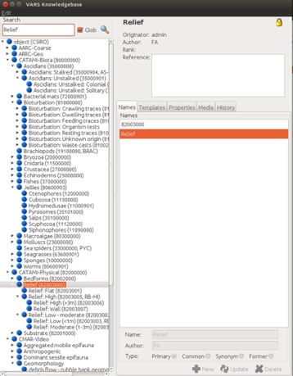
VARS Annotation System
Annotation
Query
Knowledgebase
VARS db: 30-yr, expertly curated, manually annotated, platform sensor data merged;
includes 26k+ hours of video (mostly tape), 6.5 M+ annotations, ~1M frame grabs
Notes:
Currently we use VARS to analyze this video record, however, the volume of video and variety of imaging systems in beginning to overtake our capacity to analyze it

Slide 25
Resource specifics - Video Lab
900k framegrabs, 80% usable, 25 images per hour for multi-label localization =>
720 weeks for single-person

Slide 26
Notes:
Spare slides after this

Slide 27
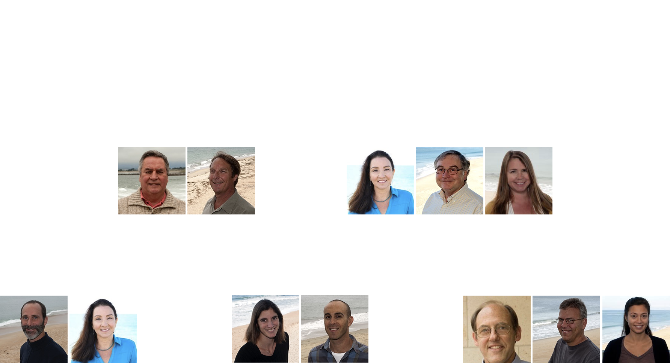

Slide 28
“The mission of MBARI is to achieve and maintain a position as a world center for advanced research and education in ocean science and technology, and to do so through the development of better instruments, systems, and methods for scientific research in the deep waters of the ocean.”
David Packard
MBARI Founder

Slide 29
Project Timeline
Generate training data by mining VARS video/image database
Year 1: Develop architecture for the FathomNet database. Establish ML workflow for generating bounding box proposals, human-in-the-loop verification, and additional classification algorithms.
Year 2: Apply workflow with expert and non-expert verification in all framegrabs within VARS. Evaluate quality and quantity of image data within FathomNet using gold standard video sets.
Year 3: Pending digitization of video archive, augment FathomNet further using remaining legacy annotations and digital video.

Slide 30
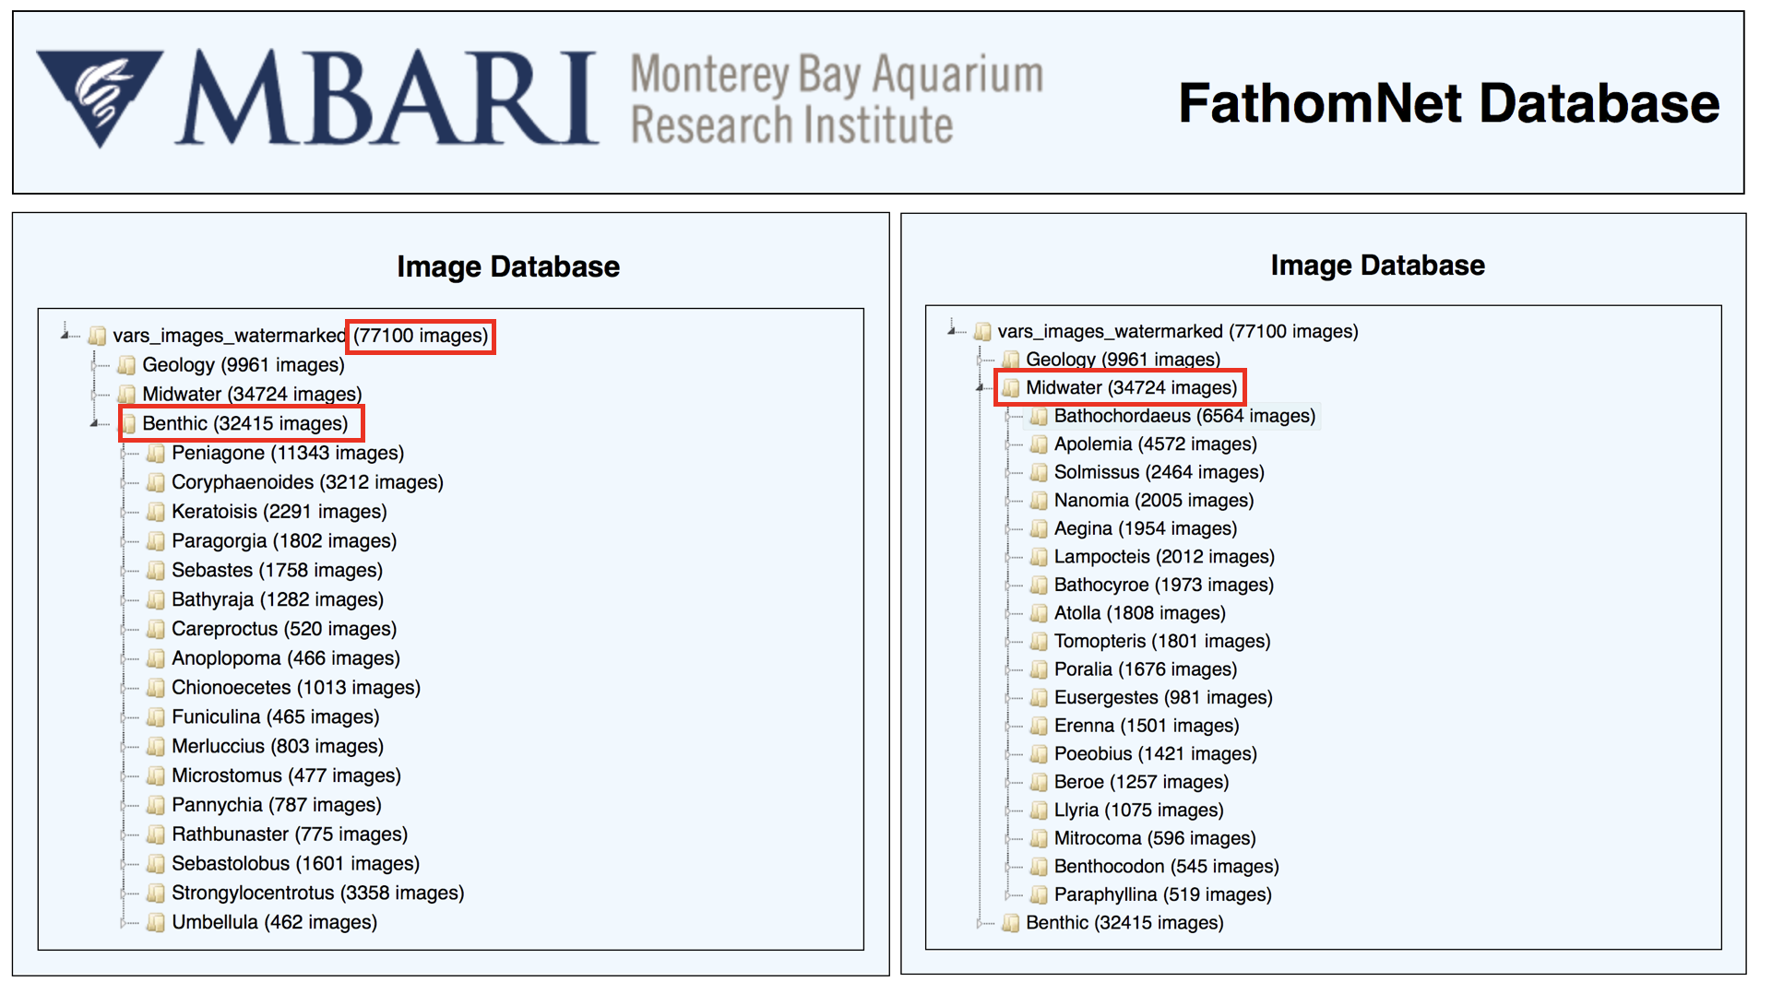

Slide 31
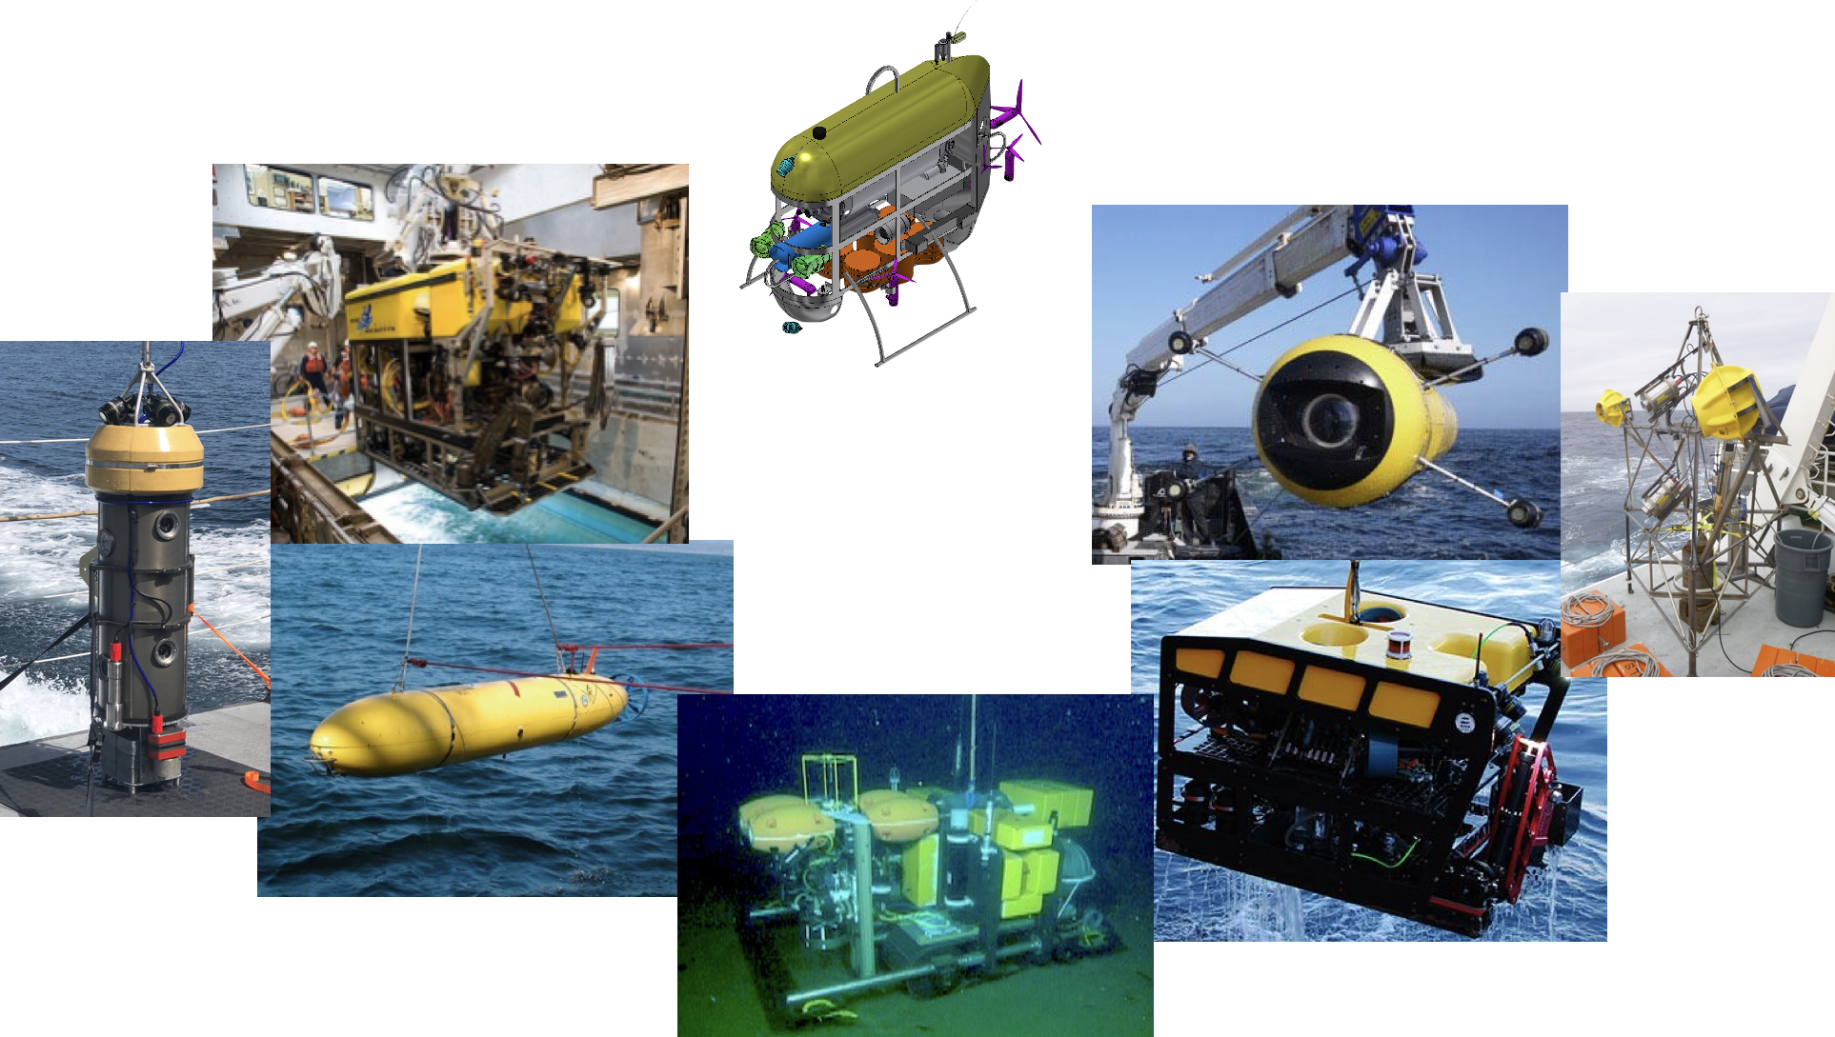
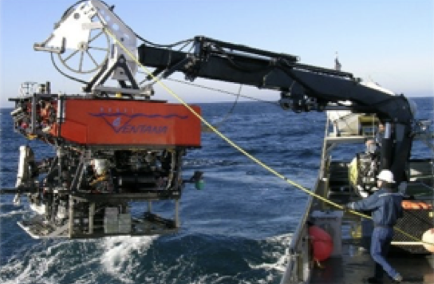

Slide 32
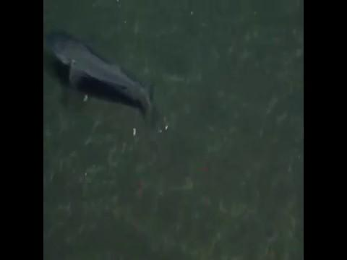
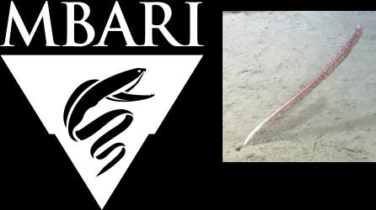
FathomNet/GradCAM++ detection of Funiculina

Slide 33
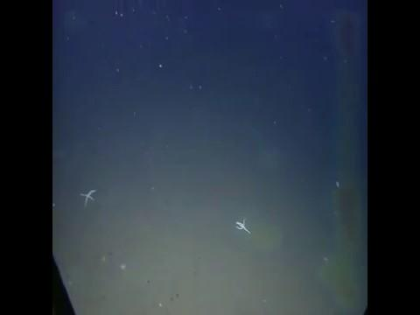
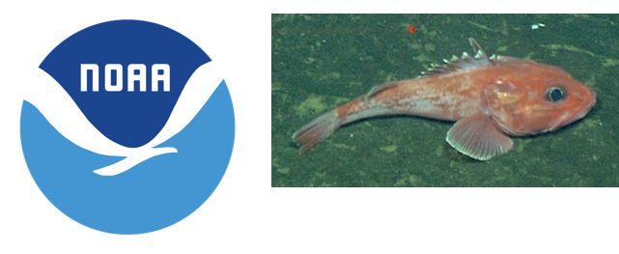
FathomNet/GradCAM++ detection of Sebastolobus

Slide 34
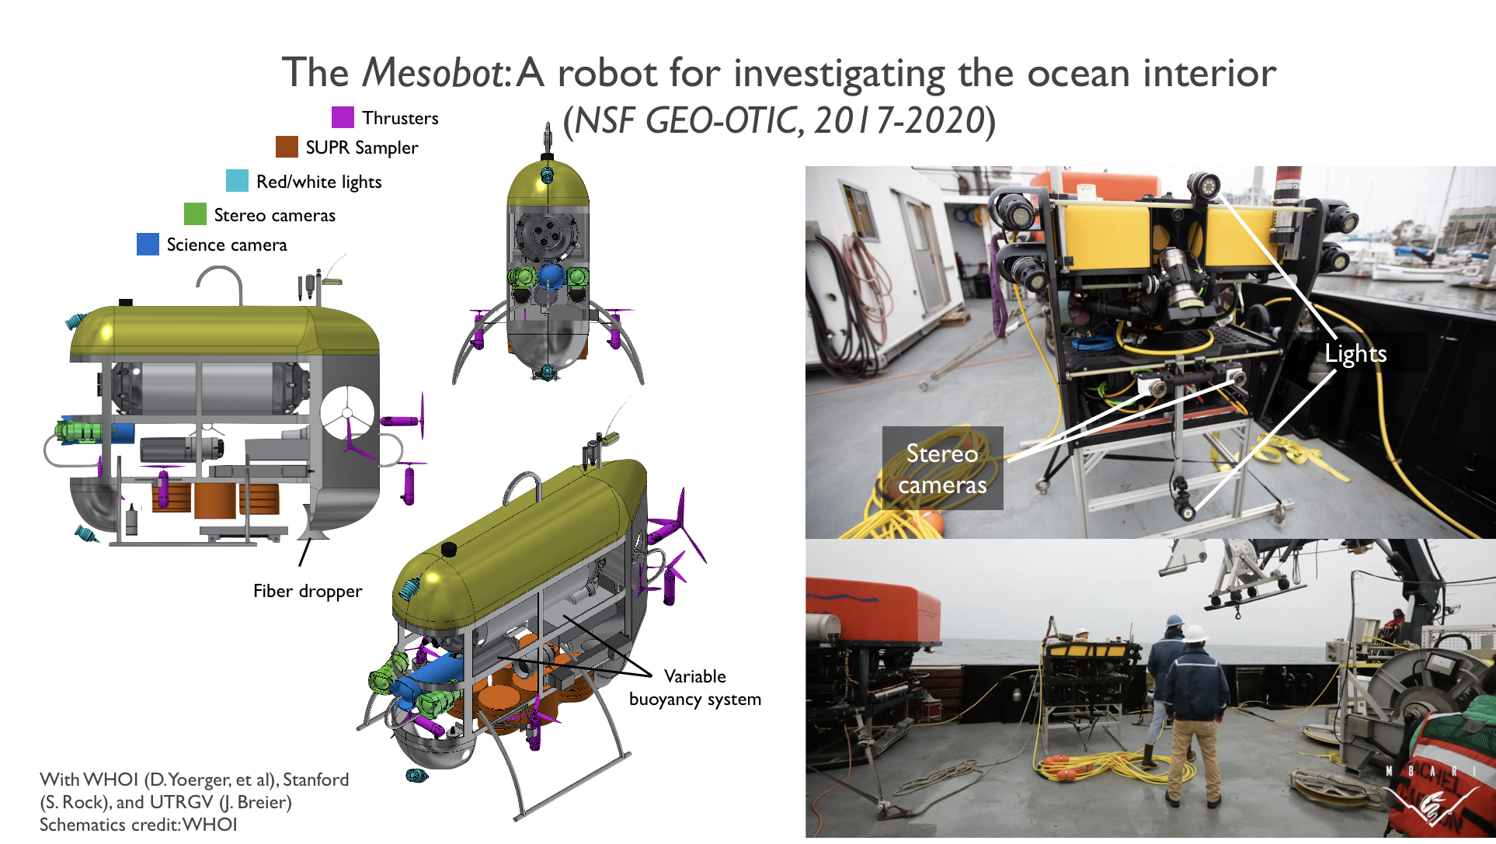

Slide 35

FathomNet potential
 |  | FathomNet (Current) | FathomNet (Future)
Images | 14,197,122 | 60,000 -- confirm? | 1,000,000 (many more with digitized tape archive)
Annotations |  |  | 6,000,000 +
Classes | 21,841 | 20 Morphotypes 194 Genera | ~40 Morphotypes 374 Genera 846 Species
Images with localizations | 1,034,908 | 3,000 images, 26,000 localizations | TBD

Slide 36
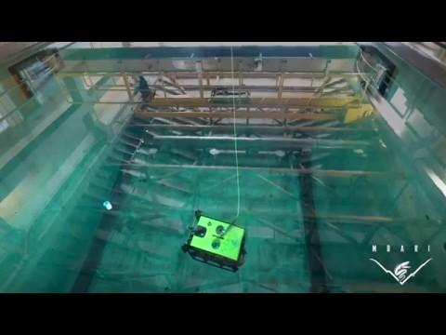
Collaborators: WHOI (D. Yoerger, et al), Stanford (S. Rock), and UTRGV (J. Breier)

Slide 37
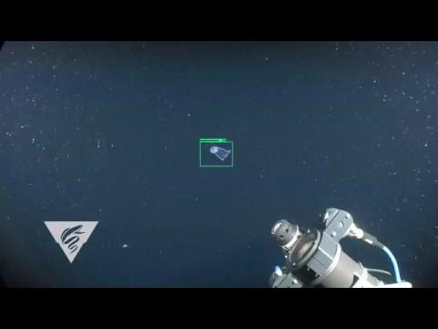
FathomNet/ML detection of Bathochordaeus (grn) and mucus house (ylw); with D. Cline

