Slide 1
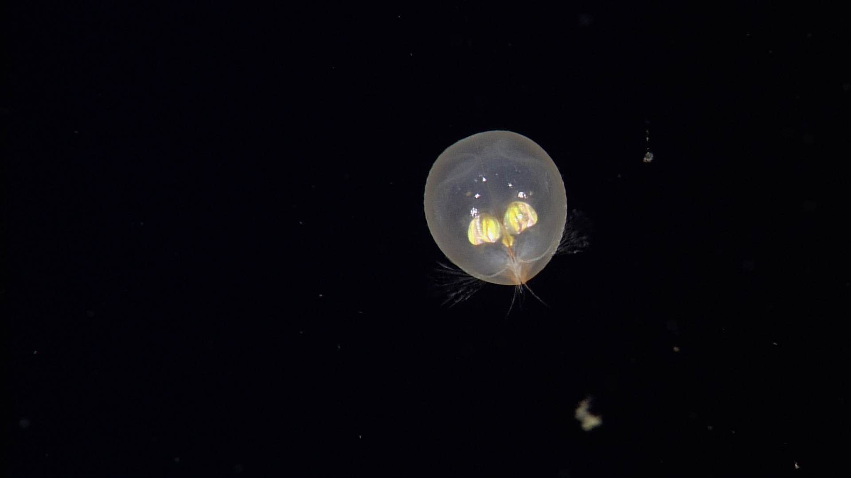
902004 Planktivore:
In-Situ Smart Microscope
Board Slides 16 Oct 2020
Notes:
‘Plank’ton = the small and microscopic organisms drifting or floating in the sea or fresh water, consisting chiefly of diatoms, protozoans, small crustaceans, and the eggs and larval stages
‘I’ = Image, internet digitized and processed
‘Vore’ = Devour, Eat, Digest

Slide 2
902004 – Planktivore,
In-situ Smart Microscope Instrument for Autonomous Vehicles
What’s the fundamental problem, question, or issue you are addressing?
  Continuous plankton imaging for autonomous vehicles, fills the imaging gap between 10 µm to 2 cm.
Why is it important/why should anyone care?
  Biological Oceanography, imaging primary producers and consumers.
  - Current imaging methods have a “blind-spot” at critical size ranges

Slide 3
902004 – Planktivore
In-situ Smart Microscope Instrument for Autonomous Vehicles
What are we doing about it/what’s MBARI’s unique contribution?
We are leveraging design principles from a microscope integrated on a Spray Glider that was built to meet the requirements of a zooplankton biologist (Dr. Mark Ohman, Scripps).
We are making significant enhancements in the housing and optics/lighting/imaging design as well as the onboard compute capabilities (hardware and software).
What are your project plans for next year (2021)?
To design and fabricate a first iteration of the Planktivore Smart Microscope and integrate on a Spray Glider with a goal for first deployment May 2020.
- Benchtop and Fluum based development of computer vision for particle size statistics and storage of ‘just the plankton’ images (~10,000 to 1 storage reduction)
- Emphasis will be on darkfield lighting.
- 10um to 2cm

Slide 4
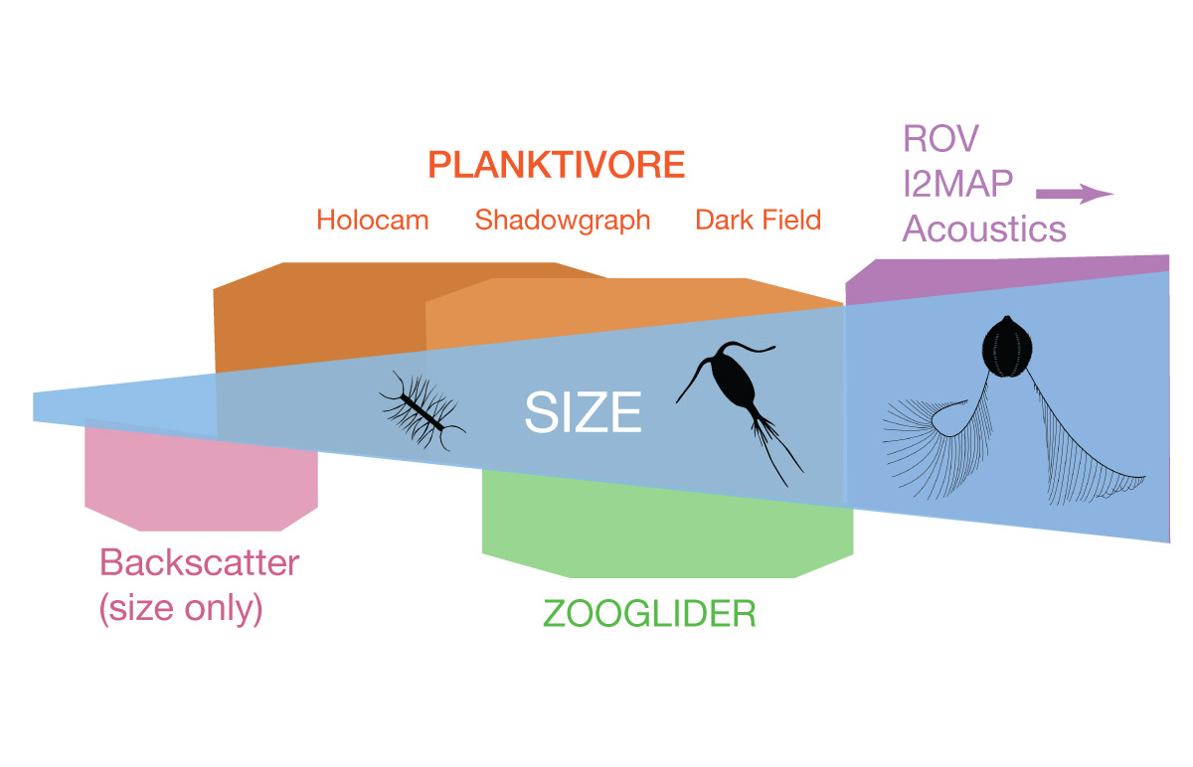
Planktivore: ‘Why’ - Fills the gap between 10 µm to 2 cm
Plankton Imaging Instrument Technologies:
Size | Instrument Technology
< 100 um : | Optical backscatter and fluorescence (LISST or similar VSF methods)
10 um - 1 mm | Planktivore side A: In situ microscopy with 5x magnification
200 um - 2 cm | Planktivore side B: In situ microscopy with 0.5x magnification (Similar to EyeRIS)
100 um - 0.5 cm | Waveglider plankton microscope (SilCam 0.125x)
> 1 cm | In situ macroscopy (i2MAP, mesobot)
> 1 m | In situ acoustic imaging
Notes:
Is there a commercial in-situ microscope available? Not with the magnification range or versatility of illumination. Make vs Buy
CiPics, ISIIS, mini-ISIIS, 4Deep, Sequoia, Zoocam, IFCB - these dont integrate and real-time (Mark Benfield paper on comparison)
Size ranges: planktivore, EyeRIS, I2map, acoustic backscatter
Validating or replacing or complementing Proxy instruments (backscatter, fluorometer, eDNA, biolume)

Slide 5
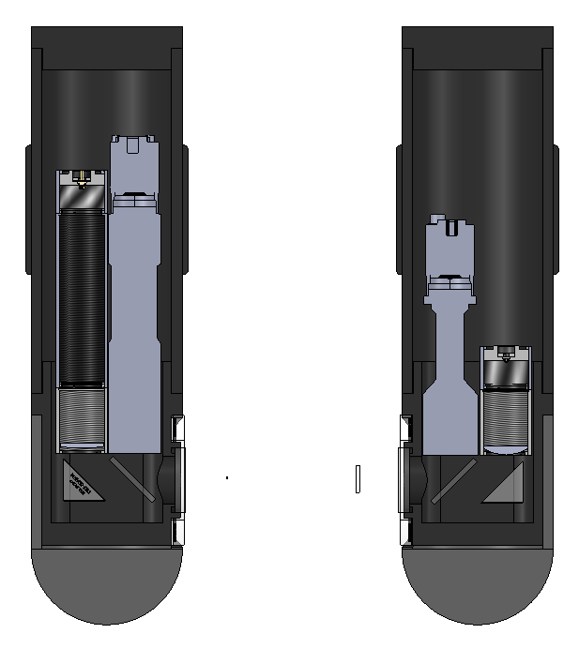
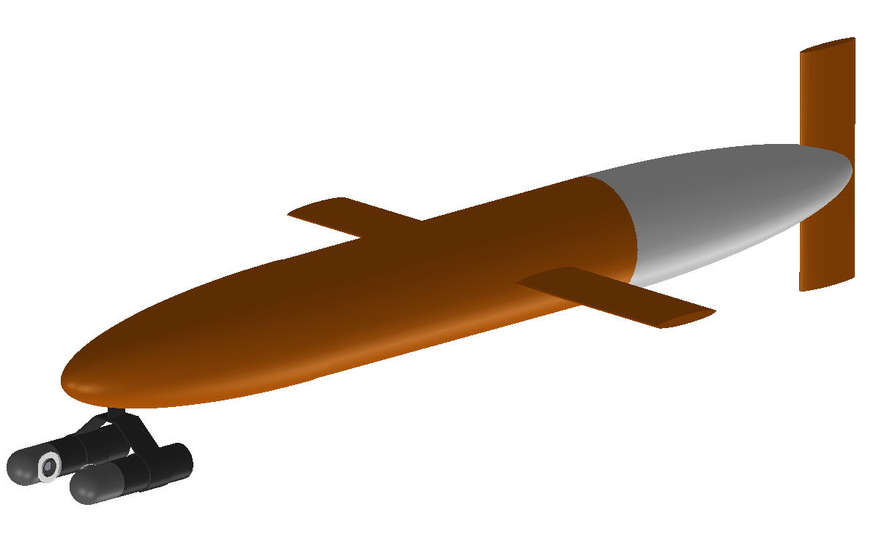
Size | 34.3 cm x 30.5 cm x 8.9 cm (13.5” x 12“ x 3.5“)
Depth Rating | 2000 m
Weight | 15 lbs / 6.8 Kg (air) Neutral in seawater
Imaging Modes | Shadowgraph/ Holography Color Darkfield
Magnification | 0.5x and 4.0x
Optical Resolution | 2 um (4x mag) 20 um (0.5x mag)
Minimum Object | 20 um (4x mag) 200 um (0.5x mag)
Imaged Volume | 0.5 uL (4x mag) 0.5 mL (0.5x mag)
Sample Rate | 20 uL / s (4x mag) 20 mL / s (0.5x mag)
12.7 cm (5 in)
34.3 cm (13.5 in)
0.5x Imaged Volume ~ 0.5 ml
4x Imaged Volume ~ 0.5 ul
Water Flow
Imaging Optics
Shadow/Holo Illumination
Darkfield Illumination
Cameras
Compute
Example of Planktivore mounted on the nose of the Spray Glider

Slide 6
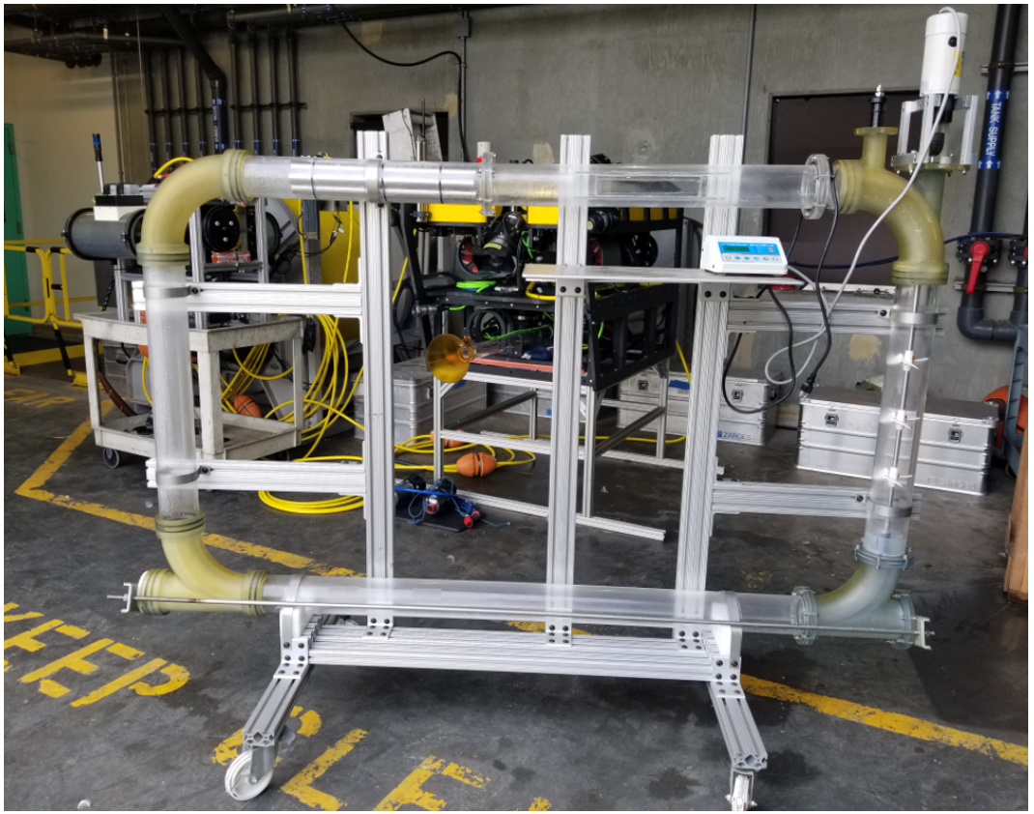
Fluum
Close circuit flume, aka, Fluum
Design based on Vogel Flume
0 to 1m/s flow rate
Modular
Custom imaging flow section with a 3D printed mockup of Planktivore housing
Imaging target port for adding calibrated glass beads, plankton

Slide 7
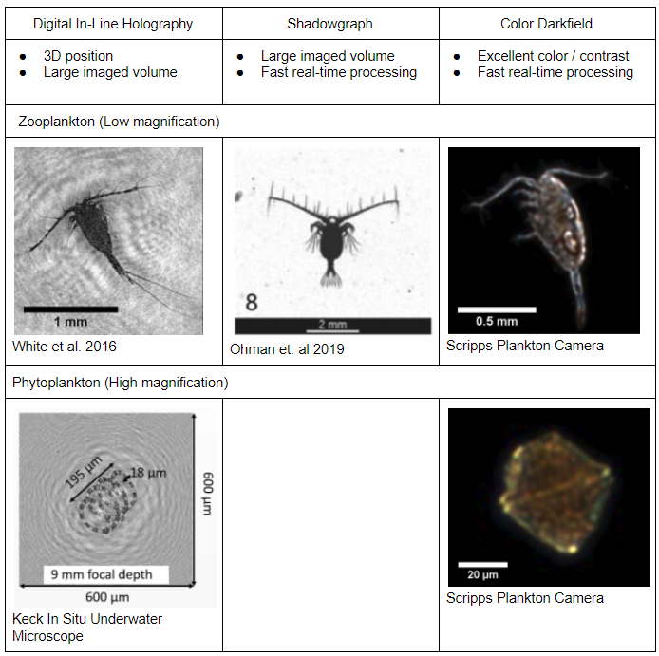
Illumination Modes
Holography
  Pro: 3D position and large imaged volume
  Pro: High resolution
  Con: Dense 3D reconstruction is computationally intensive
  Con: Reconstructed images suffer from speckle noise
Shadowgraph
  Pro: Larger imaged volume than darkfield
  Pro: Fast ROI processing is straightforward
  Con: Smaller imaged volume than holography
  Con: Lower optical resolution than holography
Color Darkfield
  Pro: Excellent color reproduction and high contrast for transparent objects
  Pro: Fast ROI processing is straightforward
  Con: Small imaged volume compared to other methods
Notes:
Holography
Pro: 3D position and large imaged volume
Pro: High resolution
Con: Dense 3D reconstruction is computationally intensive
Con: Reconstructed images suffer from speckle noise
Shadowgraph
Pro: Larger imaged volume than darkfield
Pro: Fast ROI processing is straightforward
Con: Smaller imaged volume than holography
Con: Lower optical resolution than holography
Color Darkfield
Pro: Excellent color reproduction and high contrast for transparent objects
Pro: Fast ROI processing is straightforward
Con: Small imaged volume compared to other methods

Slide 8
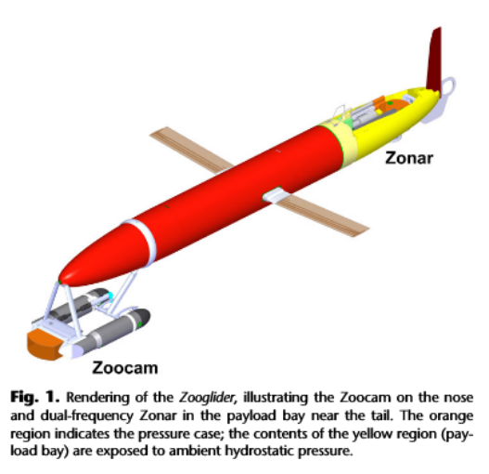
Planktivore: ‘What’
Free-space, free-flow Plankton Microscope ‘Instrument’ for MBARI assets
  New concept originated by Paul Roberts to better utilize the housing volume for extended magnification and illumination modes
  Serial Instrument for LRAUV, Glider, Profiling float, mini-ROV, ROV (2000m)
  Leverages design principles from field proven Scripps Zooglider / Zoocam (Ohman)
  Designed for persistent deployments, bio-fouling mitigation
  ~$15K cost of build
Two magnification ranges
  10µm to 2cm with real-time particle size stats and automated id
Three illumination modes
  Shadowgraph
  Darkfield
  Holographic

Slide 9
902004 Planktivore: Plankton Imaging and Particle Size Instrument
What: In-Situ Plankton Microscope (10µm to 2cm) with particle size spectra.
  For MBARI assets: LRAUV, Glider, Profiling float, ROV.
    First integration on Spray Glider for May 2021 deployment, CENCOOS funding.
Why: Biological Oceanography, imaging primary producers and consumers
  Current imaging methods have a “blind-spot” at critical size ranges
How: MBARI design engineering to leverage and improve Scripps Zoocam
  Extend size range down to 10µm and add lighting modes. Add particle size spectra with a roadmap to automated identification with machine learning.
2021 Plans:
CENCOOS funding Aug 2020. Feasibility study partially completed, re-prioritizing project (8/2020) towards first design iteration for Spray Glider with shadowgraph lighting.
Housing design has started, lighting and imaging development aided by a custom designed 0 to 1m/s flow rate flume. Machine vision on NVidia Xavier NX.
Notes:
Paul Roberts originated the idea, but is full time on EyeRIS
What’s the fundamental problem, question, or issue you are addressing?
Why is it important/why should anyone care?
What are we doing about it/what’s MBARI’s unique contribution?
What are your project plans for next year (2020)?

