Slide 1
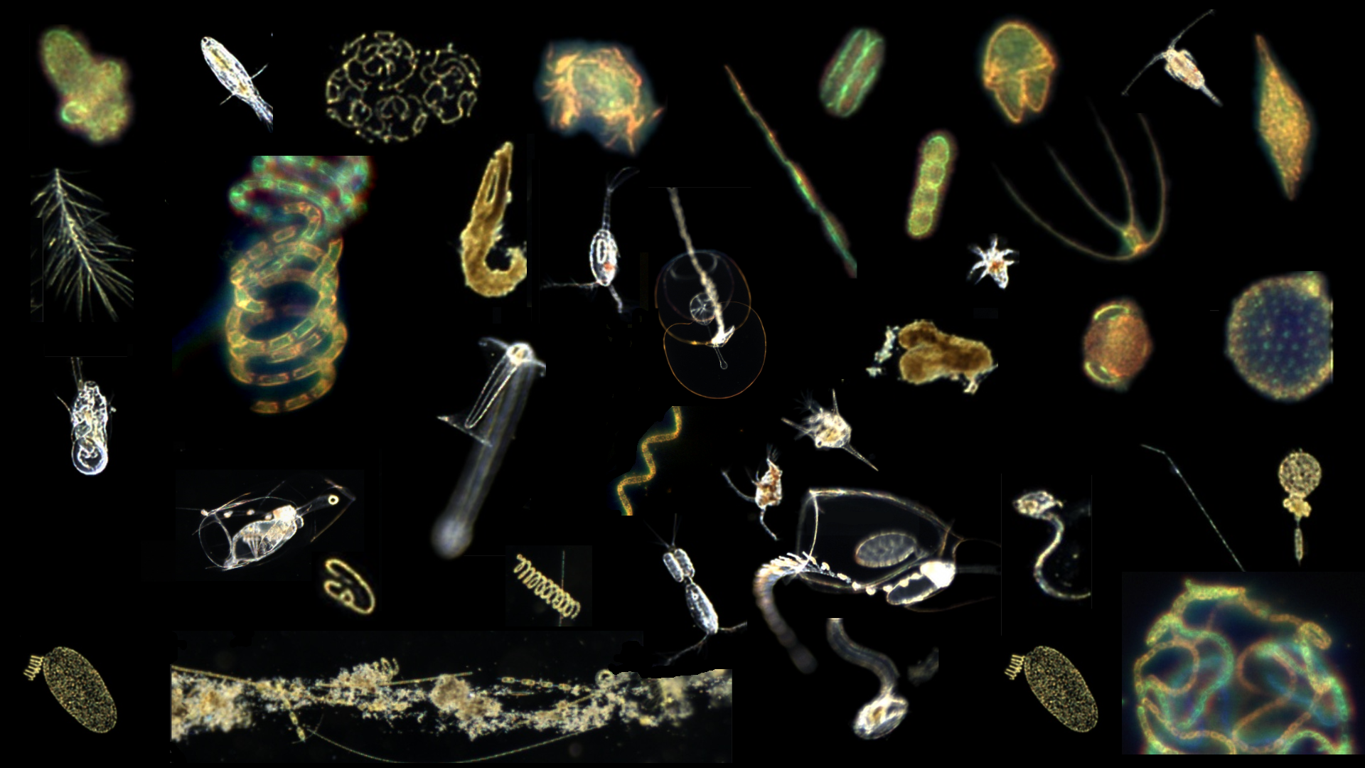
Planktivore In-Situ Microscope
Francisco Chavez (PI), Henry Ruhl / Steve Haddock (Chief Scientist), Thom Maughan (PM), Paul Roberts (Lead Engineer)
902004 Abstract Presentation 22 May 2023
Notes:
‘Plank’ton = the small and microscopic organisms drifting or floating in the sea or fresh water, consisting chiefly of diatoms, protozoans, small crustaceans, and the eggs and larval stages
‘I’ = Image, internet digitized and processed
‘Vore’ = Devour, Eat, Digest

Slide 2
Planktivore Project Abstract in a nutshell
Planktivore is an in-situ optical sampling tool, size range ~20um to 2cm, aligned with MBARI’s strategic roadmap.
Planktivore can be deployed on a wide variety of MBARI vehicles, constrained by speed thru water, 0 to 1m/s, and depth, 0 to 1500m. Routine deployment on autonomous underwater vehicles is the goal.
Request is for 3 (possibly 4) years.
Deploy for Science.
  Workflow automation and documentation to reduce the need for engineering staff. Regularly scheduled.
Define/refine data products, shoreside and onboard. Dash, ODSS, STOQS. Data archive plan.
Engineering Improvements:
  decrease power consumption,
  increase imaging volume for use in sparsely populated waters
Notes:
What is Planktivore? (probably an animation, stepping through the three topics):
Stommel diagram, optical imaging, etc (PAUL, bedazzle)
V1 photo and example deployments and images
Key point: imaging worked great, vehicle access was a challenge, didn’t glide well
V2 photo and example deployments and images
Key point: imaging continue to work great, we expect integration to work well (ref Chiton same mech/software interface)

Slide 3
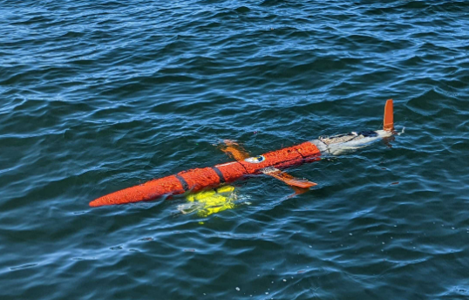
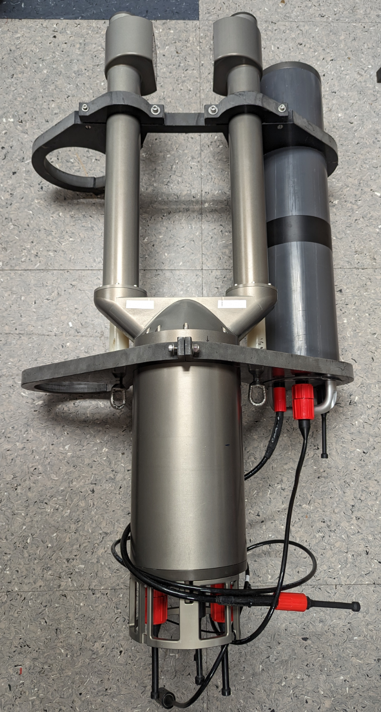
What is Planktivore? In-situ Instrument for imaging Plankton
Vehicle Interface
Planktivore V1 (2020-2022)
Planktivore V2 (2022-2023)
Nvidia Jetson Compute / Storage
System Controller
5 MP Machine Vision Camera
5 MP Machine Vision Camera
0.5x Telecentric Microscope Objective (25 um resolution)
4x Telecentric Microscope Objective (2 um resolution)
Depth Rating | 2000 m
Housing | Titanium
low-mag imaged volume (200 um to 2 cm objects) | 1 ml per frame / 10 ml per second
high-mag imaged volume (20 um to 2 mm objects) | 0.2 ul per frame / 2 ul per second
Tested vehicle speeds | Spray Glider (25 cm/s) Paragon (1 m/s)
Depth Rating | 1500 m
Housing | Aluminum
low-mag imaged volume (200 um to 2 cm objects) | 1 ml per frame / 10 ml per second
high-mag imaged volume (20 um to 2 mm objects) | 0.2 ul per frame / 2 ul per second
Tested vehicle speeds | LRAUV (TBD) Paragon (1 m/s)
Turning Prism, LED Strobe and Viewport
Turning Prism, LED Strobe and Viewport
Strobe Ballast
Strobe Ballast
0.5x Image Plane
4x Image Plane
Free flow of water from vehicle motion ~ 1 m/s

Slide 4
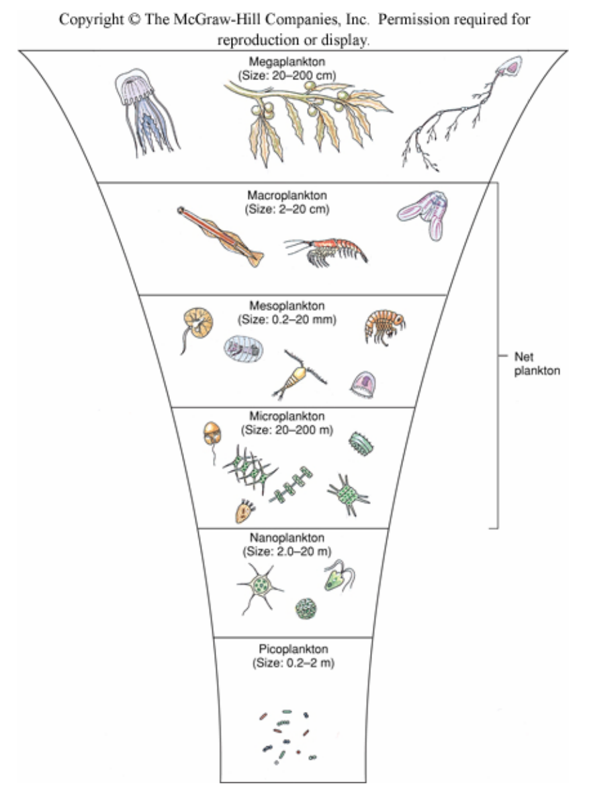
Where Planktivore Fits in MBARI’s imaging capabilities
ROV, I2MAP, Acoustics
Centimeters To Meters
In situ macroscopy (MxD, i2MAP), short durations (hours to a few days), Bioacoustics, long durations, lower specificity
Chiton / SiLCam
Millimeters to Centimeters
Straddles in situ microscopy and macroscopy Chiton, ISIIS, SES
Planktivore
Micrometers to Centimeters
In Situ microscopy Planktivore, IFCB
Backscatter / Biolume / Fluorescence
< Micrometer to Millimeter (Size only)
In Situ backscatter, volume scatter, biolume, and fluorometry

Slide 5

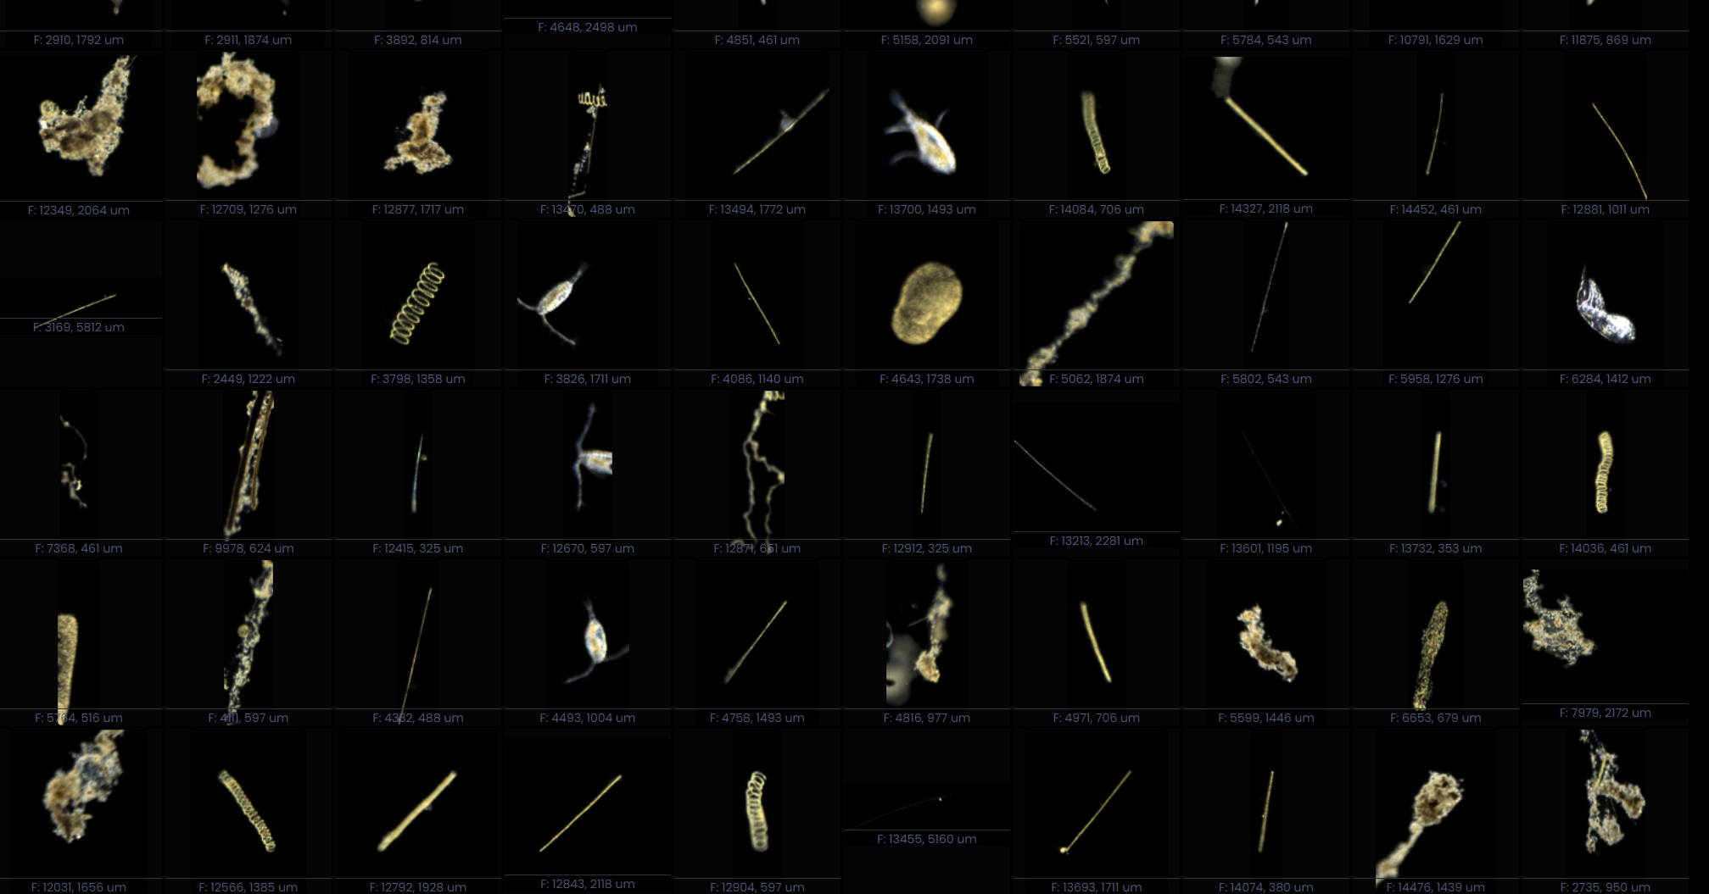
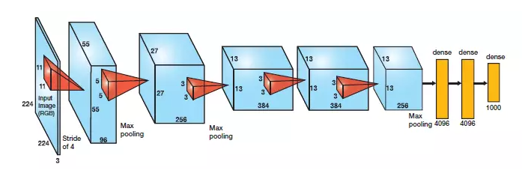
Planktivore Sampling, Data processing
100-1000 MB/s
100x Data Reduction
1-10 MB/s
1000x Data Reduction
Machine Vision Imager
Real-time ROI detection
Telecentric Lens
Functional Group Relative Abundance
Sparse 3D in situ Volume
Sampled 10 frames / sec x2 for Hi Mag and Lo Mag
Real-Time Vision System
Collections of ROIs
ROI Classification / Quantification
Real-time image processing onboard Planktivore
Shoreside processing on HPC (DeepRip)
Plankton rich waters, ~10K ROIs / minute. Clear water over the Canyon, ~1K ROIs / minute.
ROI = Region of Interest
HPC = High Perf Compute
Notes:
Archiving ROIs - at 10Hz, it’s not reasonable to record or store the raw data.
There is room to improve the data visualization - Steve’s straw
10hz and 1m/s - a continuous straw. What is your encounter rate?
ISIIS

Slide 6
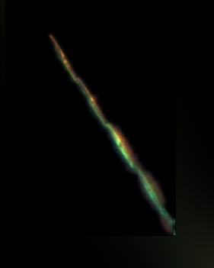
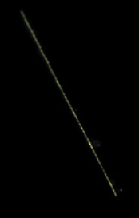
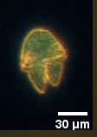
Plankton!!!
Pseudo-Nitzschia (P-N)
High Mag
Pseudo-Nitzschia (P-N)
Low Mag
Akashiwo
Notes:
Images look nice, images are relevant to MBARI science, genus PN, species? (http://oceandatacenter.ucsc.edu/PhytoGallery/Diatoms/pseudo%20nitzschia.html)

Slide 8
Notes:
Lots of Plankton… 175000 images in 20 minutes…

Slide 9
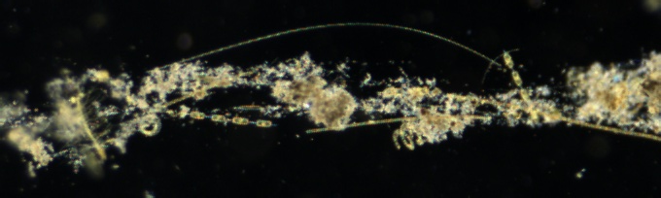
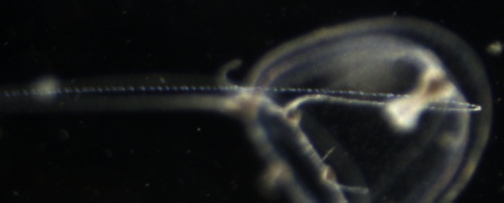
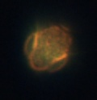
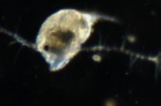
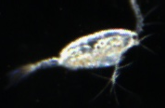
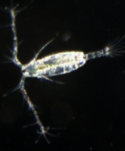
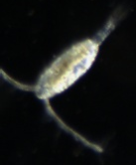
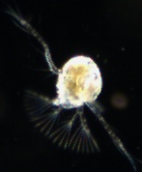
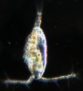
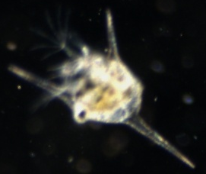
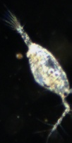
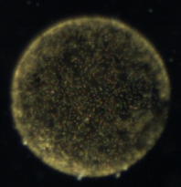


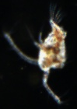
1 mm

Slide 10
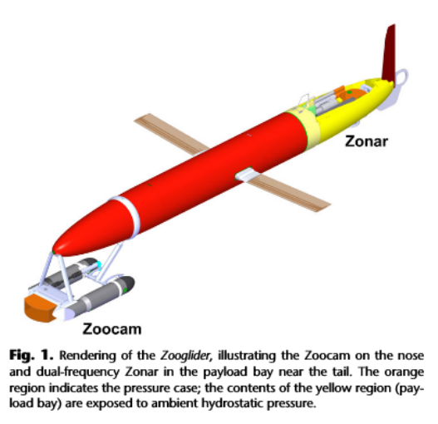
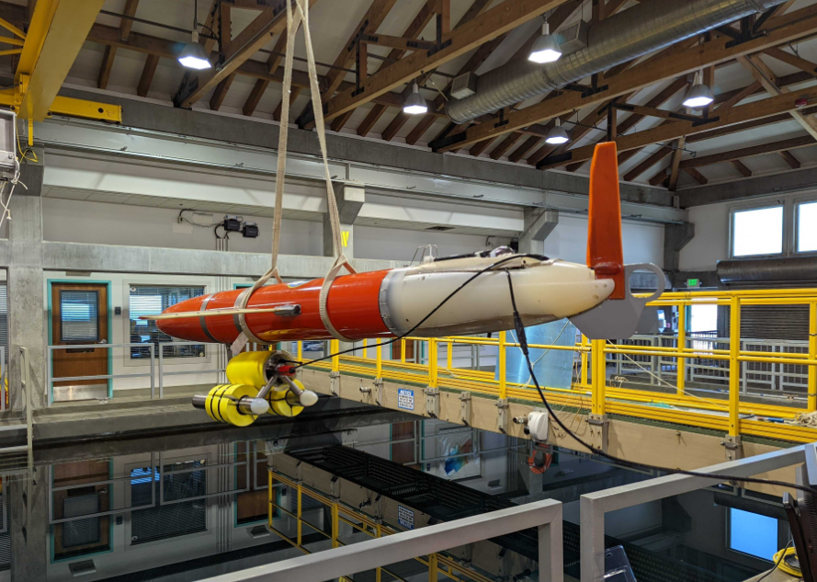
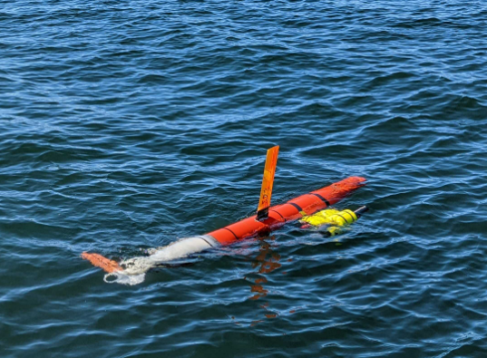
Planktivore v1 on Spray Glider
Dual Microscopes, 2000m depth capable
Hi Mag: 20um to 200um
Lo Mag: 100 um to 2 cm
Image Quality (0 to 0.25m/sec) : Great!
Access to Spray: Difficult
Spray at sea performance: Poor
Lessons Learned: Shrink size, shrink power and integrate in the nose.
Notes:
Key point: imaging worked great, vehicle access was a challenge, didn’t glide well

Slide 11
Planktivore v2
Assembled and tested.
Lab testing
  20 hours continuous in a bucket with dense plankton
At sea off the Paragon (opportunistic) 6 times.
  Deployments of 10 min to 40 min.
  Simulated 1 m/s speed thru water
Image quality is good, same as Planktivore v1
  P-N imaged during EcoHAB
Mooring is planned for 1st week of June.
  Battery for ~60hrs of sampling
LRAUV Galene testing will commence soon after nose shell is received - June / July timeframe.
By the end of 2023, we will have wrapped up the engineering tests
Notes:
Key point: imaging works great, we expect integration to work well (ref Chiton same mech/software interface)

Slide 12
High level science use cases
Validation (enhance the understanding of a proxy measurement)
Optical validation of bioacoustical measurements
Plankton proxy validation
Mesopelagic marine snow
Abundance measurements, quantification (whos there and where),
Regional scale, CANON participation,
Sustained diel measurements, seasonal
Daphne water sampler, once a month, time series, MBTS
Marine snow. Surface water imaging and correlation to sediment trap / SES
Zooplankton enumeration for prey-field and nearest-neighbor density calculations
Targeted Measurements (another system / vehicle changes behavior based on planktivore data)
Front following, patch tracking
Targeted sampling, scalar data or in-situ plankton identification
EcoHAB
CANON
Notes:
Name projects instead of names… PI agnostic, List projects In-situ organism detection
‘Team’
CANON Francisco Chavez:
Regional scale, CANON participation,
Steve Haddock:(midwater large gelatinous plankton, far reaching results)
Optical measurement, Plankton proxy validation
zooplankton enumeration for prey-field and nearest-neighbor density calculations
Henry Ruhl:Biological carbon pump (sample contionuously over large scales)
Long duration, consistent space-time coverage of regional-scale features (cal current or m2)
Kelly Benoit-Bird:
Optical validation of Acoustical measurements
Colleen Durkin:
sustained diel measurements, same as Paul re Sinker
John Ryan:
EcoHAB, thin layer fan, PN detection
Yanwu Zhang:
like Chiton, front following
Monique Messie:
Plankton proxy,

Slide 13
Key Remaining Challenges
Deployment time has been limited (< 3 hours total for project)
  Propose to perform regular deployments with V2 system on LRAUV and opportunistic deployments of V1 system. Goal: > 6 weeks data in 2024
Imaged volume is small with darkfield
  Propose to add shadowgraph illumination to enable larger imaged volume for improved sample statistics (expect 2-4x increase in effective imaged volume)
Power consumption is large compared to vehicle hotel
  Propose to test and integrate reduce power consumption compute and storage (Pi4, OAK-D, Orin Nano)
Notes:
Abstract document lists and exuberant request of 12 deployments. This number of days is equal to the DMO allocation for all LRAUV vehicles.

Slide 14
Project Timeline
2024 | 2025 | 2026
System Enhancements Increased Deployments | Data Visualization Transition to Science | Complete Transition to Science

Slide 15
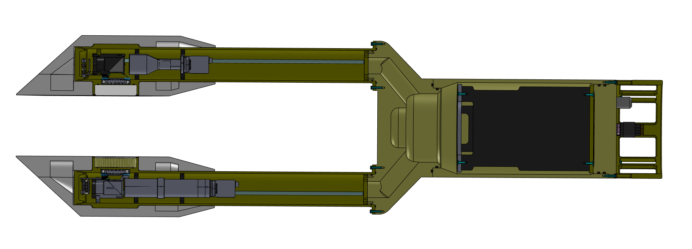
Increasing imaged volume

Slide 16
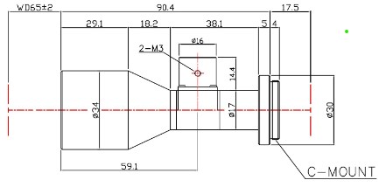
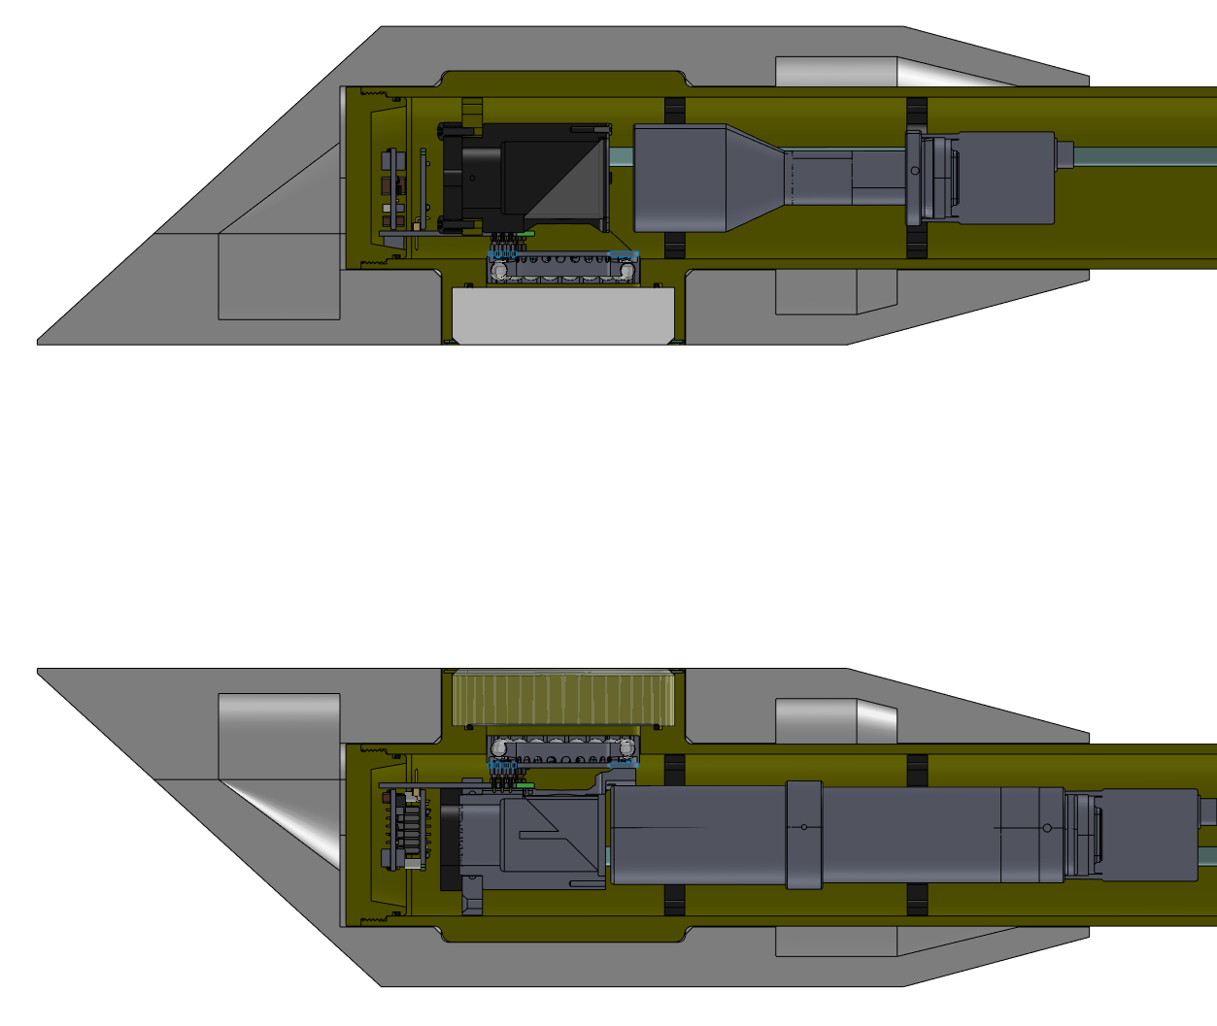
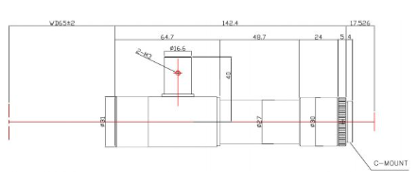
Increasing imaged volume
Low-Mag Coaxial Illumination
Low-mag imaged volume 10x scale
Low-mag imaged volume
High-mag imaged volume 10x scale
High-mag imaghed volume
High-Mag Coaxial Illumination

Slide 17
Reducing Power Consumption
 | Power draw | Onboard GPU? | Software complexity
Xavier NX with dual 5MP USB3 cameras | 15 W | Yes | NA
OAK-D Stereo cameras | 2.5 W | Yes | Moderate
StereoPi V2 | 3.5 W | No | Low

Slide 18
End

Slide 19
2024 Planktivore Abstract Presentation v1
17 May 2023
10:30am 15min
20 slides, 20 sec each

Slide 20
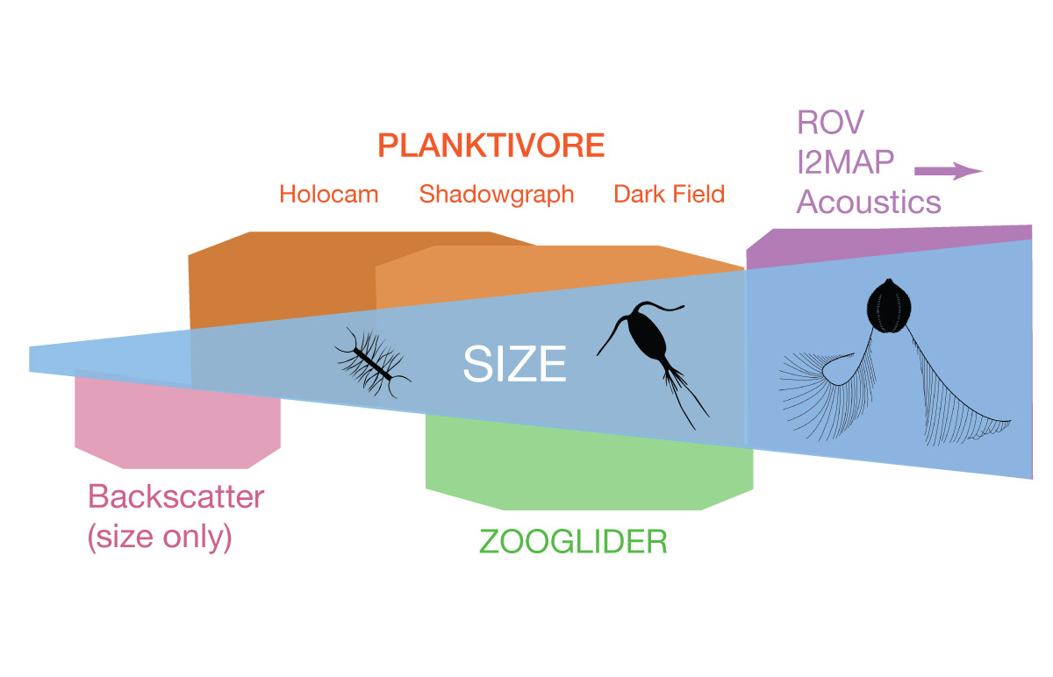
Planktivore: ‘Why’ - Fills the gap between 10 µm to 2 cm
Plankton Imaging Instrument Technologies:
Size | Instrument Technology
< 100 um : | Optical backscatter and fluorescence (LISST or similar VSF methods)
10 um - 1 mm | Planktivore side A: In situ microscopy with 5x magnification
200 um - 2 cm | Planktivore side B: In situ microscopy with 0.5x magnification (Similar to EyeRIS)
100 um - 0.5 cm | Waveglider plankton microscope (SilCam 0.125x)
> 1 cm | In situ macroscopy (i2MAP, mesobot)
> 1 m | In situ acoustic imaging
Notes:
Is there a commercial in-situ microscope available? Not with the magnification range or versatility of illumination. Make vs Buy
CiPics, ISIIS, mini-ISIIS, 4Deep, Sequoia, Zoocam, IFCB - these dont integrate and real-time (Mark Benfield paper on comparison)
Size ranges: planktivore, EyeRIS, I2map, acoustic backscatter
Validating or replacing or complementing Proxy instruments (backscatter, fluorometer, eDNA, biolume)

Slide 21
2020-2023 Mission statement
Build a free space plankton microscope, 20 micron to 2 cm, for a wide range of applications and platforms with an emphasis on autonomous underwater vehicles.
Capture microscope expertise developed in the Jaffe Lab at Scripps into MBARI projects for autonomous underwater vehicles.
Reach deep and far to efficiently and routinely record images of plankton for science.
To seek out an record plankton where no microscope has gone before…

Slide 22
Timeline 2024
 | Q1 | Q2 | Q3 | Q4
Thom Maughan (300 hours) | Project Management | Lower Power Compute Testing | Project Management | Deployment Support
Paul Roberts (300 hours) | Deployment Support | Shadowgraph Electronics | Compute Integration | Deployment Support
Denis Klimov (300 hours) | Shadowgraph Optics | Shadowgraph Optics | Optics Assembly | Deployment Support
Aaron Schnittger (300 hours) | Deployment support | Shadowgraph Mechanics | Optics Assembly | Deployment Support
Manufacturing (150 hours) |  | Optics Tube Fabrication | Compute Module Assembly / Wiring
DMO / LRAUV (6-12 deployments) | 1-3 deployments | 1-3 deployments | 1-3 deployments | 1-3 deployments

Slide 23
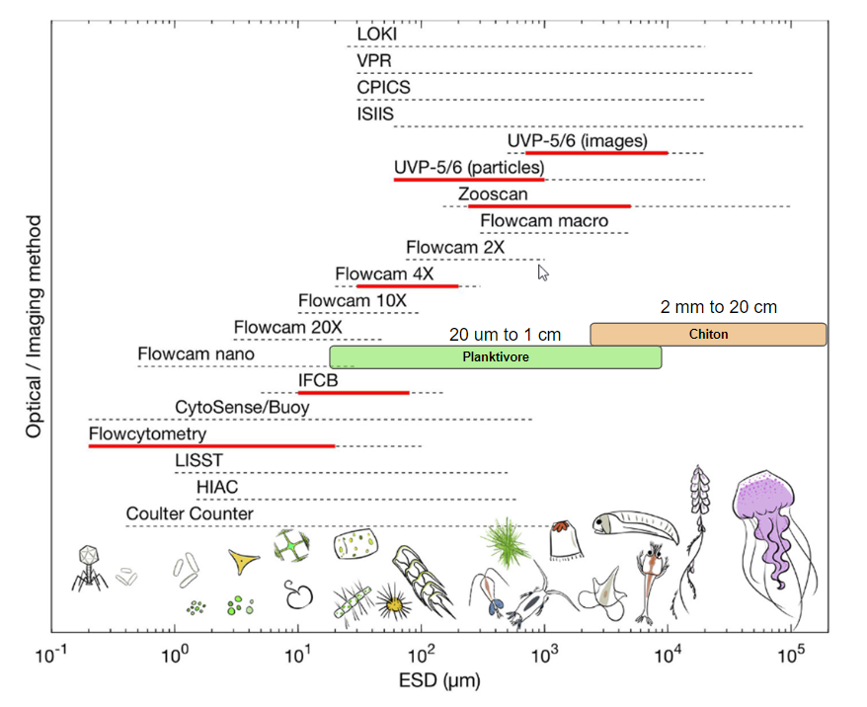
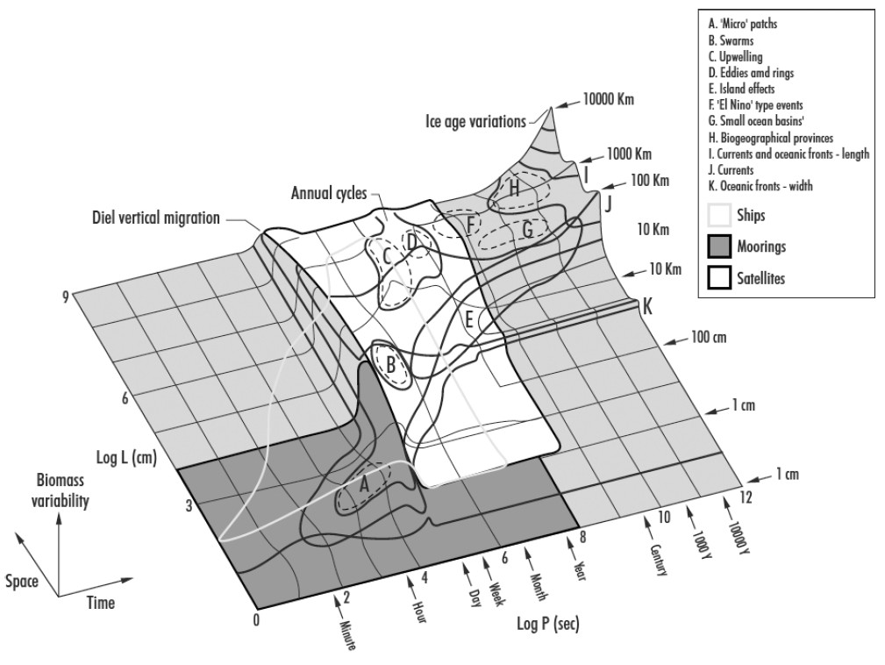

Slide 24
What are we proposing to do in the next three years?
  Address limitations of the current system
    imaged volume and impact on sampling deeper / sparser
    power consumption, still have large impact on vehicle mission duration, we want to be able to support full duration missions on the LRAUV
    Deployments and data visualization still require a lot of resources
  How do we increase the imaged volume?
    shadowgraph (example of zooglider image or similar)
    diagram of shadowgraph integration into current system
  How do we reduce power consumption
    camera/compute integration (no more USB3, direct to shared memory)
    lower-power compute (we only need frame->canny->contour->pixels)
    Example of options with power budgets
  How do we simplify and standardize deployments and data workflows
    Increase deployments in 2024 to learn more about time/cost what works well and what does not
    More science use to inform better data workflows
    In-situ organism detection

Slide 25
Project Timeline
2024 Science use case detailed definition.
LRAUV + Planktivore v2 deployed 12 times for ~1 week duration.
  Each deployment takes (not counting watch standing). 4 to 8 hours (factoring in some training).
  Separate payloads would make it faster. Paul, Thom, Aaron. Brent is a maybe?
    Chiton and Planktivore vie for Galene
  Ahi as 2nd vehicle
Increased image volume effort would start. Lensation custom mod.
Power consumption. More power efficient, but not sure they can keep.
  Bigger sensor would be increased image volume
2027 build our own plankton glider. Acoustics (broadband high frequency) and Optics.
Notes:
Time estimates do not include watch standing.

Slide 26
What are we proposing to do in the next three years? NEEDS WORK
  Deployments for science.
    Science ‘use cases’ to inform improvements to data workflows and products
    Simplify and standardize deployments. Document and automate workflow.
    Participate in field programs. CANON, EcoHAB, MBTS
  Address limitations of the current system
    Imaged volume and impact on sampling deeper / sparser
    Power consumption, still have large impact on vehicle mission duration, we want to be able to support full duration missions on the LRAUV
    Deployments and data visualization still require engineering resources
  Maintenance
Notes:
Routine deployments in 2024 to learn more about time/cost and what works well and what does not.

Slide 27
Project timeline and chart
  three-year chart with limited details
  2024 with details of milestones and resources

