Slide 1
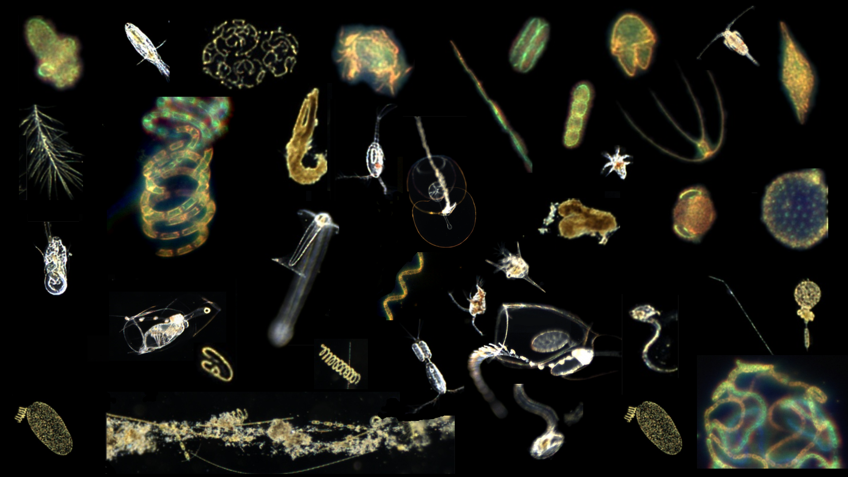
Planktivore In-Situ Microscope
Kickoff Meeting (part 2)
Francisco Chavez (PI), Steve Haddock (Chief Scientist), Thom Maughan (PM), Paul Roberts (Lead Engineer)
902004 Planktivore 2024 Kickoff
2x Feb 2024
Notes:
‘Plank’ton = the small and microscopic organisms drifting or floating in the sea or fresh water, consisting chiefly of diatoms, protozoans, small crustaceans, and the eggs and larval stages
‘I’ = Image, internet digitized and processed
‘Vore’ = Devour, Eat, Digest

Slide 3
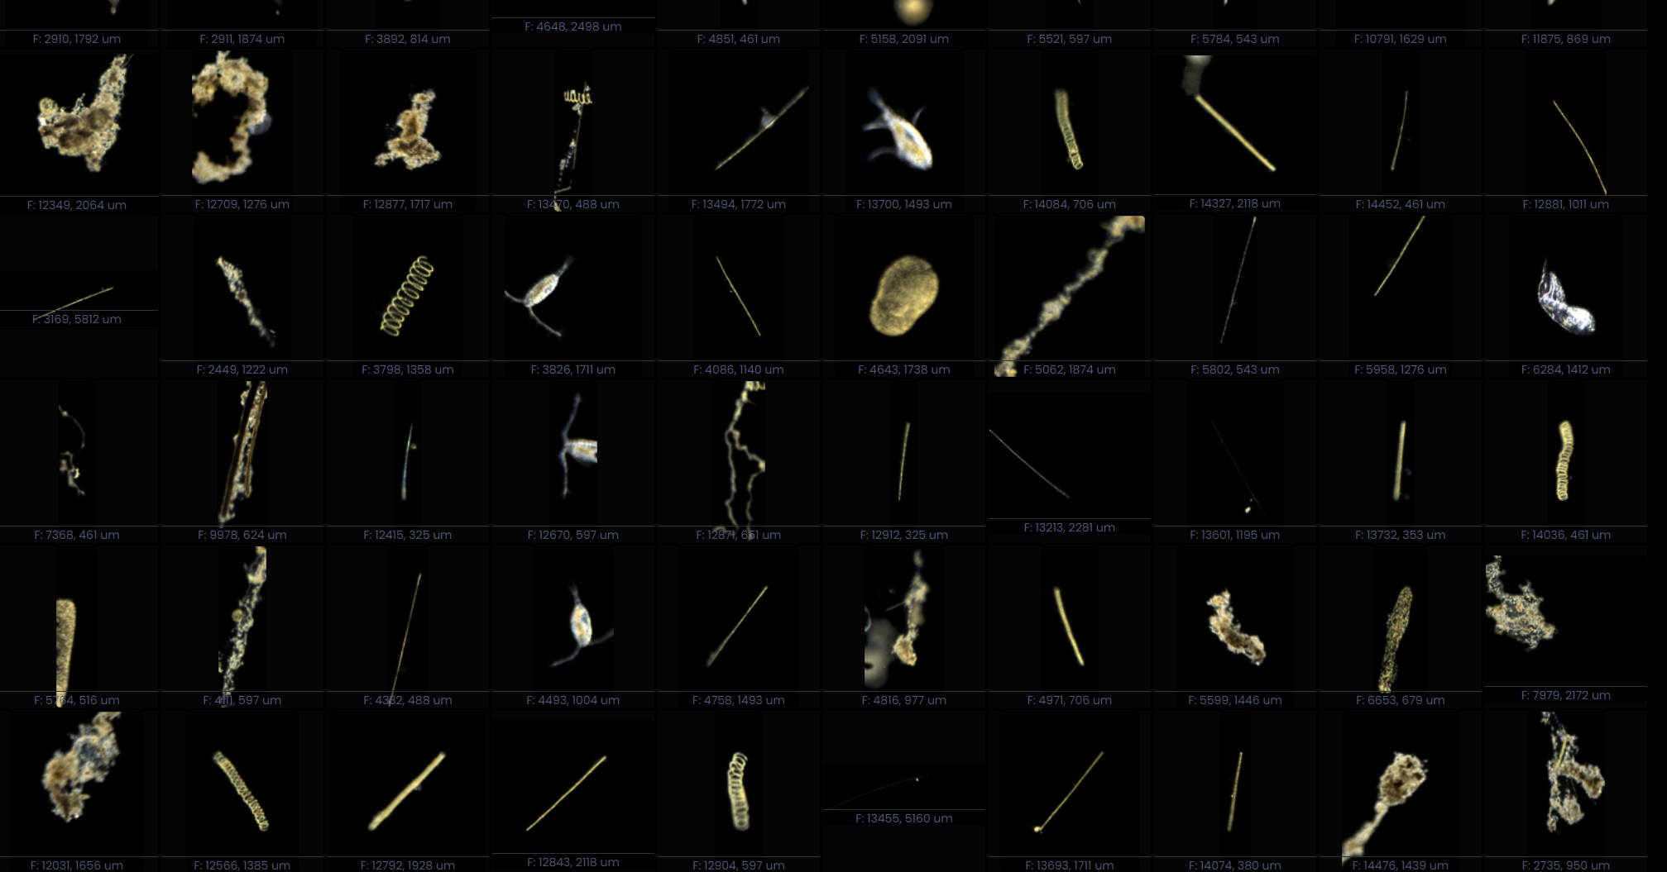
Notes:
Lots of Plankton… 175000 images in 20 minutes…

Slide 4
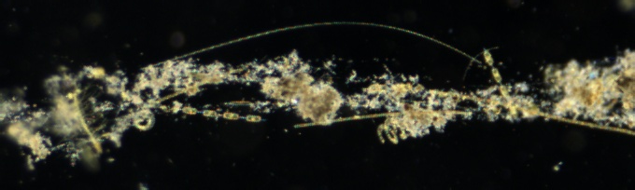
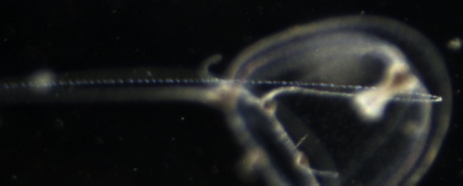
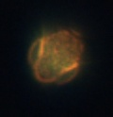
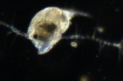
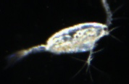
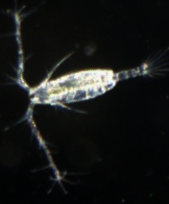
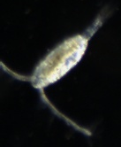
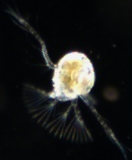
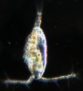
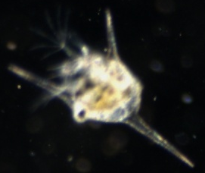
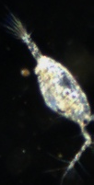
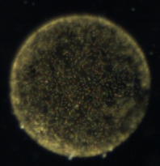


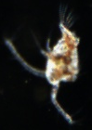
1 mm

Slide 5
Agenda
Deployment requests and plans, discussions
Planktivore ‘big picture’
Planktivore details, sampling, data processing and tools
Note:
Planktivore planning meeting was held Feb 6. Monthly planning info has been moved to the start of the slides. Please add info (dates, locations, guidance) for your project.
Next Planktivore planning meeting is Feb 26 (moved from 27/28) to enable participation.

Slide 6
Deployment Plans
March
Possible Plankton Proxies validation. Ahi+V2 and Daphne (C1 to M1).
Possible V1 on March 14 CTD cast
March 18, Galene Optum Waveglider
MBTS March 13, 15. Daphne C1 to M2
I2MAP survey (21st). Coordinate day/night transects up to 300m. M1 vicinity?
April
CENCOOS / Synchro. 3rd week
  C1 to M2
Proxies Pontus on dock / with possible Ahi+V2 3rd week. Pontus (ubat), piscivore)
April 15 - 17 MBTS Daphne
Proxies Validation (eDNA sipper from Daphne) after MBTS.
IFCB should be out
(Note: 110 hours)
I2MAP not available in April

Slide 7
Deployment Plans
May
Durkin lab May 6th, Ahi+V2 + Traps + Galene+Chiton, V1 maybe.
Proxies (possible) Ahi+V2 and Daphne+sipper on MBTS line
Ahi done by May 15, Planktivore V2 removed
Daphne MBTS May 22
I2MAP (likely not, but possible)
CTD Rosette (May 22)
June (tbd)
Possible Triton + Planktivore V2
LRAUV lab in Denmark June (two different windfarms)

Slide 8
Deployment Plans
July
FIrst option for Coral 1300m. 2 days.
I2MAP tow out (better option than April)
August

Slide 9
Deployment Plans
September
CANON
  Ahi + Planktivore V2
  2nd half of Sept (at MARS), a week or so.
  Possible Galene+Chiton
EcoHAB
  Ahi + V2, if scheduling permits wrt CANON
  Ship based; test new sensing; no ESPs
  R/V Carson days:
    Sep 11-12
    Sep 25-27
  To target ship sampling
    LRAUV sensing to identify features
    Planktivore may spot Pseudo-nitzschia
CENCOOS / Synchro
  C1 to M2 and taking advantage of CANON activity.
Coral Ecology (sep/oct)
  Planktivore V1 + deep battery
October
Plankton Proxies 2nd validation. Ahi + Planktivore V2 along with Daphne for water sampling. Places with fluorescence highest signal. North Bay.
Possible Coral Ecology for V1 (sponge ridge 600m, Carson cruises, Stabs - all three. Work it with Aaron. BRS cruises also. Macro Cam 6months. 1m from the Coral (tbd).

Slide 10
Deployment Plans
November
December

Slide 11
Notes
Emergent Zooplankton

Slide 12
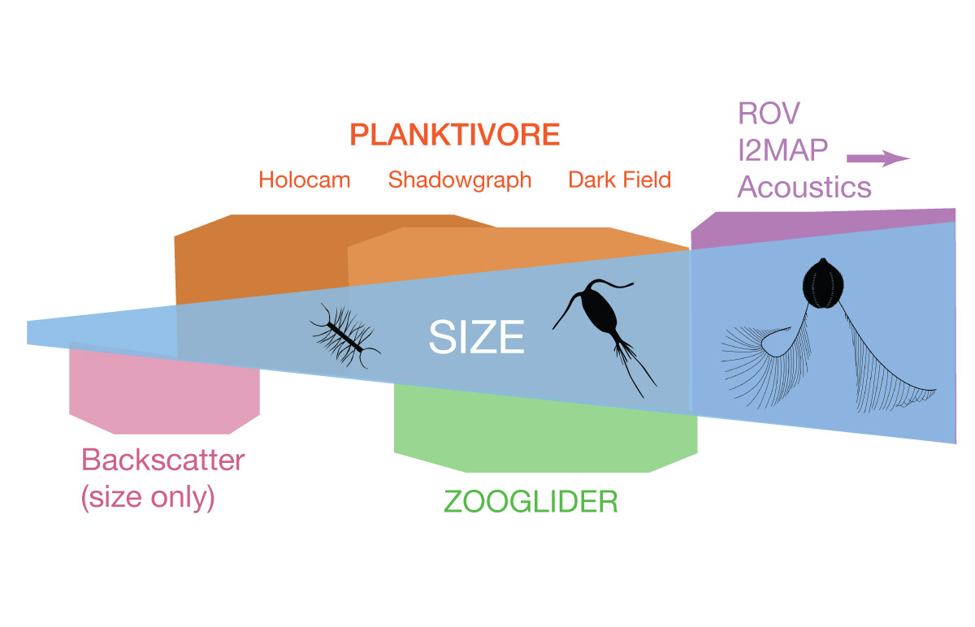
Planktivore: ‘Why’ - Fills the gap between 20 µm to 2 cm
Size | Instrument Technology
< 100 um : | Optical backscatter and fluorescence (LISST or similar VSF methods)
20 um - 2 mm | Planktivore side A: In situ microscopy with 5x magnification
200 um - 2 cm | Planktivore side B: In situ microscopy with 0.5x magnification (Similar to Chiton)
100 um - 0.5 cm | Waveglider plankton microscope (SilCam 0.125x)
> 1 cm | In situ macroscopy (i2MAP, mesobot)
> 1 m | In situ acoustic imaging
Plankton Imaging Instrument Technologies:
Notes:
Is there a commercial in-situ microscope available? Not with the magnification range or versatility of illumination. Make vs Buy
CiPics, ISIIS, mini-ISIIS, 4Deep, Sequoia, Zoocam, IFCB - these dont integrate and real-time (Mark Benfield paper on comparison)
Size ranges: planktivore, EyeRIS, I2map, acoustic backscatter
Validating or replacing or complementing Proxy instruments (backscatter, fluorometer, eDNA, biolume)

Slide 13
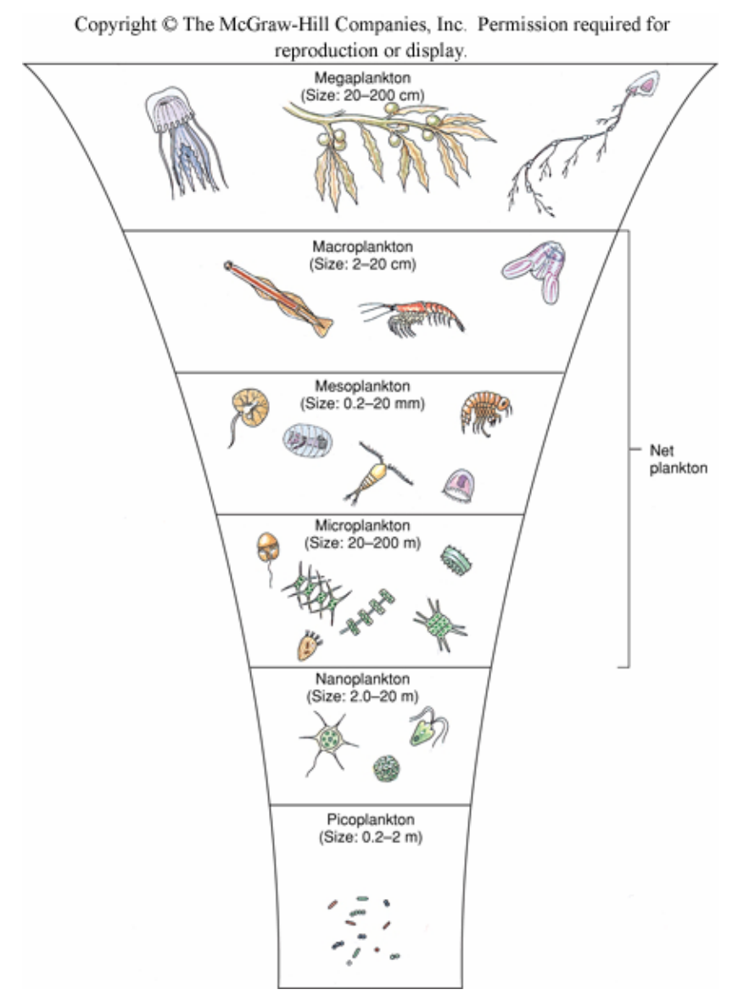
Where Planktivore Fits in MBARI’s imaging capabilities
ROV, I2MAP, Acoustics
Centimeters To Meters
In situ macroscopy (MxD, i2MAP), short durations (hours to a few days), Bioacoustics, long durations, lower specificity
Chiton / ISIIS
Millimeters to Centimeters
Straddles in situ microscopy and macroscopy Chiton, ISIIS, SES
Planktivore
Micrometers to Centimeters
In Situ microscopy Planktivore, IFCB
Backscatter / Biolume / Fluorescence
< Micrometer to Millimeter (Size only)
In Situ backscatter, volume scatter, biolume, and fluorometry

Slide 14
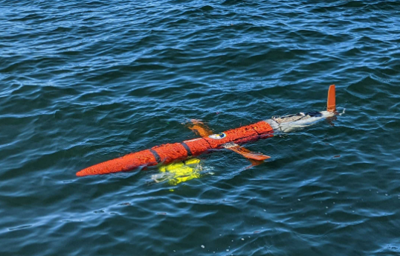
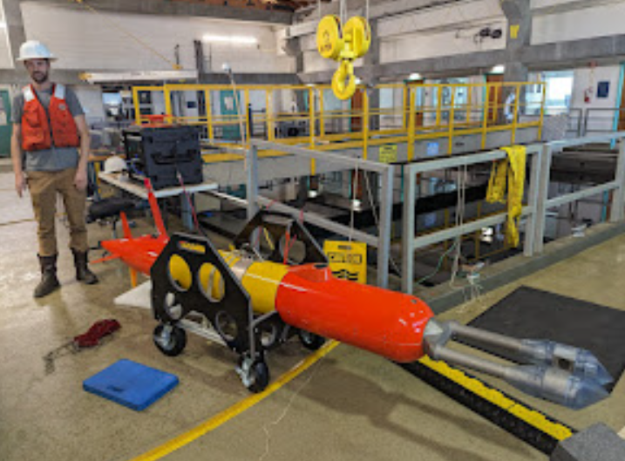
What is Planktivore? In-situ Instrument for imaging Plankton
Vehicle Interface
Planktivore V1 (2020-2022)
Planktivore V2 (2022-2023)
Nvidia Jetson Compute / Storage
System Controller
5 MP Machine Vision Camera
5 MP Machine Vision Camera
0.5x Telecentric Microscope Objective (25 um resolution)
4x Telecentric Microscope Objective (2 um resolution)
Depth Rating | 1500 m
Housing | Aluminum
low-mag imaged volume (200 um to 2 cm objects) | 1 ml per frame / 10 ml per second
high-mag imaged volume (20 um to 2 mm objects) | 0.2 ul per frame / 2 ul per second
Tested vehicle speeds | LRAUV (1 m/s) Paragon ~(1 m/s)
Depth Rating | 1500 m
Housing | Titanium
low-mag imaged volume (200 um to 2 cm objects) | 1 ml per frame / 10 ml per second
high-mag imaged volume (20 um to 2 mm objects) | 0.2 ul per frame / 2 ul per second
Tested vehicle speeds | Spray Glider (25 cm/s) Paragon (tbd m/s)
Turning Prism, LED Strobe and Viewport
Turning Prism, LED Strobe and Viewport
Strobe Ballast
Strobe Ballast
0.5x Image Plane
4x Image Plane
Free flow of water from vehicle motion ~ 1 m/s

Slide 15

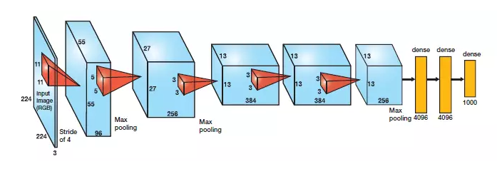
Planktivore Sampling, Data processing
100-1000 MB/s
100x Data Reduction
1-10 MB/s
1000x Data Reduction
Machine Vision Imager
Real-time ROI detection
Telecentric Lens
Functional Group Relative Abundance
Sparse 3D in situ Volume
Sampled 10 frames / sec x2 for Hi Mag and Lo Mag
Real-Time Vision System
Collections of ROIs
ROI Classification / Quantification
Real-time image processing onboard Planktivore
Shoreside processing on HPC (DeepRip)
Plankton rich waters, ~10K ROIs / minute. Clear water over the Canyon, ~1K ROIs / minute.
ROI = Region of Interest
HPC = High Perf Compute
Notes:
Archiving ROIs - at 10Hz, it’s not reasonable to record or store the raw data.
There is room to improve the data visualization - Steve’s straw
10hz and 1m/s - a continuous straw. What is your encounter rate?
ISIIS

Slide 16
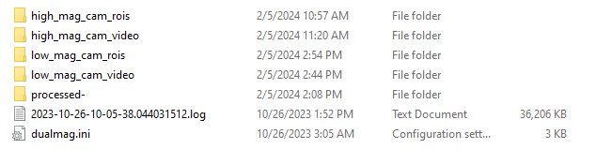
Planktivore Raw Data (recorded during one power cycle)
Camera Settings File
Log File:
- Env Sensors
- Object Counts
- Status
- Startup / Shutdown
Raw (Bayer Pattern) Images in flatfile:
- Recorded periodical for ground truth
- Can control recording period and # images per recording
Raw (Bayer Pattern) ROIs:
- 1000 per subdir
- each subdir tarred
Image Metadata (saved in filename)
Timestamp
Image Metadata (saved in binary file)
Timestamp, frame timestamp, frame number, frame size, pixel type
ROI Metadata (saved in filename)
Timestamp, frame number, roi number (within the frame), roi location within the frame, roi size in pixels

Slide 17
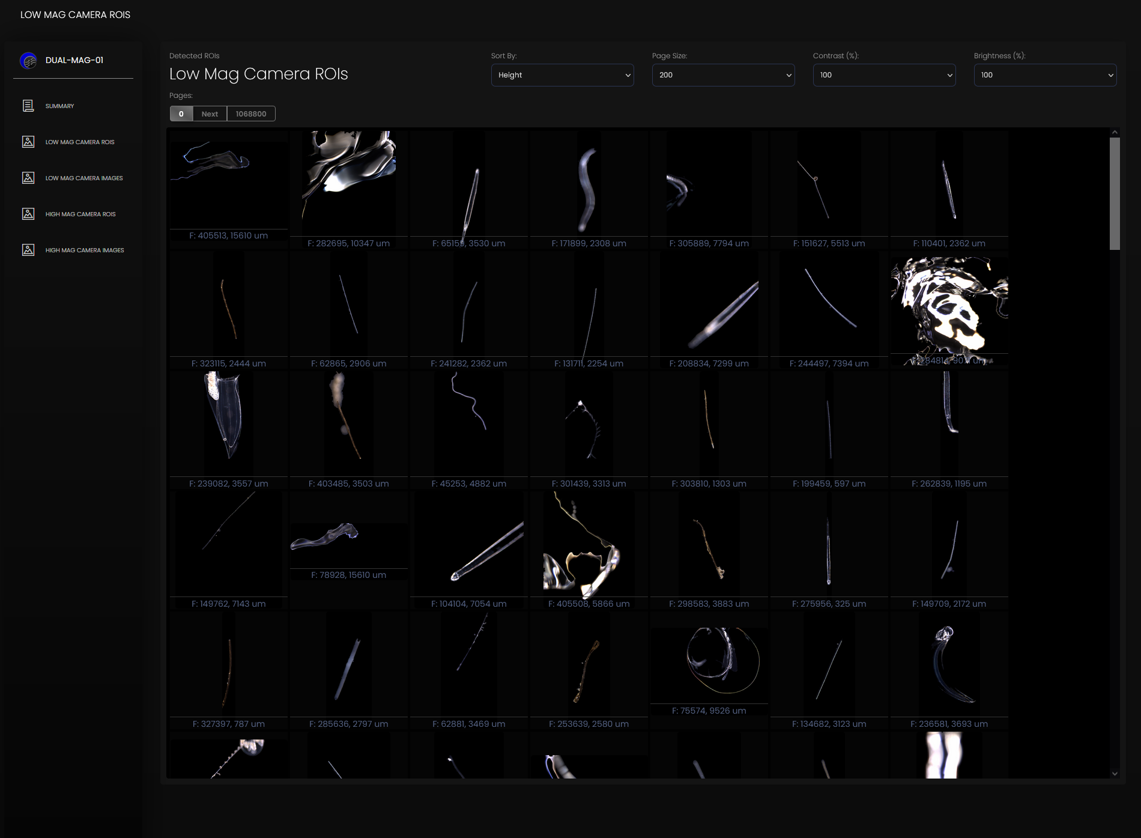
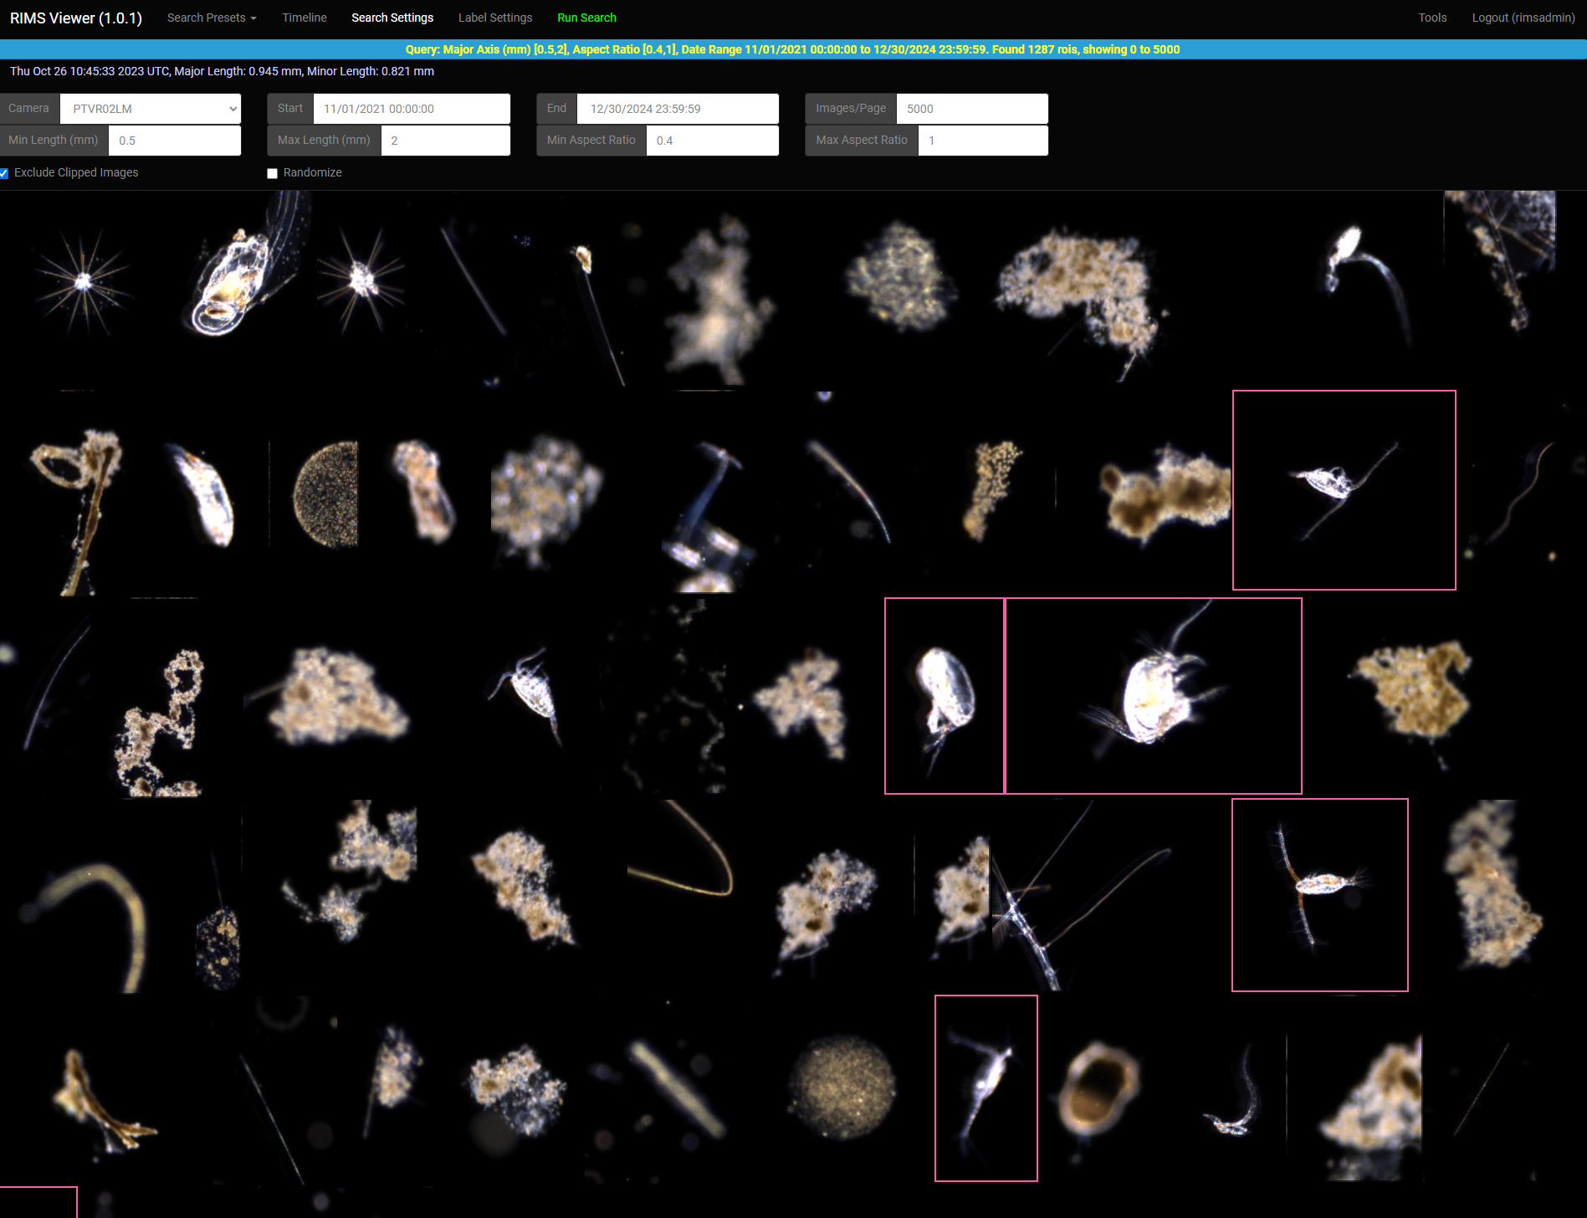
Tools for Data Management and Visualization
Dual-Mag-Data Viewer
Python scripts to convert raw planktivore recordings into React frontend with javascript database.
Useful for standalone deployments up to 100s of thousands of ROIs.
Shareable (standalone web app bundled with all deps)
Limited search options and no labeling capabilities.
RIMS - Region of Interest Management System
Postgres database with Django / nginx / gunicorn
API for searching ROIs by date, size, shape, label, etc. Returns JSON with ROI urls, and ROI metadata
Javascript client to visualize mosaics of images, label images, and adjust search settings.
Adapted from Scripps Plankton Camera
Can handle large numbers of ROIs, in the 100s of millions

Slide 18
What we have
Planktivore V2
LRAUV Ahi + Planktivore V2 integration.
  Two deployments in Oct 2023
  Five day deployments
Second V2 housing for spare, shadowgraph development
Upgraded electronics, plan for install in housing tbd.
  Battery backup for onboard compute
  Serial connection for graceful linux shutdown
Pressure sensor housing for depth activated (not installed for LRAUV usage)
Planktivore V1
Depth activated
Mounting bracket, protective cage.
2x Battery housings.,
  200m, 20v, 60 amp-hr
Upgraded electronics, plan for install in housing tbd.
600m of line on a spool

Slide 19
What we have…
DeepRip Server
Planktivore data transfer from Planktivore to DeepRip
Ingest processing for image browsing and RIMS
  VPN required for external access
Archival storage on Titan
Small Mooring
~100m
Protective cage
2x ‘Noot’ batteries for 3 days continuous recording
Deep Battery (loaner from Barry Lab)
>1500m
Coral Ecology
CTD cast
Notes:
ToDo: pictures,DeepRip for ingest processing / machine learning / model training
Titan for archive data storage

Slide 20
High level science use cases
Validation (enhance the understanding of a proxy measurement)
Optical validation of bioacoustical measurements
Plankton proxy validation
Mesopelagic marine snow
Abundance measurements, quantification (whos there and where),
Regional scale, CANON participation,
Sustained diel measurements, seasonal
Daphne water sampler, once a month, time series, MBTS
Marine snow. Surface water imaging and correlation to sediment trap / SES
Zooplankton enumeration for prey-field and nearest-neighbor density calculations
Targeted Measurements (another system / vehicle changes behavior based on planktivore data)
Front following, patch tracking
Targeted sampling, scalar data or in-situ plankton identification
EcoHAB
CANON
Notes:
Name projects instead of names… PI agnostic, List projects In-situ organism detection
‘Team’
CANON Francisco Chavez:
Regional scale, CANON participation,
Steve Haddock:(midwater large gelatinous plankton, far reaching results)
Optical measurement, Plankton proxy validation
zooplankton enumeration for prey-field and nearest-neighbor density calculations
Henry Ruhl:Biological carbon pump (sample contionuously over large scales)
Long duration, consistent space-time coverage of regional-scale features (cal current or m2)
Kelly Benoit-Bird:
Optical validation of Acoustical measurements
Colleen Durkin:
sustained diel measurements, same as Paul re Sinker
John Ryan:
EcoHAB, thin layer fan, PN detection
Yanwu Zhang:
like Chiton, front following
Monique Messie:
Plankton proxy,

Slide 21
Science Users
Planktivore V1
Chavez BOG
  CTD Rosette
Durkin Lab
  Paragon
Barry Coral Ecology
  1300m
Planktivore V2
Chavez BOG, CANON
Haddock Lab
Durkin Lab
Ryan EcoHAB
Messie Plankton Proxies
  C1 to M2 along with Daphne (water and instruments
Zhang Targeted Sampling
  In-situ plankton detection (P-N)
Ruhl CENCOOS & Synchro
  off shore wind pilot study
  In conjunction with Chavez BOG

Slide 22
End

Slide 23
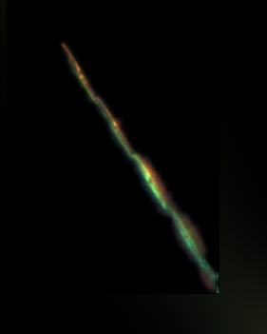
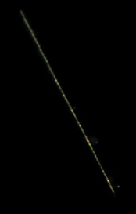
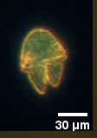
Plankton!!!
Pseudo-Nitzschia (P-N)
High Mag
Pseudo-Nitzschia (P-N)
Low Mag
Akashiwo
Notes:
Images look nice, images are relevant to MBARI science, genus PN, species? (http://oceandatacenter.ucsc.edu/PhytoGallery/Diatoms/pseudo%20nitzschia.html)

Slide 24
2020-2023 Planktivore Mission statement
Build a free space plankton microscope, 20 micron to 2 cm, for a wide range of applications and platforms with an emphasis on autonomous underwater vehicles.
Capture microscope expertise developed in the Jaffe Lab at Scripps into MBARI projects for autonomous underwater vehicles.
Reach deep and far to efficiently and routinely record images of plankton for science.
To seek out an record plankton where no microscope has gone before…

Slide 25
