Slide 1
Planktivore
Enabling In Situ Microscopy on Autonomous Underwater Vehicles
MidSEC, June 15, 2026
Paul Roberts, Thom Maughan, Larry Bird, Denis Klimov, Aaron Schnittger, Jon Erickson, Brent Jones , Colleen Durkin , Henry Ruhl, Steve Haddock, Francisco Chavez
Notes:
My Name is Paul Roberts and I’m an electrical engineer at MBARI, I’ve been here for just over 5 years.
Today I’ll give an overview of imaging systems in production and development at MBARI

Slide 2
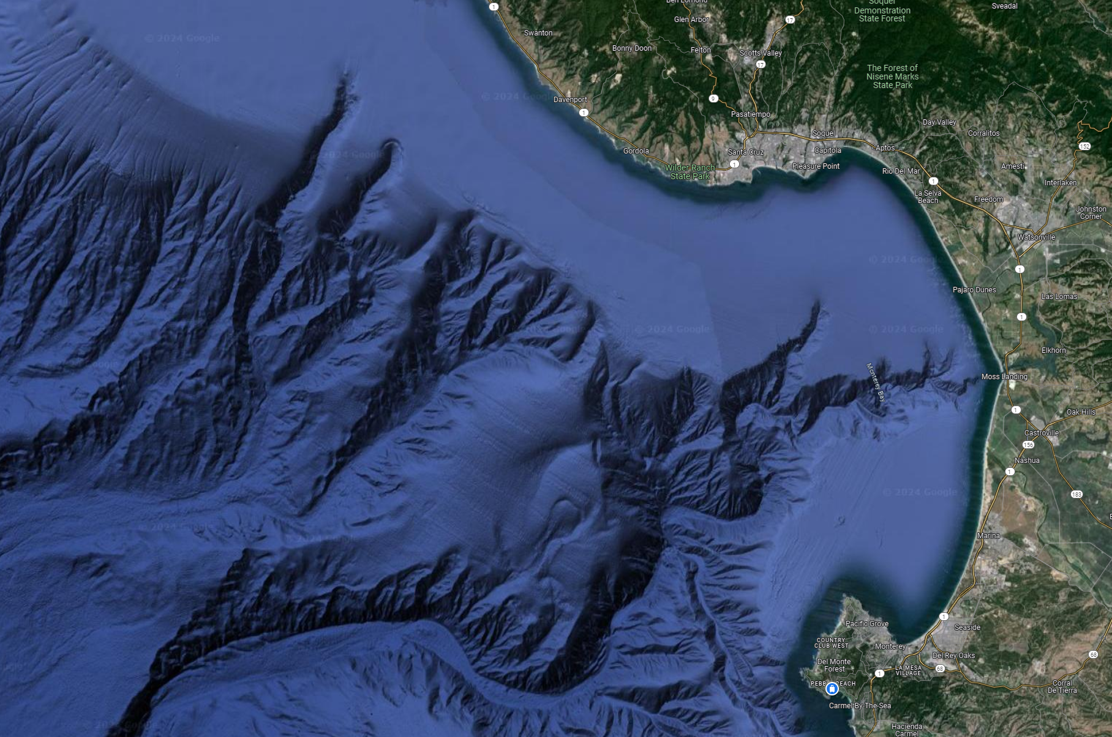
Key Biological Questions
Who’s there?
How many and what size?
How do they interact?
How does the above change in space and time?
Notes:
Motivation:
Zooming out to the satellite view of the Monterey bay, when thinking how to explore and protect the ocean, these are some of the fundamental biological oceanography questions that we aim to answer
While these questions are easy to state, they are exceptionally difficult to answer in the ocean…

Slide 3
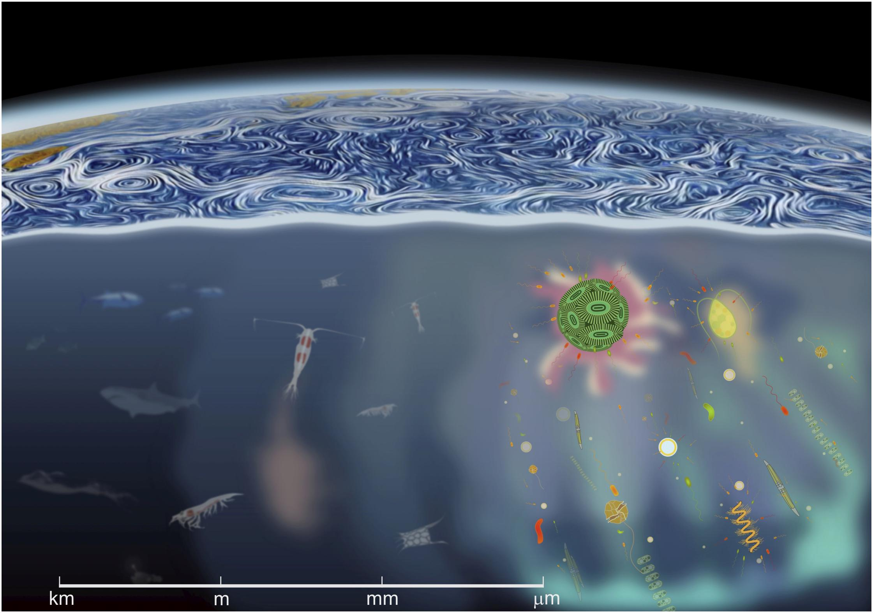
Vast Size and Space Scales
Basterratxea et al. Front. Mar. Sci., 25 March 2020
Notes:
Why are they so difficult to answer?
The ocean is a complex volume of fluid with a vast assortment of organisms that span nearly 9 orders of magnitude in size.
On the bottom right, we have the micron sized phytoplankton, protists, and bacteria
Moving to the left we have the zooplankton grazers like krill and copepods that feed on phytoplankton and other zooplankton
And on the left we have the large fish and mammals that feed on the zooplankton and other top predators
Despite this vast range is sizes, many of these organisms directly depend on and interact with each other. This makes it necessary to broaden our questions and samples to cover this immense range of space and time scales

Slide 4
Complementary Imaging Systems
Basterratxea et al. Front. Mar. Sci., 25 March 2020
Piscivore (Mega)
Triton (Macro)
Planktivore (Micro)
Notes:
Why are they so difficult to answer?
The ocean is a complex volume of fluid with a vast assortment of organisms that span nearly 9 orders of magnitude in size.
On the bottom right, we have the micron sized phytoplankton, protists, and bacteria
Moving to the left we have the zooplankton grazers like krill and copepods that feed on phytoplankton and other zooplankton
And on the left we have the large fish and mammals that feed on the zooplankton and other top predators
Despite this vast range is sizes, many of these organisms directly depend on and interact with each other. This makes it necessary to broaden our questions and samples to cover this immense range of space and time scales

Slide 5
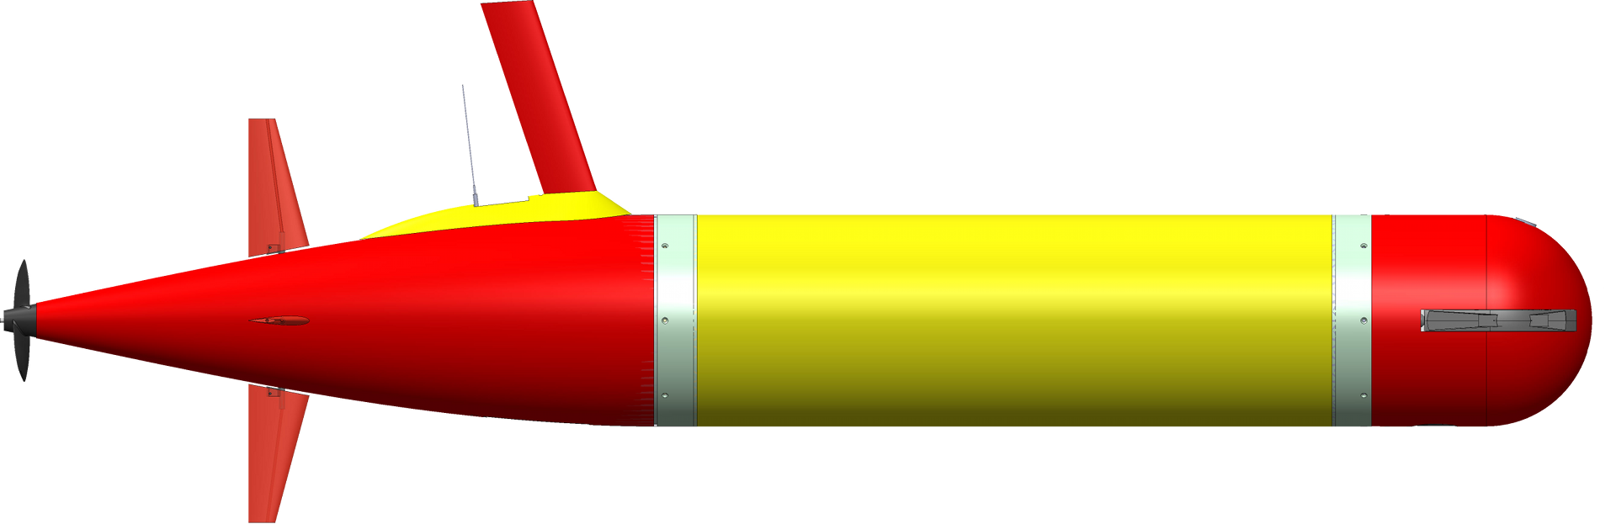
Platforms Expand our Sensing Range
Basterratxea et al. Front. Mar. Sci., 25 March 2020
Piscivore (Mega)
Triton (Macro)
Planktivore (Micro)
Notes:
Why are they so difficult to answer?
The ocean is a complex volume of fluid with a vast assortment of organisms that span nearly 9 orders of magnitude in size.
On the bottom right, we have the micron sized phytoplankton, protists, and bacteria
Moving to the left we have the zooplankton grazers like krill and copepods that feed on phytoplankton and other zooplankton
And on the left we have the large fish and mammals that feed on the zooplankton and other top predators
Despite this vast range is sizes, many of these organisms directly depend on and interact with each other. This makes it necessary to broaden our questions and samples to cover this immense range of space and time scales

Slide 6
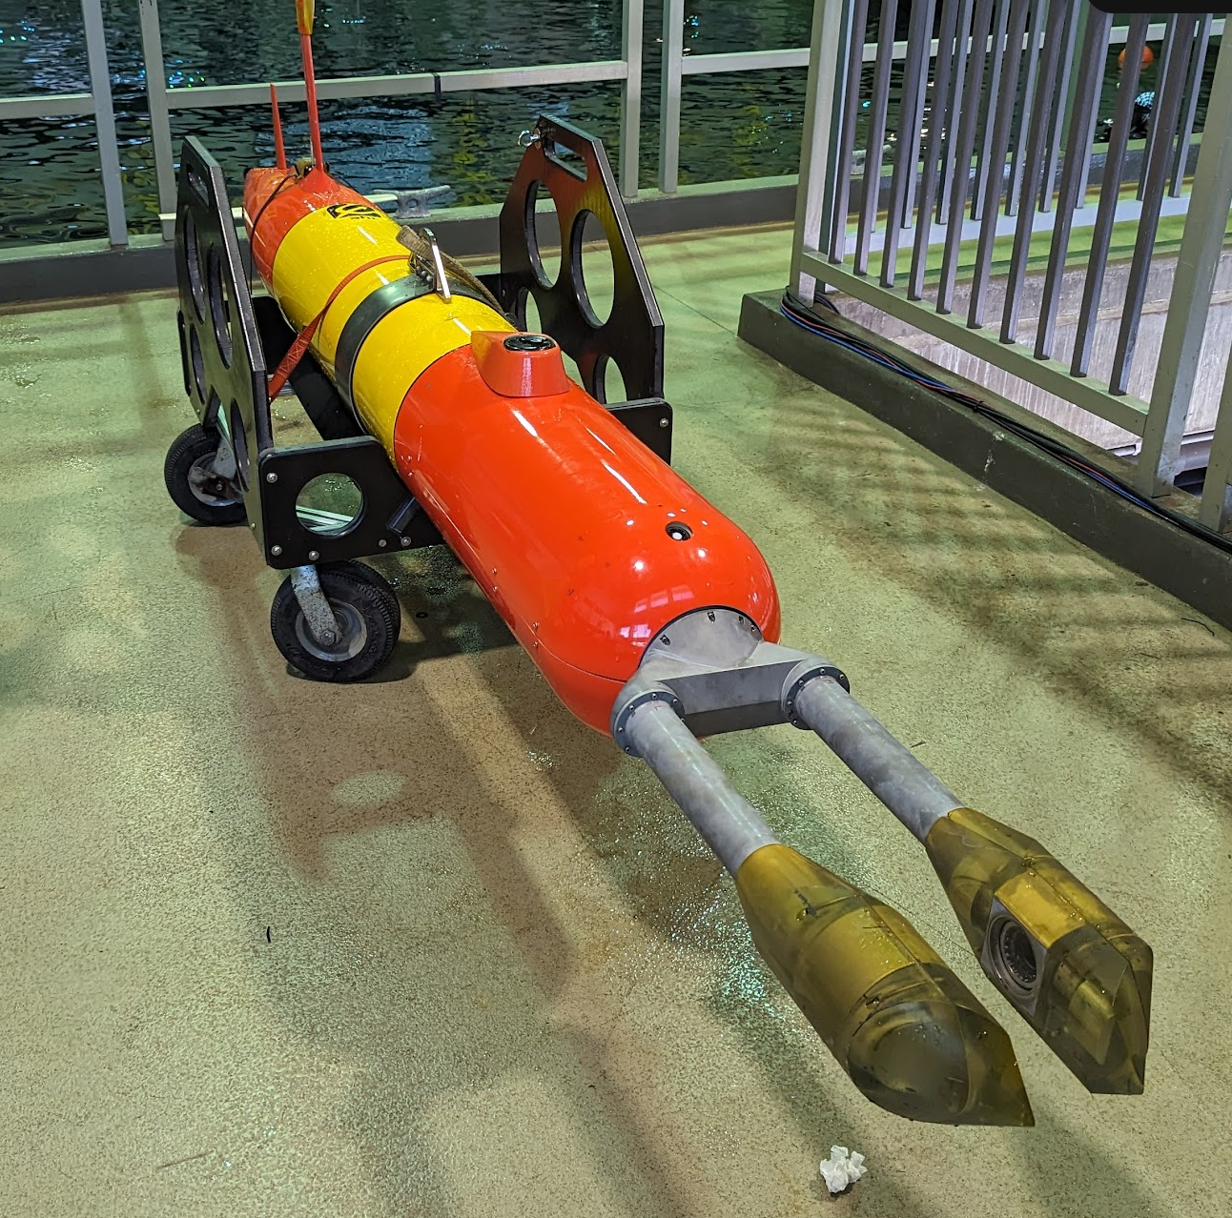
What is Planktivore?
Complementary pair of underwater microscopes
A standardized vehicle power and data interface
A collection of automated and semi-automated workflows for transforming pixels into size, abundance, and taxonomic information

Slide 7
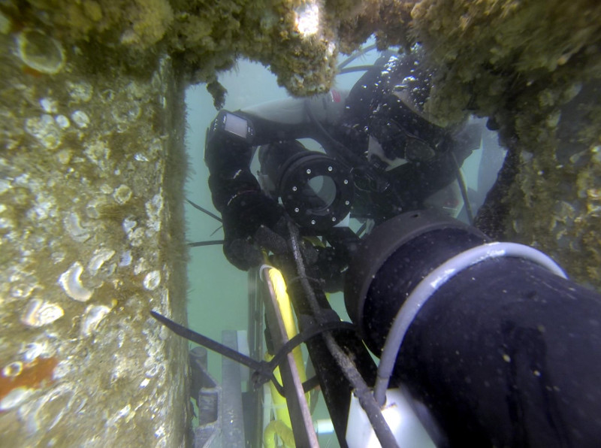
The Planktivore Origin Story
Notes:
Dr. Jules S. Jaffe
With Rob McGowan conceived the idea of a plankton microscope at the end of Scripps pier
2013 We built and deployed the first unit in and it was immediately of great interest
2014 We added a “high-mag” version to compliment the “low-mag”

Slide 8
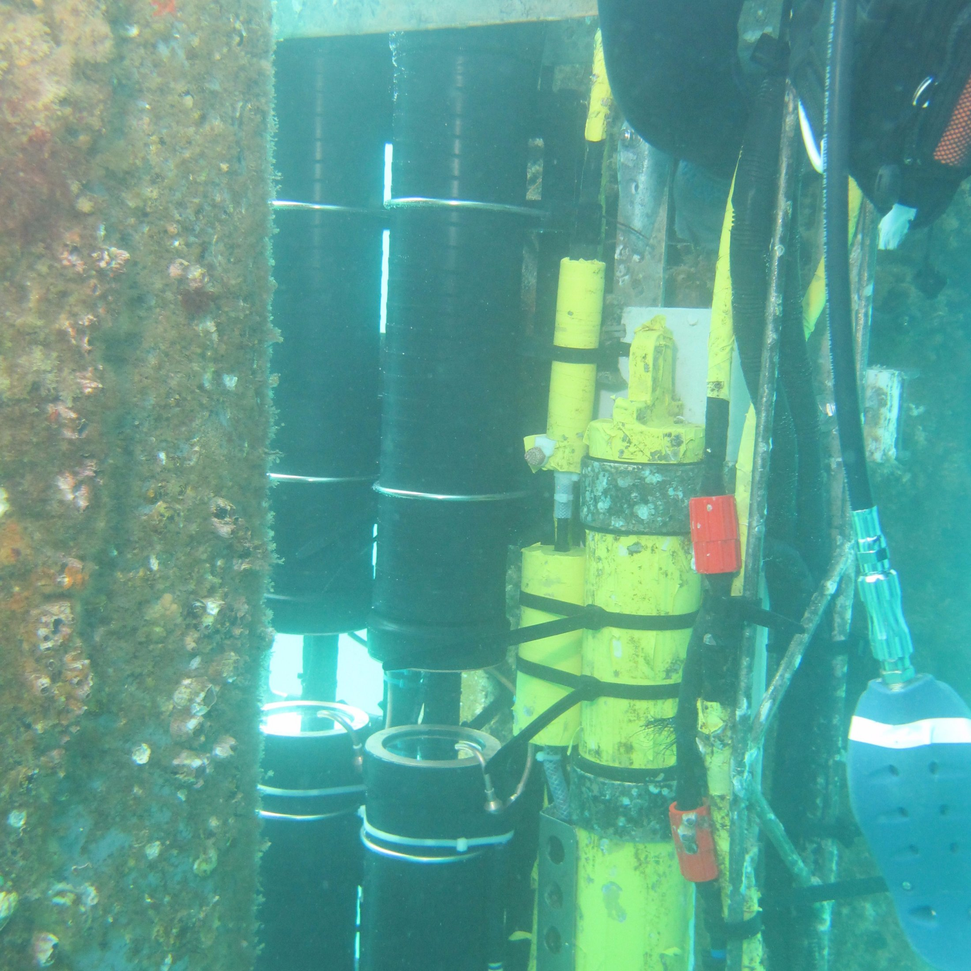

Slide 9
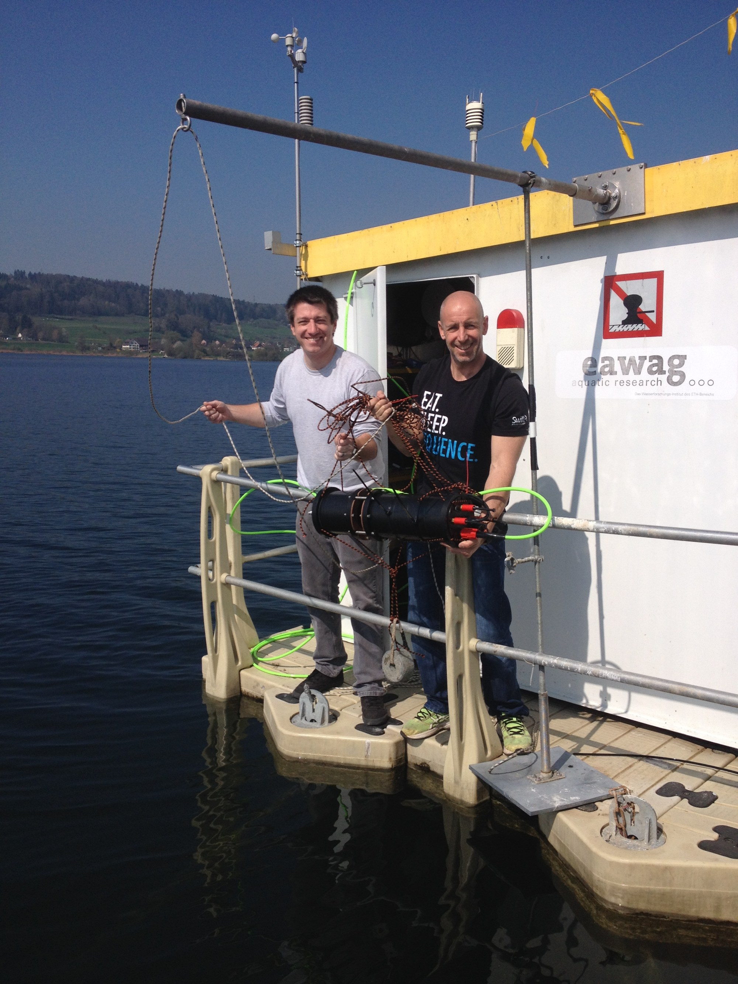

Slide 10
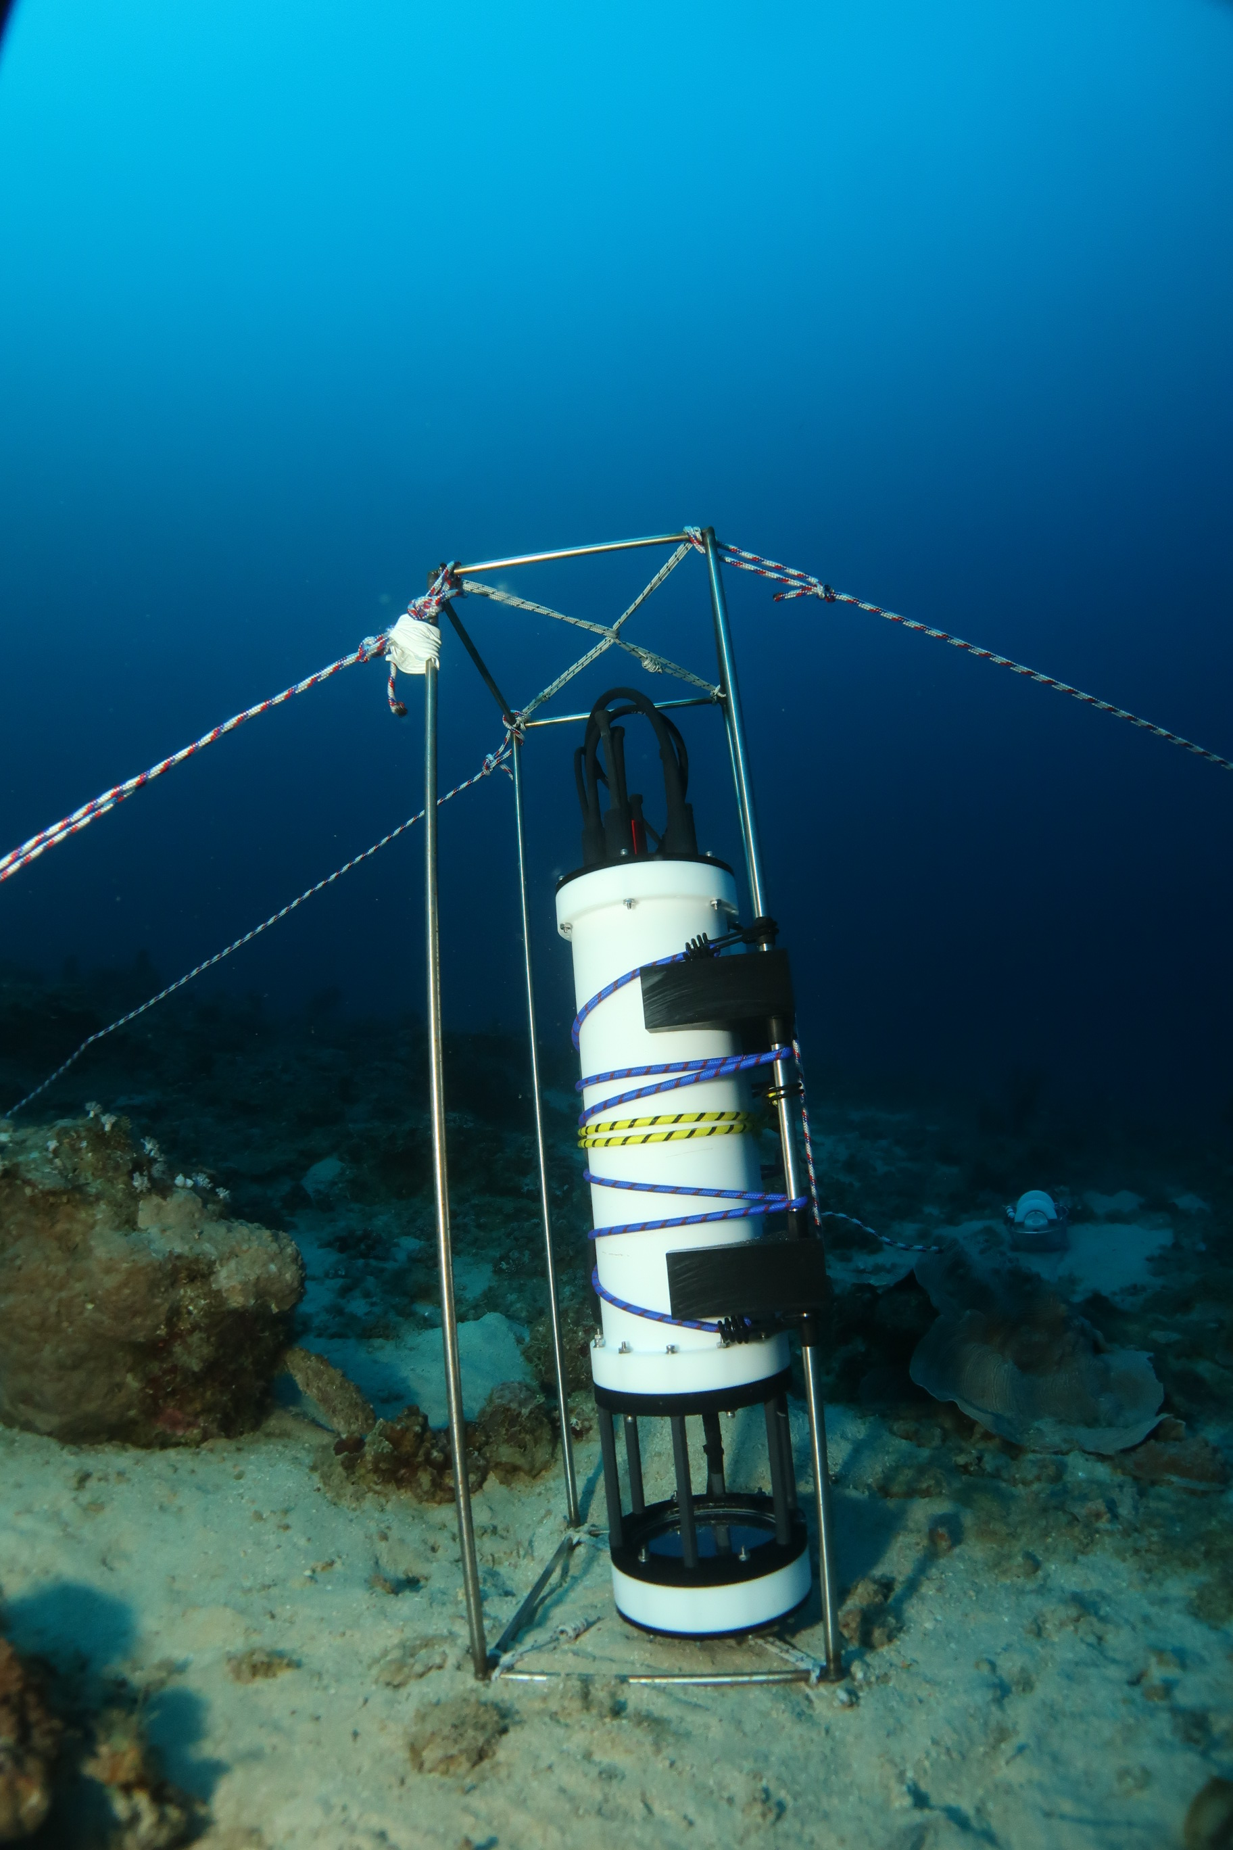

Slide 11
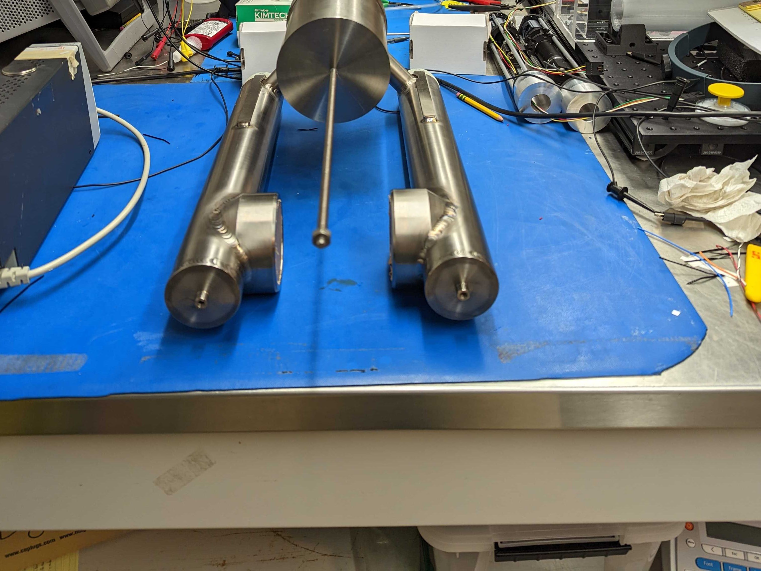
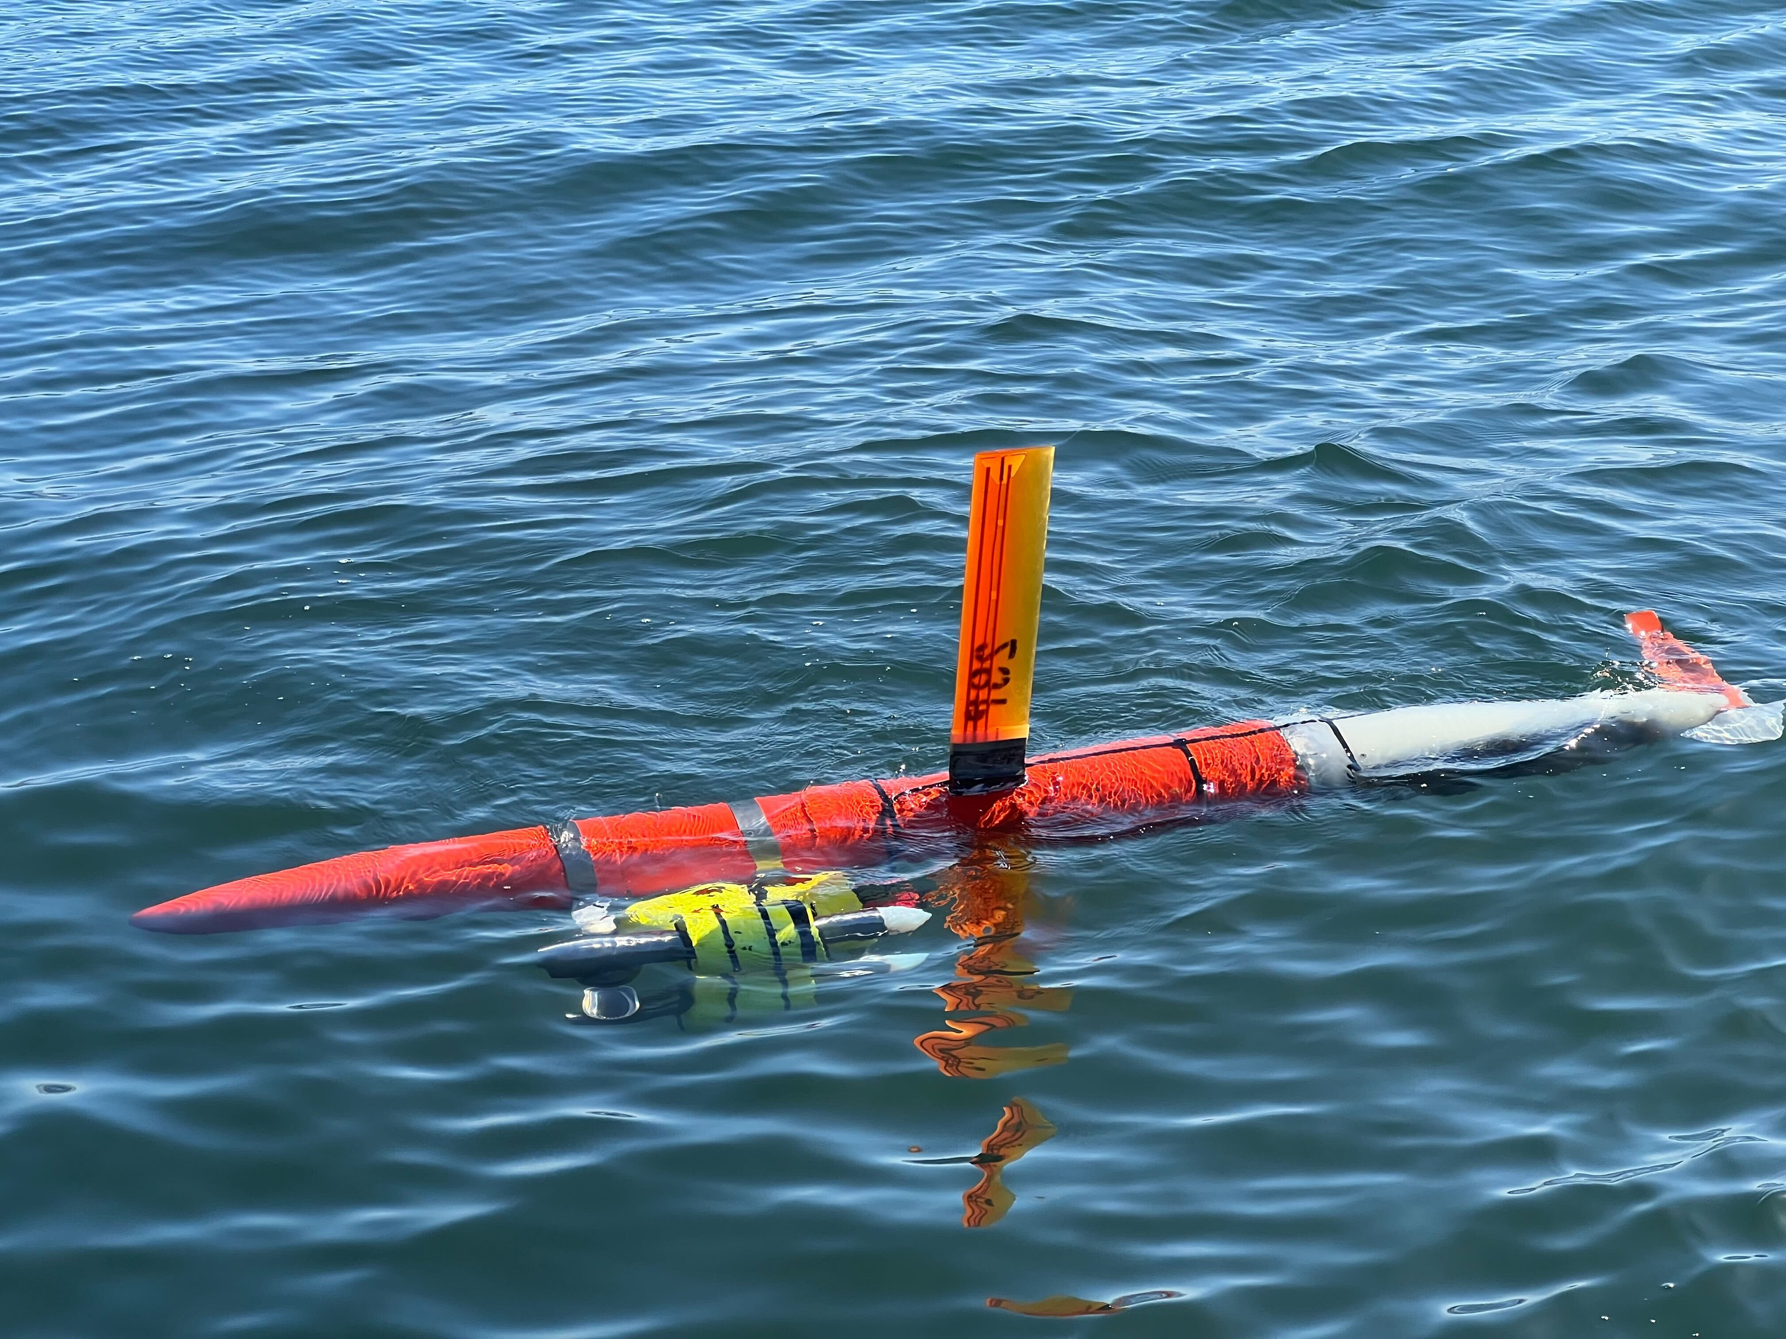

Slide 13
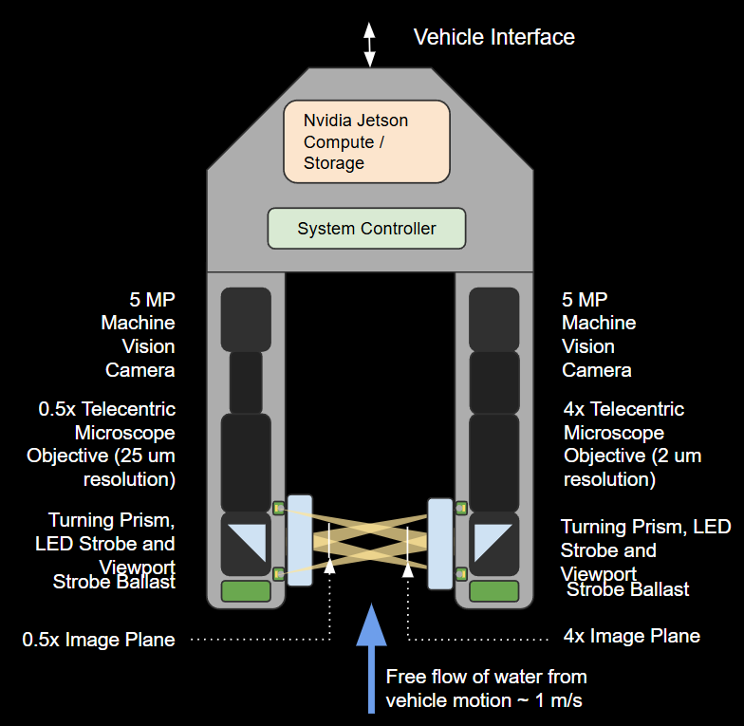

Slide 14
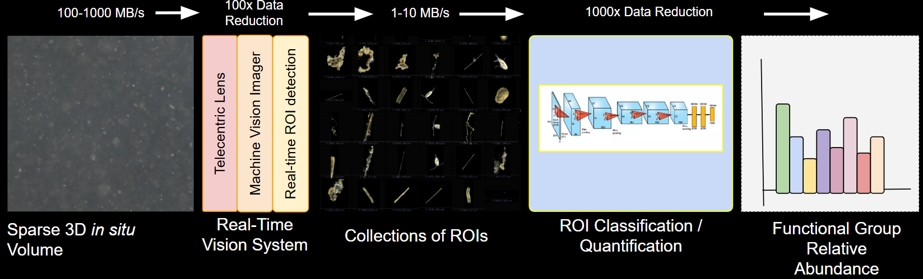

Slide 15
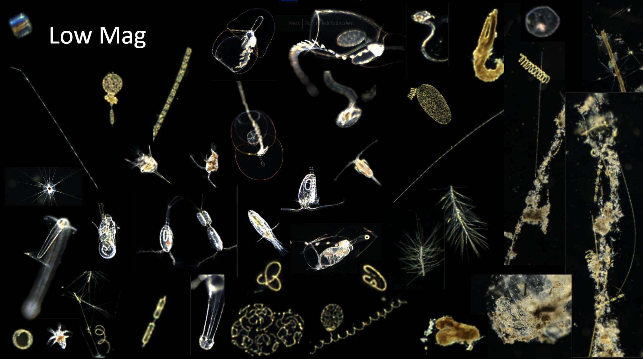

Slide 16
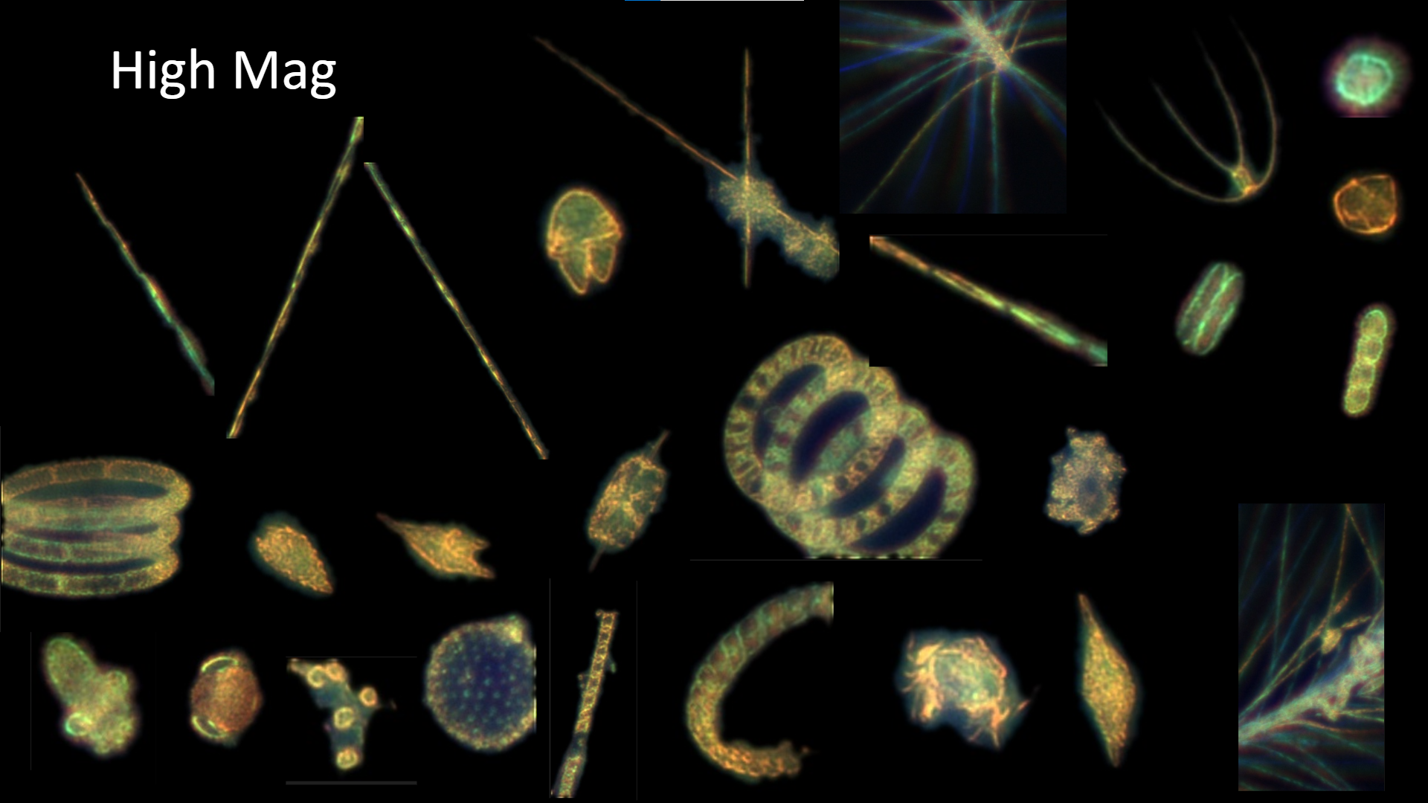

Slide 17
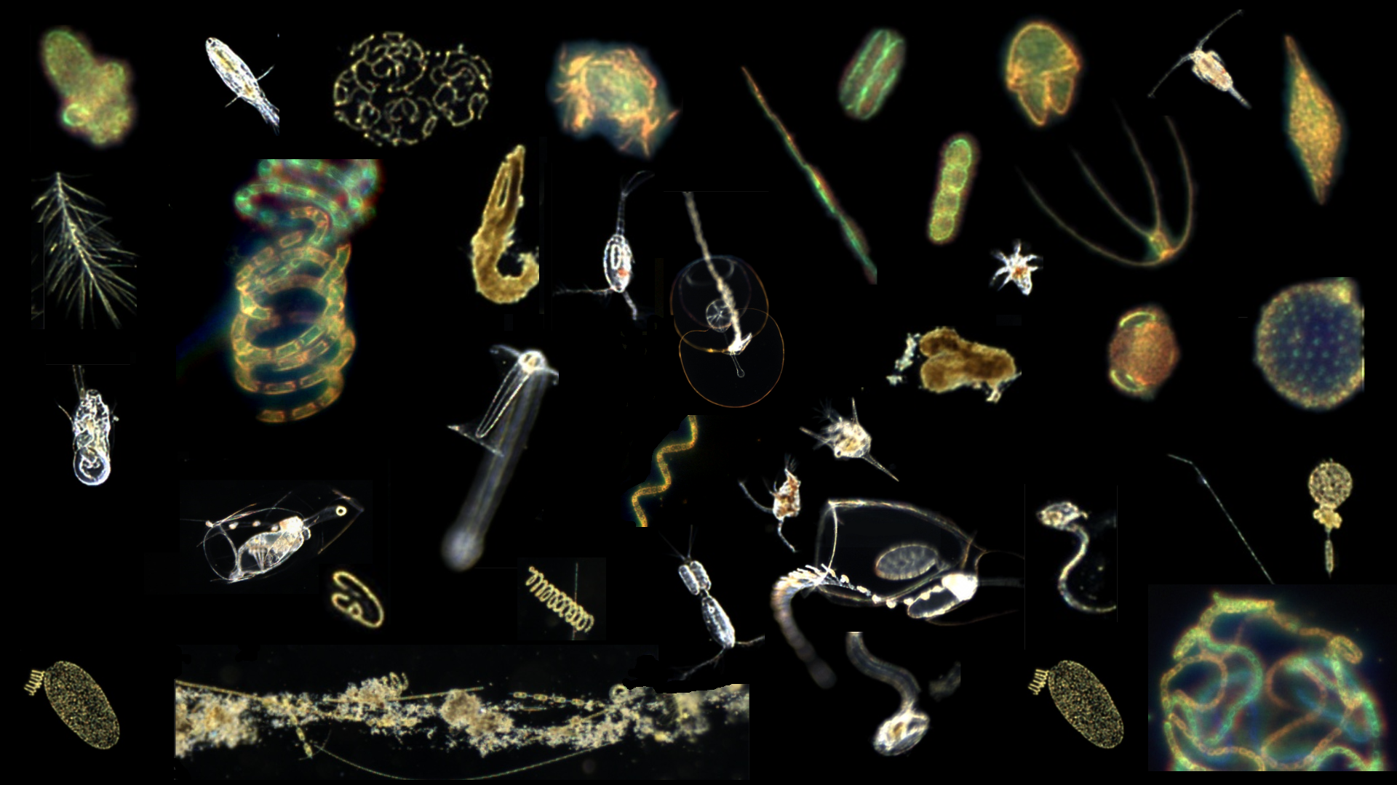

Slide 18
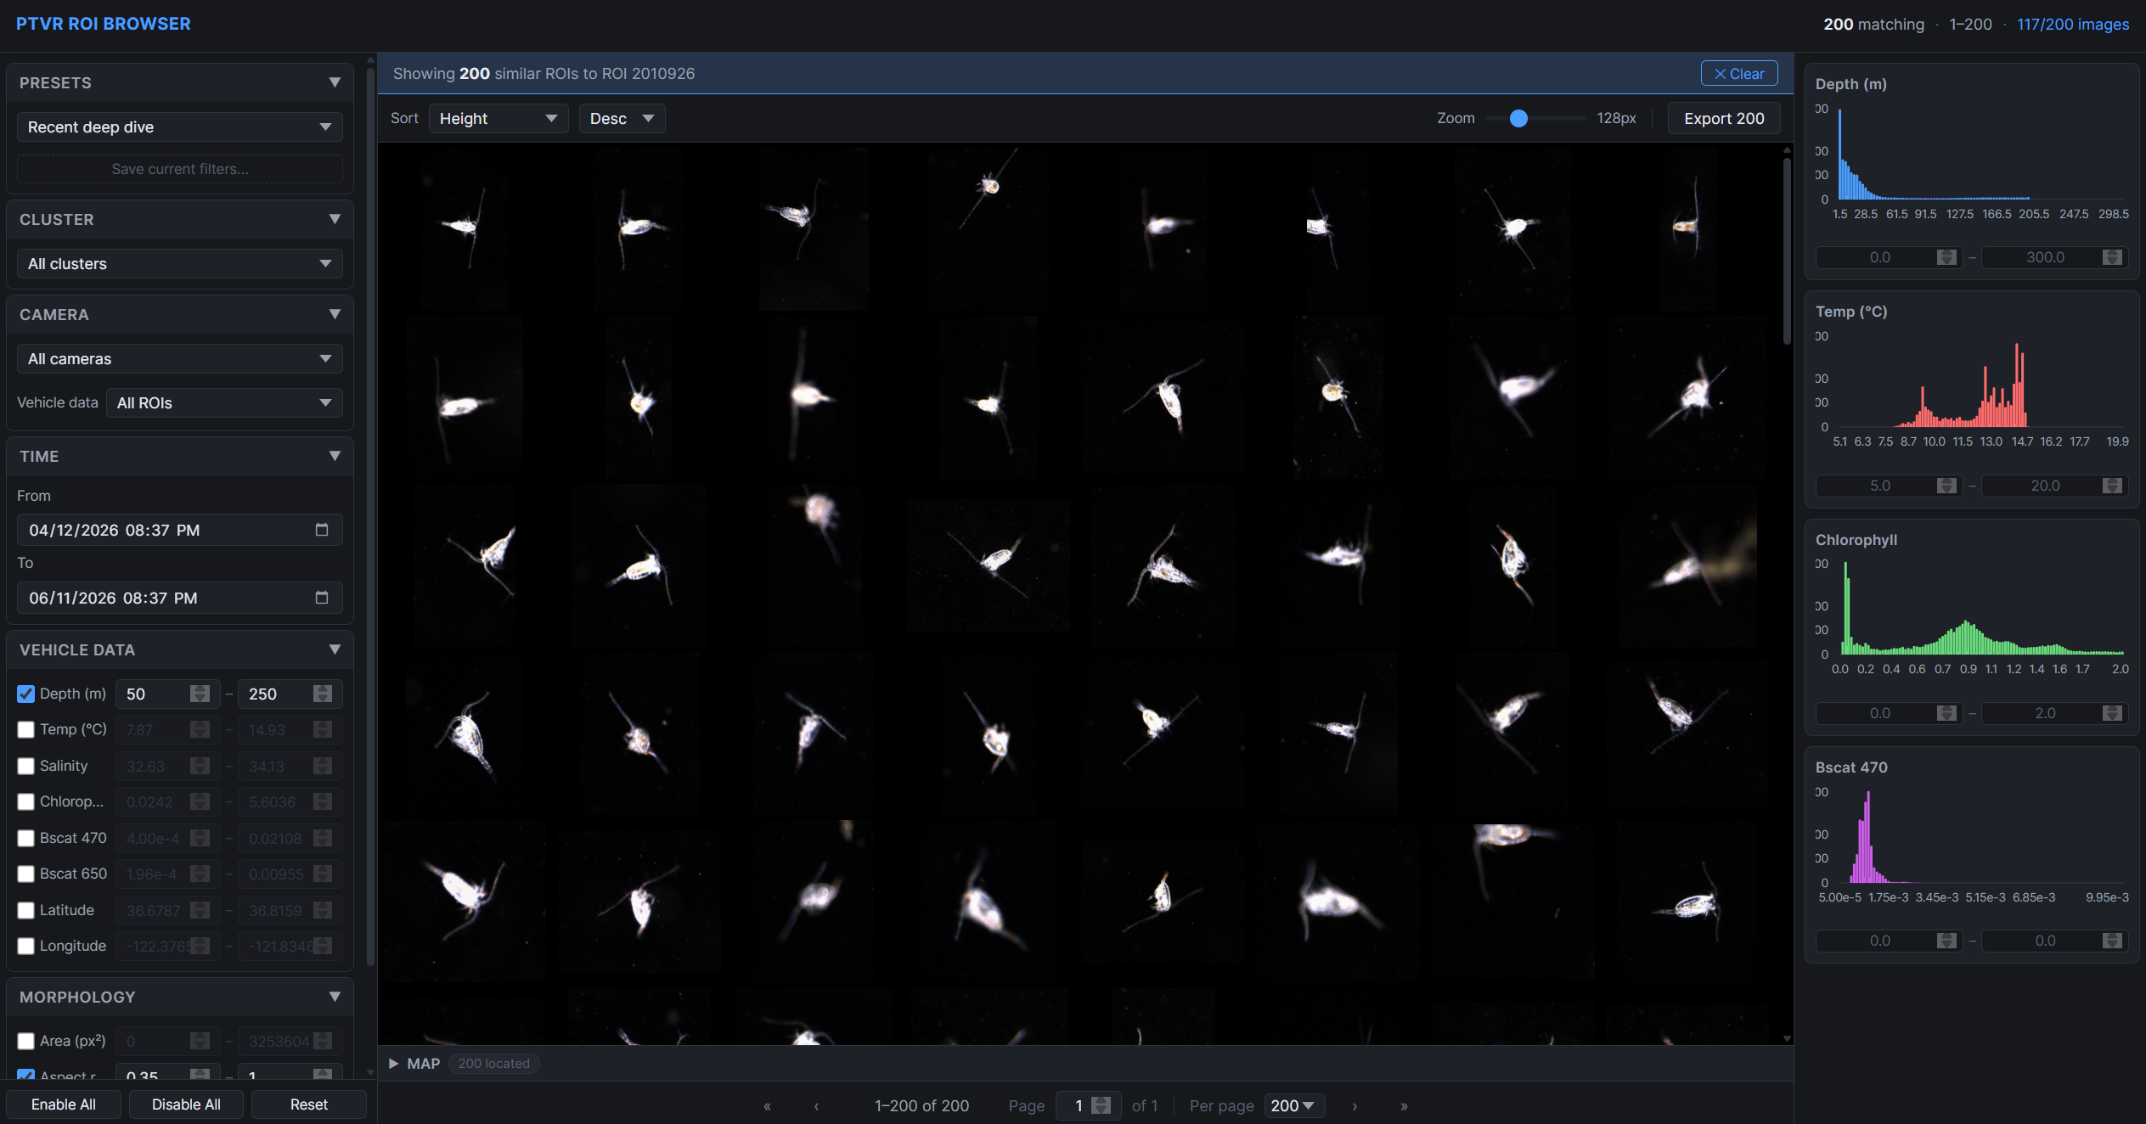

Slide 19
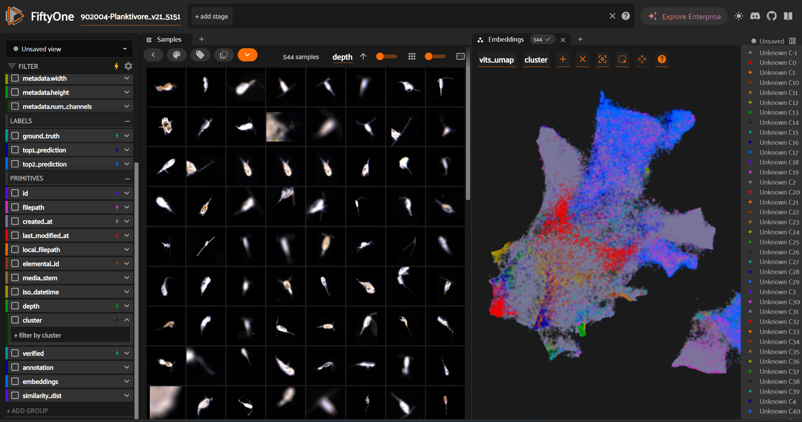

Slide 20
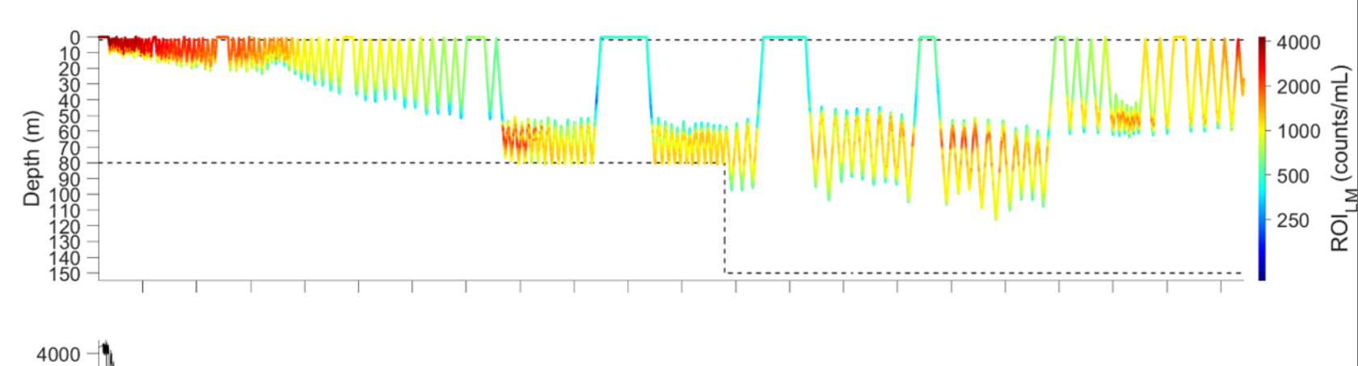

Slide 21
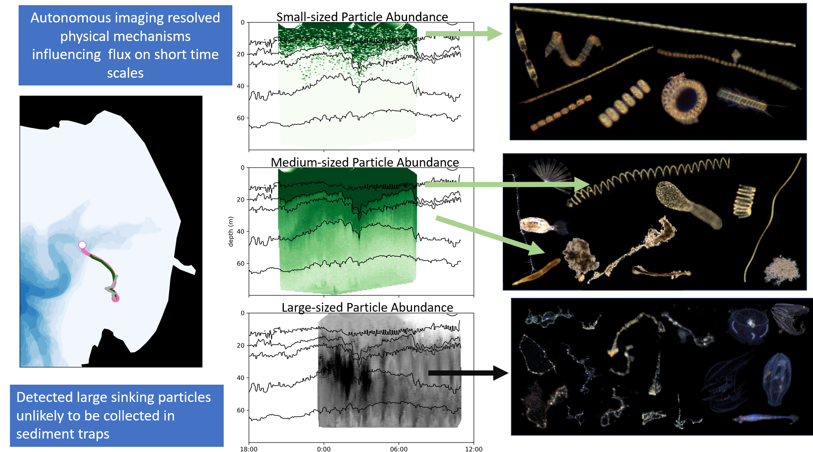

Slide 22
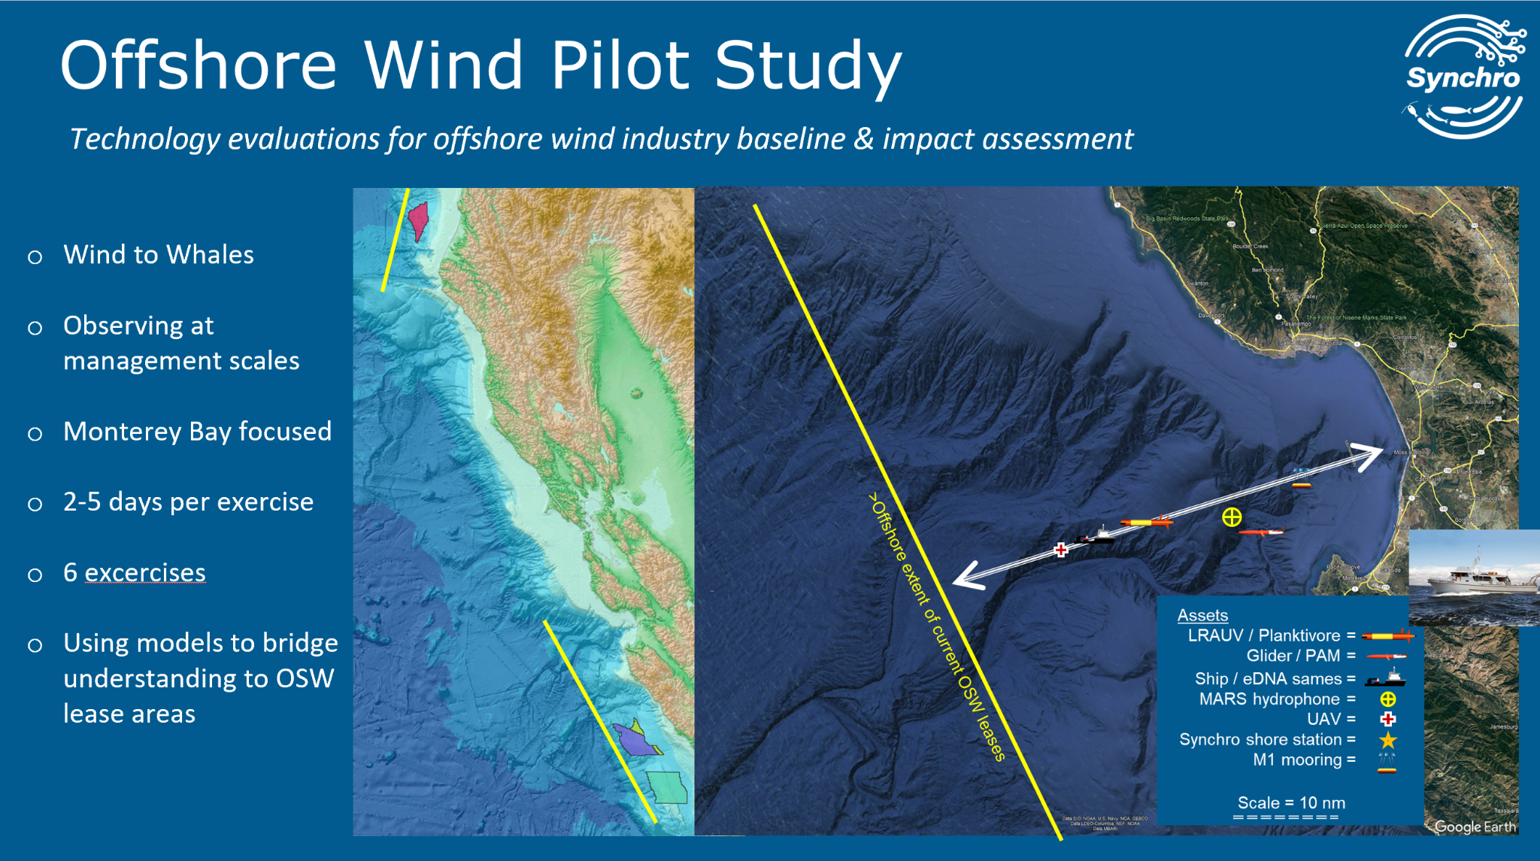

Slide 23
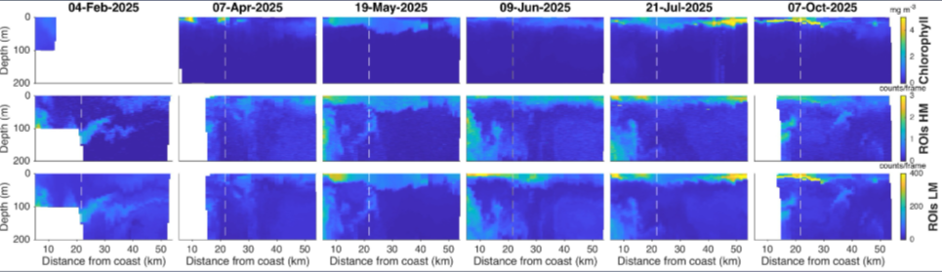

Slide 24
