Slide 1
Planktivore:
Enabling In-situ Microscopy on Autonomous Underwater Vehicles
Paul Roberts
MidSEC June 15, 2026
Notes:
‘Plank’ton = the small and microscopic organisms drifting or floating in the sea or fresh water, consisting chiefly of diatoms, protozoans, small crustaceans, and the eggs and larval stages
‘I’ = Image, internet digitized and processed
‘Vore’ = Devour, Eat, Digest

Slide 2
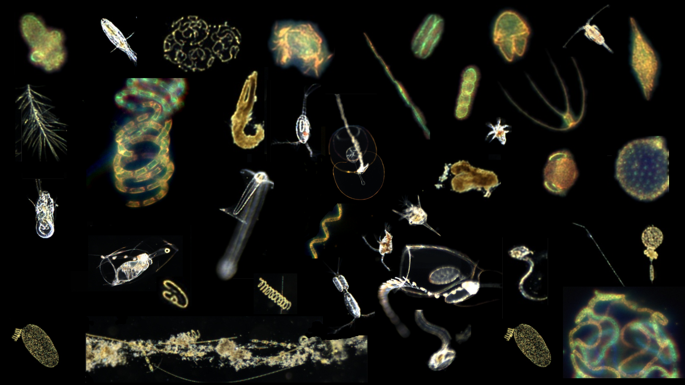

Slide 4
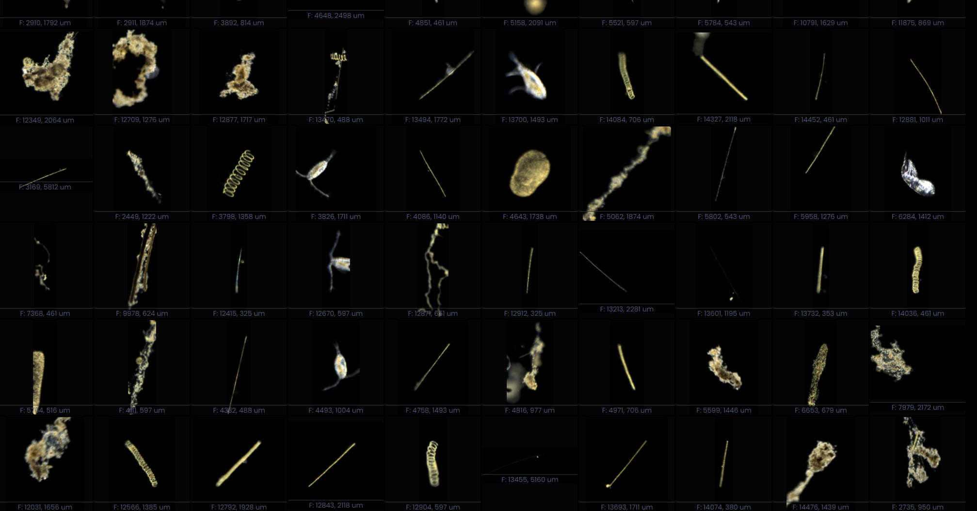
Notes:
Lots of Plankton… 175000 images in 20 minutes…

Slide 5
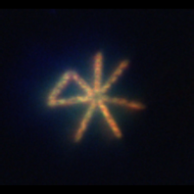
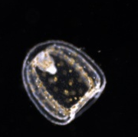
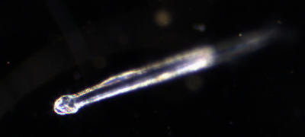
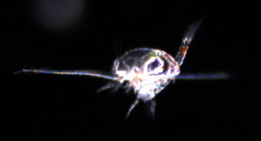
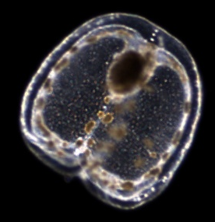

Slide 6
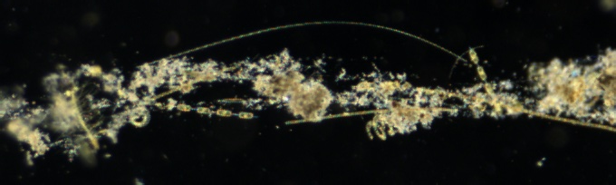
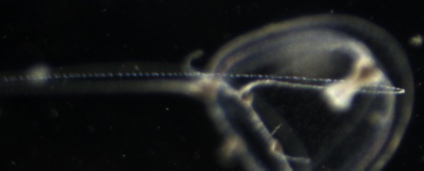
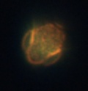
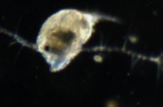
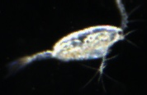
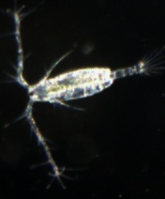
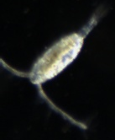
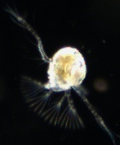
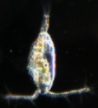
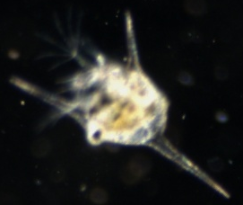
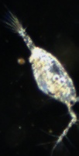
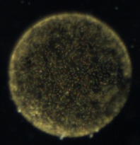


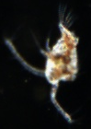
1 mm

Slide 7
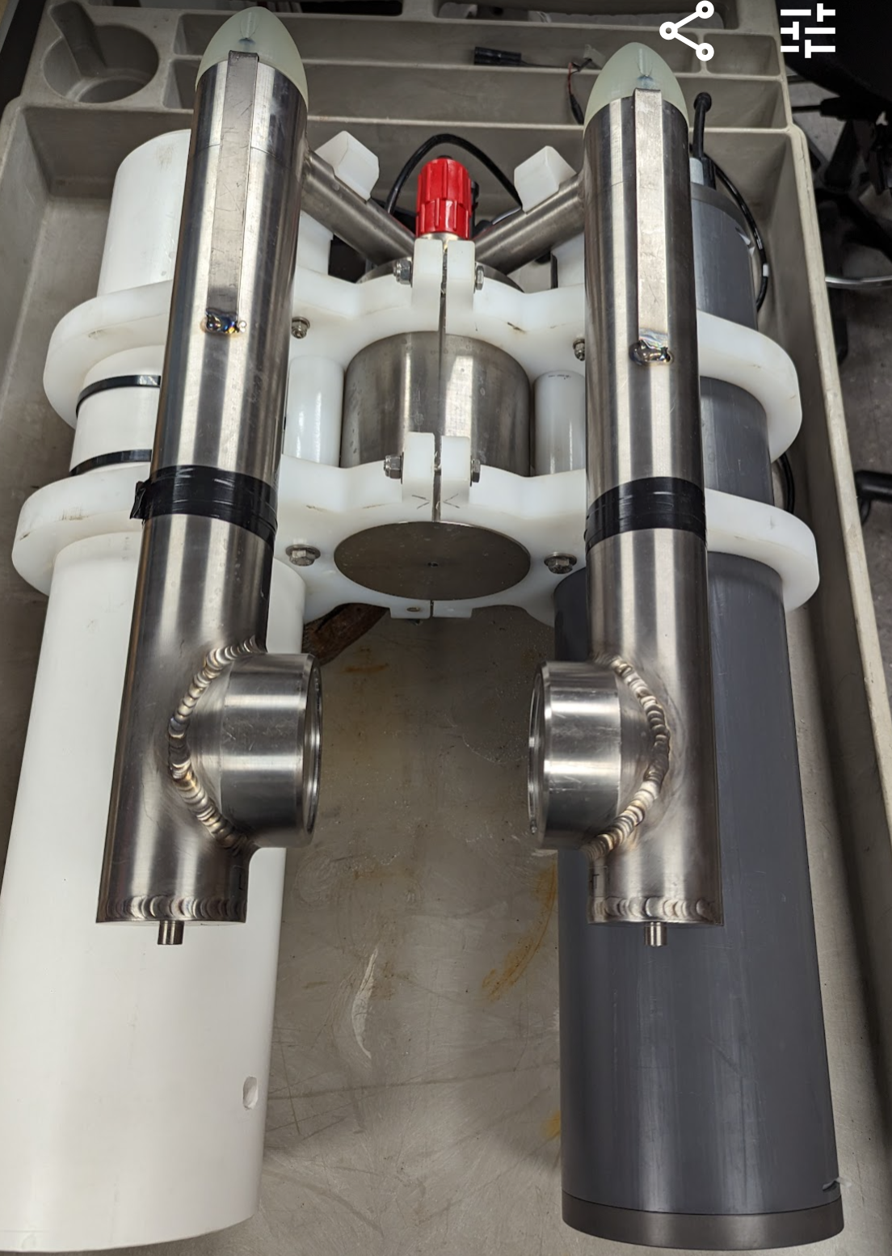
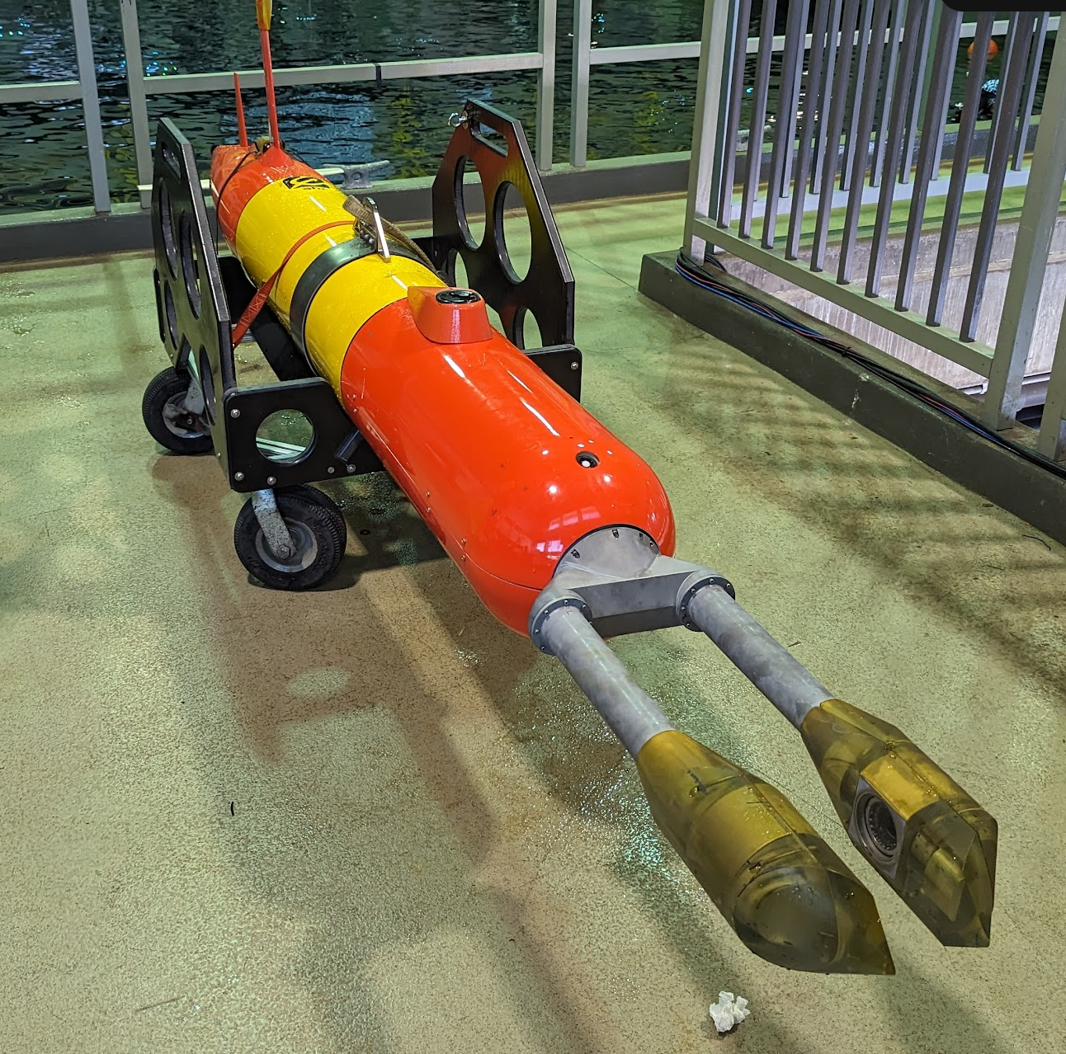
Planktivore Microscopes
Deep LRAUV Opah 3Q2026
Standalone
LRAUV Ahi
Notes:
‘Plank’ton = the small and microscopic organisms drifting or floating in the sea or fresh water, consisting chiefly of diatoms, protozoans, small crustaceans, and the eggs and larval stages
‘I’ = Image, internet digitized and processed
‘Vore’ = Devour, Eat, Digest

Slide 8
Planktivore Project Status
Year 3 of 3, successful adoption of Planktivore by science users with DMO ASO support. Haddock Lab, Carbon Flux Ecology, Plankton Proxies, Targeted Sampling, BOG Lab, Benthic Ecology, CENCOOS
19 Deployments in 2025, operated by science users
On track to ~20 Deployments in 2026
We have demonstrated in-situ real-time plankton detection, model trained with a targeted set of plankton.
Shadow graph engineering effort has been delayed by resource descoping.

Slide 9
Planktivore Technology Roadmap
LRAUV (Monterey Bay) (2020 to 2026)
  Engineering development
  Transfer operations to Science with DMO ASO group support
Plankton Data Workflow and automated classification (2027 - 2029)
Glider (California Current) 2030
Floats (Global Ocean) 2035
The Planktivore team in collaboration with the Subsea Advanced Imaging Lab, strives to
Reduce power consumption, Automate software processing and workflow tasks, increase image volume, improve optics, increase resolution, shrink form factor, improve lighting

Slide 10
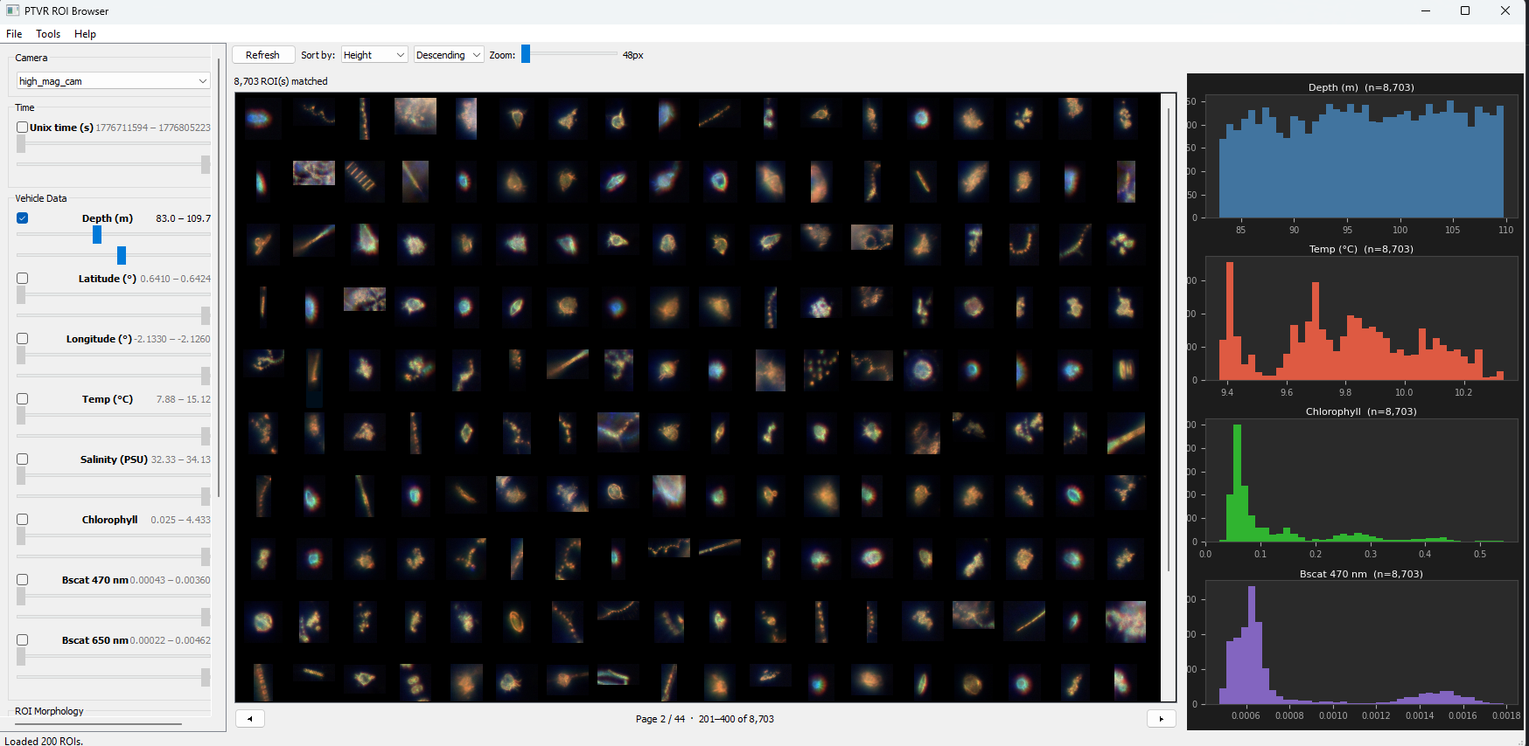
Using AI to generate code to speed Tool Implementation
Claude code generated

