Slide 1
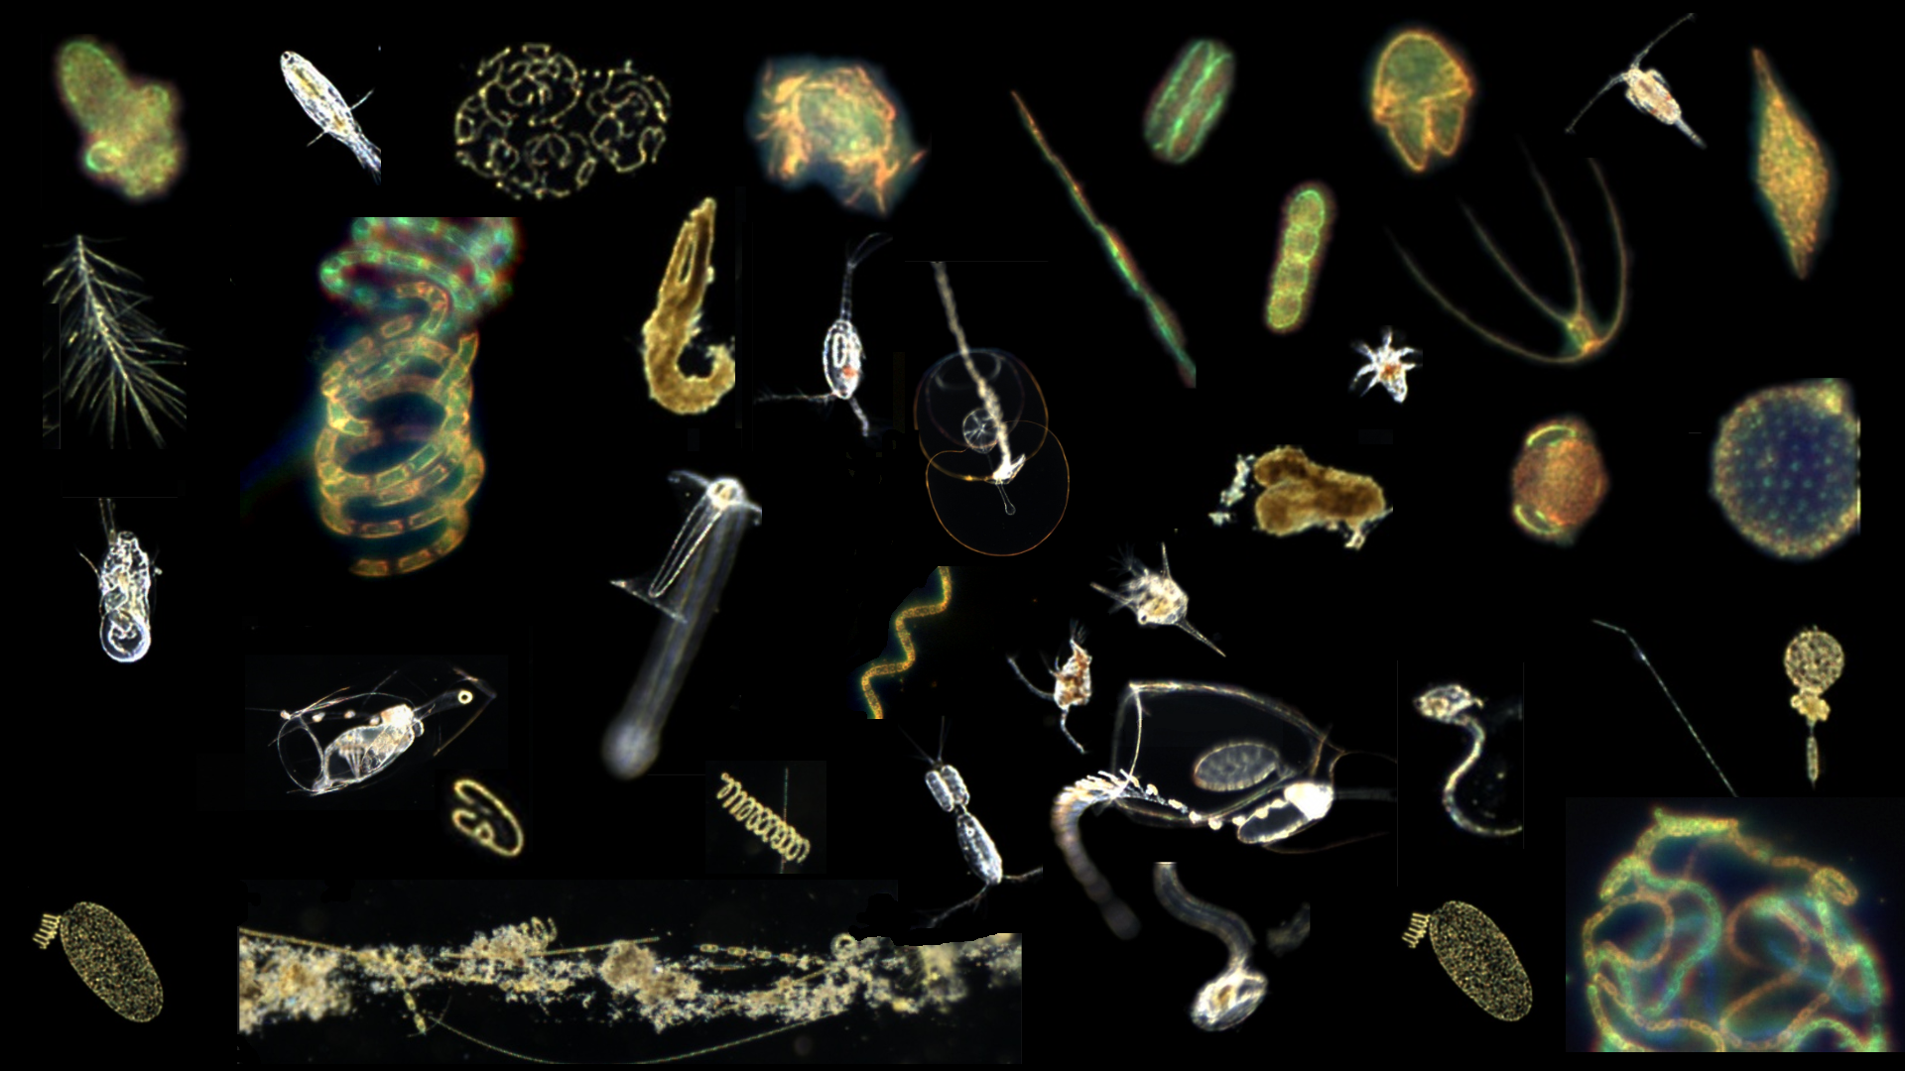
902004 Planktivore:
In-situ Free Space Microscopy on Autonomous Underwater Vehicles
Planktivore Abstract
6 May 2026
Notes:
‘Plank’ton = the small and microscopic organisms drifting or floating in the sea or fresh water, consisting chiefly of diatoms, protozoans, small crustaceans, and the eggs and larval stages
‘I’ = Image, internet digitized and processed
‘Vore’ = Devour, Eat, Digest

Slide 3
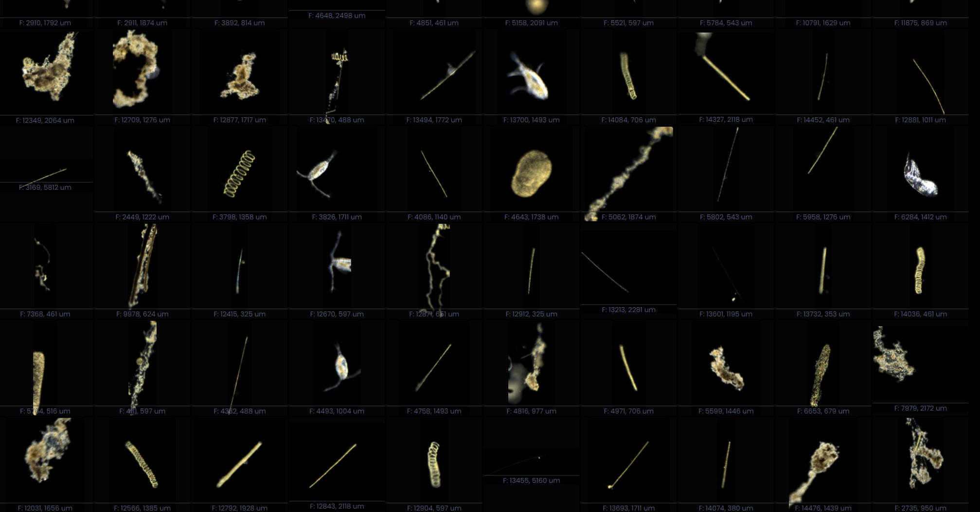
Notes:
Lots of Plankton… 175000 images in 20 minutes…

Slide 4
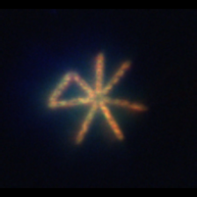
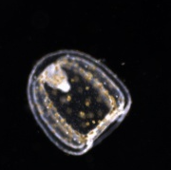
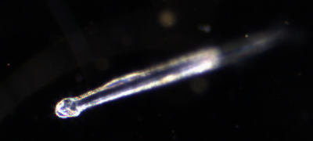
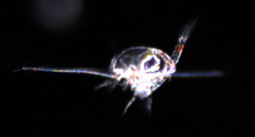
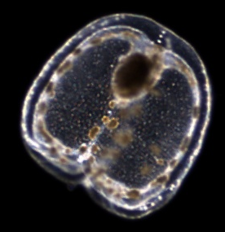

Slide 5
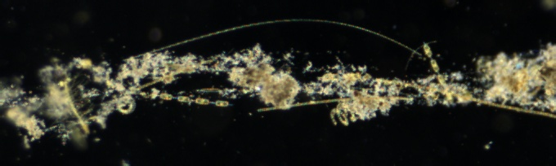
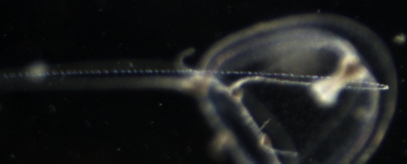
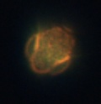
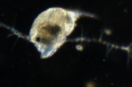
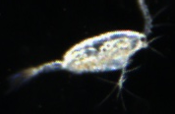
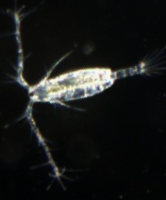
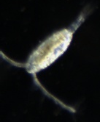
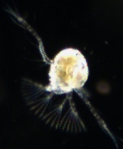
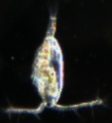
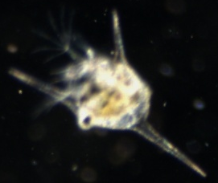
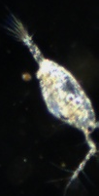
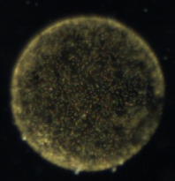


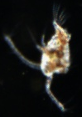
1 mm

Slide 6
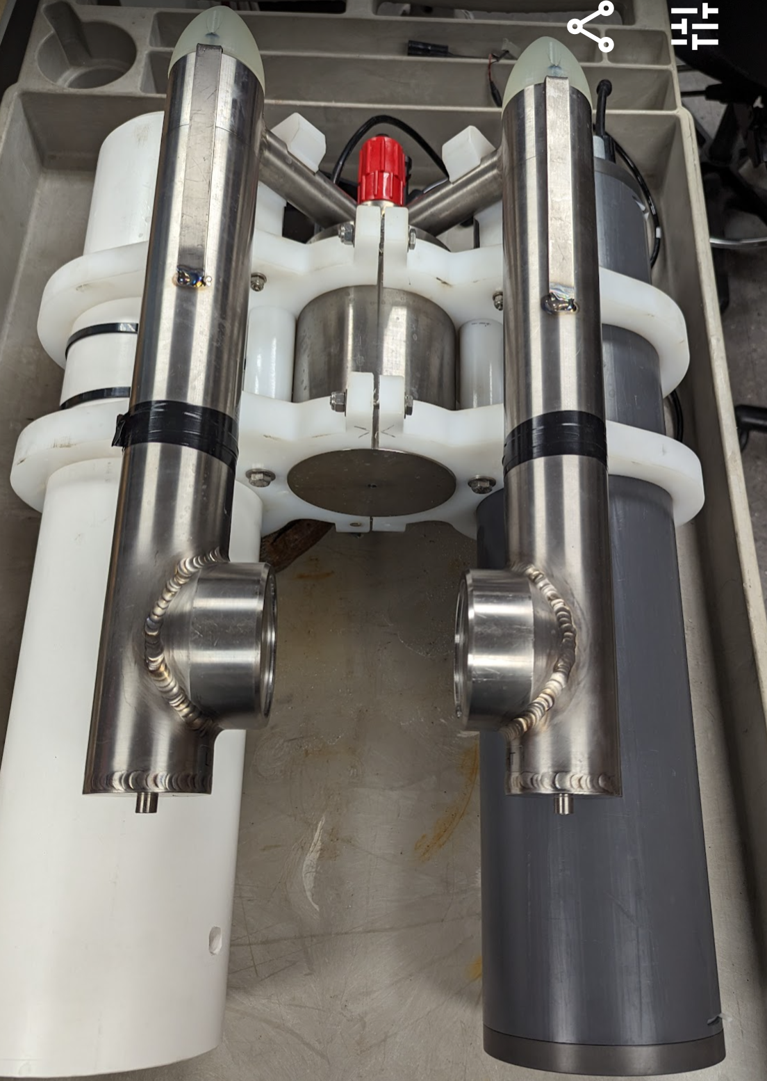
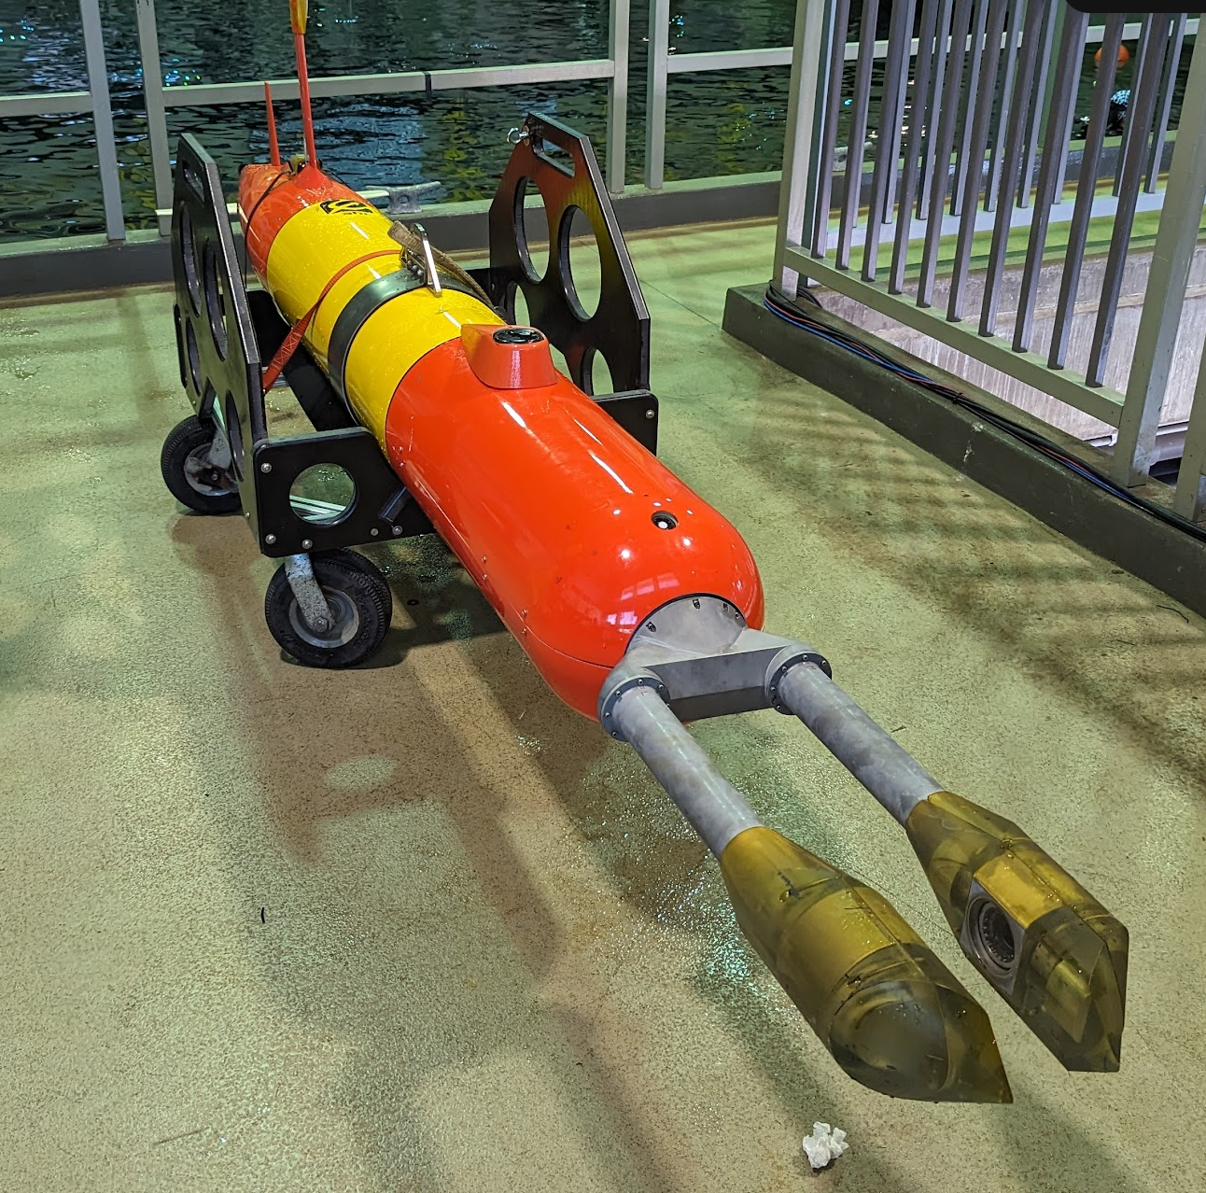
Planktivore Microscopes
Deep LRAUV Opah 3Q2026
Standalone
LRAUV Ahi
Notes:
‘Plank’ton = the small and microscopic organisms drifting or floating in the sea or fresh water, consisting chiefly of diatoms, protozoans, small crustaceans, and the eggs and larval stages
‘I’ = Image, internet digitized and processed
‘Vore’ = Devour, Eat, Digest

Slide 7
Planktivore Project Status
Year 3 of 3, successful adoption of Planktivore by science users with DMO ASO support. Haddock Lab, Carbon Flux Ecology, Plankton Proxies, Targeted Sampling, BOG Lab, Benthic Ecology, CENCOOS
19 Deployments in 2025, operated by science users
On track to ~20 Deployments in 2026
We have demonstrated in-situ real-time plankton detection, model trained with a targeted set of plankton.
Shadow graph engineering effort has been delayed by resource descoping.

Slide 8
Planktivore Technology Roadmap
LRAUV (Monterey Bay) (2020 to 2026)
  Engineering development
  Transfer operations to Science with DMO ASO group support
Plankton Data Workflow and automated classification (2027 - 2029)
Glider (California Current) 2030
Floats (Global Ocean) 2035
The Planktivore team in collaboration with the Subsea Advanced Imaging Lab, strives to
Reduce power consumption, Automate software processing and workflow tasks, increase image volume, improve optics, increase resolution, shrink form factor, improve lighting

Slide 9
‘Institutional’ Plankton Data Workflow
Draft Pipeline
  Transfer data from Planktivore into the right directory on a storage server
  Verify the copy
  Delete data off vehicle
  Software automation activates when new Planktivore data is detected.
  Kick off Machine Learning pipeline for identification. Model selected ahead of time
  Update the database with metadata for deployment, campaign, etc.
  One second NETCDF is produced along with standard plots using lrauv-python
  STOQs et al
  Support for ISIIS microscope
Science data access use cases. Define requirements for tools, scripts, examples to be produced to meet the needs of the science users.
  Who’s there, how many, how do those two things change in space and time
Apply latest tools such as Claude Code and Gemini

Slide 10
Resource request
<$50K per year for Year 1, ~75K Year 2 and 3.
$15K for outside contractor / expertise
0.6 FTE data software engineering (600 to 1000 hours)
Project Management / System Engineering (200 hours)
Planktivore Methods paper (80 to 100 hours)
Benchtop prototype has lower priority in year 1, (80 to 120 hours)

Slide 11
Related projects / efforts 2026
901900 Monique’s plankton project with Mike McCann and auv-python Planktivore LRAUV Operational Pipeline , LRAUV data pipeline meeting notes
Danelle Cline has made great progress on developing machine learning models in the Carbon Flux Ecology project.

Slide 12
End of Slides

Slide 13
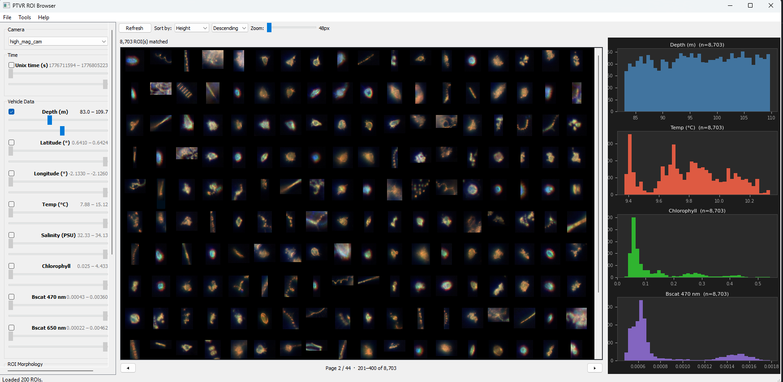
Using AI to generate code to speed Tool Implementation
Claude code generated

