Slide 1
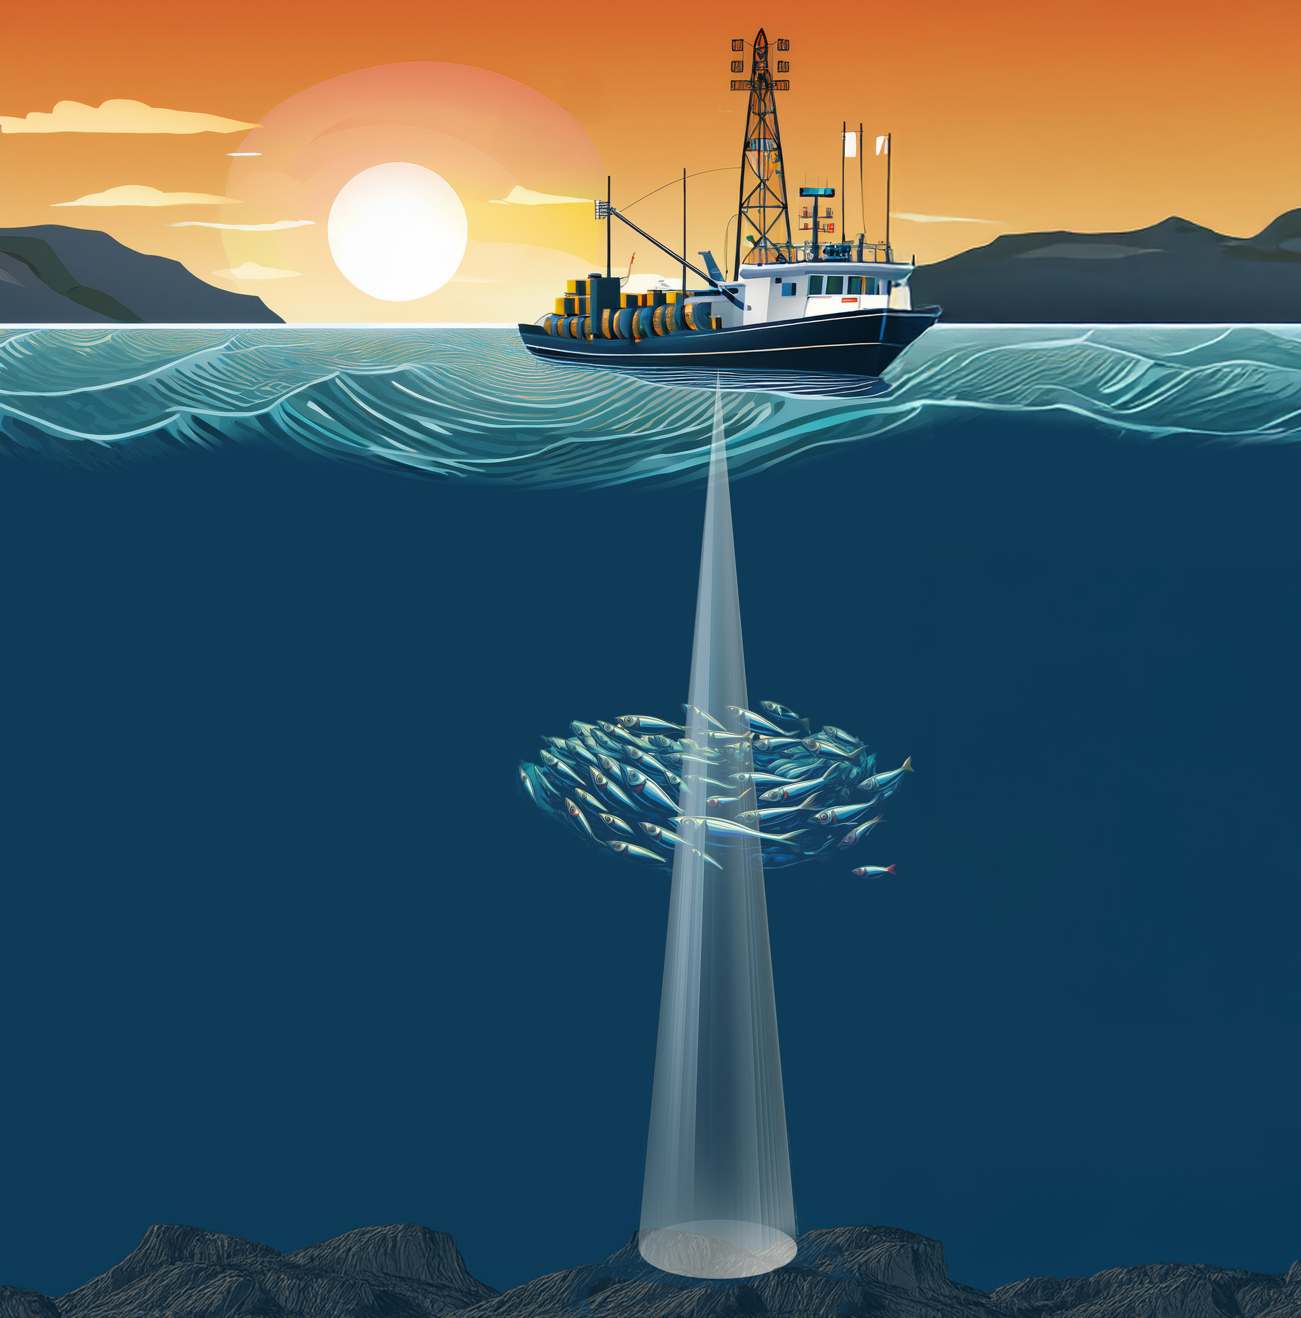
Active acoustics
Study, Monitor, & Manage
Ocean animals

Slide 2
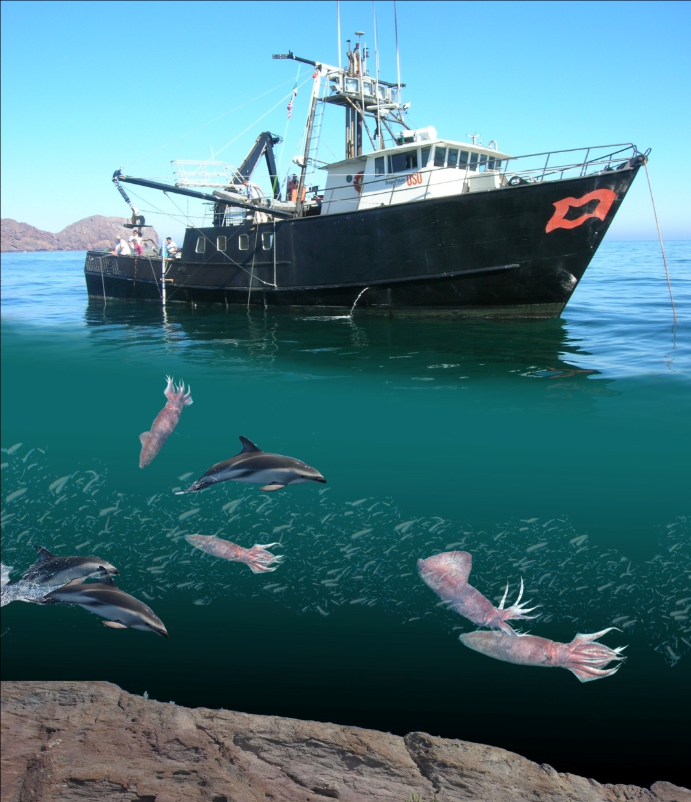

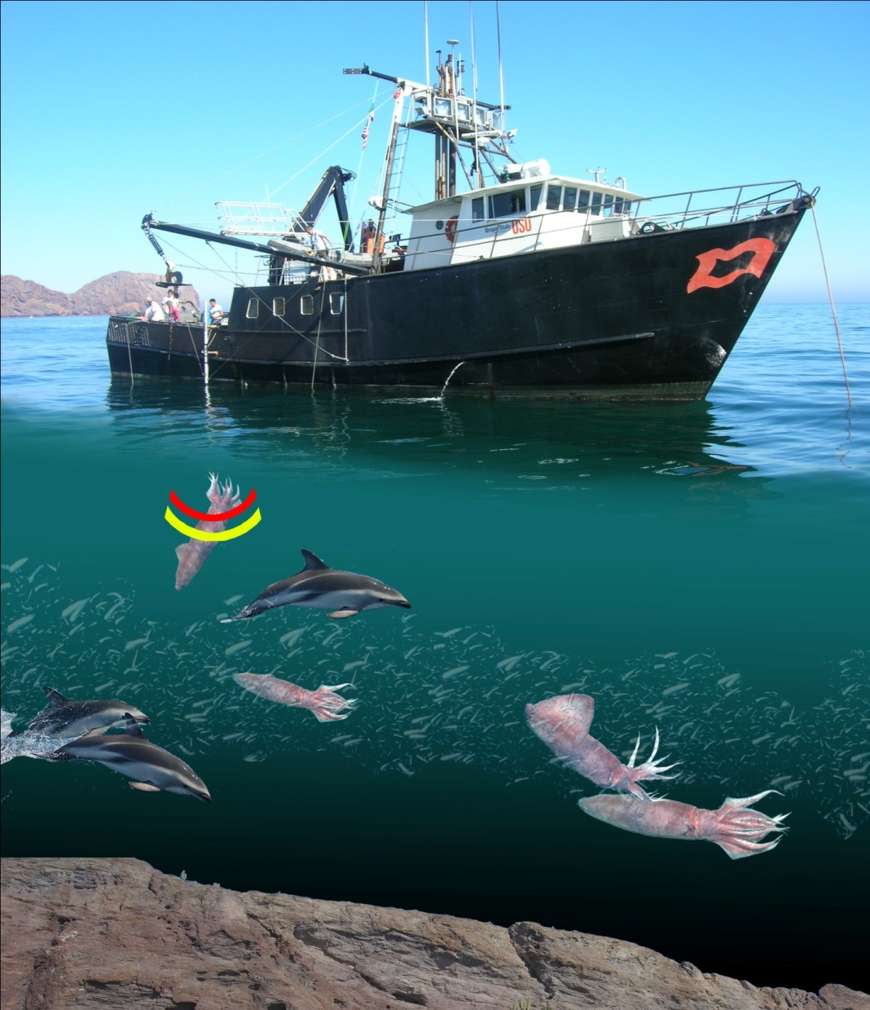


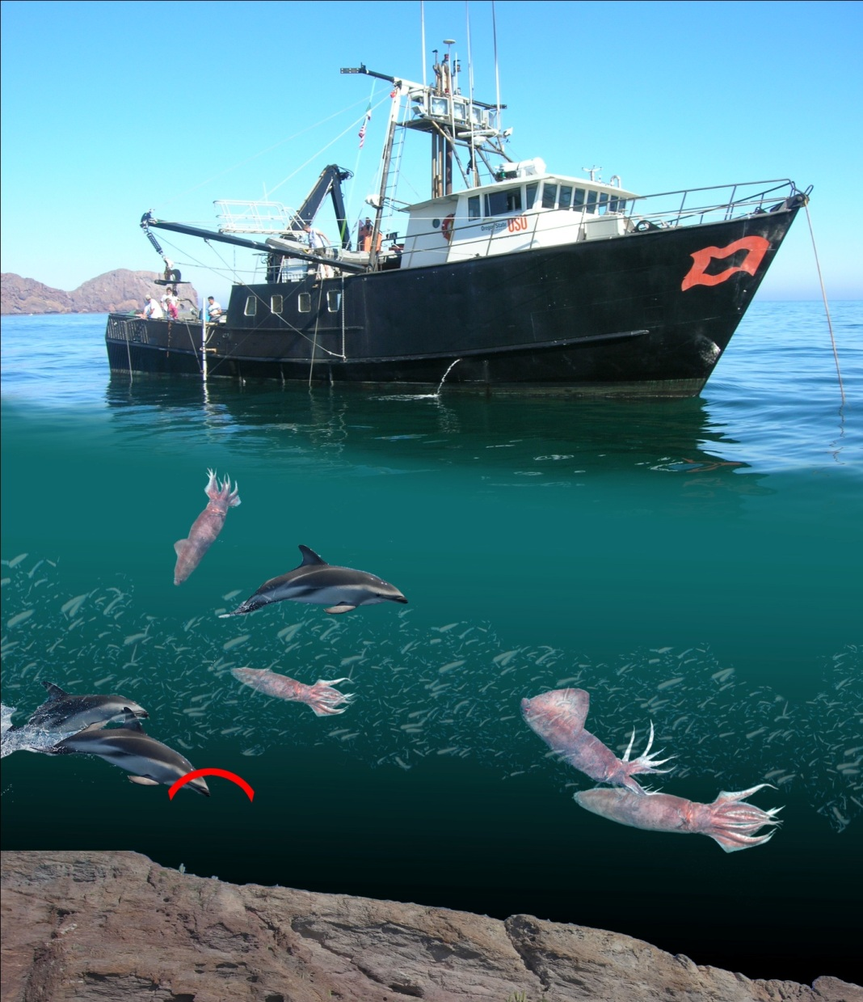
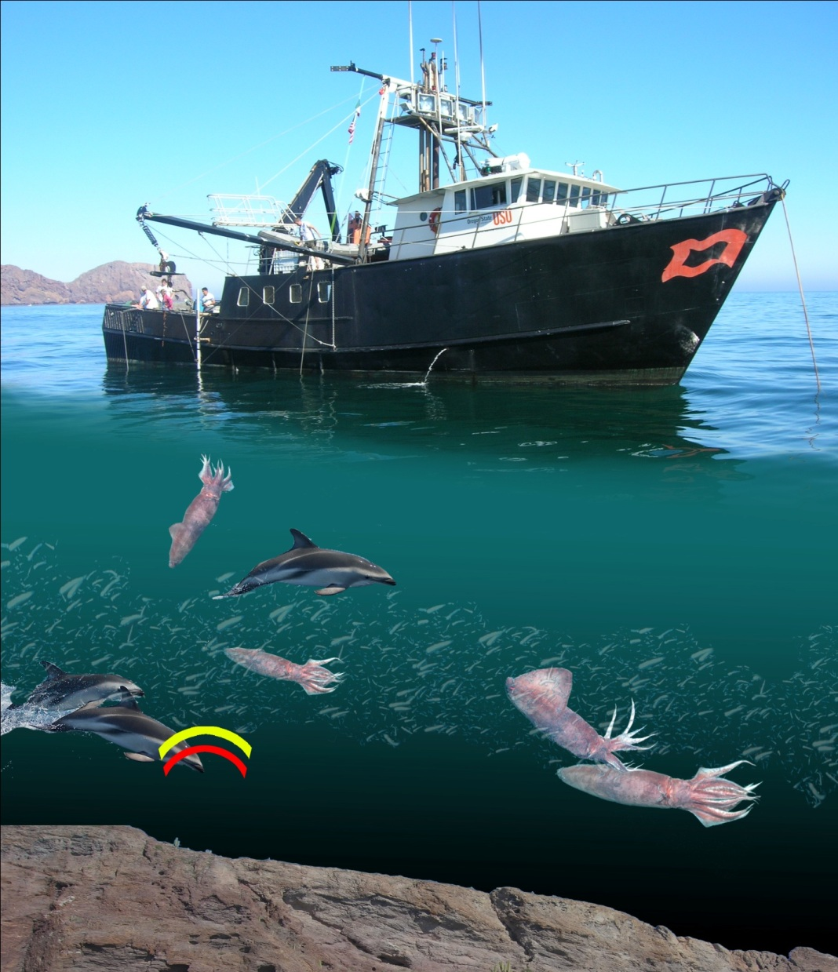
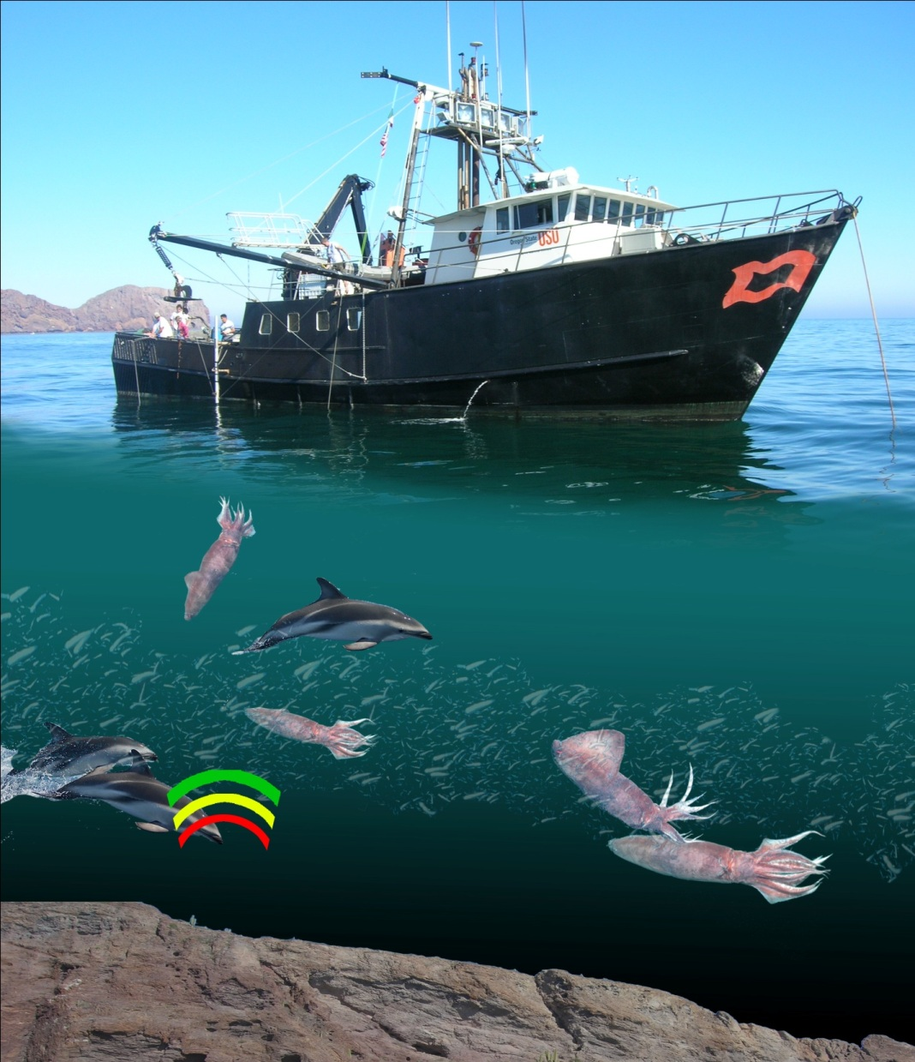

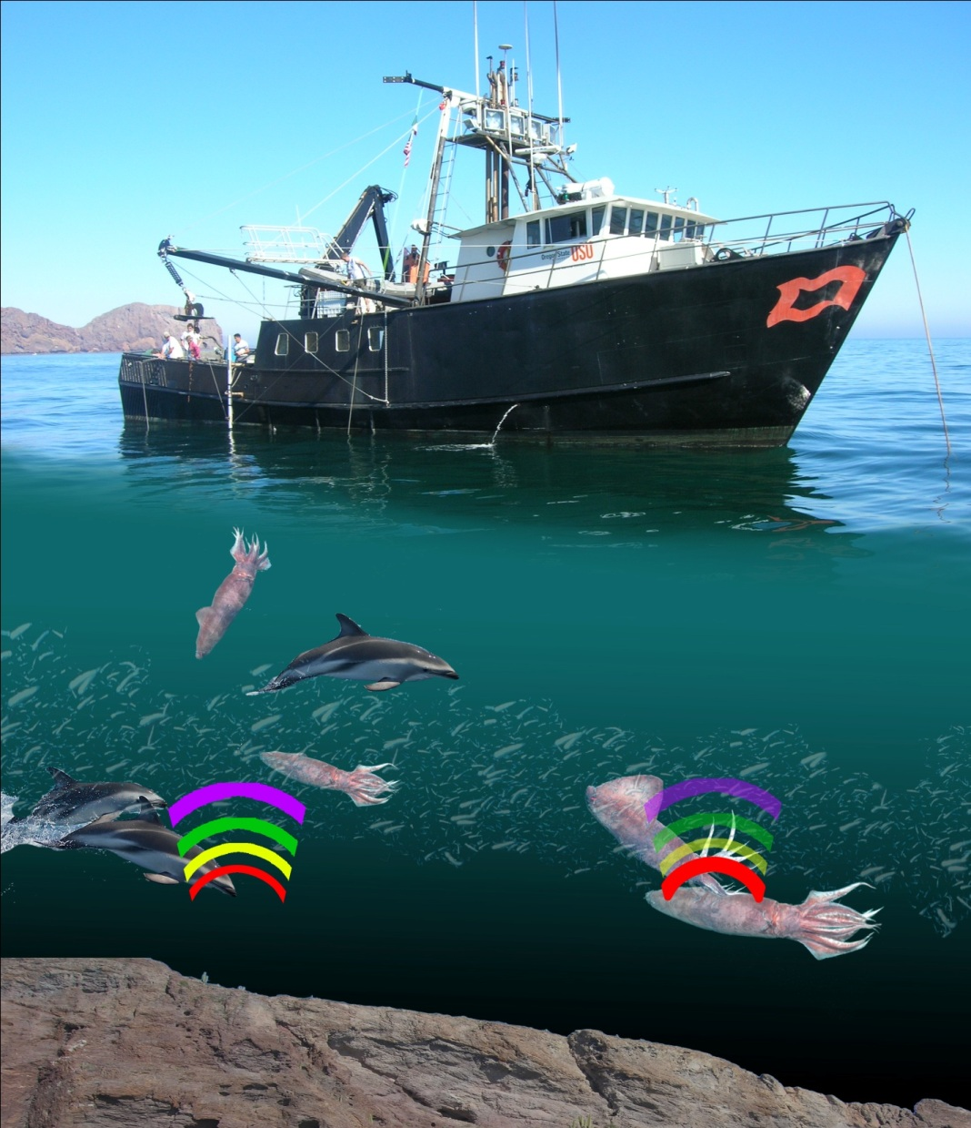
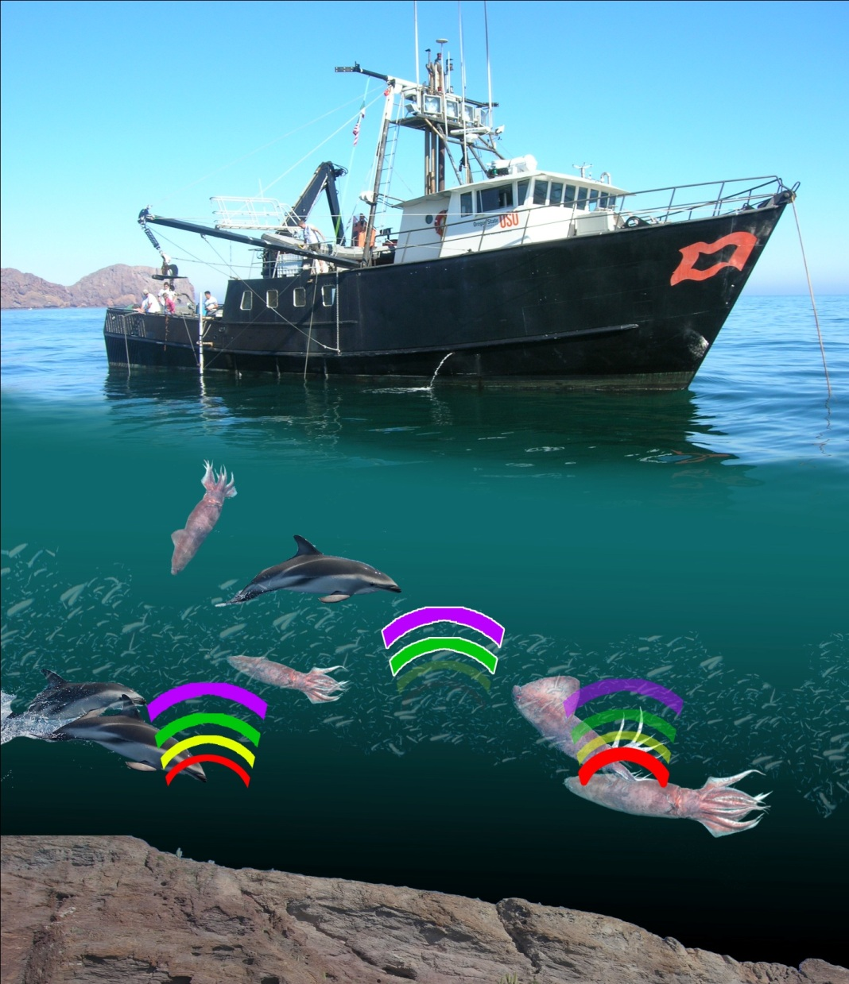


Slide 3
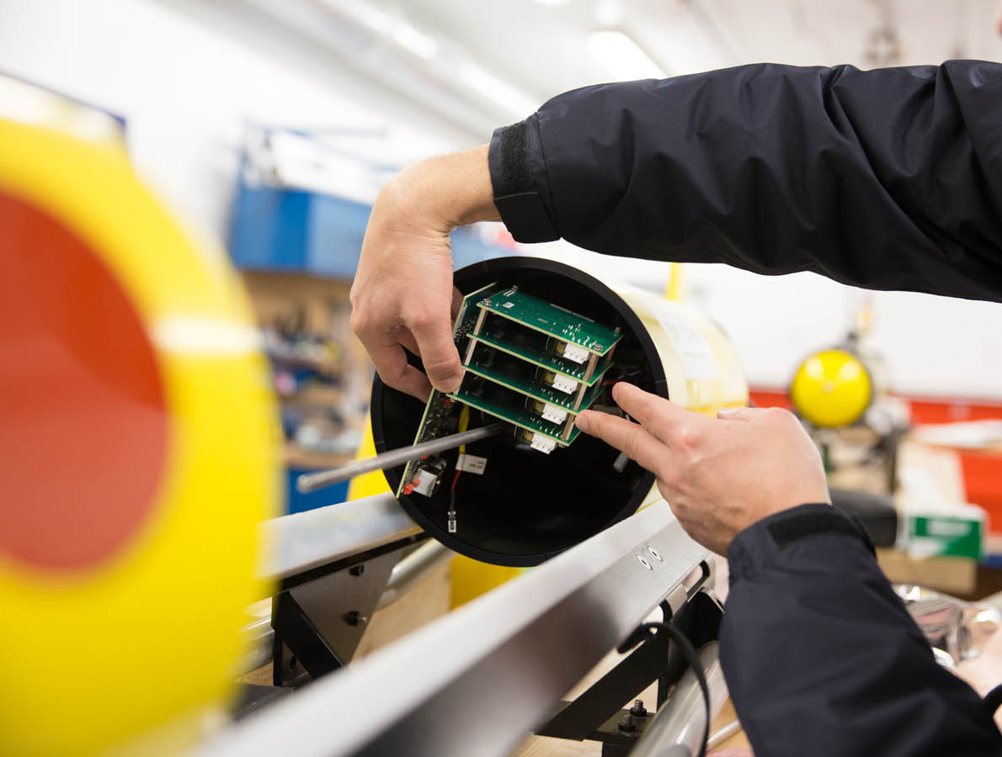
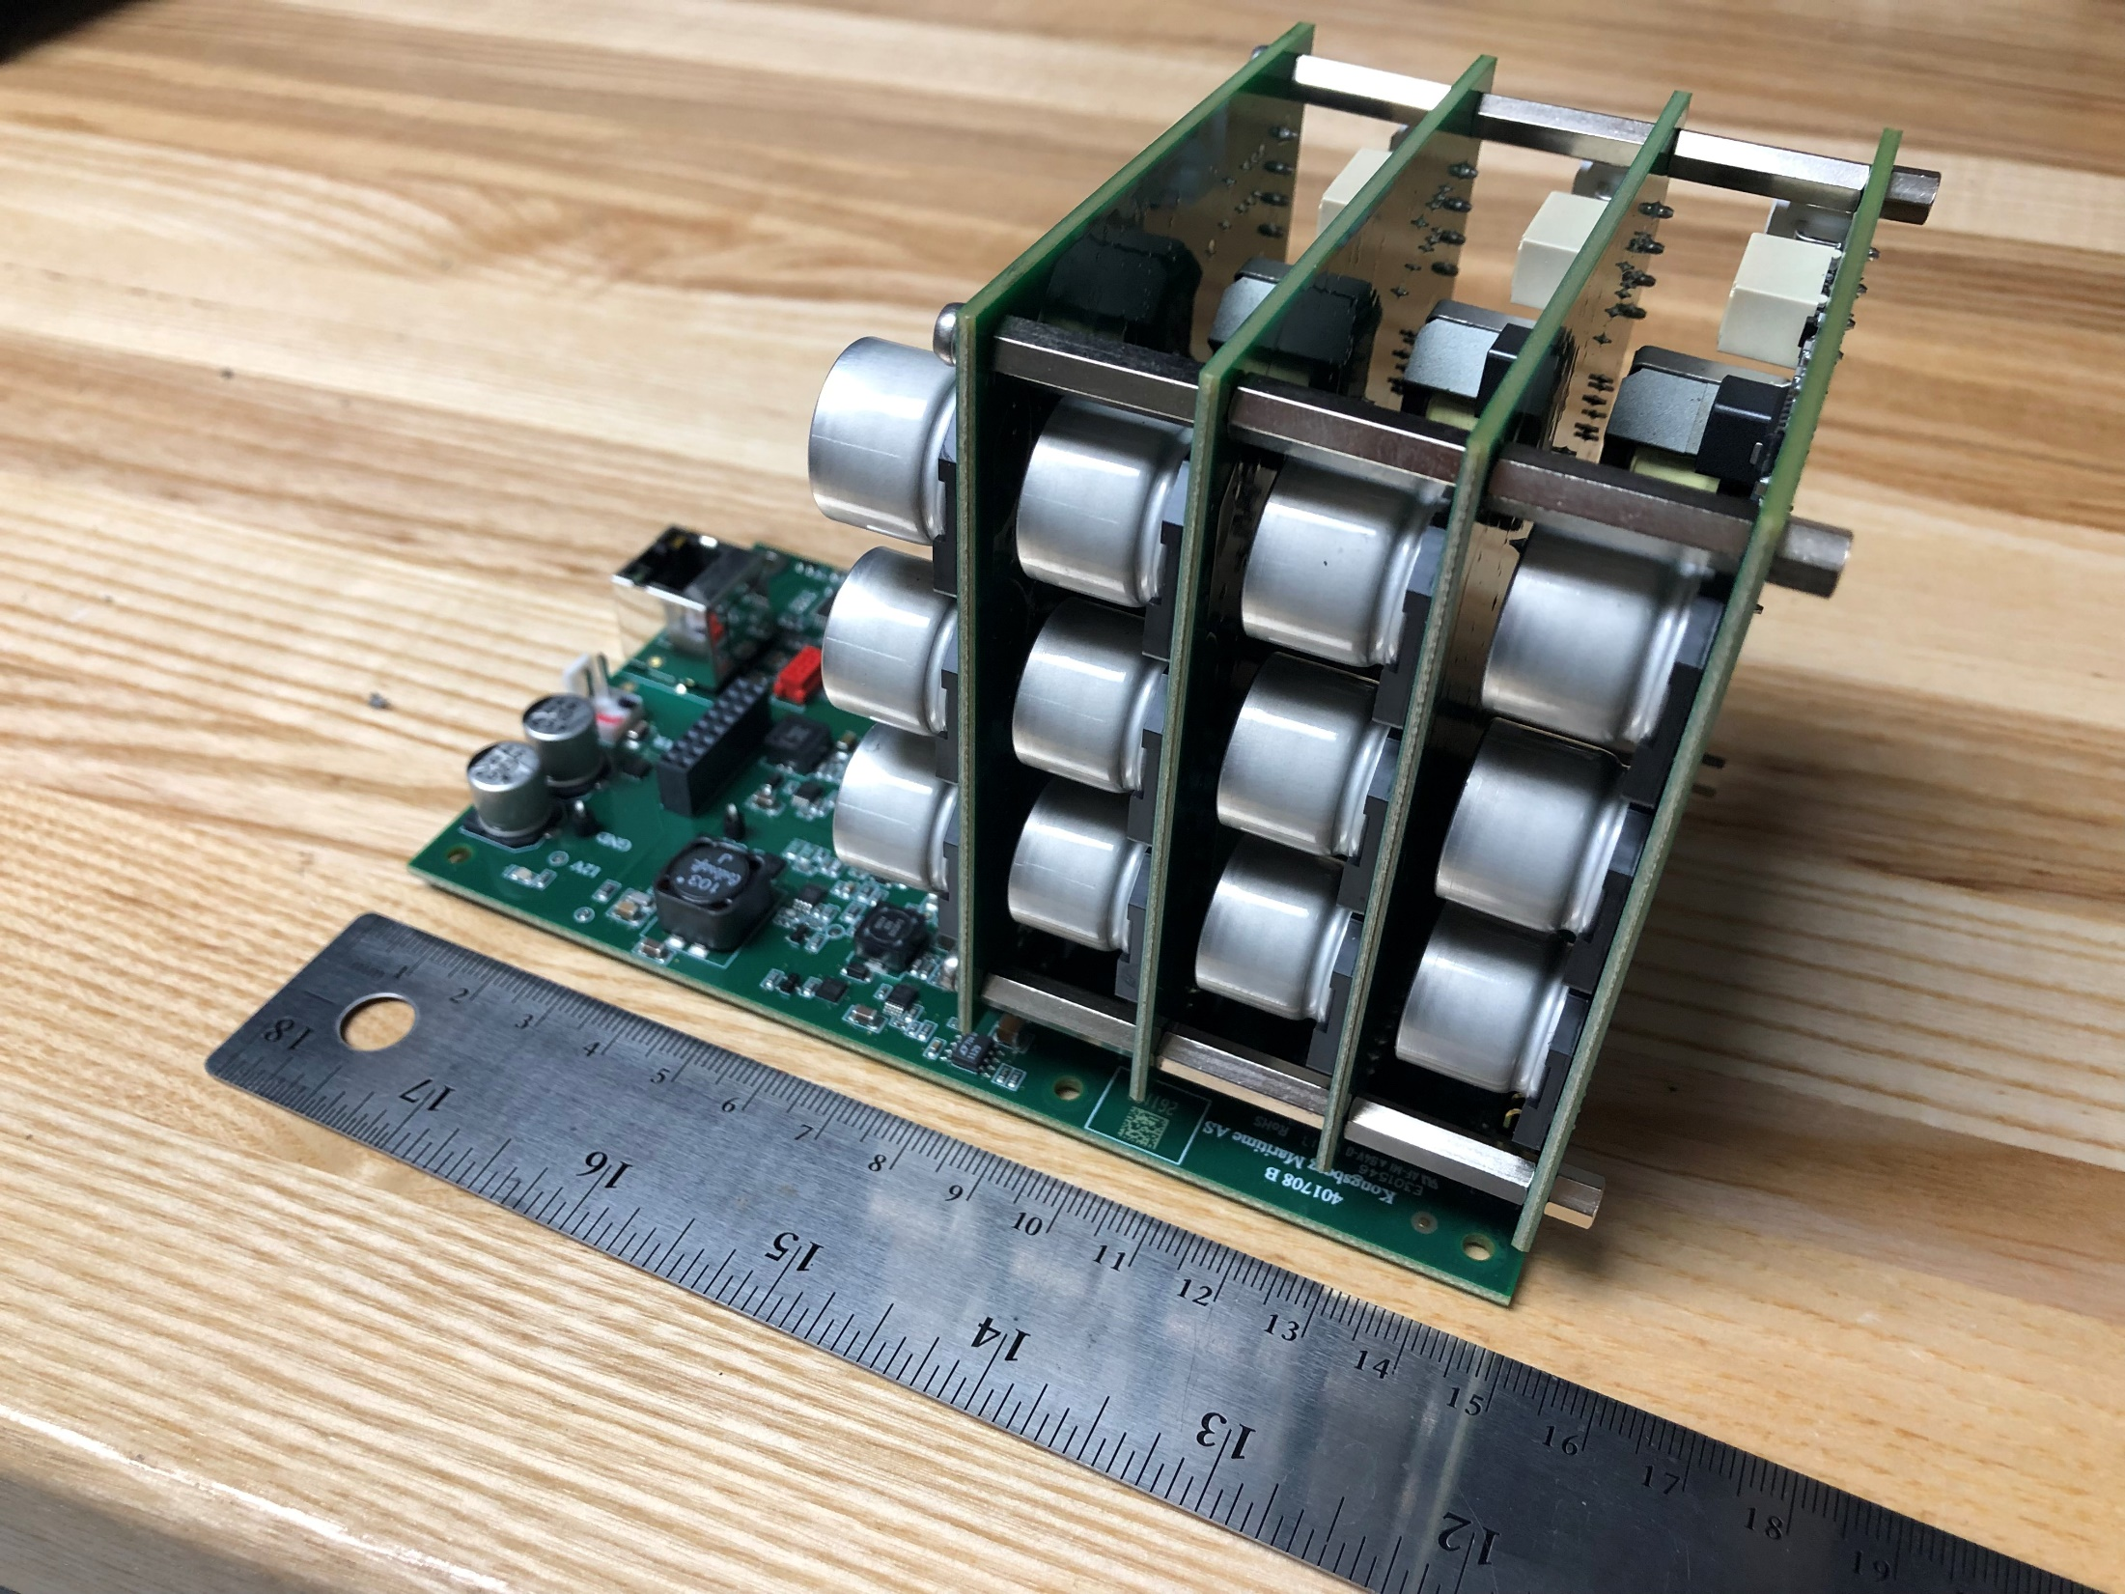
Simrad EK80 Mini
Miniaturization + Lower Power

Slide 4
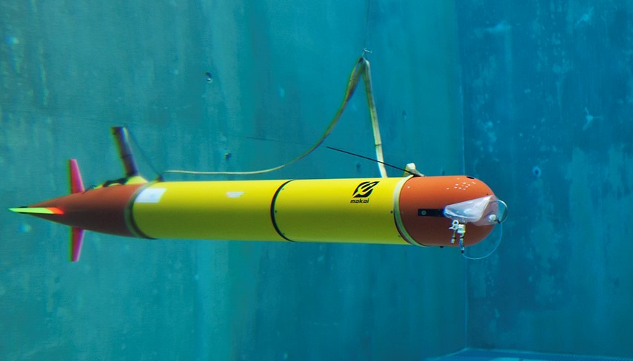
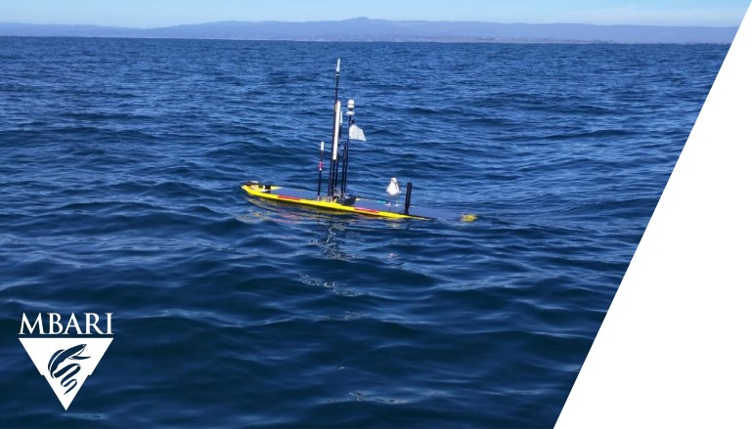
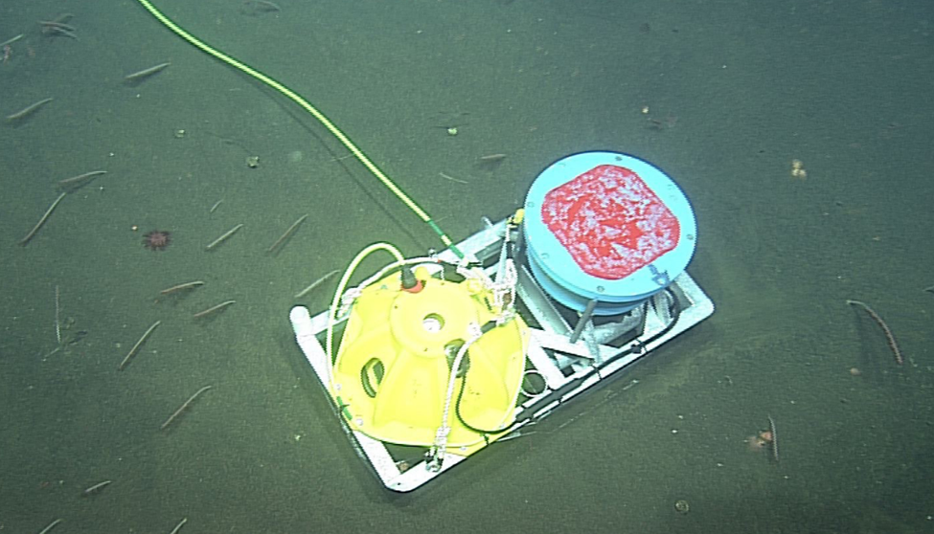
Robots
Persistent observations
Stationary

Slide 5
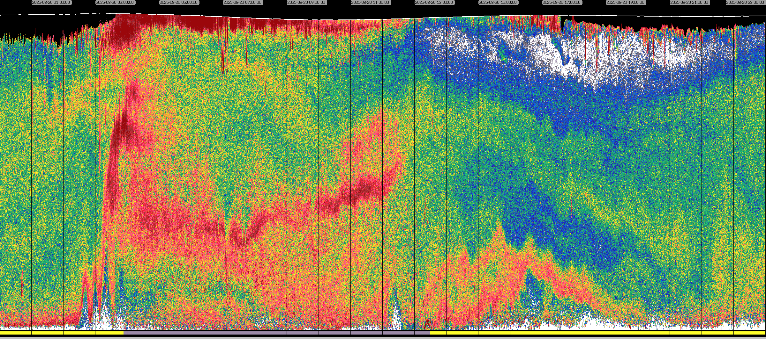



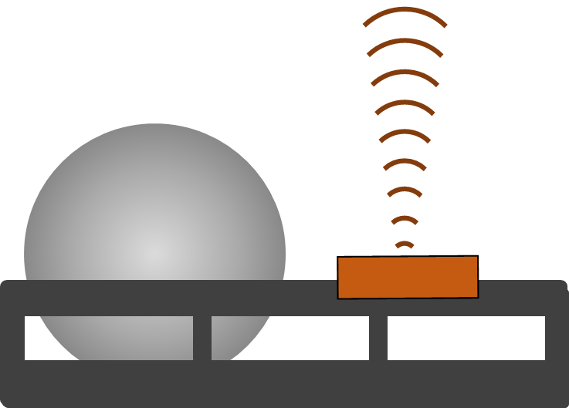
—25 m
—50 m
—75 m
-30
s_{v} (dB re 1 m⁻¹)
-85

Slide 6
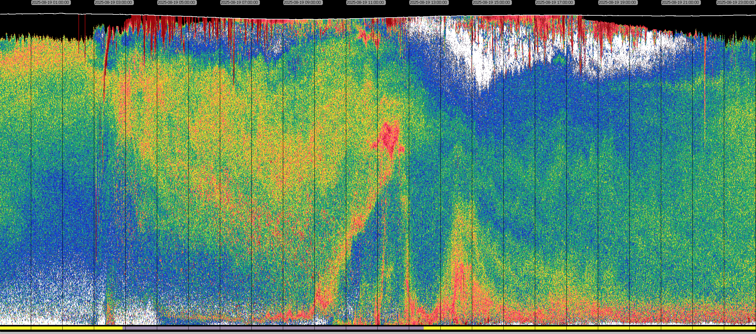
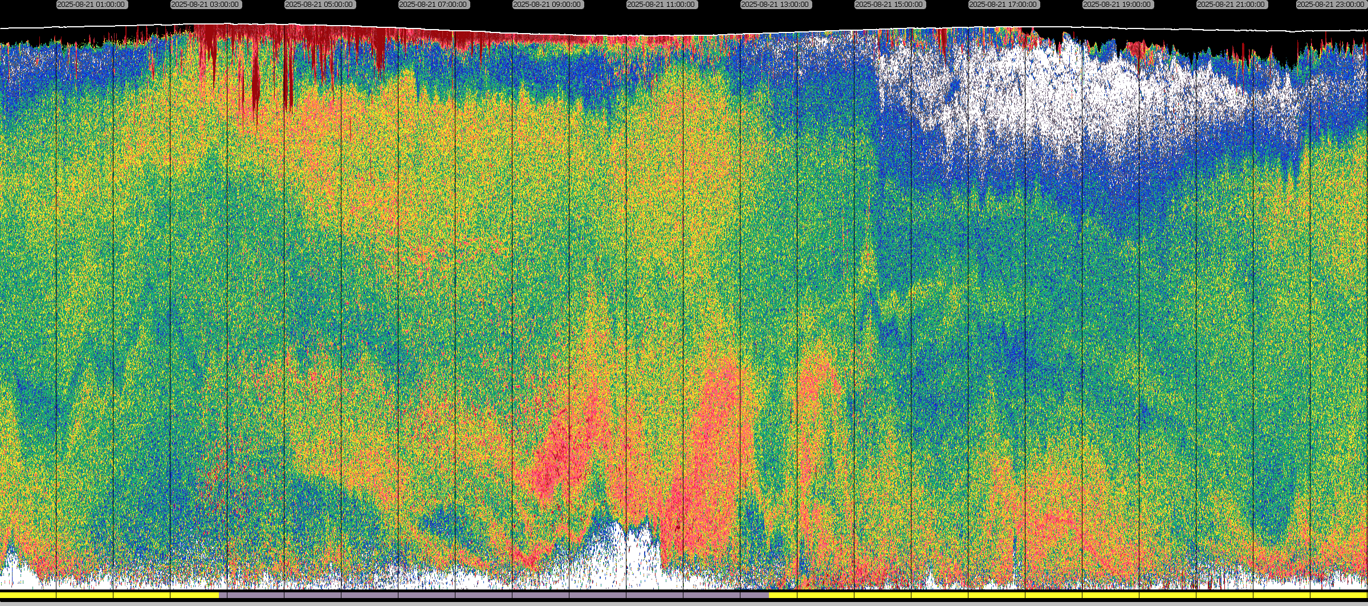
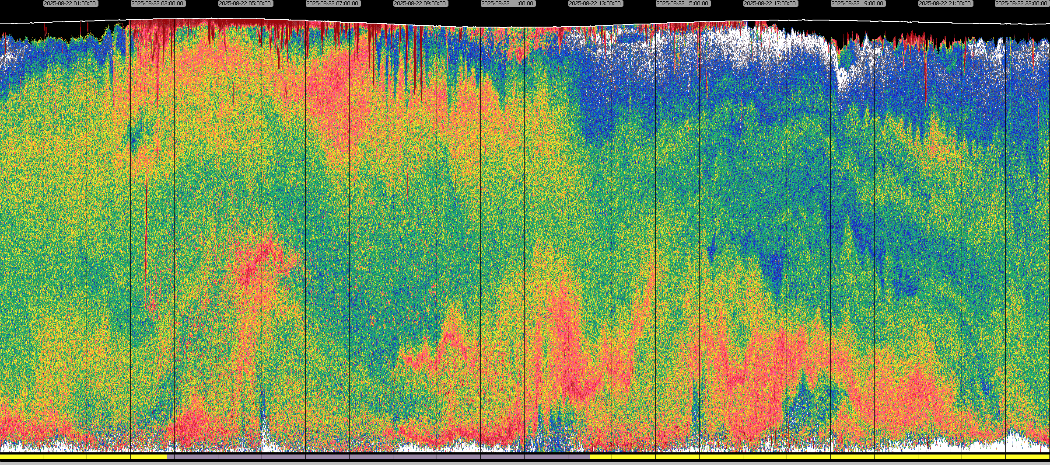
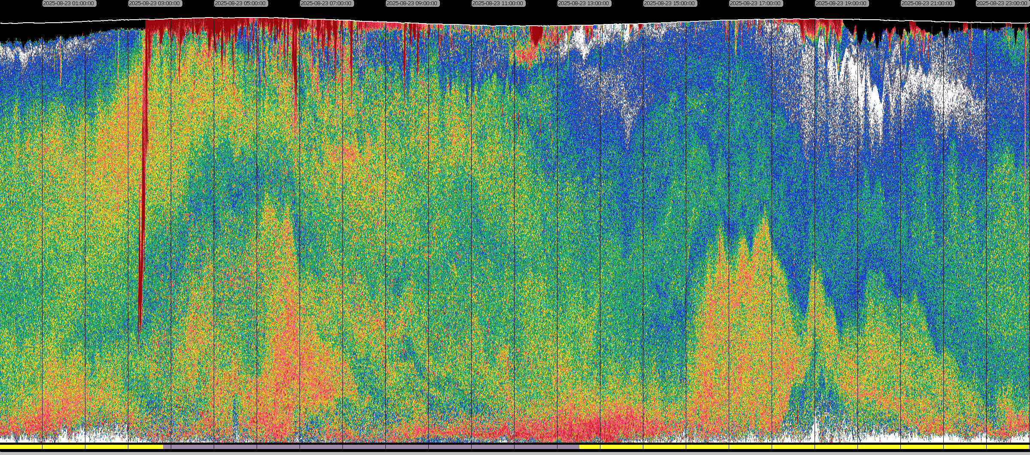
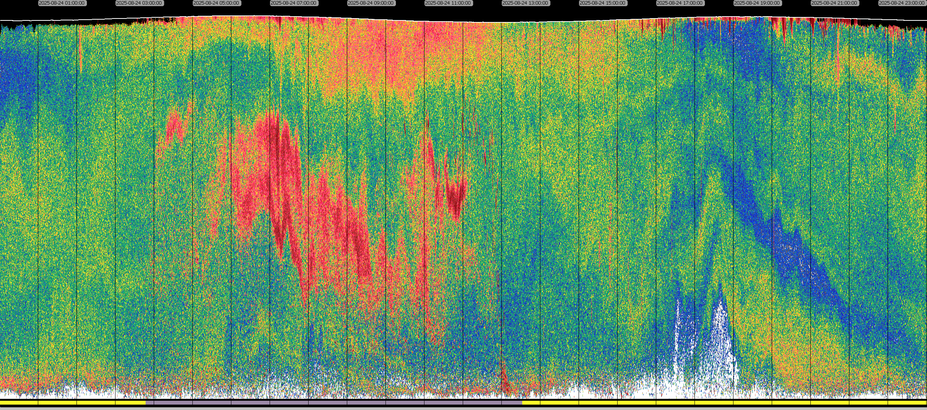
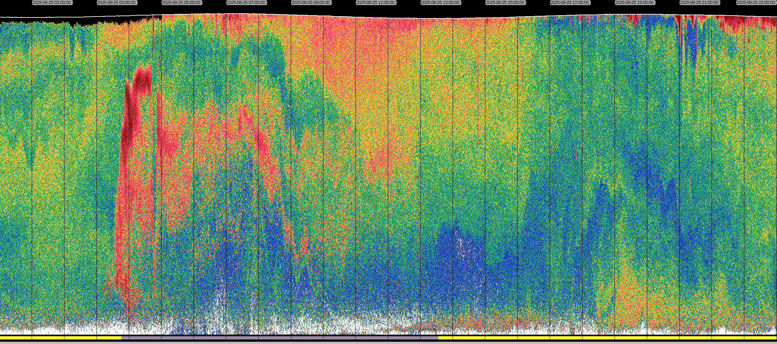
—25 m
—50 m
—75 m
-30
s_{v} (dB re 1 m⁻¹)
-85

Slide 7
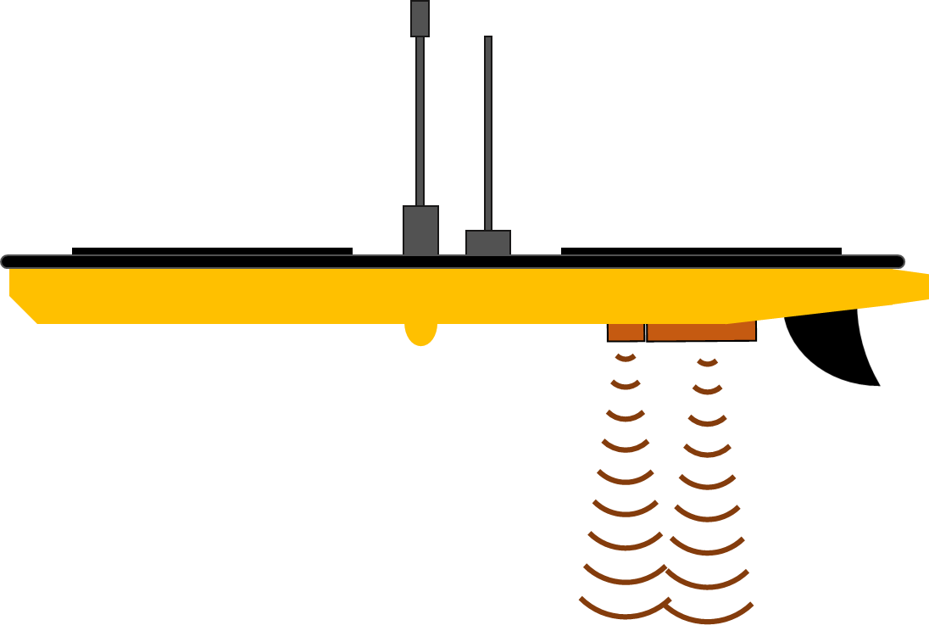
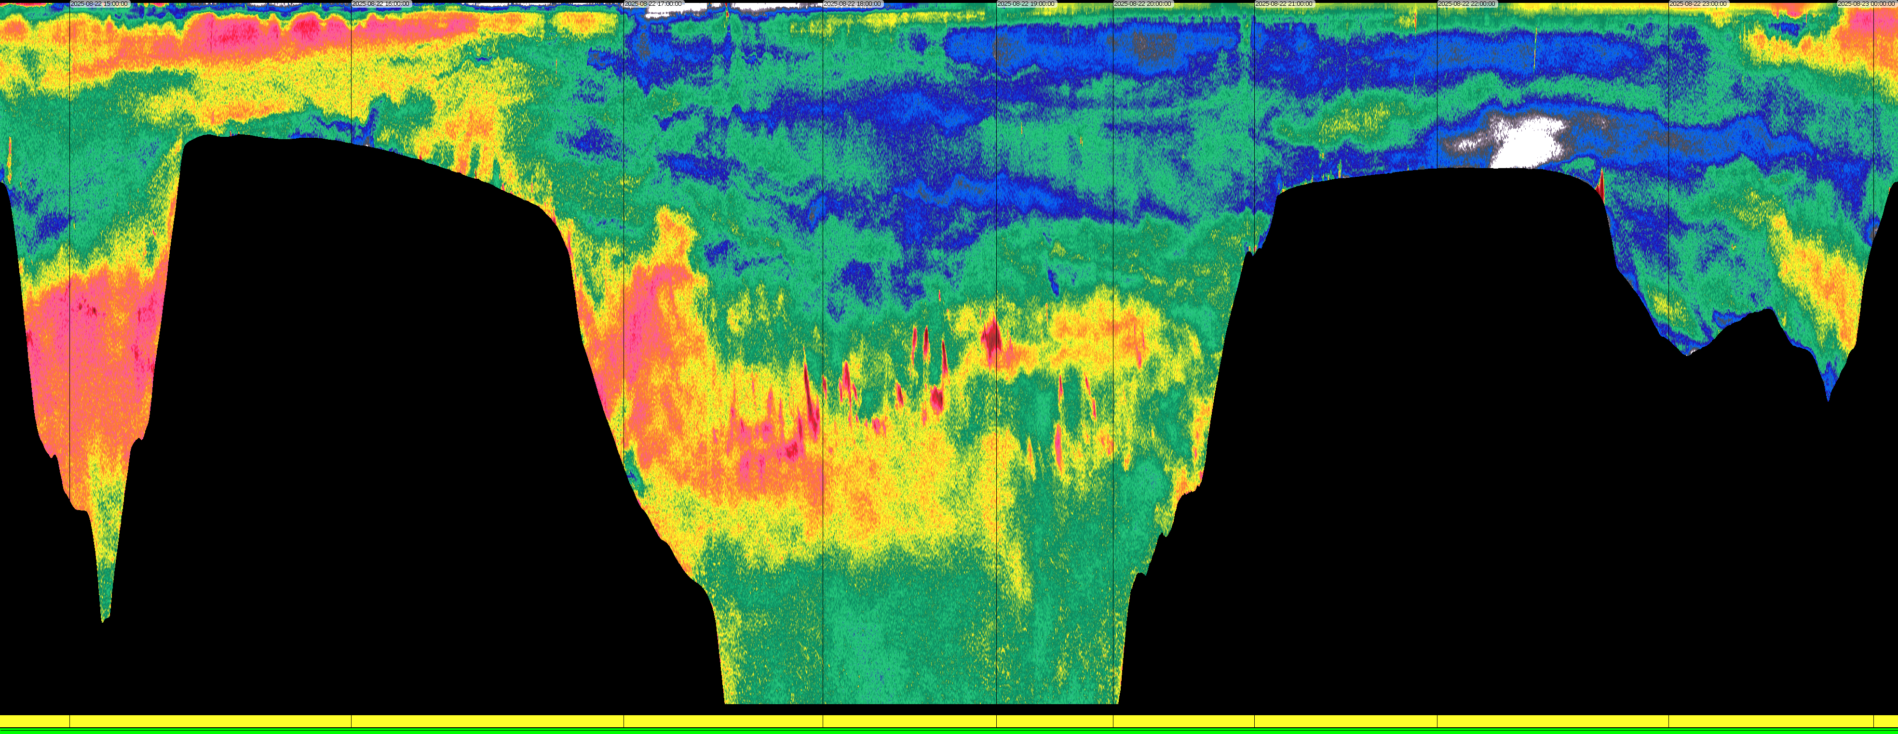
—100 m
—200 m
-30
Monterey Canyon
s_{v} (dB re 1 m⁻¹)
-85

Slide 8
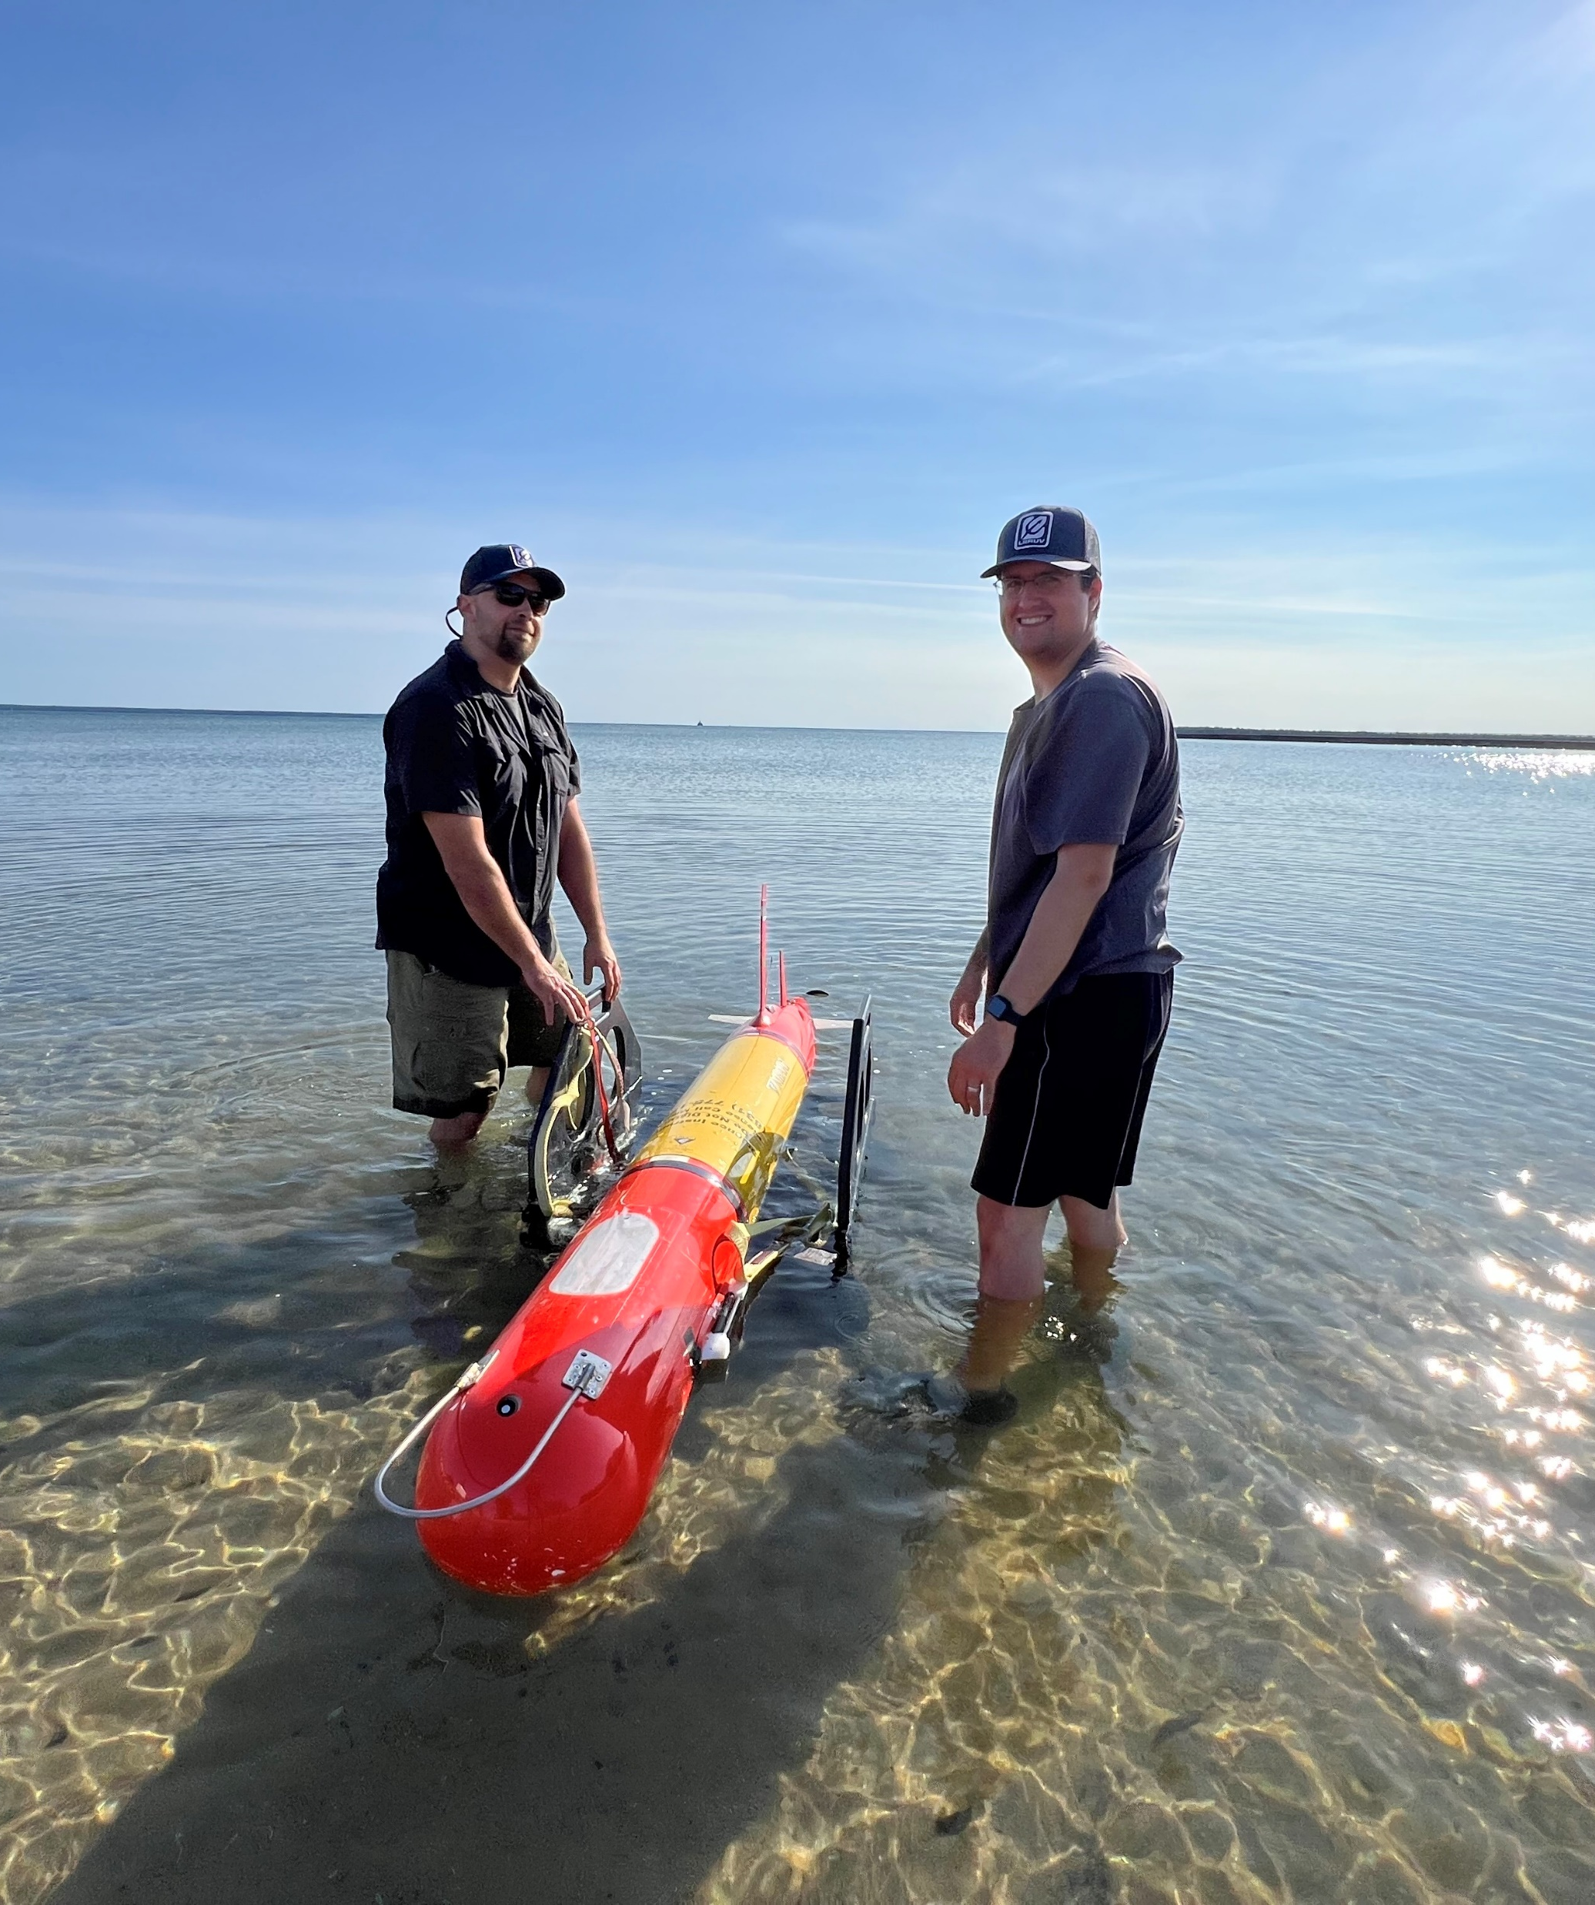
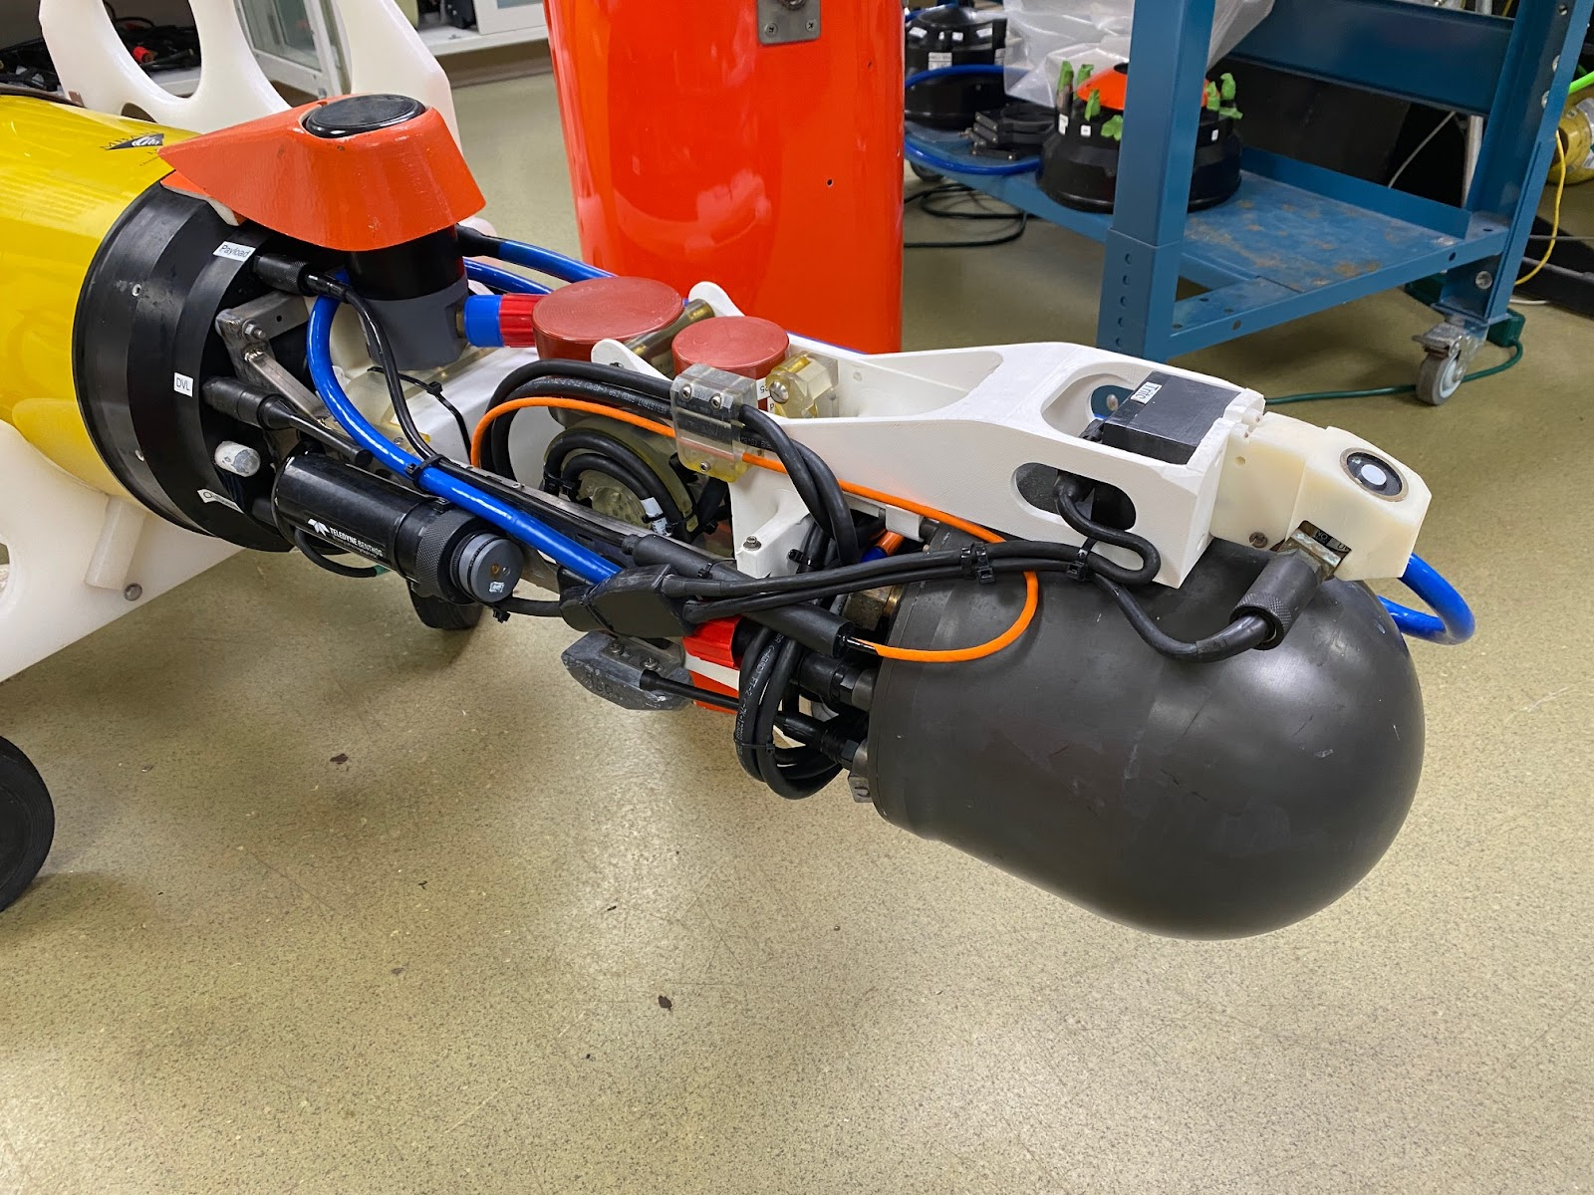
Upward-looking
transducers
200 kHz
333 kHz
Downward-looking
transducers
(not visible)
Electronics
housing

Slide 9




Simultaneous measures of environment and animals
Notes:
Objective

Slide 10

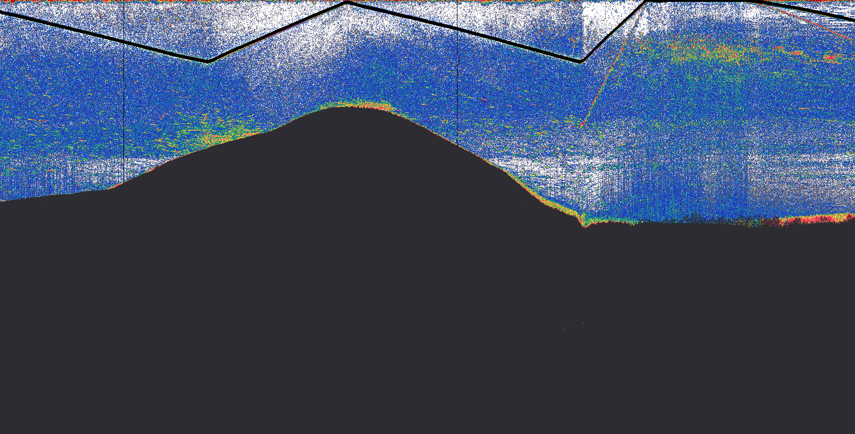
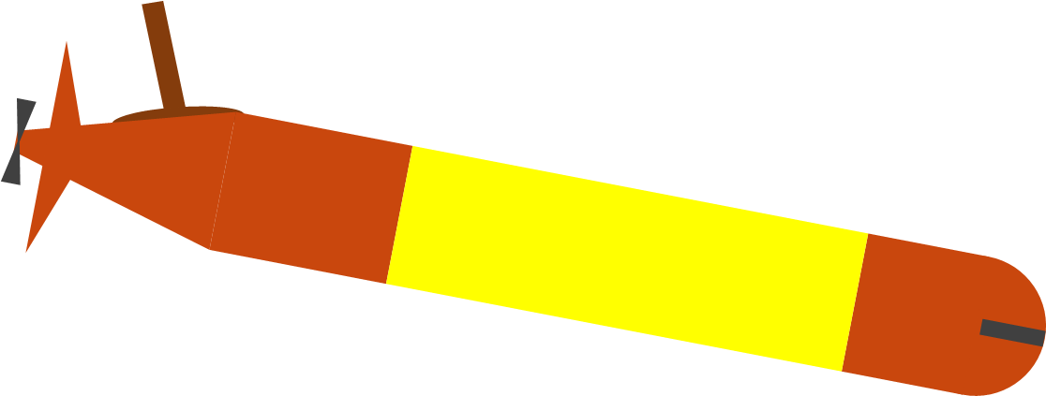
—50 m
VEHICLE’S PATH
—100 m
—150 m
-35
-45
200 kHz
—200 m
s_{v} (dB re 1 m⁻¹)
-55
2 km
-65
-75

Slide 11
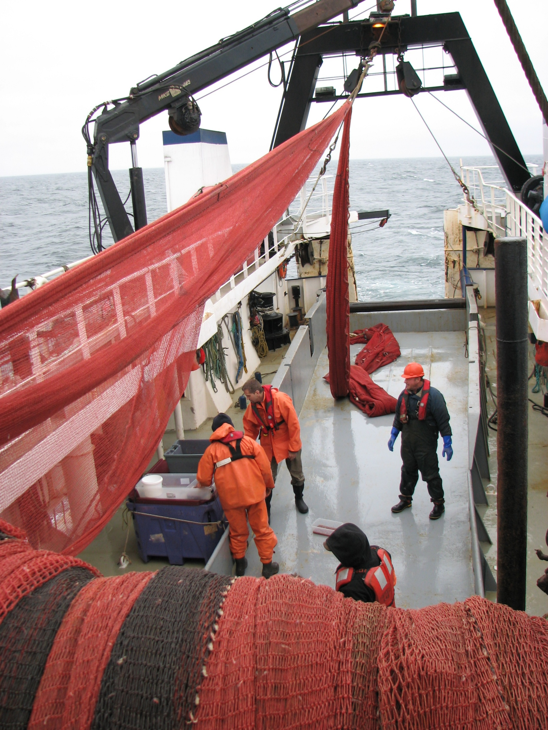
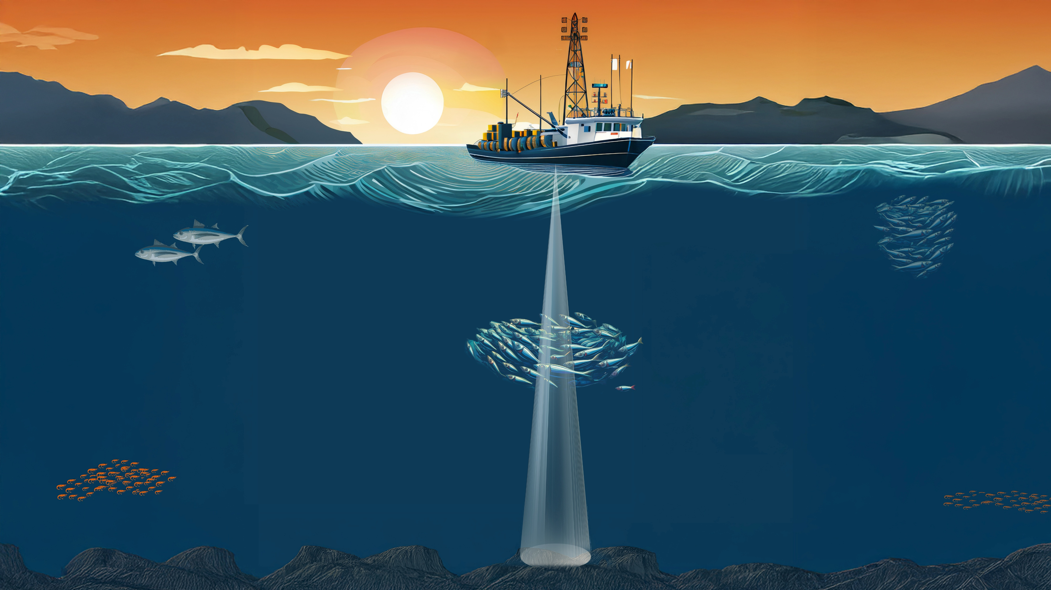

Slide 12
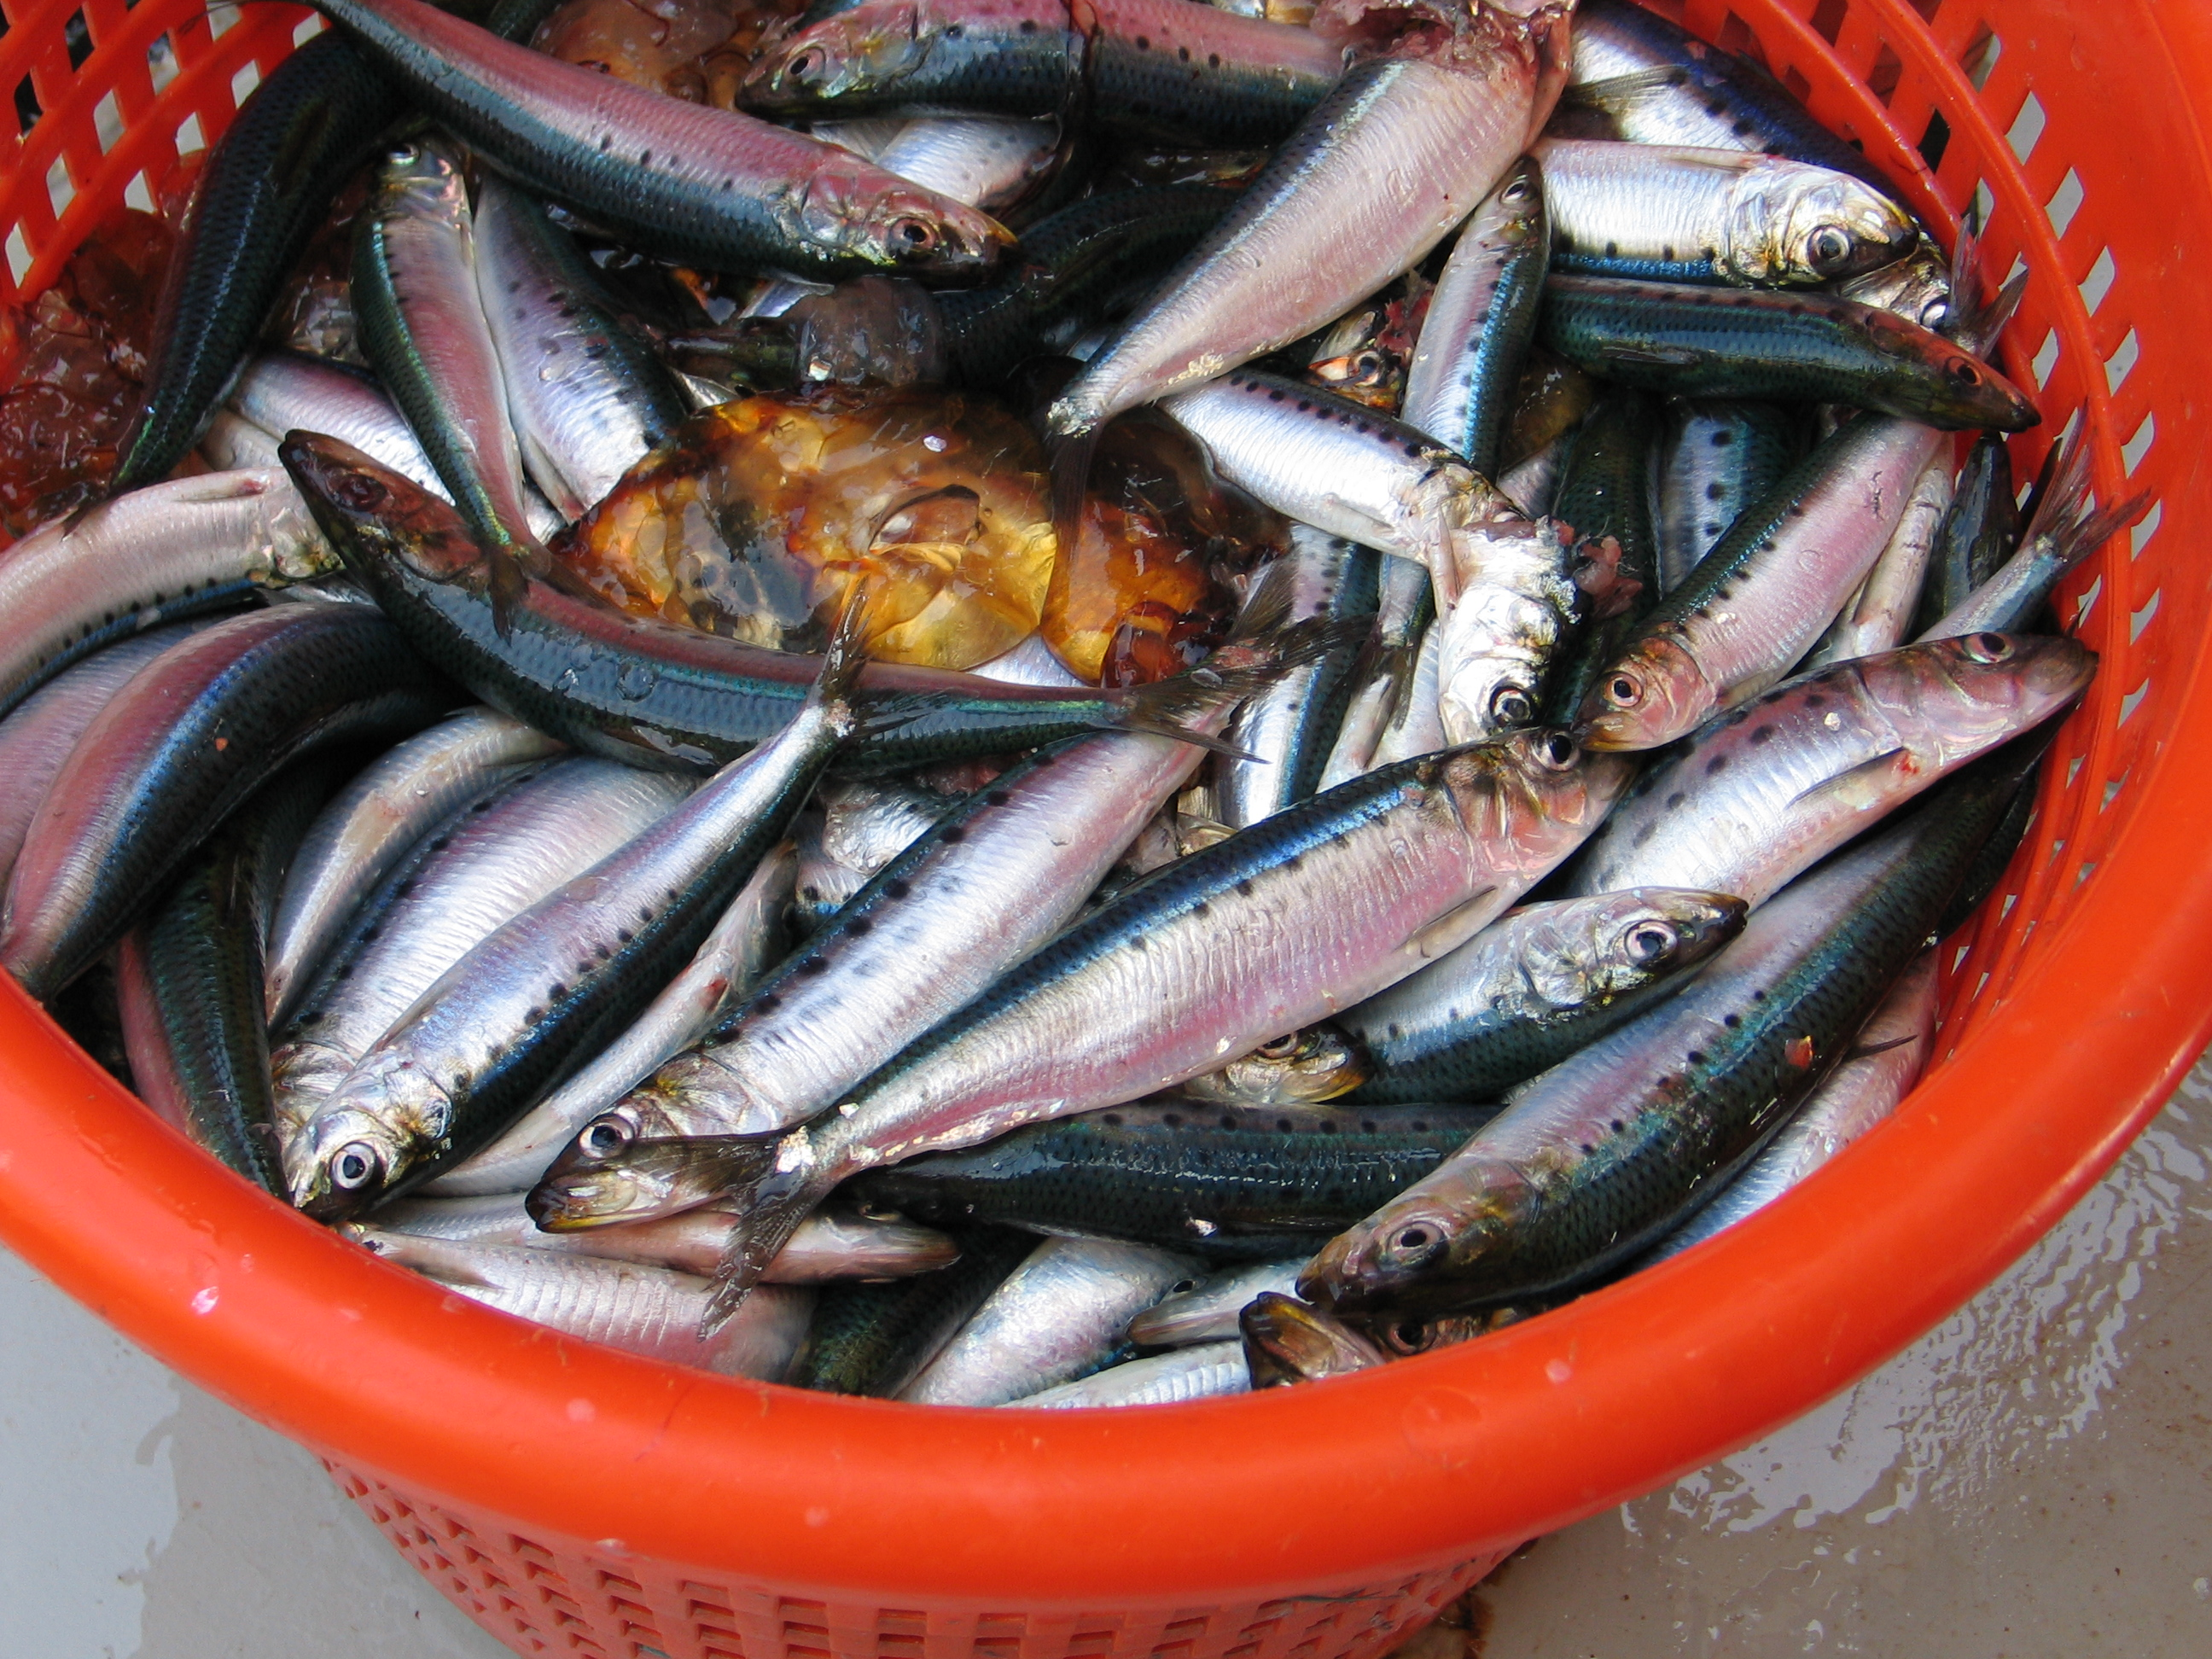

Slide 14
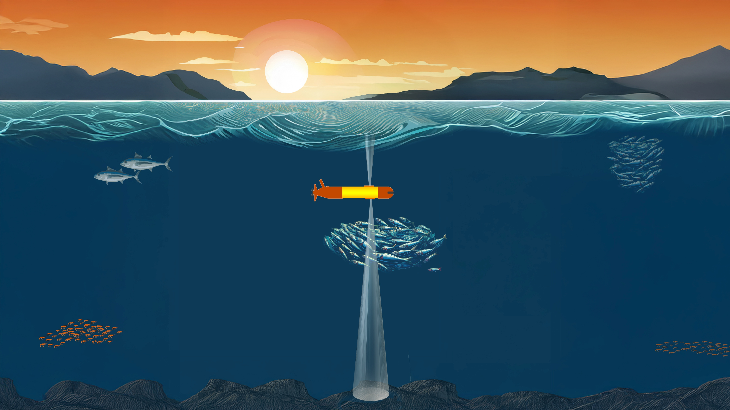
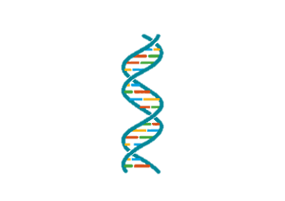



Active acoustics+
Study
Monitor
Manage
Ocean animals

Slide 16


VEHICLE’S PATH
—25 m
—50 m
—75 m
-30
200 kHz
s_{v} (dB re 1 m⁻¹)
-85

Slide 17
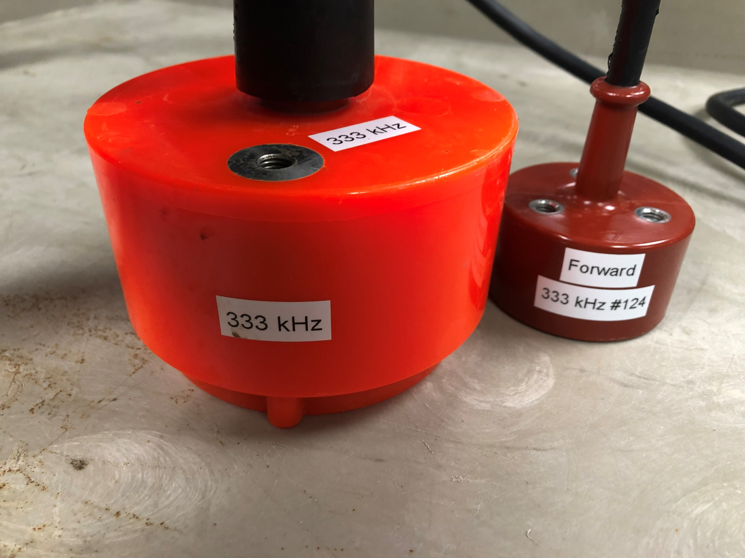
Miniaturization
333 kHz, split 7° transducers
Diameter:
12 cm
6 cm
Weight:
4.2 kg
0.55 kg

