Slide 1
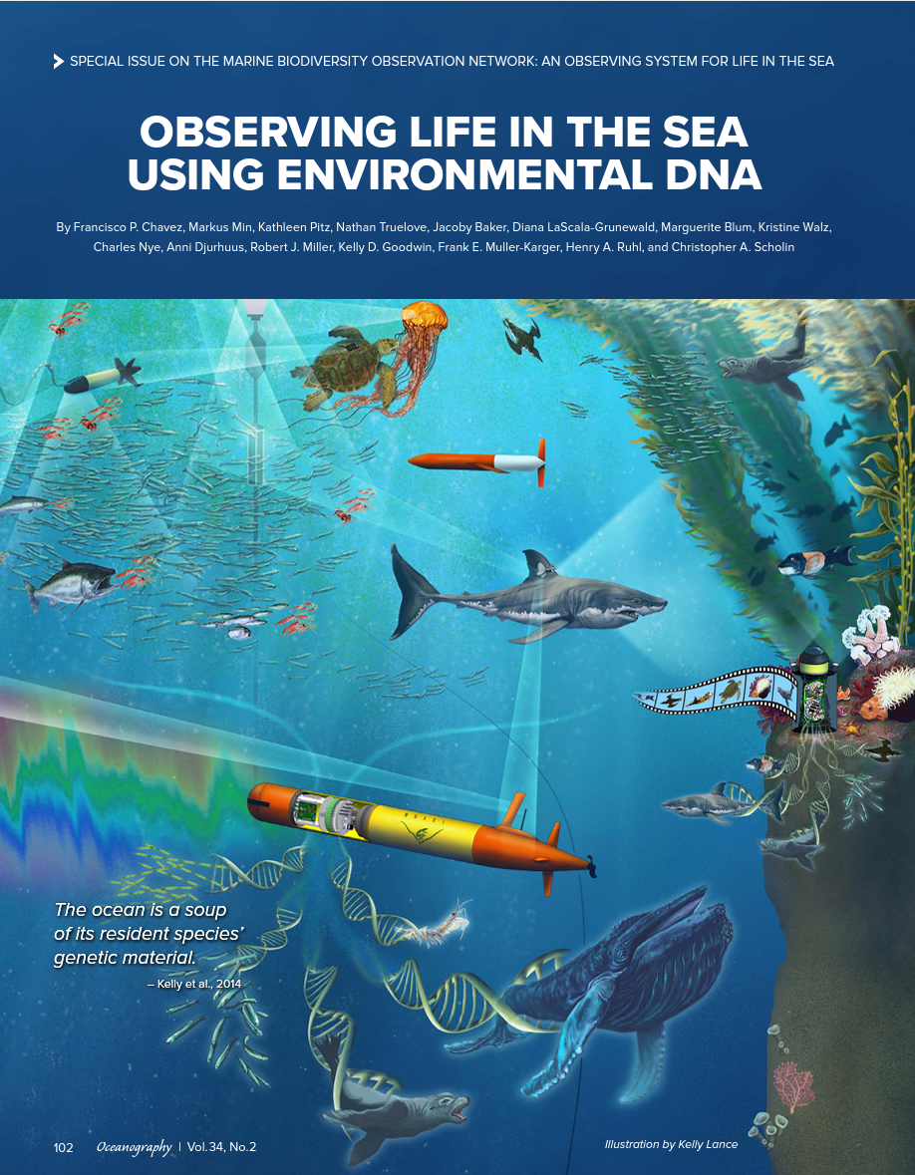
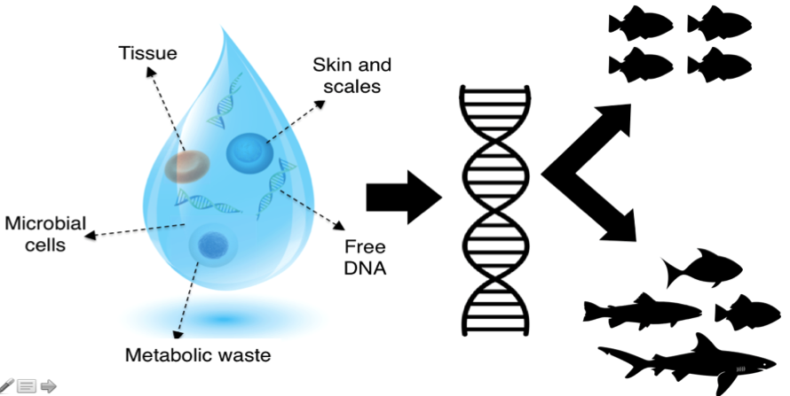
Observing Life in the California Current
Francisco Chavez
Monterey Bay Aquarium Research Institute
LooselyTarget
Fish+ 12S
Zoo+ COI
Phyto+ 18S

Slide 2
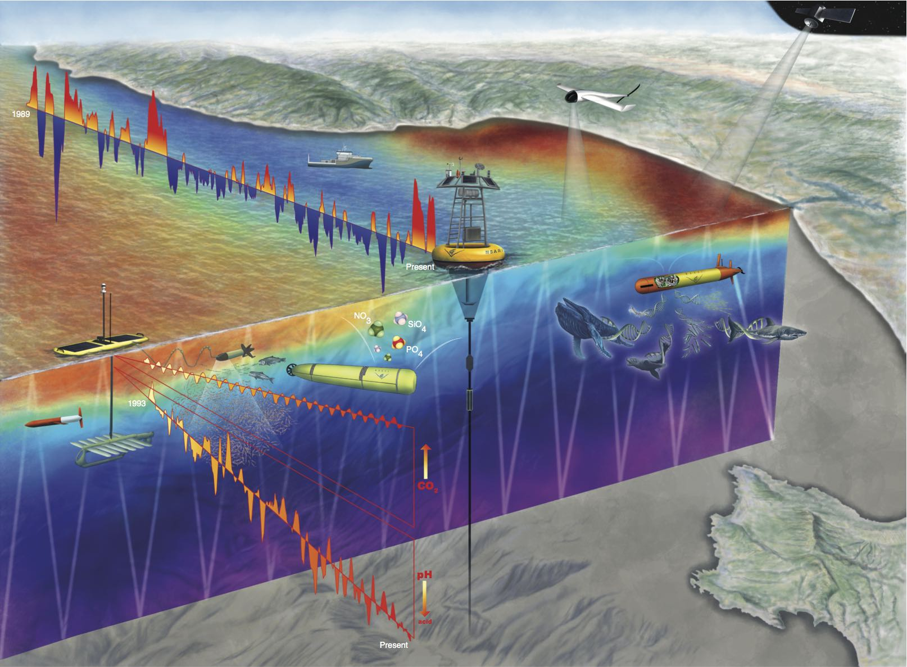
Monterey Bay Time Series
Three stations sampled monthly from ships for close to 40 years; more recently with robots
C1
M1
M2

Slide 3
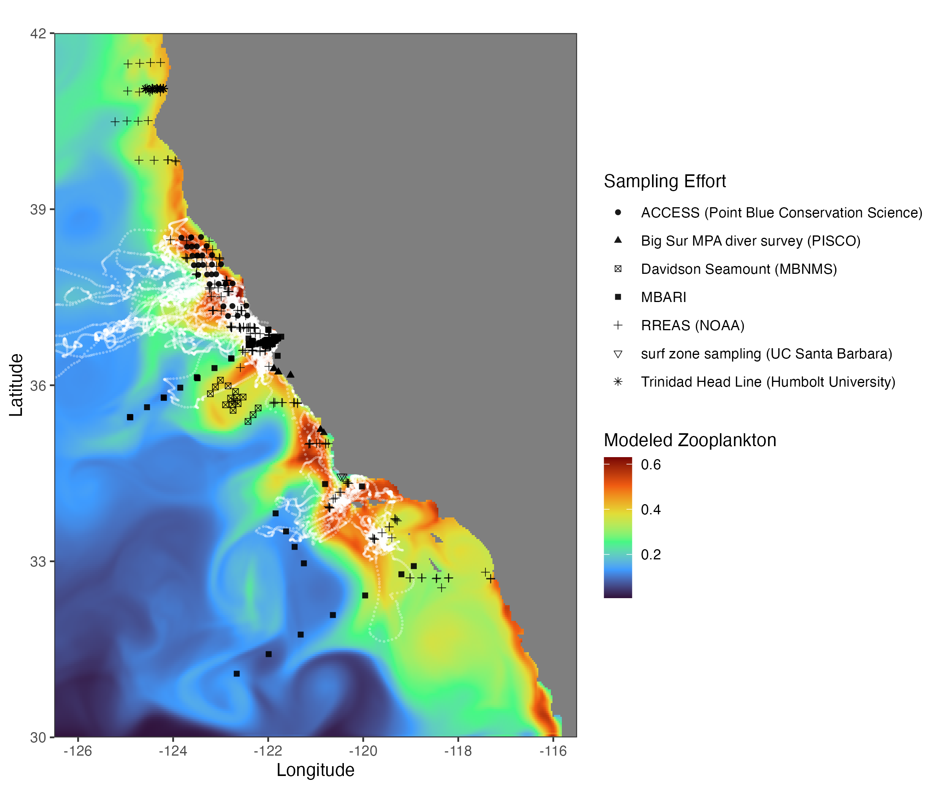
Programs and locations where samples collected
CeNCOOS Marine Biodiversity Observation Network (MBON). In the third round of funding, first in 2014, renewed in 2019 and again for 5 years on 9/1/2022. Collect discrete samples and use remote sensing and models for context.
Providing biological observations to modelers to improve predictions

Slide 4
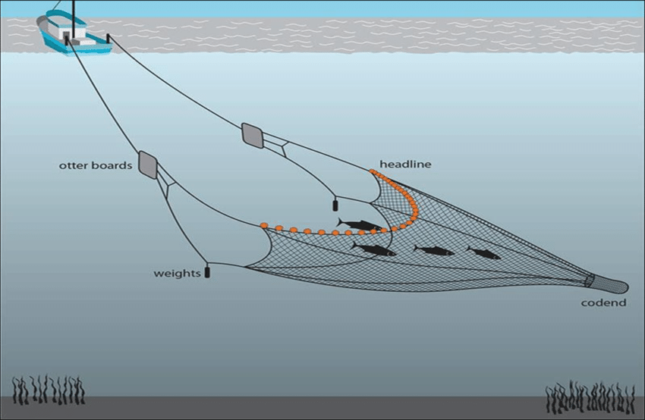
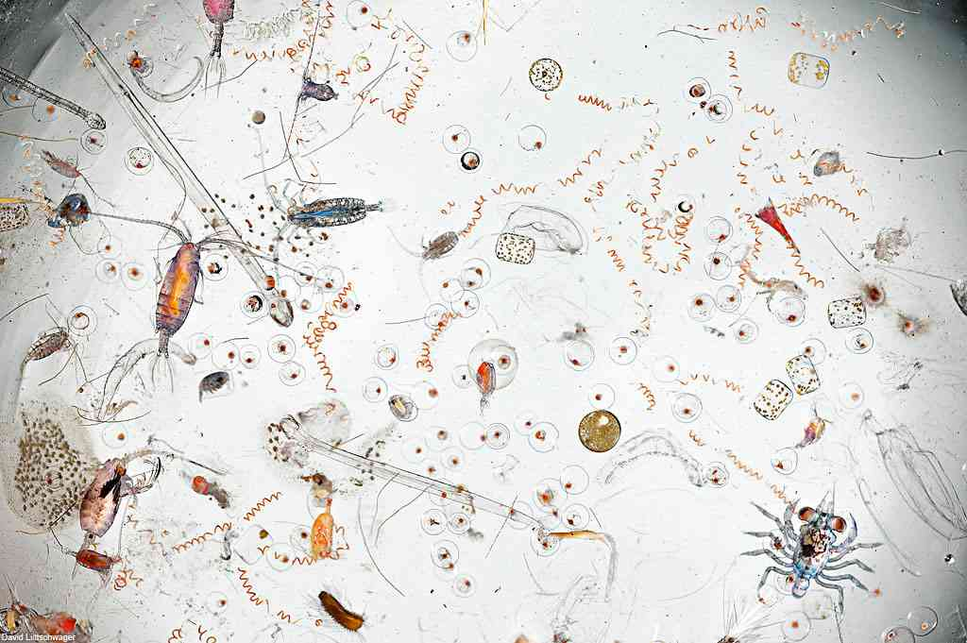
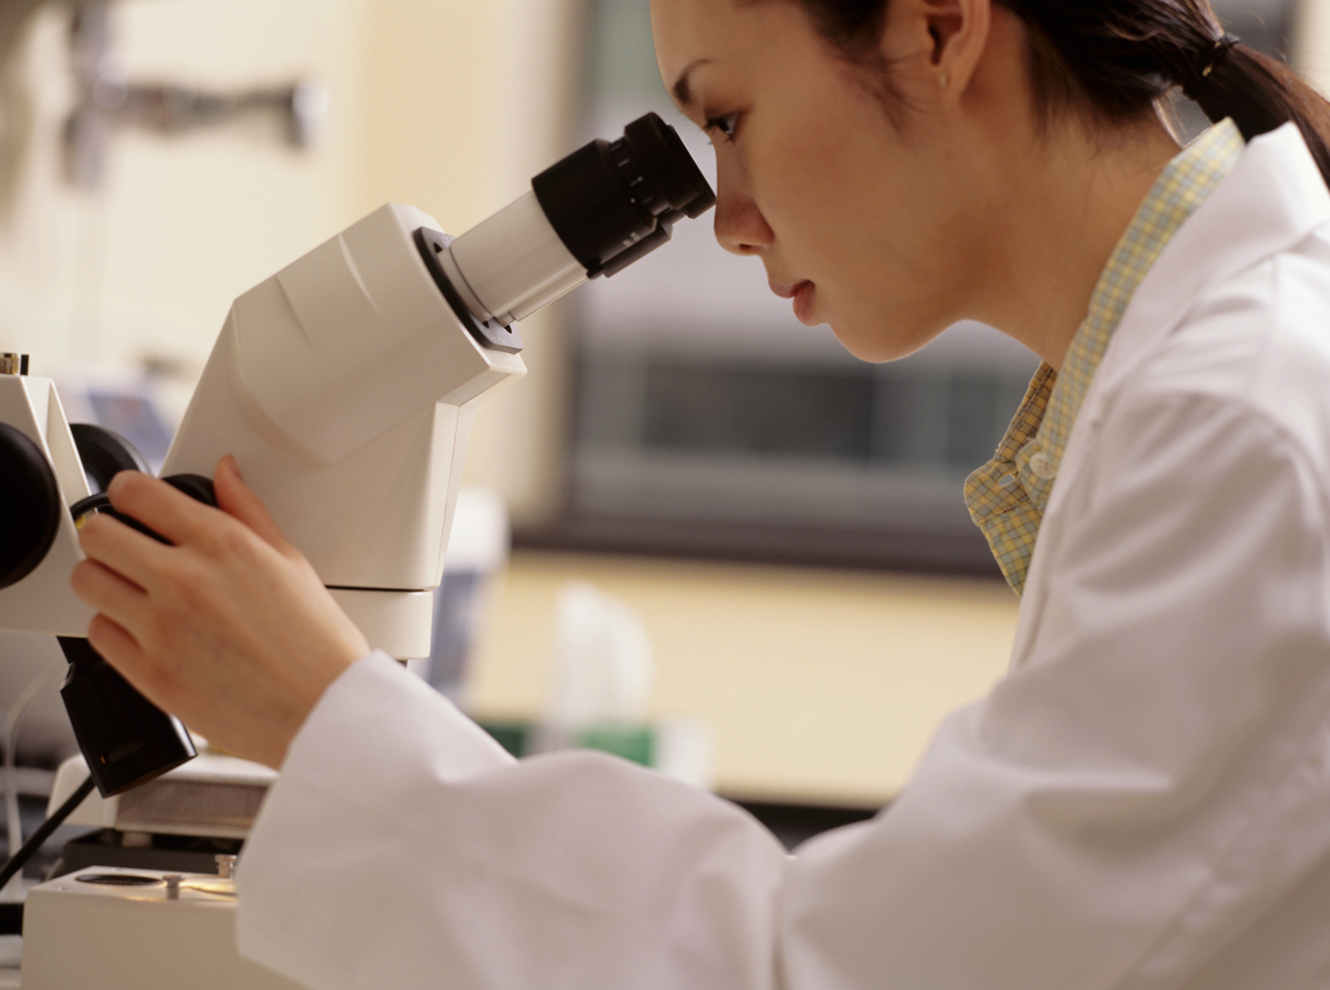
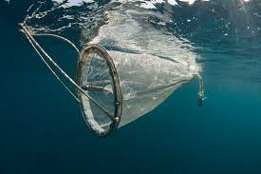
Traditional Approach to Marine Biological/Biodiversity Monitoring
Go to sea
Collect samples, multiple nets, etc.
Process samples visually (species and abundance, etc.)
Synthesize information over years

Slide 5
A new set of requirements
Near real-time information (i.e. moorings on the TOGA-TAO array are used to track El Niño) requires continuous presence.
Globally distributed information (i.e. Argo floats track the distribution of heat and salt) requires smaller and lower cost platforms
Multidisciplinary (wind to microbes to whales) real-time and large scale information (i.e. how can we tell if Life in the Sea is changing and why), requires a new model
Emerging technologies: autonomous cameras, sound, environmental DNA

Slide 6
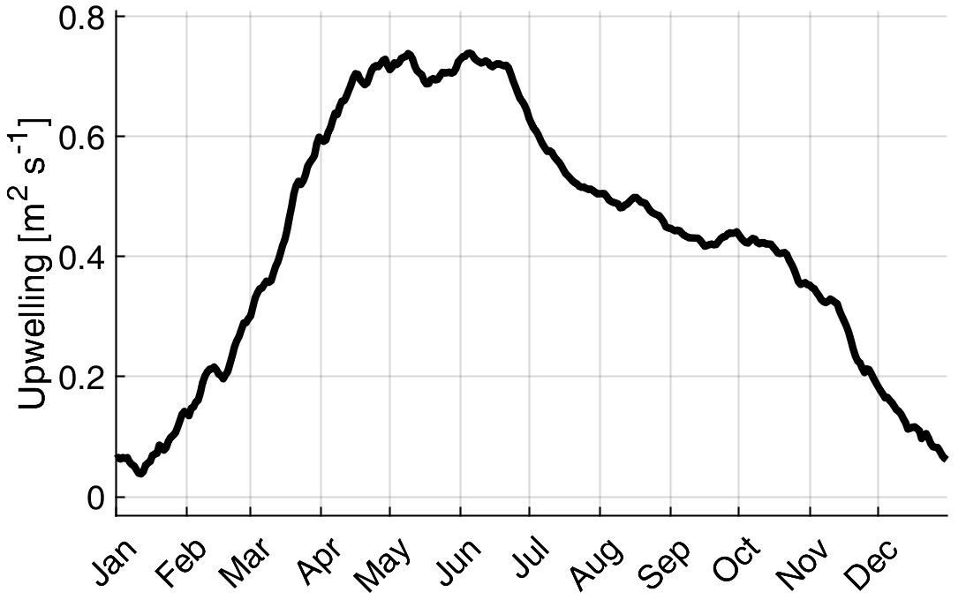
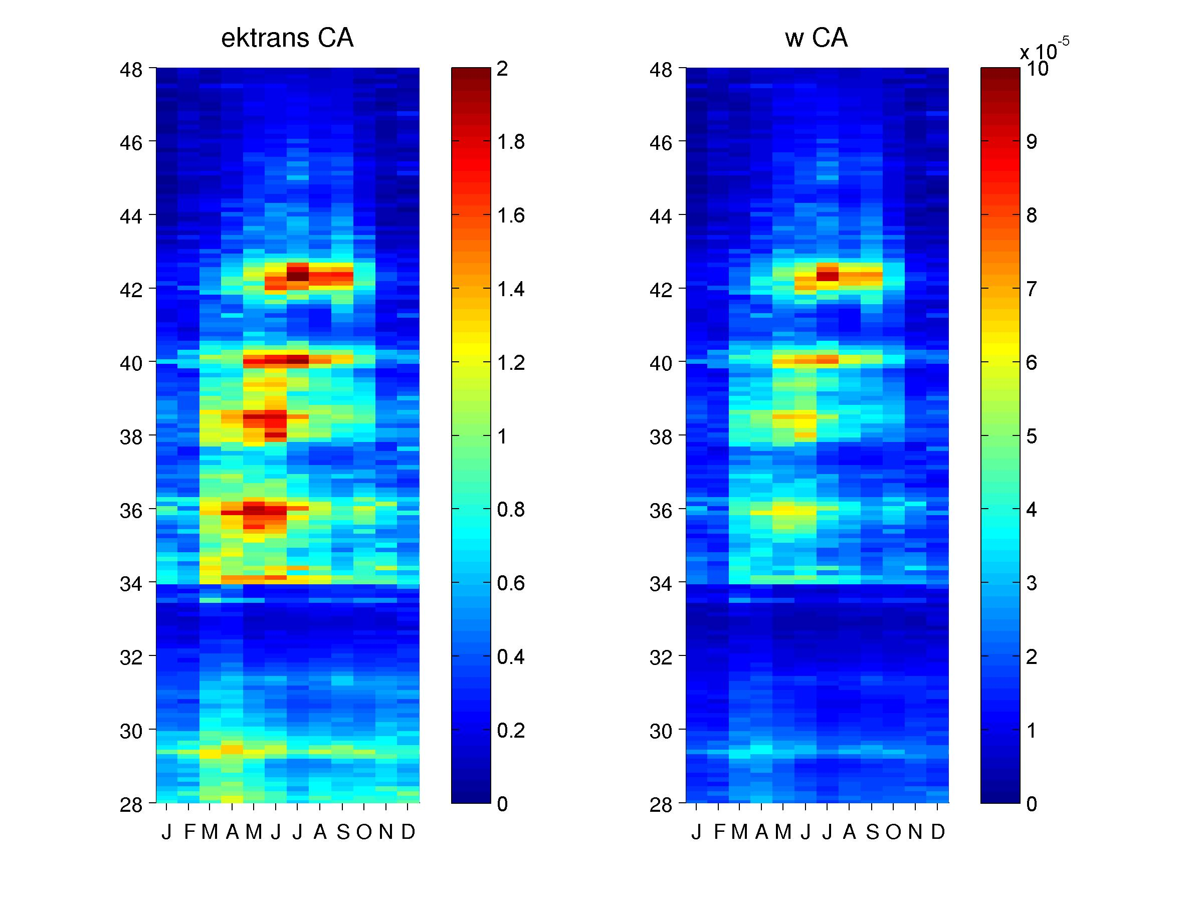
California Current is an Eastern Boundary Upwelling System where ocean fertilization, productivity, forage fish acidity and hypoxia are enhanced
Seasonal upwelling, spatially variable
Iron (Fe)
Washington
Humboldt
Monterey Bay
Southern Cal
Modified during El Niño

Slide 7
Biodiversity “observed” visually, with genes, and sound

Slide 8
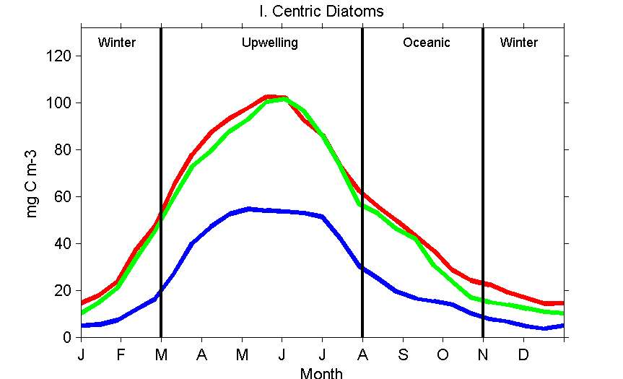
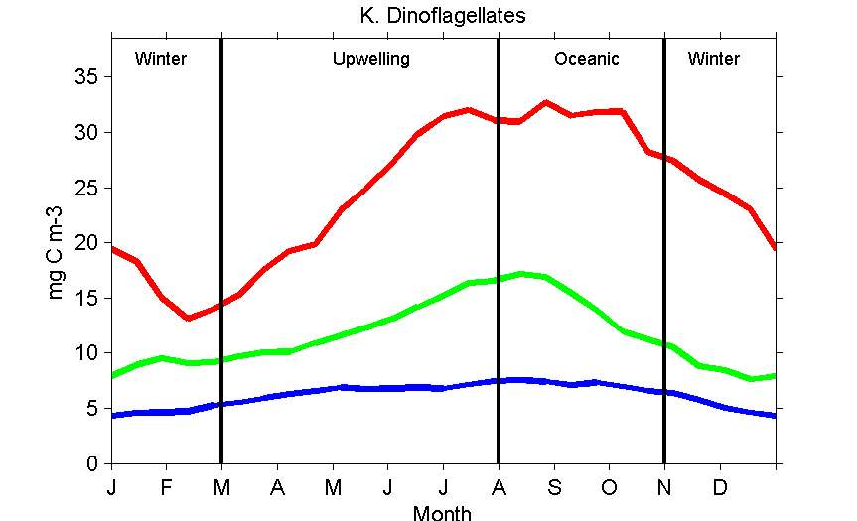
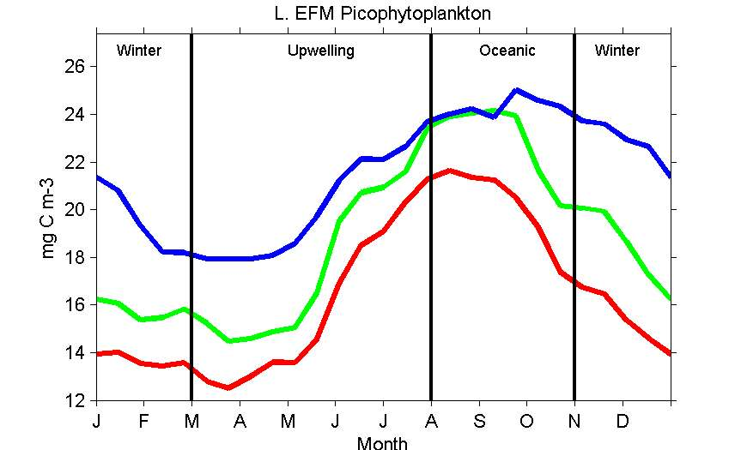
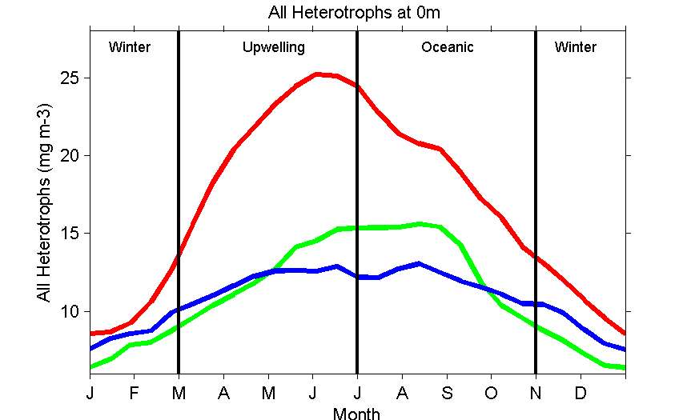
From microscopy we know plankton is highly seasonable in California Current

Slide 9
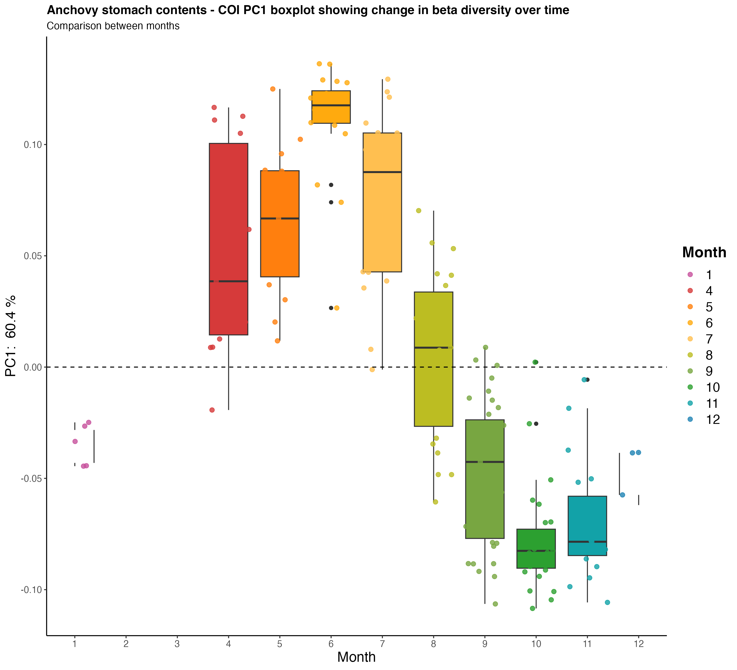
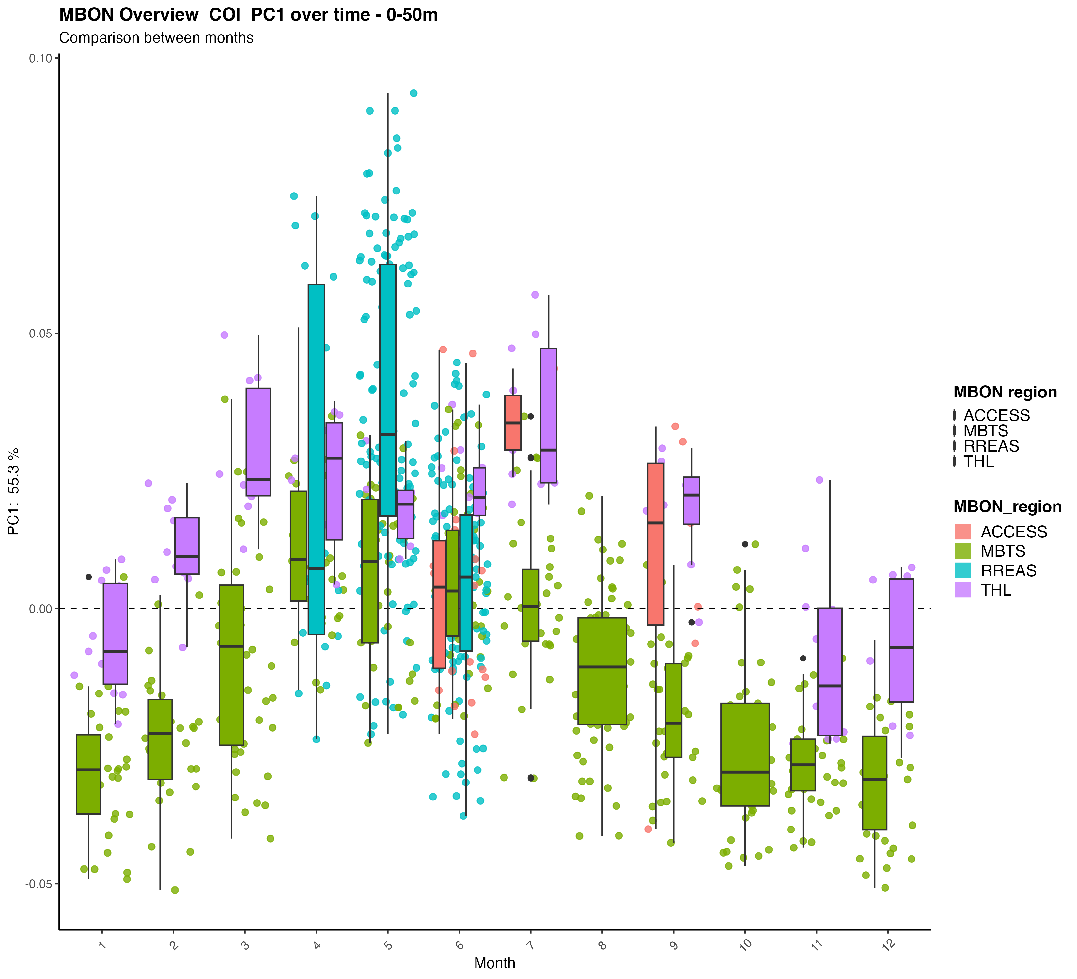
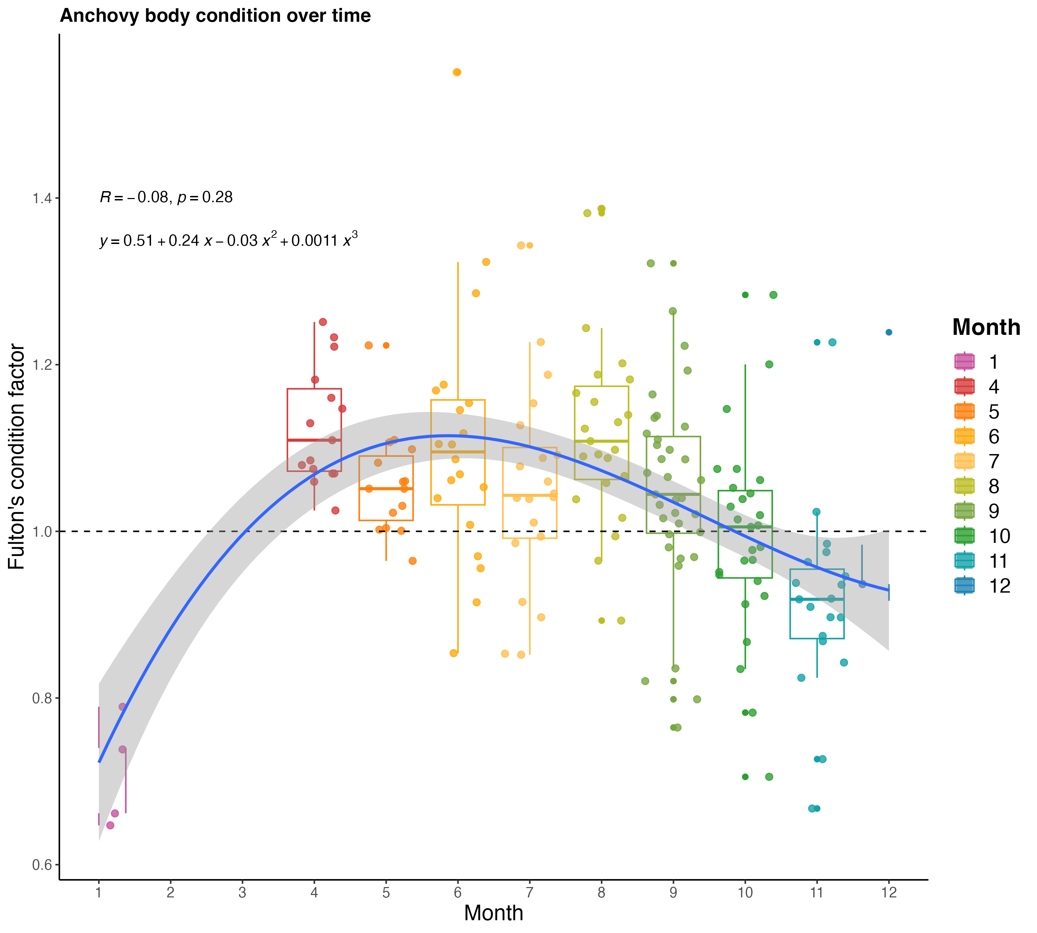
Pseudocalanus mimus
Anchovy stomachs
Plankton in Central California seasonal driven by upwelling
Upwelling community from eDNA, copepods, diatoms (COI or18S)
Jan
Dec
Fish caught at depth during day, diet similar to surface/C1 eDNA not deep eDNA
Rotifers
Water samples
SoCal is different
Condition factor
Jan
Dec

Slide 10
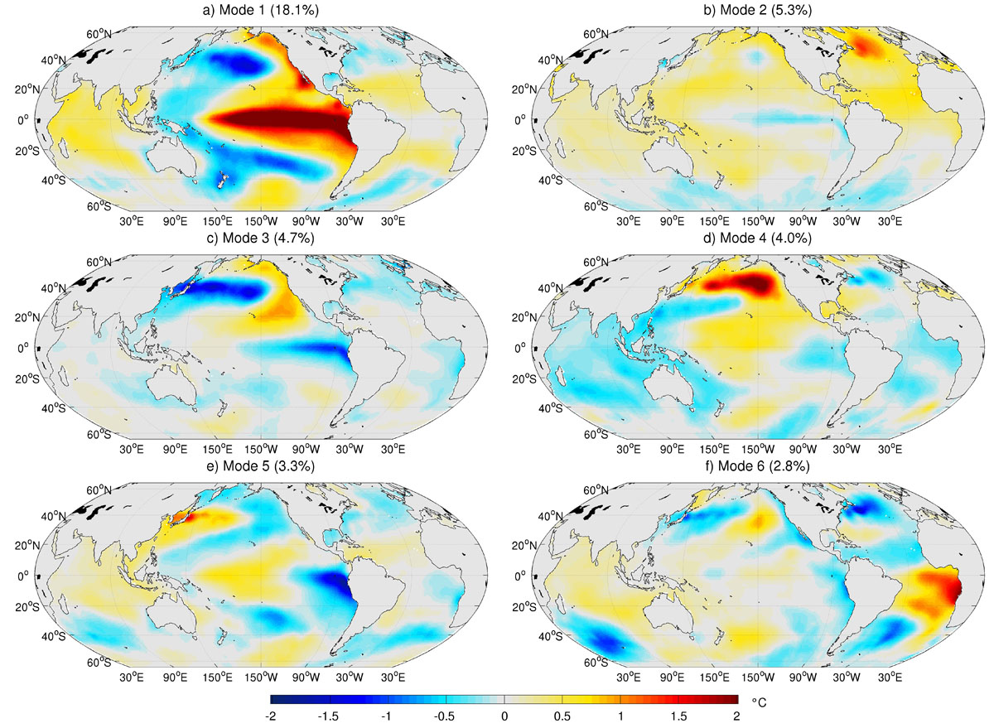
Climate variability – from interannual to multidecadal (and longer), new modes have appeared, increased in amplitude, others likely, El Niño, PDO and NPGO most important in California Current
AMO
El Niño
PDO
NPGO
Atlantic
El Niño
El Niño Modoki
Messie and Chavez, 2011

Slide 11
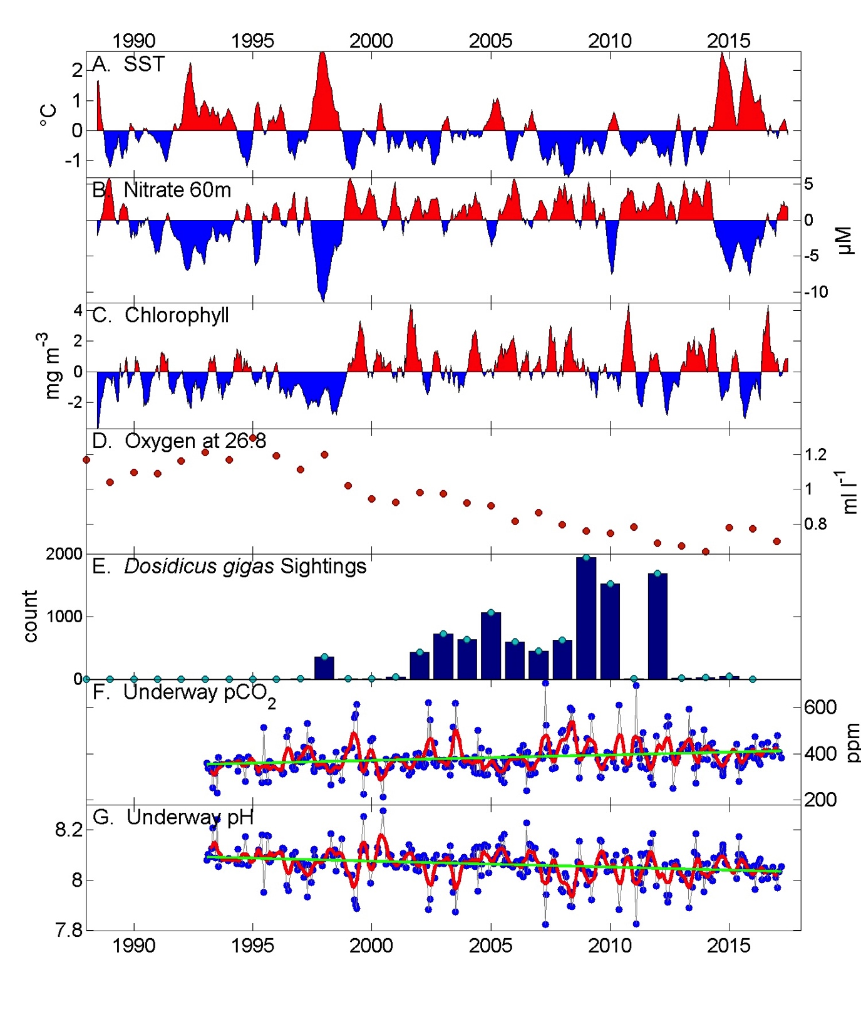
Temperature
Nitrate
Chlorophyll
Oxygen
Chavez etal. 2017
Jumbo squid
From underway data
pCO₂
pH
Strong interannual to multidecadal variability in MB+CC
Notes:
PDO and NPGO

Slide 12
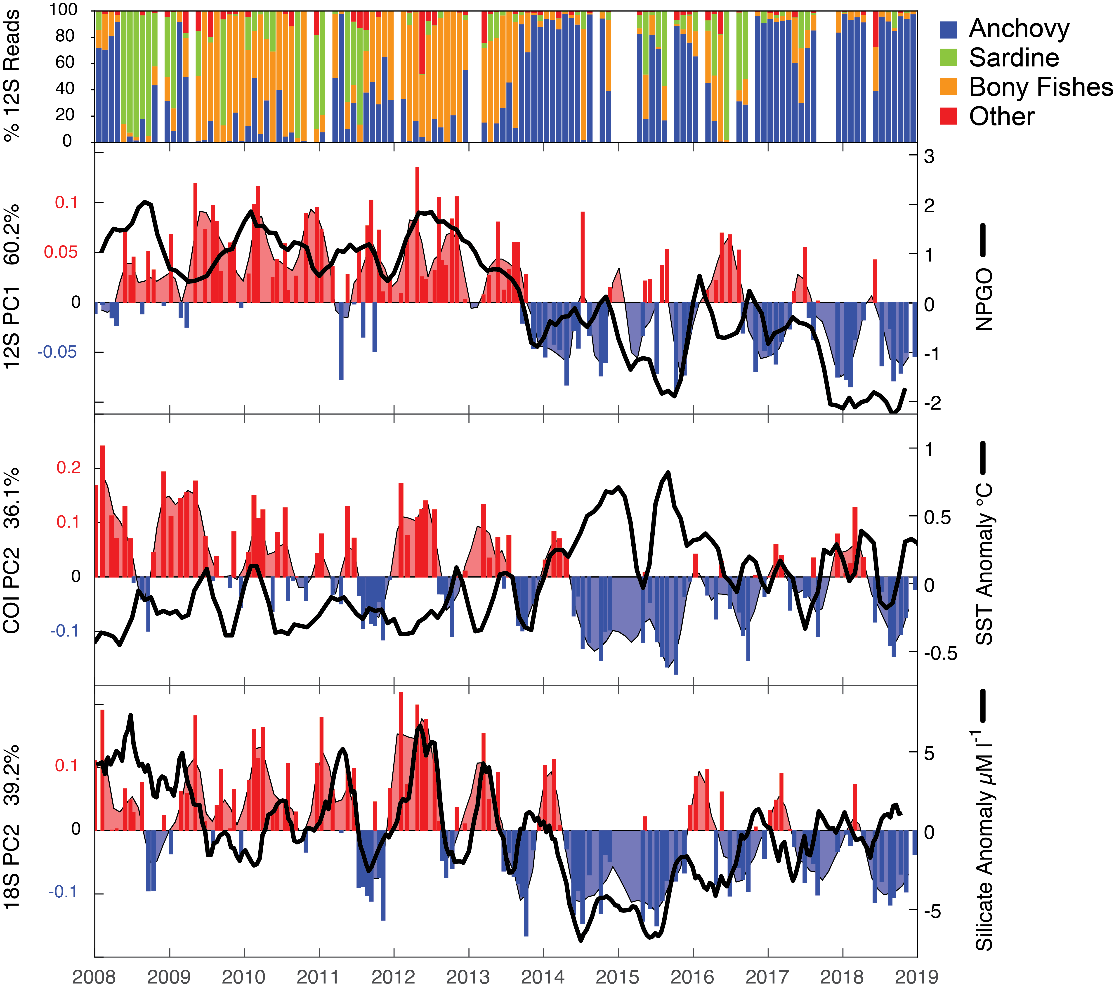
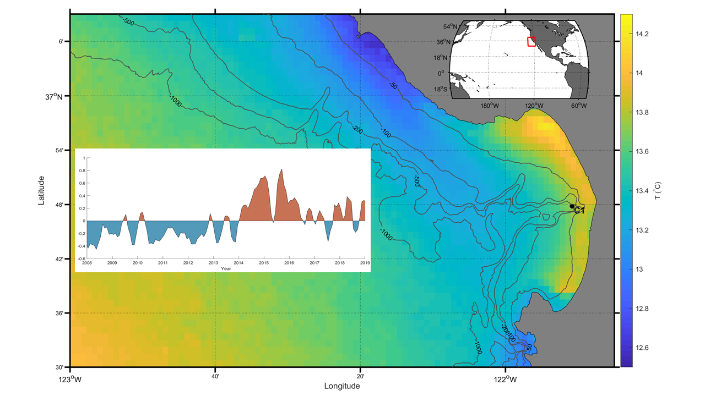
Marine regime shift –from sardines to anchovies
Changes over time
Samples from
Vertebrates
Sea surface temperature
Invertebrates
Phytoplankton
2008-2018 time series
Sometimes anchovies like it hot
Identified using eDNA
Pitz and Chavez in prep

Slide 13
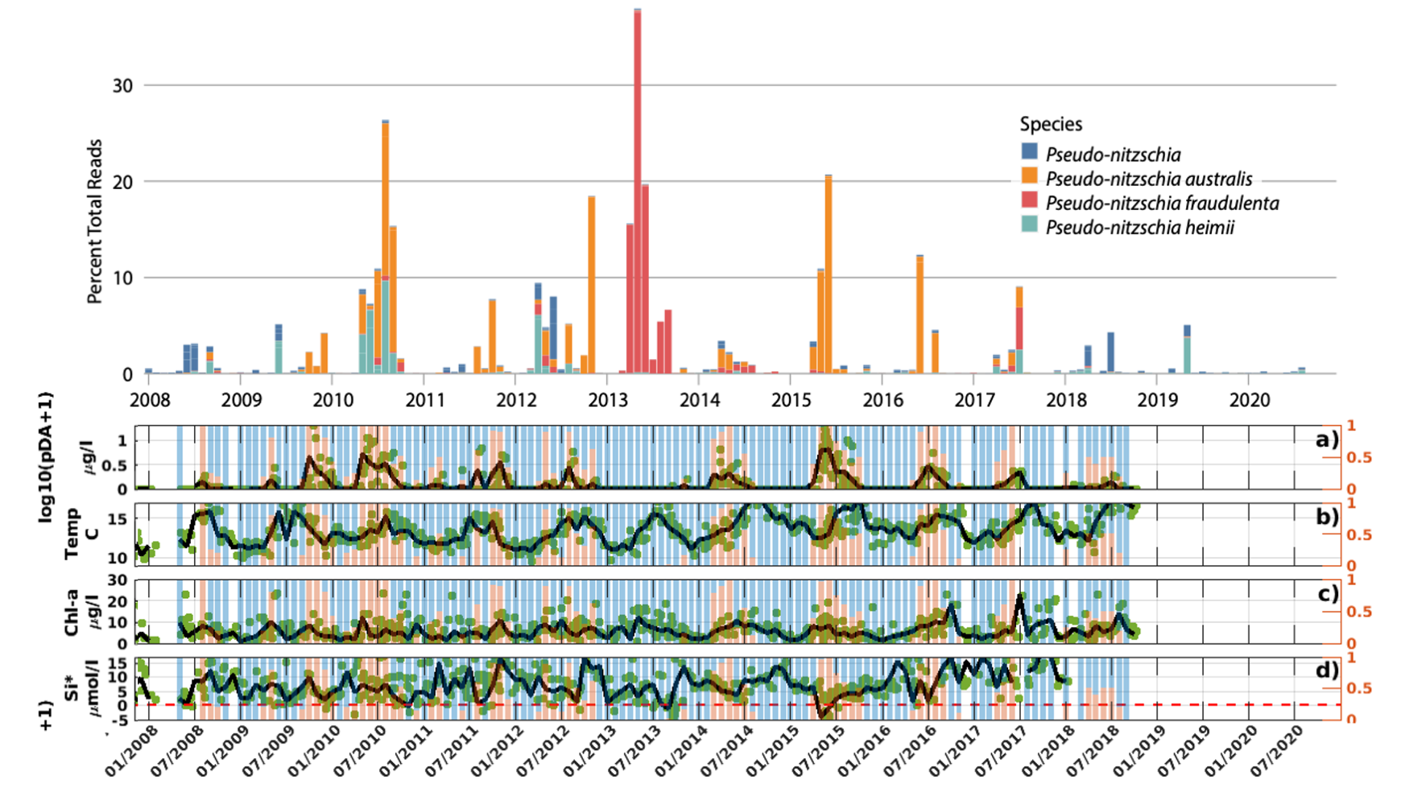
Harmful algal blooms in California Current
Chavez etal. 2021
Domoic acid producer
Domoic acid
Time series of Pseudo-nitzschia and Domoic acid
Sandoval etal. 2023

Slide 14
Monterey Bay Time Series
Three stations sampled monthly from ships for close to 40 years; more recently with robots
C1
M1
M2

Slide 15
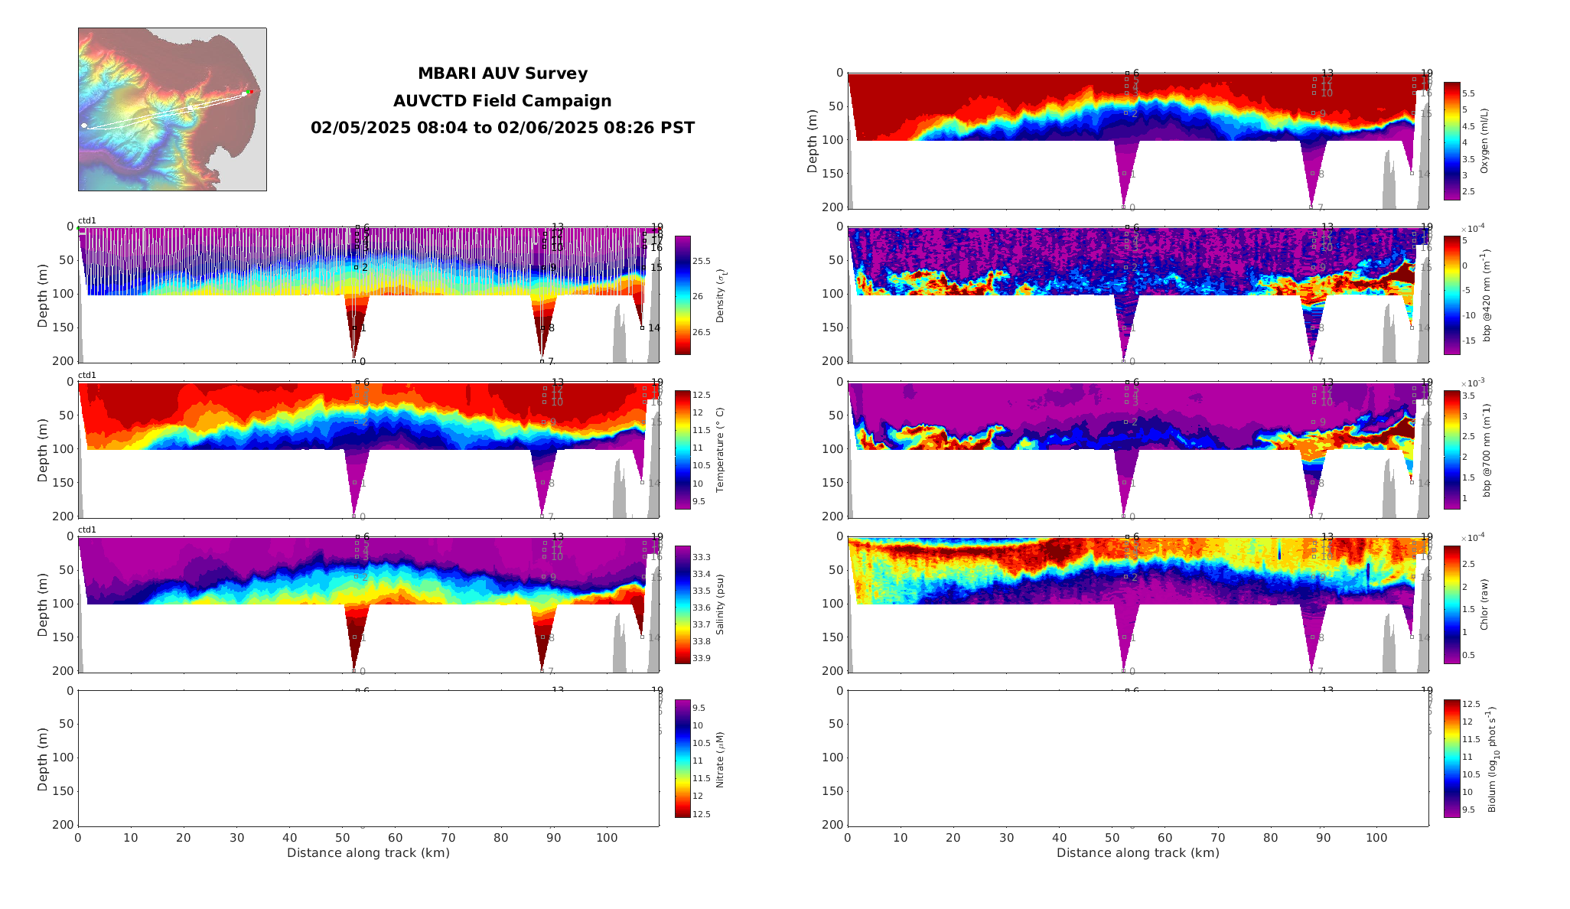
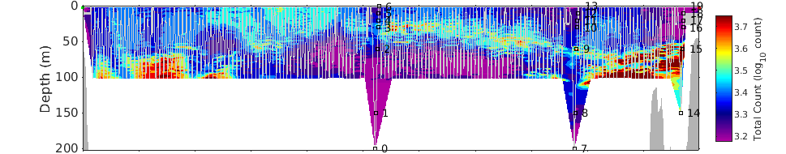

Slide 16
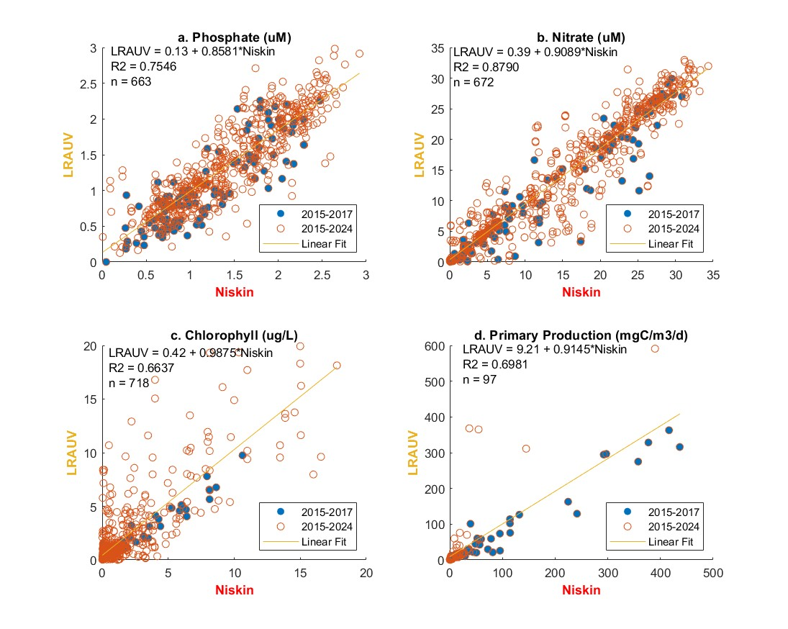
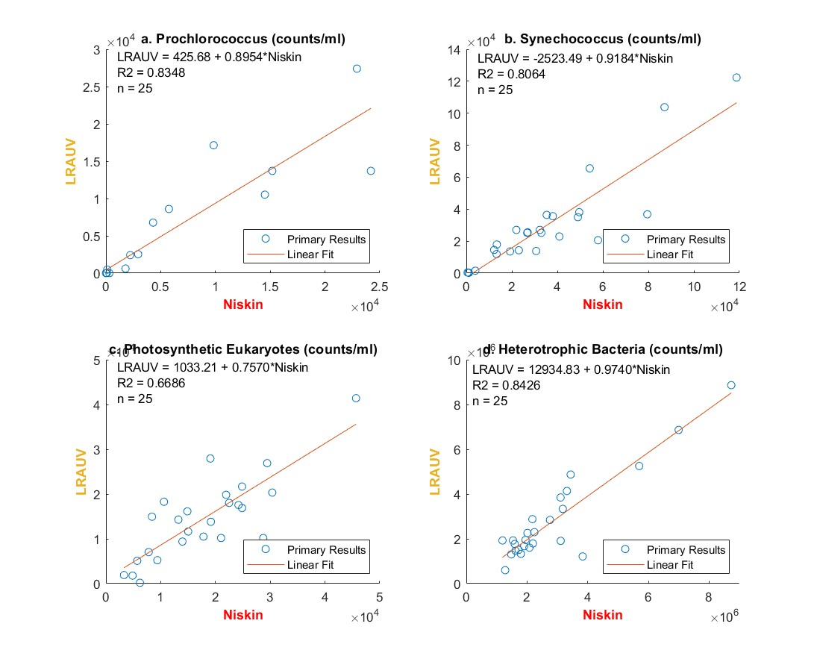
Comparisons between ship and AUV collected samples, at same general location but slightly different time, done for most variables
Pennington, J. T., M. Blum, and F. P. Chavez (2016). Seawater sampling by an autonomous underwater vehicle: “Gulper” sample validation for nitrate, chlorophyll, phytoplankton, and primary production. Limnology and Oceanography: Methods. DOI: 10.1002/lom3.10065

Slide 17
Summary
California Current is an eastern boundary wind-driven upwelling ecosystem where productivity is enhanced
Productivity and species distributions vary temporally and spatially at multiple scales
A wide variety of ecosystem observations required to assess the impacts of changing winds and climate on life in the sea
Wildcard: upwelling favorable winds may change/increase in a warmer world

Slide 18

Ecosystem shift aligns with NPGO
Variability in the NPGO index reflects variability in physical forces that are driving biological communities: correlated with salinity, nutrients, and chlorophyll-a
(reflects regional and basin-scale variability)

