Slide 1
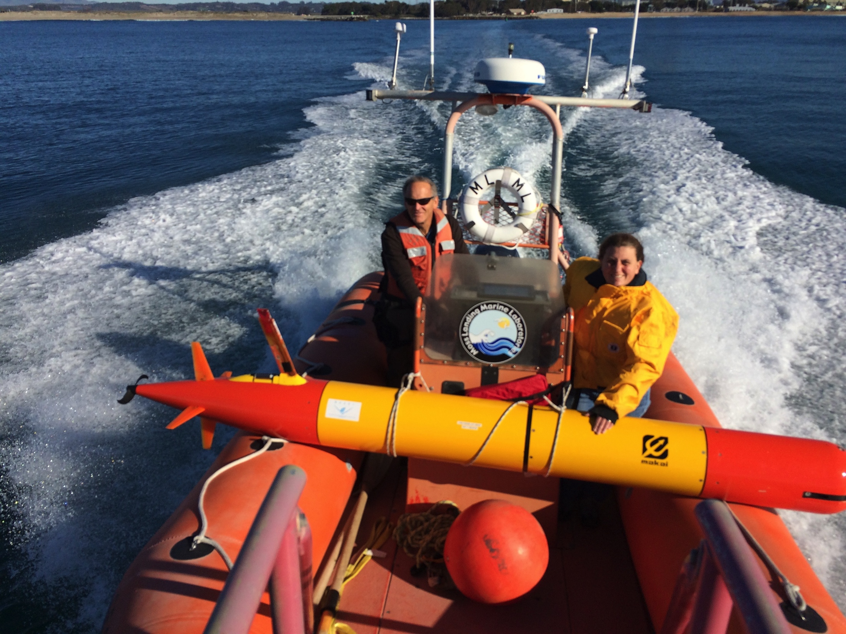
The Environmental Sample Processor (ESP)

Slide 2
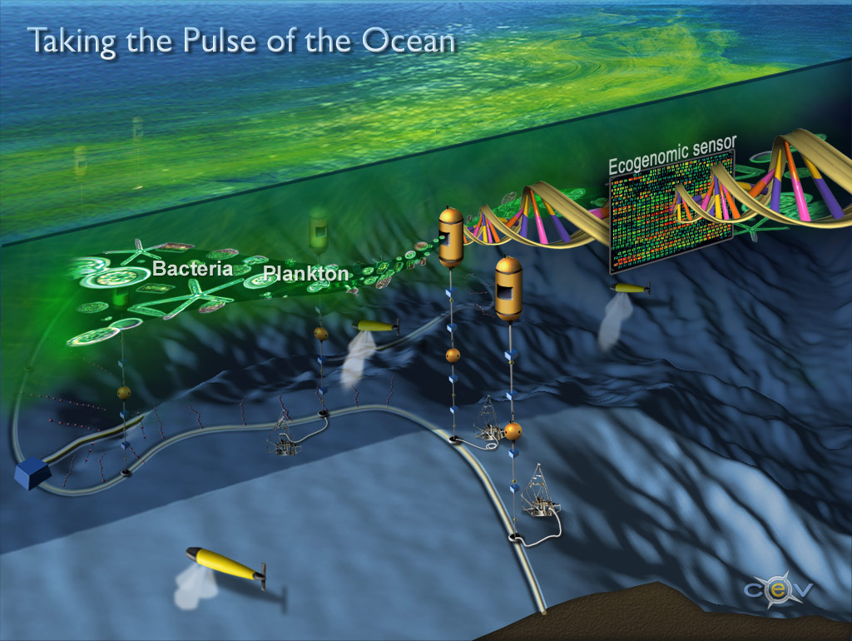
What is an Ecogenomic Sensor?
Image courtesy of the Center for Environmental Visualization, University of Washington
Notes:
Ginger Armburst and John Delany at UW had this illustration made in 2005. Where they envisioned
Retrieve information from the field directly, under natural conditions, and eliminate the traditional requirement for shore-side analyses of retrieved samples
Based on outcomes of a DOE workshop with a microbiology focus

Slide 3

What is an Ecogenomic Sensor?
A molecular analytical device capable of autonomous operation and 2-way comms –
a “lab in a can”
clients
command
control
data
sample and reagent volume handling spans ~6 orders of magnitude:
native water intake (L’s) to reagent (µL’s)
native water sample
intake
target
acquisition
analyte
detection
sample
handling
Scholin et al. 2017 Oceanography 30:100-113
Notes:
Ginger Armburst and John Delany at UW had this illustration made a little over a decade ago. Where they envisioned
Retrieve information from the field directly, under natural conditions, and eliminate the traditional requirement for shore-side analyses of retrieved samples
Based on outcomes of a DOE workshop with a microbiology focus

Slide 4
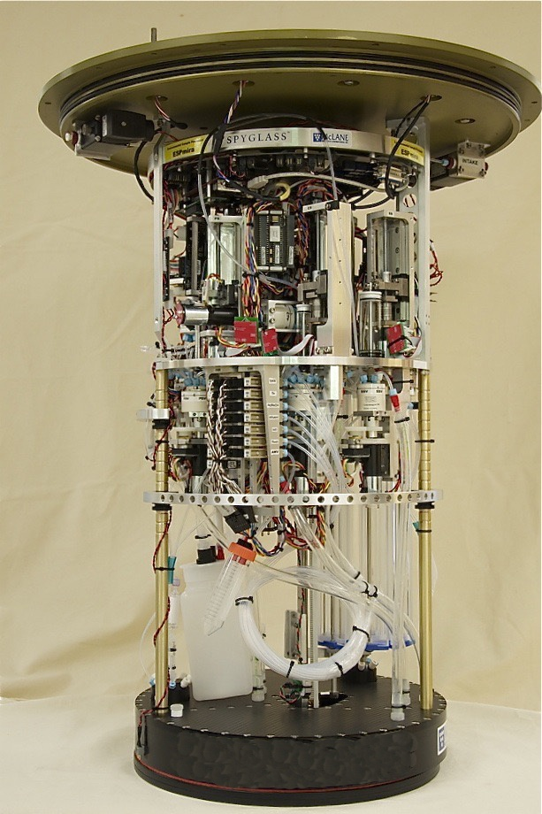
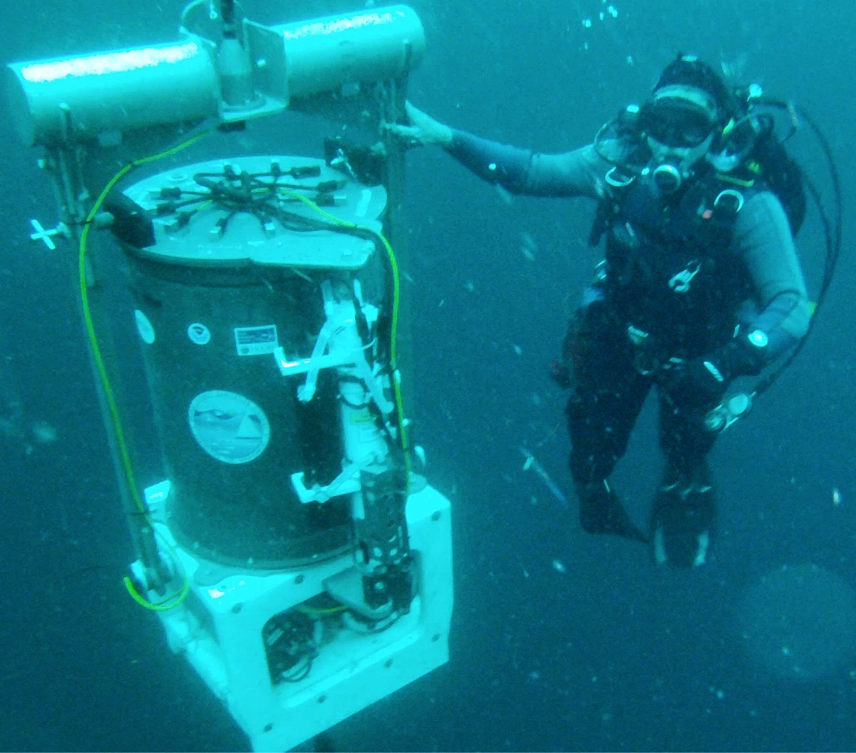
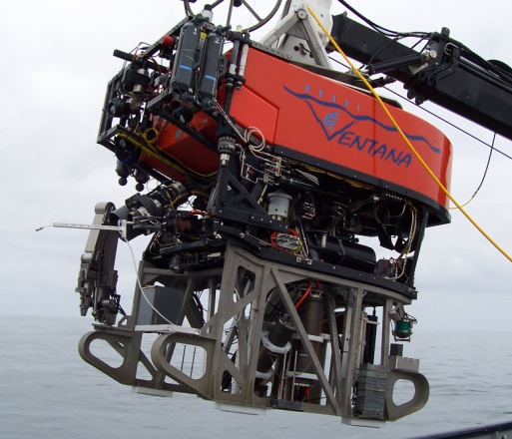
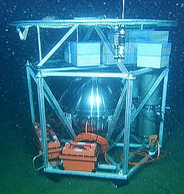
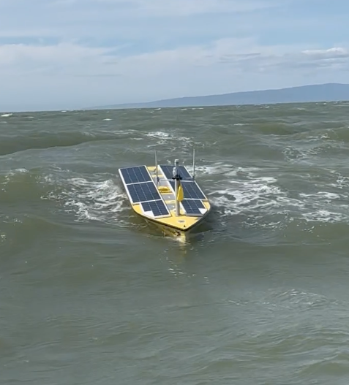
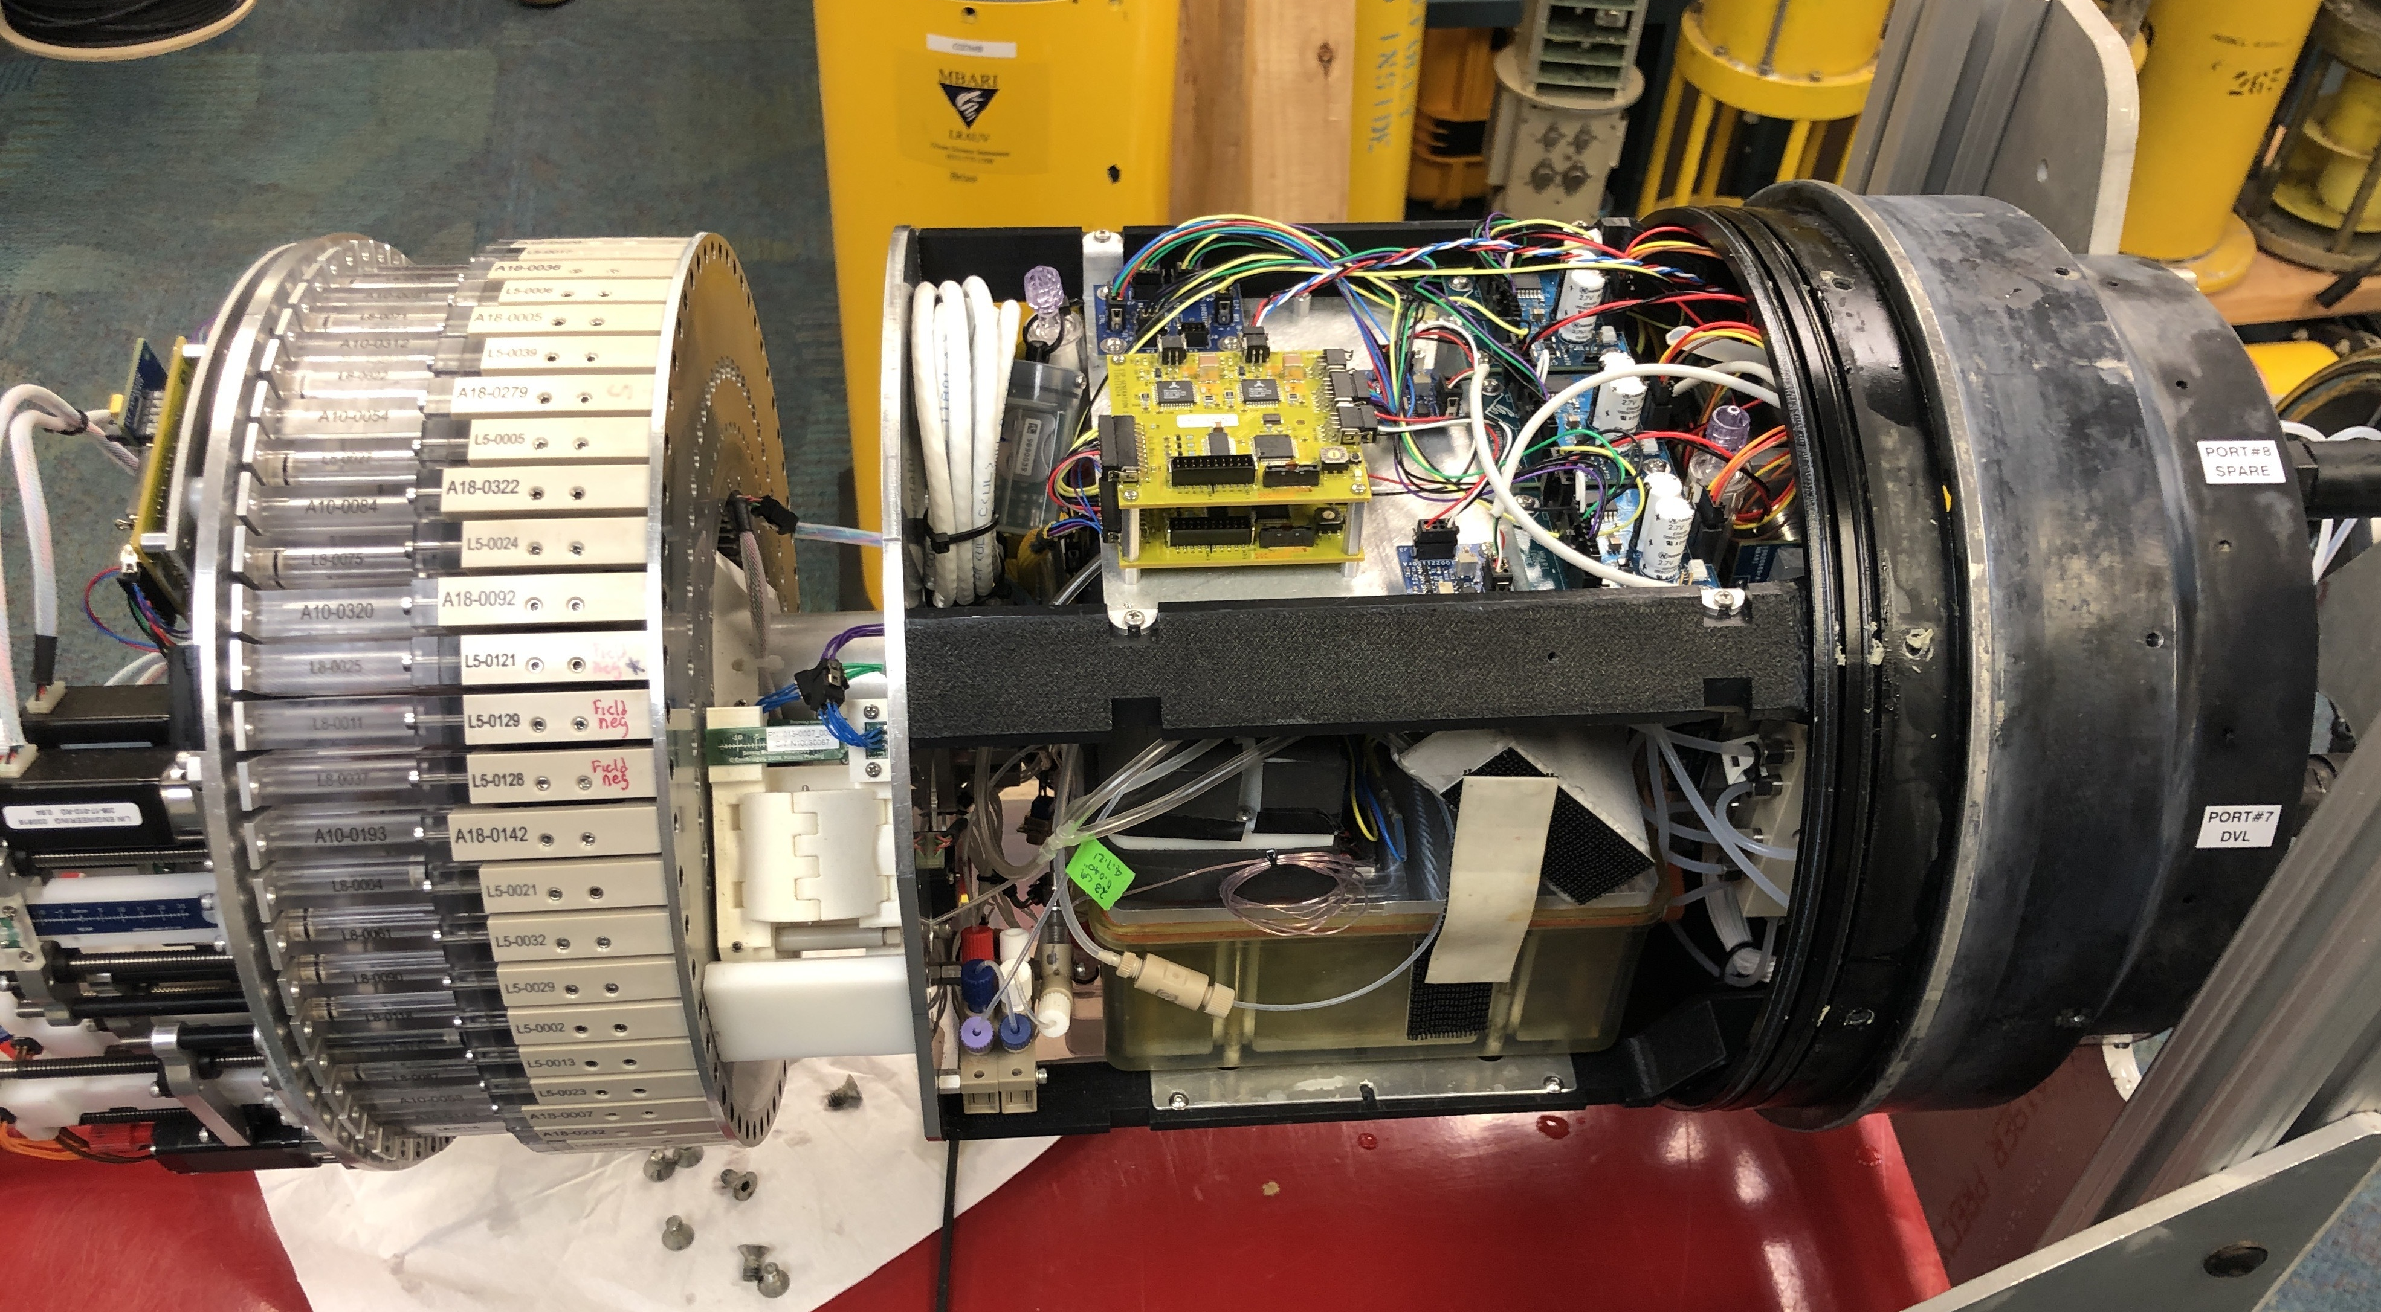
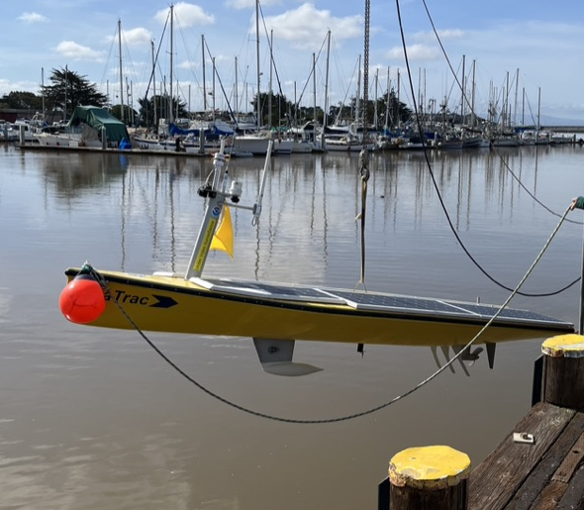
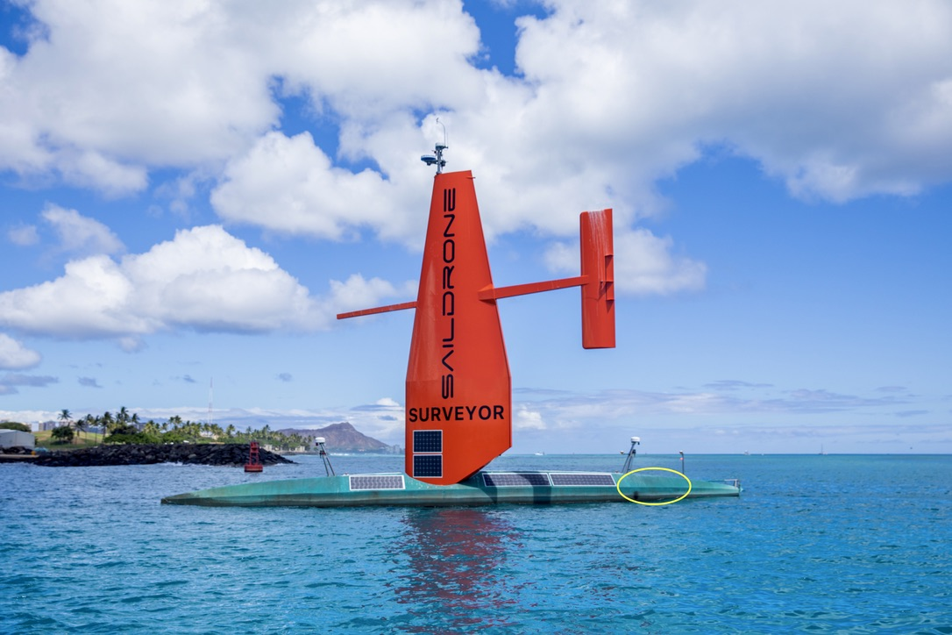
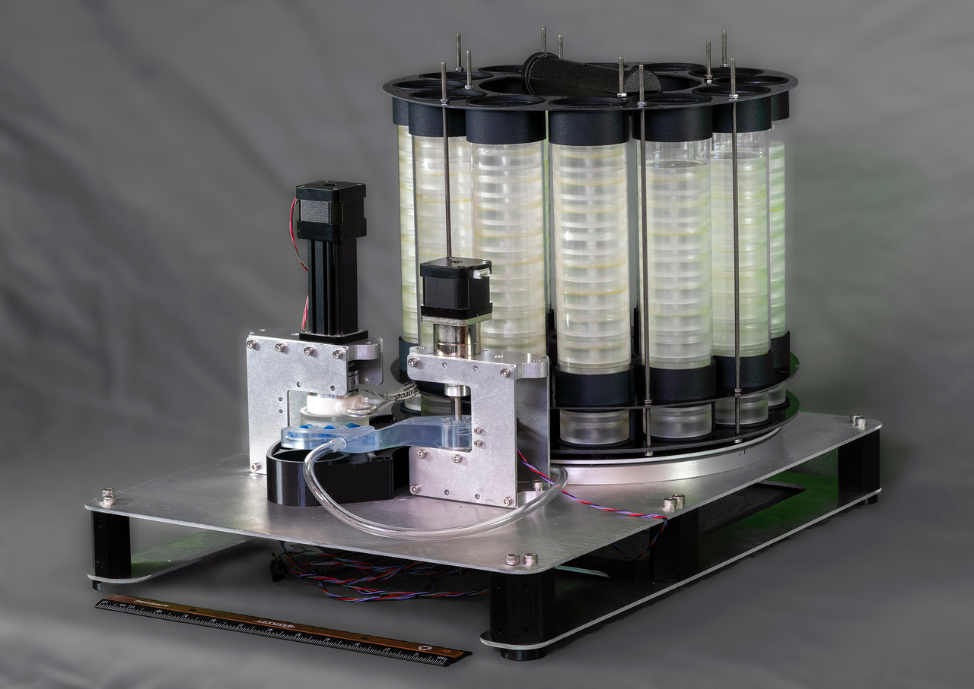
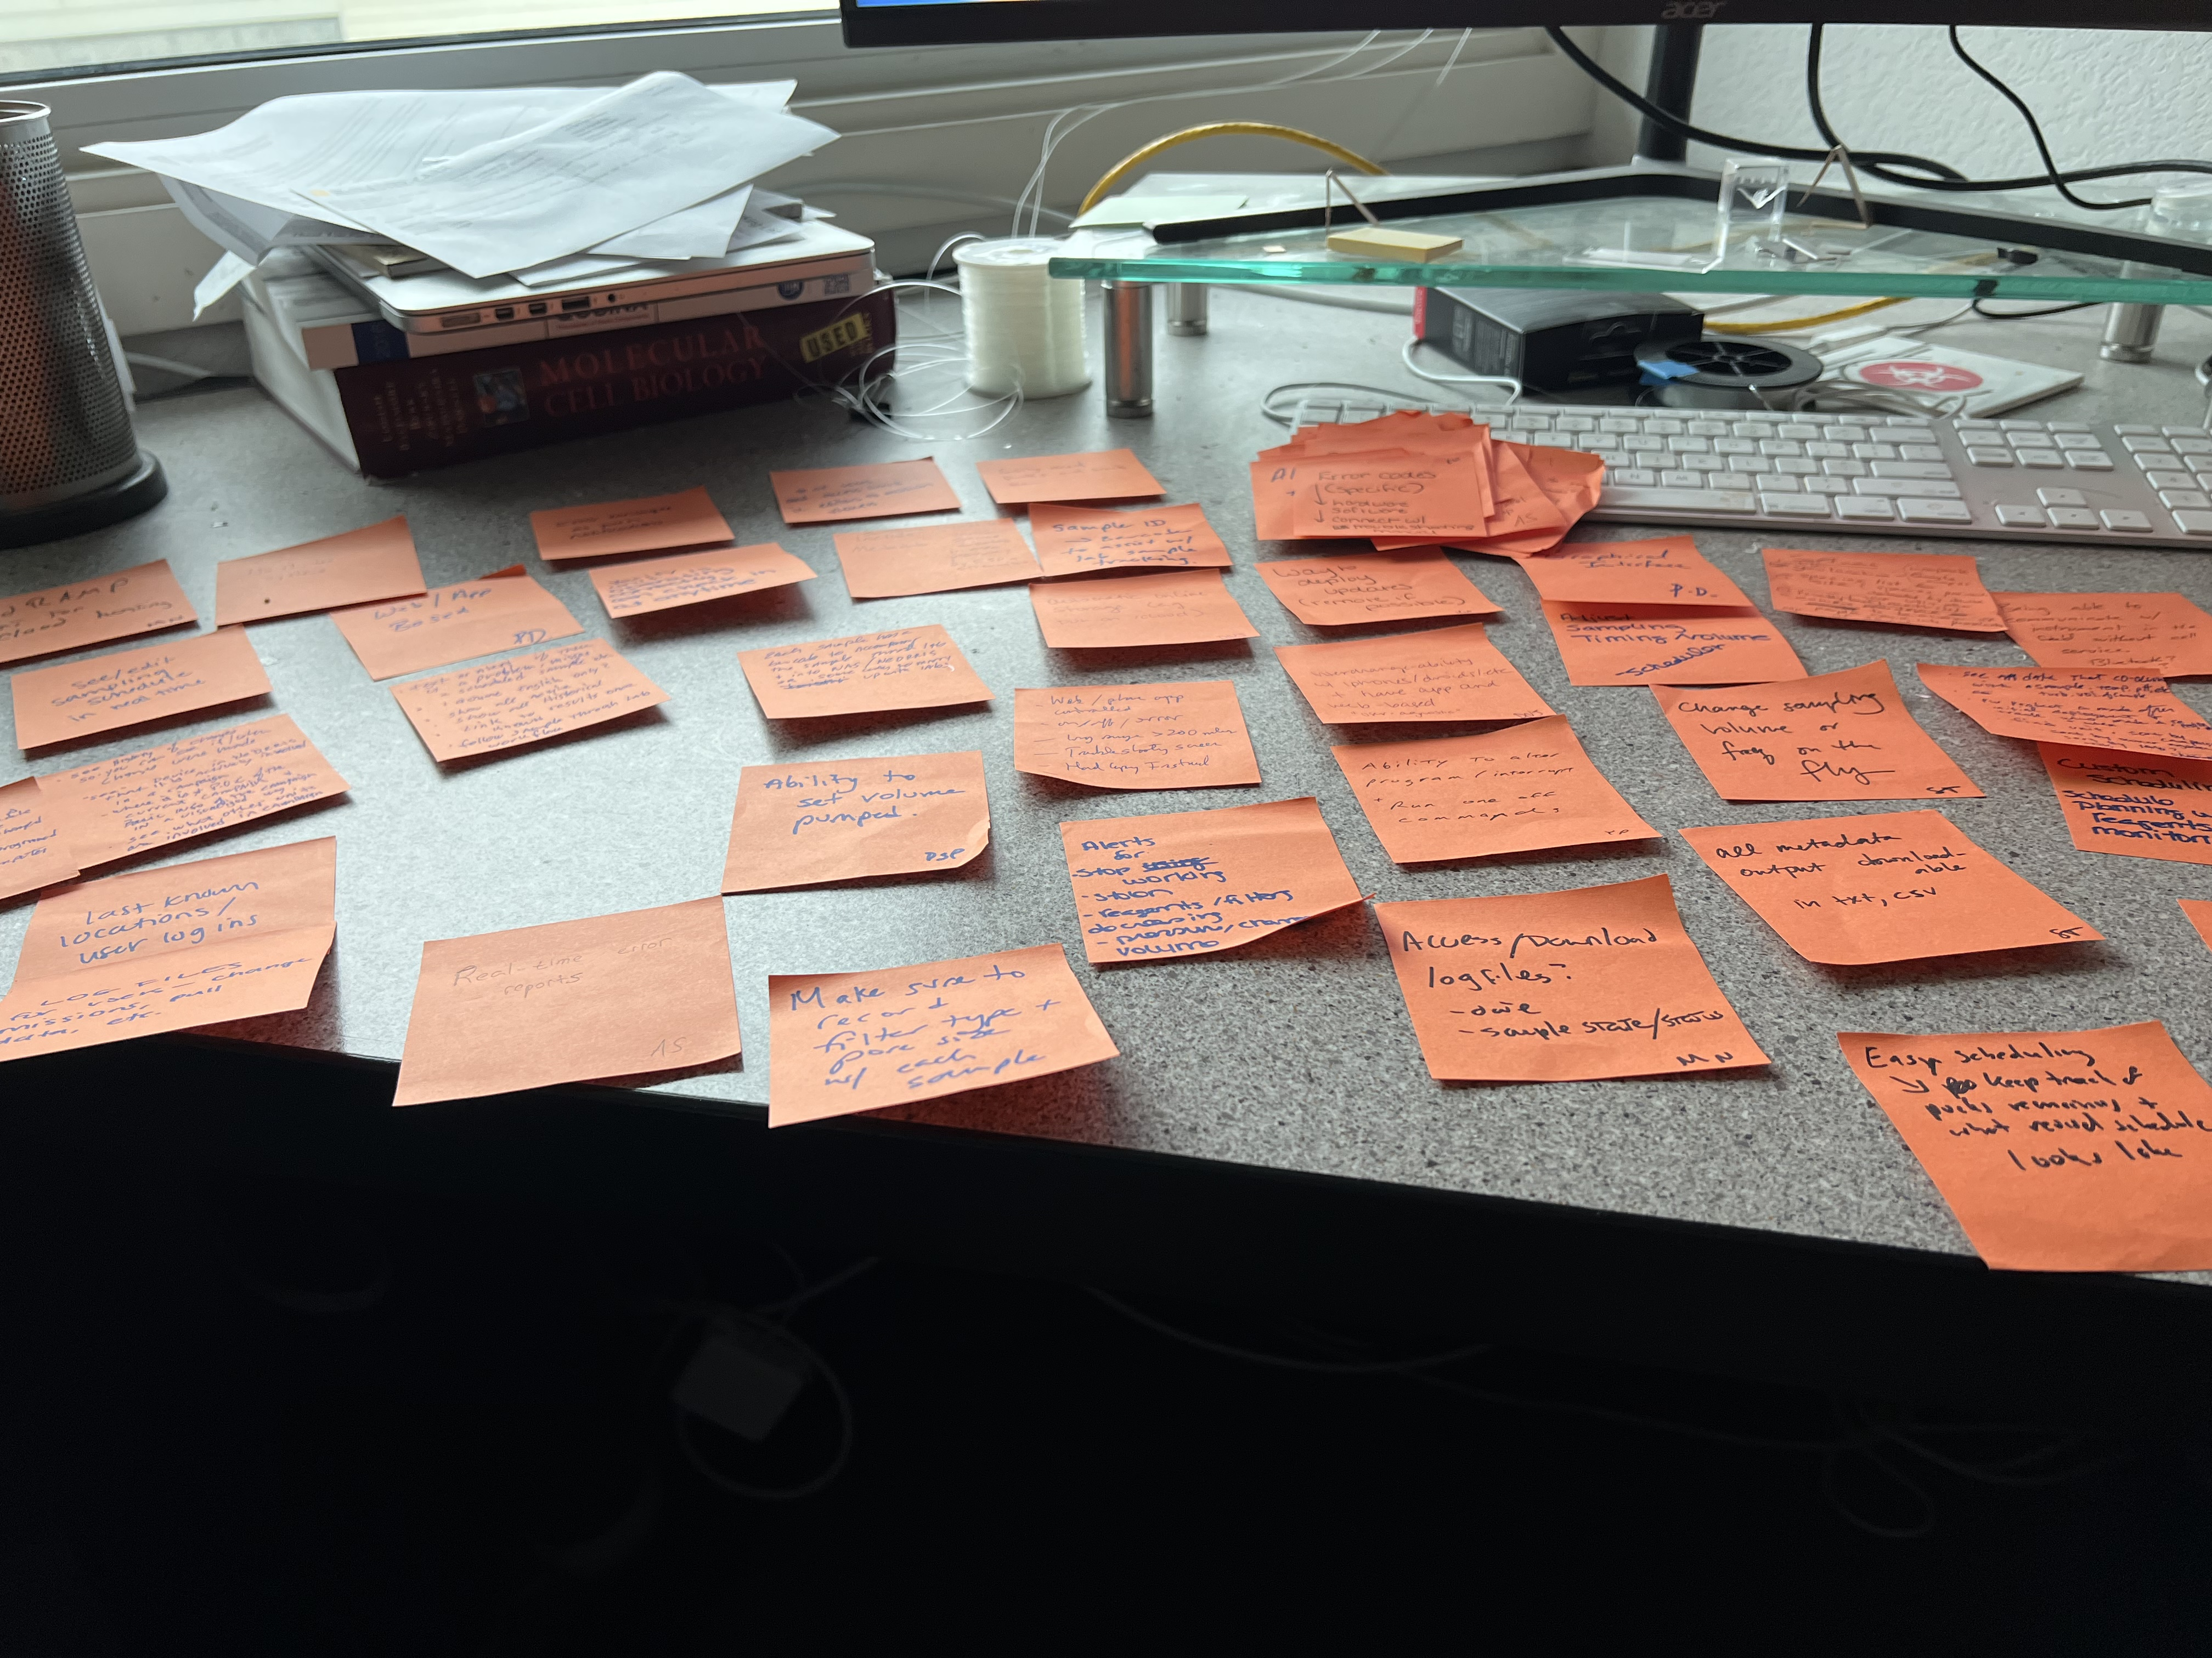
The Environmental Sample Processor
Stationary sampling
2G ESP manages contextual sensors and communications
Fully integrated sampling and sample processing
Add-on sampling and analytics
2nd
Generation ESP
Enables mobile sampling
Deployment platform manages power, contextual sensors, communications
Modular system
  Sample preservation or homogenization
  Add-on Analytics
3rd
Generation
ESP
All internet-accessible and remotely controllable
Co-design with USGS for freshwater applications
Crewed ship operation demonstrated
Purpose built for sample collection/preservation only
Simplified, easy-to-use interface
ESP FIDO

Slide 5
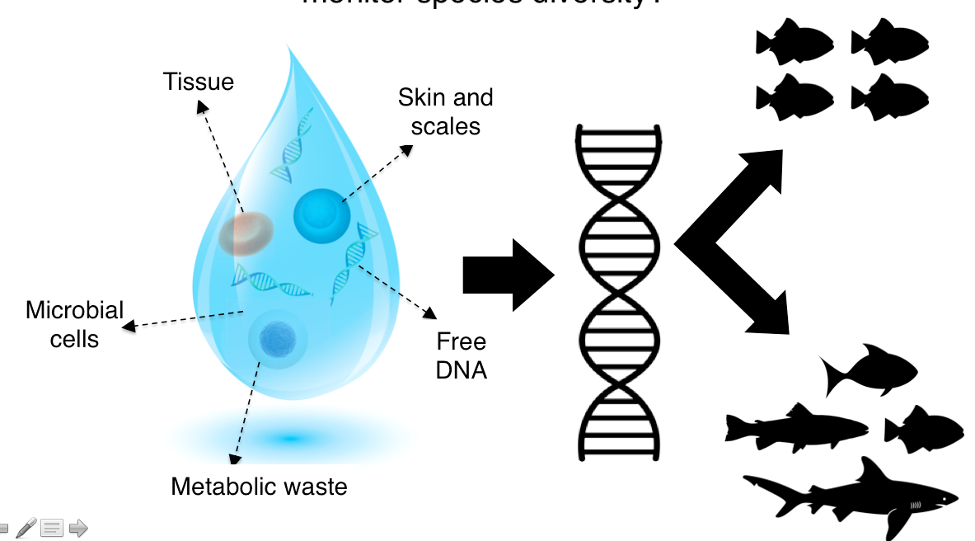














Environmental DNA
A cheaper, less invasive and larger scale approach to monitor species diversity – two approaches: next generation sequencing (NGS) or species specific primers, latter is easier
Each marker targets a different group of organisms.
12S rDNA
Vertebrates
?
COI
Invertebrates, some vertebrates, & phytoplankton
18S rDNA
Phytoplankton & invertebrates,
some vertebrates
16S rDNA
Microbes
(Bacteria & Archaea)
After Djurhuus et al. 2017 Frontiers in Marine Science

Slide 6
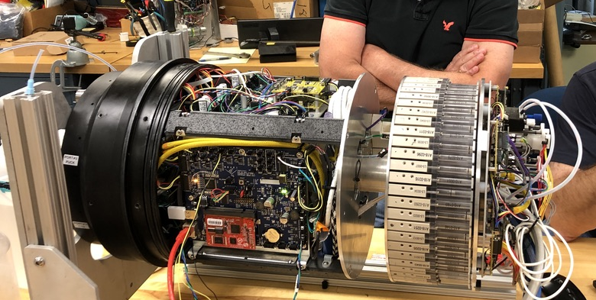
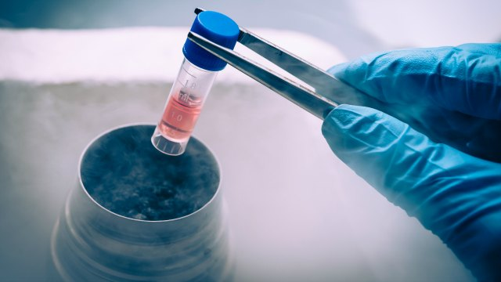
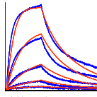
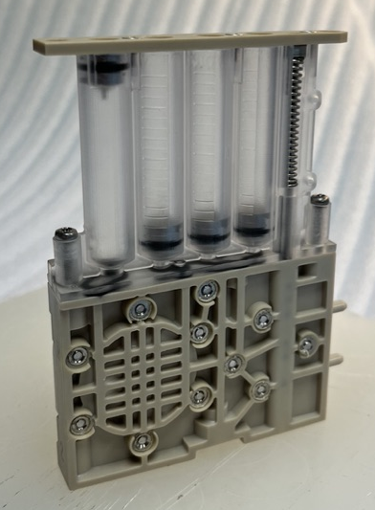
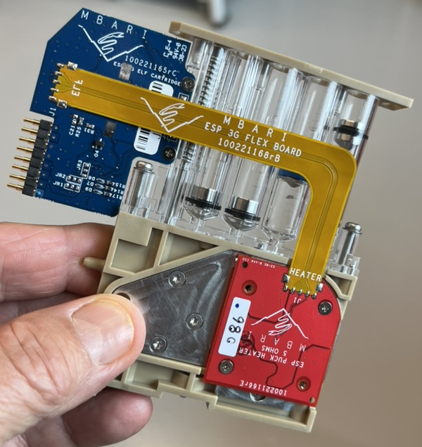
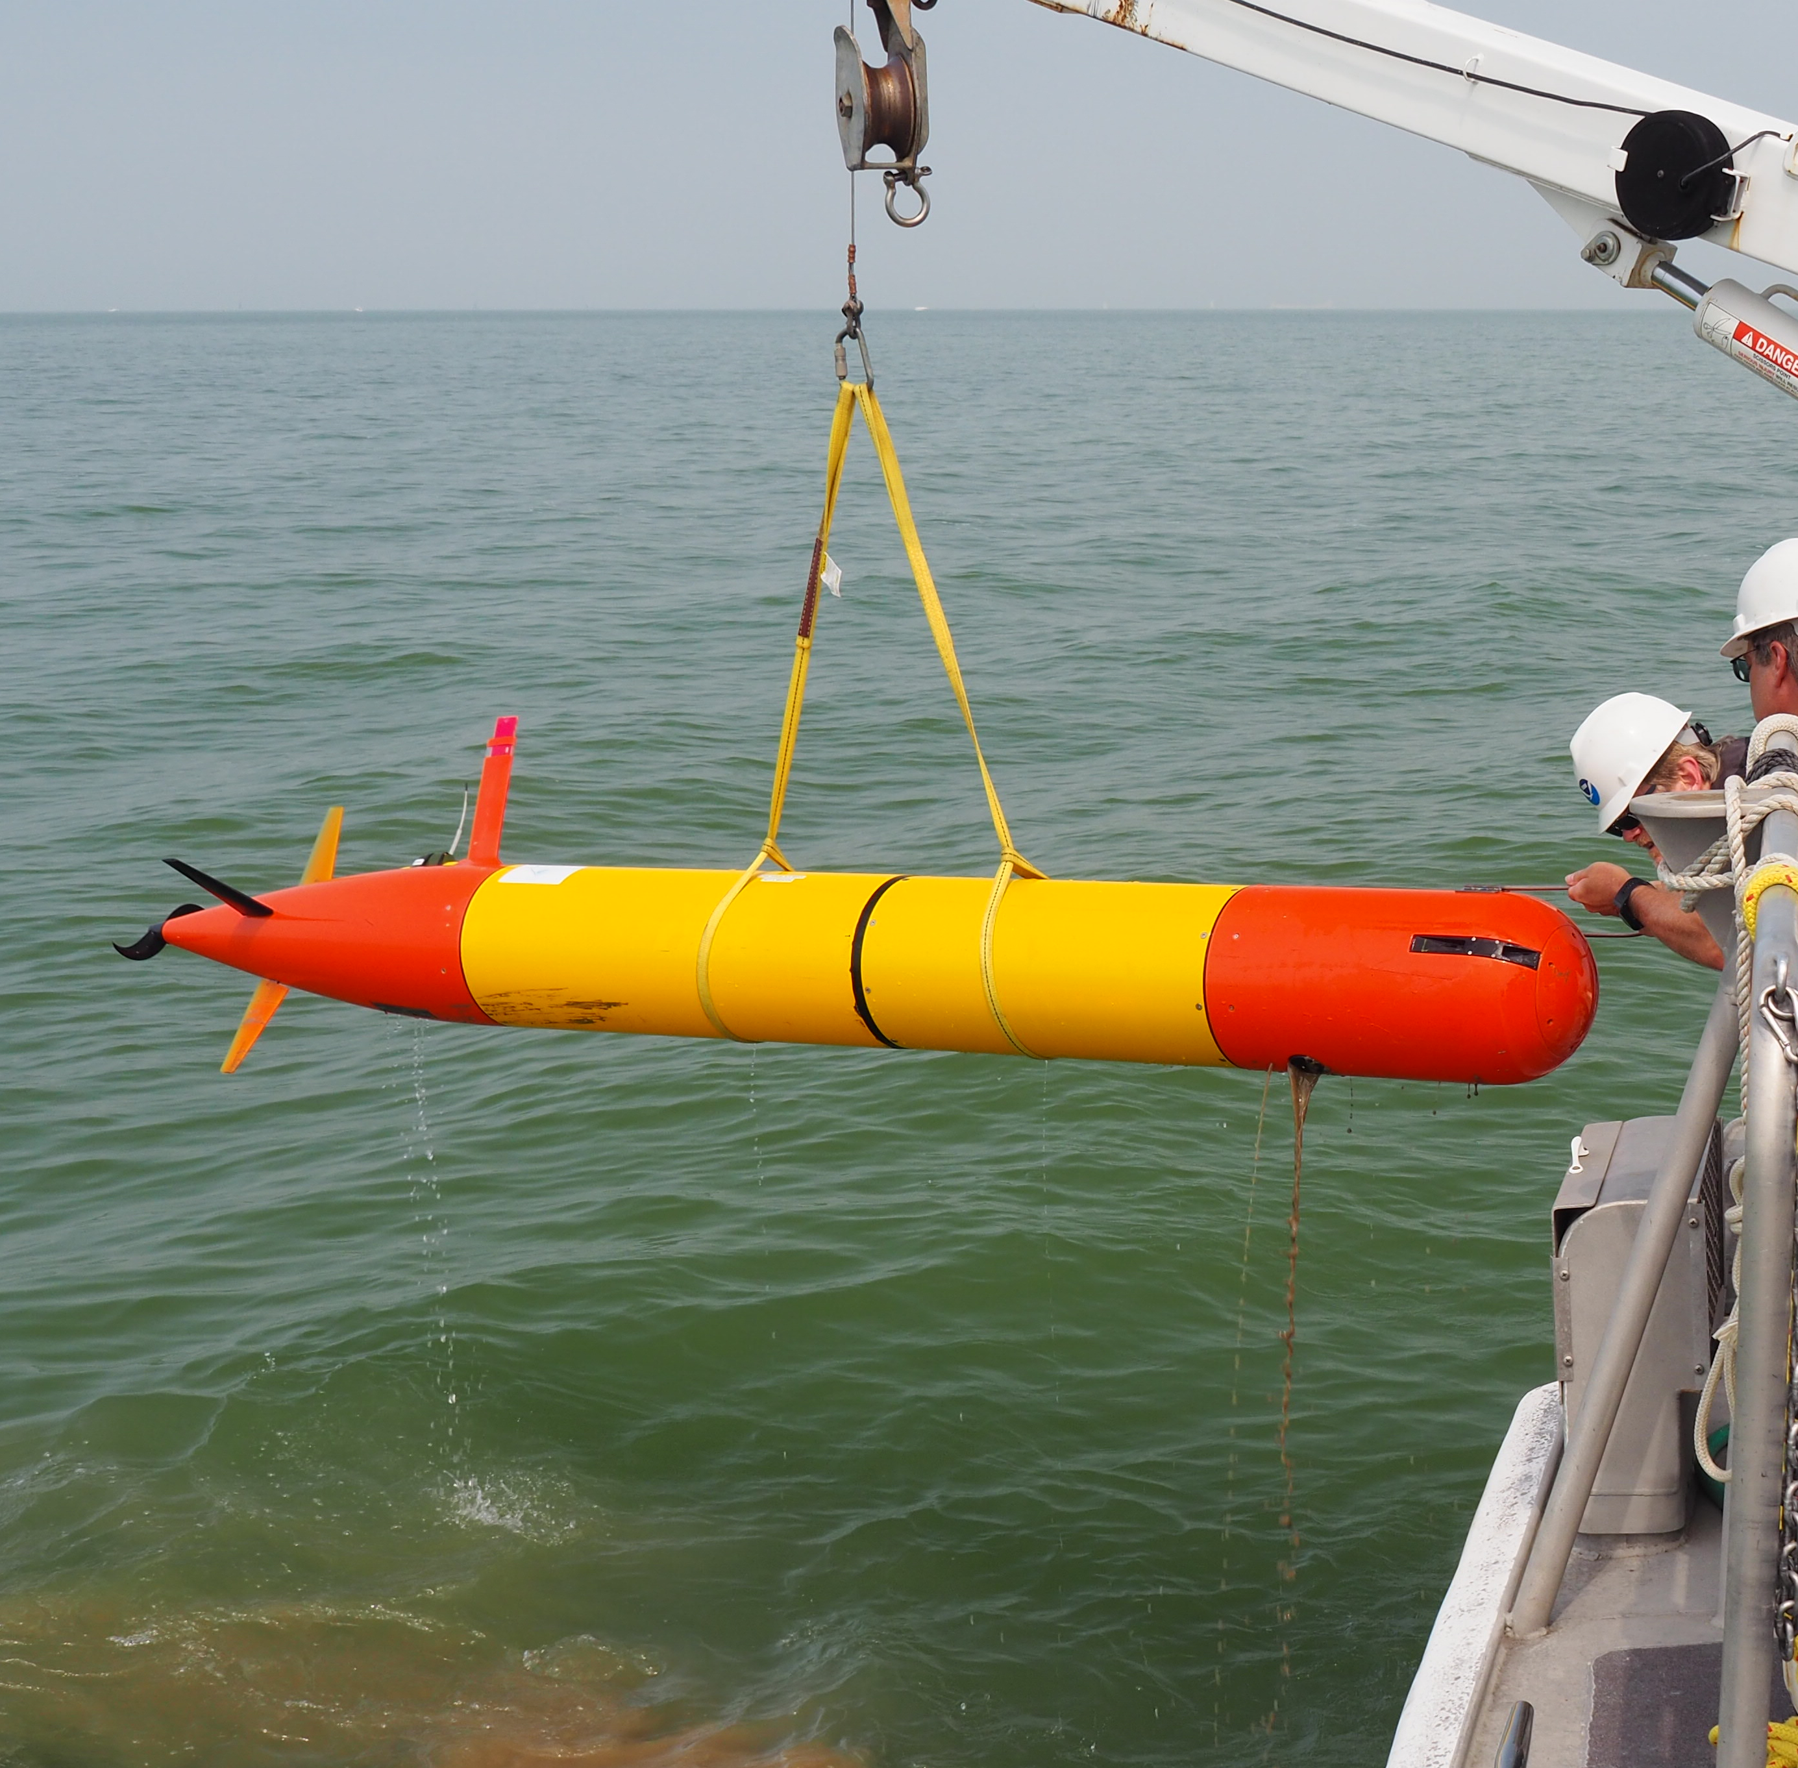
3rd Generation ESP
Sample preservation
  - filter & preserve
In situ sample homogenization
  cartridge lysate storage
  enable real-time analysis
  surface plasmon resonance
Autonomous Vehicle Integration
Notes:
Point out the 2G ESP. All the hanging bags and puck. 3G, smaller, only carry reagents needed one cartridge. More functionality than the 3G.
Each cartridge holds sample collection material and all reagents needed to preserve it or process to provide real time data.
Developed protocols for preservation, lysis and to modifiy so it could be analzyed imeddiately by the AM
One cartridge = everything to process one sample
Filter (25 mm)
Preservative reagent (RNAlater)

Slide 7
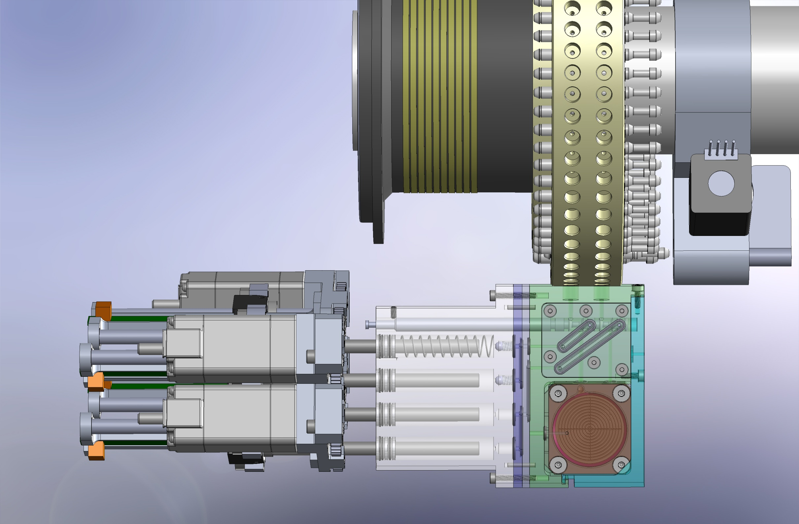
Modularity and Standardized Interfaces = Flexibility
electrical bus
mechanical actuation
sample in, filtrate out
To analytical device
Allow for different types of cartridges, same form factor

Slide 8
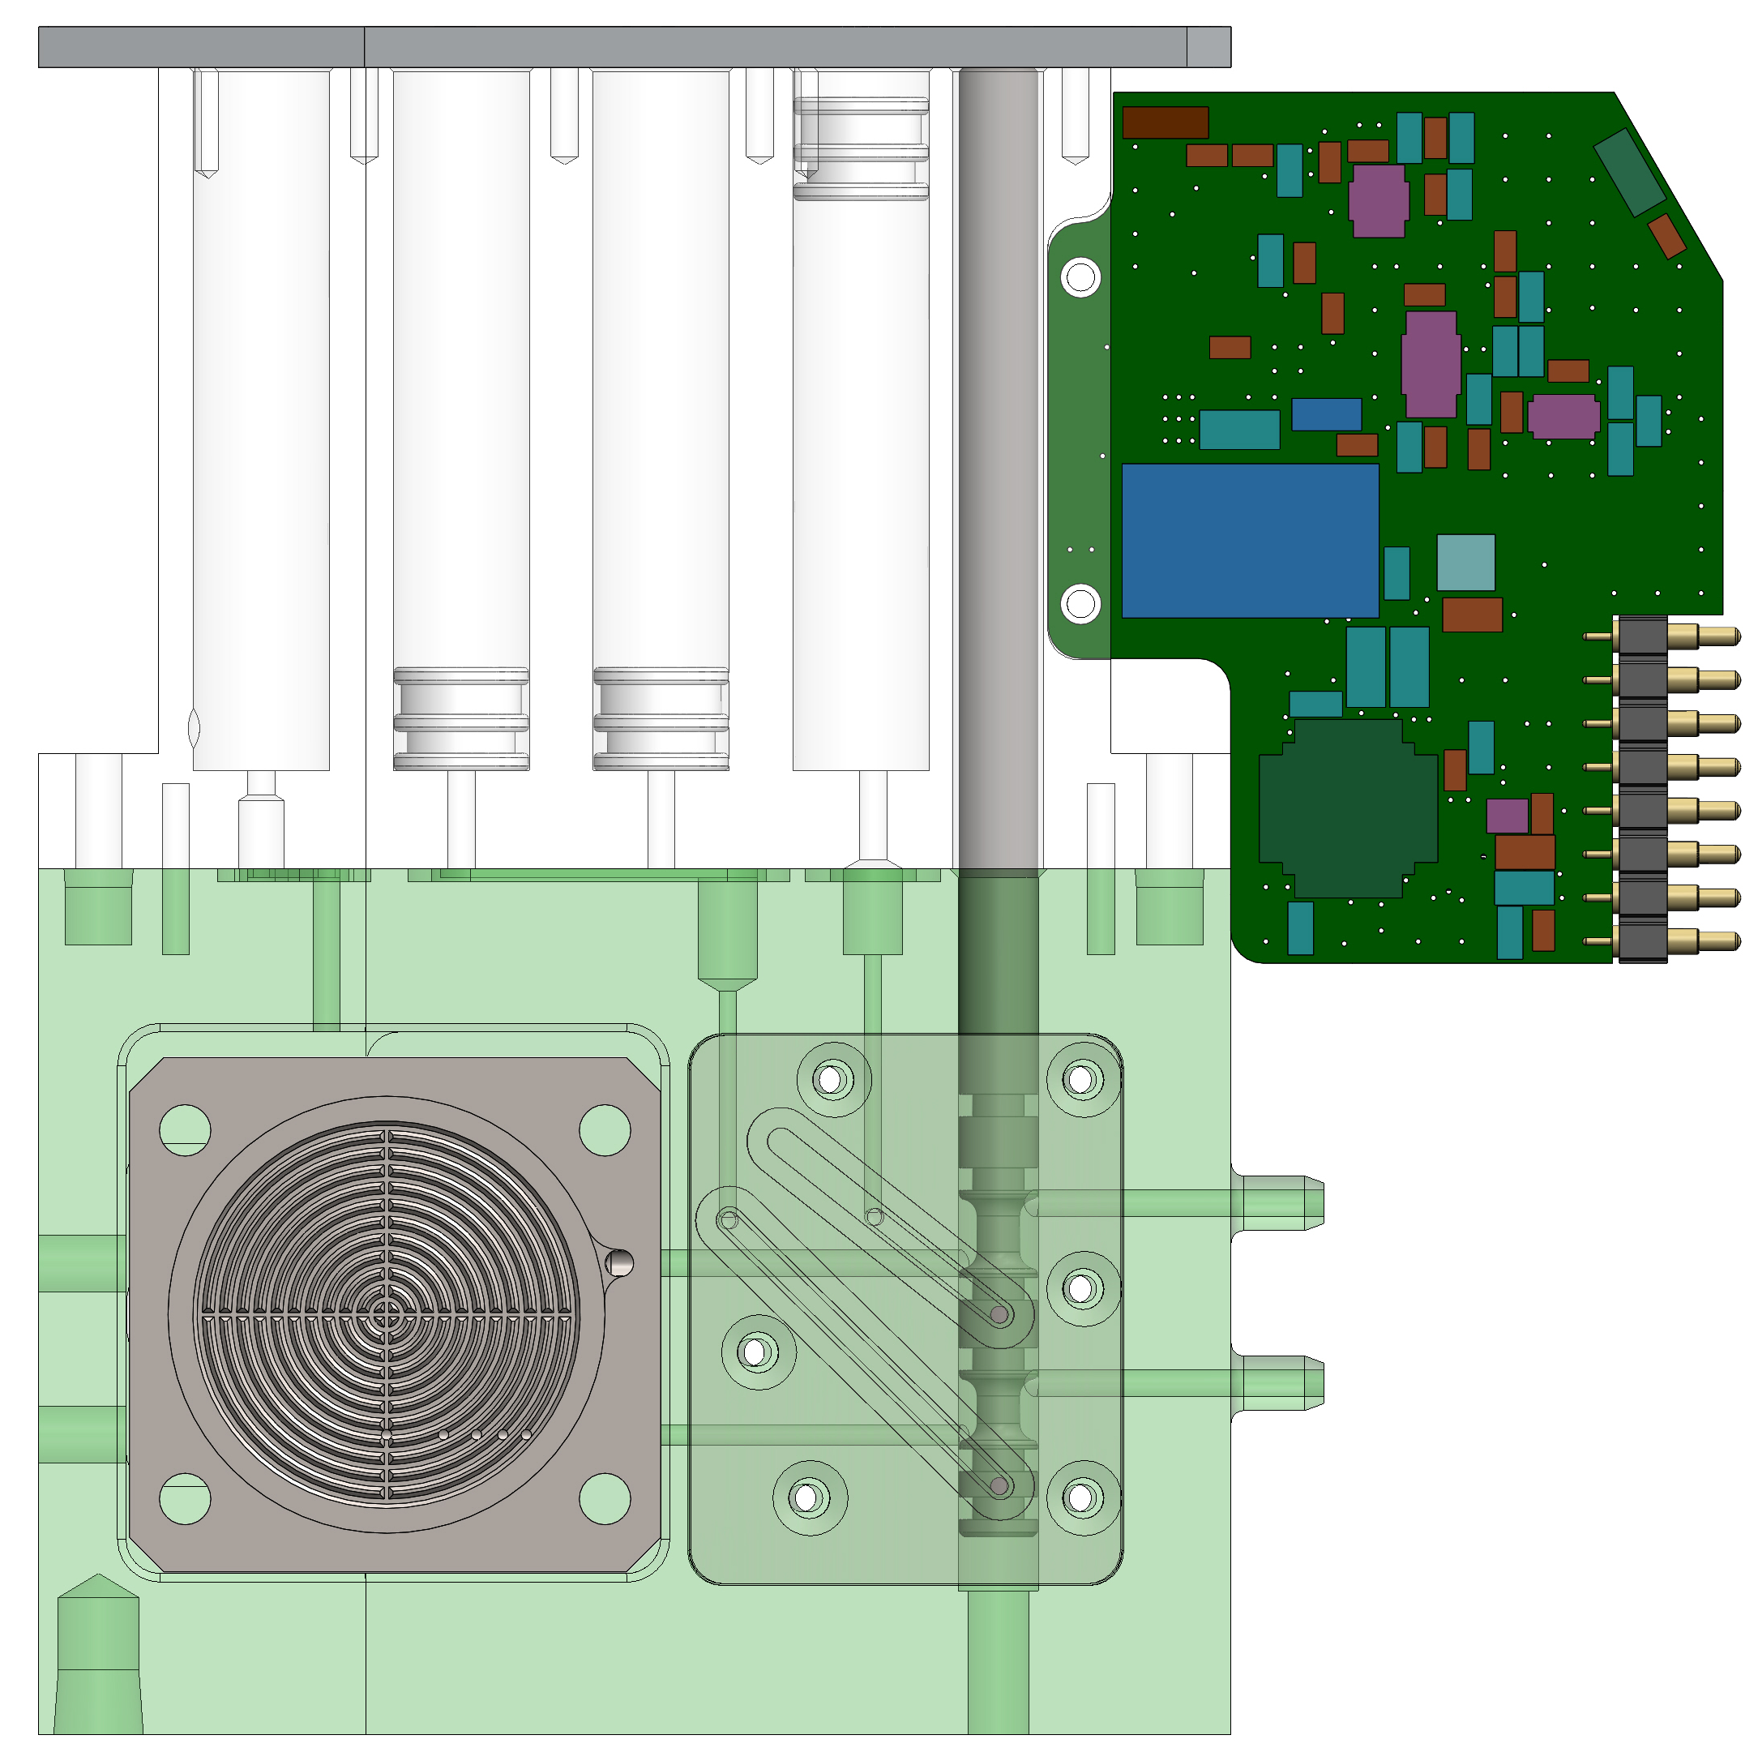

ESP Sample Preservation
Sample collection
1
2
Preservative displaces residual sample water to waste on cartridge.
Preservative (1.6ml)
waste
Preservative (1.6ml)
Valve Sample Position
Valve Reagent Position
waste
Water Sample in
Sample
Filtration
Sample
Preserved
Preservative (RNAlater) pushed in and displaces the sample water to waste.
Preservative reaches >95% concentration.

Slide 9
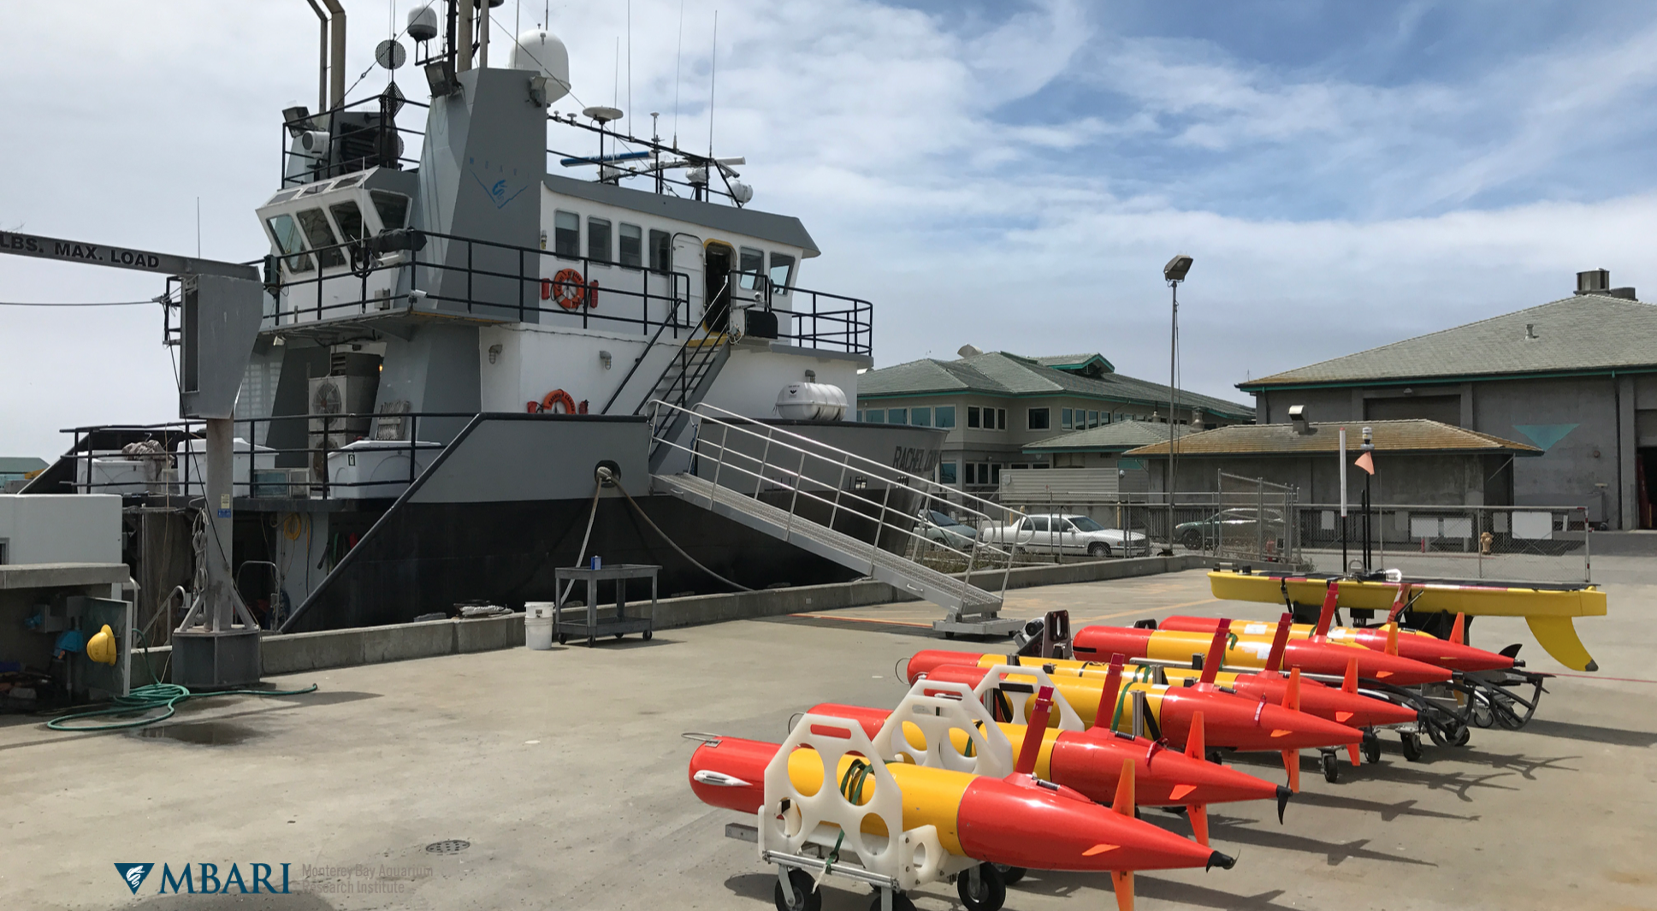
Increasing eDNA spatial and temporal sampling
Solution #1
  increase the fleet size

Slide 10
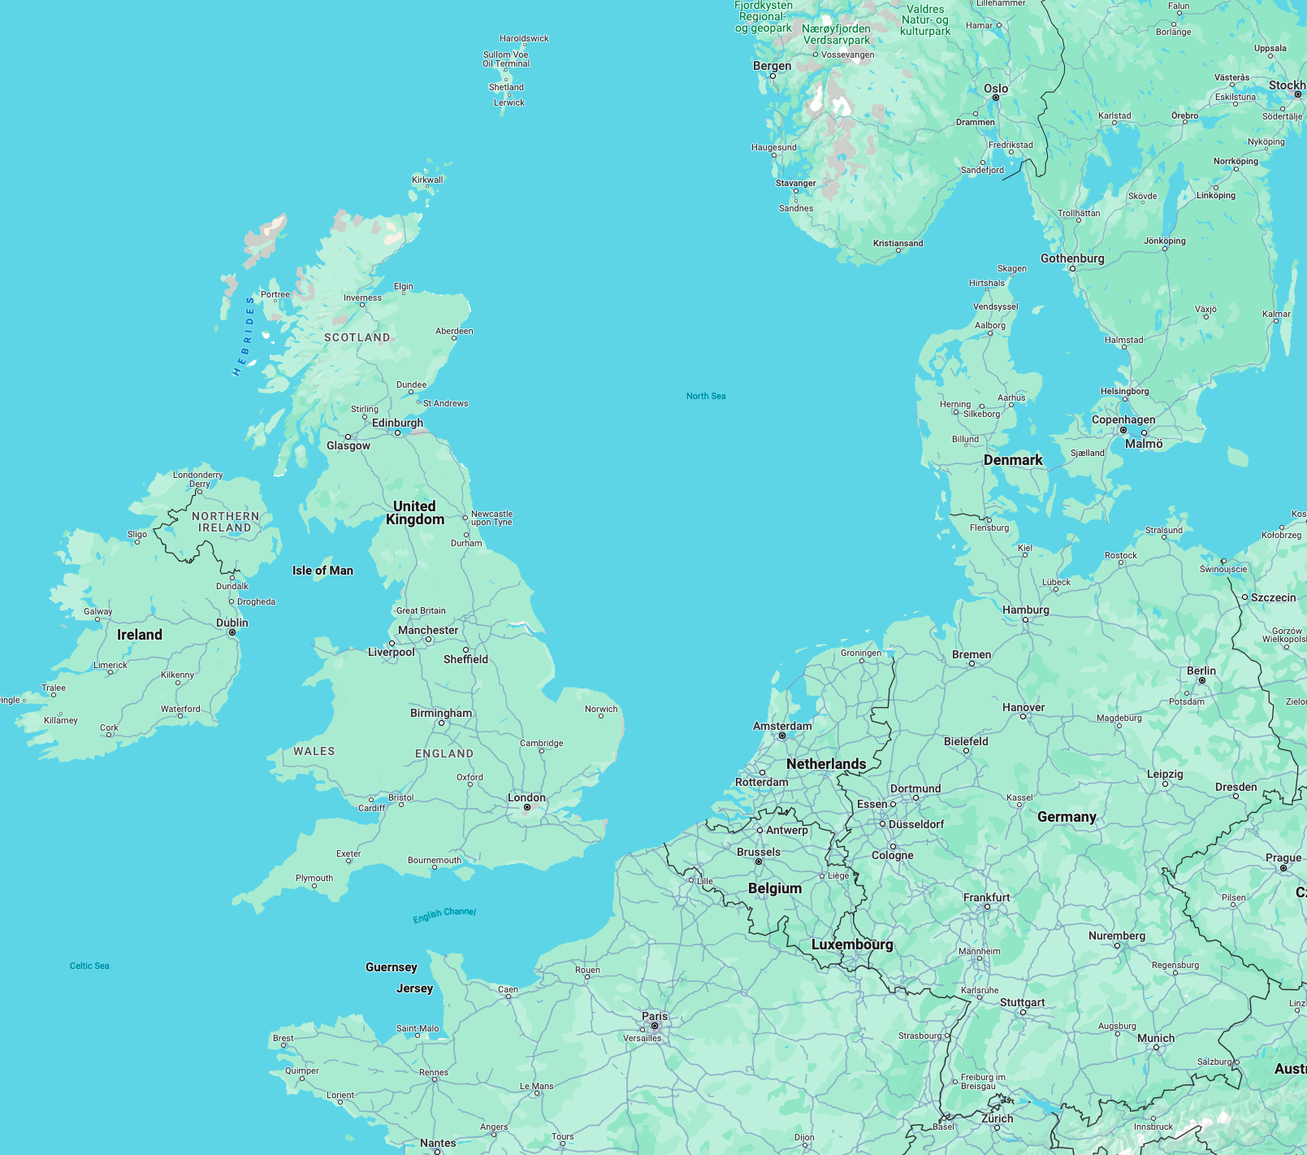
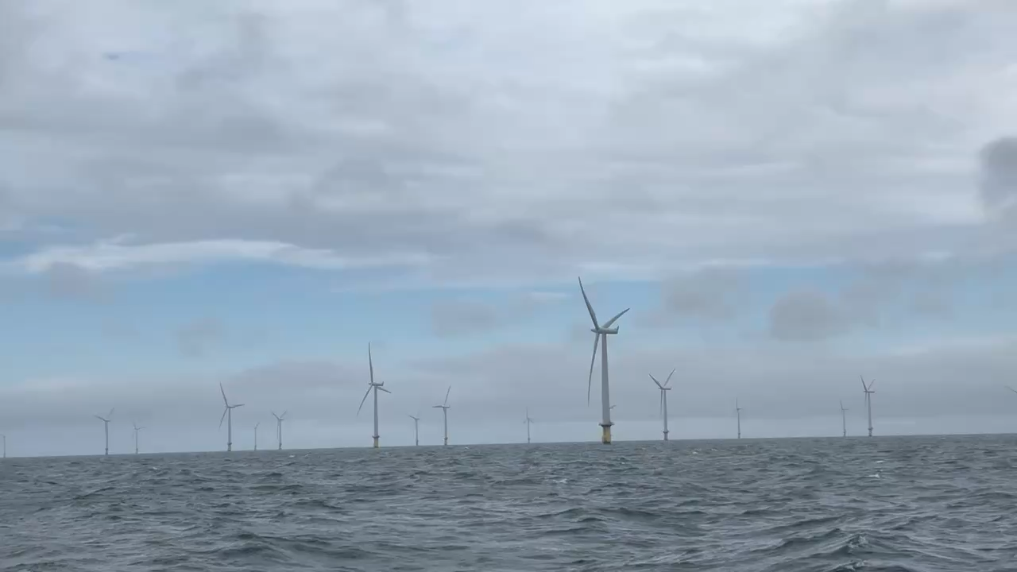
Offshore Windfarm eDNA Survey
91 Turbines; 209MW capacity. 30km offshore. 35 km².
Blade diameter = 93m
Tower height = 68m
LRAUV/ESP operations--June 6-18, 2024

Slide 11
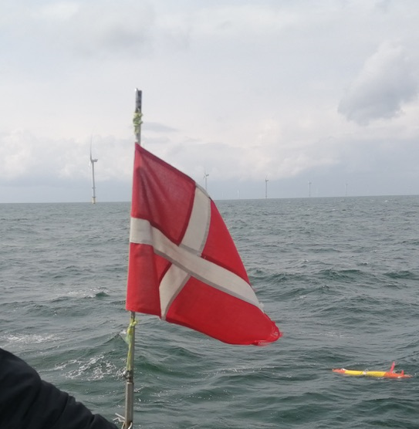
Offshore Windfarm eDNA Survey
June 2024 – Denmark – Biodiversity Monitoring
104 eDNA Samples
New Challenges:
Navigation within the windfarm & cathodic protection
Shallow (< 15m), large tides and current
Notes:
Denmark has 13 operational wind farms. We focused on Horn’s Reef II.

Slide 12
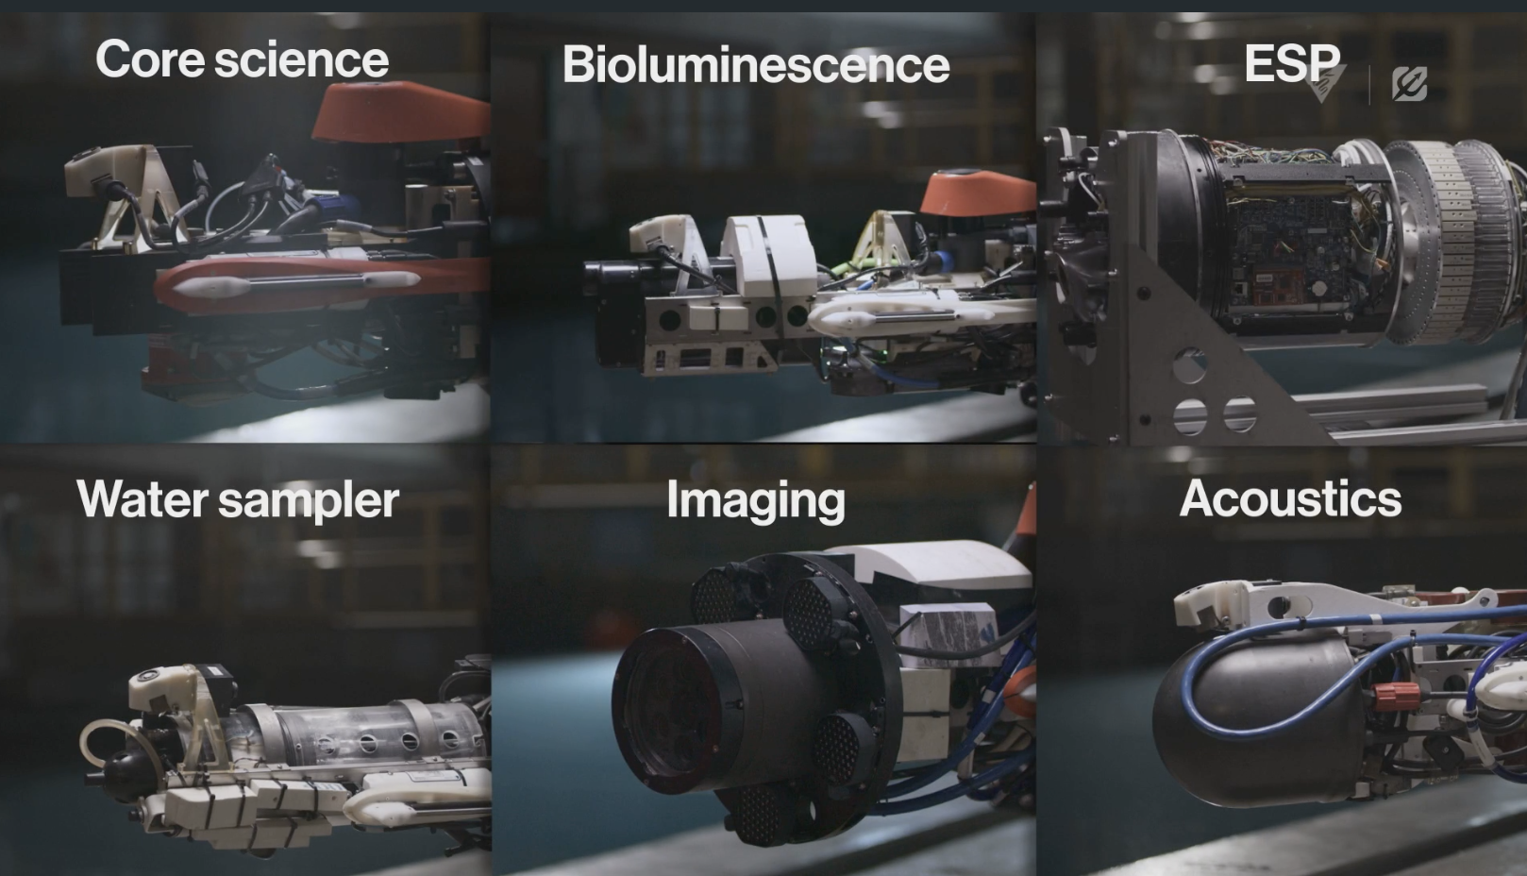
Increasing spatial and temporal coverage
Solution #1
  increase the fleet size
Solution #2
use complementary sensing/sampling modalities
inter-vehicle coms/ranging to target sampling
AUV Docking

Slide 13
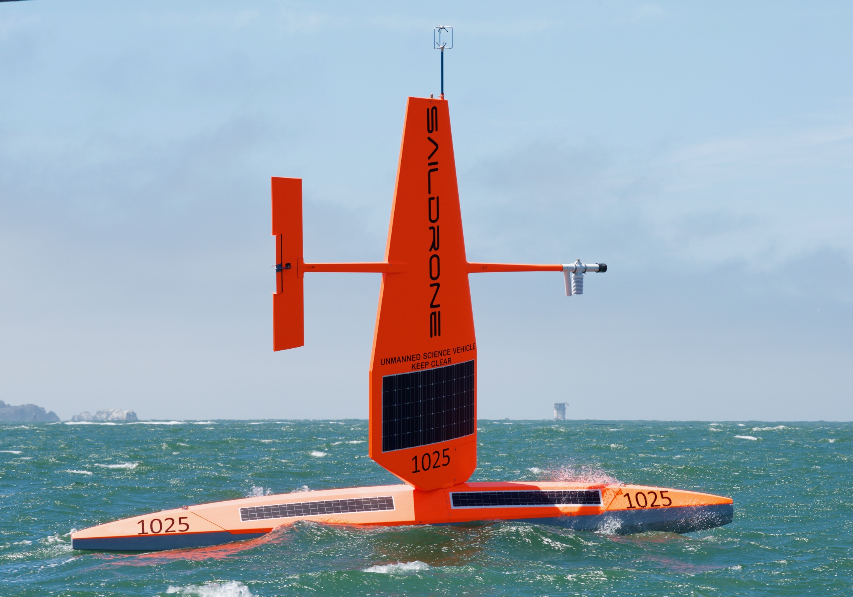
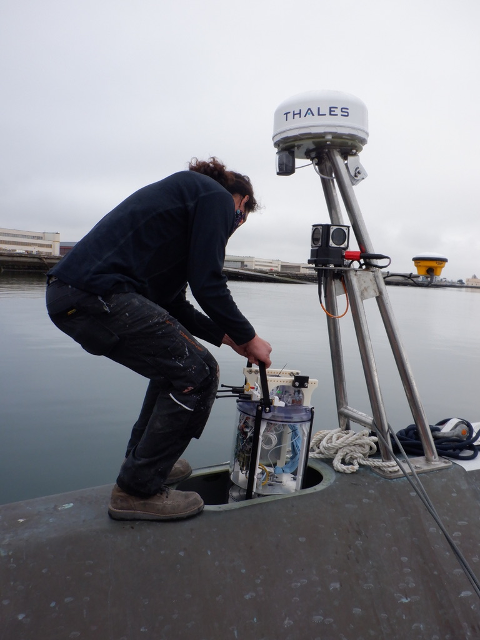
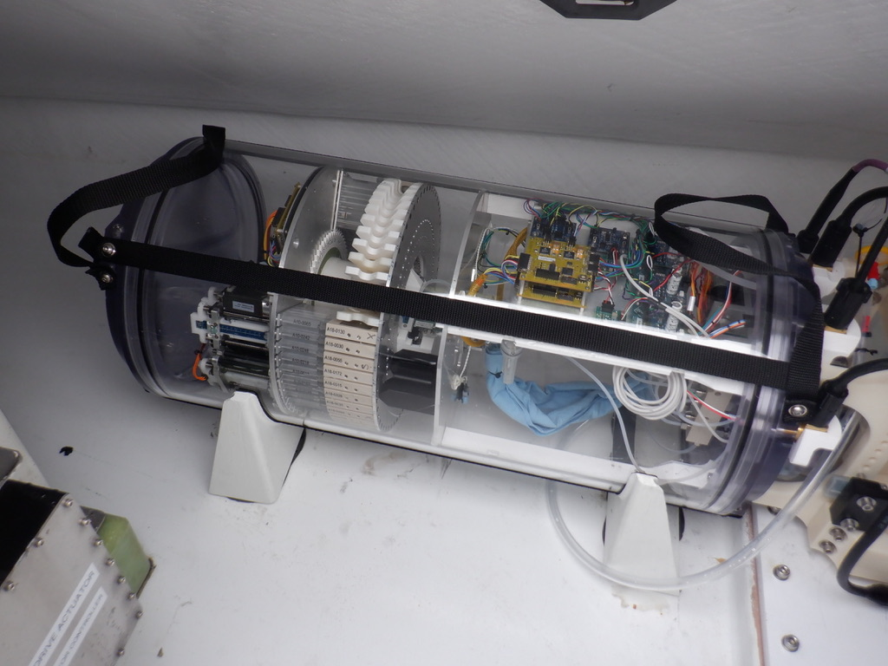
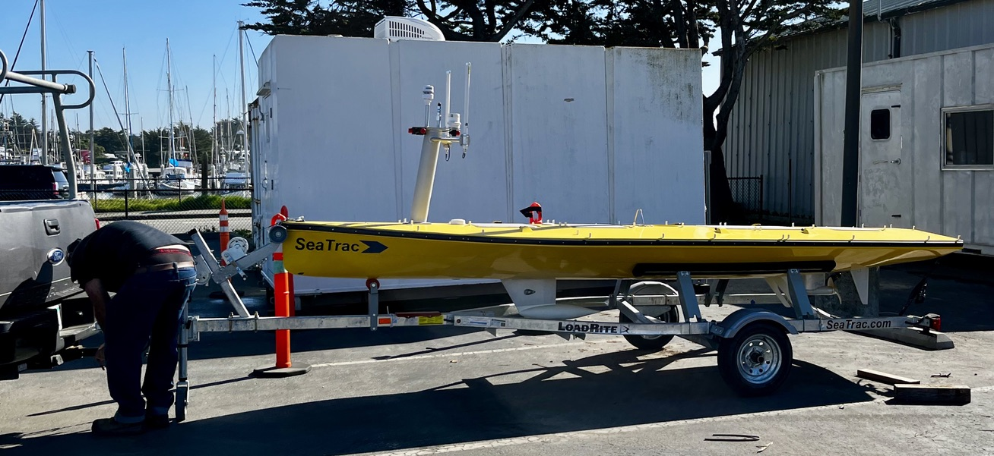
Increasing spatial and temporal scales
Solution #1
  increase the fleet size
Solution #2
complementary payloads
multi-vehicle ops
adaptive response
docking
Solution #3
multiple deployment platforms
Crewed ships
Saildrone Surveyor
- Seatrac
- Tidewise Tupan (in progress)

Slide 14
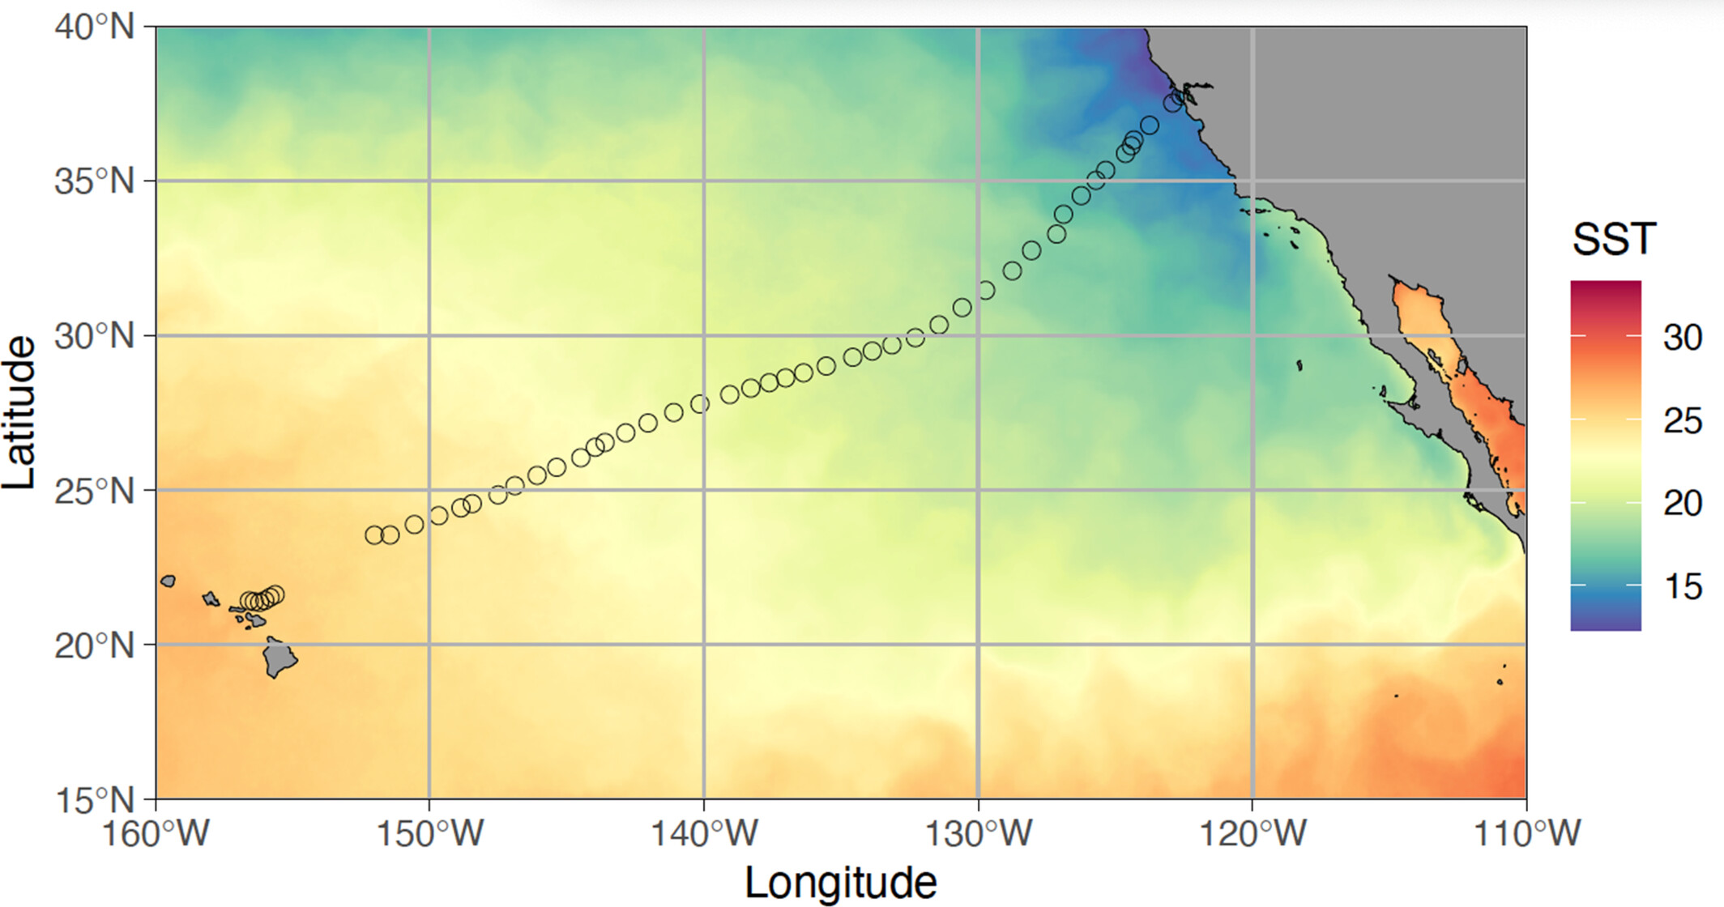
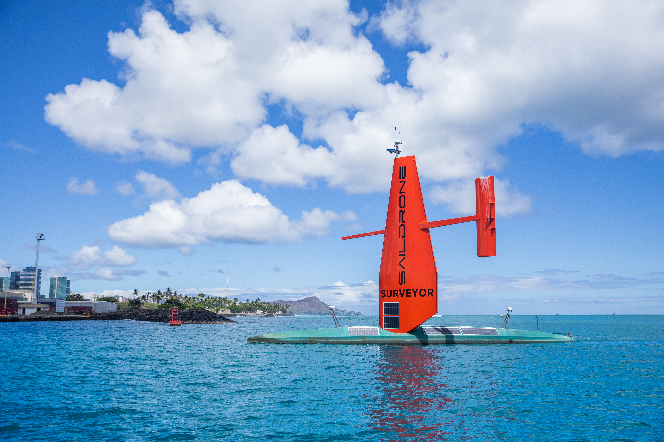
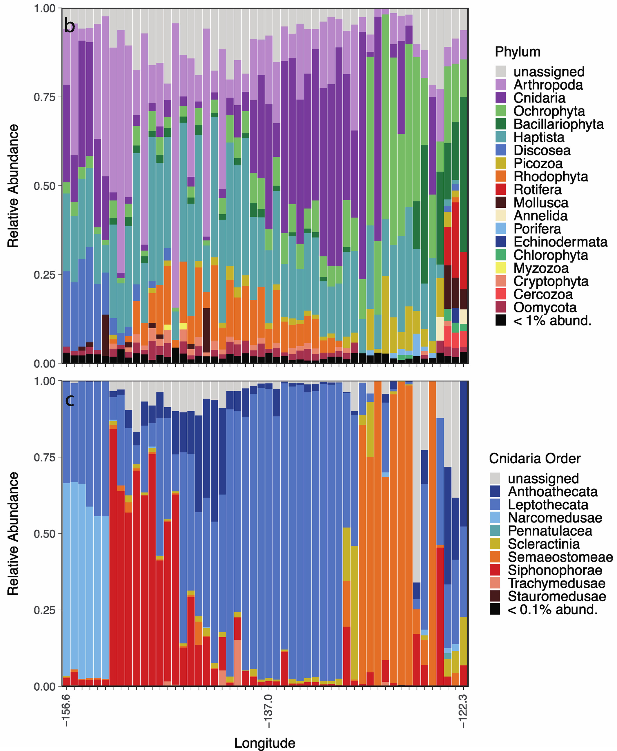
Saildrone Surveyor CA to HI
2021 – CA to HI – 29 days, 4200 km, 52 eDNA samples
Combined with seafloor mapping
Preston, C., et al., Environmental DNA, 6, e468. https://doi.org/10.1002/edn3.468
Notes:
When we begin to start deploying these types of instruments on autonomous surface vehichles, such as Saildrone surveyor here we can increase the spatial coverage of biodiversity observation through eDNA. Here I am showing a deployment of the ESP onboard the Saildrone Survey on a deployment from Califronia to Hawaii, where we collected 52 eDNA samples over 4200 km and the result relative abundance of taxa returned through metabarcoding of CO1 and we can drill down into the metabarcoding data to investigate changes in the cnidarian population of the transect.
Coupling these autonomous eDNA samplers with autonomous surface vehichle like saildrone surveyor is providing the ability to collect biodiversity data with eDNA over large spatial areas.
Rodney saildrone testing technology for Aleutians.

Slide 15
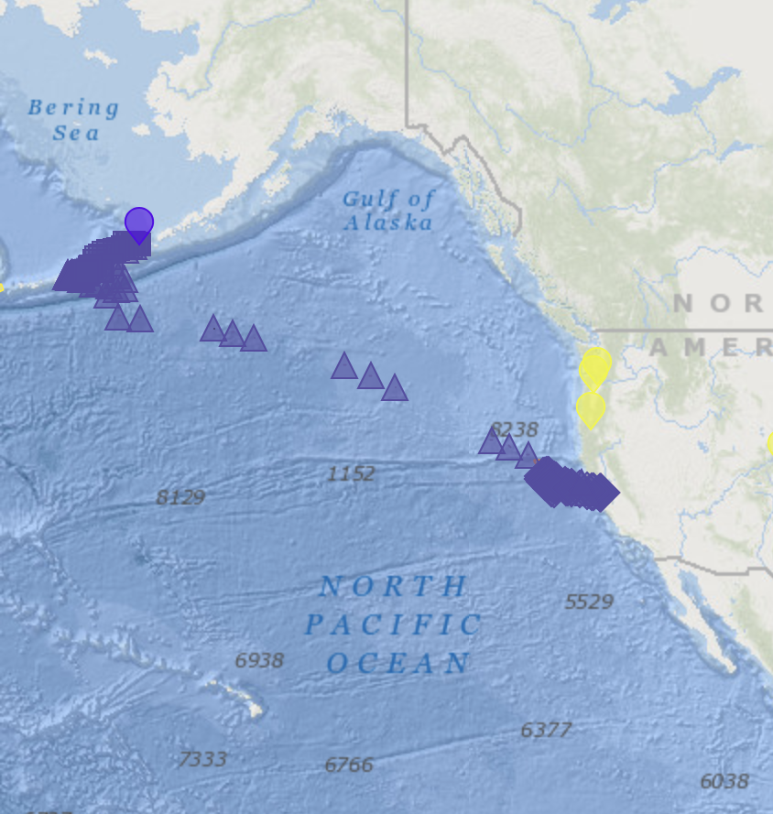
Saildrone Surveyor CA to AK
August 2022 – February 2023 (110 days)
45,000 km² seafloor mapped
163 eDNA samples over 17,000 km traveled
Notes:
Notes from Neah’s Mission Posts: 2/22/23
At least 50% of the area was previously unmapped
1.5 X size of Massachusetts
20 X size Luxemburg
August 2022 – February 2023
45,000 km² seafloor mapped over 96 mapping days
163 eDNA samples collected over 17,000 km traveled
All performed autonomously, overseen by pilots all throughout the US.

Slide 16
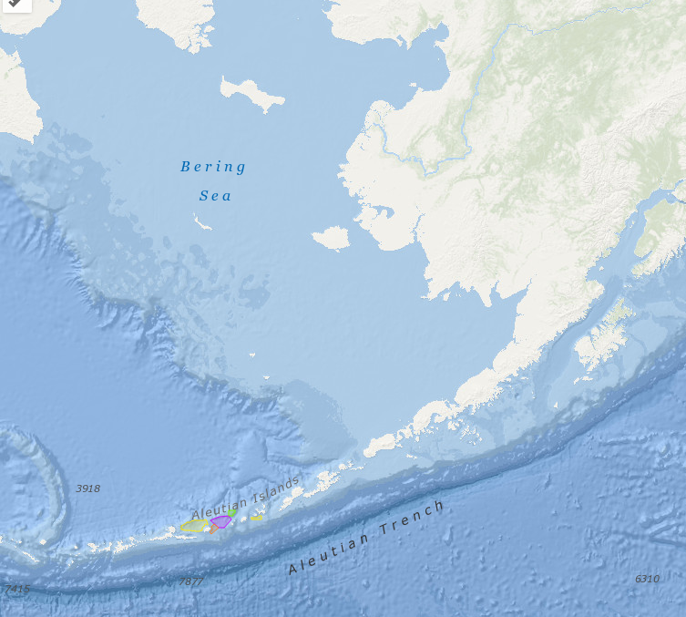
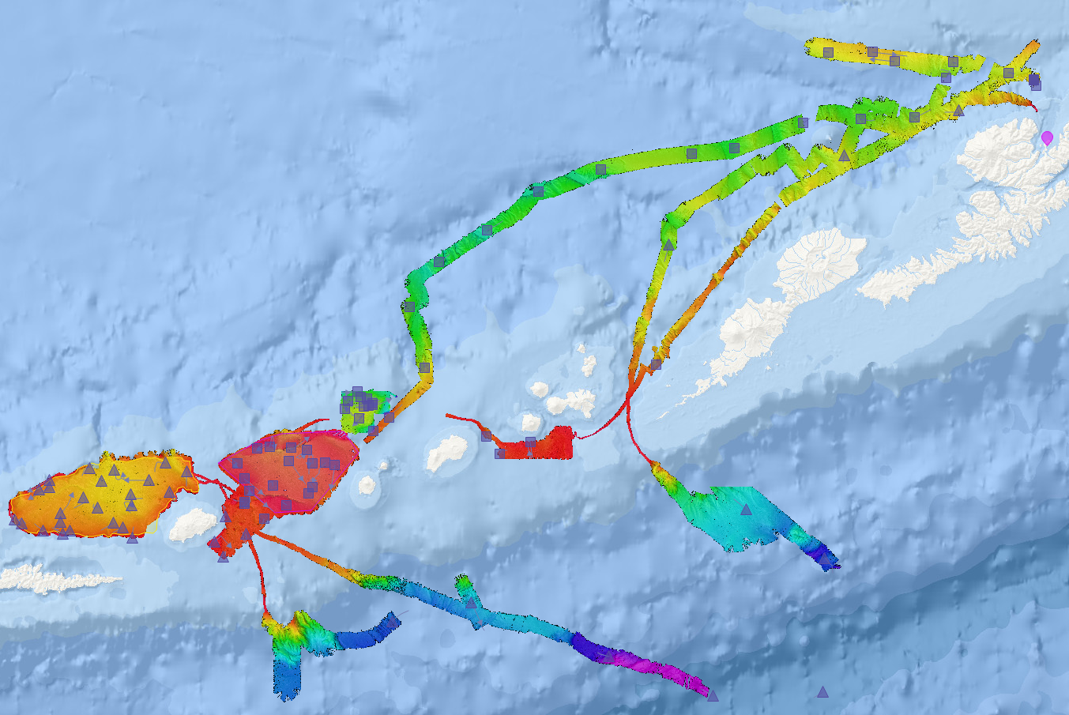
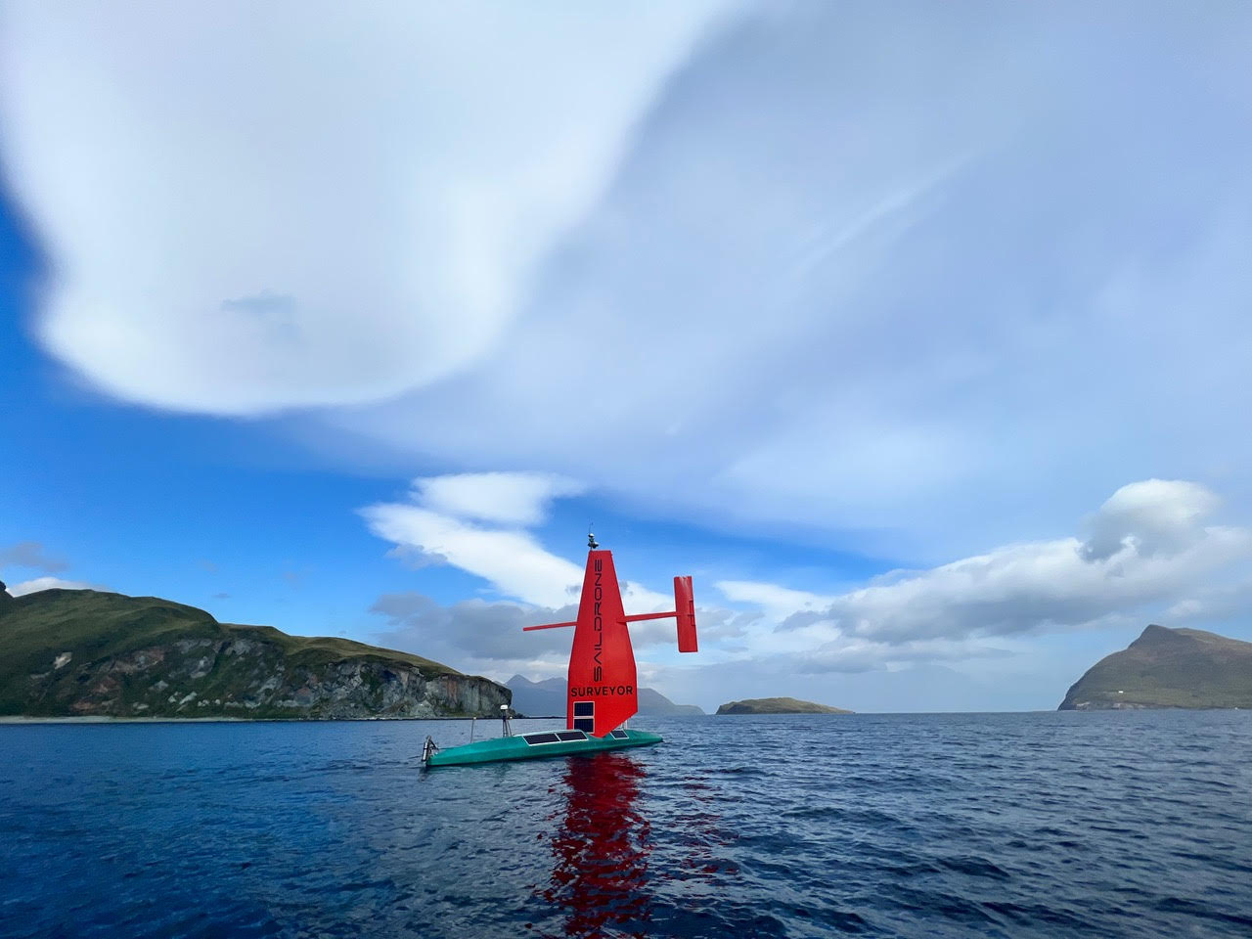
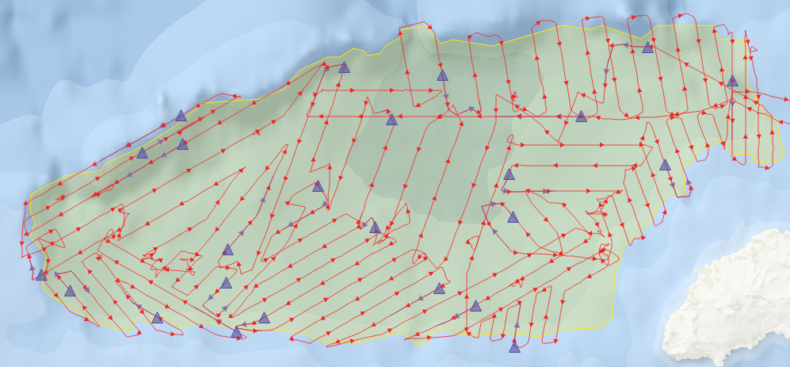
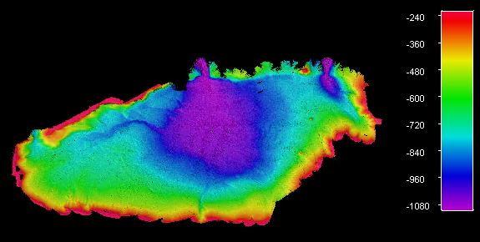



Aleutian Islands: eDNA sampling & mapping leg
Alaska
50 nm
97 eDNA samples collected along the Aleutian Islands
August 12 to October 3, 2022
Amlia Basin
10 nm
Notes:
The expedition focused on a 300nm region of the Aleutian Islands west of Dutch Harbor. Filtration of eDNA samples occurred while SD-1200 was underway and mapping the seafloor in priority areas identified by X. An example of the mapping path of Amlia Basin and the location of eDNA samples collected.
US Department of Interior: Bureau of Ocean Energy Management
300nm from Dutch Harbor to Western point Amlia Basin
August 12 to October 3. Sampling within Aleutian Chain
Winds up to 40+ kn and gusts to 50+ kn (58 mph)
Seas up to 8+ m (26 ft)
Still sampling during as transit back to Alameda.

