Slide 1
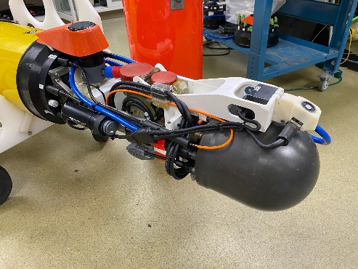
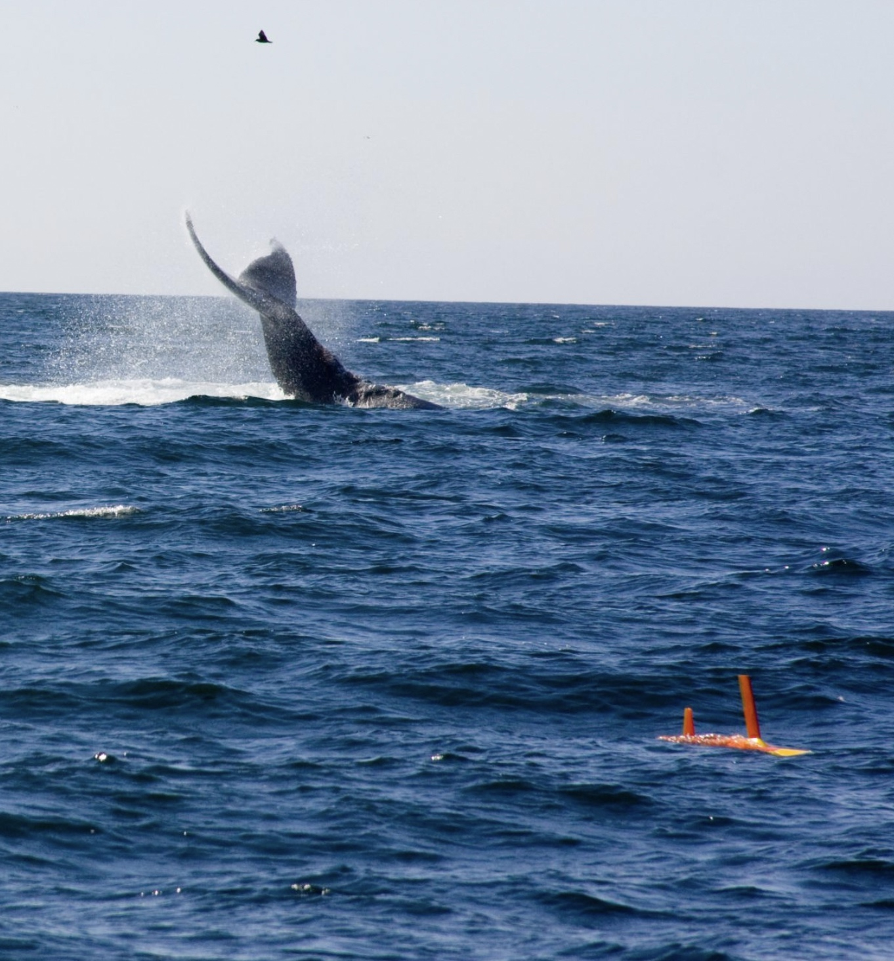
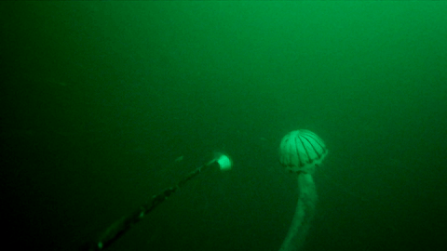
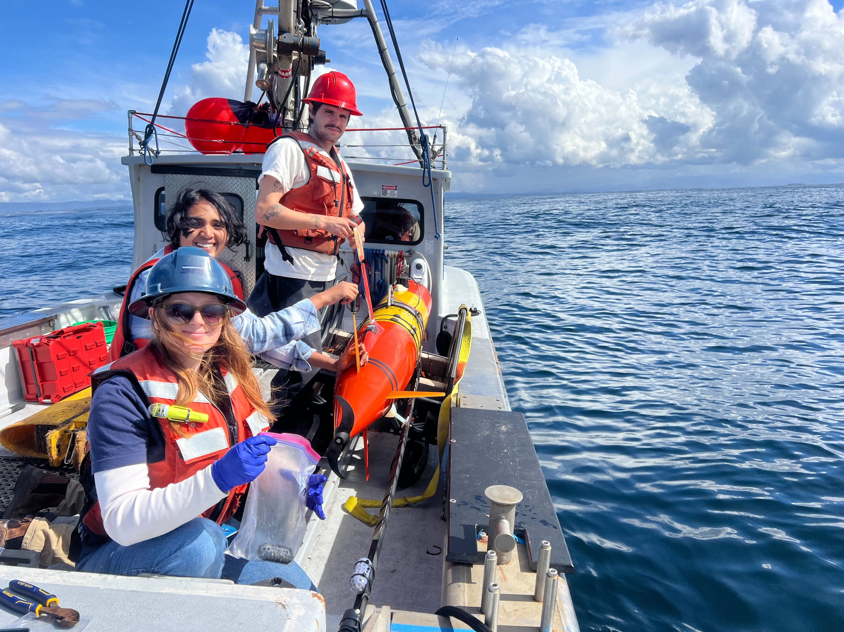
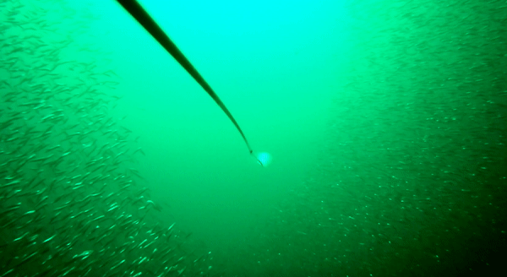
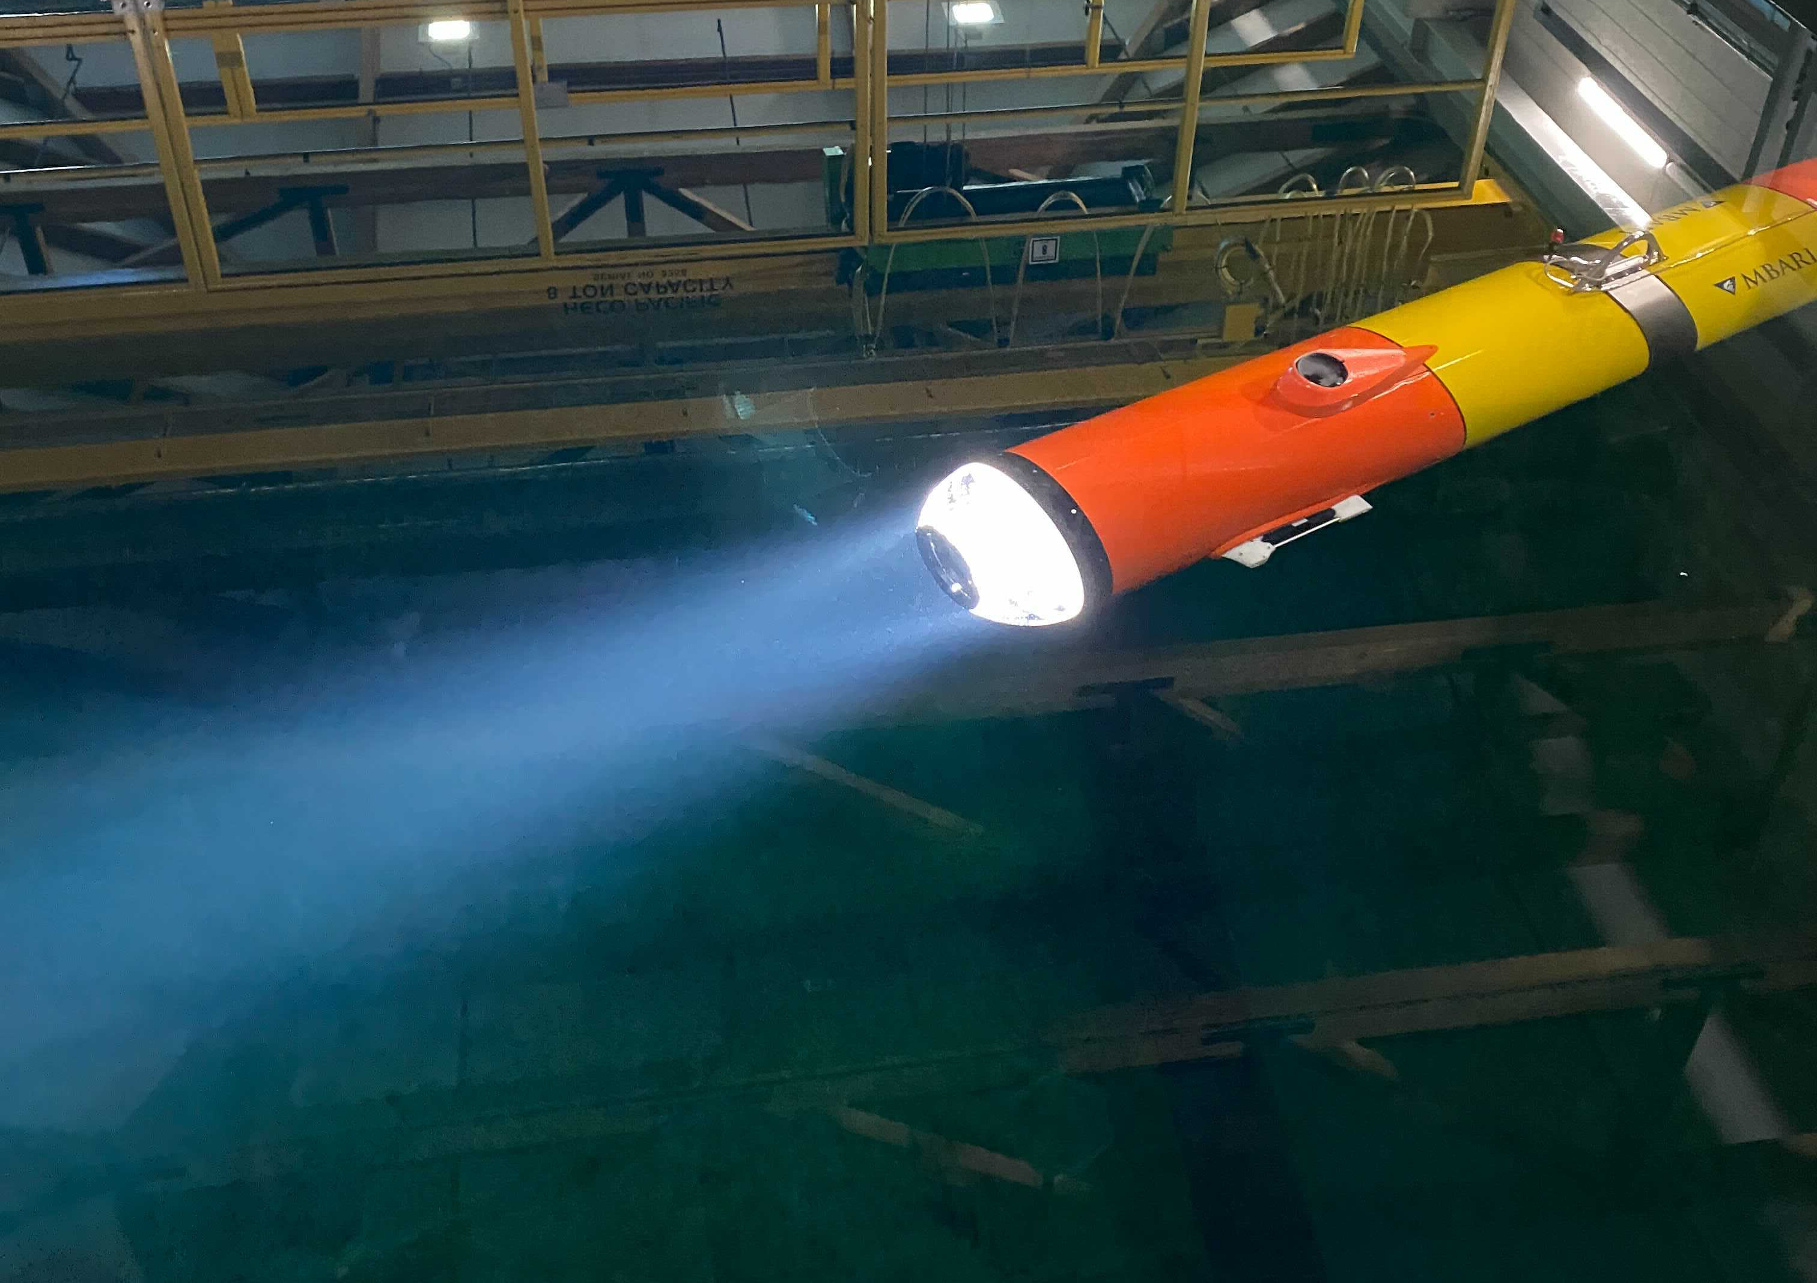
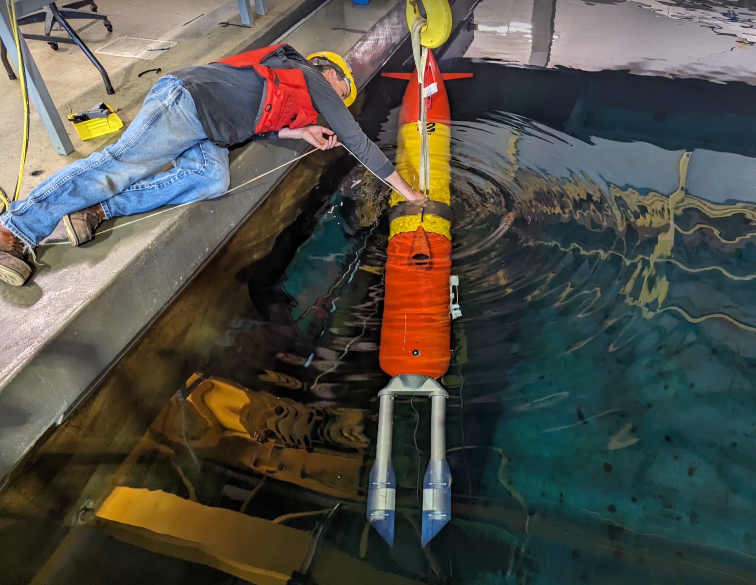
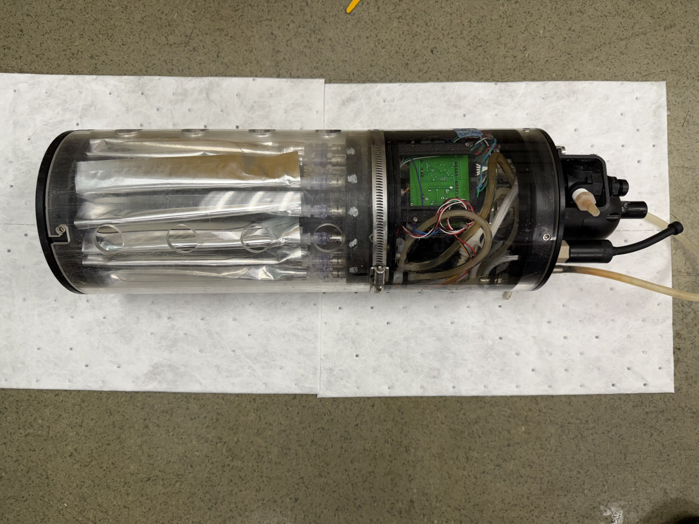
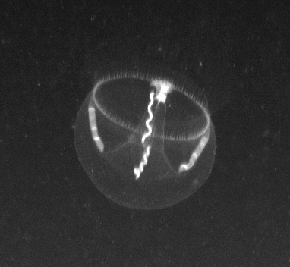
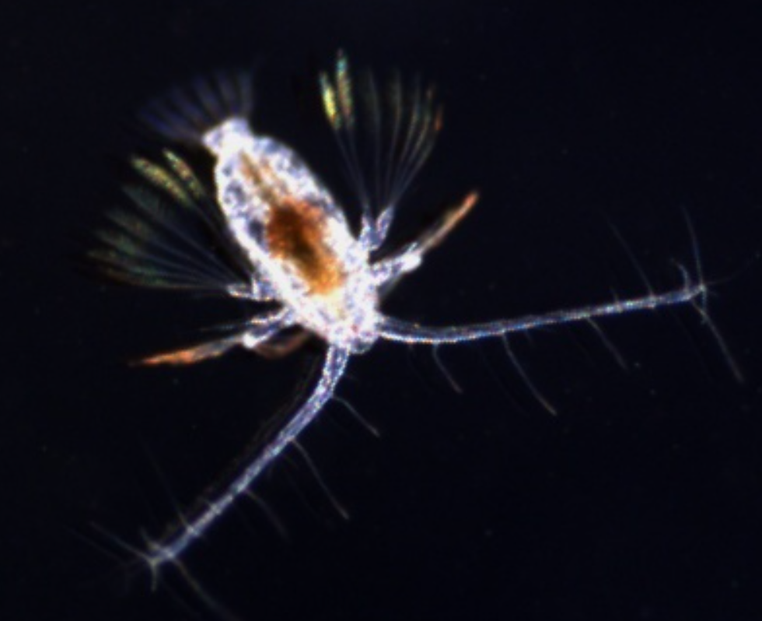
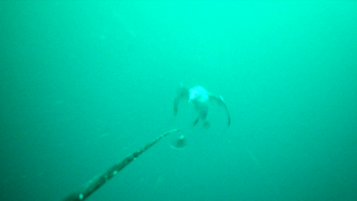
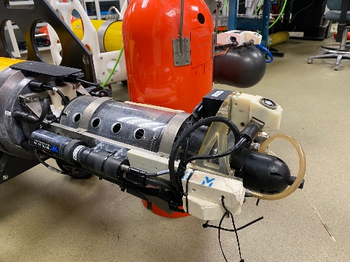
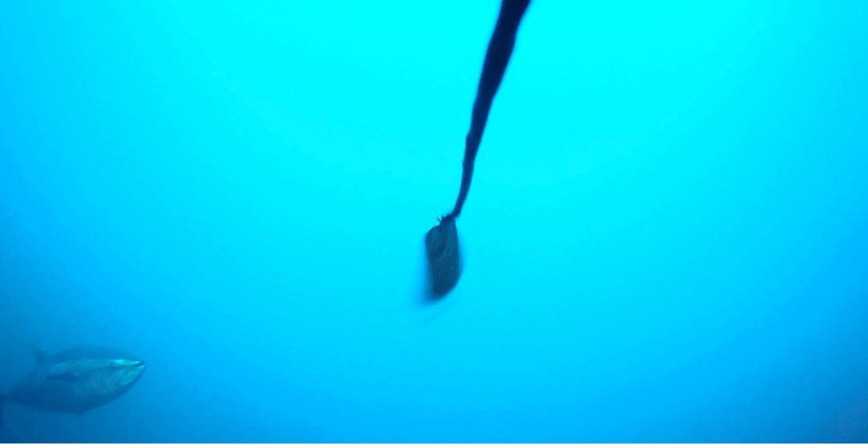
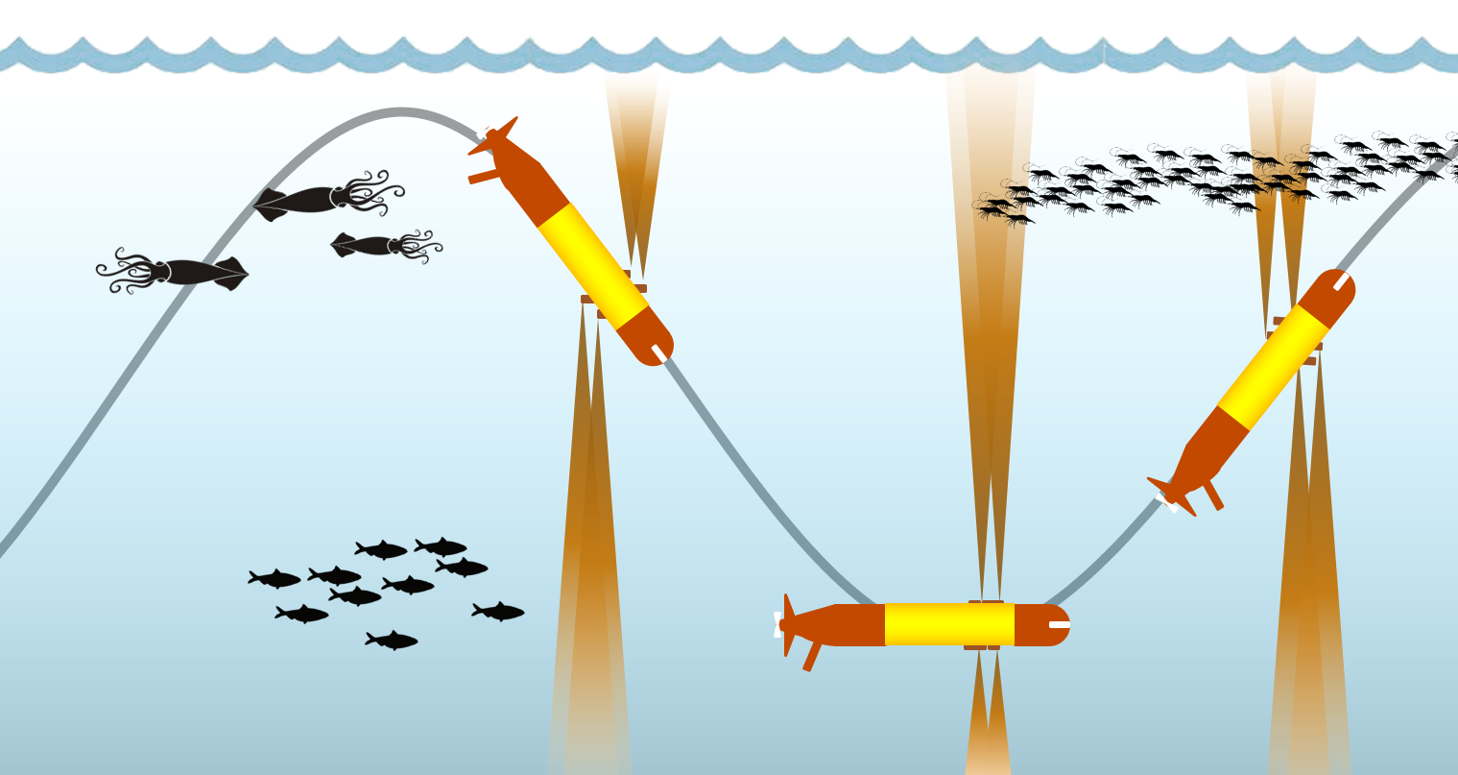
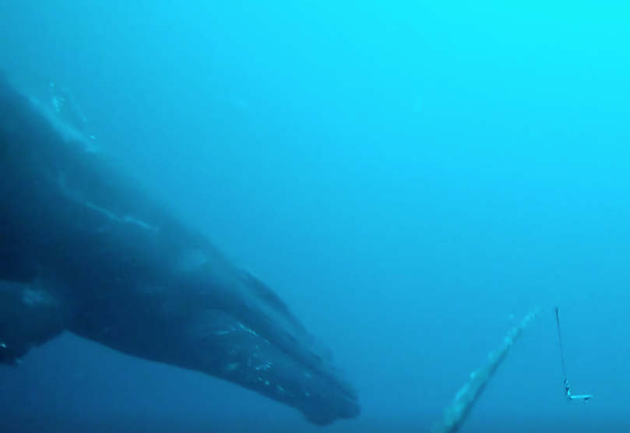
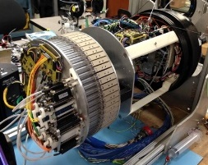
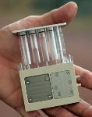
LRAUV Payloads for Water Column Observations
*
Bioacoustics
  active
  passive
Imaging
  Planktivore 20µm-2cm
  Triton 1mm-20cm
  Piscivore 10cm-10m
Water collection (whole)
eDNA collection/preservation
  toward real-time eDNA analysis
* used in CANON25
*
300k Lumen Strobe
253 MP 7 Camera Array
2 L Imaged Volume
@ 50 um Resolution
*
Oct 2014

Slide 2
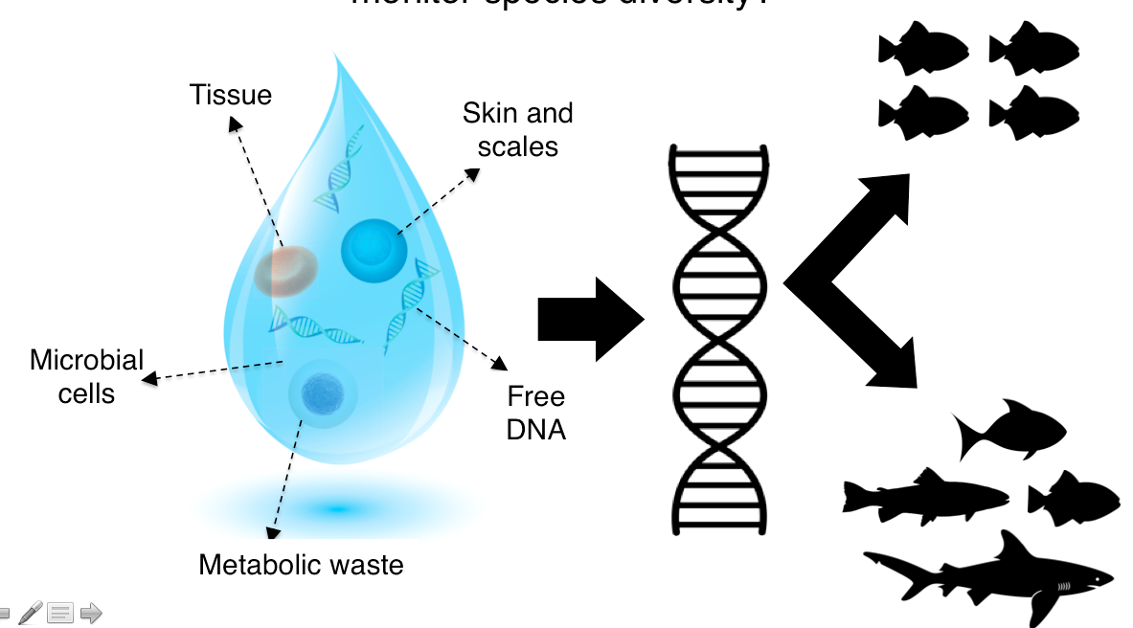














Environmental DNA
A cheaper, less invasive and larger scale approach to monitor species diversity – two approaches: next generation sequencing (NGS) or species specific primers, latter is easier
Each marker targets a different group of organisms.
12S rDNA
Vertebrates
?
COI
Invertebrates, some vertebrates, & phytoplankton
18S rDNA
Phytoplankton & invertebrates,
some vertebrates
16S rDNA
Microbes
(Bacteria & Archaea)
After Djurhuus et al. 2017 Frontiers in Marine Science

