Slide 1
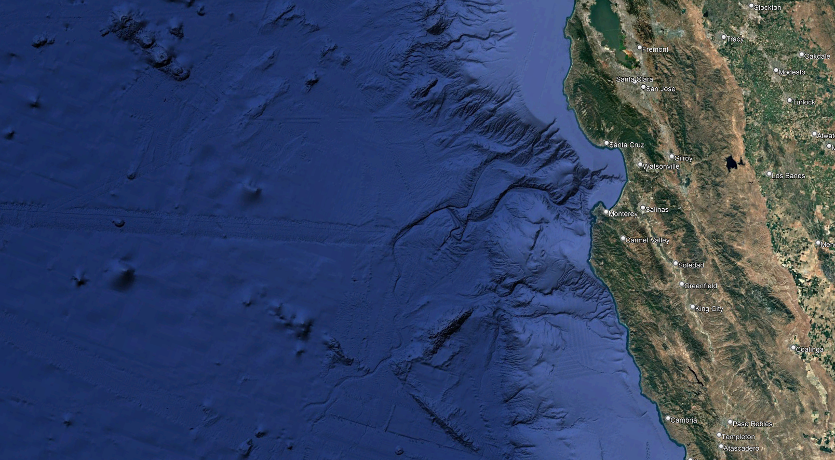
Mobile Pelagic Observing System
The Challenge:
How Can We Monitor a Dynamic 3-D Ecosystem, In the Open Ocean, Far from Shore?
Persistence – 24/7 to match natural variability
Mobility – throughout the water column
Appropriate Sensing to Observe: Microbes, Phytoplankton, Zooplankton, Forage Fish, Predator Fish and Mammals
Time-Series plus Targeted Sampling
Brett Hobson, hobson@mbari.org

Slide 2
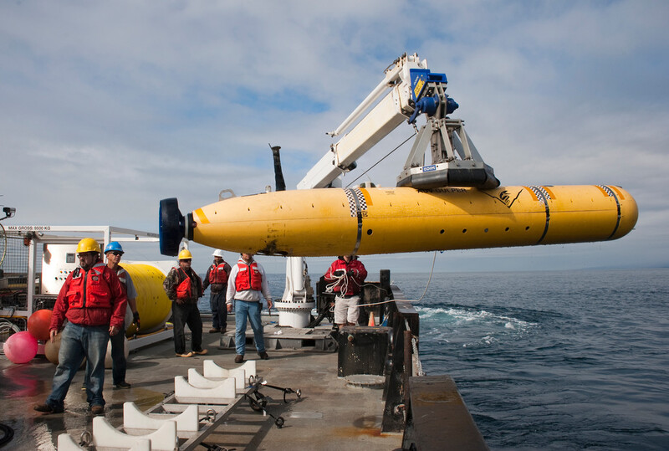
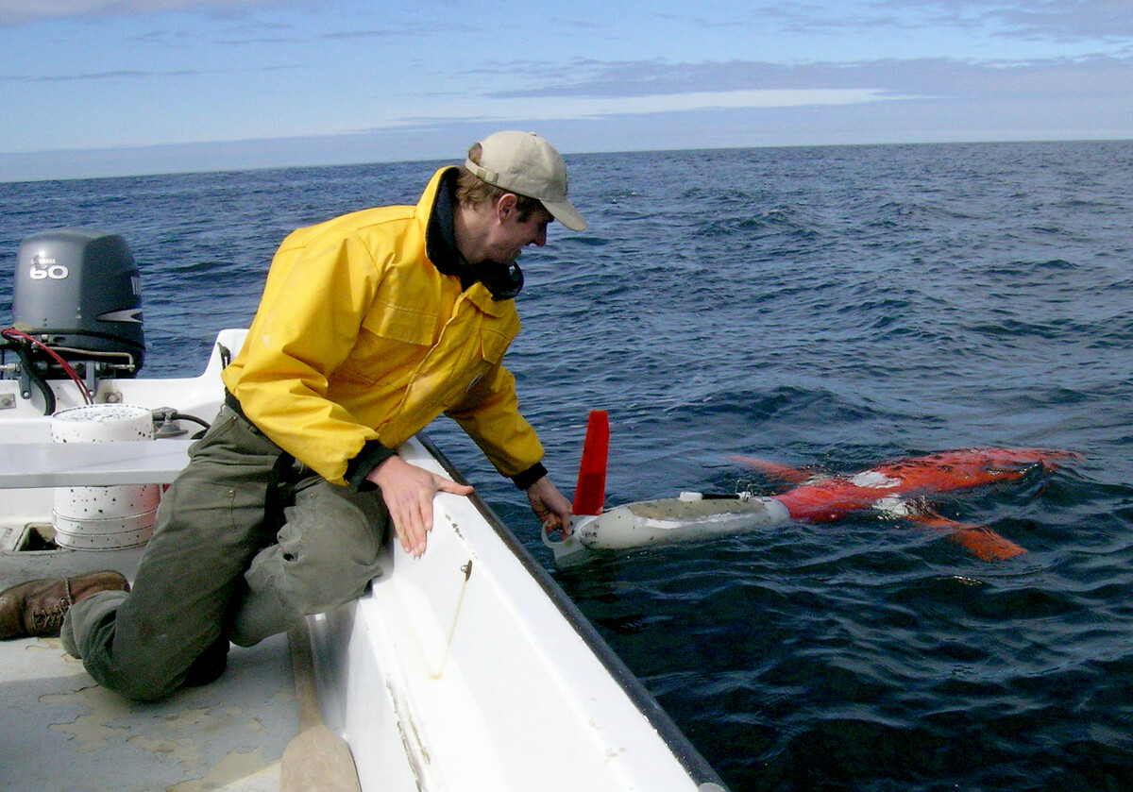
Available Options:
Large AUVs, like MBARI’s Dorado
Easy to add instruments, lots of power and fairly fast
Ship-supported
Up to a Few Days of Endurance
Small Buoyancy-Driven Gliders, like MBARI’s Spray
Great Endurance – months
Easy to deploy near shore
Slower than some offshore currents
Difficult to integrate instruments
Notes:
Continuous Stream of Improvements:
Enhanced Command & Mission Control
Full support for TethysL mission scripts
Improved "Send via" options with configurable timeouts
Command queue management with cancellation ability

Slide 3
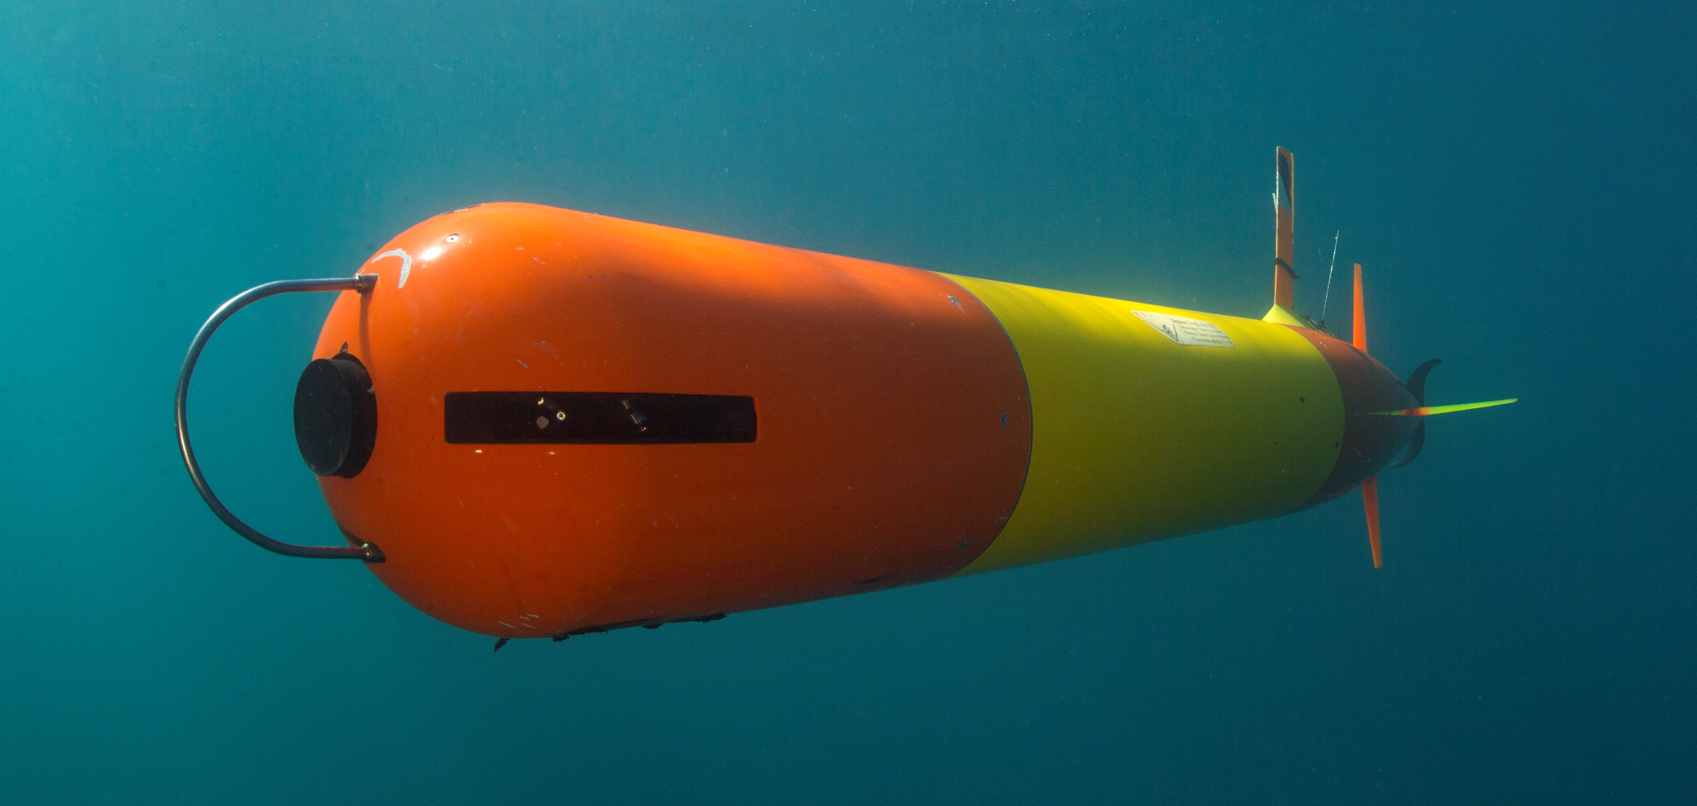
Available Options:
Large AUVs, like MBARI’s Dorado
Easy to add instruments, lots of power and fairly fast
Ship-supported
Up to a Few Days of Endurance
Develop A New Option: - Long Range AUV (LRAUV)
Medium sized, propeller driven AUV
Expandable Payload
One-month Endurance
Small Buoyancy-Driven Gliders, like MBARI’s Spray
Great Endurance – months
Easy to deploy near shore
Slower than some offshore currents
Difficult to integrate instruments
Notes:
Continuous Stream of Improvements:
Enhanced Command & Mission Control
Full support for TethysL mission scripts
Improved "Send via" options with configurable timeouts
Command queue management with cancellation ability

Slide 4
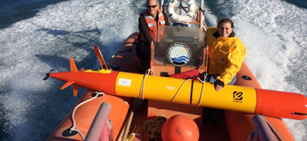
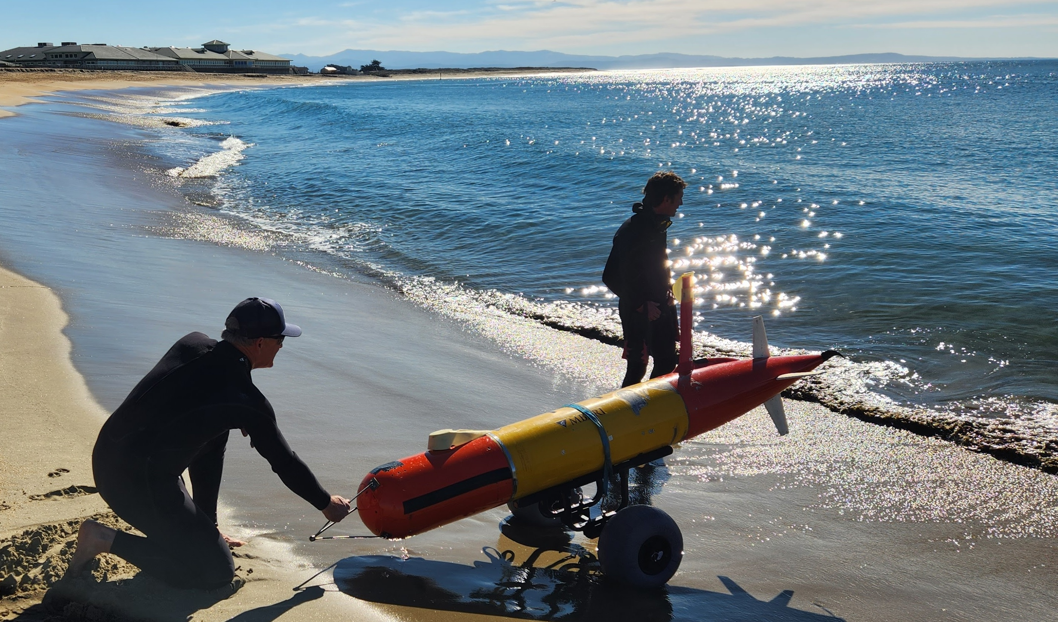
LRAUV - Key Characteristics
Length: 6.6 – 10.4 ft (2-3 M)
Diameter: 1 ft (0.3 M)
Weight: 243-350 lbs (110-160 kg)
Speed: 0 – 3 knots
Range: 200km - 1000 km +, Depending on Payload
Battery: 5.7 kW-hr Rechargeable or 14 kW-hr Primary
Low-Speed/Long range or Optional High Power Payloads
Shipless Operations - Submarine verses a Submersible
Neutrally Buoyant at Depth – Efficient Cruise + Lagrangian Drift
Mature: Over 60,000 Hours of Offshore Operations, commercially available from Saab

Slide 5
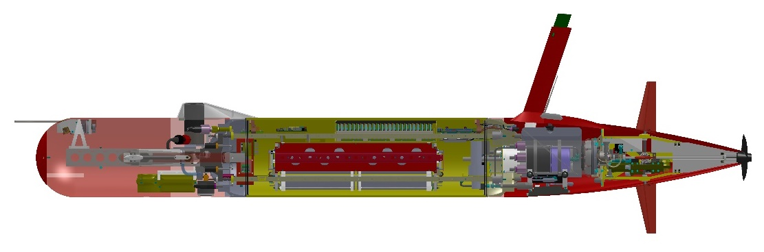
Core Vehicle Features
24 Channel Load/Comms Control
Antenna Mast Sat/Cell/WiFi/Argos/VHF
Antenna Mast
Core Science Payload
24 Channel Configurable Load Control
High Efficiency Direct Drive Thruster
Backseat Computer
1/3 Watt Main Computer
Backseat Computer
Main Vehicle Computer
Direct-Drive Thruster
Open Payload Bay
1L Variable Buoyancy
Open
Payload Bay
Paired Elevators and Rudders
Move-able Mass Battery Pack
Variable Buoyancy System Plus Emergency Drop Weight
Move-able Battery Pack

Slide 6
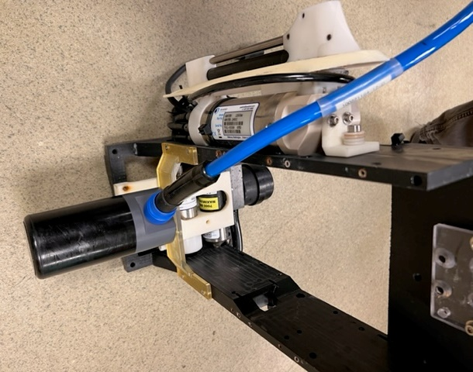
LRAUV Core Sensors
Always take the vital signs of the ocean
CTD
Seabird GPCTD
Acoustic Modem + iUSBL Benthos DAT
Chlorophyll + OBS
Wetlabs Triplet Puck
Dissolved Oxygen
Seabird SBE-43

Slide 7
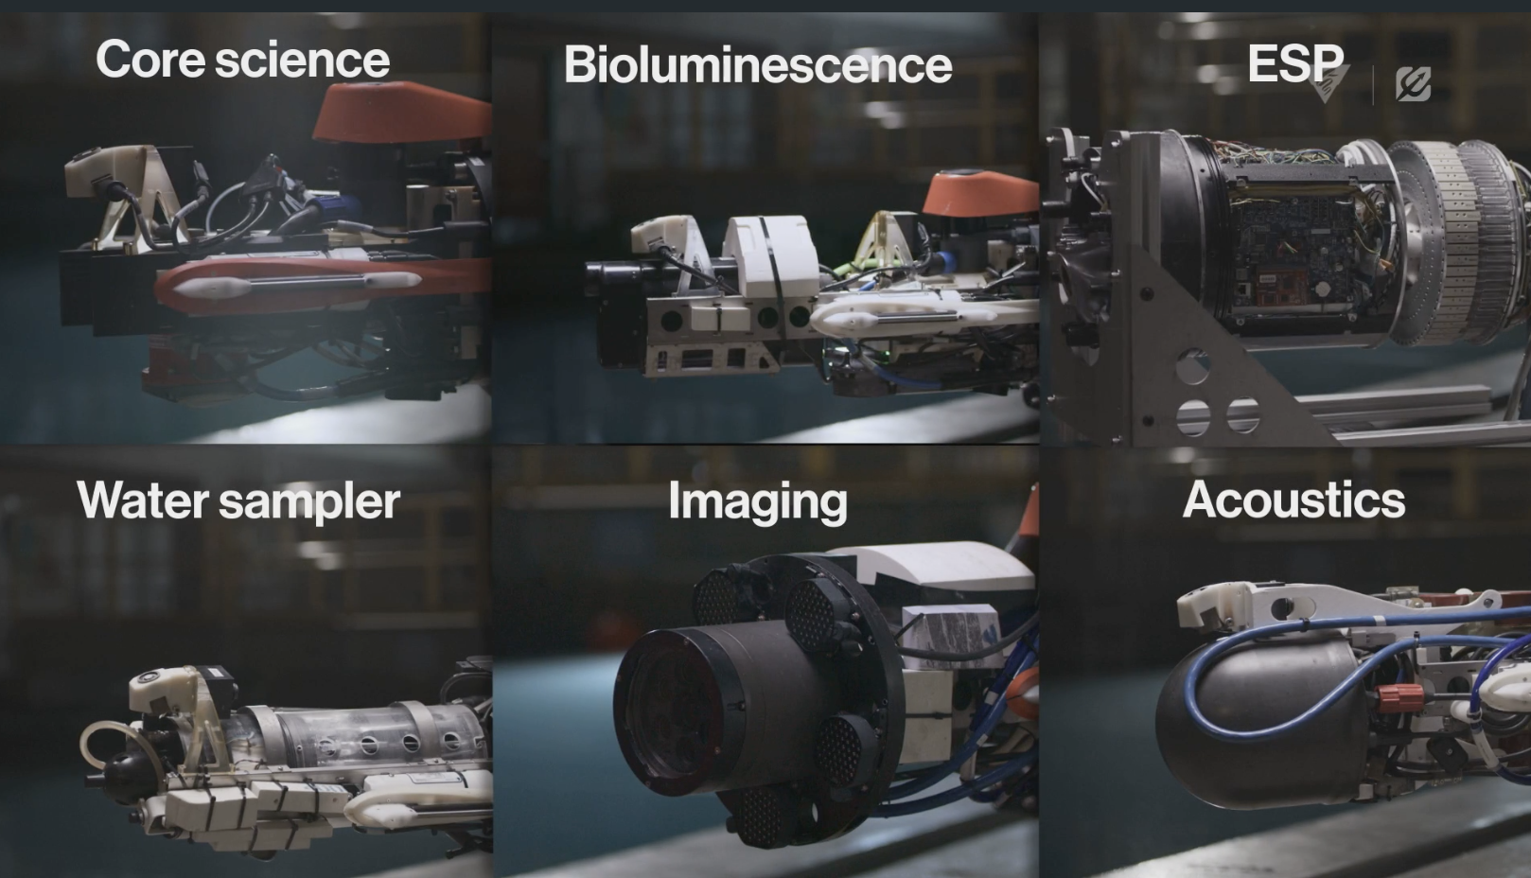
Operational LRAUV Payloads

Slide 8
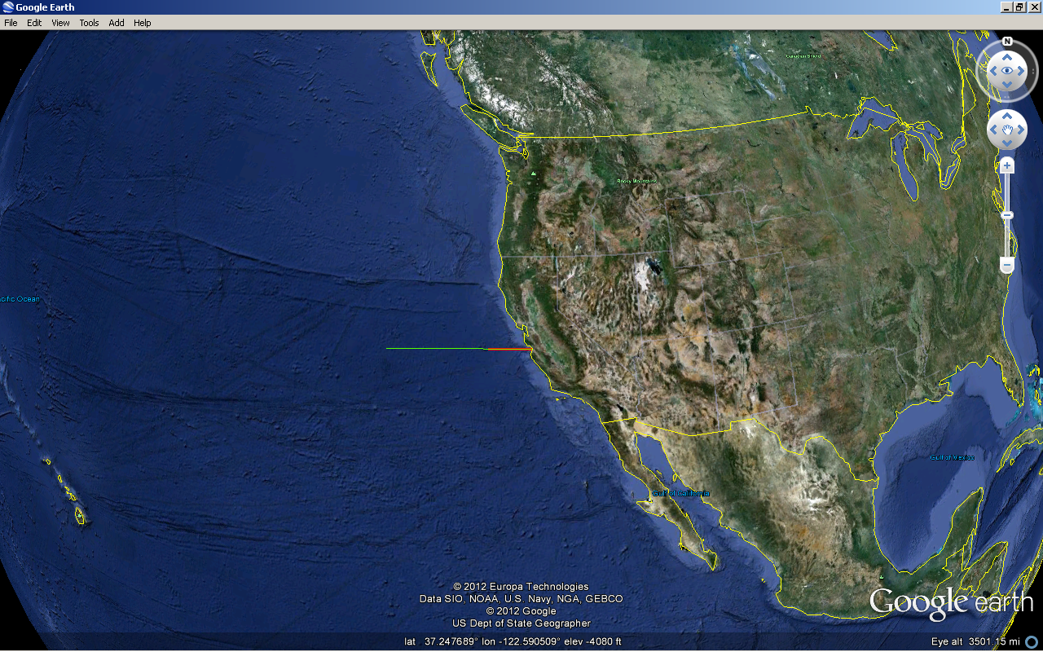
Operational Range:
Primary Batt: 2000 km
Rechargeable: 1000 km

Slide 9
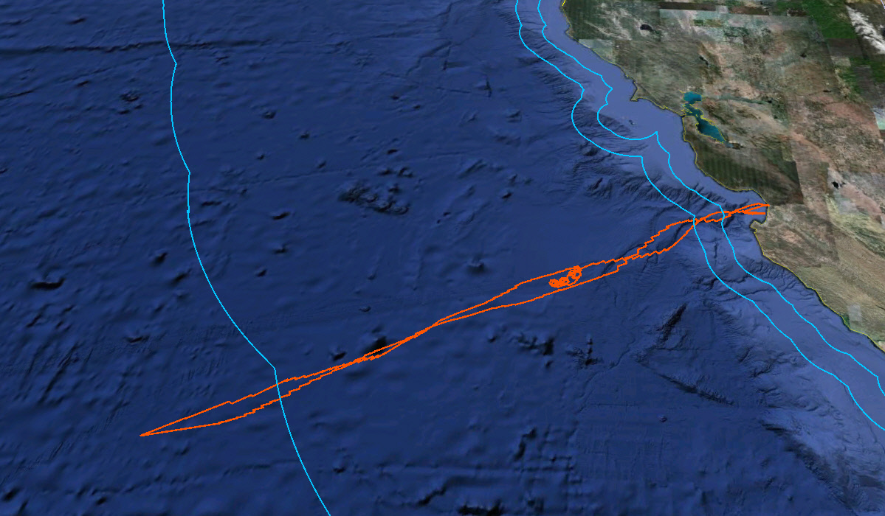
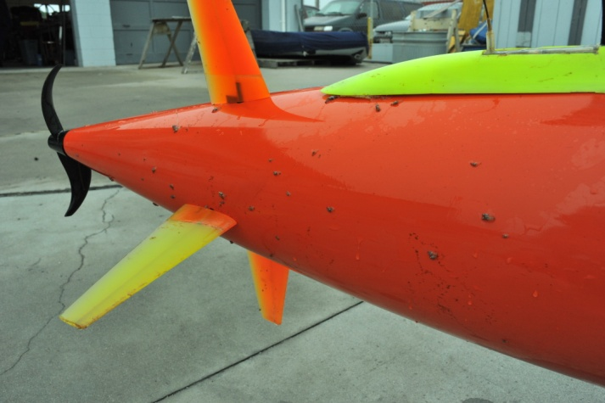
Tethys AUV Offshore Run, September 2010
  24 days, >1800 km, 500 km offshore, Three different missions
    Bottom Boundary Layer Experiment (NPS/MLML Collaboration)
200 MILE U.S. EEZ BOUNDARY
CANON Drifter Tracking
500 km offshore on CalCOFI Line 69
Goose Barnacles

Slide 10



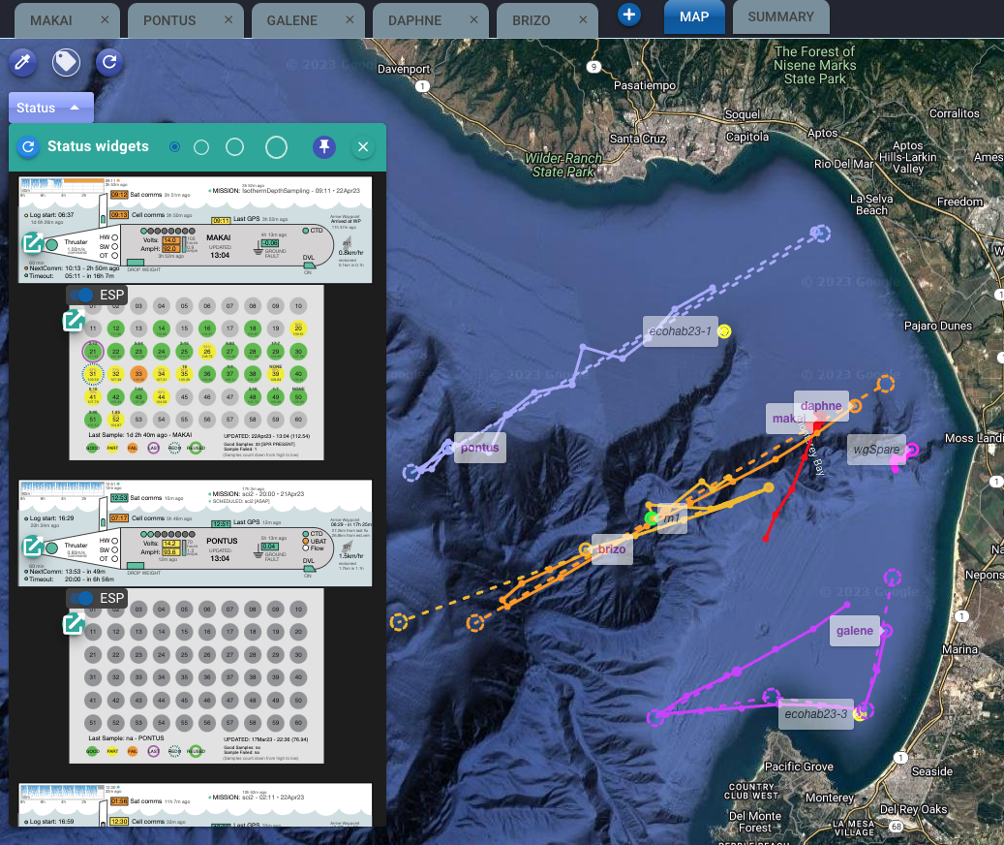
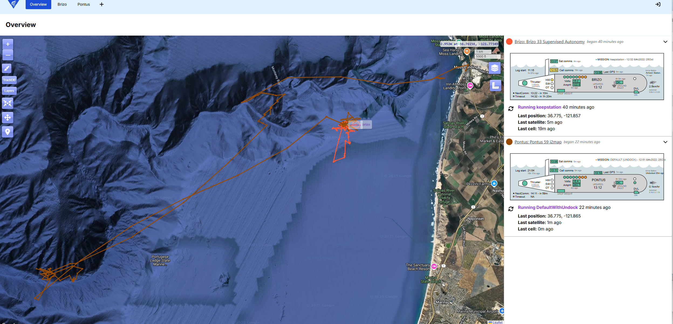
TethysDash System
LRAUV Command and Control Interface
Dash UI
Dash V4
Dash V5
TethysDash
Server/Backend
TrackDB
Situational Awareness
Other assets
Notes:
Continuous Stream of Improvements:
Enhanced Command & Mission Control
Full support for TethysL mission scripts
Improved "Send via" options with configurable timeouts
Command queue management with cancellation ability

Slide 11
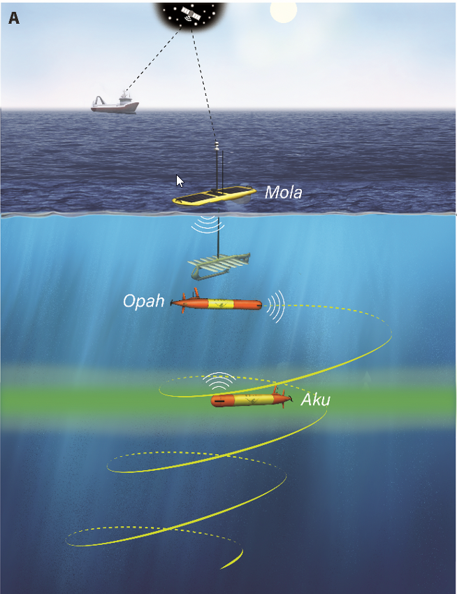
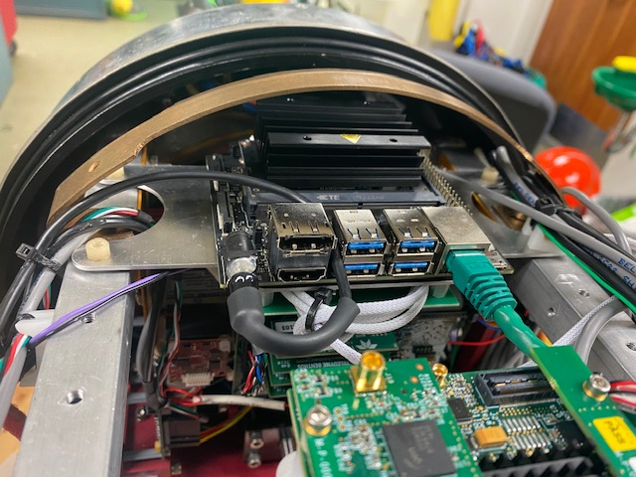
Open Architecture
Easy 3rd Party Integration
Backseat Computer (BSC) Architecture: High performance computers; 3rd party applications; High-rate sensors; Machine learning
Front-seat API – Open source LCM Protocol
Access to all control inputs and sensor outputs
All vehicle safety envelopes remain
Backseat Computer
Backseat Application
Network Interface
TETHYS LCM* API
DATA
COMMANDS
Main LRAUV Application
Simulation
Host
LRAUV
Main Computer
NVIDIA Jetson Orin BSC
Multi-vehicle Coordination
Hardware
Software

Slide 12
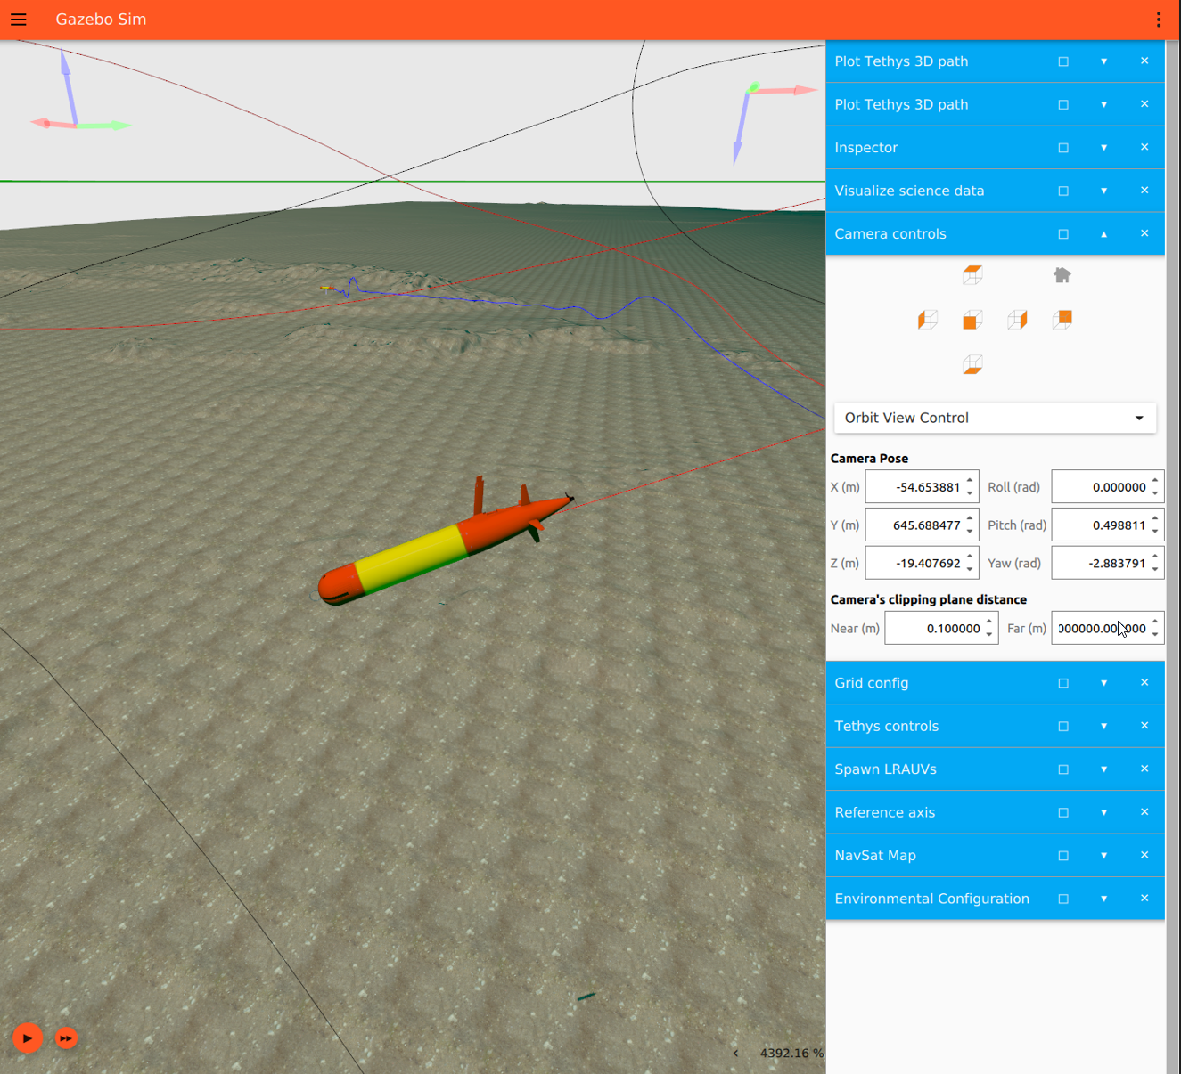
Vehicle Simulator
Desktop Development
Open Robotics Gazebo Simulator
Modular plug-in based
~100x faster than real-time
High fidelity vehicle dynamics
Simultaneous multi-vehicle sims
Sensor Plug-ins: CTD, Chl, DVL, Acoustic Modem
World Plug-ins: 1m Resolution Seafloor DEMs; 3-D Water Column parameters;
4-D ROMs Models

Slide 13
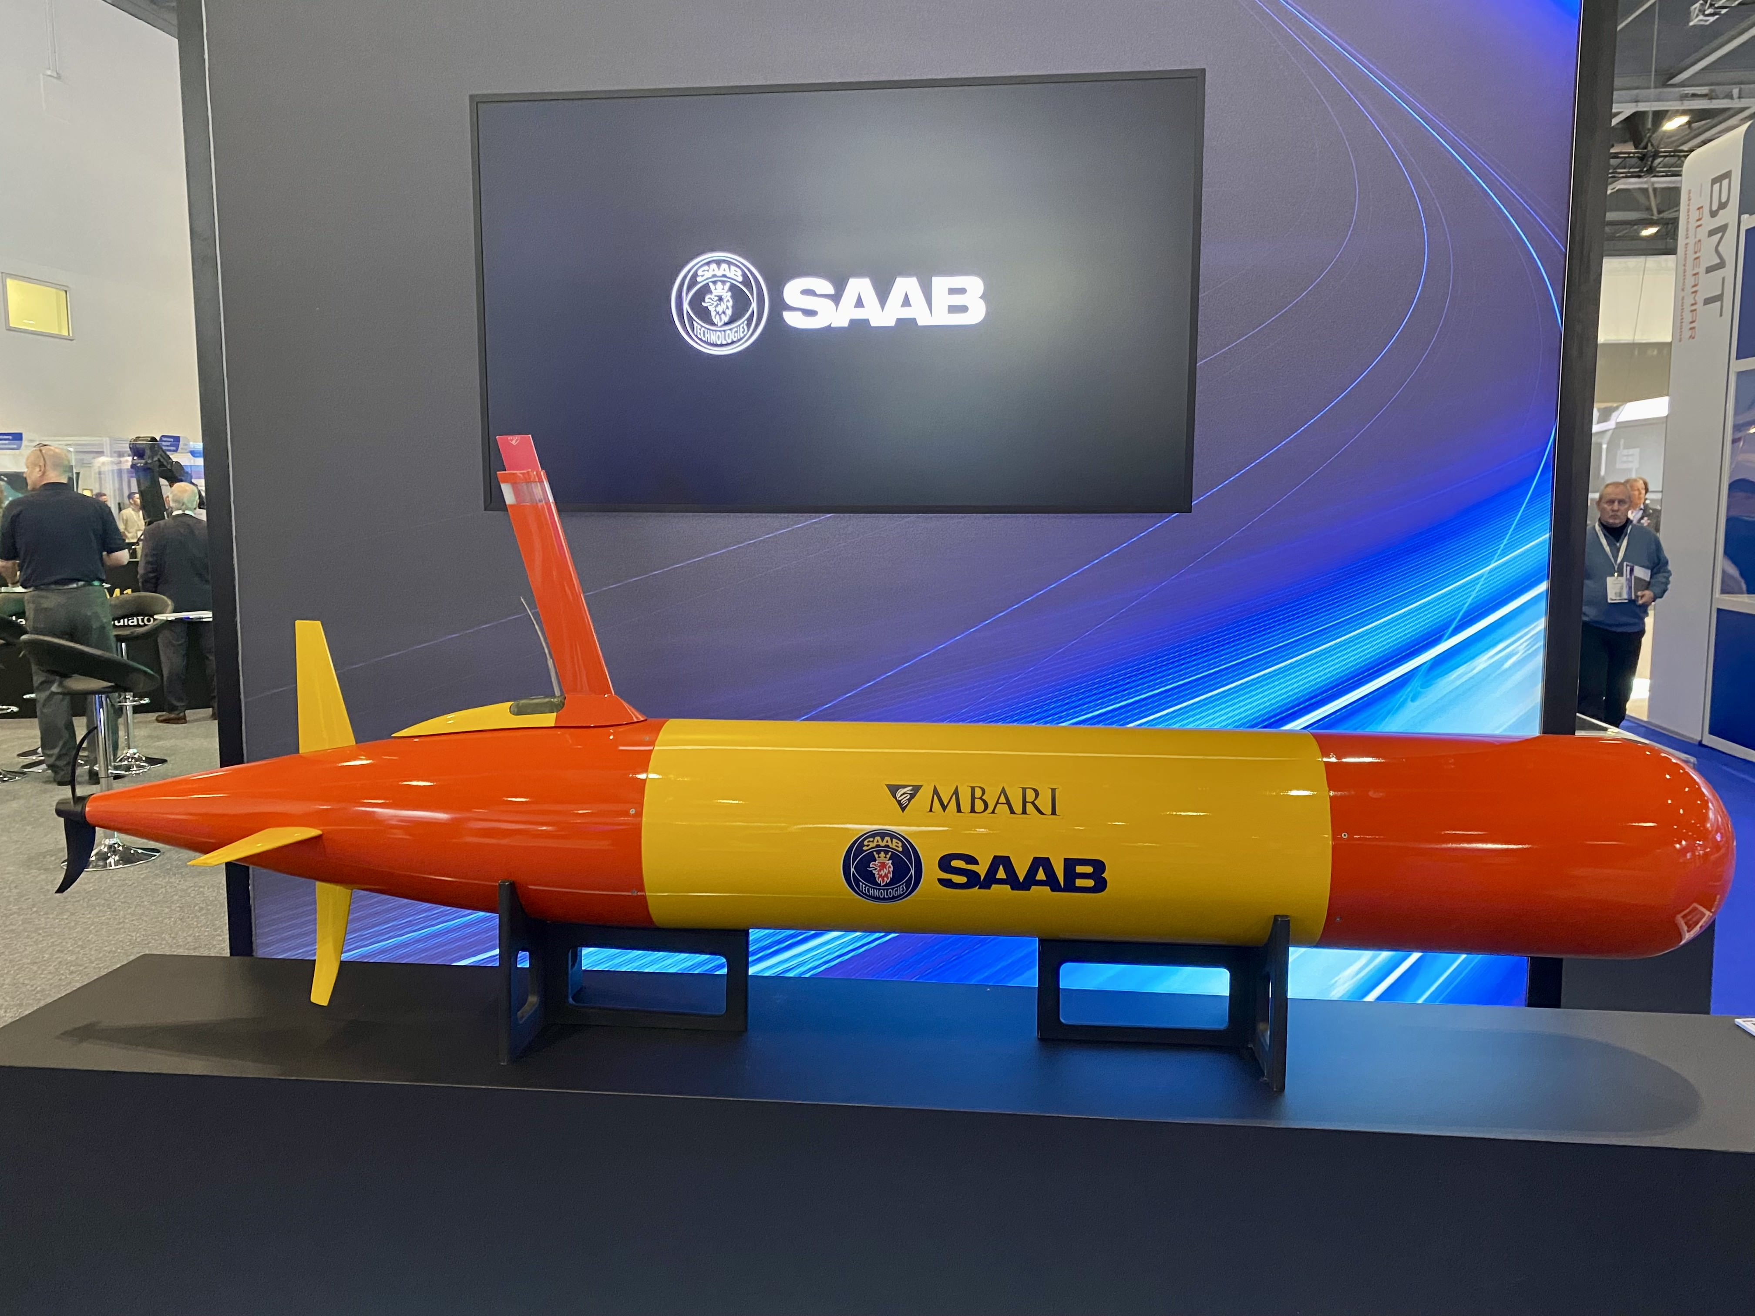
MBARI LRAUV
Now Available from Saab

Slide 14
Sometimes Even Long Range,
Isn’t Long Enough
Multi-Month Deployments
High Power Payloads
  Imaging Systems with Lights
  Multi-Beam Sonars
  High-Performance Computers consume as much energy as the LRAUV

Slide 15
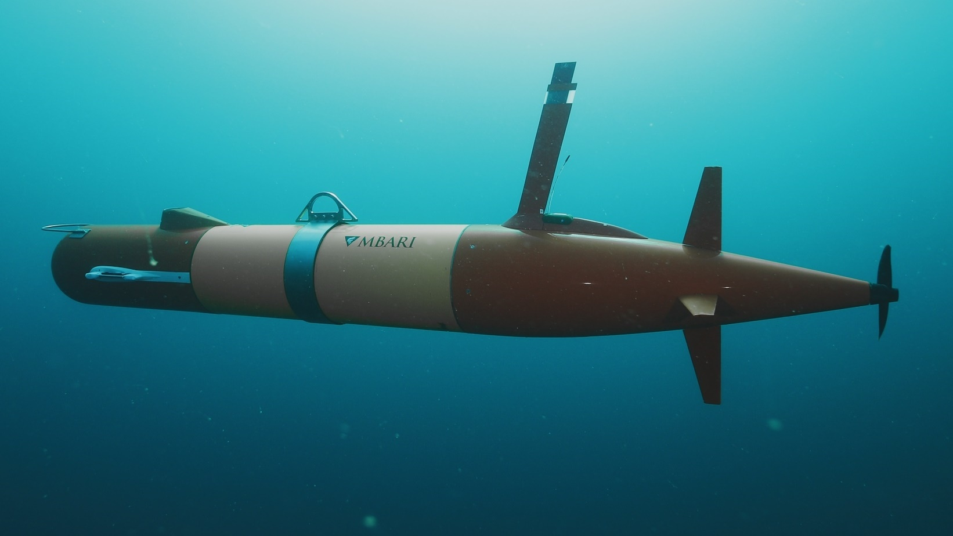
Summary
MBARI’s LRAUV is:
Medium Sized, Multi-Mission AUV
Long-Range Transit Mode for Ship-less Opps
Suite of Payloads, including
eDNA Sampling, Fisheries Echo-sounder, Imaging Systems, Passive Acoustics
Multi-vehicle, Coordinated Operations
Targeted Sampling
Docking Station for Persistent Operations

Slide 16
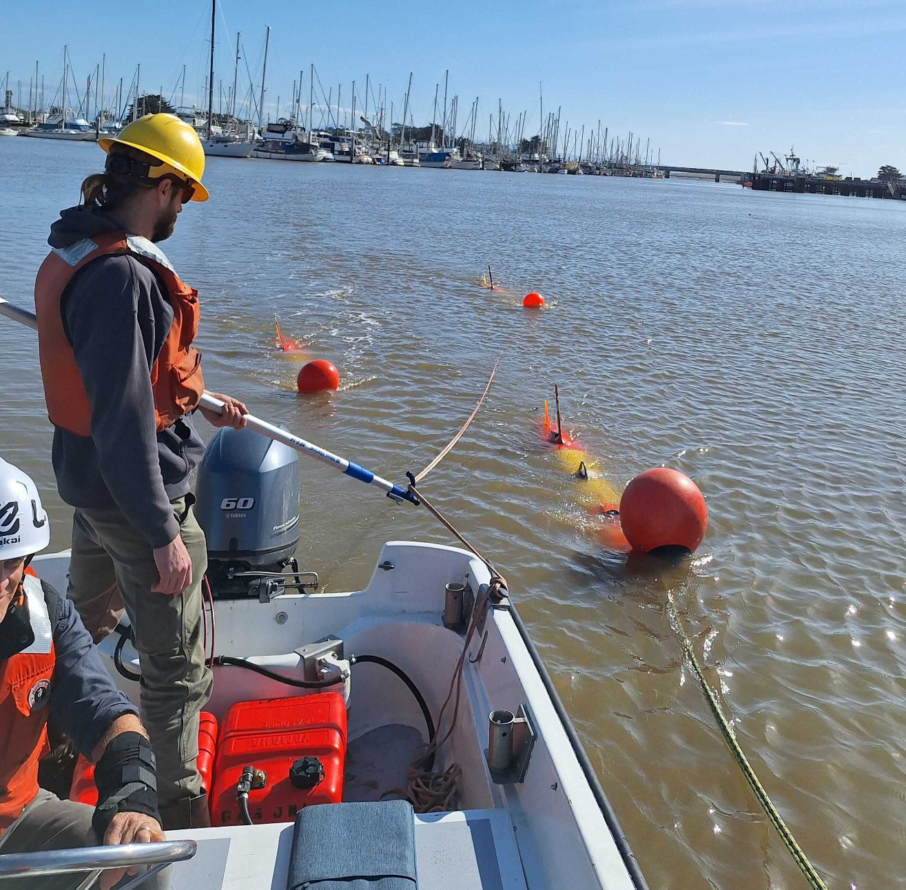
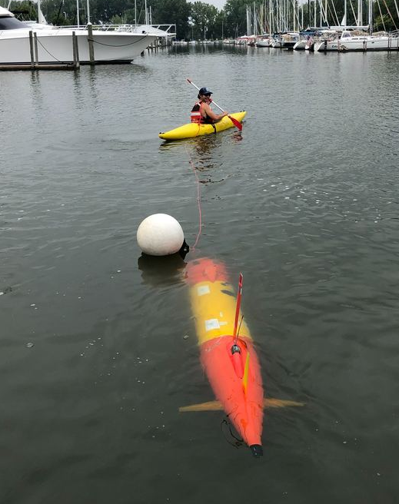
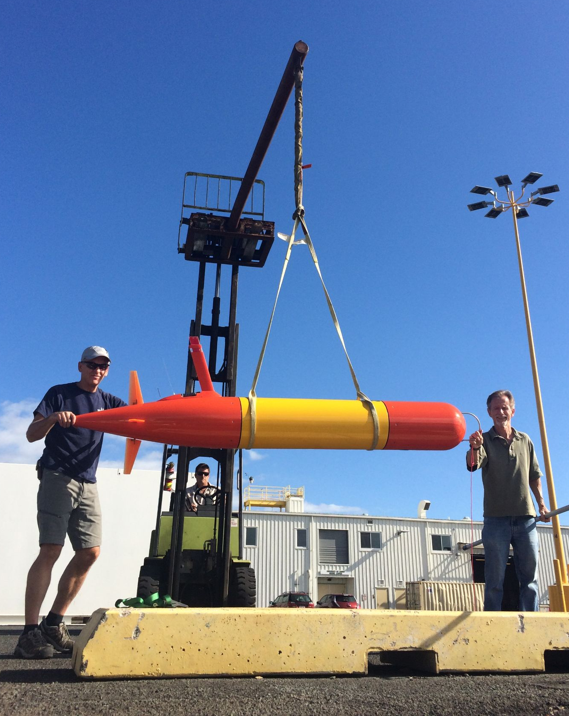
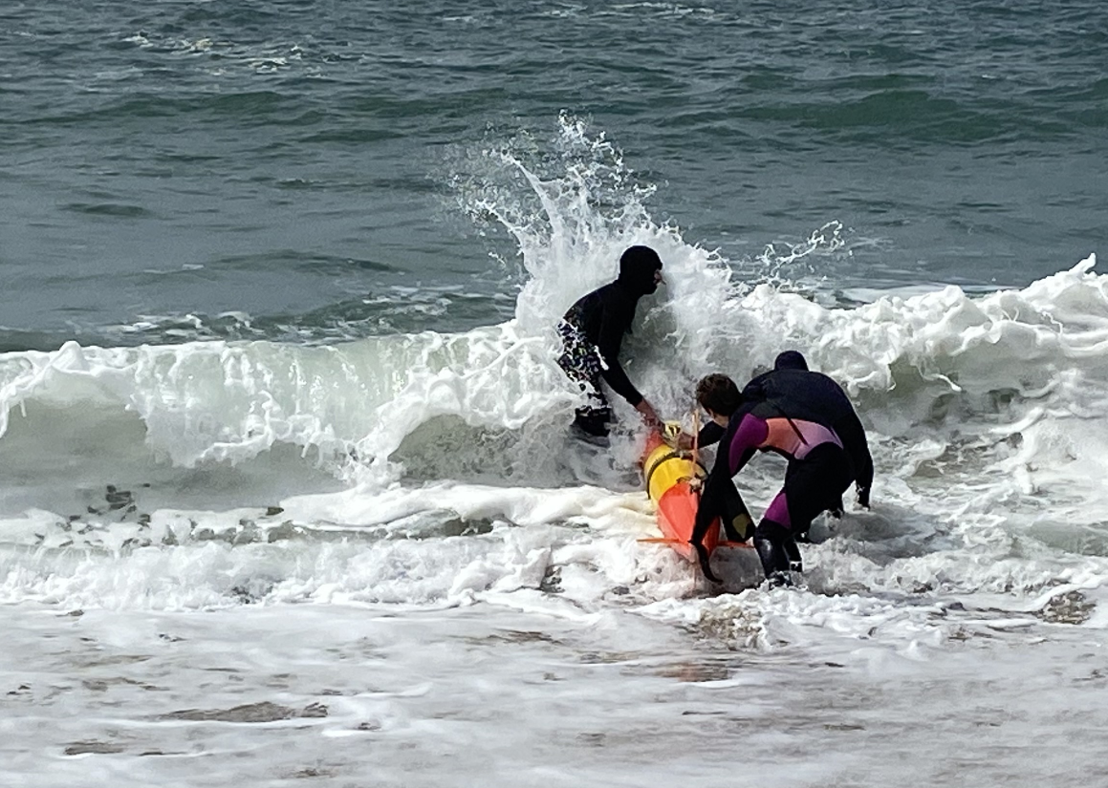
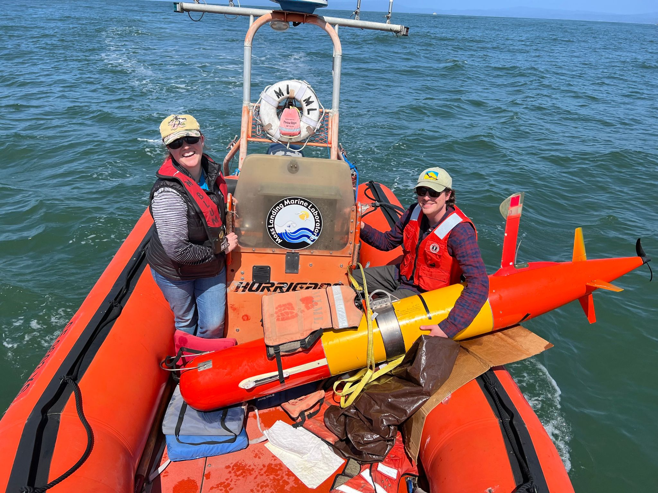
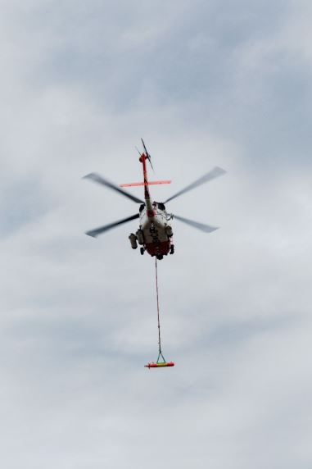
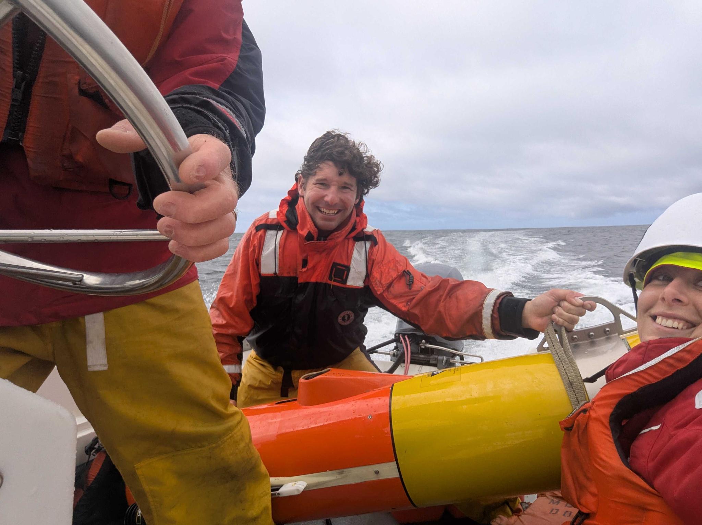
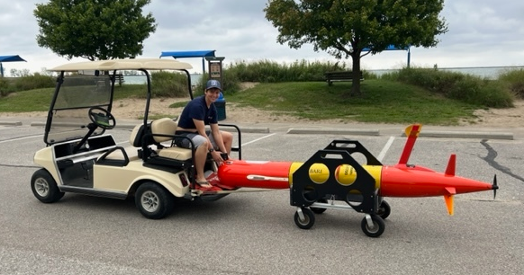
Wasn’t easy pushing vehicles offshore to clock 60,000 hours
Notes:
And many of those launches and recoveries didn’t require vessel support.
Also well-established over the course of the program is our ability to operate shiplessly.
We can beach launch and recover, tow in and out from a small craft, even launch from a helicopter. Essentially, if we can find a way to get an LRAUV in and out of the water, we can operate, no boat needed.
[click]
But there’s one big exception.

Slide 17
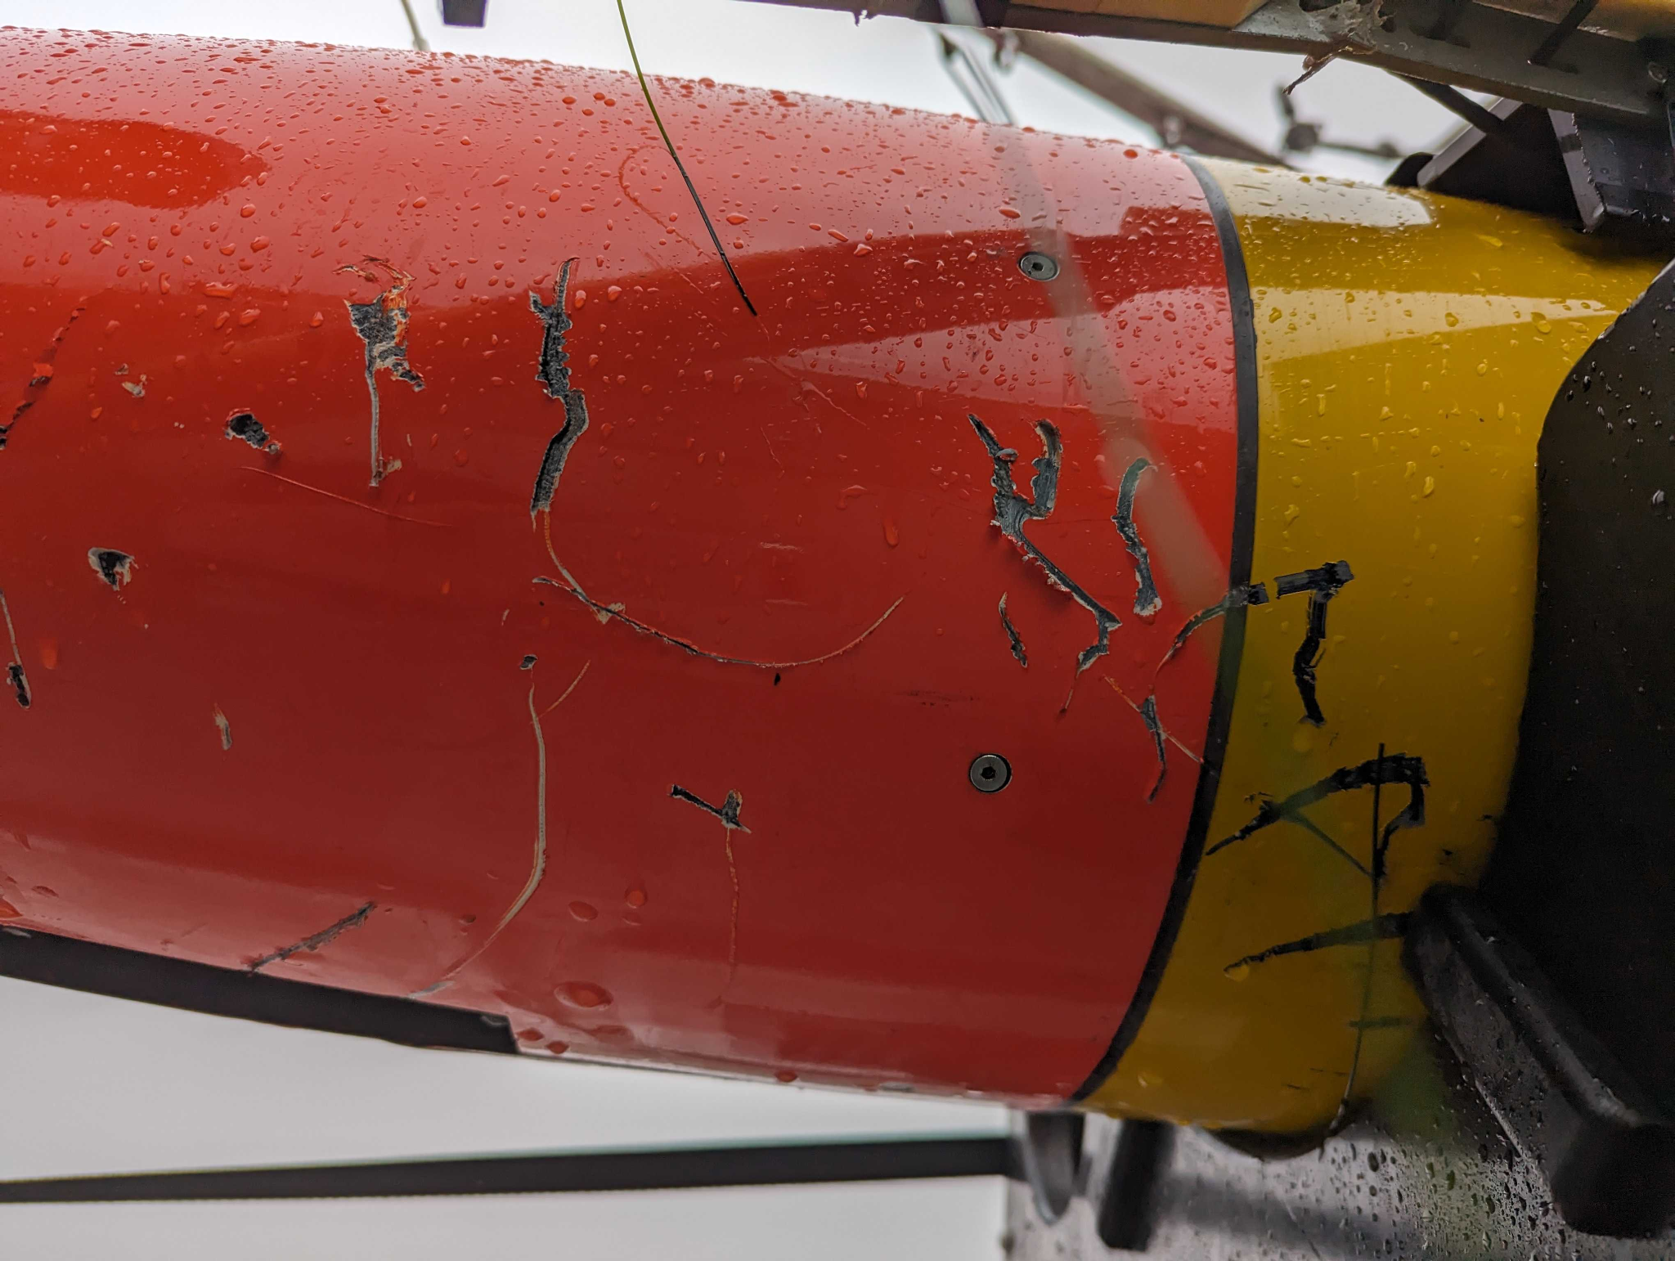
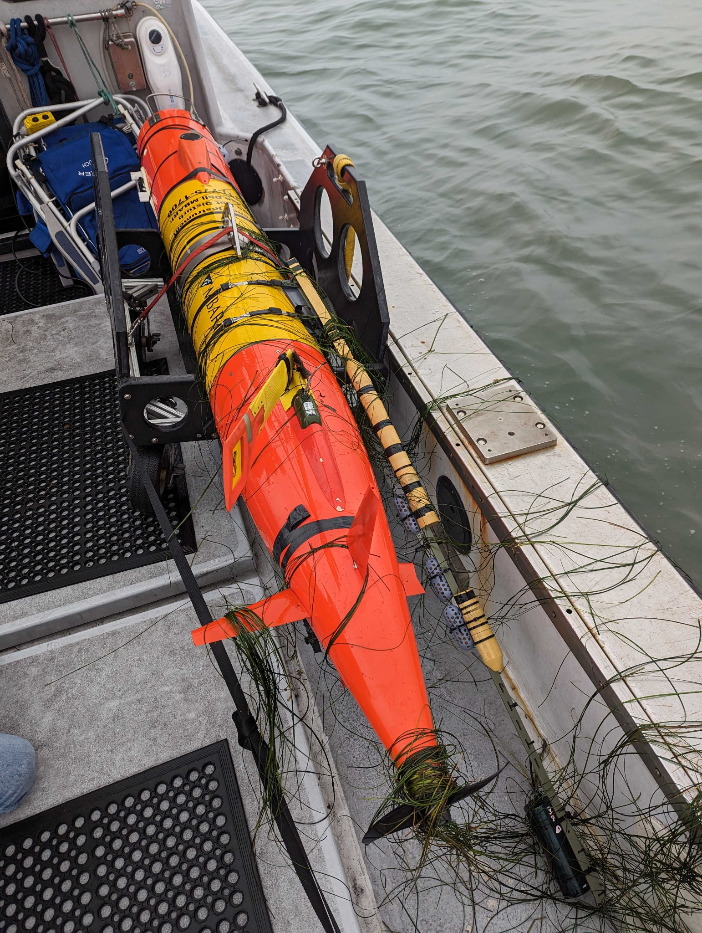
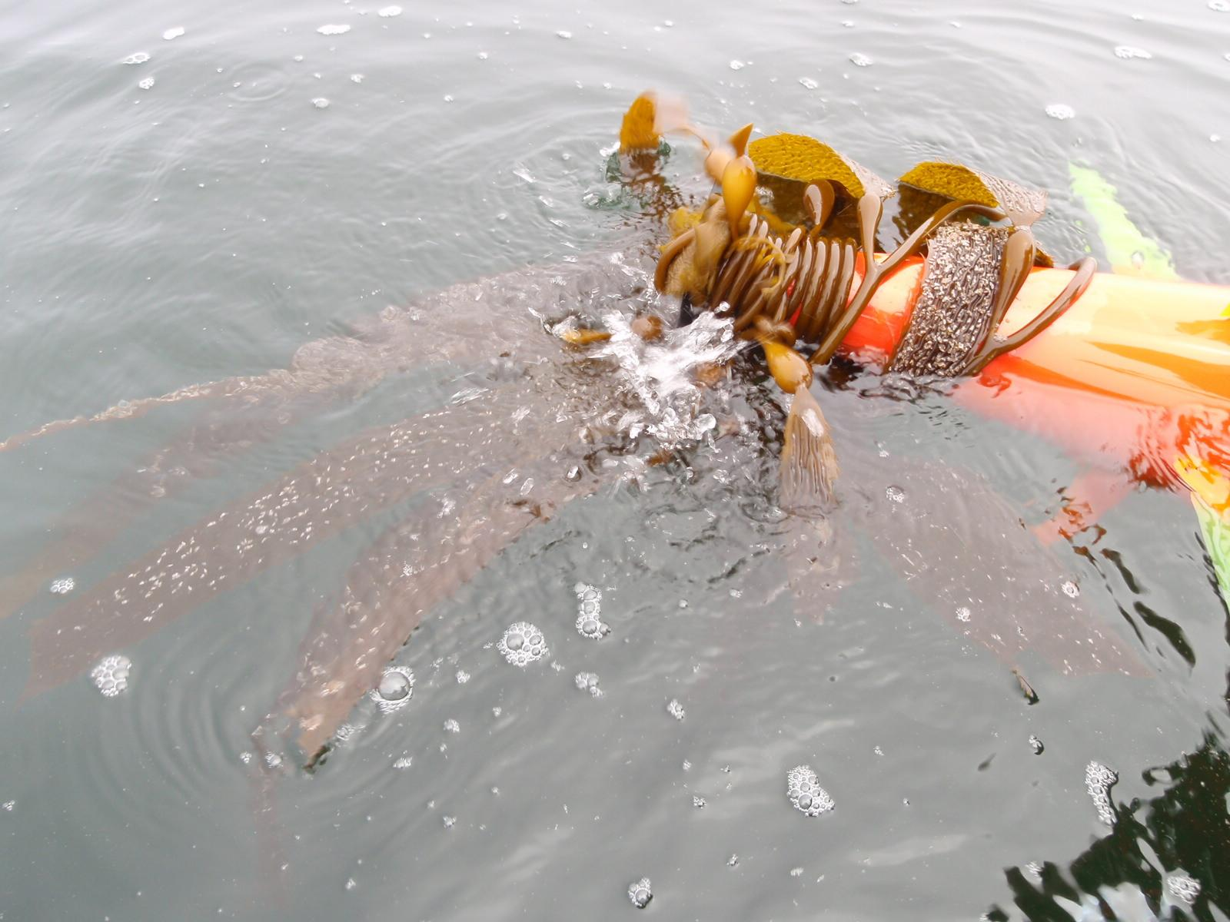
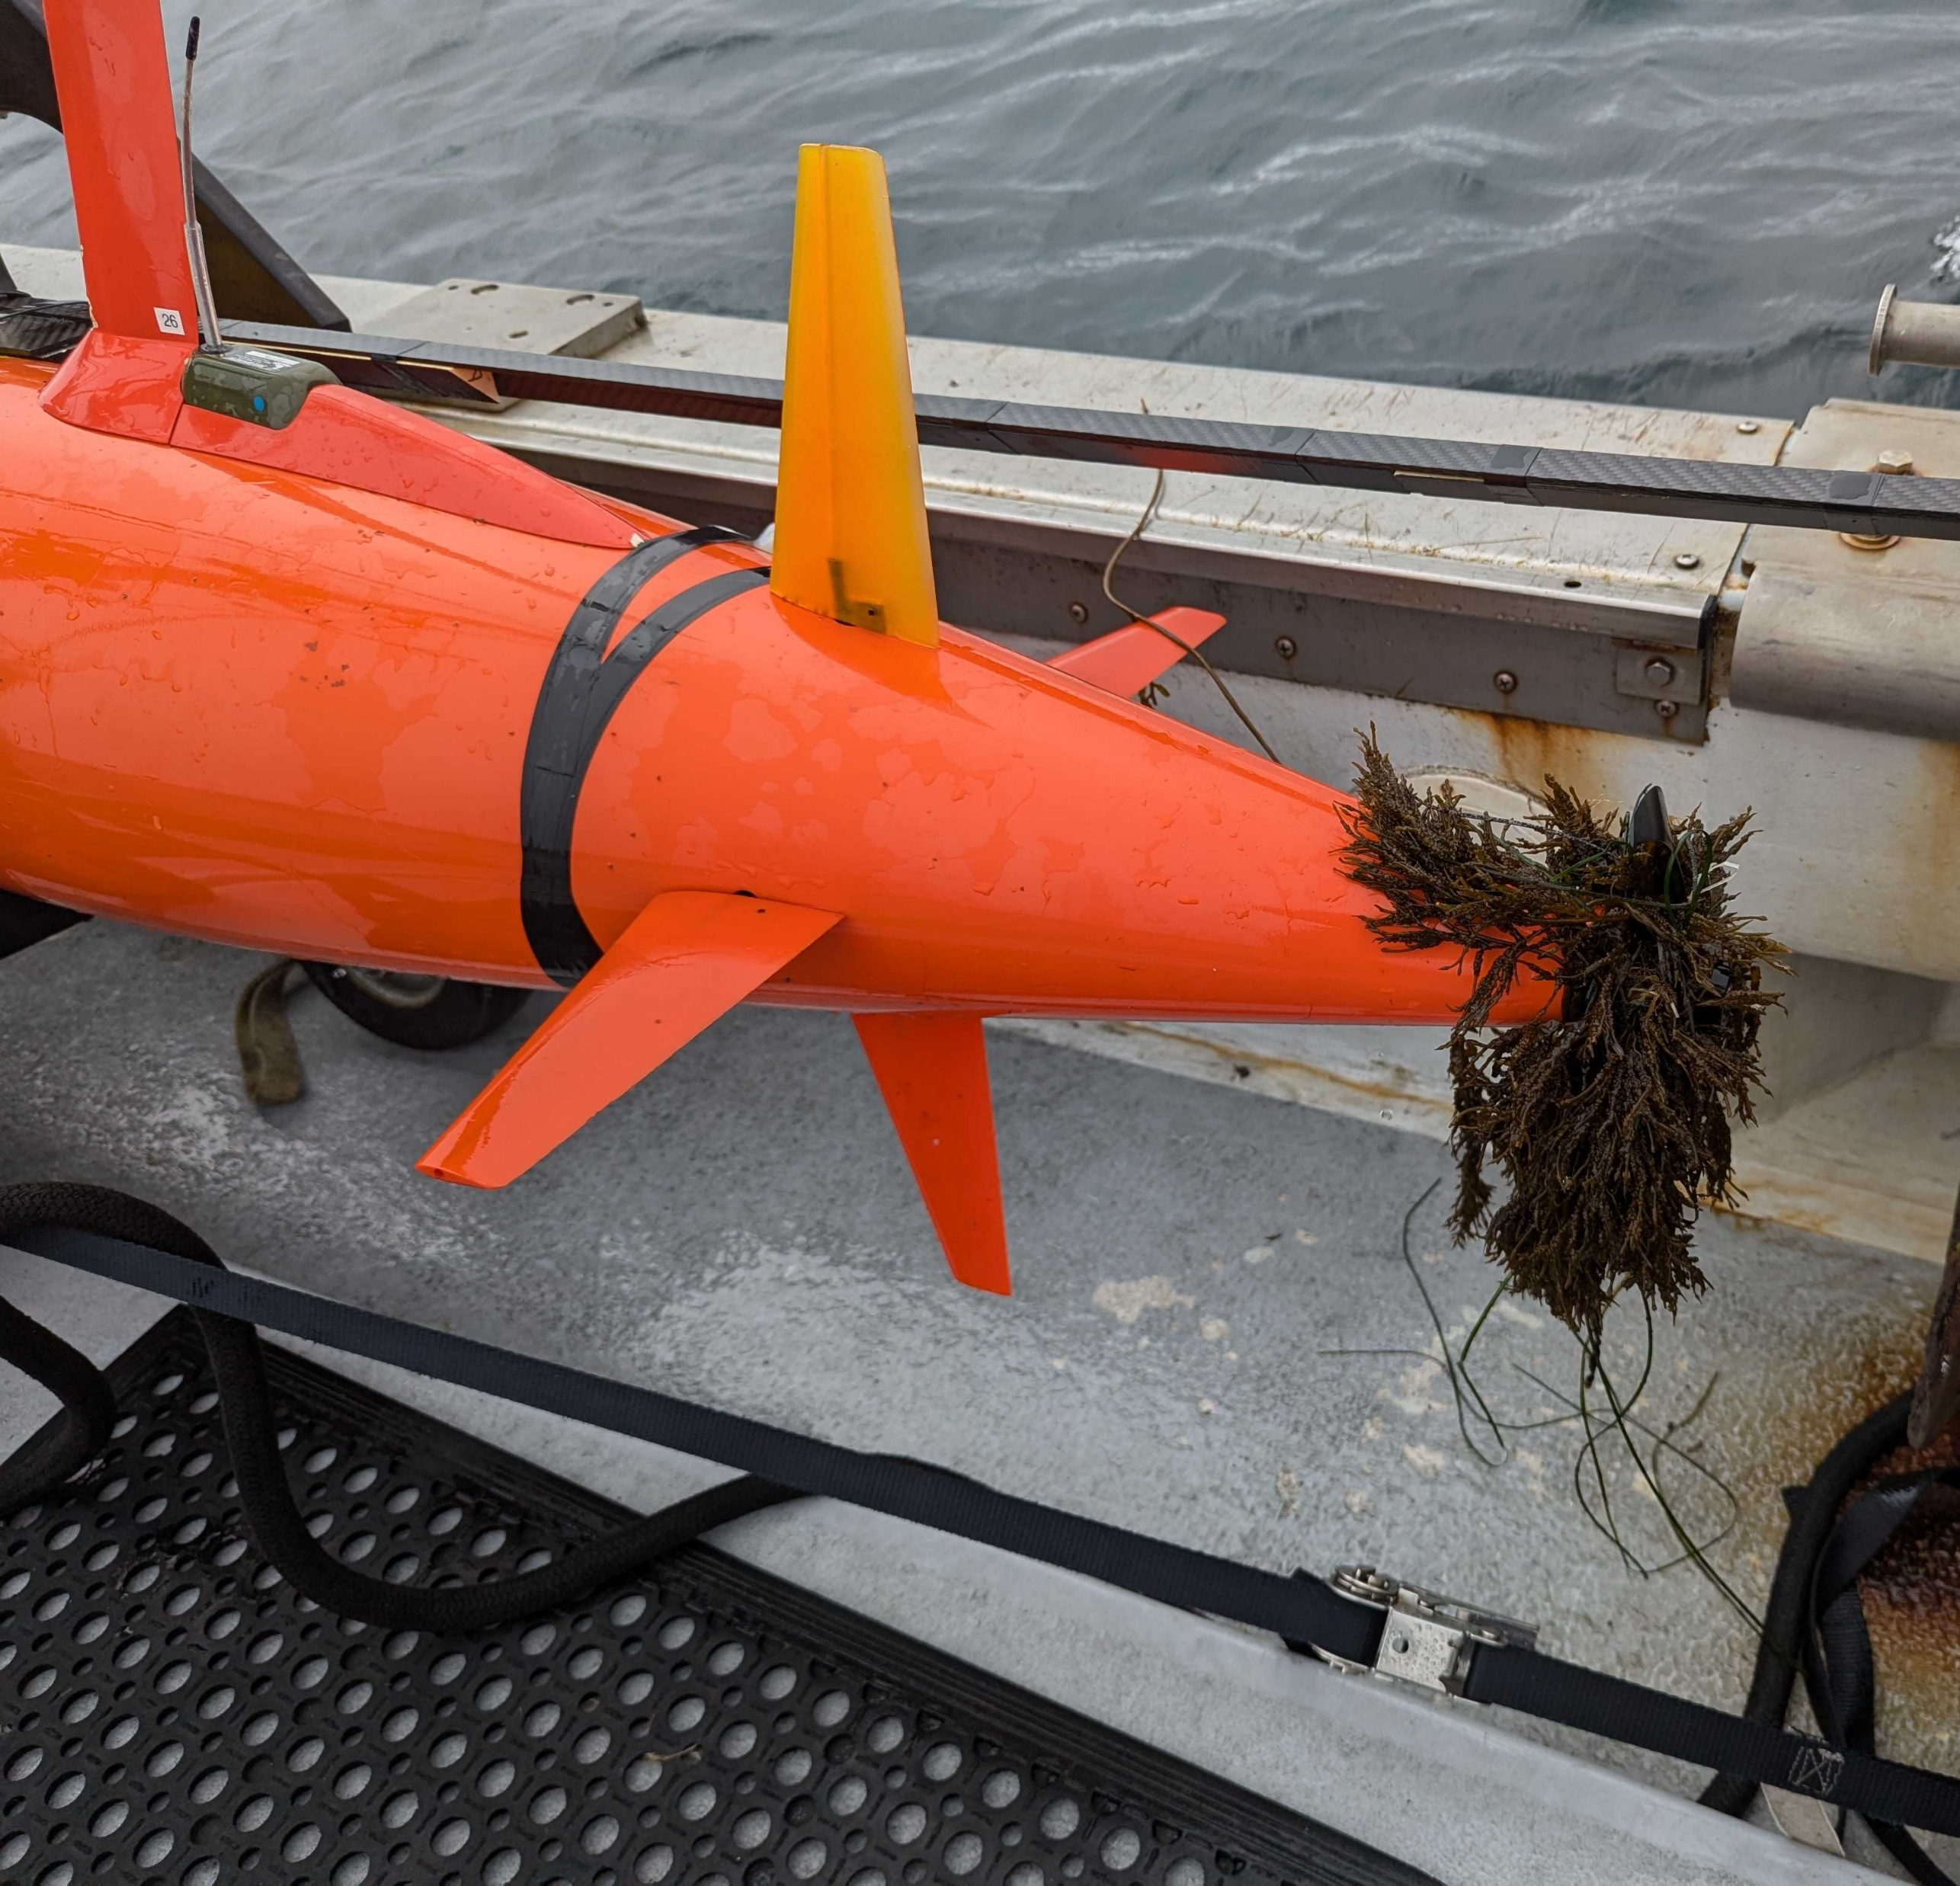
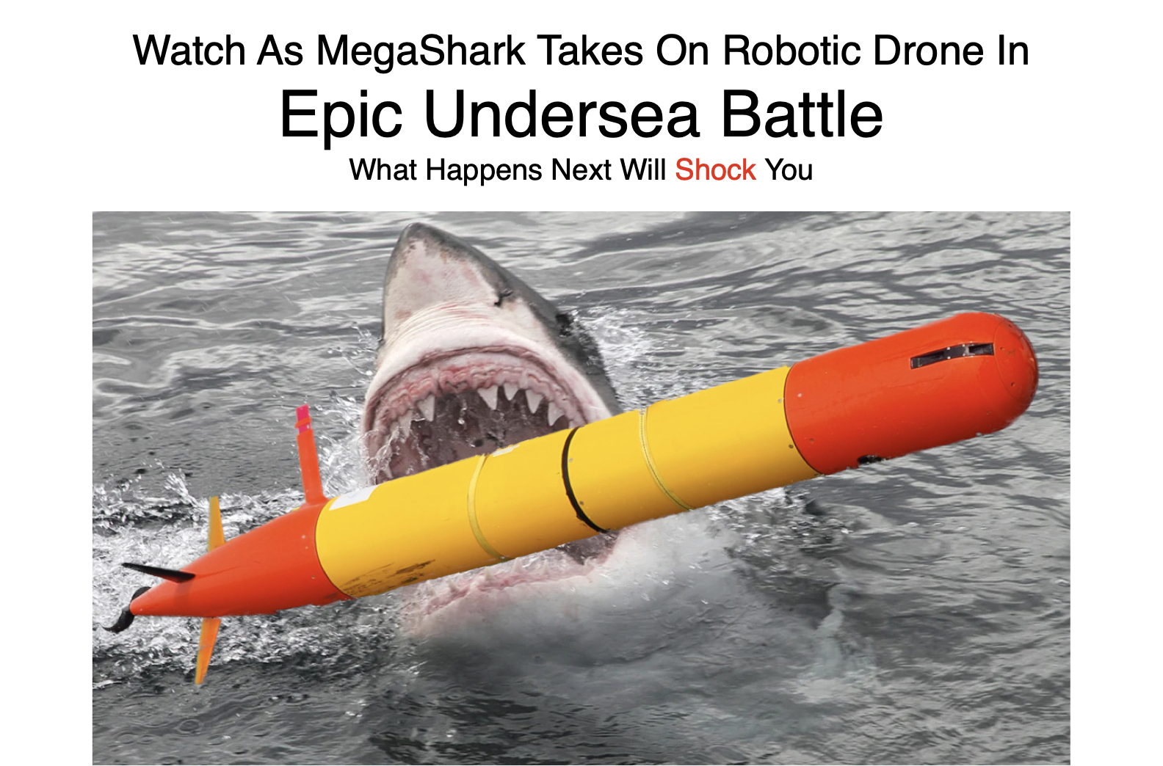
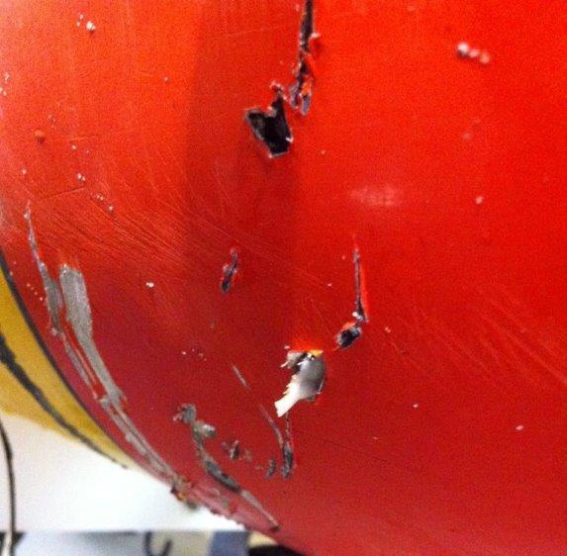
Some things are beyond our Control!
Notes:
Of those 74 recoveries, a handful of them were “emergency recoveries”. Exactly how many depends on how you count, but broadly, an emergency recovery is one where the vehicle could not return to the recovery point under its own power.
We’re constantly working on making the vehicles more reliable, but [click] designing for reliability will not eliminate emergency recoveries.
There’s always the risk of events outside our control. A vehicle can get fouled in kelp, or bitten by a shark, as the photos on the right show.
Those 50 thousand hours at sea have demonstrated that there’s a lot we can handle. If we can get an intermittent 50 rpm on the prop and 2 degrees of rudder we can drive a vehicle home.,
But [click] fundamentally, if a vehicle is completely without propulsion or steerage, that vehicle is going to need assistance to get back to shore.
And our only way to provide that assistance is with a vessel capable of going offshore to retrieve a vehicle [click] for now.
Info: 11 foulings escalating to a critical in 2024,

Slide 18
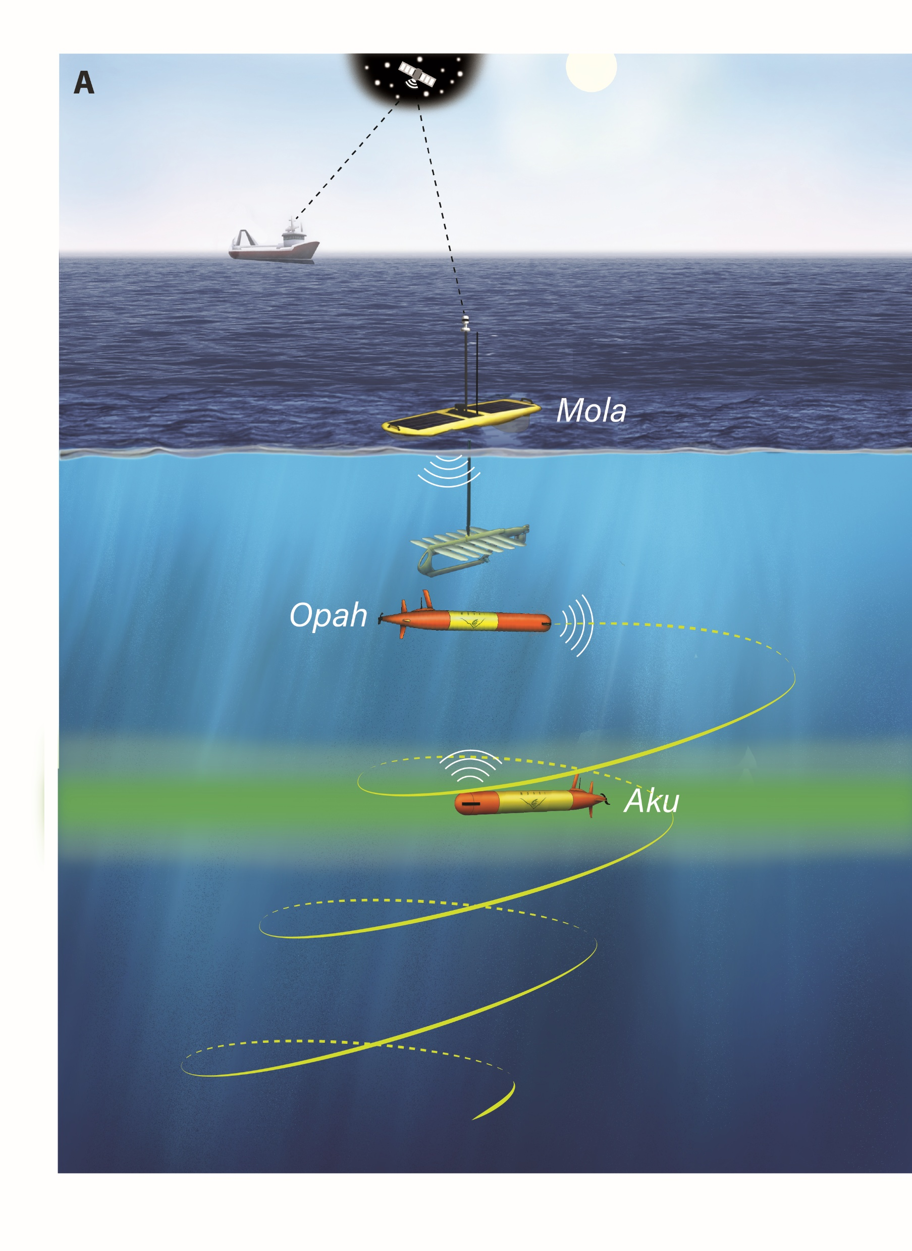
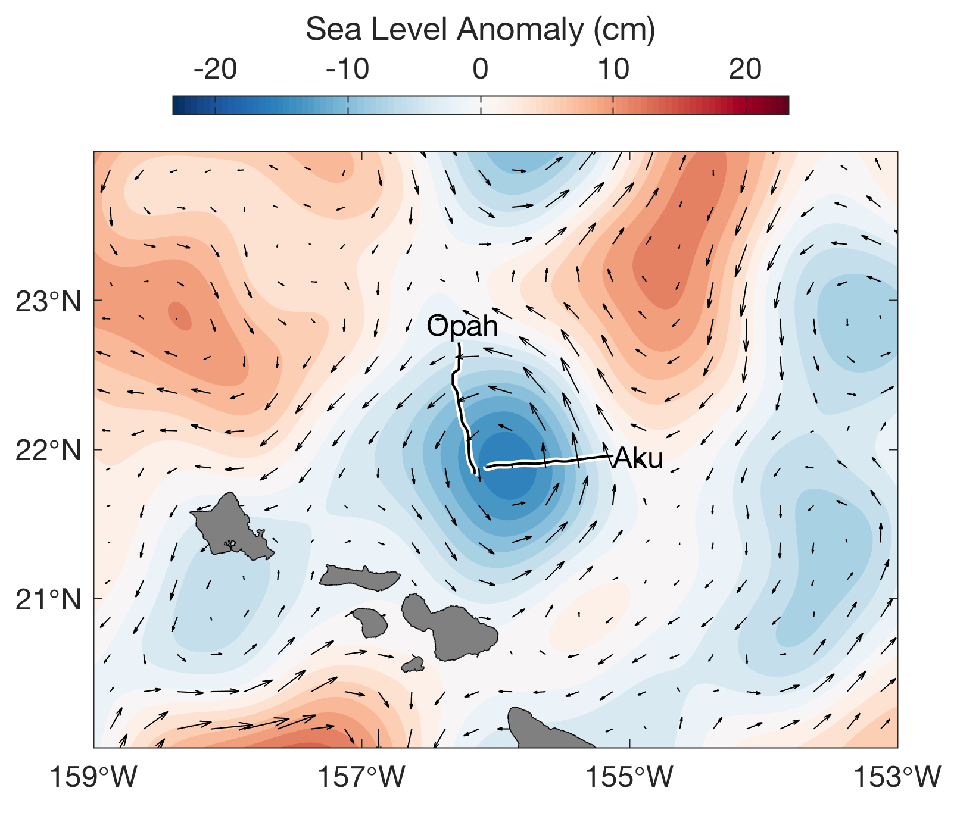
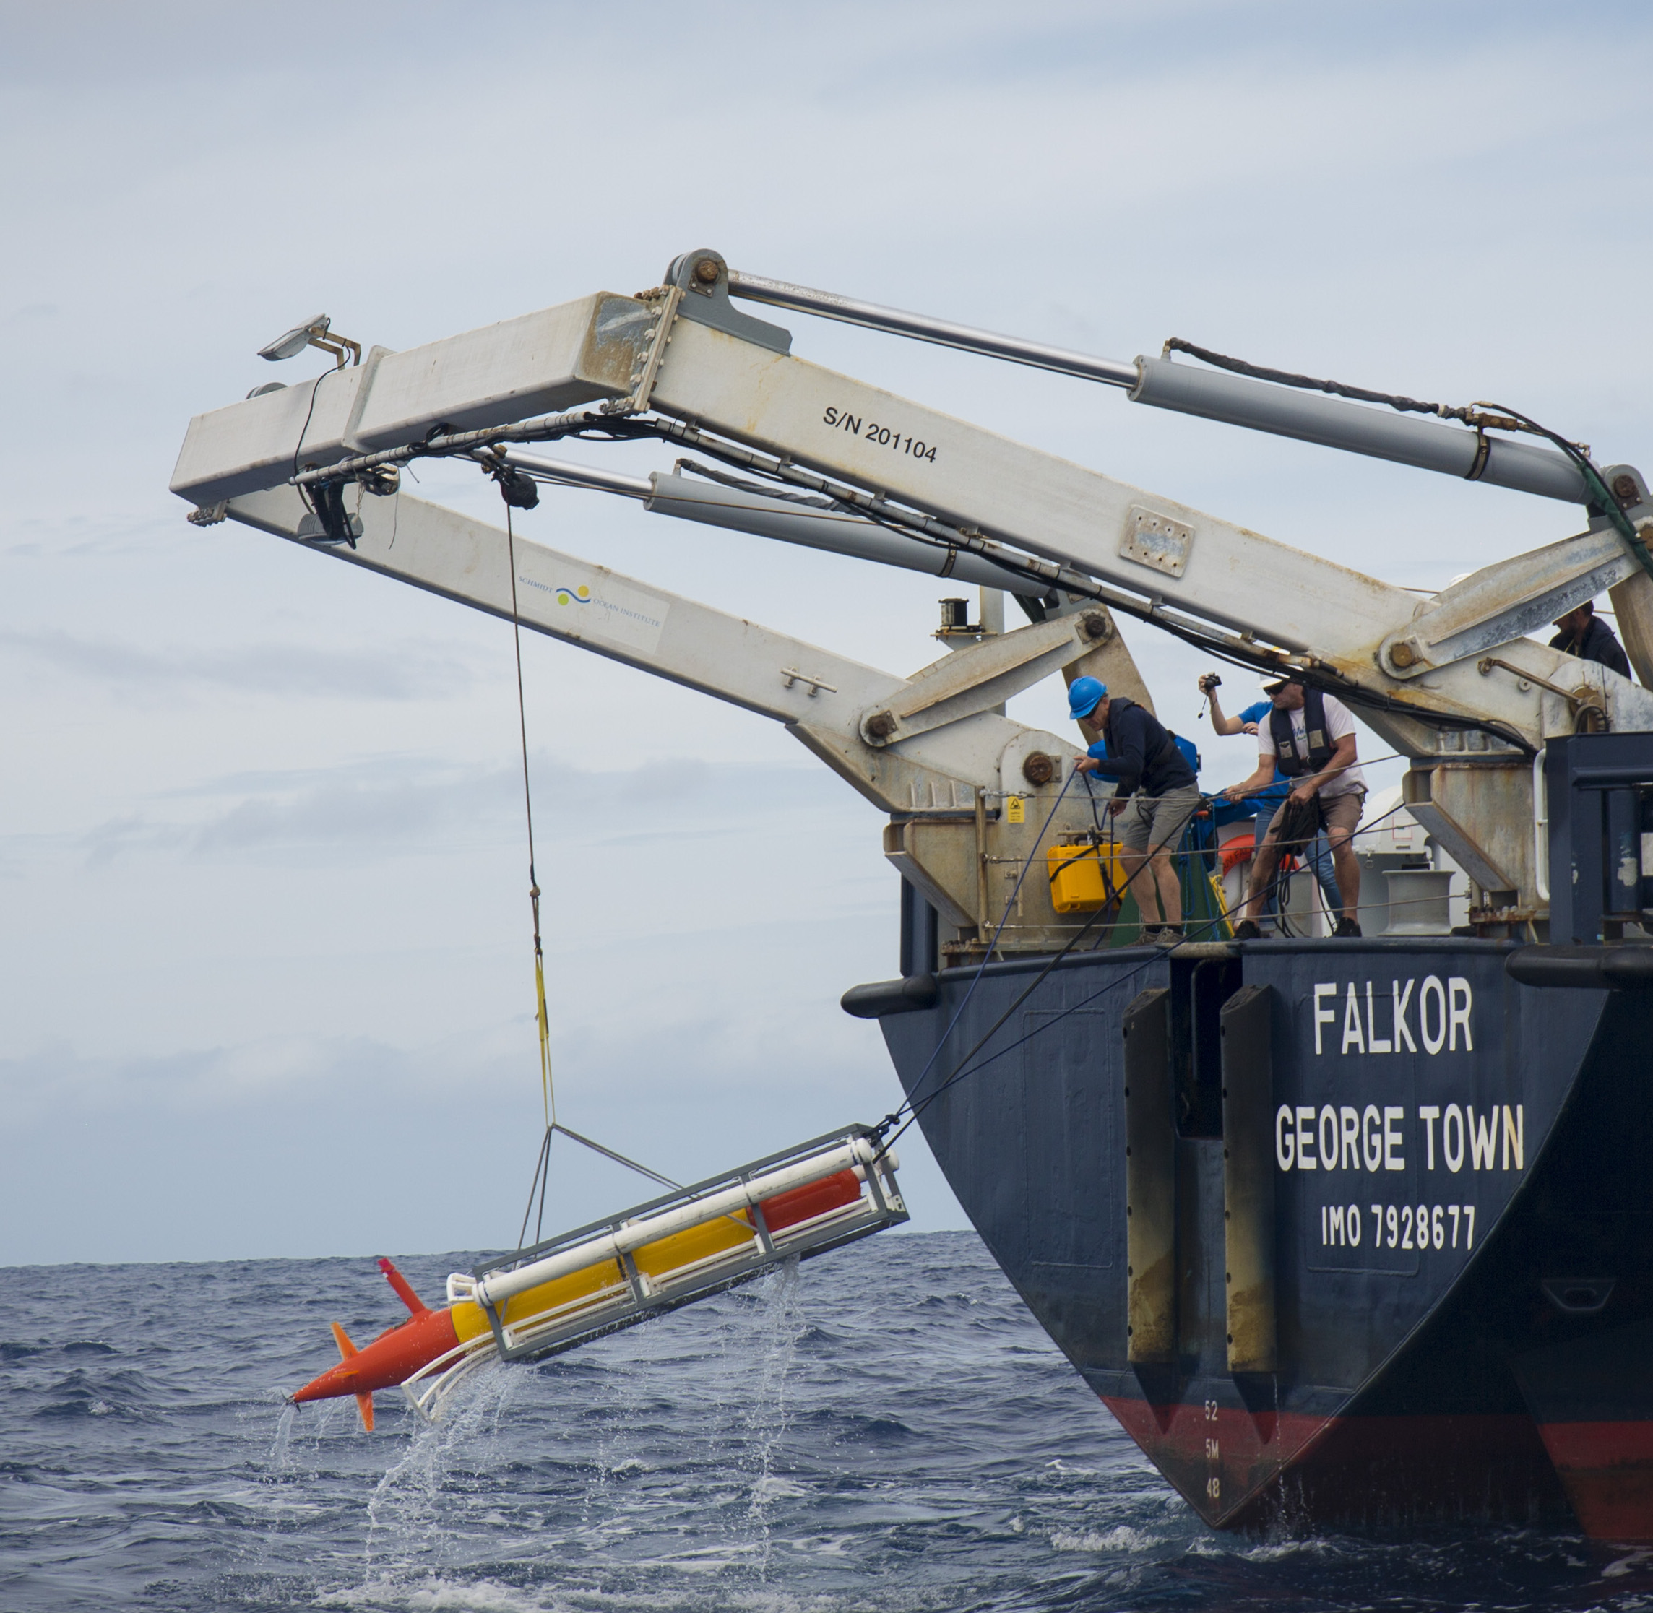
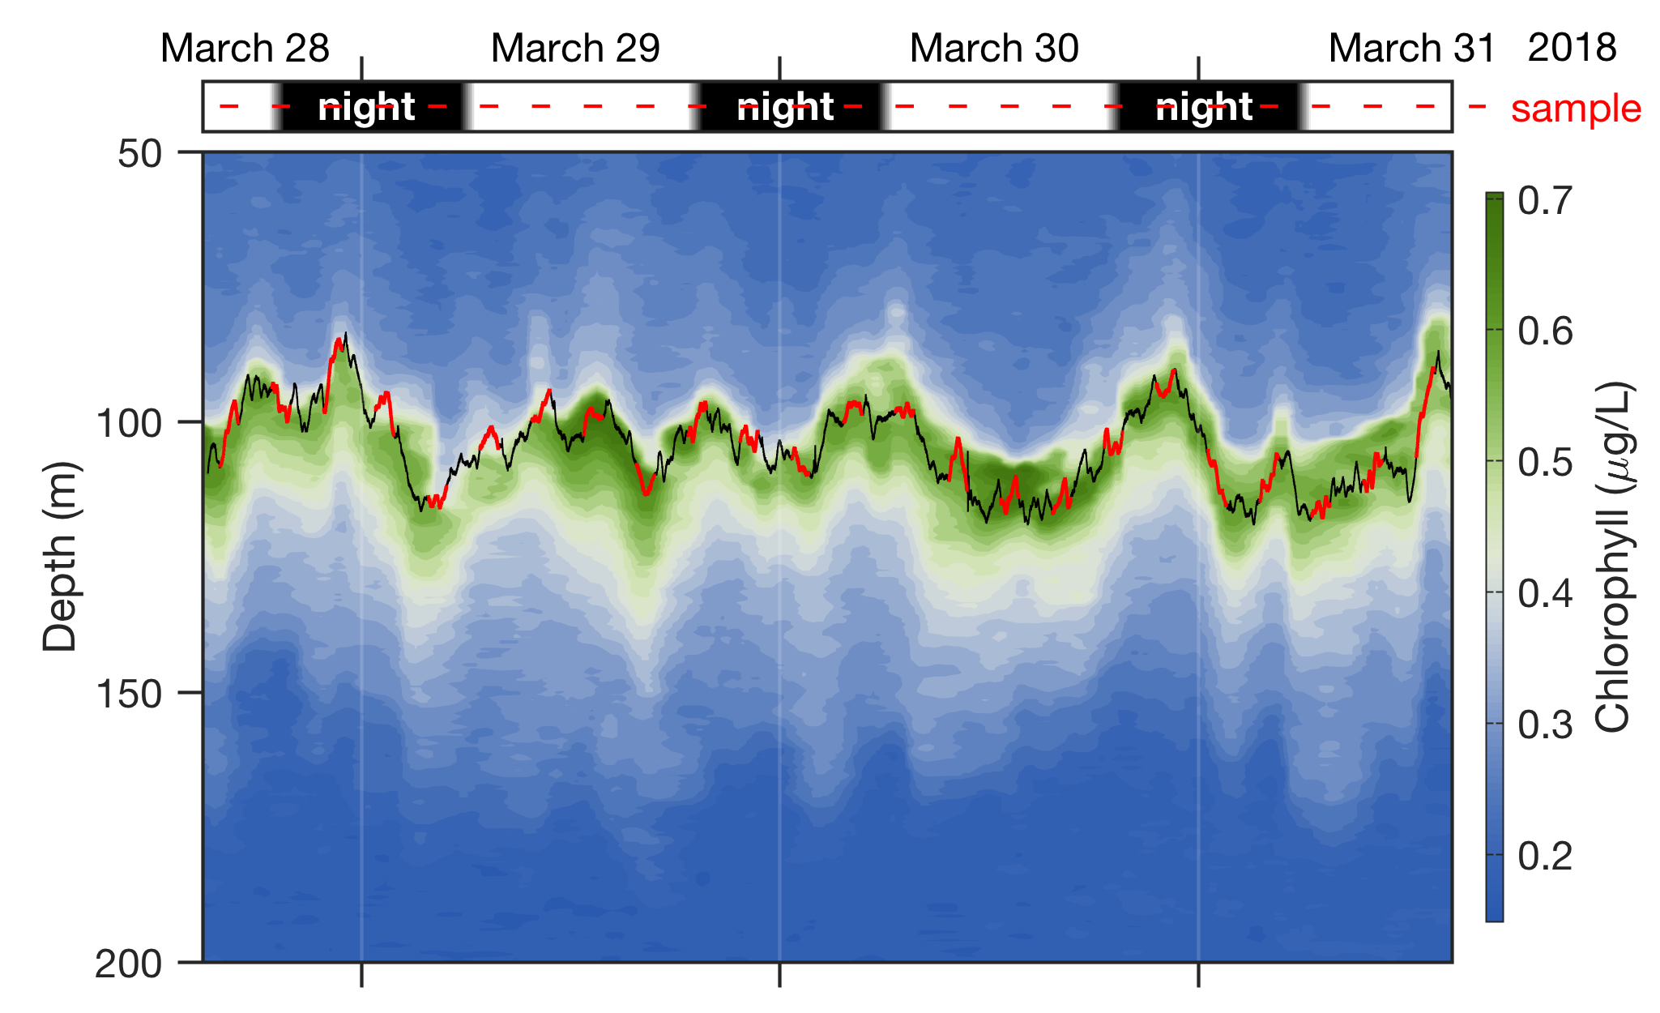
Use Case – Chasing Eddies
Multi-vehicle, ESP, Adaptive Sampling, Endurance
Time-series of Microbes in the Deep Chlorophyll Maximum (DCM) Beneath a Cyclonic Eddy in mid Pacific
Open Ocean NE of Hawaii, supported by R/V Falkor
3 Vehicles:
  Wave Glider: comms/nav aid
  LRAUV1 + ESP follows DCM
  LRAUV2 profiles water column
Autonomous targeted sampling Collected 82 samples at, above and below the DCM over 9 diel cycles (4, 3 and 2 days continuous)
T. Hoffman
Combined Data Plot Confirms Targeted Sampling of the DCM
Aku’s water column contextual data
Opah’s depth track w ESP samples
Time of day + sample time

