Slide 1
MBARI Imaging Systems Overview
NOWRDC, Jan 27, 2026
Paul Roberts
Notes:
My Name is Paul Roberts and I’m an electrical engineer at MBARI, I’ve been here for just over 5 years.
Today I’ll give an overview of imaging systems in production and development at MBARI

Slide 2
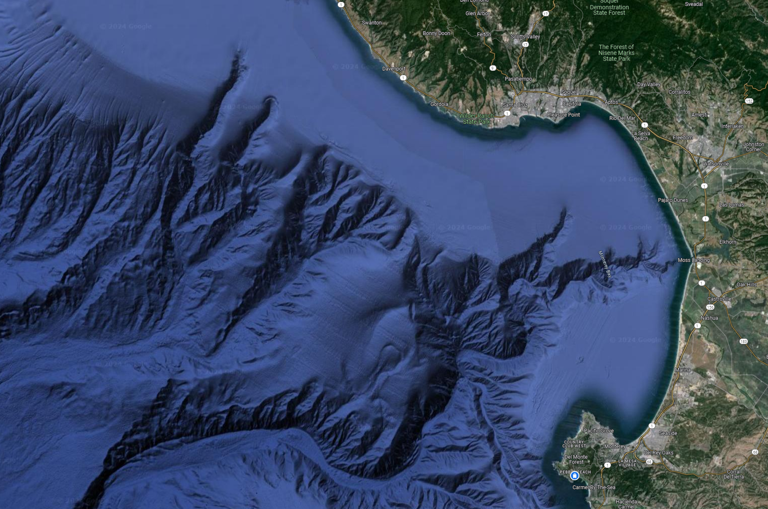
Key Biological Questions
Who’s there?
How many and what size?
How do they interact?
How does the above change in space and time?
Notes:
Motivation:
Zooming out to the satellite view of the Monterey bay, when thinking how to explore and protect the ocean, these are some of the fundamental biological oceanography questions that we aim to answer
While these questions are easy to state, they are exceptionally difficult to answer in the ocean…

Slide 3
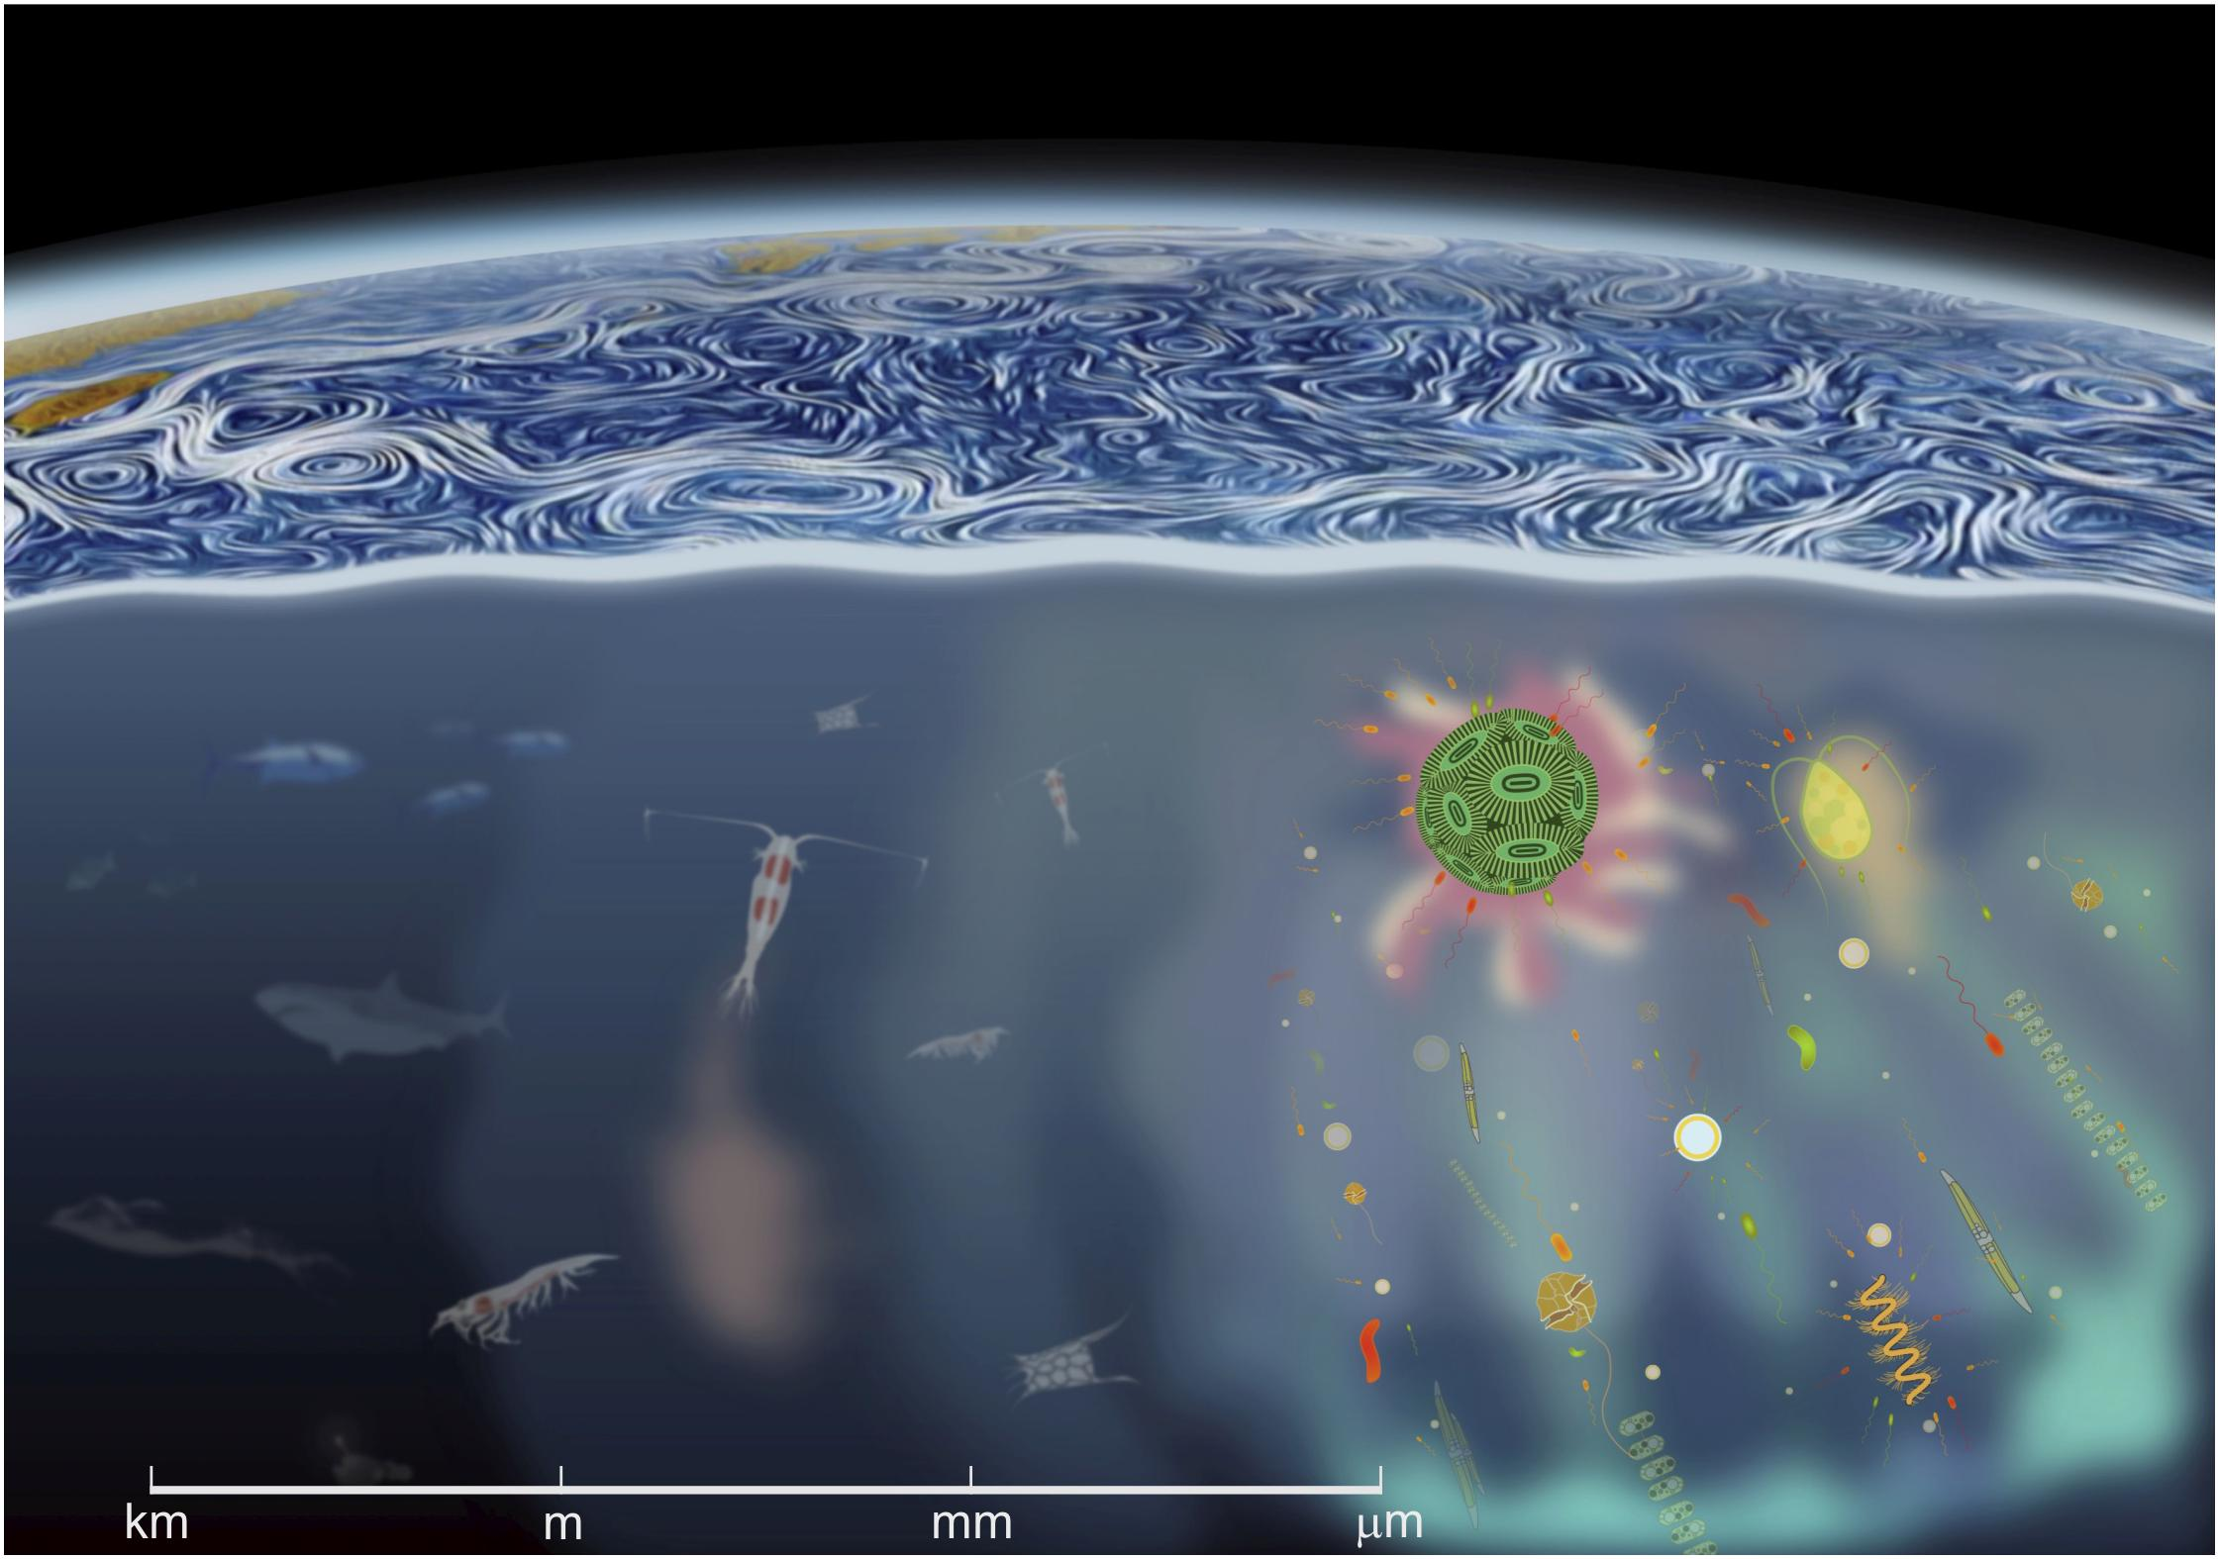
Vast Size and Space Scales
Basterratxea et al. Front. Mar. Sci., 25 March 2020
Notes:
Why are they so difficult to answer?
The ocean is a complex volume of fluid with a vast assortment of organisms that span nearly 9 orders of magnitude in size.
On the bottom right, we have the micron sized phytoplankton, protists, and bacteria
Moving to the left we have the zooplankton grazers like krill and copepods that feed on phytoplankton and other zooplankton
And on the left we have the large fish and mammals that feed on the zooplankton and other top predators
Despite this vast range is sizes, many of these organisms directly depend on and interact with each other. This makes it necessary to broaden our questions and samples to cover this immense range of space and time scales

Slide 4
Complementary Imaging Systems
Basterratxea et al. Front. Mar. Sci., 25 March 2020
Piscivore (Mega)
Triton (Macro)
Planktivore (Micro)
Notes:
Why are they so difficult to answer?
The ocean is a complex volume of fluid with a vast assortment of organisms that span nearly 9 orders of magnitude in size.
On the bottom right, we have the micron sized phytoplankton, protists, and bacteria
Moving to the left we have the zooplankton grazers like krill and copepods that feed on phytoplankton and other zooplankton
And on the left we have the large fish and mammals that feed on the zooplankton and other top predators
Despite this vast range is sizes, many of these organisms directly depend on and interact with each other. This makes it necessary to broaden our questions and samples to cover this immense range of space and time scales

Slide 5
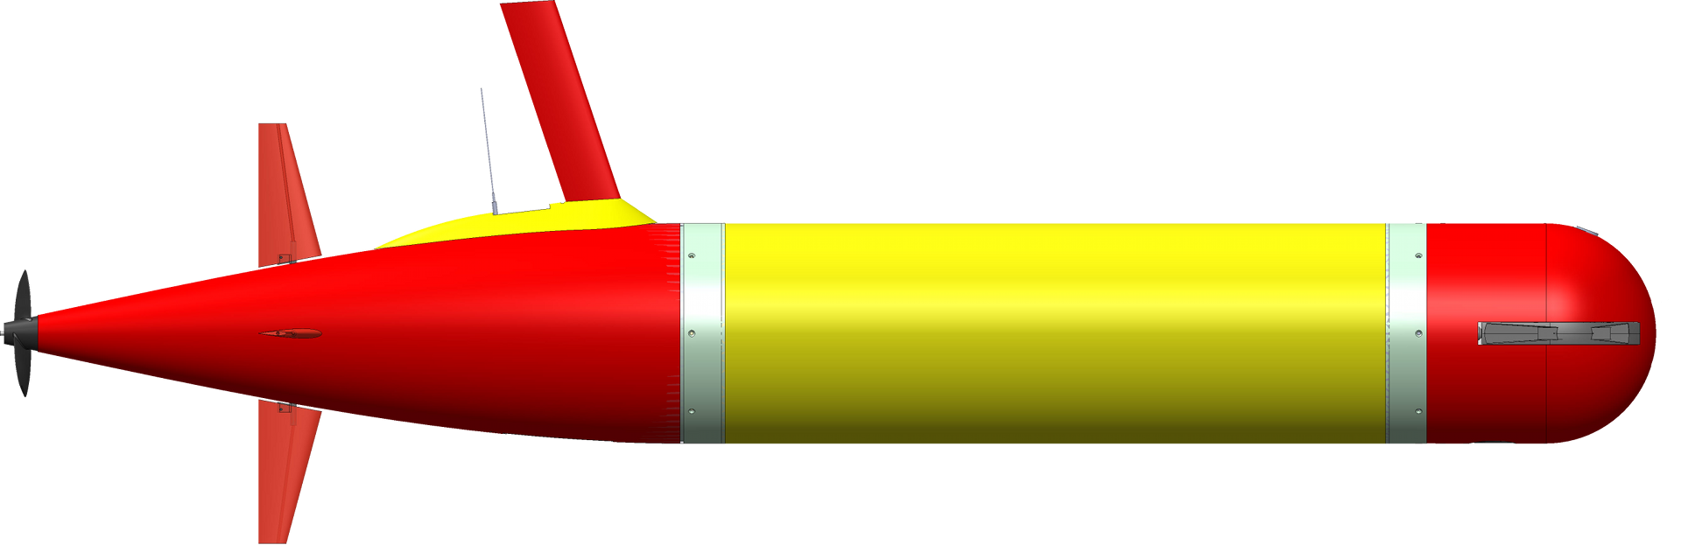
Platforms Expand our Sensing Range
Basterratxea et al. Front. Mar. Sci., 25 March 2020
Piscivore (Mega)
Triton (Macro)
Planktivore (Micro)
Notes:
Why are they so difficult to answer?
The ocean is a complex volume of fluid with a vast assortment of organisms that span nearly 9 orders of magnitude in size.
On the bottom right, we have the micron sized phytoplankton, protists, and bacteria
Moving to the left we have the zooplankton grazers like krill and copepods that feed on phytoplankton and other zooplankton
And on the left we have the large fish and mammals that feed on the zooplankton and other top predators
Despite this vast range is sizes, many of these organisms directly depend on and interact with each other. This makes it necessary to broaden our questions and samples to cover this immense range of space and time scales

Slide 6
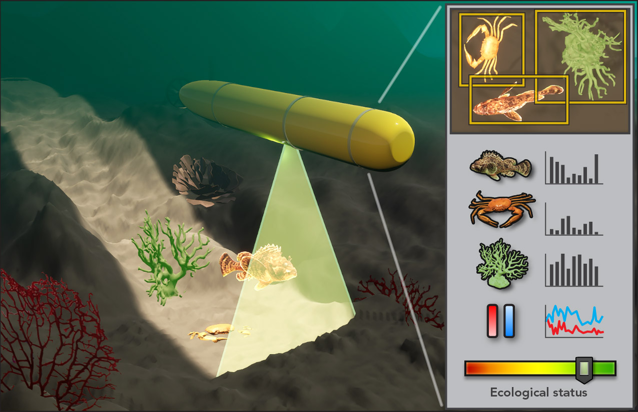

Slide 9
Innovate and Build
Onboard quantification and decision making
Inter-Vehicle Coordination
Synoptic
Quantification
Mapping
Autonomy
Extending human perception
Measurement and quantification
Navigation, control, mapping, and tracking
ROV Cameras
AUV Cameras
Time Lapse Cameras
Machine Vision
Laser Imaging
Lightfield
Microscopy
Heterogenous Imaging
Camera Arrays
Lidar
Imaging Sonar

Slide 10
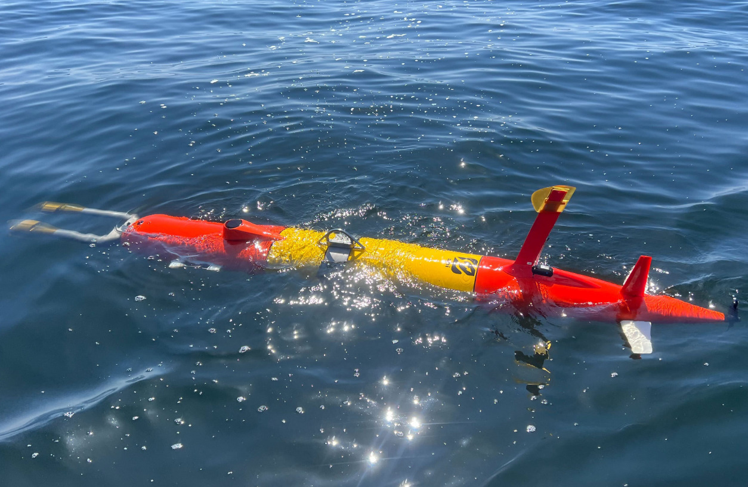
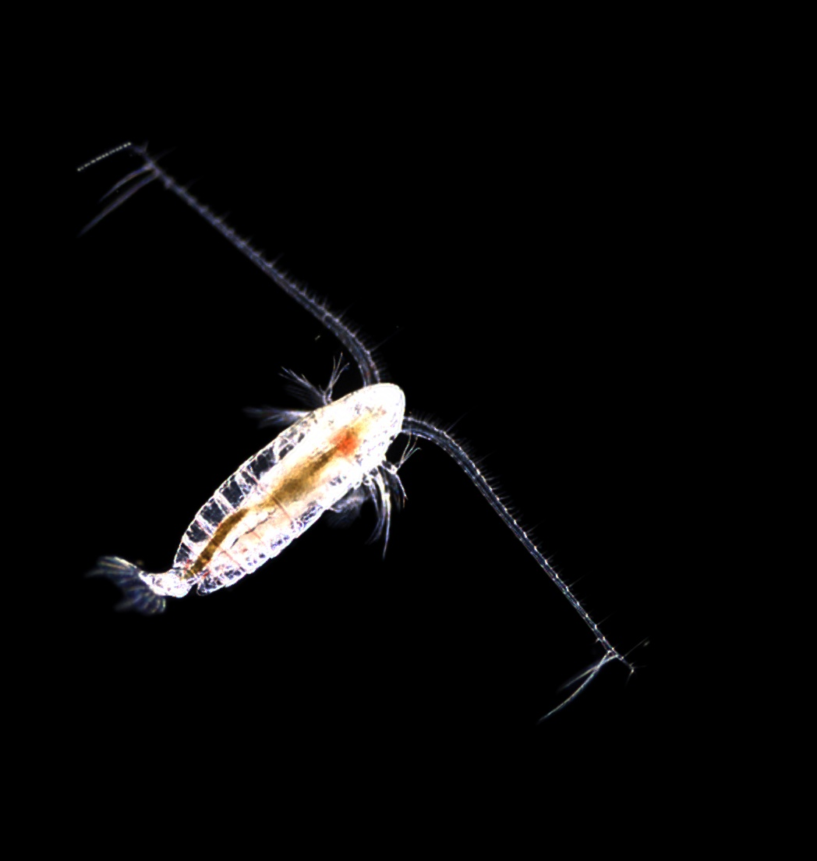
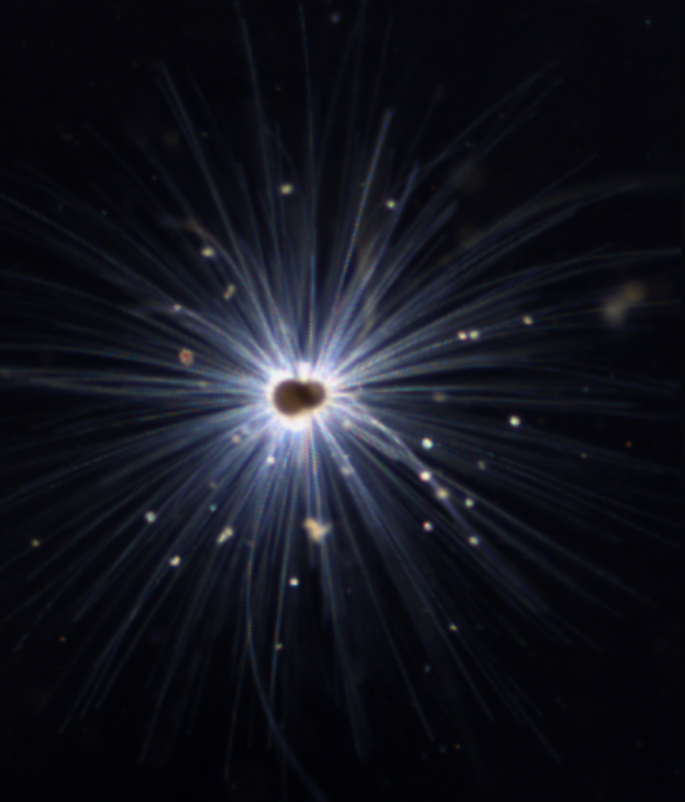
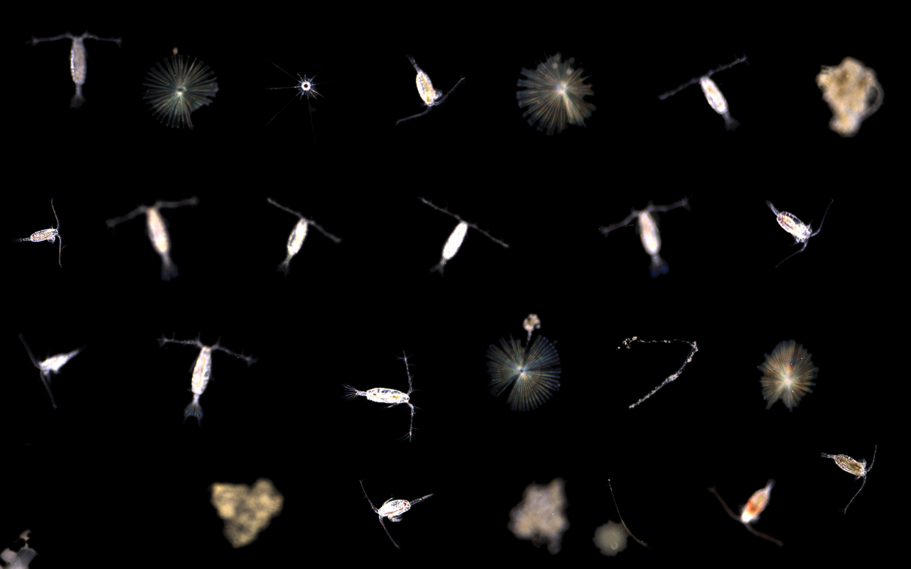
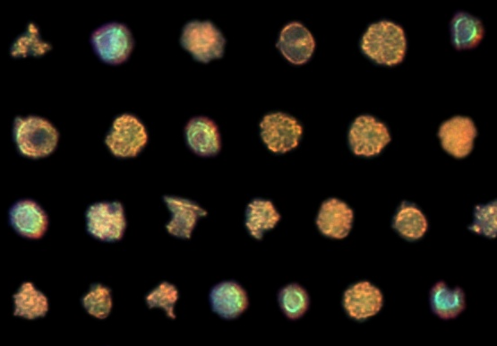
Planktivore
Imaging: Dual 5 MB stills up to 10 Hz
Data Rate: 100 MB/s (1 MB/s)
Imaged Volume: milliliters / microliters
20 um to 2 cm size range
7 mm
1 cm
2 mm
80 um
3 mm

Slide 11
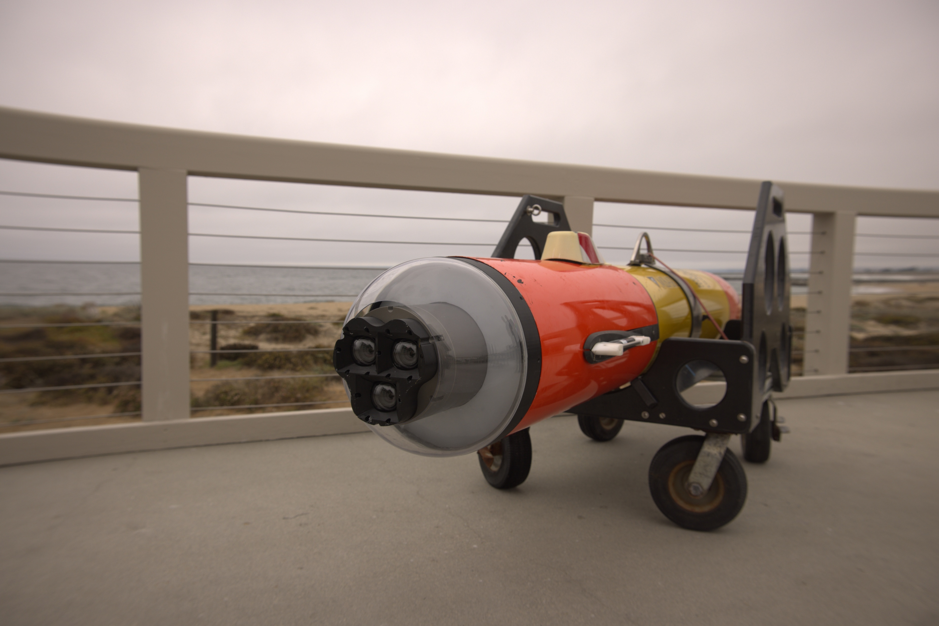
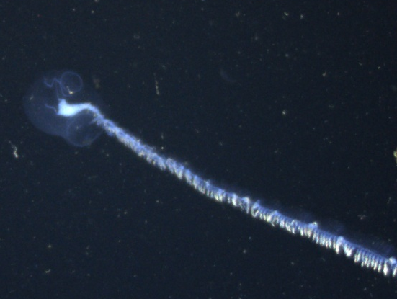
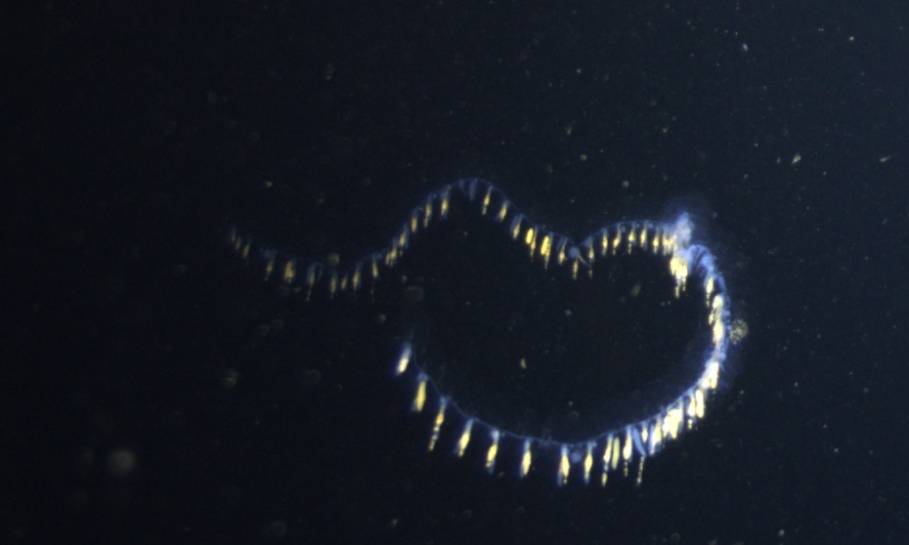
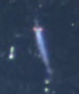
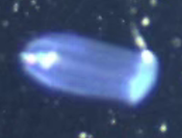
Triton Camera (2025)
Three, 8 MP cameras 10 Hz
Nvidia Orin AGX
YOLOv11s
1 DOF (pitch control)
Automated targeted sampling
Power scaling, 1-60 Hz FPS , 20-200 W

Slide 12
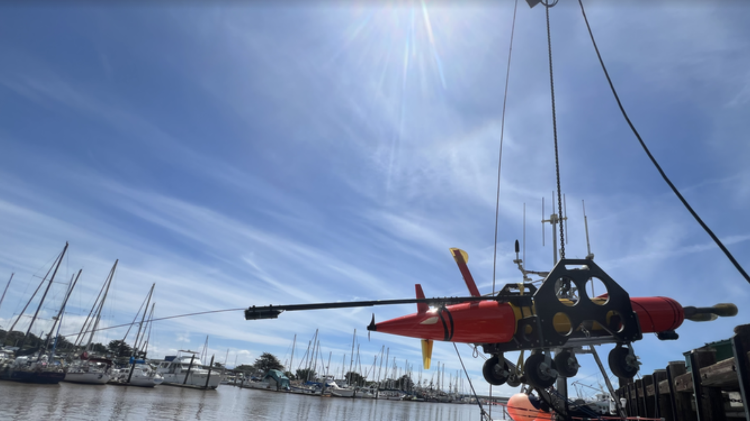
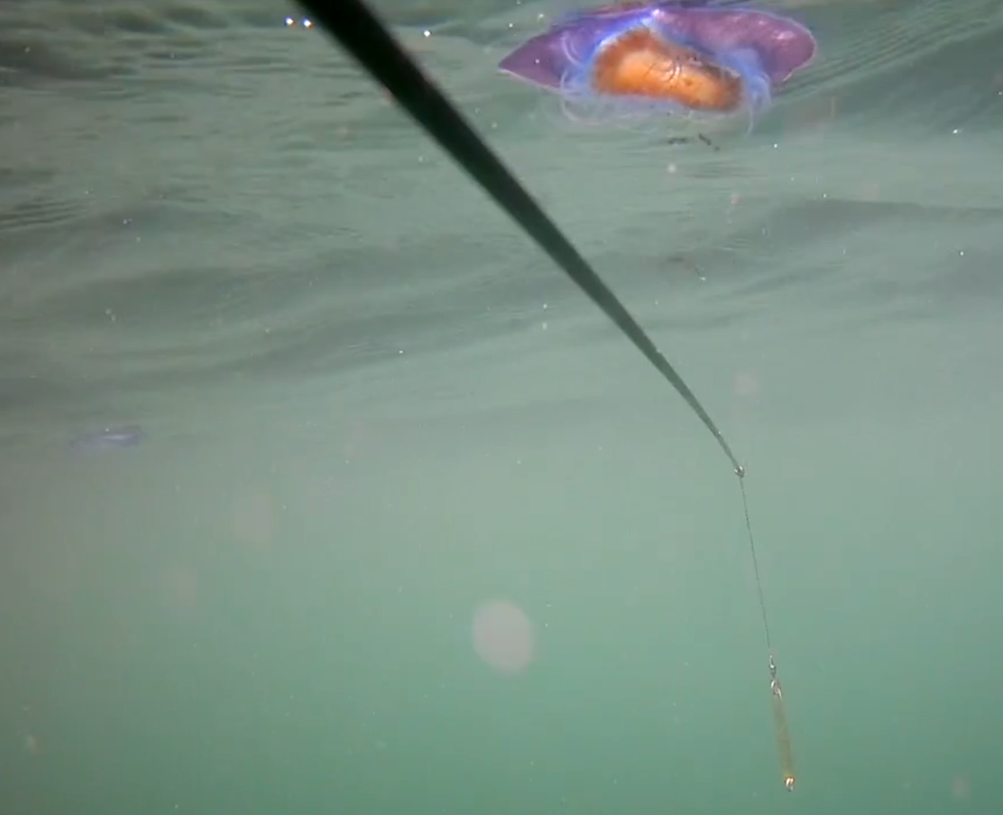
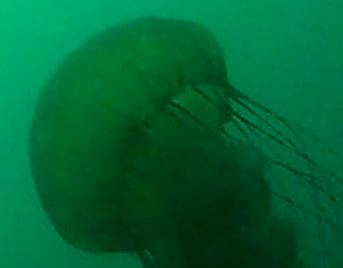
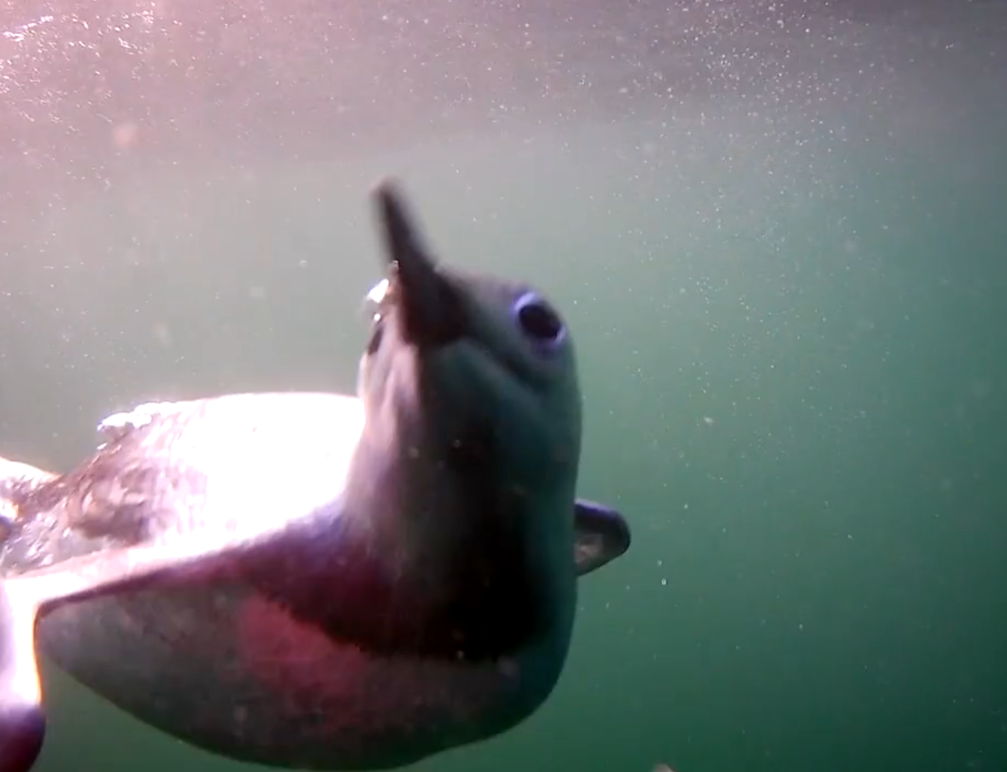
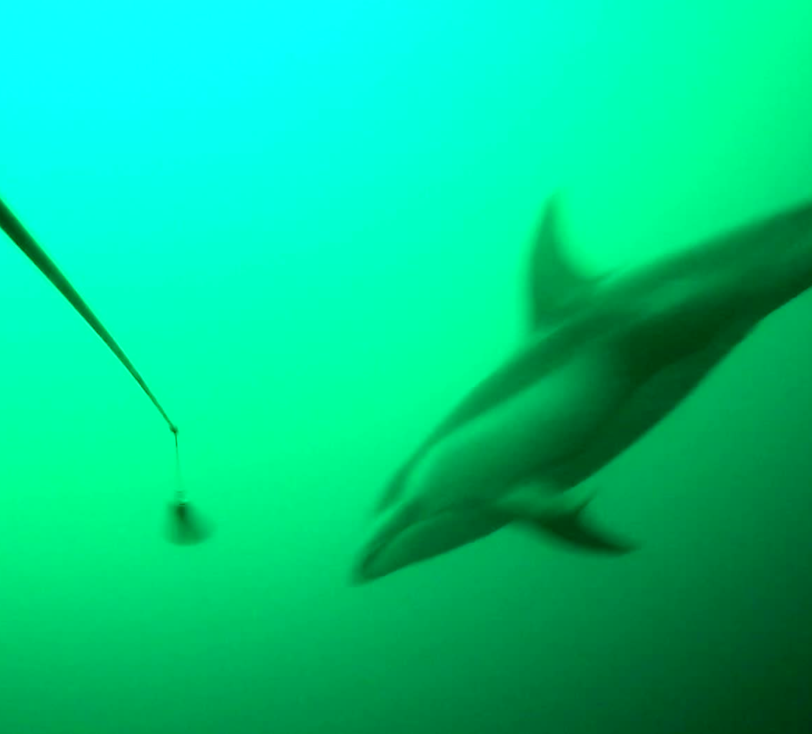
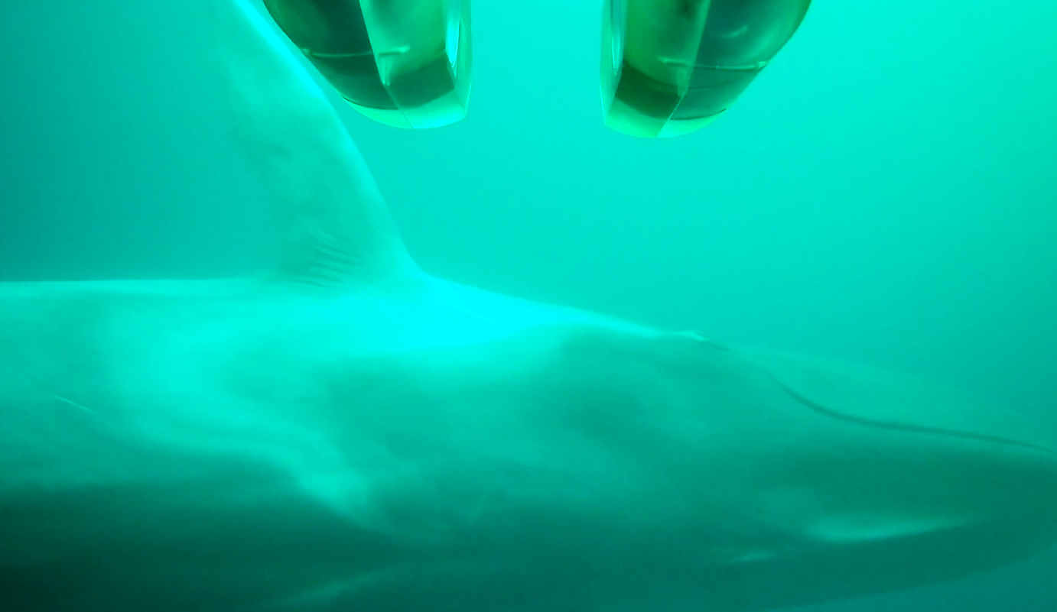
Piscivore
Imaging: 1920x1080p60
Data Rate: 3 MB/s
Imaged Volume: cubic meters
10 cm to 10 m size range

