Slide 1

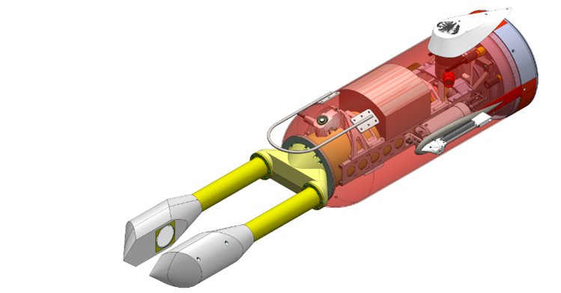

Planktivore: Example use as part of the Synchro tech testbed – Offshore wind pilot study
HA Ruhl, T Maughan, PLD Roberts, FP Chavez, CA Durkin, JH Adelaars, FL Bahr, J Erickson, SHD Haddock, B Jones, K Katija, D Klimov, T A Schnittger, L Chrobak, D Cline – MBARI
RM Kudela, P Daniel, B Marinovic - University of California Santa Cruz
An evolution of Zooglider of M Ohman et al. at UCSD

Slide 2
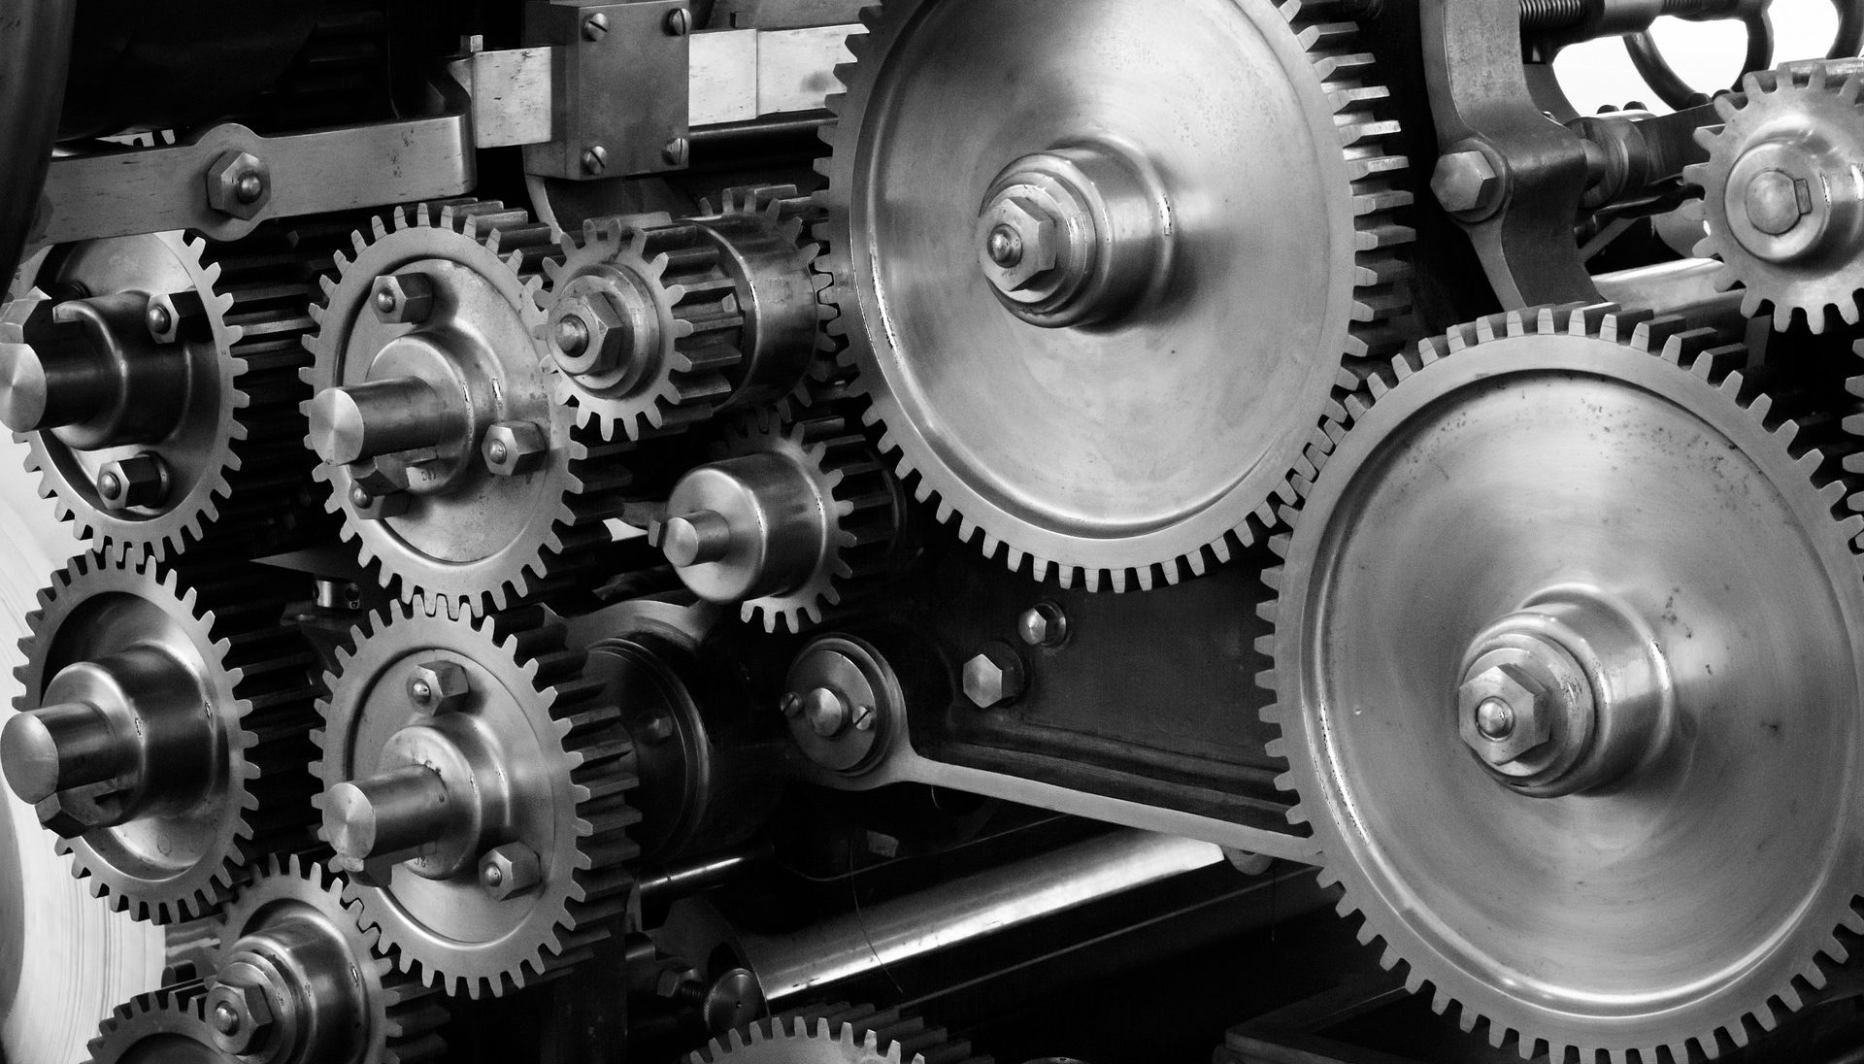


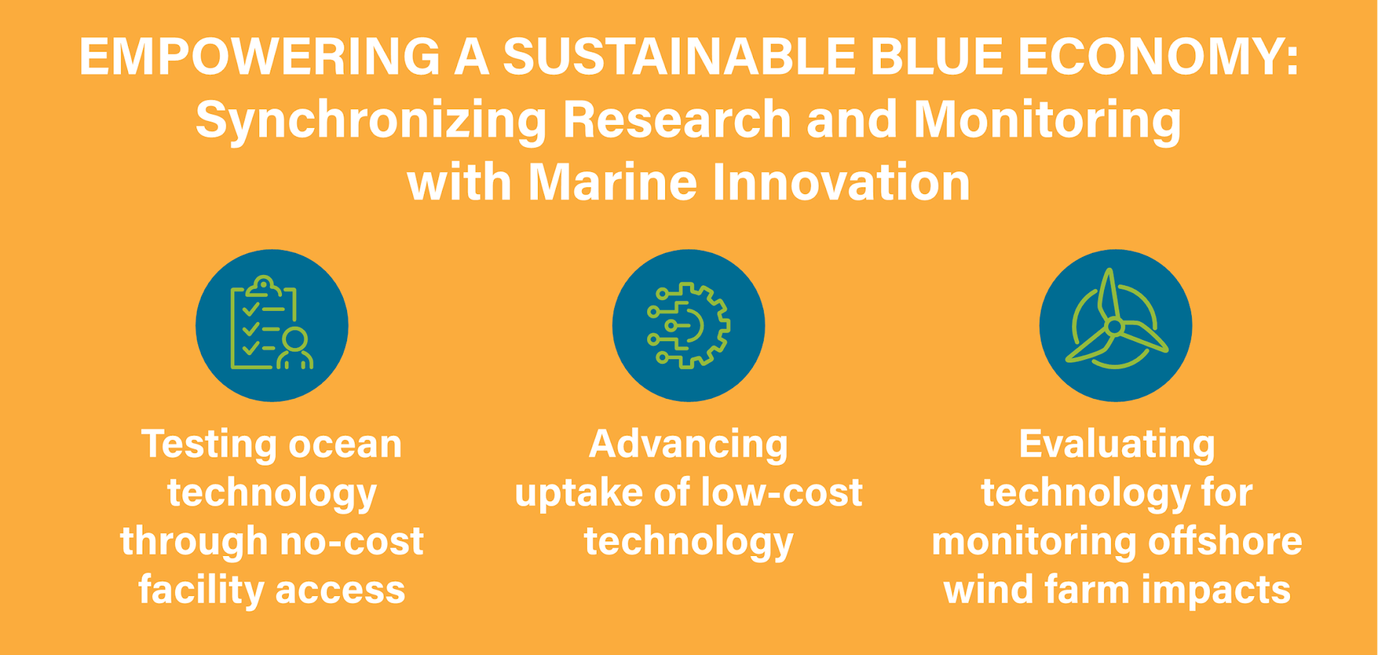










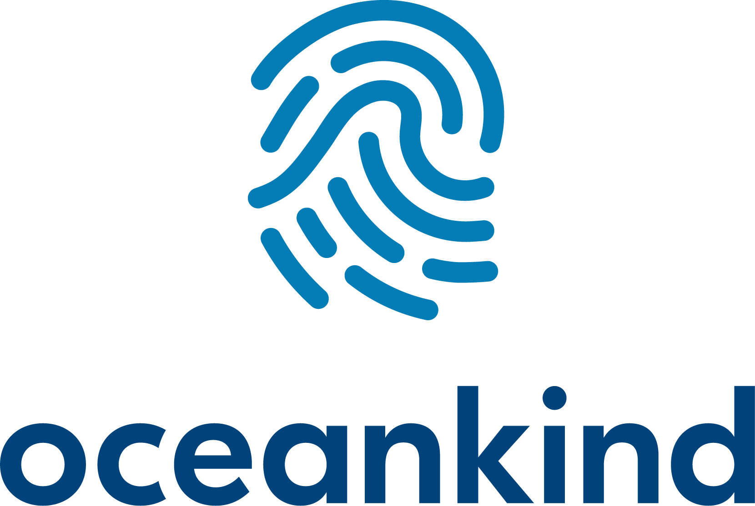
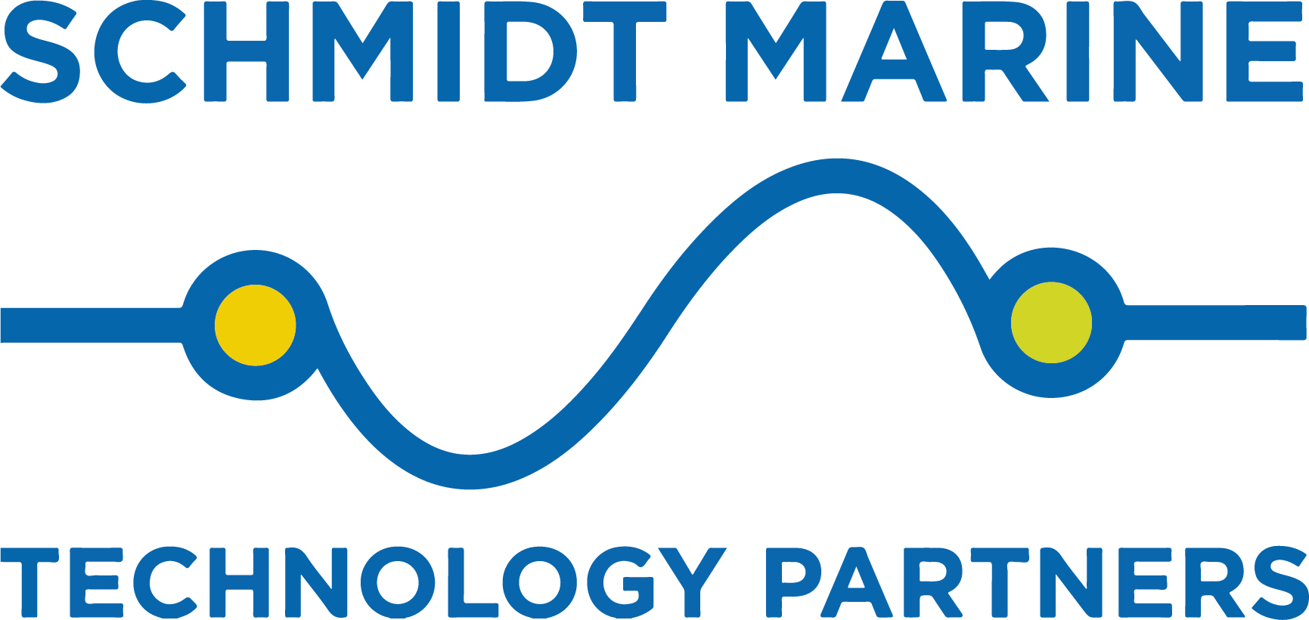
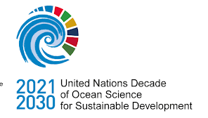
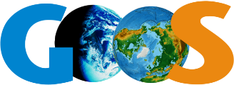

What is Synchro?
Empowering a sustainable Blue Economy: Synchronizing Research and monitoring with marine innovation
Testing ocean technology through facility access
Advancing Accessible Ocean Technology (AOT)
Evaluating tech for offshore wind farm monitoring needs

Slide 3
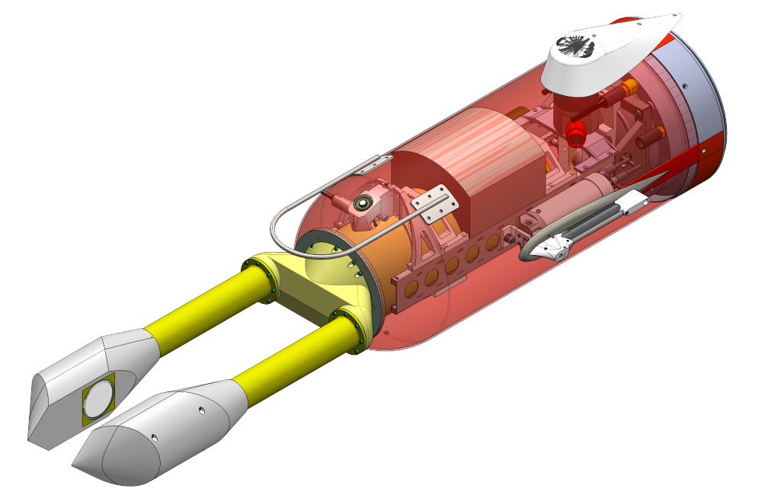
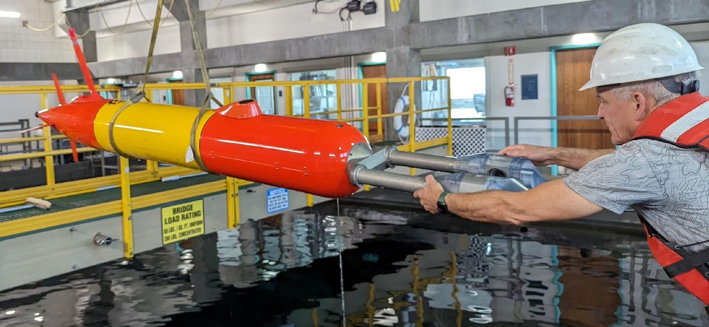
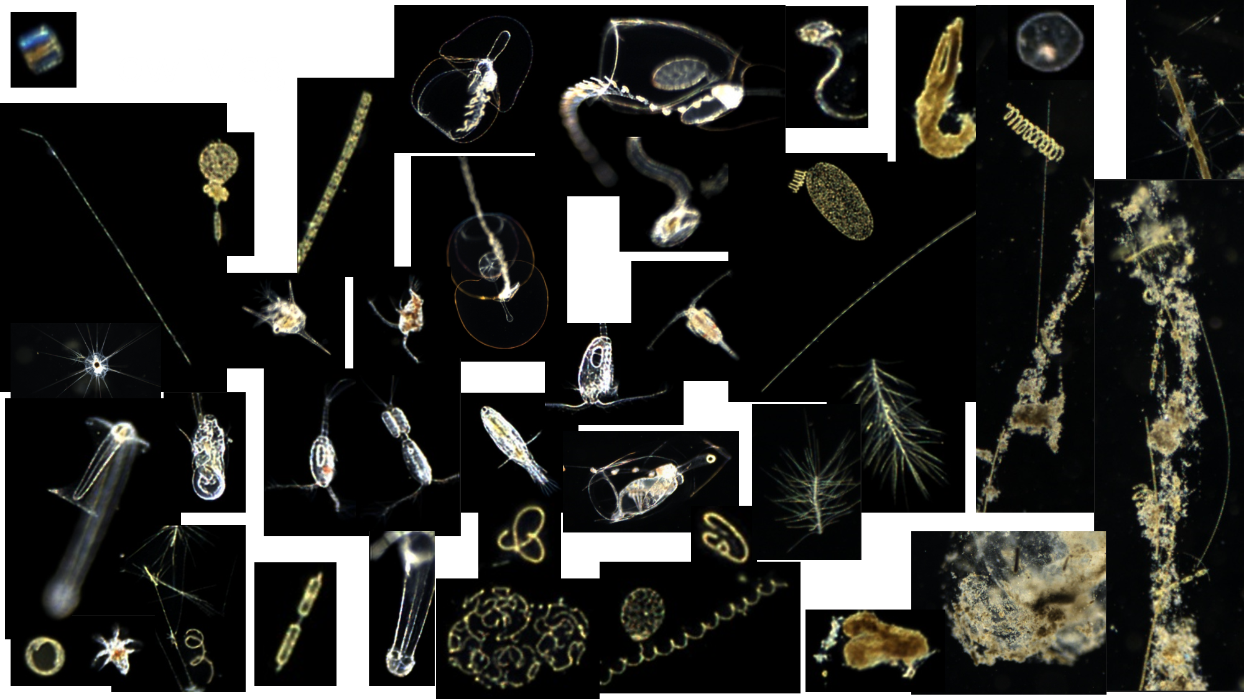
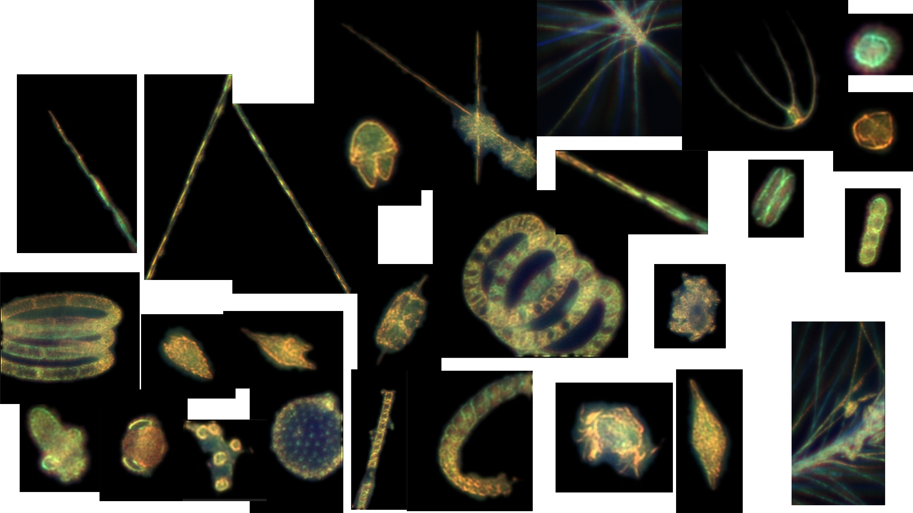
Planktivore on LRAUV
Builds on Zooglider of Ohman et al.
LRAUV available via SAAB
low mag volume: ~ 0.8 ml
high mag volume: ~ 0.2 ul
frame rate: 10 fps

Slide 4
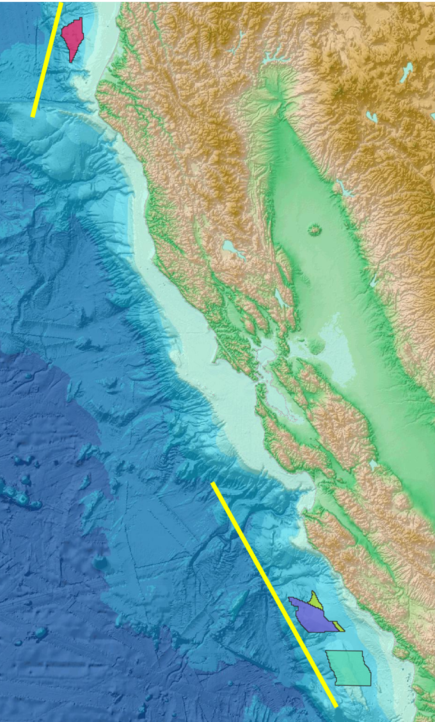
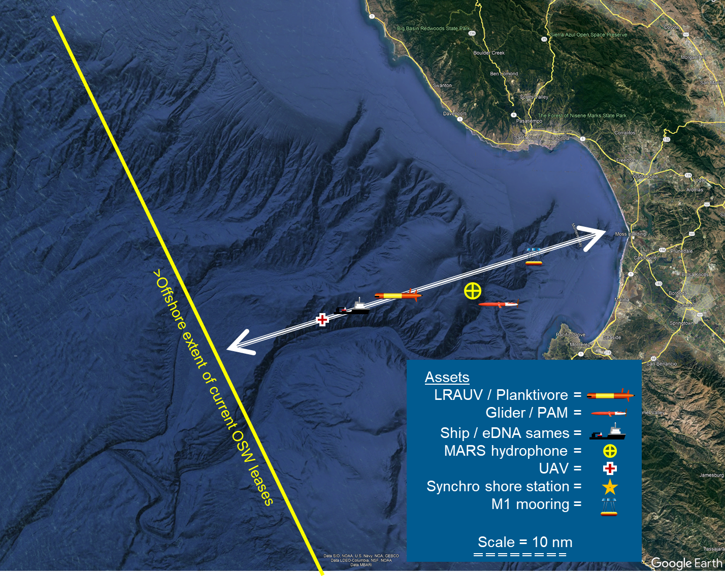
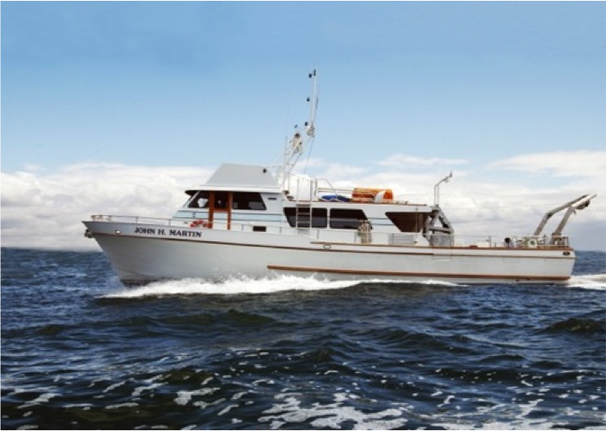
Offshore Wind Pilot Study
Technology evaluations for offshore wind industry baseline & impact assessment
Wind to Whales
Observing at management scales
Monterey Bay focused
2-5 days per exercise
6 excercises
Using models to bridge understanding to OSW lease areas
Notes:
2nd chart to highlight possibility of siting in CA waters

Slide 5
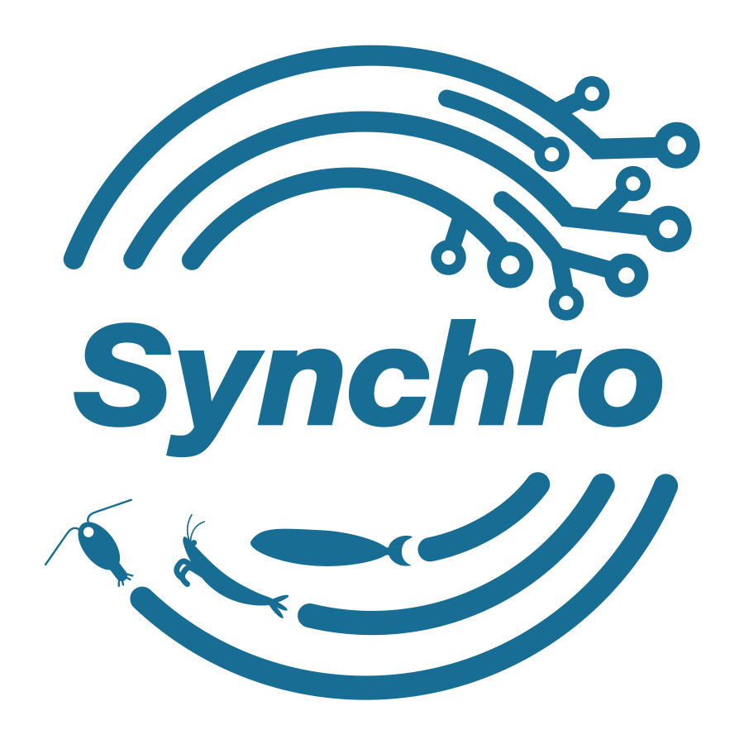
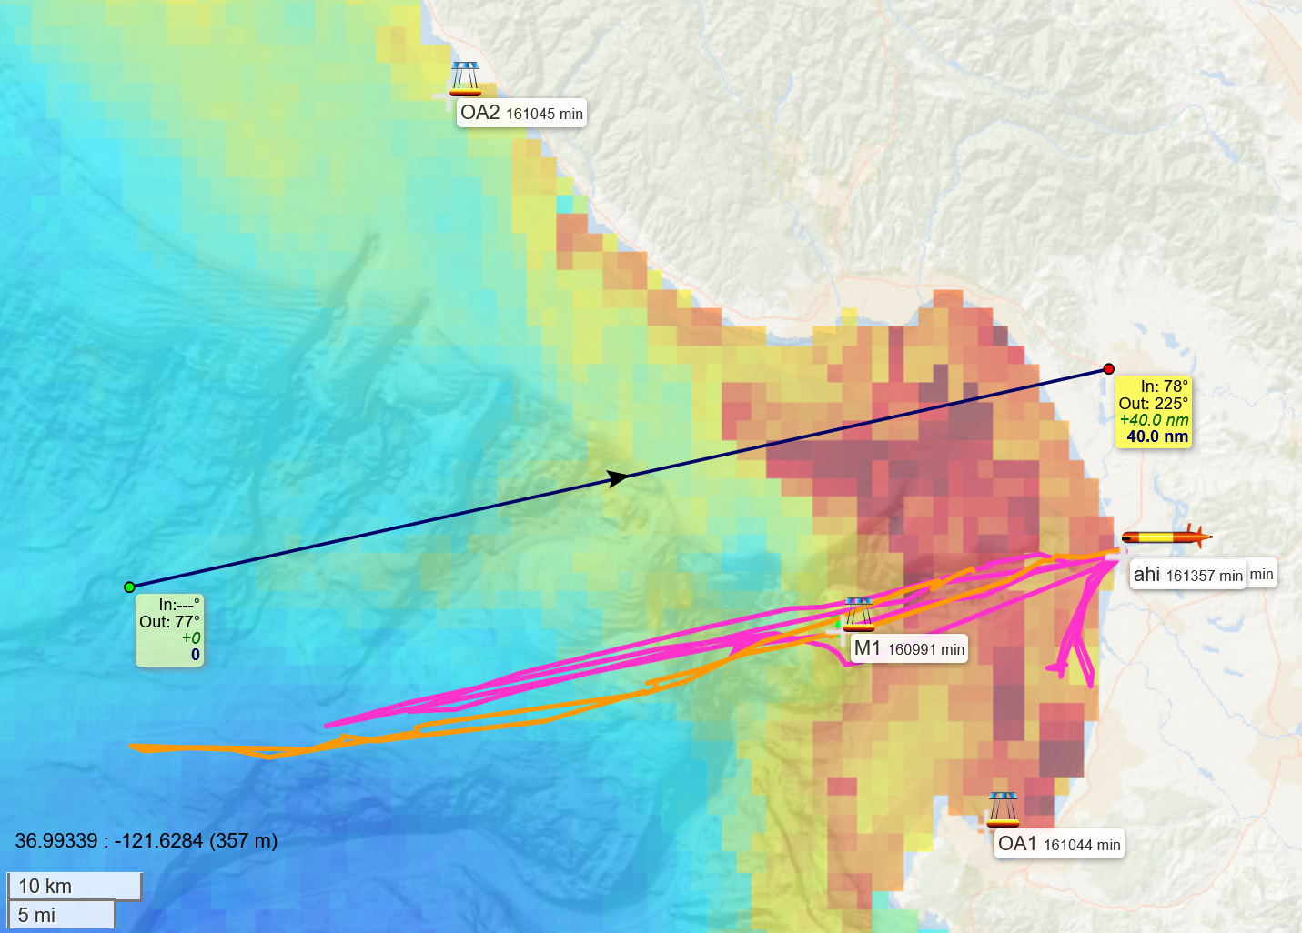
Drone flight
Spring 2024
Fall
2024
Spring
2025
Summer
2025
Fall
2025
Spring
2026
Drone flights
CTD Casts
eDNA filtering, TorpeDNA tows
Aquasens sample collection
T,S,O,Chl-a,backscatter
Scale of floating OSW lease areas
R/V Martin (MLML)
LRAUV/Planktivore
C1
MARS
M2
Synchro1
Synchro2

Slide 6
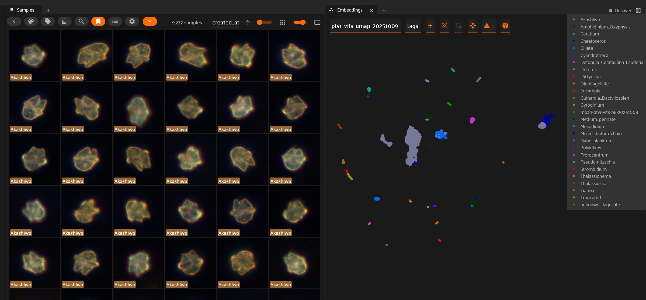
AI/ML Approach
Example Clustering
5 Missions for Synchro, 2 for CANON + more = Millions of images so far…
Hierarchical clustering w/ human augmentation.
Efficient way to develop a first-pass training set.
Clustering images based on features and manually validating the clustered images.
Example Planktivore Annotated Images
Notes:
2nd chart to highlight possibility of siting in CA waters

Slide 7
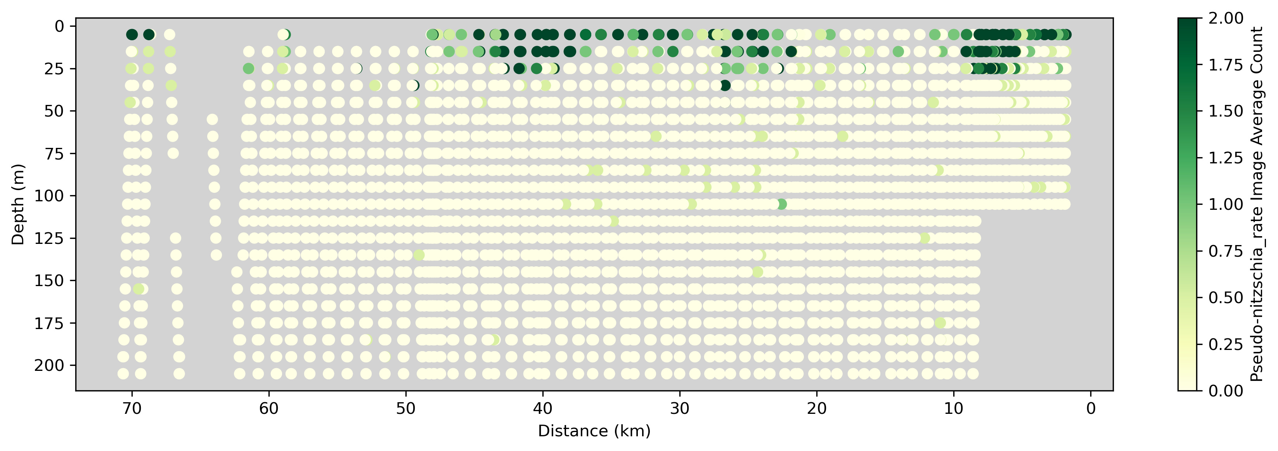
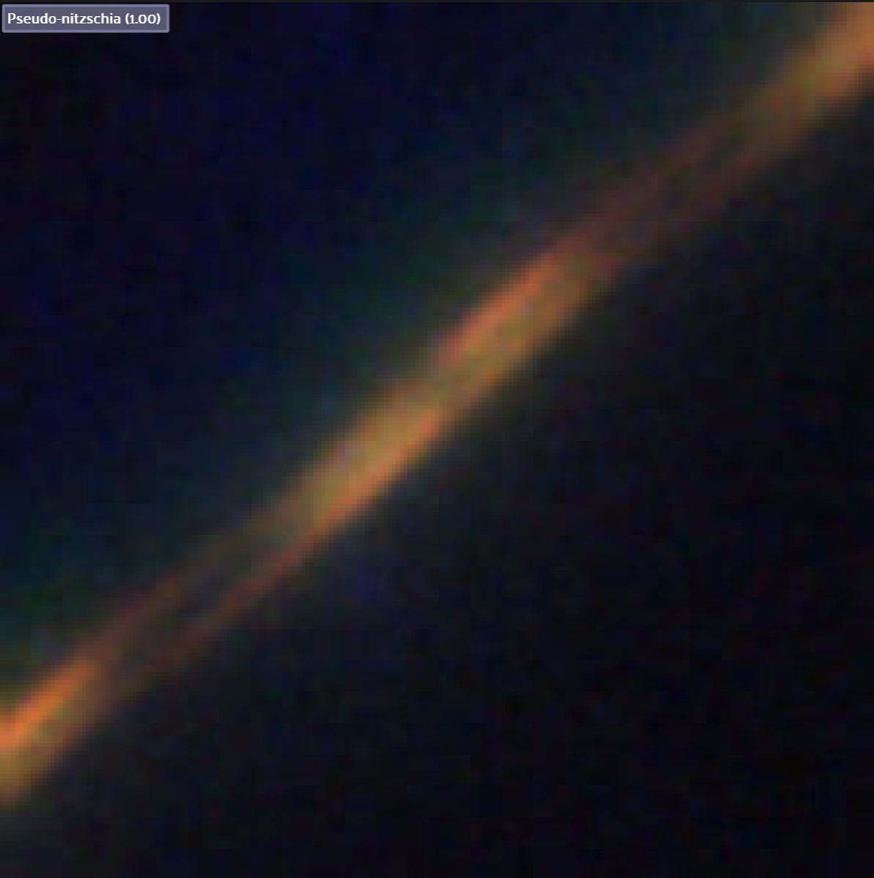
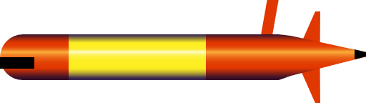
outbound
Spring 2024
Fall
2024
Spring
2025
Summer
2025
Fall
2025
Spring
2026
Drone flights
CTD Casts
eDNA
Aquasens sample collection
T,S,O,Chl-a,backscatter
R/V Martin (MLML)
LRAUV/Planktivore
C1
MARS
M2
Synchro2
Synchro1
Scale of floating OSW lease areas

Slide 8
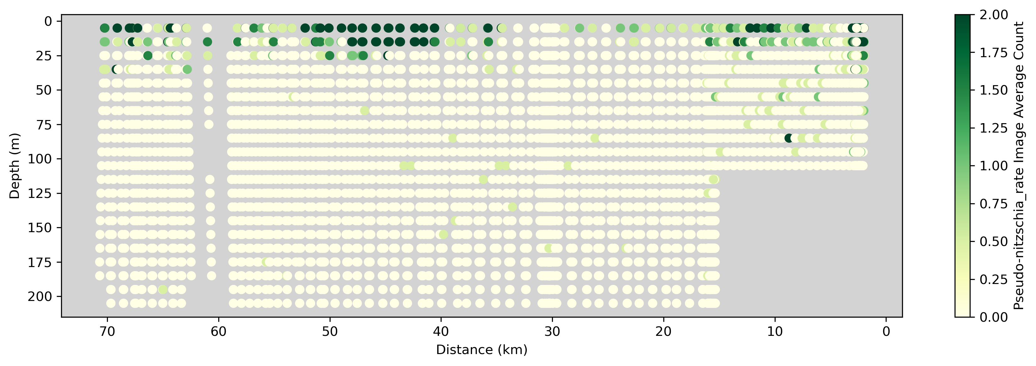
inbound
Spring 2024
Fall
2024
Spring
2025
Summer
2025
Fall
2025
Spring
2026
Drone flights
CTD Casts
eDNA
Aquasens sample collection
T,S,O,Chl-a,backscatter
R/V Martin (MLML)
LRAUV/Planktivore
C1
MARS
M2
Synchro2
Synchro1
Scale of floating OSW lease areas

Slide 9
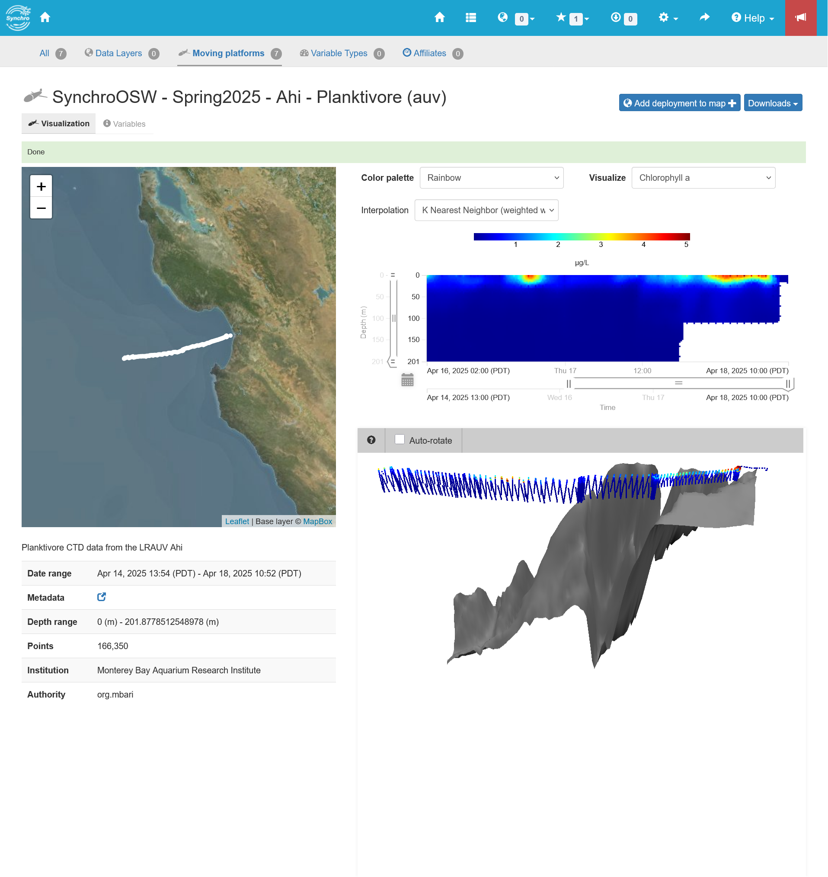
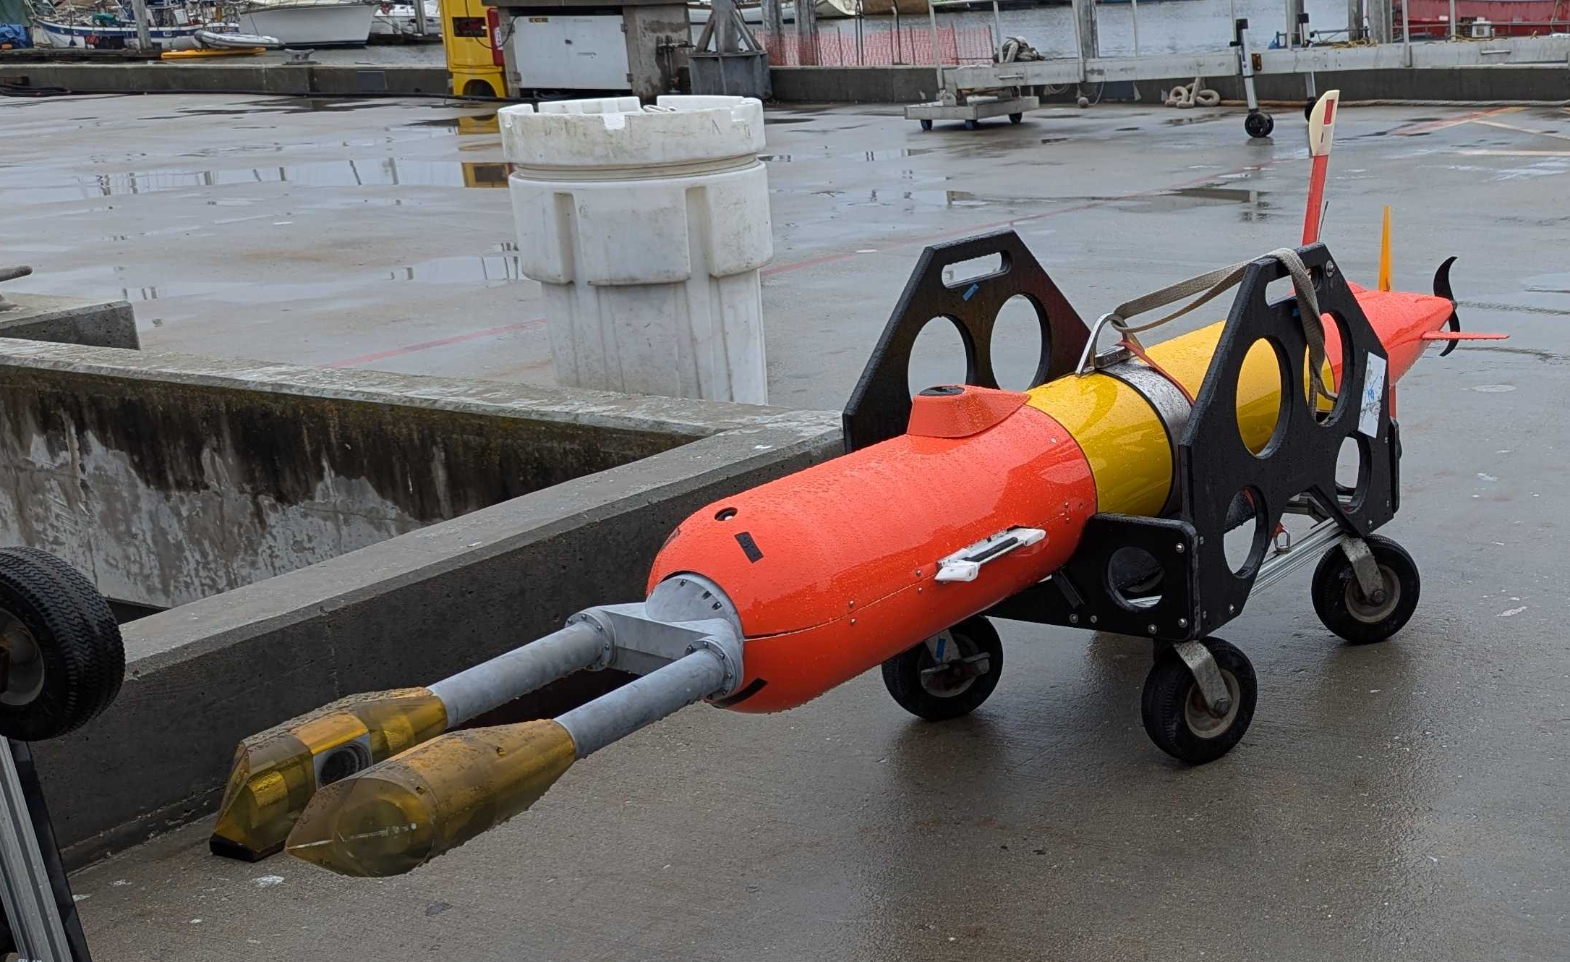

Slide 10
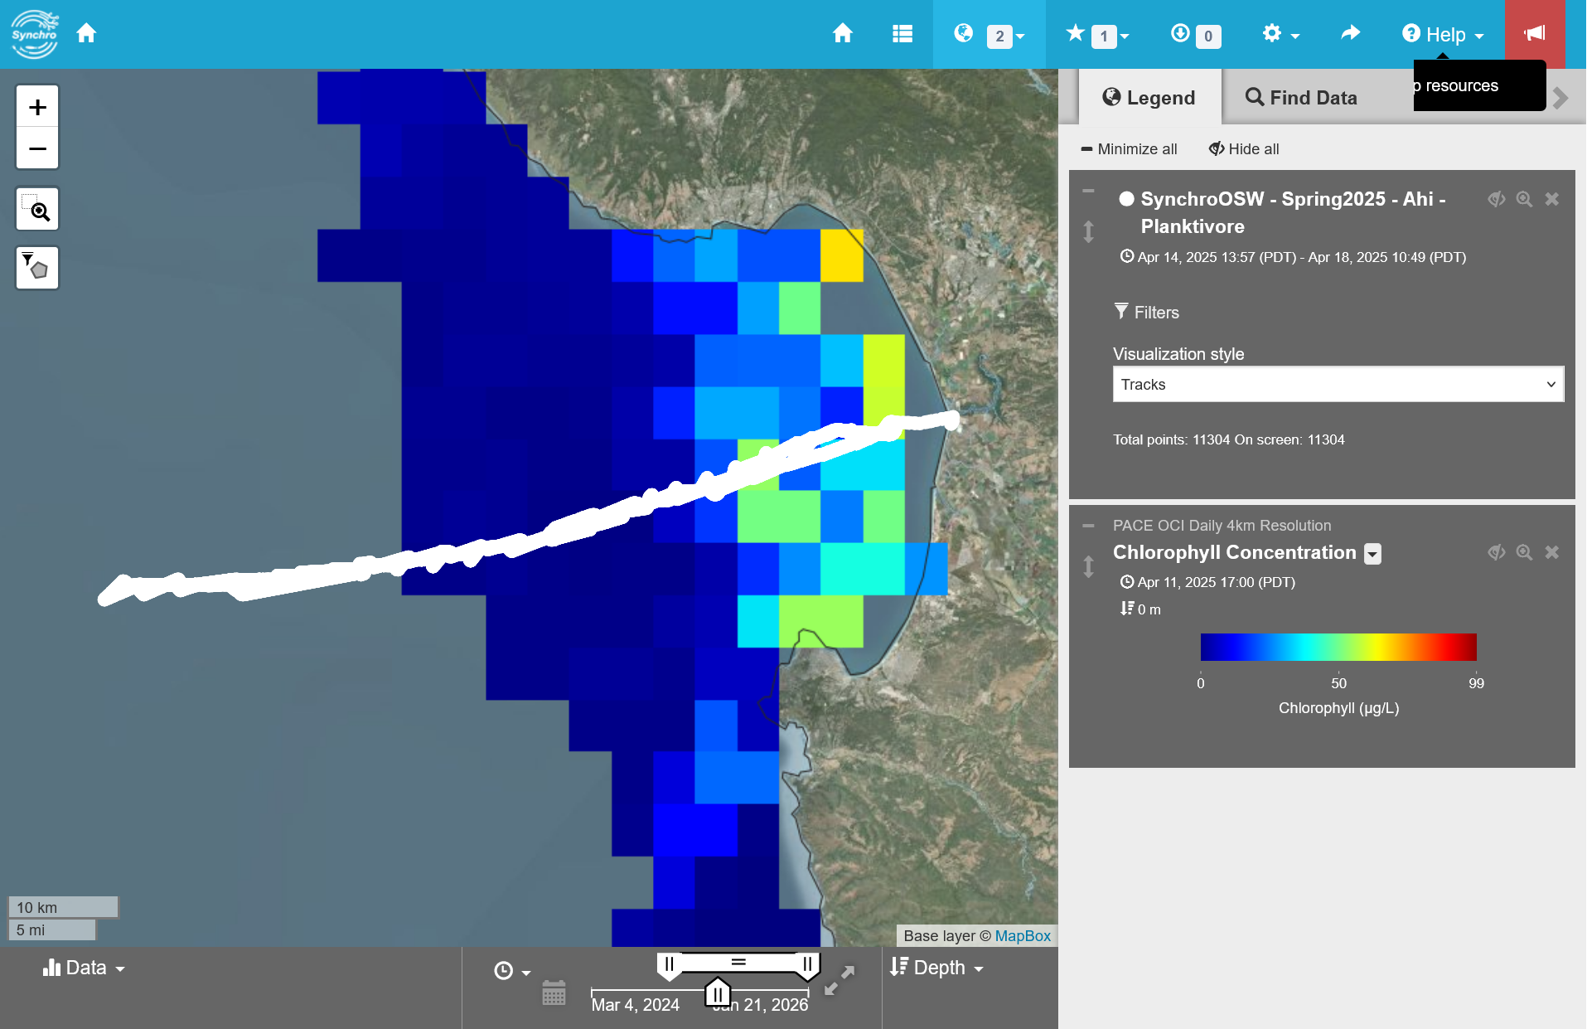

Slide 11

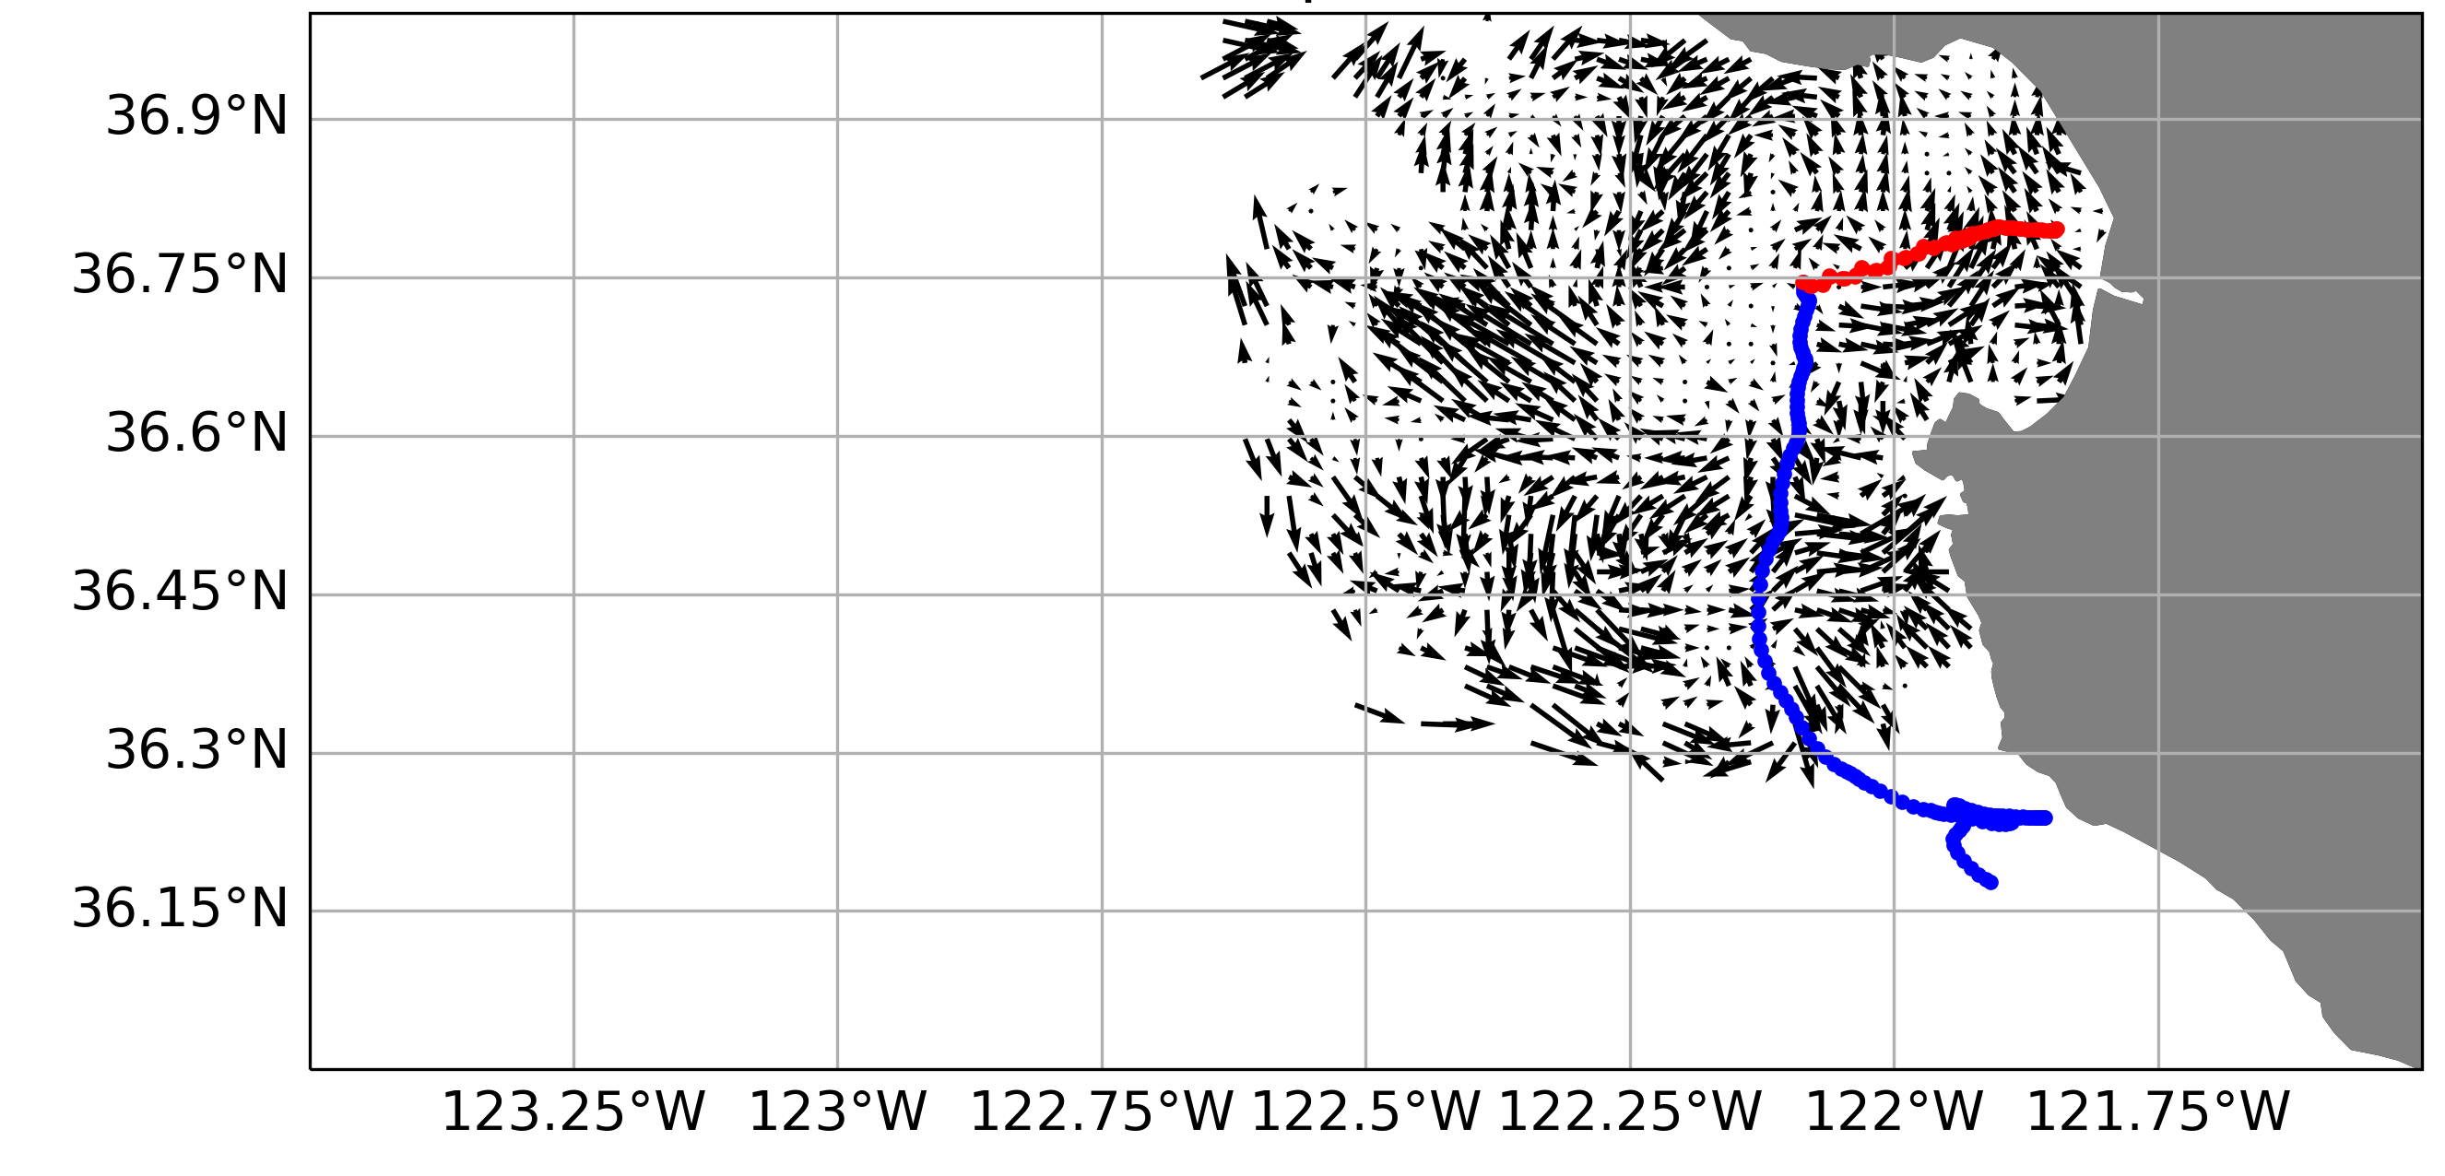
outbound
Pseudo-nitzchia spp.
Diatom
Demoic Acid producer
HFR hourly surface currents
LRAUV track
7-day history (where did the water likely come from)

Slide 12
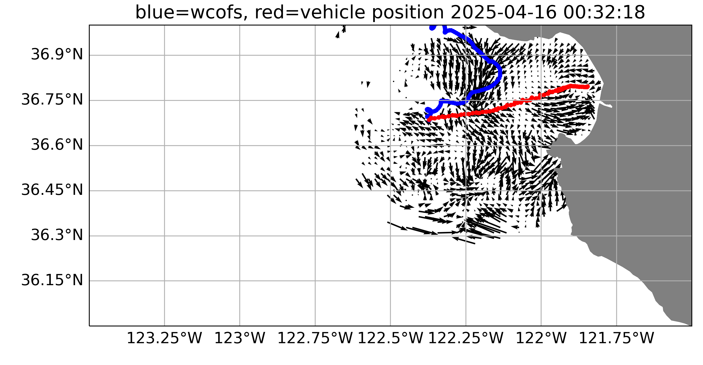
outbound
Pseudo-nitzchia spp.
Diatom
Demoic Acid producer
HFR hourly surface currents
LRAUV track
7-day history (where did the water likely come from)

Slide 13
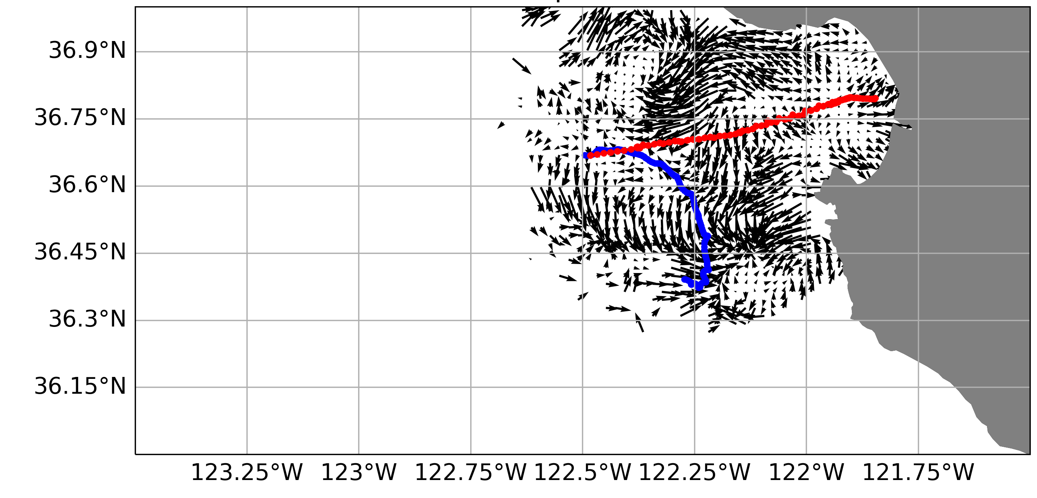
outbound
Pseudo-nitzchia spp.
Diatom
Demoic Acid producer
HFR hourly surface currents
LRAUV track
7-day history (where did the water likely come from)

Slide 14
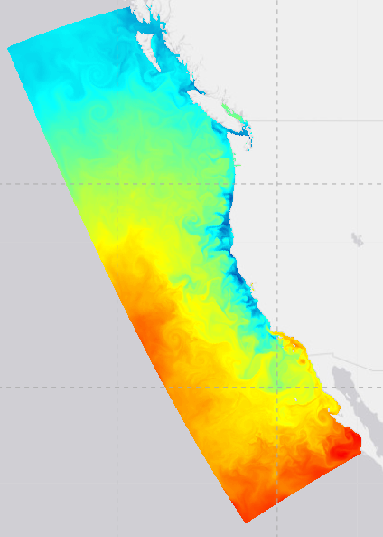
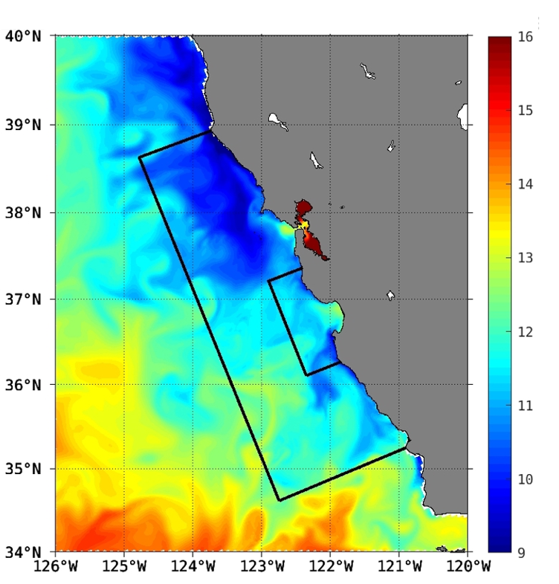
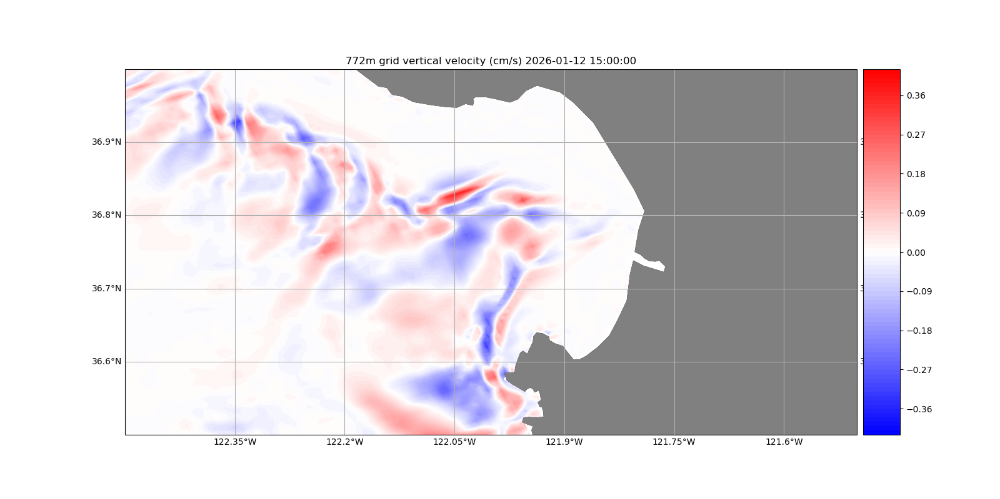
Upwelling Quantified
Example:
West Coast Operational Forecast System (WCOFS) - Regional Ocean Modeling System (ROMS)
Currents, upwelling and more
Nested 772 m resolution domain
772m WCOFS Nest plot of vertical velocity (near surface) in cm/s
Overall WCOFS 4 km
resolution domain
Nested 154 m resolution domain

Slide 15
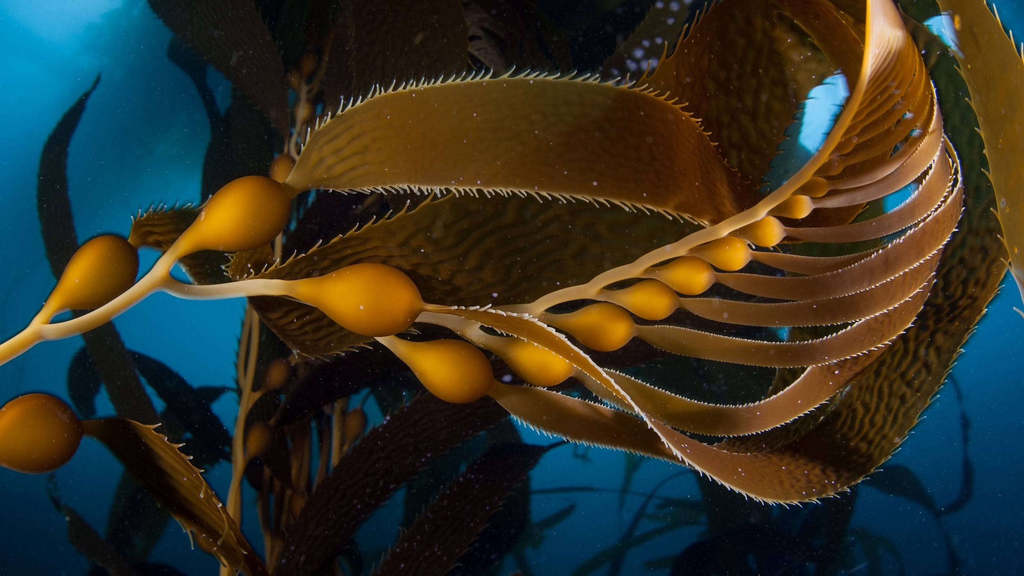
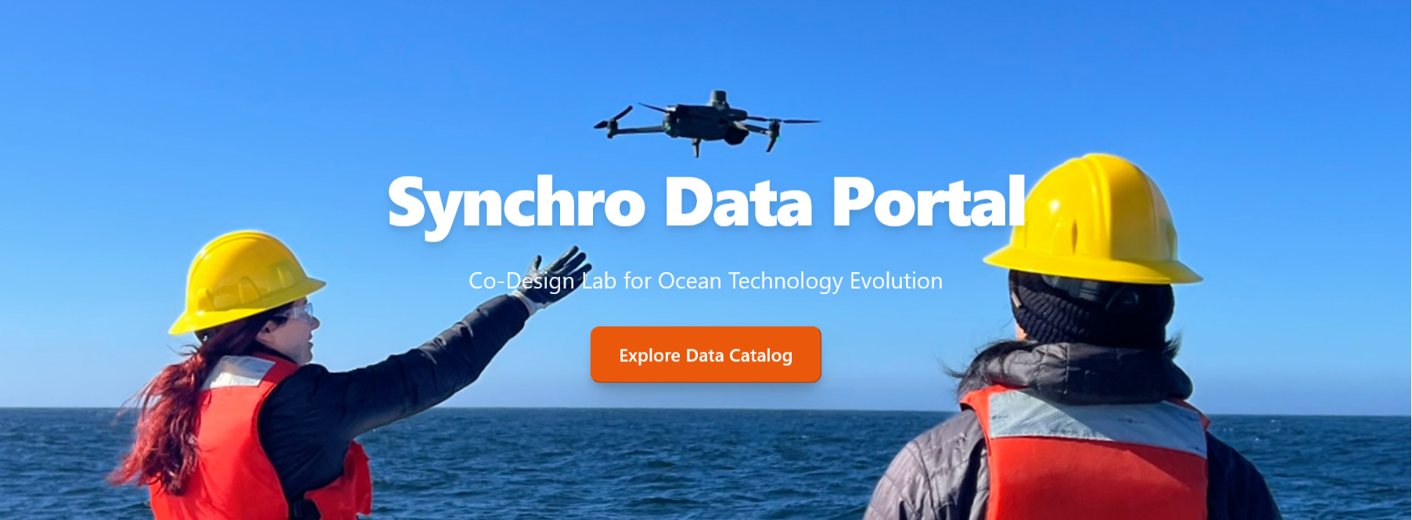

Thanks!!!

Slide 16
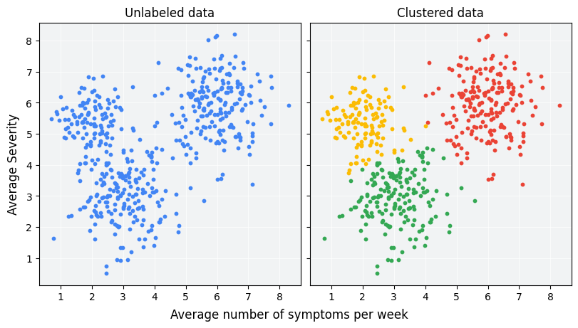
AI/ML Approach
Each point represents an individual / image
Similarity of features/individuals is distance between points
Begin to label and examine / edit labels using the clusters and other tools
5 Missions for Synchro, 2 for CANON + more = Millions of images so far…
Hierarchical clustering w/ human augmentation.
Efficient way to develop a first-pass training set.
Clustering images based on features and manually validating the clustered images.
https://developers.google.com/machine-learning/clustering/overview
Notes:
2nd chart to highlight possibility of siting in CA waters

Slide 17
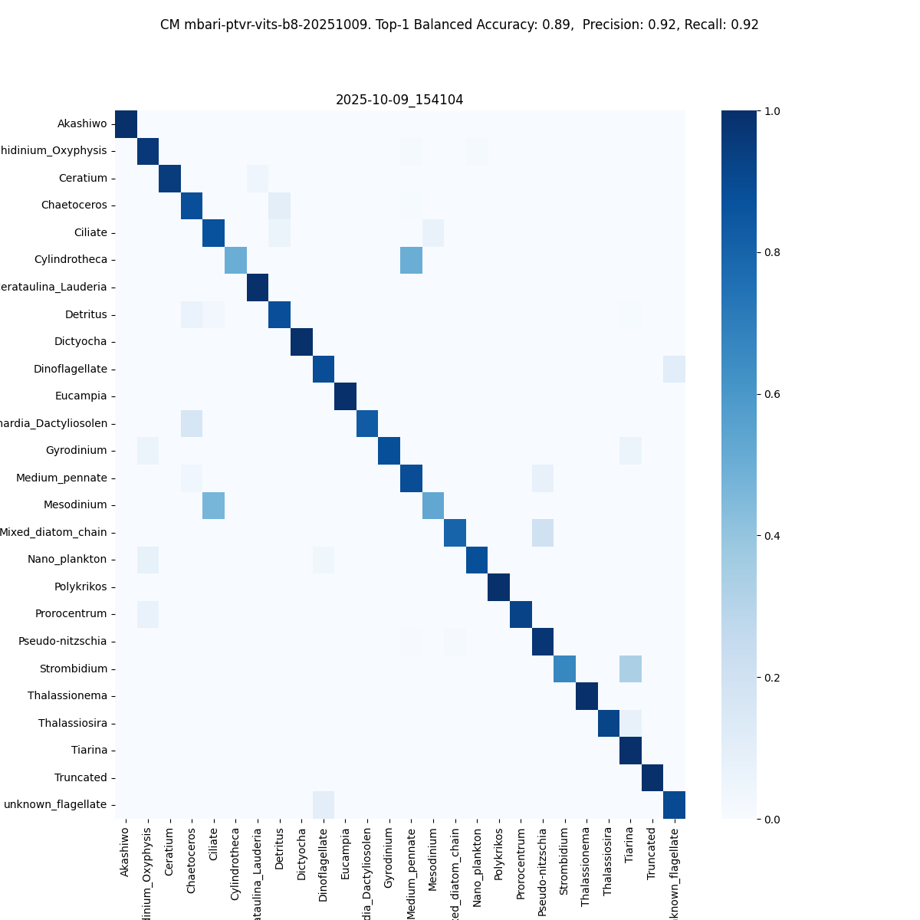
AI/ML Approach
5 Missions for Synchro, 2 for CANON + more = Millions of images so far…
Hierarchical clustering w/ human augmentation.
Efficient way to develop a first-pass training set.
Clustering images based on features and manually validating the clustered images.
Expert validated
Machine annotated
Notes:
2nd chart to highlight possibility of siting in CA waters

Slide 18
Bulk Editing / Validation – Akashiwo
Example Planktivore Annotated Images
Example Clustering

Slide 19
Bulk Editing / Validation – Akashiwo
Example Planktivore Annotated Images
Example Clustering

Slide 20
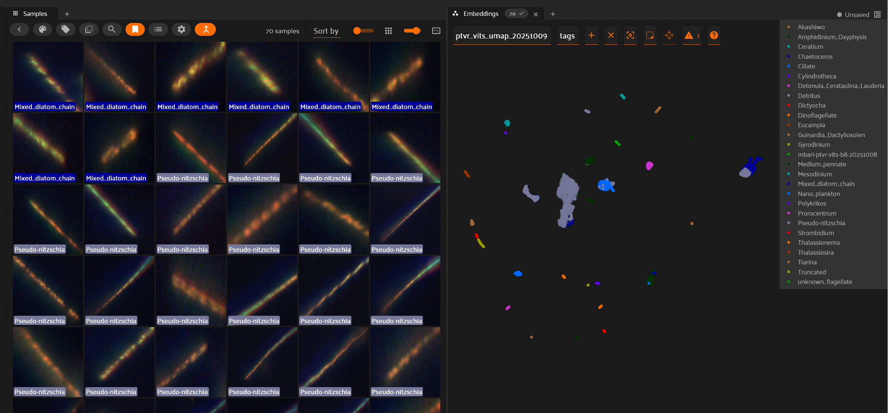
Bulk Editing / Validation – Diatoms
Example Planktivore Annotated Images
Example Clustering

Slide 21
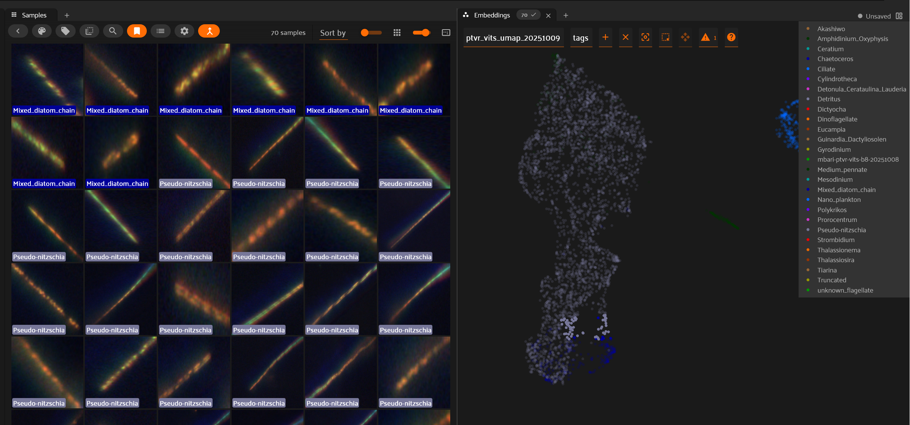
Bulk Editing / Validation – Diatoms
Example Planktivore Annotated Images
Example Clustering

Slide 22
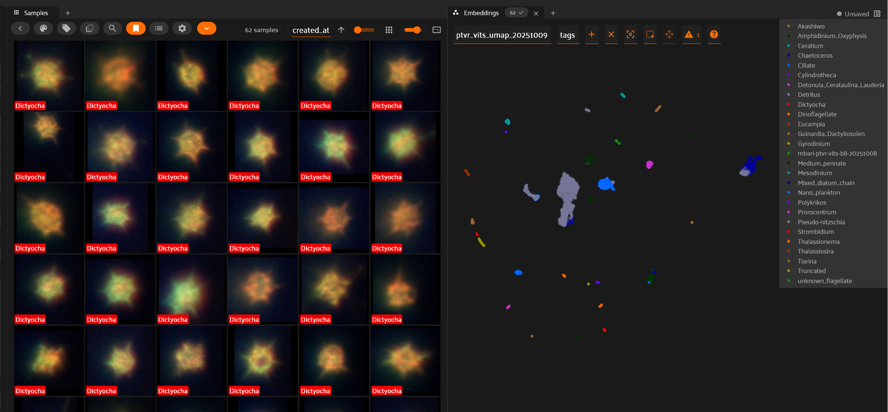
Bulk Editing / Validation – Dictyocha
Example Planktivore Annotated Images
Example Clustering

Slide 23
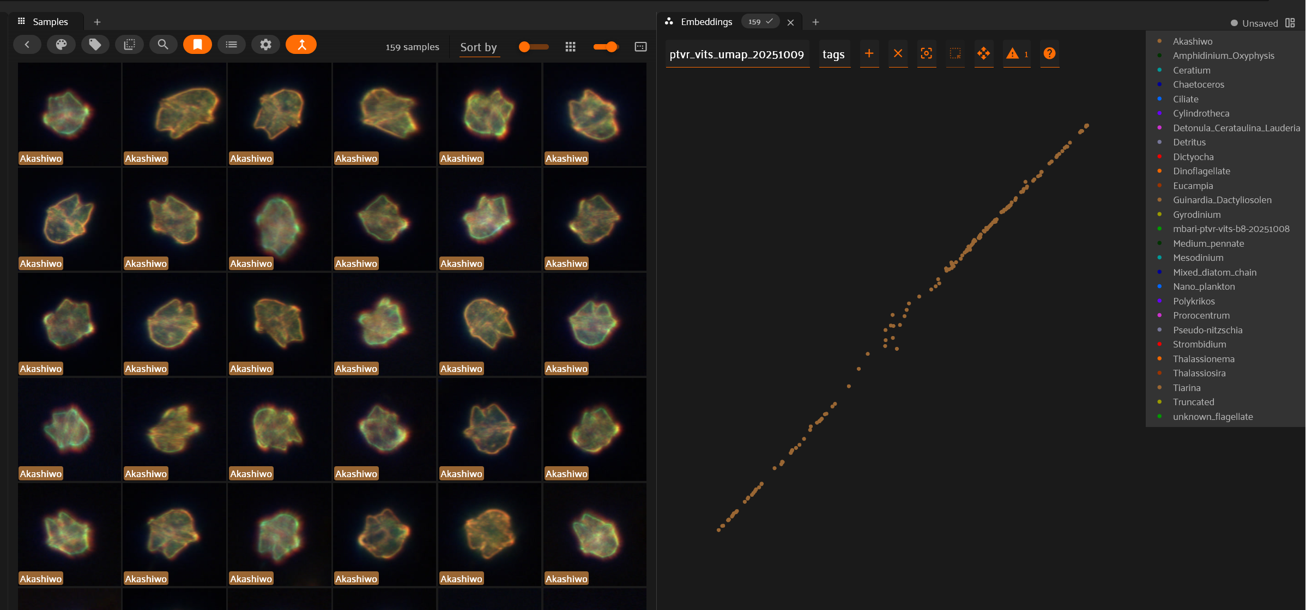
Bulk Editing / Validation – Akashiwo

Slide 24
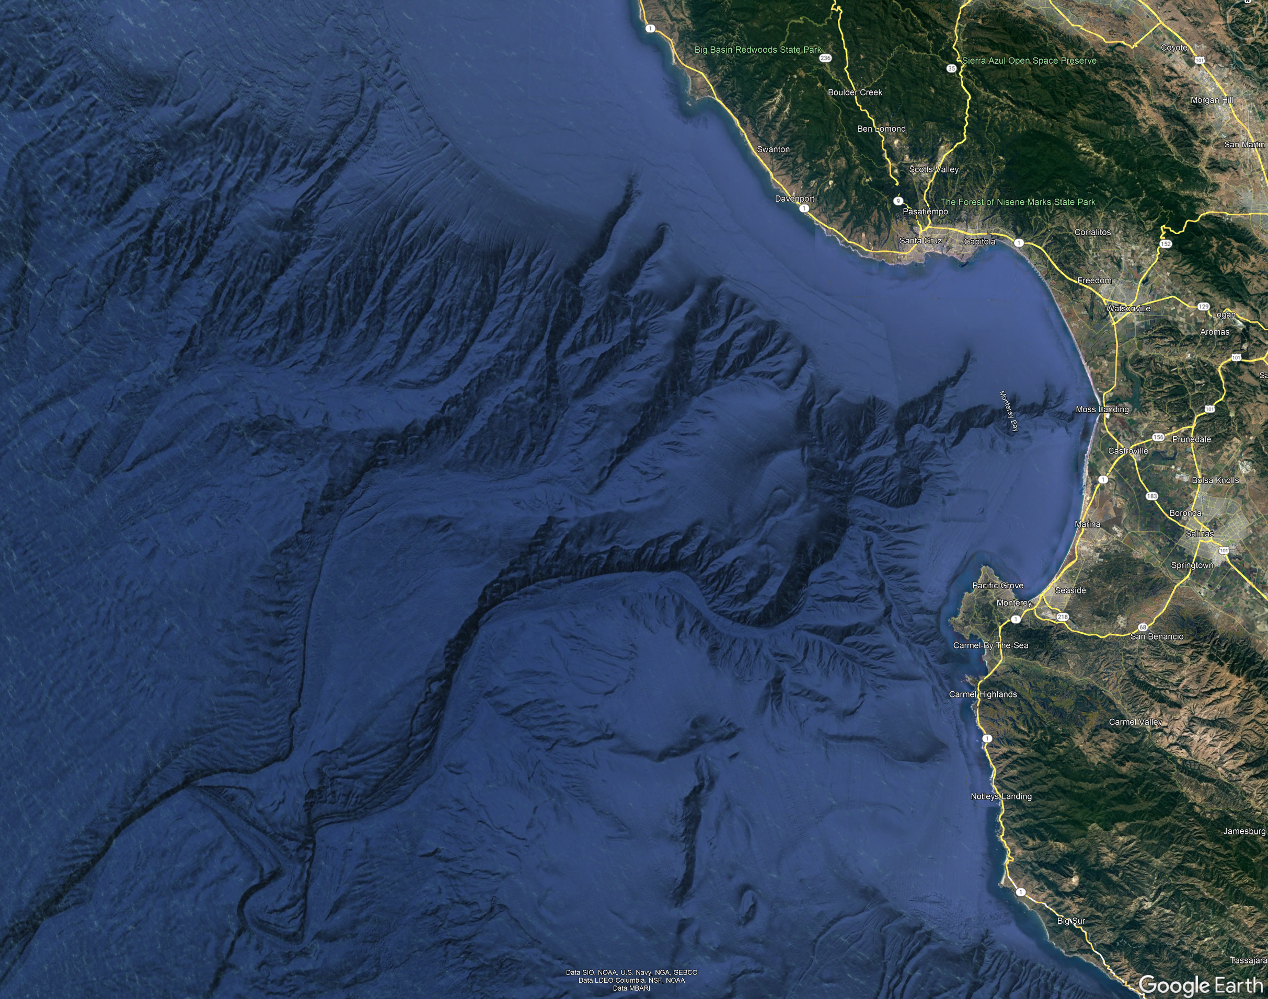

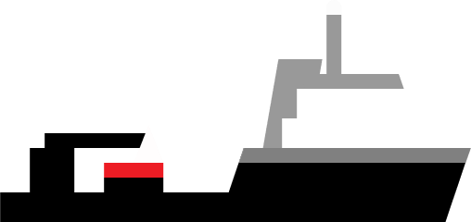
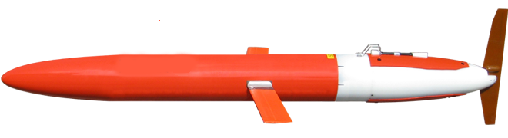
Assets
LRAUV / Planktivore =
Glider / PAM =
Ship / eDNA sames =
MARS hydrophone =
UAV =
Synchro shore station =
M1 mooring =
>Offshore extent of current OSW leases
Scale = 10 nm

Slide 25
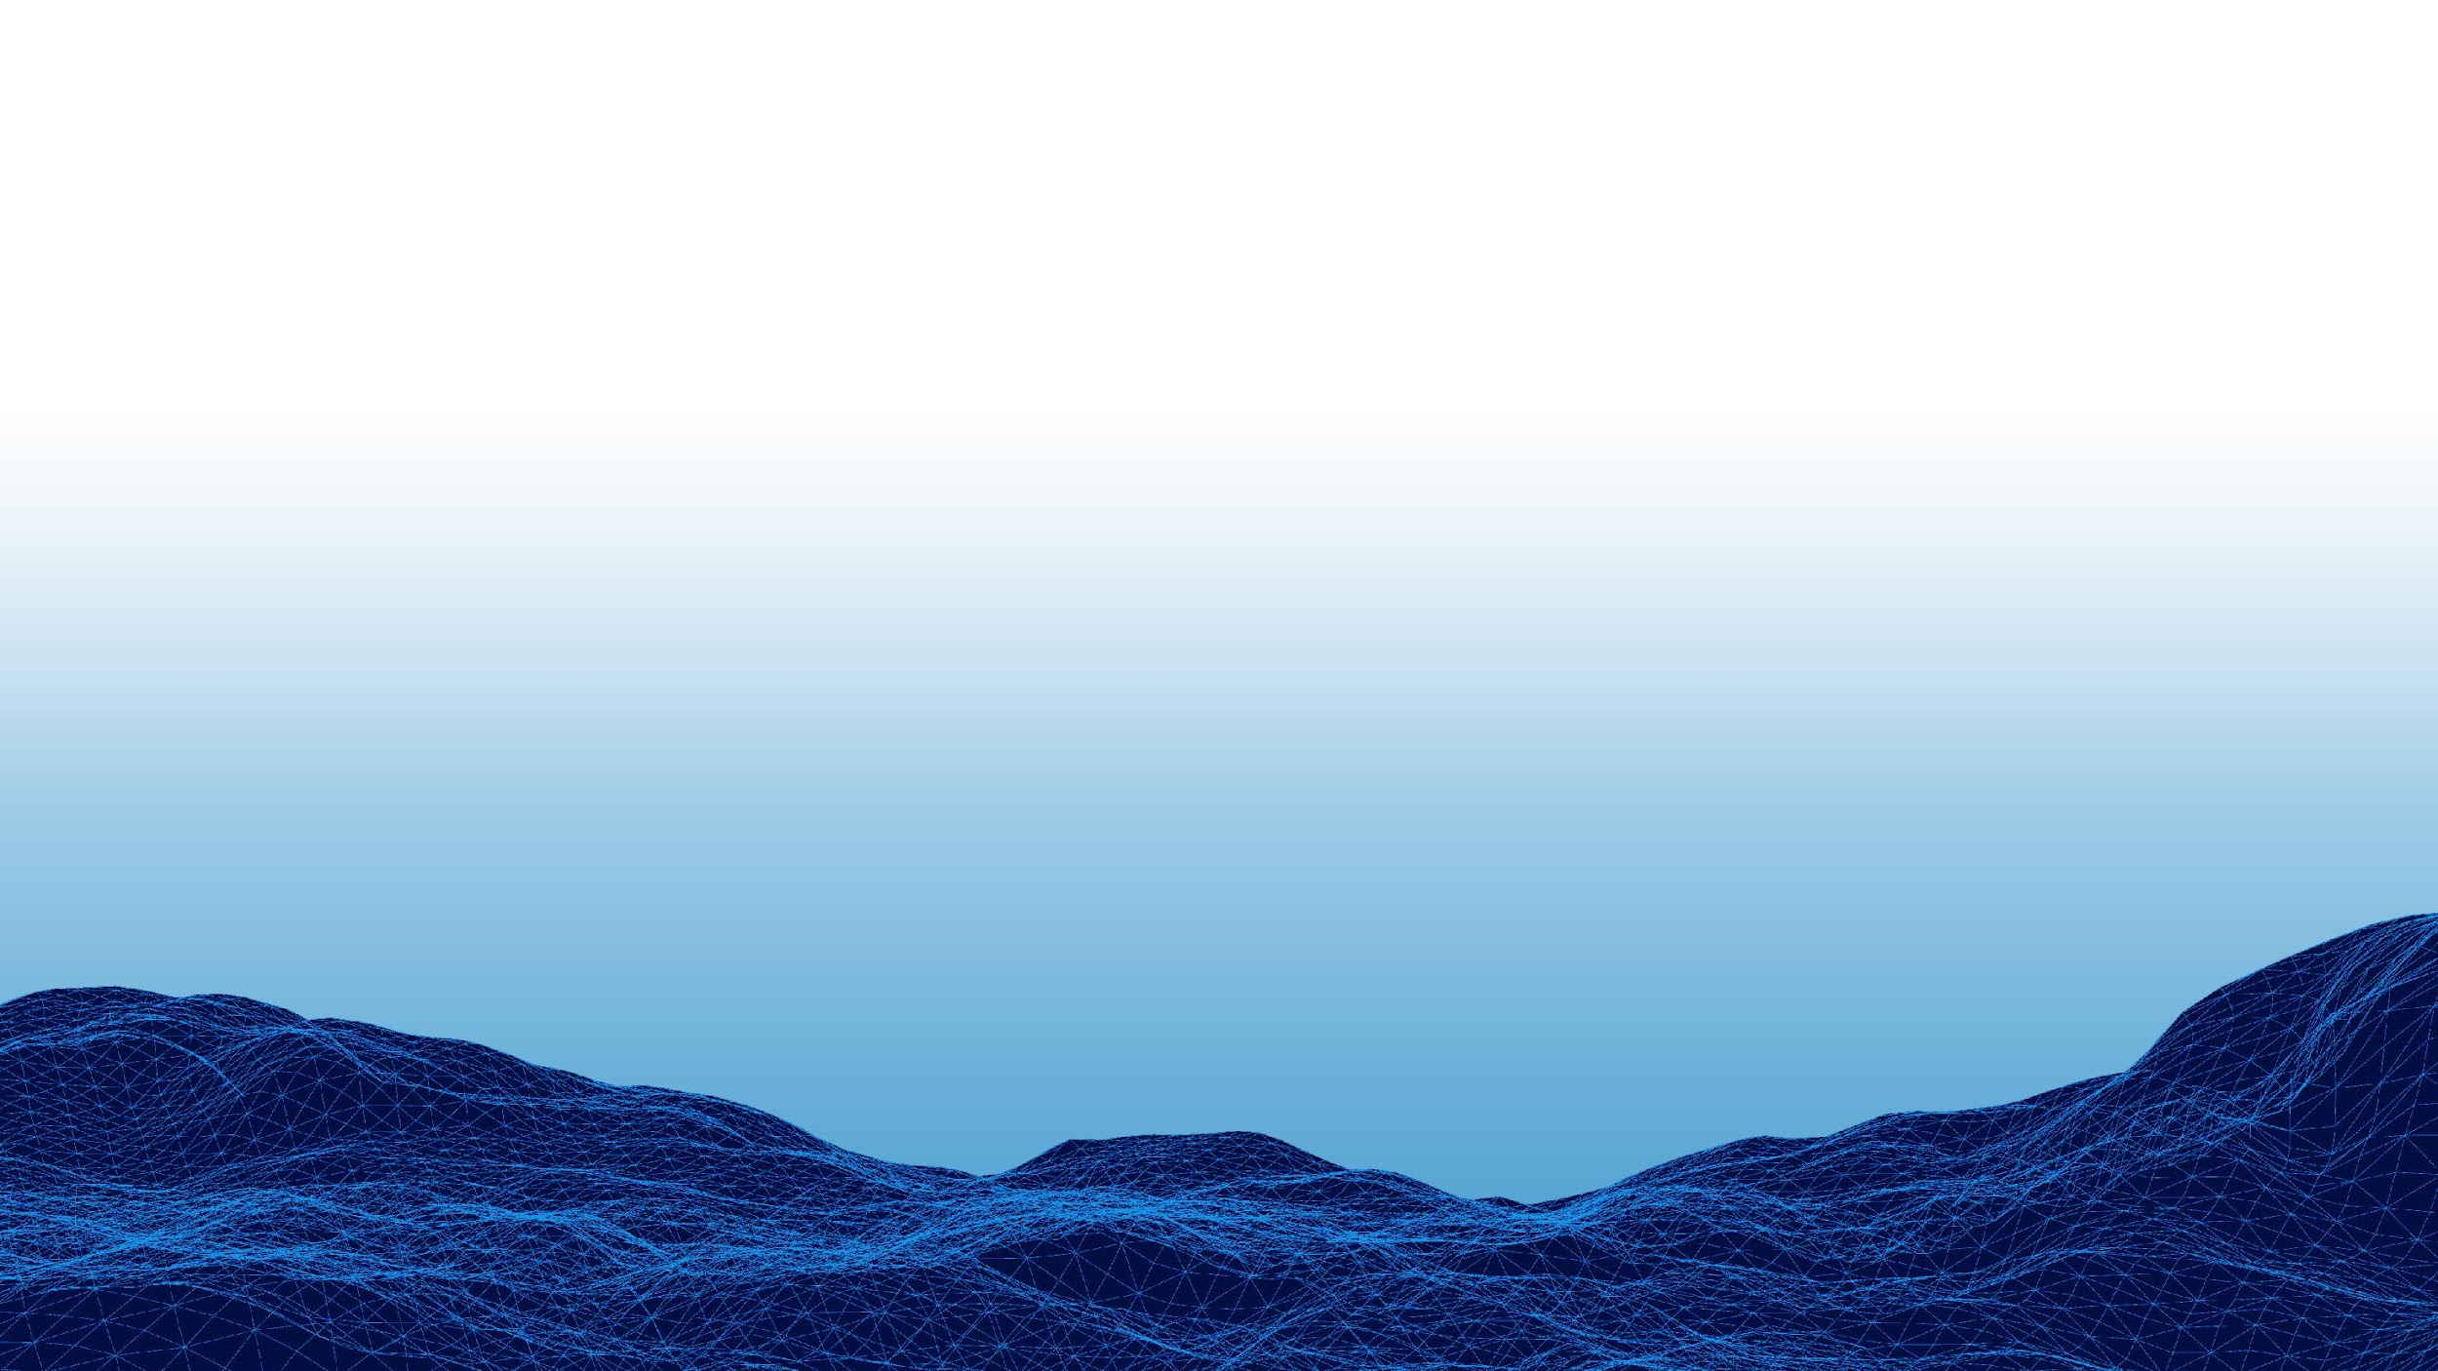
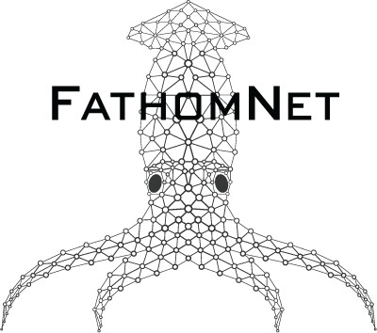
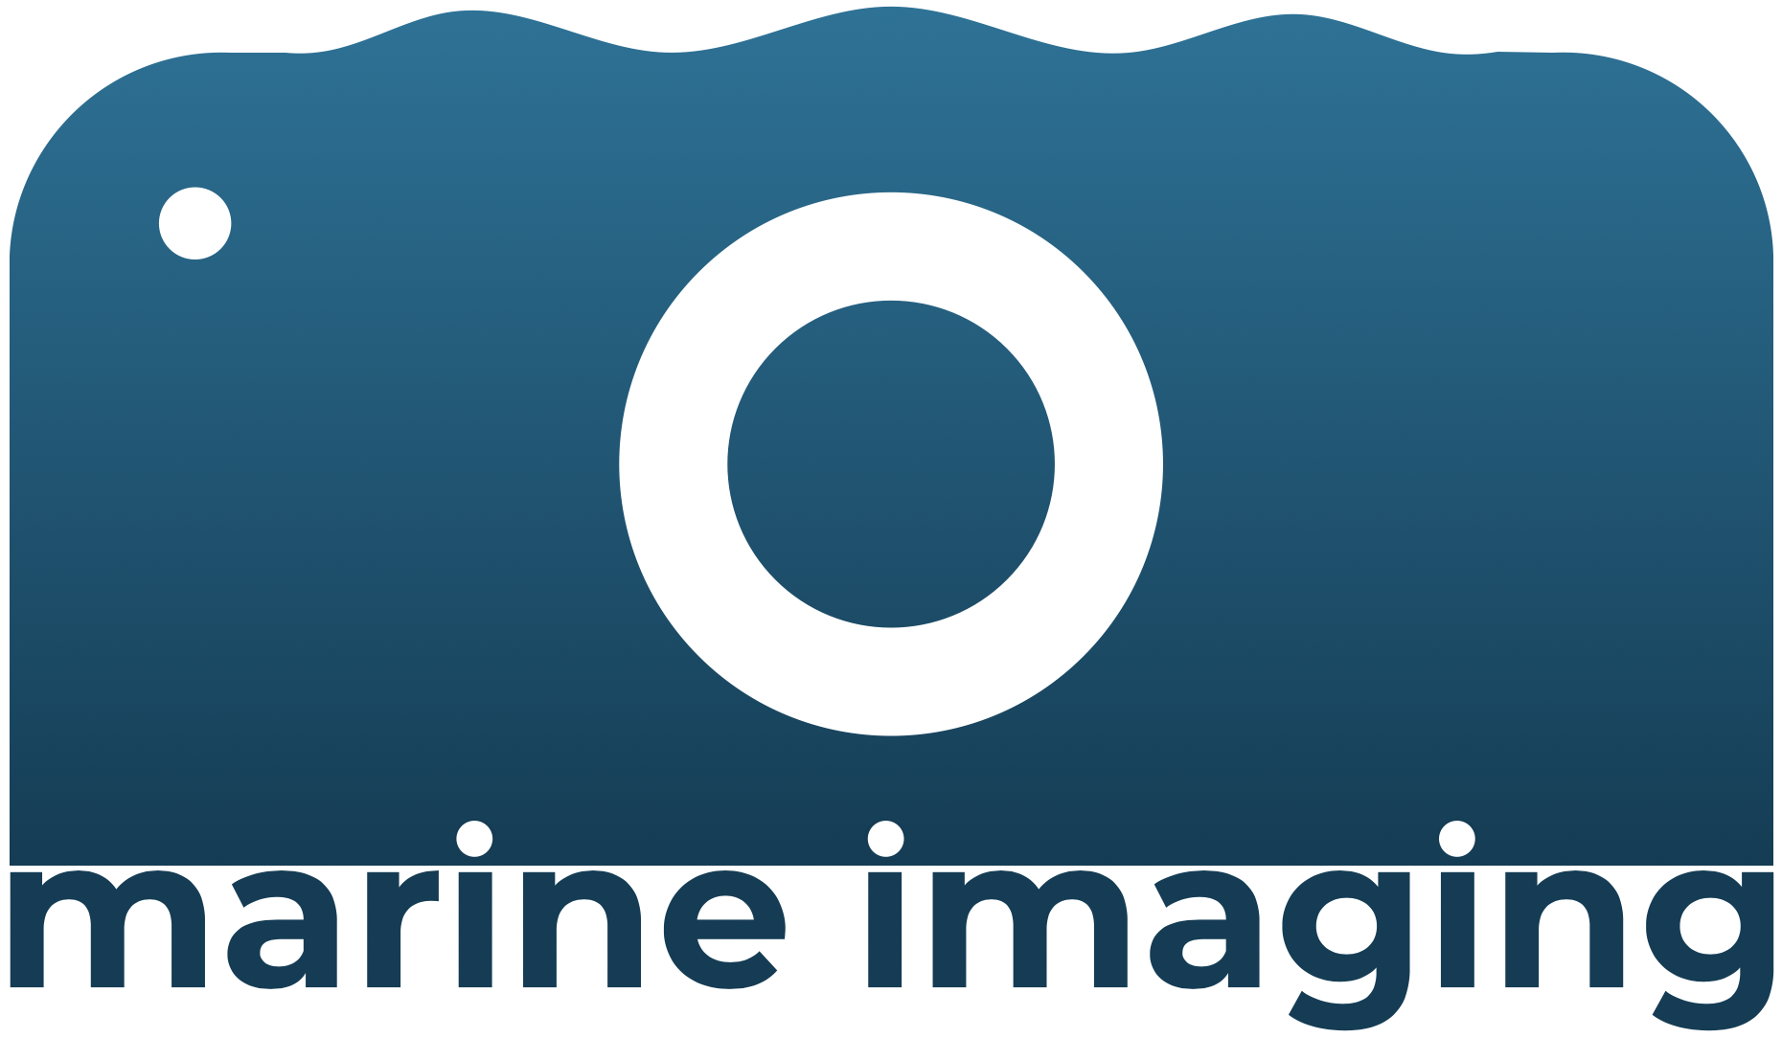

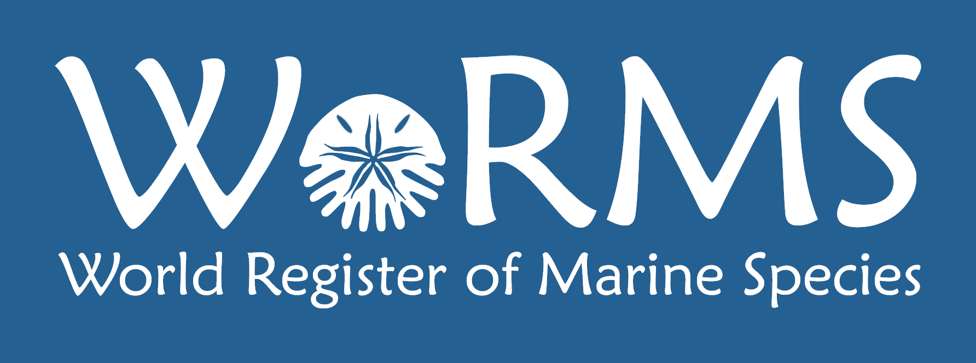
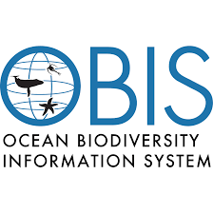
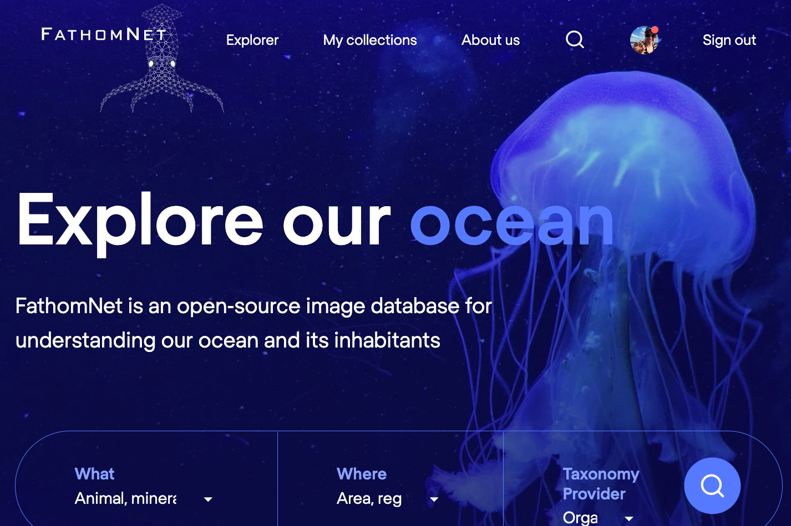
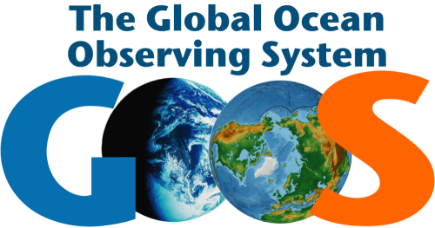

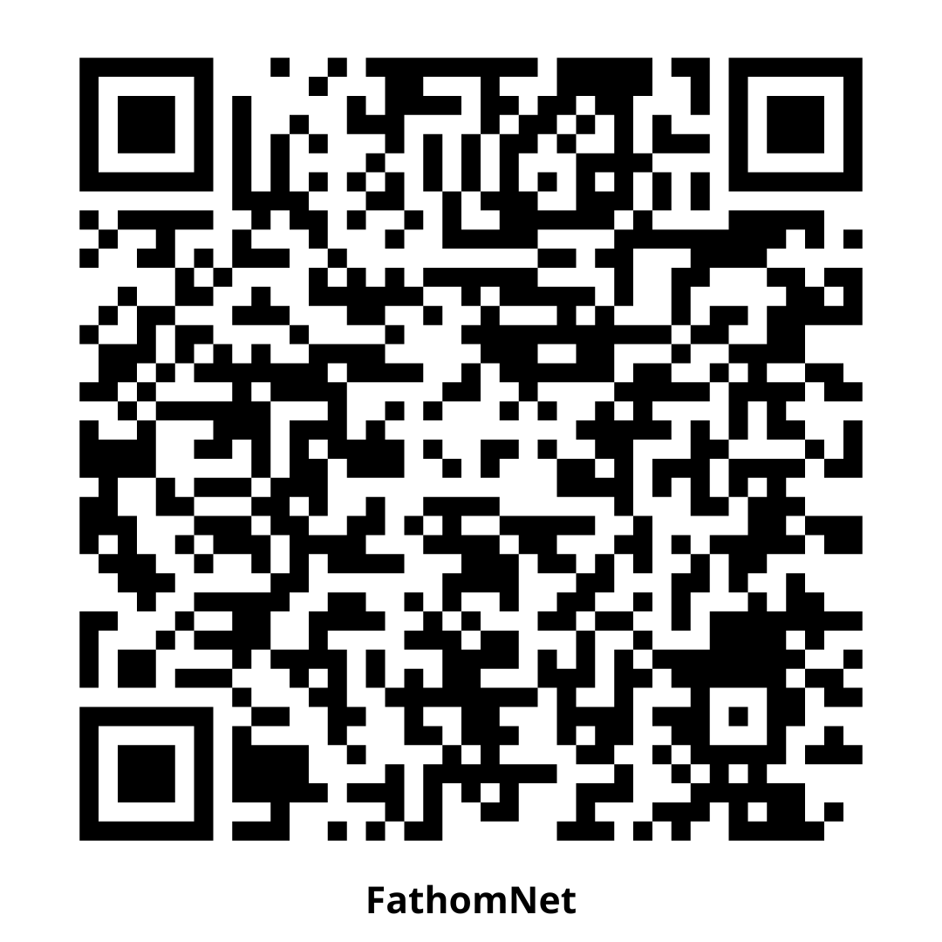
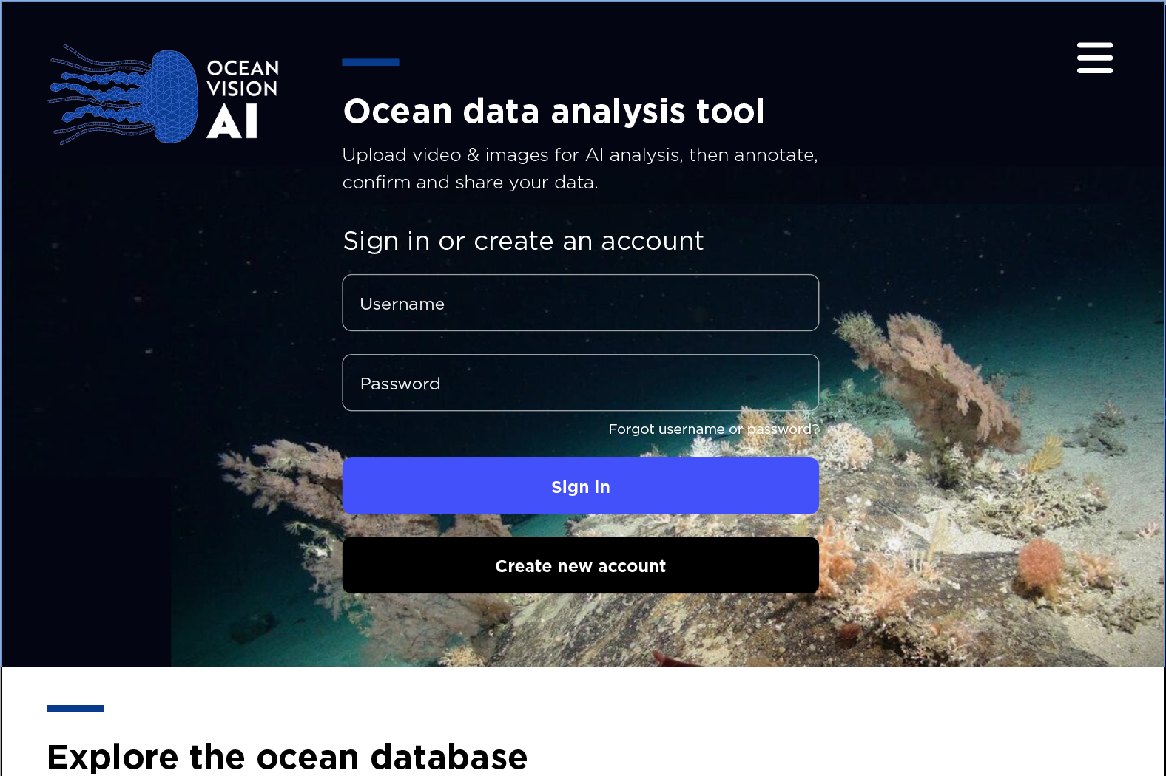


Integrated Pipeline
Labeled data, ML models
FathomNet Database
labeled data / ML models
new labeled data
Processed data
new labeled data / ML models
labeled data
Visual data
new labeled data
unlabeled data
FathomNet Portal
FathomVerse
Notes:
[PORTAL BACKEND DERIVED FROM TATOR, ANNOTATION TOOL FROM CVISION THAT HAS BEEN SUPPORTED BY NOAA IN THE PAST]
Our three-pronged approach integrates [CLICK] OVAI Portal, FathomNet, and Game interfaces to synergistically process underwater visual data.
[CLICK] FathomNet is a stand-alone, global repository for labeled data and machine learning models that seeks to aggregate expert knowledge of marine life.
[CLICK] The Portal allows users to upload their visual data, [CLICK] utilize FathomNet models and labeled data, deploy models, and generate proposals for verification.
[CLICK] Through gaming, an enthusiast community will correct and verify these proposals, thereby playing a role in training the models that we use.
Once complete, verified game labels will be [CLICK] ingested back into the Portal and exported as processed data to stakeholders; in addition, [CLICK] verified data from the Portal will go into FathomNet, creating a positive feedback loop.

Slide 26









Integrated Observing – Global to Regional
West Coast Regional Associations of IOOS

Slide 27





Documentation→Understanding→Trust→Use
https://ifcb.caloos.org/dashboard
Operations & Maintenance
Model documentation
& source code
https://habdac.portal.axds.co/

Slide 28










Downstream product development: OBIS use case
Building FAIR data products from IFCB autoclassification and size data
Link to our notebook
Implemented EU Horizon 2020 “Best practices and recommendations for plankton imagery data management”
Darwin Core Tables:
event
occurrence
emof
Side from Stace Beaulieu
PCMHAB 2020: Harmful Algal Bloom Community Technology Accelerator

Slide 29

Upwelling Quantified
154m WCOFS Nest plot of vertical velocity (near surface) in cm/s
772m WCOFS Nest plot of vertical velocity (near surface) in cm/s

Slide 30

Upwelling Quantified
https://mjacox.com/upwelling-indicies

Slide 31

Quantifying/Categorizing Ocean Conditions
Lagrangian “growth-advection” (GA) satellite-derived product – Messié et al.
Submesoscale coupling of krill and whales revealed by aggregative Lagrangian coherent structures – Fahlbusch et al.
https://royalsocietypublishing.org/doi/10.1098/rspb.2023.2461

Slide 32




How? – Three Pillars of Evolution
TECH
INDUSTRY
SCIENTISTS
Synchro aims to bridge testing and evaluation gaps in R&D innovation
Widespread adoption of promising ocean technology
Synchro
modes
Co-design → evolution
INFO
USERS

Slide 33
Impact | Stressor | Receptor | Synchro analog | Source
Changes in upwelling induced by offshore wind farms | Wind turbines | Ecosystem | BioEco obs. Across upwelling and front gradients | Raghukumar et al., 2023
Bat and bird interactions with offshore wind farms | Wind turbines | Birds, bats | Bat detector, camera on test mooring | SEER, Code of Federal Regulations, Title 30, §585
Presence of vessels and the effects of vessel collision on marine life | Vessels | Marine mammals, sea turtles | Working with Whale Watch 2.0 https://whalesafe.com, https://www.bluewhalesblueskies.org/aboutand or Pt. Blue(?) | SEER, Code of Federal Regulations, Title 30, §585
Risk to marine life from marine debris and floating offshore wind cable systems | Cables in the water column | Marine mammals, sea turtles | - | SEER, Code of Federal Regulations, Title 30, §585
Underwater noise effects on marine life associated with offshore wind farms | Pile driving, noise (all types, all phases) | Marine mammals, fish, sea turtles | BioEco obs. Across upwelling and front gradients; cross referencing with vessel and other anthropogenic sources/sounds | SEER, Code of Federal Regulations, Title 30, §585
Introduction of new offshore wind farm structures and the effects on fish ecology | Foundations, anchors, cables | Marine mammals, fish, sea turtles | BioEco obs. Across upwelling and front gradients, including CCE IEA variables | SEER, Code of Federal Regulations, Title 30, §585
Electromagnetic field effects on marine life | Cables | Fish, invertebrates | - | SEER, Code of Federal Regulations, Title 30, §585
Benthic disturbance from offshore wind foundations, anchors, and cables | Foundations, anchors, cables | Habitat, ecosystem, invertebrates, fish | NMFS - Hydrus AUV collaboration (in discussion) | SEER, Code of Federal Regulations, Title 30, §585
Fisheries research access limited in WEAs | Research Vessel and/or operations types access restriction | science to understand interactions with fisheries resources, the marine ecosystem, and fishing industries/communities | Include prospective tools for mitigation of fisheries survey impacts., e.g. PAM, eDNA, optical and video imaging, animal tagging and telemetry, autonomous platforms, and data provision for IEAs via regional data systems | Methratta et al. 2023

Slide 34






Vision, Mission & Strategy
Re-Certified in 2024!
https://www.cencoos.org/strategic-plan/
https://data.caloos.org/
Notes:
What’s the fundamental problem, question, or issue you are addressing?
The ocean observing community faces challenges in the measurement and prediction of ocean weather and climate variability and change to support safe and efficient transportation and commerce, risk reduction for coastal communities, and sustaining healthy ecosystems and water quality. These issues require measurement and improved information delivery of many ocean, coastal and estuary phenomena including ocean warming and marine heatwaves, acidification and hypoxia, sea-level rise and flooding, managing protecting species and habitats, growing fisheries and aquaculture trade, vessel navigation, and supporting search and rescue operations.
Why is it important/why should anyone care?
Shipping, fisheries, tourism and recreation are key pillars of a Blue Economy that have the potential to double between 2010 and 2030, when powered by information solutions to enable sustainable growth and address the many compounding challenges.

Slide 35


Current Core CeNCOOS Activities
Maintain CeNCOOS Program Office;
Operations and maintenance of:
31 high-frequency radars (HFR), with recapitalization of 7% of our infrastructure;
3 glider lines; +Argo equivalent BGC & PAM
15(+) Coastal Observing Network stations;
4 HAB sampling sites;
Zooplankton, bird and ship sampling;
4+ stations of eDNA sampling
Elephant seal and shark tagging.
DMAC & regional data assembly center;
Hindcast, nowcast and forecast models with new biogeochemistry and biology outputs;
New high-resolution coastal nowcasts in Monterey Bay with ~160 m grid cells;
>250 data products - new support for kelp cover, climate, fisheries, marine protected areas & aquaculture indicators;
Engagement and planning activities towards realizing equitable service delivery

Slide 36

Modeling Overview
NRL COAMPS
  4D-Var DA 12-4km Atmospheric model (Doyle)
  1999-present (in various grid configurations)
West Coast ROMS
  1/10º (~10km) ROMS nowcast (Edwards/Moore, UCSC)
  NEMURO in Portal staging
CA ROMS – Support will be ended in Oct 2022
  3.3km ROMS (Chao, Seatrec)
California-Harmful Algae Risk Mapping (C-HARM)
  3.3 km CA ROMS/VIIRS driven (Anderson, UCSD/SCCOOS)
West Coast Operational Forecast System (WCOFS)
  4D-Var DA 4km ROMS nowcast/forecast (Kurapov, NOAA)
  Hi-resolution nests
San Francisco Bay Operational Forecast System (SFBOFS)
  Now in Portal and supporting bay currents
COAMS
WCOFS
SFBOFS
CA ROMS
West Coast ROMS
West Coast ROMS – NEMURO BGC
https://data.caloos.org/

Slide 37




Place Based-Mgmt Tools
habdac.portal.axds.co
oah.caloos.org
mpa-dashboard.caloos.org

Slide 38


Climate & Coastal Resilience
Ruhl et al., https://doi.org/10.5670/oceanog.2021.221

Slide 39




































Who? - Growing a Synchro Network
Team
Text
Text
Case
Study Users
Prospective
Sponsors
/ Partners
Scale to
Global Impact
Scale to
Global Impact

