Slide 1
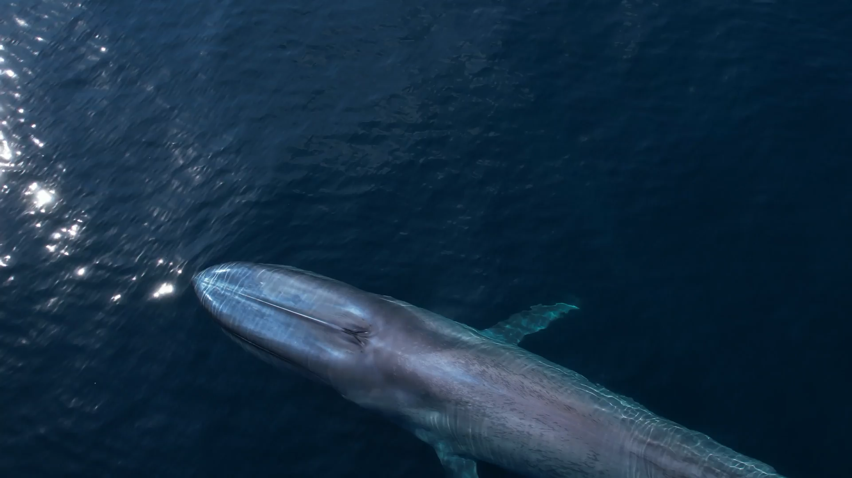
Passive Acoustic Monitoring (PAM)

Slide 2
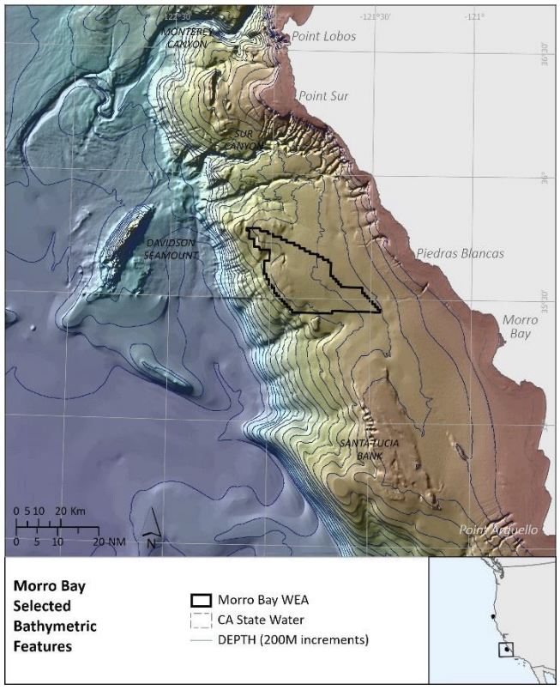
Listening near a wind energy development area
We began recording the ocean soundscape at La Cruz Canyon (Sanctuary Ecologically Sensitive Area #15) in summer 2022.
A collaboration between Monterey Bay Aquarium, MBARI, NOAA and the Naval Postgraduate School
La Cruz
WEA

Slide 3
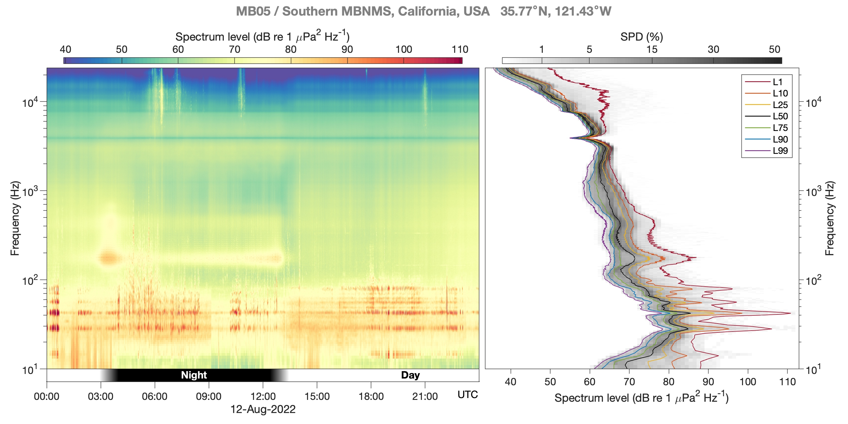

A day in the life of a soundscape: hearing biodiversity
1
2
3
4

Slide 4
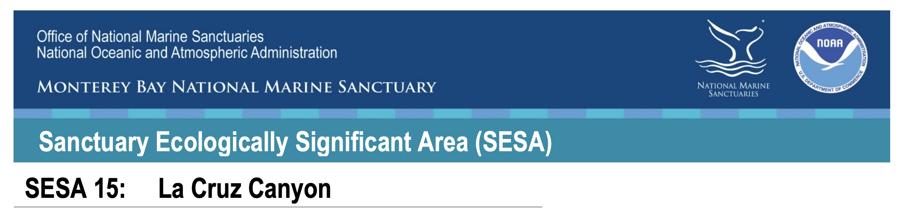
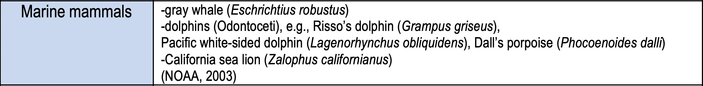
Expanding awareness of species presence
Table 1. Species known to occur within SESA 15: La Cruz Canyon
.…

Slide 5
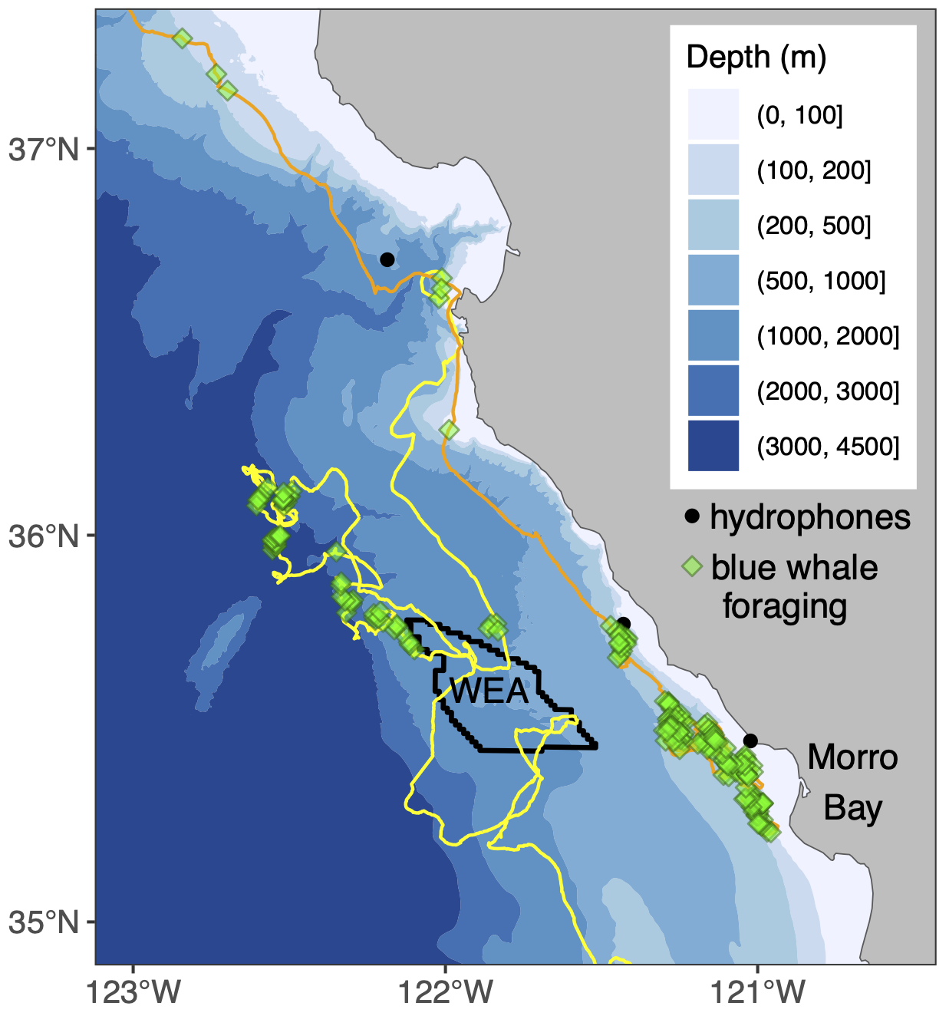
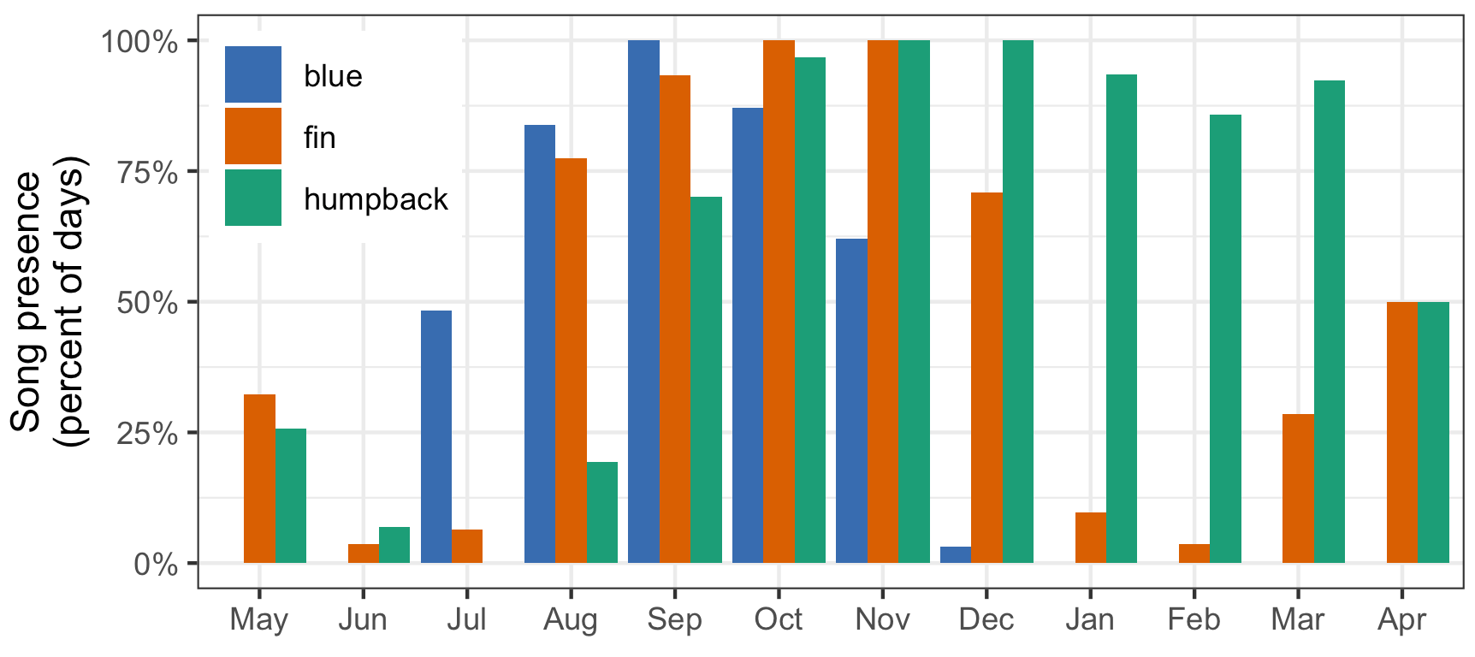
Expanding awareness of species presence
Blue whale tag data from Cascadia Research Collective
Notes:
The map on the left shows the location of the Morro Bay wind energy area (WEA) relative to passive acoustic monitoring sites (hydrophones) and direct observations of individual blue whale movement (tracks) and foraging (green diamonds). Whale tag data are from collaborators at Cascadia Research Collective.
The plot on the right shows levels of acoustic detection of three whale species from our first year of passive acoustic monitoring inshore of the WEA. None of these species were listed as known inhabitants of this Sanctuary Ecologically Sensitive Area (SESA 15, La Cruz Canyon), simply due to limited available data. Such baseline biodiversity assessment is essential to careful wind energy development, and we will continue to characterize this region for a more comprehensive assessment. We will also monitor in the new Chumash Heritage National Marine Sanctuary, immediately south of Monterey Bay National Marine Sanctuary.

Slide 6
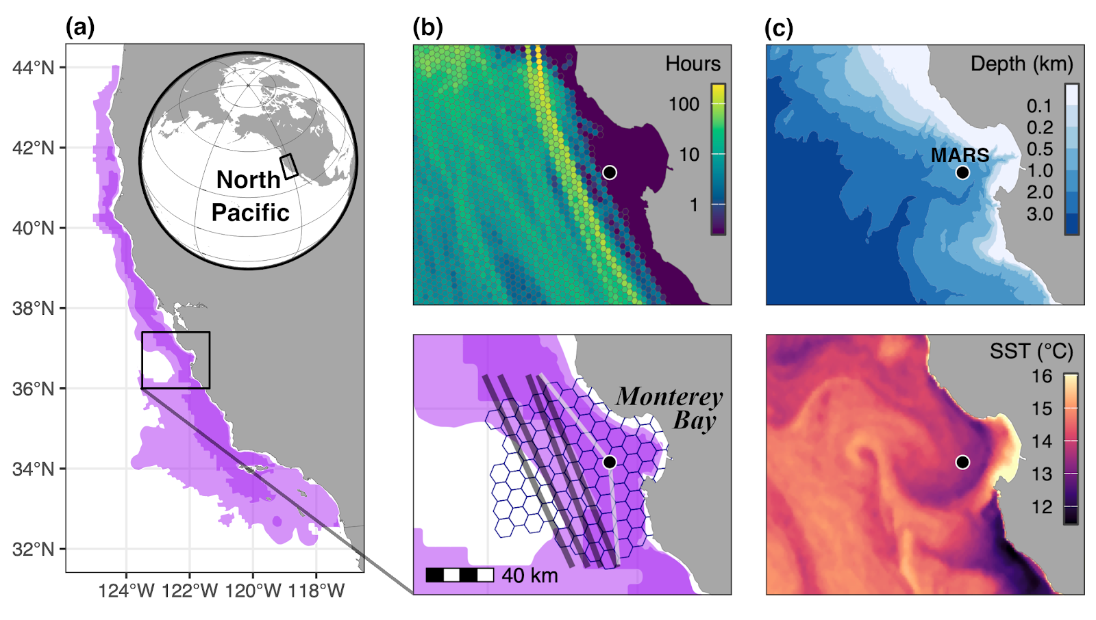
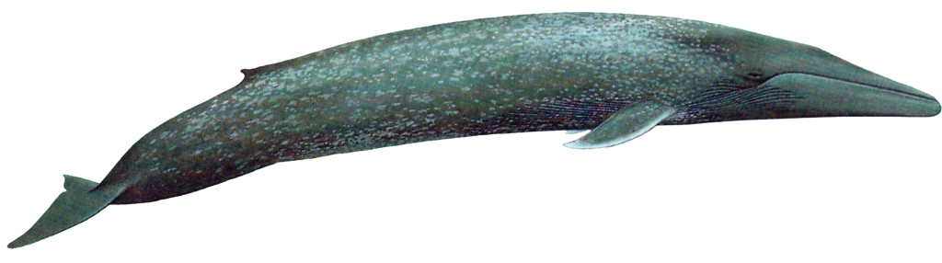
Beyond presence: directional passive acoustic sensing

Slide 7
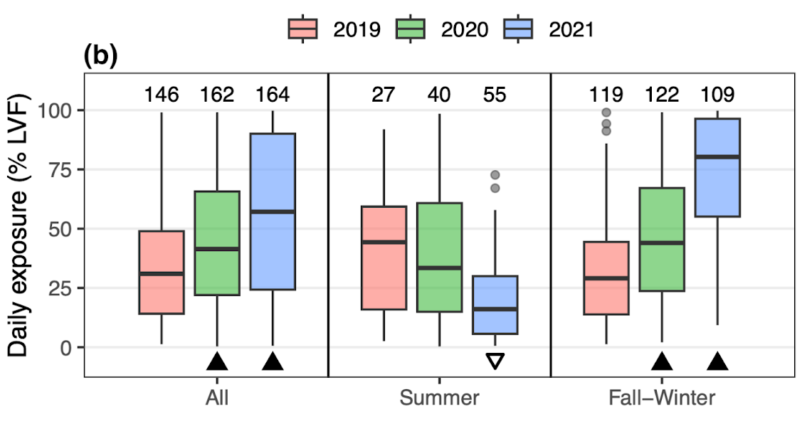
Conservation: ship-strike risk
Notes:
The map on the left shows the location of the Morro Bay wind energy area (WEA) relative to passive acoustic monitoring sites (hydrophones) and direct observations of individual blue whale movement (tracks) and foraging (green diamonds). Whale tag data are from collaborators at Cascadia Research Collective.
The plot on the right shows levels of acoustic detection of three whale species from our first year of passive acoustic monitoring inshore of the WEA. None of these species were listed as known inhabitants of this Sanctuary Ecologically Sensitive Area (SESA 15, La Cruz Canyon), simply due to limited available data. Such baseline biodiversity assessment is essential to careful wind energy development, and we will continue to characterize this region for a more comprehensive assessment. We will also monitor in the new Chumash Heritage National Marine Sanctuary, immediately south of Monterey Bay National Marine Sanctuary.

Slide 8
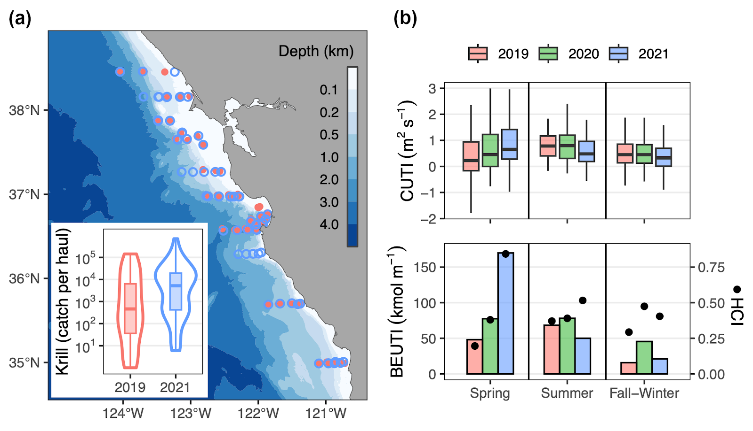
Ecological underpinnings of risk exposure
Notes:
The map on the left shows the location of the Morro Bay wind energy area (WEA) relative to passive acoustic monitoring sites (hydrophones) and direct observations of individual blue whale movement (tracks) and foraging (green diamonds). Whale tag data are from collaborators at Cascadia Research Collective.
The plot on the right shows levels of acoustic detection of three whale species from our first year of passive acoustic monitoring inshore of the WEA. None of these species were listed as known inhabitants of this Sanctuary Ecologically Sensitive Area (SESA 15, La Cruz Canyon), simply due to limited available data. Such baseline biodiversity assessment is essential to careful wind energy development, and we will continue to characterize this region for a more comprehensive assessment. We will also monitor in the new Chumash Heritage National Marine Sanctuary, immediately south of Monterey Bay National Marine Sanctuary.

Slide 9
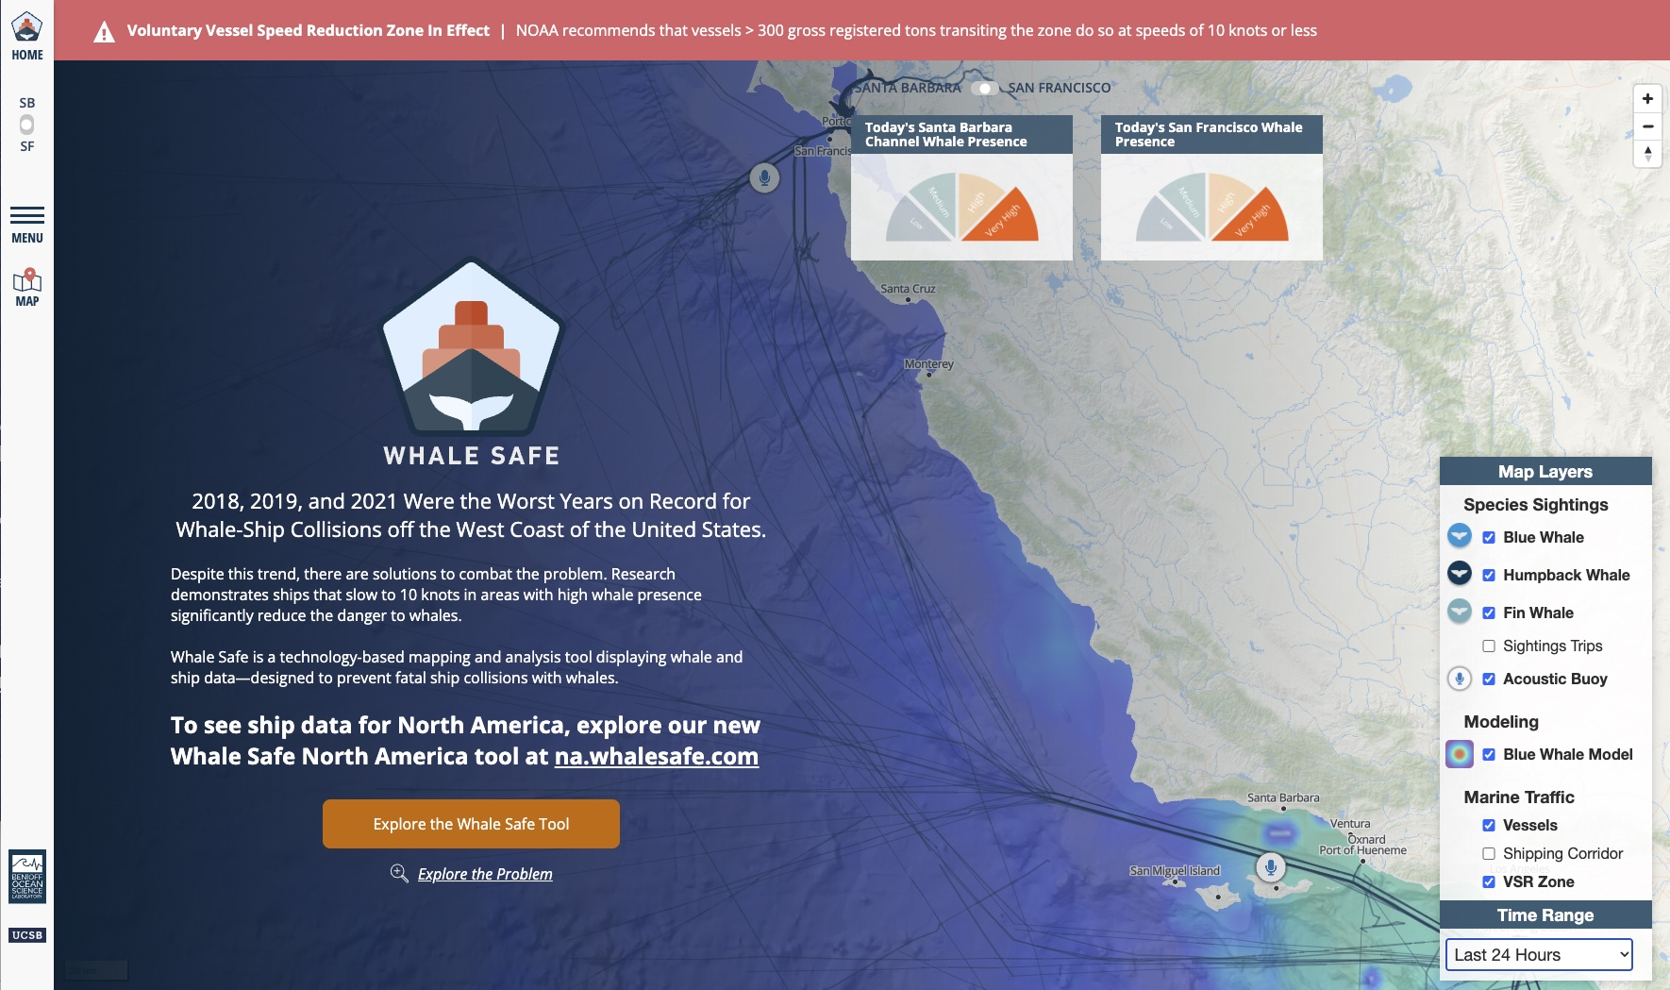
Real-time monitoring
Notes:
The map on the left shows the location of the Morro Bay wind energy area (WEA) relative to passive acoustic monitoring sites (hydrophones) and direct observations of individual blue whale movement (tracks) and foraging (green diamonds). Whale tag data are from collaborators at Cascadia Research Collective.
The plot on the right shows levels of acoustic detection of three whale species from our first year of passive acoustic monitoring inshore of the WEA. None of these species were listed as known inhabitants of this Sanctuary Ecologically Sensitive Area (SESA 15, La Cruz Canyon), simply due to limited available data. Such baseline biodiversity assessment is essential to careful wind energy development, and we will continue to characterize this region for a more comprehensive assessment. We will also monitor in the new Chumash Heritage National Marine Sanctuary, immediately south of Monterey Bay National Marine Sanctuary.

Slide 10
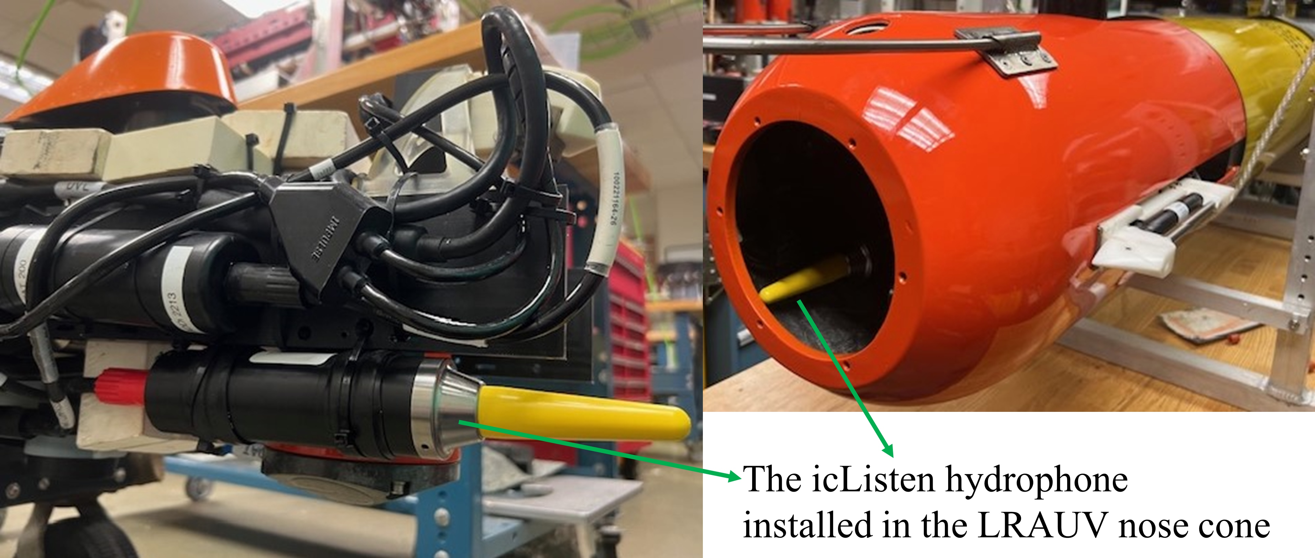
Real-time and mobile
Notes:
The map on the left shows the location of the Morro Bay wind energy area (WEA) relative to passive acoustic monitoring sites (hydrophones) and direct observations of individual blue whale movement (tracks) and foraging (green diamonds). Whale tag data are from collaborators at Cascadia Research Collective.
The plot on the right shows levels of acoustic detection of three whale species from our first year of passive acoustic monitoring inshore of the WEA. None of these species were listed as known inhabitants of this Sanctuary Ecologically Sensitive Area (SESA 15, La Cruz Canyon), simply due to limited available data. Such baseline biodiversity assessment is essential to careful wind energy development, and we will continue to characterize this region for a more comprehensive assessment. We will also monitor in the new Chumash Heritage National Marine Sanctuary, immediately south of Monterey Bay National Marine Sanctuary.

Slide 11

Listening from an AUV in Zen mode
Notes:
The map on the left shows the location of the Morro Bay wind energy area (WEA) relative to passive acoustic monitoring sites (hydrophones) and direct observations of individual blue whale movement (tracks) and foraging (green diamonds). Whale tag data are from collaborators at Cascadia Research Collective.
The plot on the right shows levels of acoustic detection of three whale species from our first year of passive acoustic monitoring inshore of the WEA. None of these species were listed as known inhabitants of this Sanctuary Ecologically Sensitive Area (SESA 15, La Cruz Canyon), simply due to limited available data. Such baseline biodiversity assessment is essential to careful wind energy development, and we will continue to characterize this region for a more comprehensive assessment. We will also monitor in the new Chumash Heritage National Marine Sanctuary, immediately south of Monterey Bay National Marine Sanctuary.

Slide 12
Summary
Clean energy is important, and the development of offshore wind energy motivates understanding of biodiversity and habitat use in areas where this technology will be installed and operated.
The prevalence of acoustic behavior in marine animals and the powerful transmission of sound through the ocean make Passive Acoustic Monitoring (PAM) essential and effective.
PAM is a versatile technology, deployable from many platforms and providing omnidirectional and directional information. Automated detection and classification is key to both real-time and long-term monitoring applications.

