Slide 1
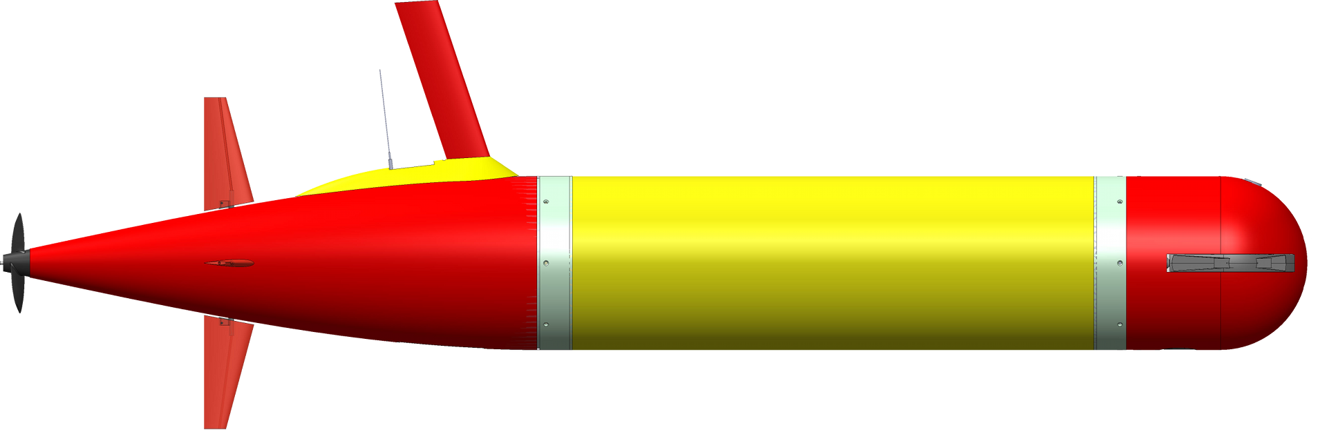
Collaborative Sampling and Imaging of Phytoplankton Communities
AUVs (for sampling) and AUVi (for imaging) both transit to the waypoint:
Waypoint for sampling
AUVs
AUVi
1. The vehicle reaching the waypoint first spirals up and down to wait for the other vehicle.
2. AUVi starts to acoustically track AUVs when within range. When the distance falls below threshdist,
AUVi acoustically transmits a “near” message to AUVs.
Synchonized sampling and imaging at the waypoint:
3. When AUVs receives the
“near” message, it terminates
or bypasses the “wait” phase
to start the sampling phase.
4. While AUVs takes water samples in
the peak chlorophyll layer, AUVi
acoustically tracks AUVs and
spirals up and down to take images.
5. When sampling is completed,
AUVs acoustically transmits a
“terminateMission” message to AUVi.
AUVs
Y. Zhang et al., “Collaborative Sampling and Imaging of Phytoplankton Communities by Two Long‐Range Autonomous Underwater Vehicles Using Acoustic Tracking and Messaging,” Journal of Field Robotics, 2025.
AUVi

Slide 2
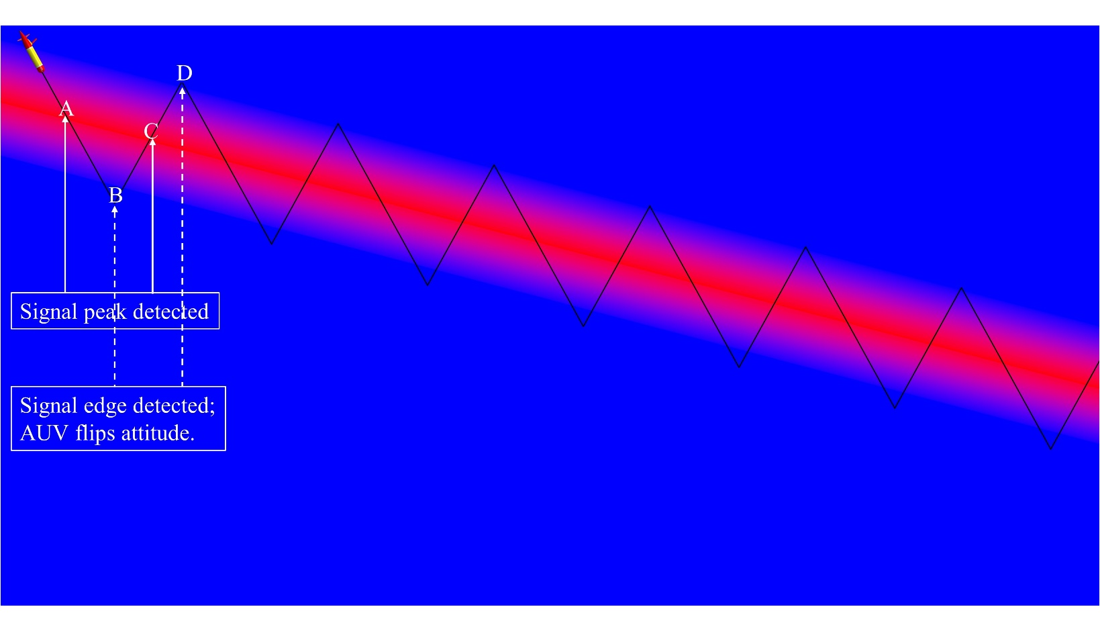
LRAUV Adaptive Yo-Yo for Concentrated Imaging of Plankton Layers
Y. Zhang et al., “AUV Adaptive Yo-Yo Based on Layer Peak and Edge Detection and Its Application to Imaging Plankton Layers Using an Onboard Microscopy System,” IEEE Journal of Oceanic Engineering, under review.

