Slide 1
902005 VARS Annotation Assistance
What’s the fundamental problem, question, or issue you are addressing?
There is a need to increase annotation productivity amidst flat staffing budgets yet growing numbers of MBARI imaging systems
There is a lack of shared, accurate methods for automated underwater video analysis; this would improve productivity and provide tools to help the ocean community

Slide 2

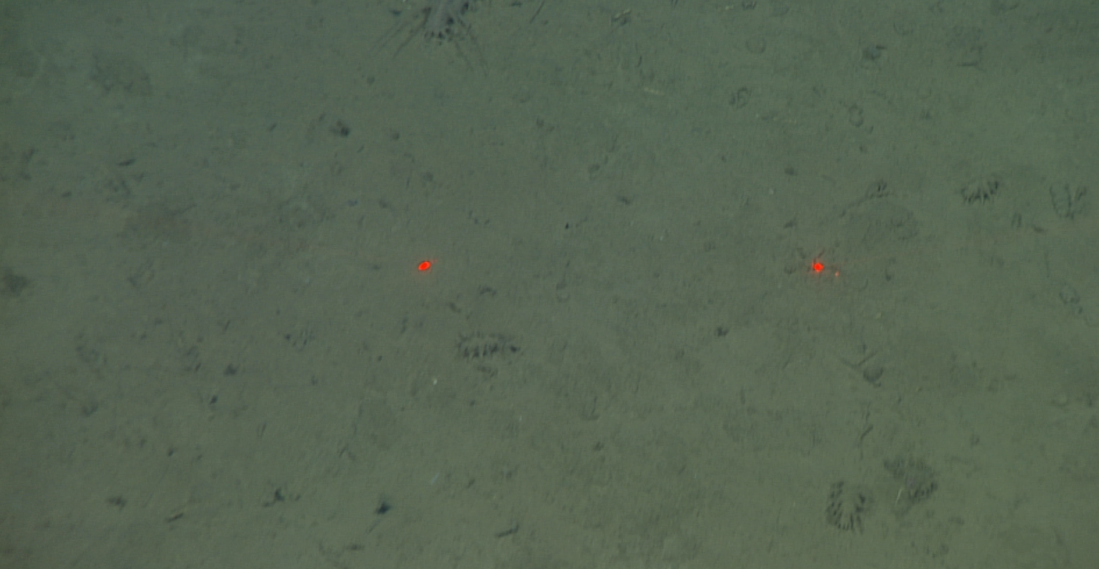
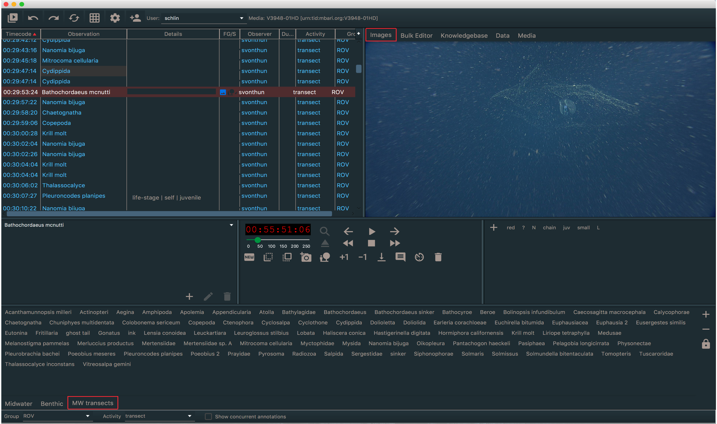
902005 VARS Annotation Assistance
Detection, Classification and Tracking Algorithms
Trained Models
Assist
Video Player
VARS User Interface
5. Elipidia, 0.76,
Notes:
The big picture for this project - on the right is the VARS annotation system used day-to-day and on the left the new video player that will display machine generated annotations for review

Slide 3
902005 VARS Annotation Assistance
Why is it important/why should anyone care?
Models created for assistance will be released to the community in model zoos. There are currently no publically available models for underwater image analysis.
Undescribed, rare, and sensitive habitats will significantly benefit from sharing models and tools.
MBARI is uniquely suited for these tasks given our vast, one-of-a-kind video archive, taxonomic knowledge, and strong in-house engineering-science partnerships

Slide 4
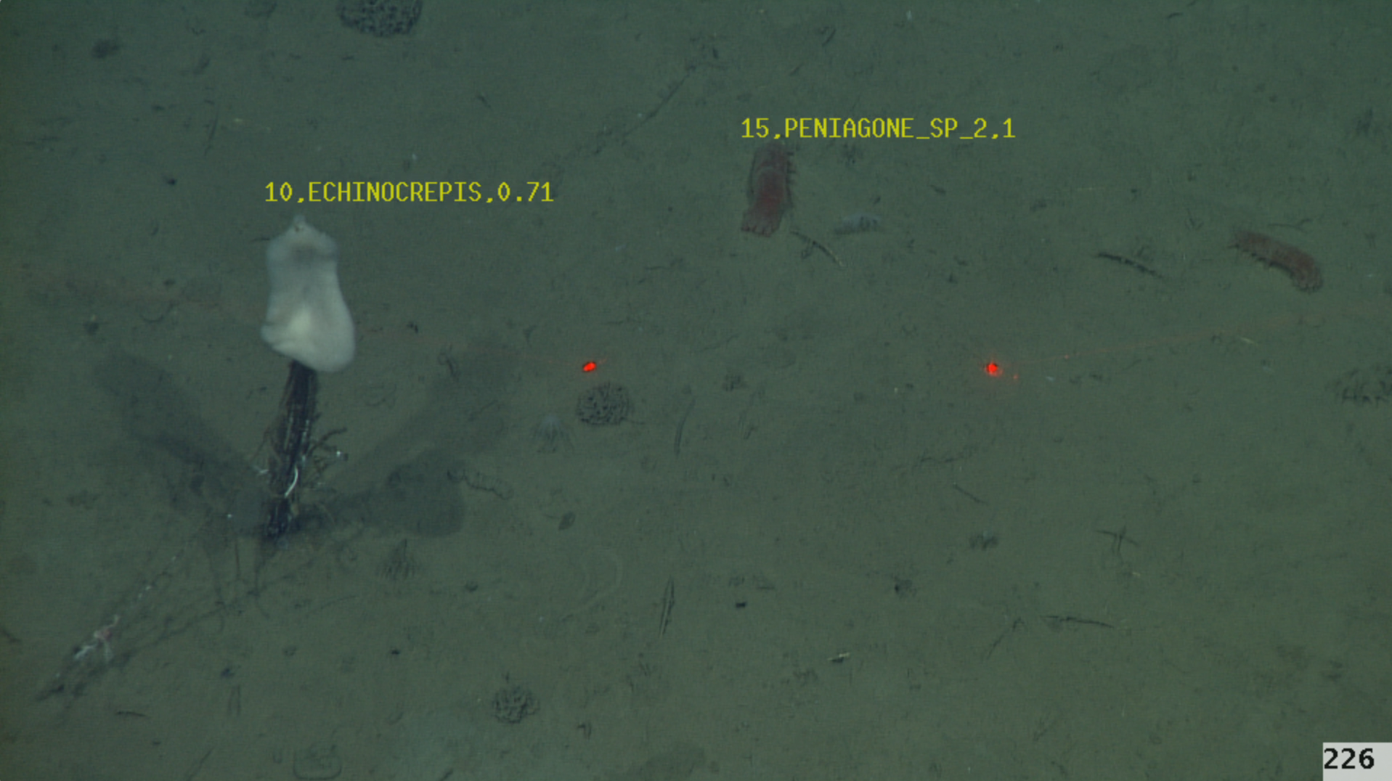
902005 VARS Annotation Assistance
Custom Video Player To Edit Machine Learning Results
Notes:
Machine learning (ML) results will be imperfect. To edit ML results, a new video player will be developed to display the results and allow editing of those results, e.g. correcting misclassified taxa or adding in missing taxa. This will be integrated with the VARS annotations system .

Slide 5
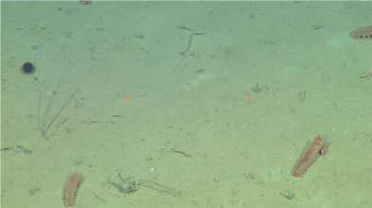

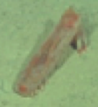
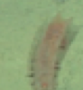
Visual events are voted across frames to find the best classification. The “best” classification is then imported into VARS to assist annotation.
902005 VARS Annotation Assistance
Machine Learning Pipeline
Track
VisualEvent1
VisualEvent1
Classify
Detect
VisualEvent1
Peniagone sp A.
Scores .78, .89, .99
VisualEvent3
Time/frames
VisualEvent2
Notes:
The machine learning pipeline is as follows: video is decomposed into frames; for each frame objects are detected and classified. Those classified objects are then tracked across time/frames and grouped into VisualEvents. A weighted voting occurs across VisualEvents using the classification scores to find the best taxa.

Slide 6
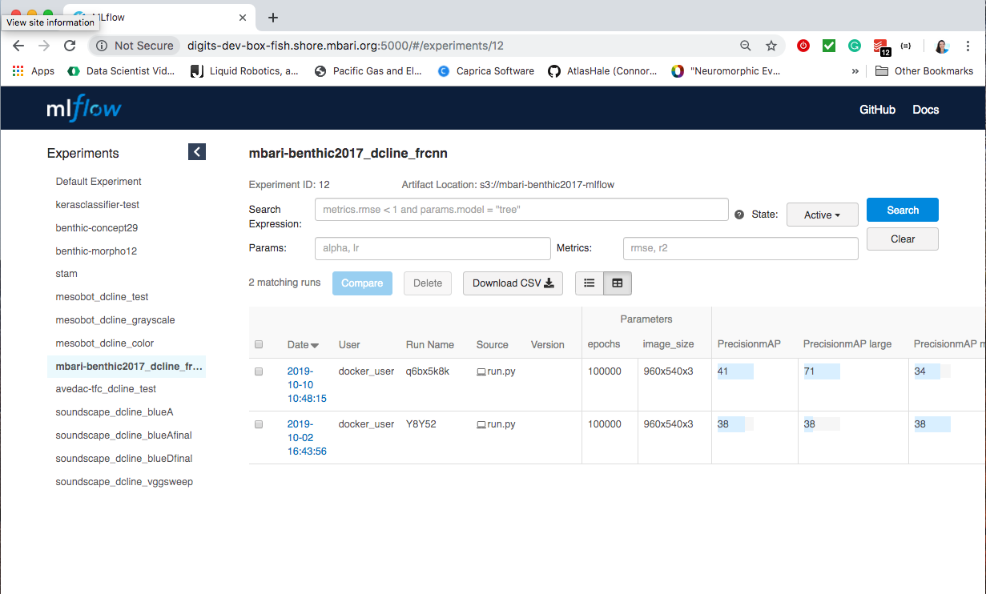
902005 VARS Annotation Assistance
Managing the Machine Learning Lifecycle
Deploy Model
Gather Raw Data
Prepare Data
Train Model
Notes:
Machine Learning is highly iterative so we need tools manage the entire lifecycle and assist with deployment. For this project, we plan to use the open source machine learning code MLFlow. Uber has Michelangelo, Facebook FBLearner, but we don’t have the resources to build a custom machine learning platform as they did. This tool has good academic support and so far has been working well with our prototype.

Slide 7
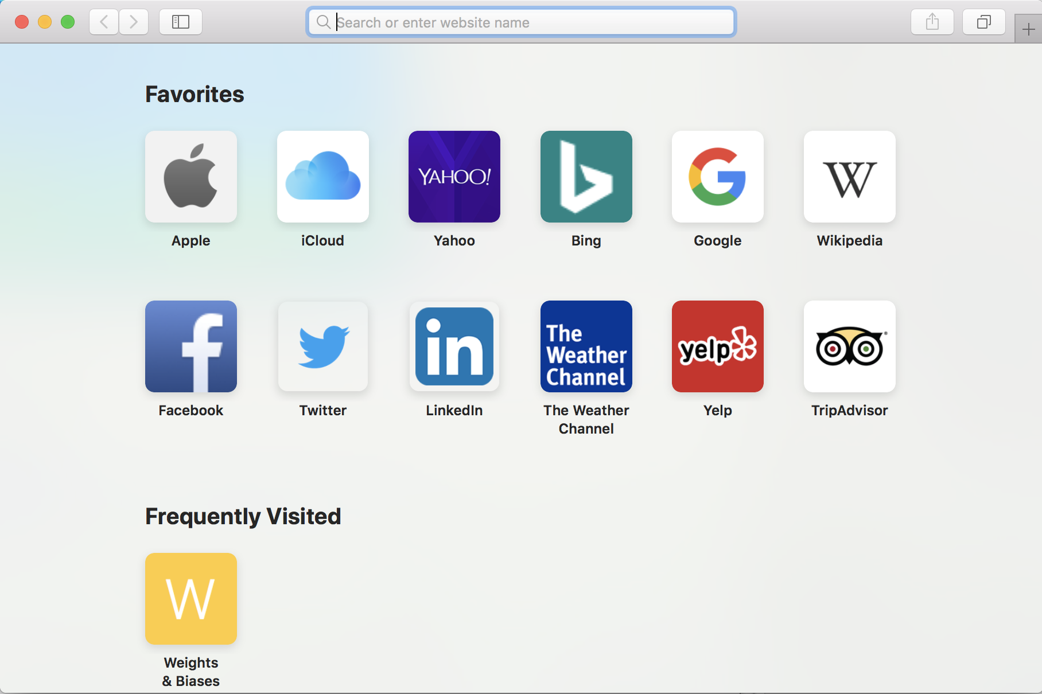

902005 VARS Annotation Assistance
Model Zoo Concept
Object Detection Model | Speed (ms) | Collection | mAP | Outputs
rcnn_resnet101_stride8 | 30 | Benthic | 72 | Box
rcnn_resnet101_stride8 | 350 | Midwater | 60 | Mask
Classification Model | Speed (ms) | Collection | Top-5 Error
GoogleNet | 30 | Benthic | 5.2
Inception v3 | 33 | Midwater | 21.9
Notes:
Model zoos are simply downloadable files, shared on a web page and/or on a github shared code page.

