Slide 1
902005 VARS Annotation Assistance

Slide 2
Goals
Integrate machine learning (ML) with MBARI’s video annotation systems

Slide 3
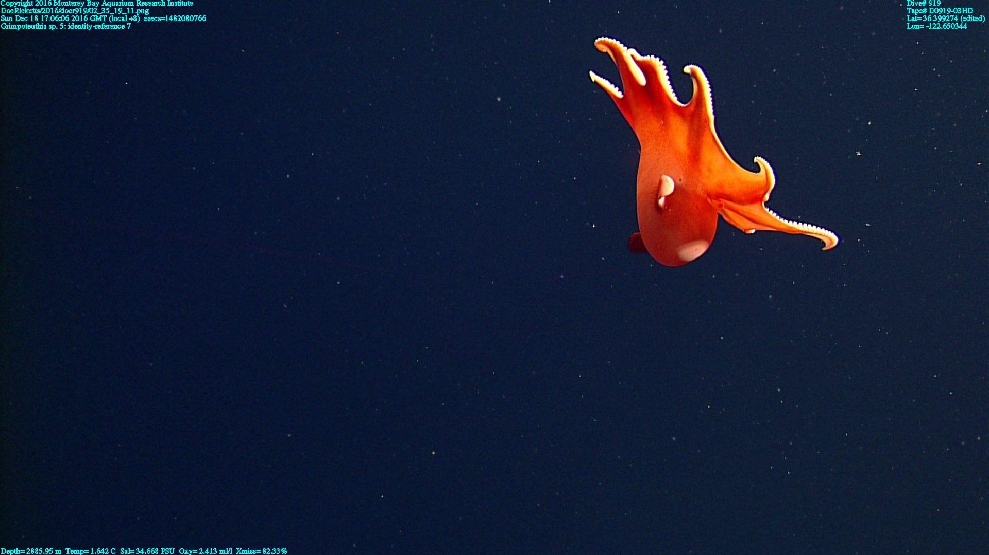
Goals
Object detection and localization

Slide 4
Goals
Object detection and localization
Classification
Opisthoteuthis

Slide 5
Goals
ID 1
Object detection and localization
Classification
Tracking
Opisthoteuthis
Time 1
ID 1
Opisthoteuthis
ID 1
Time 2
Opisthoteuthis
Time 3

Slide 6
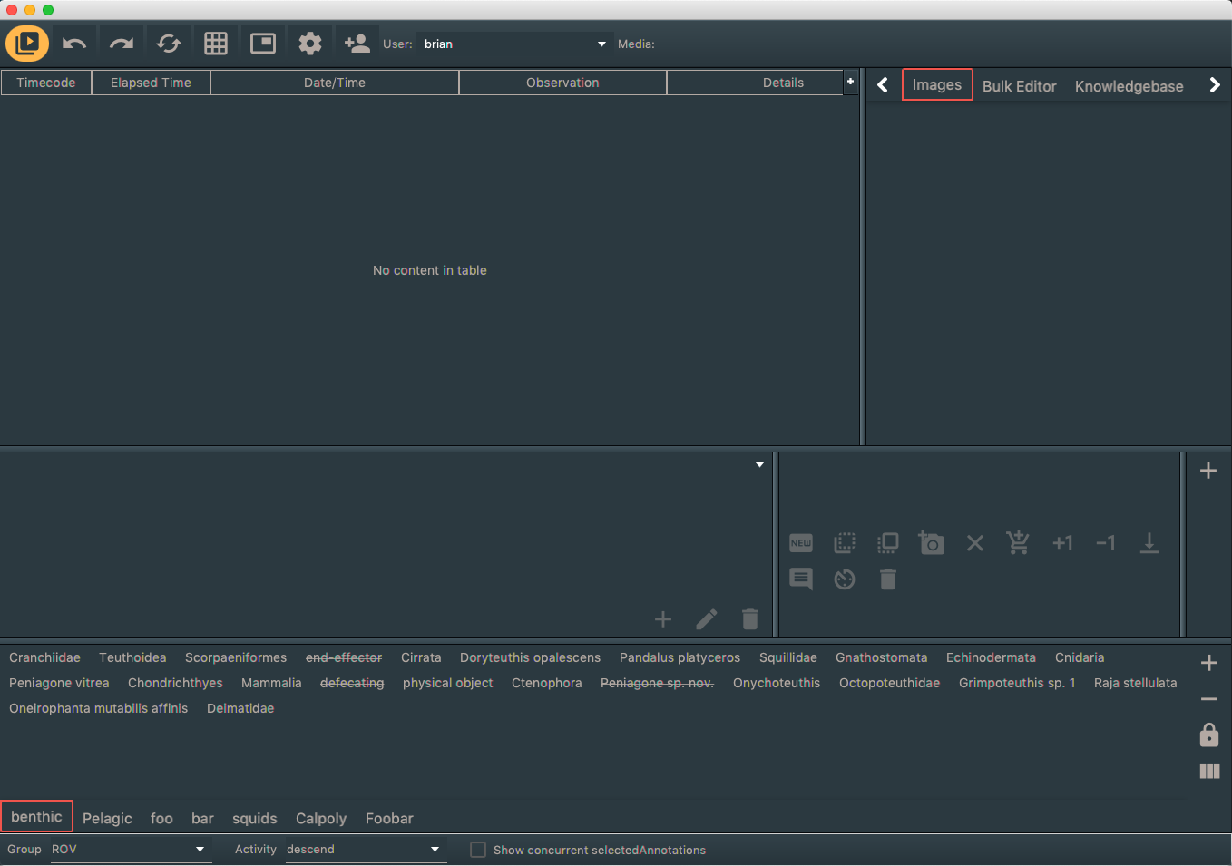
Goals
Object detection and localization
Classification
Tracking
Integration with VARS
ID 1
Opisthoteuthis

Slide 7
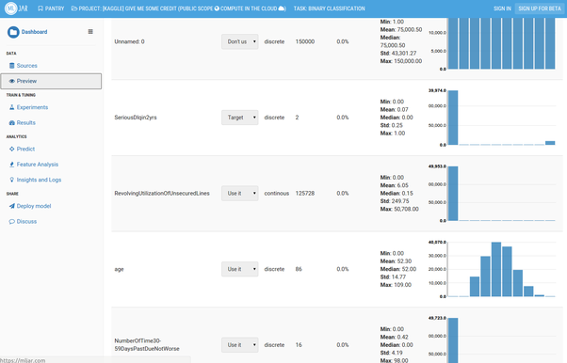
Goals
Object detection and localization
Classification
Tracking
Integration with VARS
Web app to start ML jobs
ID 1
Opisthoteuthis

Slide 8
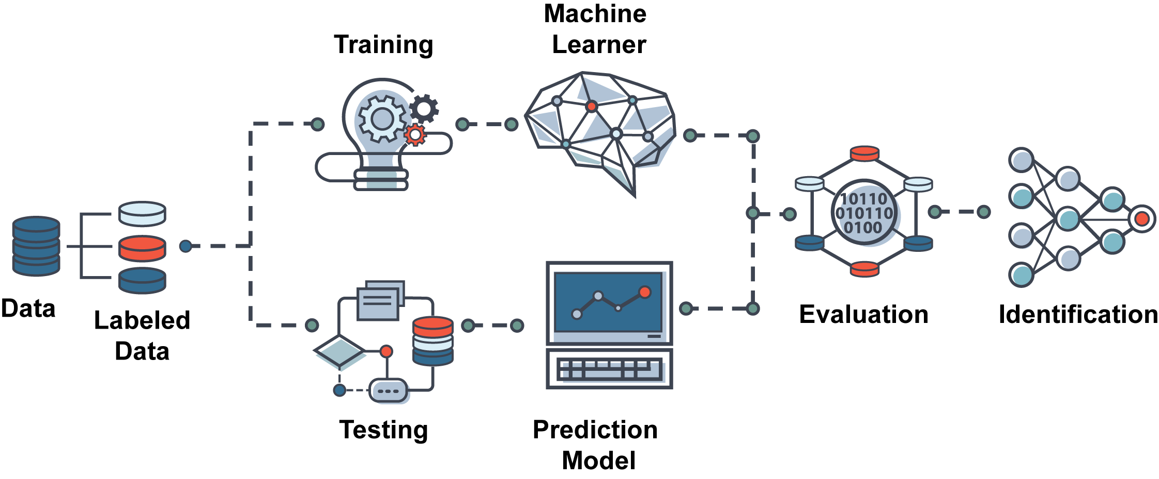
Applying machine learning techniques to annotate data.

Slide 9
Creating and Managing Labeled Data
Labor-intensive!
Leverage existing efforts ...
1 million labels from Cal Poly Collaboration
Labels from student efforts
FathomNet (currently ~60,000 labels)

Slide 10
Reproducibility and Performance Evaluation
Improve models over time
Version control models
Track performance
Inform where labeling efforts should focus

Slide 11
Scalability and Throughput
MLFlow
To cloud or not to cloud? … that is the question.

Slide 12

Workflow Integration
To Do List:
Add localization tools to VARS
Map ML data schema to VARS
How much data is too much?
Import ML annotations into VARS
Track edit history by users for ML generated annotations
Whoa … that’s a lot of data
One detection for 3 seconds at 60fps = 180 events

Slide 13
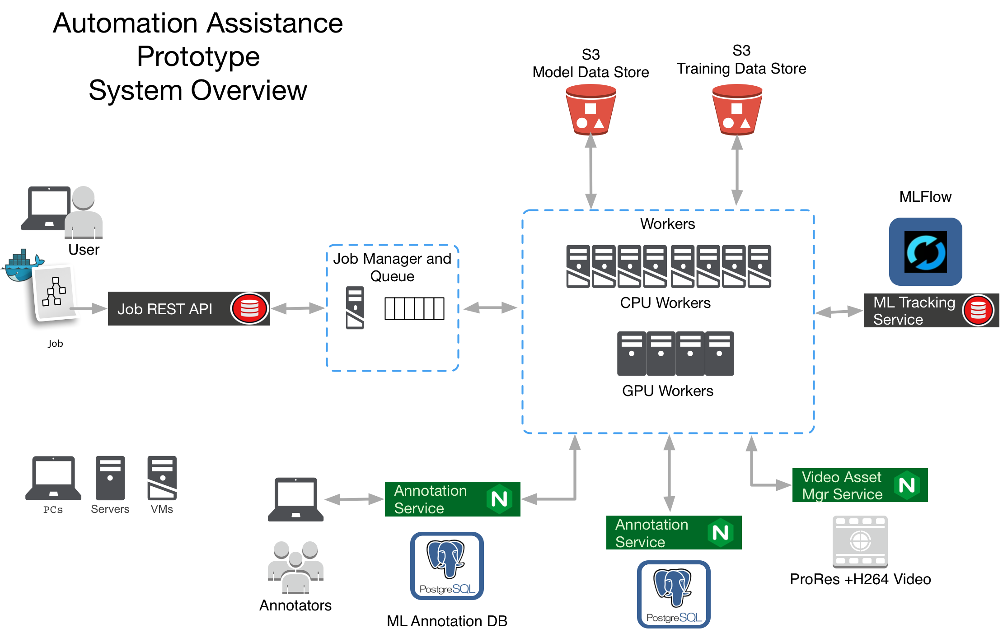

Slide 14




Slide 15
Timeline
Year 1:
Build a working ML pipeline integrated with VARS
Year 2:
Improve ML pipeline
Integrate active learning strategies to assist labeling
Integrate with FathomNet
Year 3:
Address scalability
Continue FathomNet integration

