Slide 1


Advances in Automated Stock Assessment Based on Computer Vision Deep Learning Technologies
David Zhang, Michael Piacentino
Senior Research Scientist, Director
SRI International – Vision Systems
Tuesday August 22, 2017

Slide 2
Problem:
Large collections of underwater videos but extensive manual effort to perform even limited fish classification and counting.
Manual annotations of video contents as the first step for supervised learning is impractical.
Proposed Solution:
Newly developed semi-automated, analyst-guided annotation tool
Rapid annotation methods now enable rapid stock assessment
The stock assessment tool, trained from guided annotation data supports classifying, counting and logging each detected fish/object metadata.
The tool has been integrated into the NOAA VIAME (Video and Image Analytics in a Marine Environment) open-source video processing framework for research analysts.

Slide 3
Sponsor Acknowledgements Current Programs
Program: Real-Time Image Detection and Tracking for Improved Fish Classification and Counting (FY15-FY18)
Sponsor: National Oceanic and Atmospheric Administration (NOAA)
Lead: Dr. Benjamin Richards, Hawaii at Pacific Islands Fisheries Science Center; benjamin.richards@noaa.gov
Program: Restoring Habitats through Benthic Habitat
Mapping Characterization and Assessment (FY17)
Sponsor: National Fish and Wildlife Foundation (NFWF) and University of Southern Florida (USF)
Lead: USF: Dr. Steven Murawski and Chad Lembke
NFWF Note: The views and conclusions contained in this document are those of the authors and should not be interpreted as representing the opinions, views, or policies of the National Fish and Wildlife Foundation. Nothing contained herein constitutes an endorsement in any respect by the National Fish and Wildlife Foundation.

Slide 4
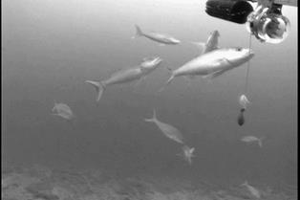
NOAA Automated Stock Assessment
NOAA Stock Assessment Objective:
Provide automated tools to determine the quantities, size and types of different fish
Approach:
Use computer vision technologies:
Fish tracking – detect presence of fish – segment each fish
Classification of the moving objects – quantities of different types of fish
Other technologies (i.e. stereo) for size estimates
Problem:
Analysis of video and still data far exceeds capabilities of human analysts
Data products not available quickly enough for use in stock assessments
Challenges:
Annotated imagery not readily available
It takes huge amount of time to produce

Slide 5
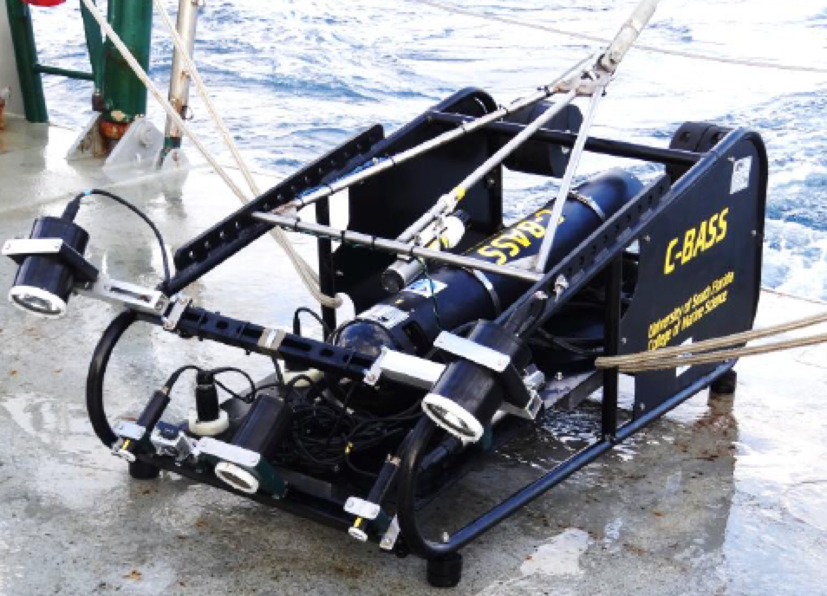
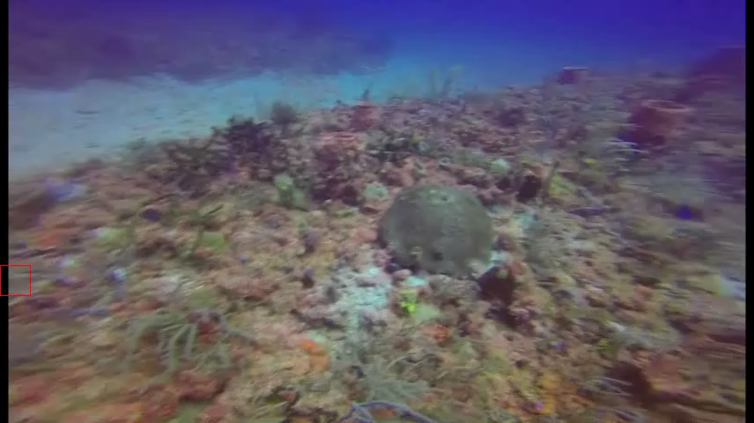
NFWF Undersea Feature Detection and Tracking
Need
Automated habitat mapping tool for classifying and locating undersea objects based on user trained fish, plant life, rocks, etc…
Challenges
- Annotated imagery not readily available and time consuming to produce

Slide 6
Goals of Underwater Classifications
Annotation Tool
Create tool to support rapid, interactive, guided annotation and training.
Assessment Tool
Allow tool to process data base of videos providing annotated and mapped video files.

Slide 7
Design Semi-supervised Cluster Based Annotation Tool
Video Stream
0
10
20
……
100
……
……
time
Object
proposals
Object
Proposals
{Object class,
Location,
Confidence
Measure}
Inferencing
Feature
Generation
Database
user
Fine-tuned
DNN model
Blind
Segmentation
Sample
Selection
Label
New Set
Deep learning
training
Distance sort
Solving the Image Annotation Challenge: Present users with a intuitive tool that allows them to rapidly annotate large classes of imagery gathered and presented as clusters of objects.

Slide 8
Design Semi-supervised Cluster Based Annotation Tool
Client-Server Concept
Client k
Client 1
Webpage http://....
Html, Java script,
Bootstrap API
Webpage: http://....
Html, Java script,
Bootstrap API
…
Web server
(Flask)
Database
(Mongodb)
Python
FishTrack, Proposal, Segment, DL
(C++)

Slide 9
Key Components in Semi-supervised Annotations
Hierarchical Spectral Clustering
Fusion of flow based segmentation (motion cues) and texture based object proposals (Selective Search)
Hierarchical deep learning model for hierarchical classifications

Slide 10
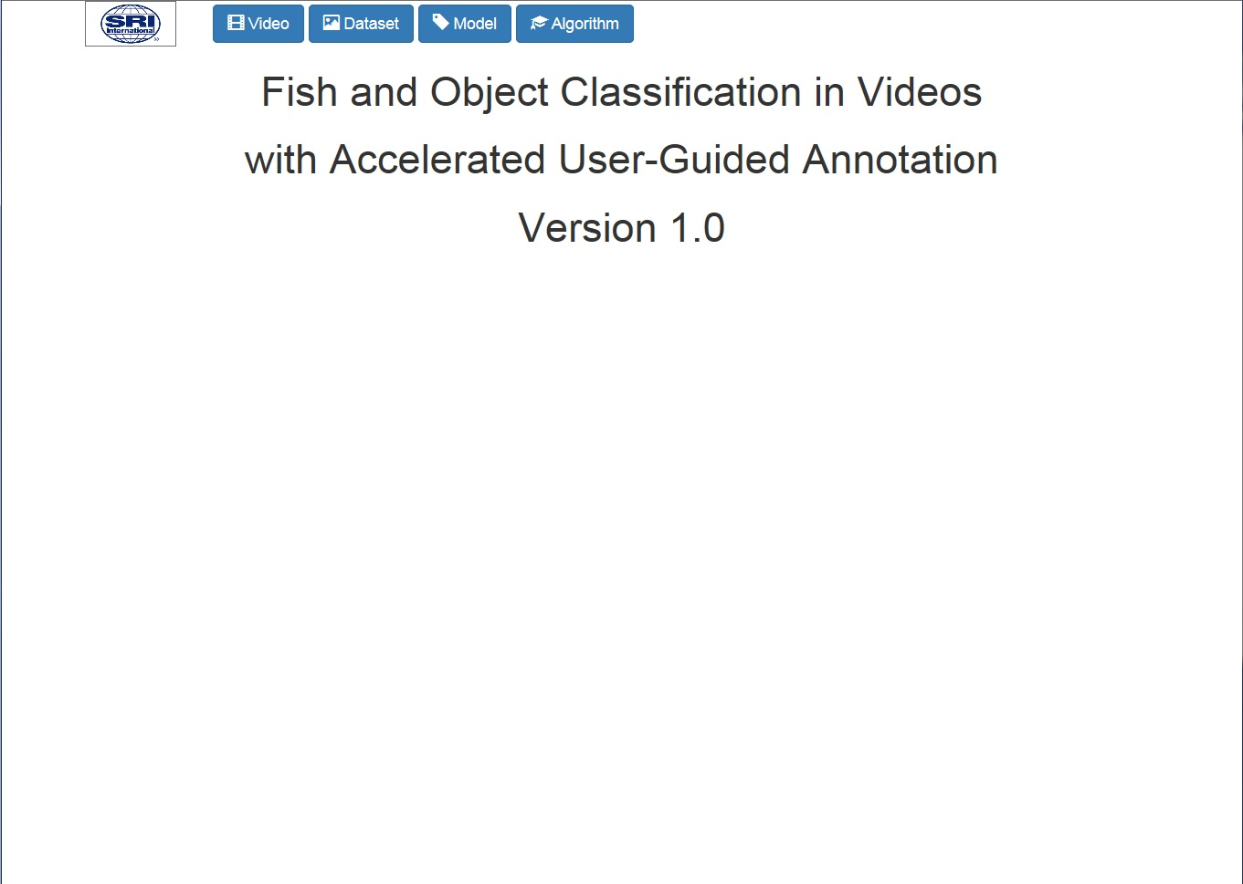
Tool Home Page
Annotation Tool

Slide 11
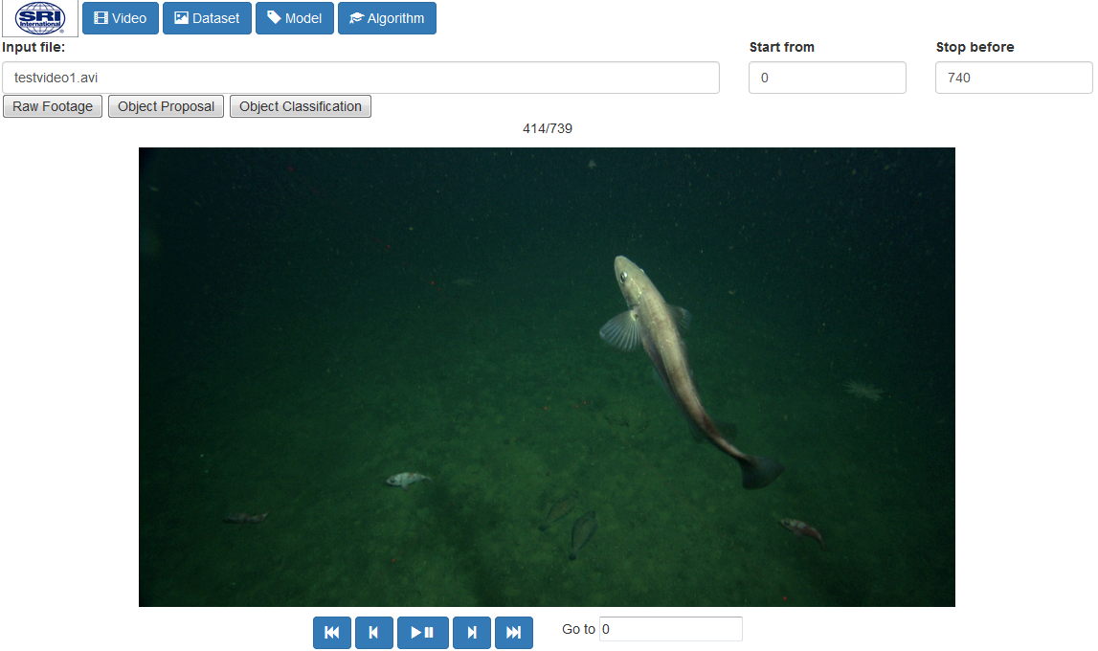
Video Page – Raw Footage
MBARI Dataset
Annotation Tool
Videos and annotations were from Monterey Bay Aquarium Research Institute

Slide 12
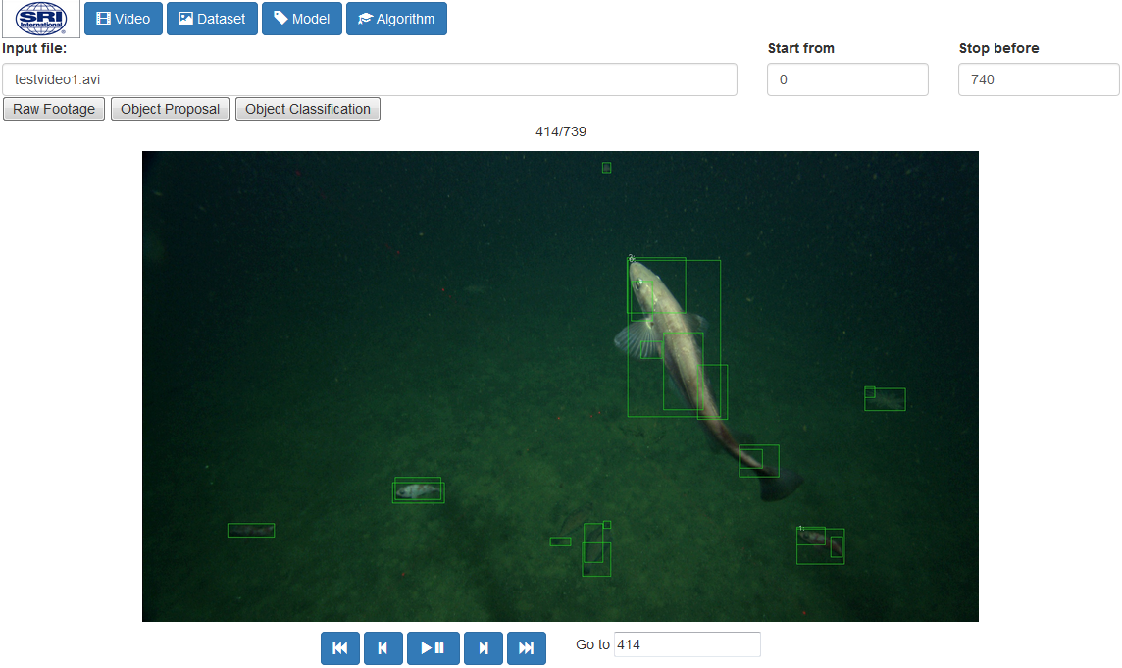
MBARI Dataset
Video Page – Object Proposal
Annotation Tool

Slide 13
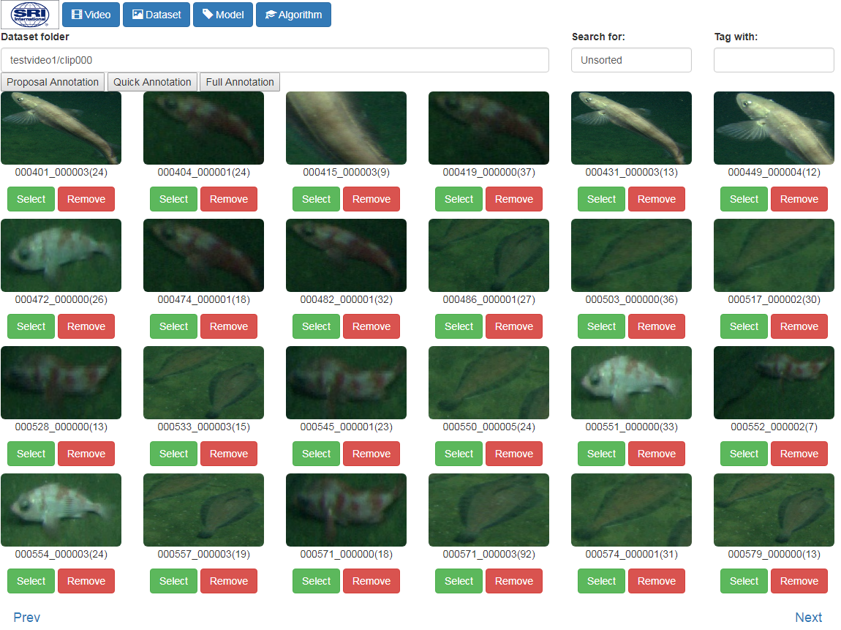
Dataset Page – Blind Segmentation and Clustering
MBARI Dataset
Annotation Tool
Centroid
Image
per cluster
Sebastes - 2 spp
Same Label
Generate ~50-200 clusters

Slide 14
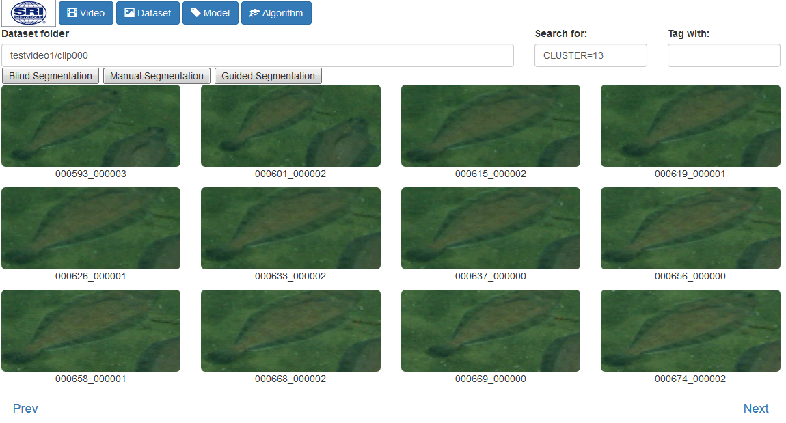
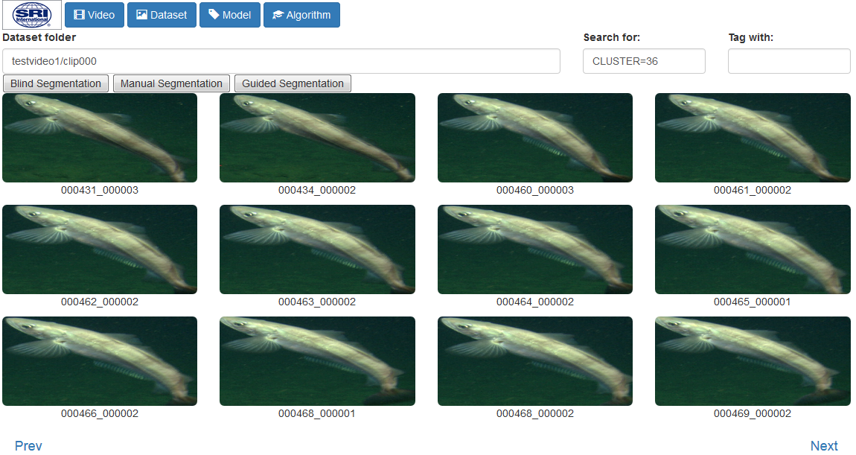
Data Clustering – Labeling
MBARI Dataset
Confidence
Score
Tag: Glyptocephalus_zachirus
Tag: Merluccius_productus
Annotation Tool

Slide 15

Video Page – Object Classification Overlaid on Raw Video
MBARI Dataset
Annotation Tool

Slide 16
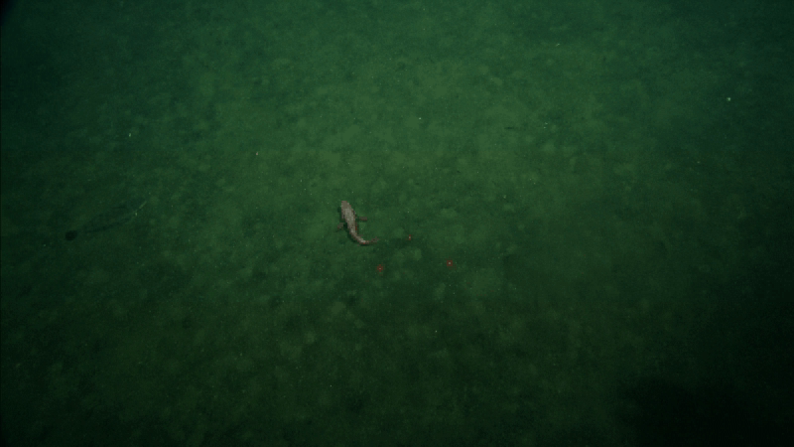
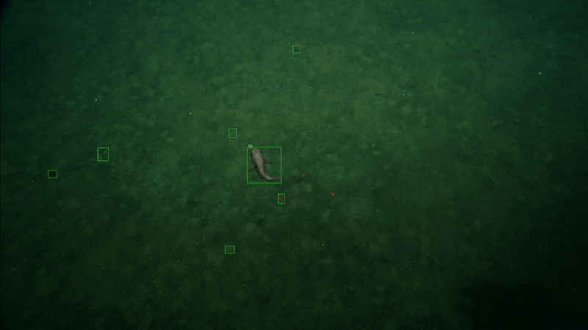
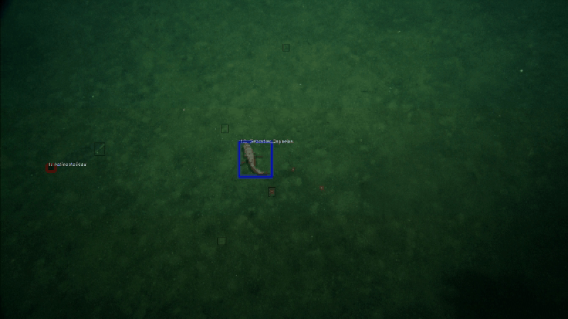
Video Raw, Object Proposals and Classifications
MBARI Dataset
Raw
Proposals
Classification
Annotation Tool

Slide 17
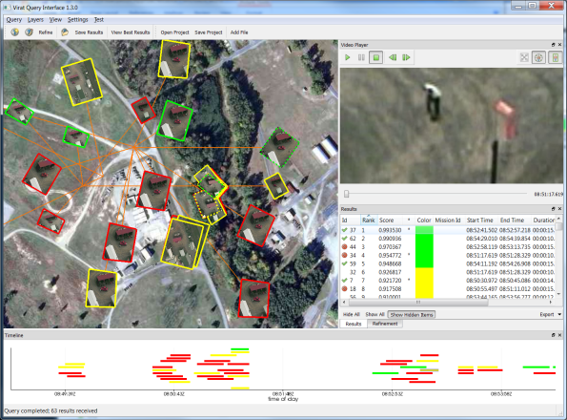
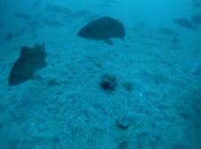
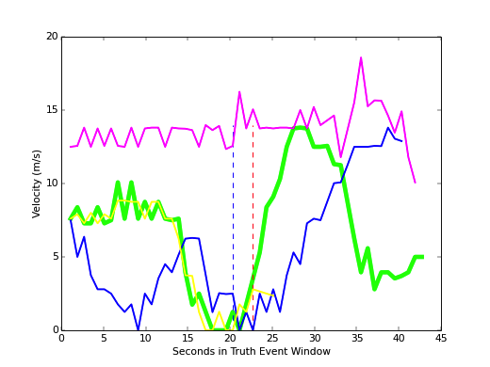
Leverage Open Source VIAME Architecture
Online Adaptation
https://github.com/Kitware/VIAME
Classifier 1
Preprocessor 1
Detector 1
Tracker 1
GUI
Classifier 1
Preprocessor 2
Detector 2
Tracker 2
Classifier 1
Preprocessor 3
Detector 3
Tracker 2
.
.
.
.
.
.
.
.
.
.
.
.
Classifier N
Tracker N
Preprocessor N
Detector N
User
annotations
Indexed Data Store (files, NoSQL, PostgreSQL)
Query management and Indexing
Work queue
VIAME is being developed by KitWare as a open source framework on the
NOAA 4 year Automated Imaging Strategic Initiative for Stock Assessment

Slide 18
Fish Detection and Fish Type Classification
Block Diagram and Scripts to run fish classification in VIAME Framework
Input port
Read frame(t) from input port
# Configurations
# Process definition
process input
:: frame_list_input
process process
:: ProcessImage_benthosdetect
process disp
:: image_viewer
Optical flow parameters
Object proposal parameters
ROI merge/fusion criteria
DNN inferencing parameters
Modified Non-Maximum Suppression parameters
Fish type bounding box coloring scheme
Flow
Segmentation
Object
Proposals
Merge Regions
of Interest
Trained
model
# Initialize
# Connections
connect from input.image
to process.image
connect from process.out_image
to disp.image
DNN
Inferencing
Modified
NMS
# Reset
ROIs, types
# Flush
Write frame(t) to output port
Output port
Matthew Dawkins, Linus Sherrill, Keith Fieldhouse, Anthony Hoogs, David Zhang, Lakshman, Prasad and Benjamin Richards, “An open-source platform for underwater image and video analytics”, WACV March, 2017.

Slide 19
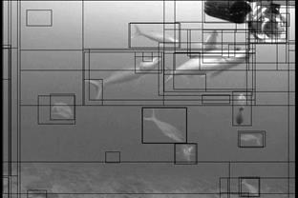
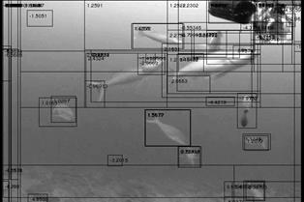
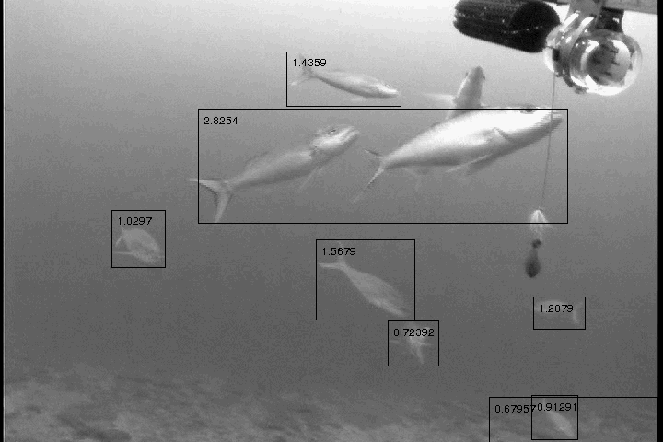
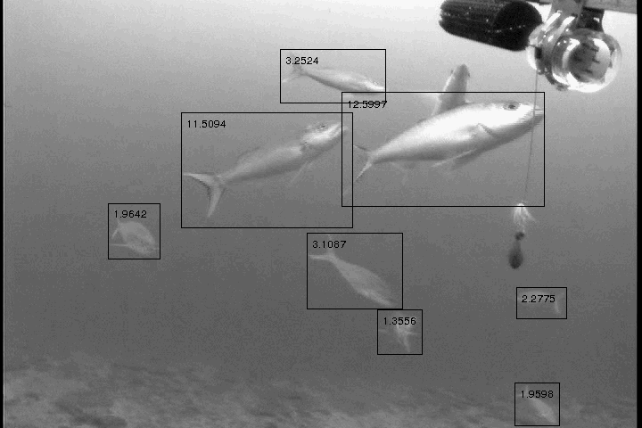
Classifying Undersea Objects
Selective Search and Motion Flow Fusion Algorithm
Added segmentation robustness algorithms to uniquely frame each fish
Images were provided by NOAA

Slide 20

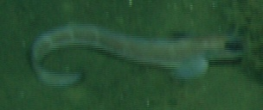
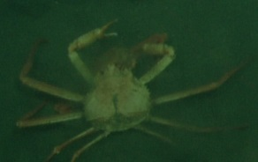
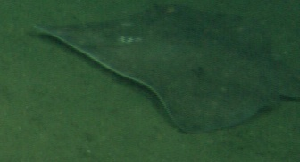
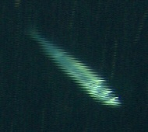
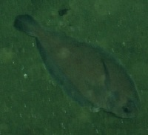
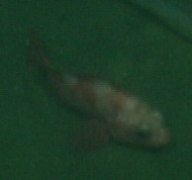
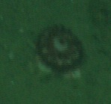
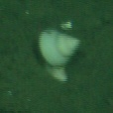
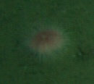
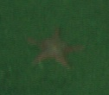
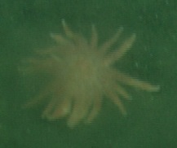
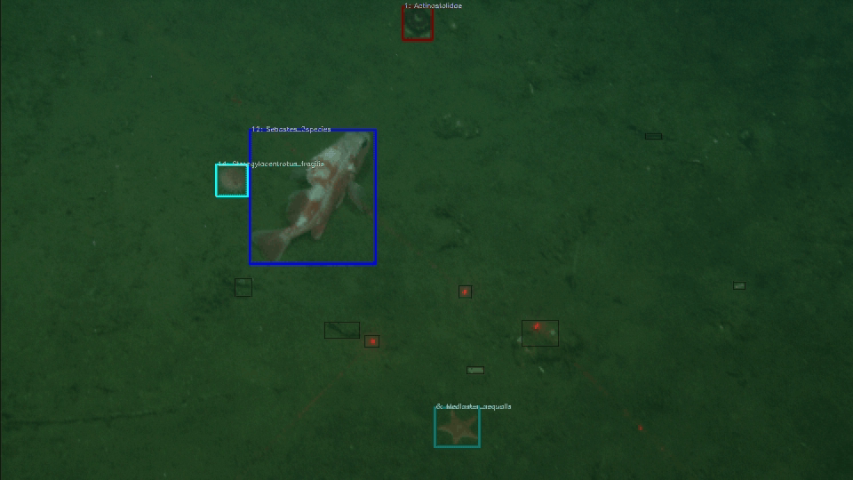
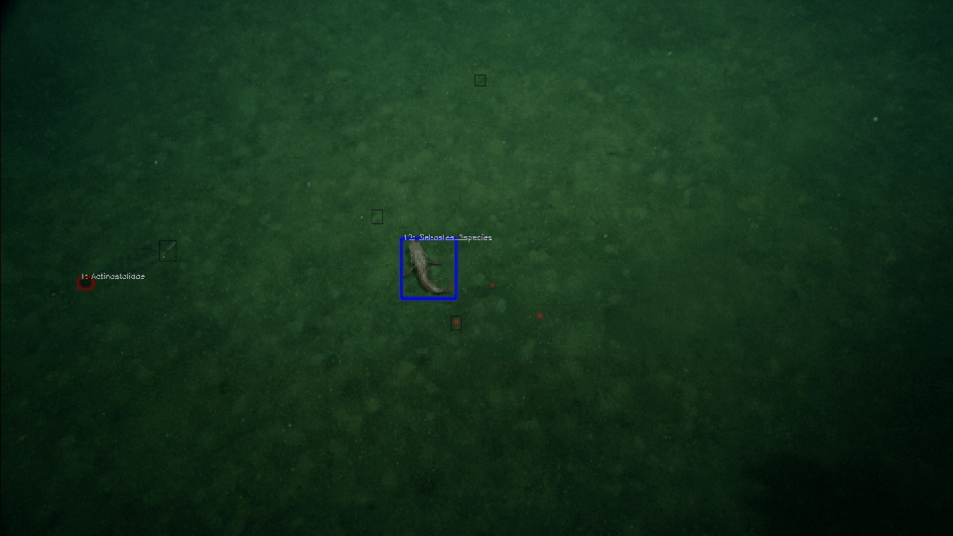
Optimize Fish and Object Proposal ROI’s for Classification
Video data provided by
MBARI - Monterey Bay
Aquarium Research Institute
Example 1
Example 2
Videos and annotations were from Monterey Bay Aquarium Research Institute

Slide 21
Summary
Developing a semi-automated annotation tool method to provide both rapid fish annotation and fish classification.
Developed a stock assessment tool, trained from guided annotation data supports classifying, counting and logging each detected fish/object metadata.
The tool has been integrated into the NOAA VIAME open-source video processing framework for research analysts.
The tool can support stock assessment needs for all fish types, environments, and underwater conditions allowing researchers to process new and existing videos.
Future Work
Develop User Friendly Controls
Compare performance against manually annotated dataset.
Enable multi-user access
Improve annotations and detections

