Slide 1
AWS SageMaker
Duane Edgington
Video Annotation Assistance project kickoff Jan 28 2020

Slide 2
SageMaker
What is SageMaker?
  Amazon SageMaker is a cloud machine-learning platform. It provides:
  AWS managed service for ML algorithms and models,
  workflow
  integration with other services:
  storage
  database
  batch processing
  real-time processing
  serverless on-demand resources

Slide 3
Why are we looking at Sagemaker?
Project milestone: Cloud or not Cloud?
  Cost
  Performance
  Scalability
  Flexibility
  Best practices

Slide 4
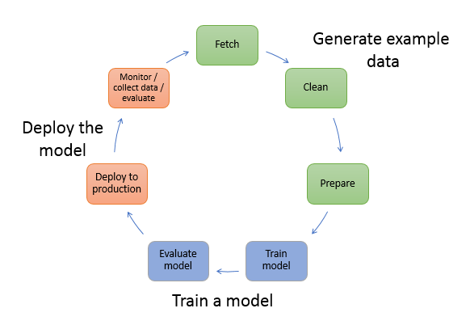
ML workflow

Slide 5
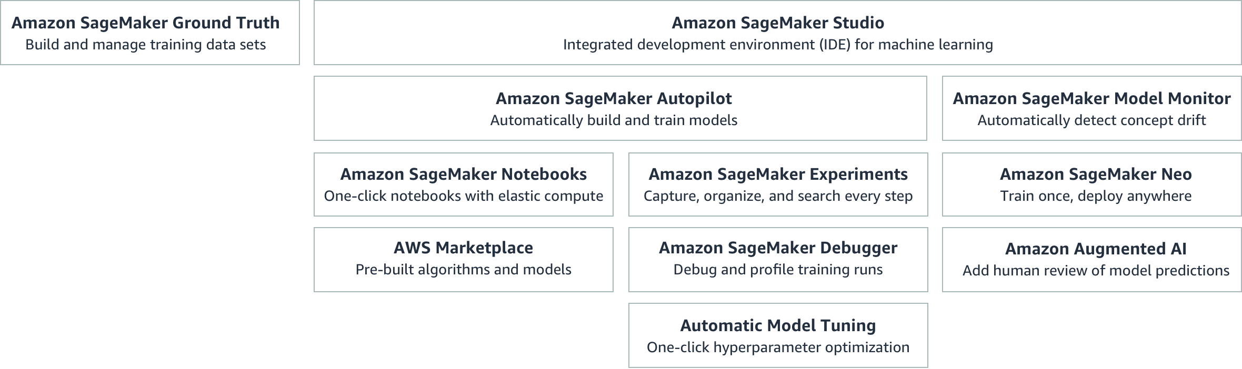
SageMaker components (as of 2020)

Slide 6
SageMaker integration
Frameworks: TensorFlow, PyTorch, Apache MXNet, Chainer, Keras, Gluon, Horovod, Scikit-learn, and Deep Graph Library
Model deployment from Mlflow
Models deployed as Docker images to AWS (Elastic Container Registry)
Data in S3 buckets (MinIO object storage integration)
…

Slide 7
SageMaker evaluation status
Completed edX SageMaker course (instructors: AWS trainers)
Demonstrated workflow with ML models / SageMaker Jupyter Notebooks
Demonstrated integration with Cloud9 IDE / workstation
Demonstrated integration with Mlflow
Investigating integration with Lambda serverless REST API (via AWS Chalice python framework)
Monitoring cost and performance and scalability

