Slide 1
LRAUV UX Brainstorm
November 12, 2020
UCSC + Sliced Bread Design + MBARI

Slide 2
LRAUV UX Brainstorm Agenda
Session 1 (25 min) - Intro and Overview
Session 2 (60 min) - Brainstorming in small groups
Session 3 (25 min) - Sharing ideas with the full group
Next steps after today
Dot vote for your favorites in the Miro boards
Design direction feedback session next week
Final design direction feedback session the following week

Slide 3
Introductions

Slide 4
Overview

Slide 5
What we have done so far
User research and prototyping
Conducted 5 in-situ, exploratory interviews with LRAUV watch standers
Prototyped different visualizations of the log, resulting in JDash
Conducted 7 remote, structured interviews with LRAUV watch standers
  Discussed both Dash3 and JDash user interfaces, using a previous mission’s logs
Shadowed 3 watch standing sessions during the Fall 2020 CANON mission
We have synthesized these findings into a set of user needs, which we will use to ground and inspire our brainstorming session today.

Slide 6
What we are doing today
Sharing a brief overview of what we have learned so far
Focusing in on the LRAUV operators’ user needs
Brainstorming LRAUV design directions for understanding vehicle state

Slide 7
What we are NOT doing today
Filtering out design ideas ← This happens later in the design process
Going deep into specific UI features
Solving design challenges once and for all
Making firm decisions about exactly what design direction to go in

Slide 8
LRAUV Operator
User Research Highlights

Slide 9
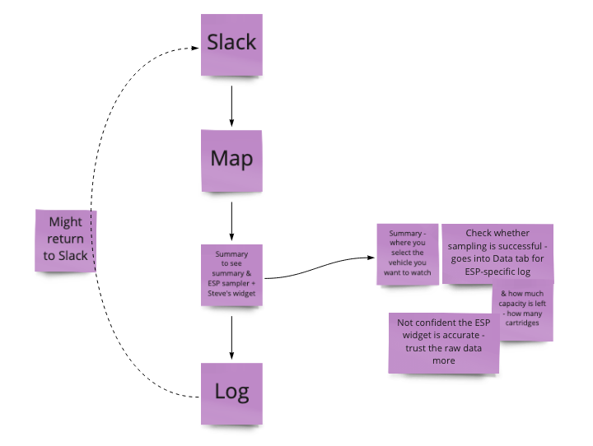
A typical watch standing session looks like this

Slide 10
1. Understand Vehicle State
Operators want a quick way to understand vehicle state to address issues and next steps.
Most operators think that whenever one of those yellow fault... messages pop up that the vehicle is going to explode. They are thinking, “Why would I be seeing an error if it’s not important?”
The log can sometimes be a little bit tedious, because there's just so much that you have to scroll through ... if a sensor reports something down. It could be buried. ... you'd have to keep scrolling up and down to see what the latest new message is, not by time, but by when it was received. And that's one of the things that I kind of find a bit irritating.

Slide 11
2. Handoff Smoothly
Operators want a clearer understanding of past, present and future LRAUV actions during shift changes.
Starting a new shift
I look back in Slack first, just to see what the conversation is, and then I really rely on what was done and what needs to be done from the previous watch stander… then I go on Dash to specifically look at the vehicle state and then the specific mission and things like that that are being run so I know what I have to do next.
Interpreting watch summary
Here is what [previous operator] gave, as the synopsis. But it’s not clear from this what leg we are on or what the waypoint setting should be… and [previous operator] wasn't sure either.

Slide 12
3. Build Confidence
Operators would operate more effectively under less stressful, uncertain conditions.
It's safer for the vehicle to be under because there's less chance of it to be run over by something… The other problem is that... you have more of a risk of being sent being blown away.
I guess my biggest concern is, these cryptic messages that come up and and wondering... is this something that I need to be concerned about?

Slide 13
4. Collaborate Effectively
Operators want efficient communication and group decision-making during deployments.
There are so many different ways to communicate that it can be difficult to figure out what is going on. Some people use notes on the dash, some use specific slack channels, some use slack direct messaging, etc.

Slide 14
User Needs
Understand vehicle state
Handoff smoothly
Build confidence
Collaborate effectively

Slide 15
LRAUV UX Brainstorm Agenda
Session 1 (25 min) - Intro and Overview
Session 2 (60 min) - Brainstorming in small groups
Session 3 (25 min) - Sharing ideas with the full group

Slide 16
Brainstorming!

Slide 17
1. Understand vehicle state
How might we...
Provide an easy and trustworthy way of understanding what’s happening with the LRAUV?
Deliver high-level, glanceable status while also allowing drill-down into detail?
Provide an easy and trustworthy way of understanding science data collection success rates?
Make it easier to understand the sequence of messages from vehicle, given they may arrive out of order?
Make it easier to understand the sequence of commands that will go to vehicle, given they may arrive out of order?

Slide 18
2. Handoff smoothly
How might we...
Enable smoother ways to get up to speed at the beginning of an LRAUV watch-standing shift?
Provide an easy and trustworthy way of understanding the current mission goals and plans?

Slide 19
3. Build confidence
How might we...
Help PICs understand when something is really important (e.g., the vehicle is in danger)?
Provide more peace of mind for PICs when communications with the LRAUV are inherently sporadic?
Reduce the level of stress about the vehicle being on the surface?

Slide 20
4. Collaborate effectively
How might we...
Provide an easy way for users to find the most timely and relevant information about the mission?
Streamline communication between teammates across watch hand-offs?

Slide 21
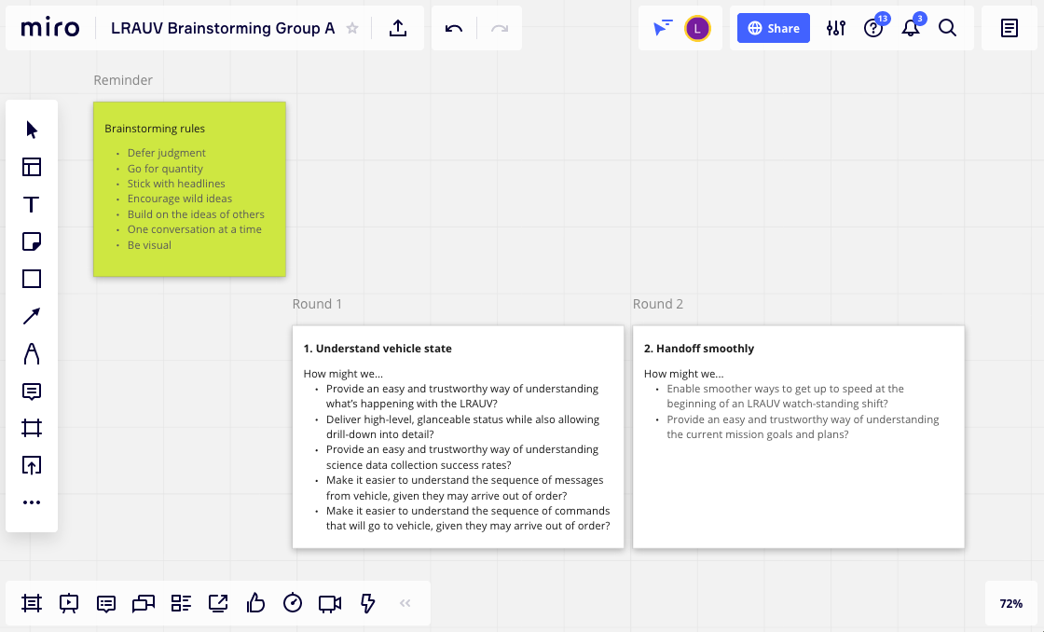

Slide 22
Brainstorming Rules
Defer judgment
Go for quantity
Stick with headlines
Encourage wild ideas
Build on the ideas of others
One conversation at a time
Be visual

Slide 23
Brainstorming warm-up
Let’s plan a birthday party for our friend Laura!
“Yes, but…” (2 minutes)
“Yes, and…” (4 minutes)

Slide 24

Small Group Brainstorming Teams
Group A: https://miro.com/app/board/o9J_kgzfqyk=/
Understanding vehicle state & Handoff smoothly
Group B: https://miro.com/app/board/o9J_lfH3h4A=/
Understanding vehicle state & Build confidence
Group C: https://miro.com/app/board/o9J_lfH3h5k=/
Understanding vehicle state & Collaborate effectively

Slide 25
LRAUV UX Brainstorm Agenda
Session 1 (25 min) - Intro and Overview
Session 2 (60 min) - Brainstorming in small groups
Session 3 (25 min) - Sharing ideas with the full group

Slide 26
Sharing

Slide 27
Small Group Brainstorming Teams
Group A: https://miro.com/app/board/o9J_kgzfqyk=/
Understanding vehicle state & Handoff smoothly
Group B: https://miro.com/app/board/o9J_lfH3h4A=/
Understanding vehicle state & Build confidence
Group C: https://miro.com/app/board/o9J_lfH3h5k=/
Understanding vehicle state & Collaborate effectively

Slide 28
Next steps

Slide 29
LRAUV Next Steps
We’ll organize the results and email you when it’s ready
Go to the summary board, find your dots, and and place them on your favorite ideas.
  Deadline: 5pm ET tomorrow (Friday)
  Don’t use more than your assigned dots!
Kim will create 2-3 conceptual directions
Meet to review directions
  Need to schedule this for next week

Slide 30
Mahalo

Slide 31
Related Documents
Figma prototype
Interview study plan, including gathering feedback on prototype UI component
Interview and shadowing session videos - raw data collected
7 interviews of LRAUV users, who are not on the LRAUV engineering team
3 shadowing sessions of Fall 2020 CANON mission
Data analysis Miro board - synthesizing data from interviews and observations
New Miro board - compilation of all three groups’ brainstorming sessions

Slide 32
LRAUV Operator
User Research Highlights

Slide 33
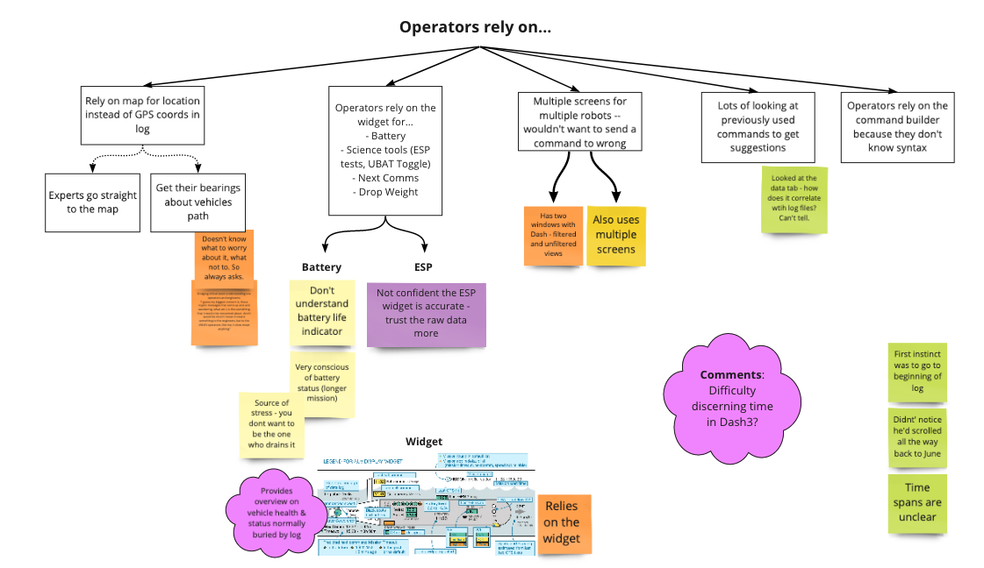
We observed many commonalities across operators

Slide 34
A typical watch standing session looks like this

Slide 35
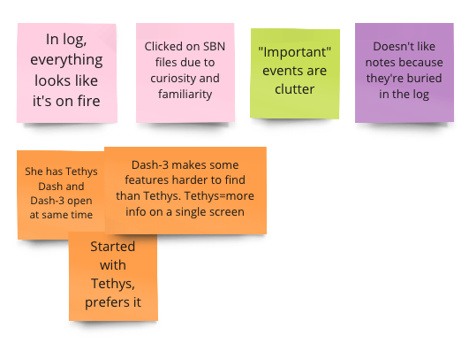
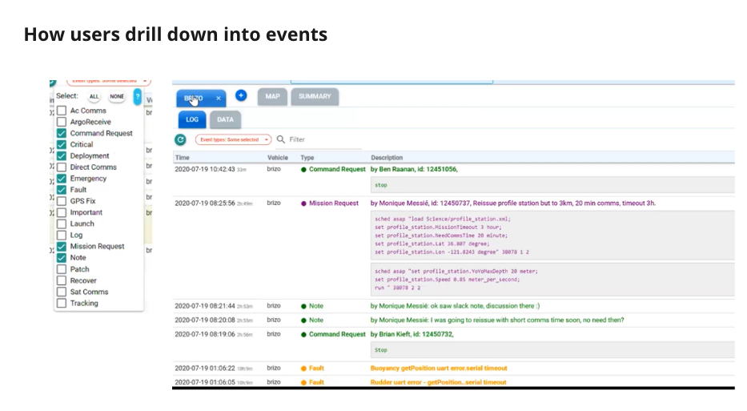
Theme: Feeling overwhelmed by “clutter”

Slide 36
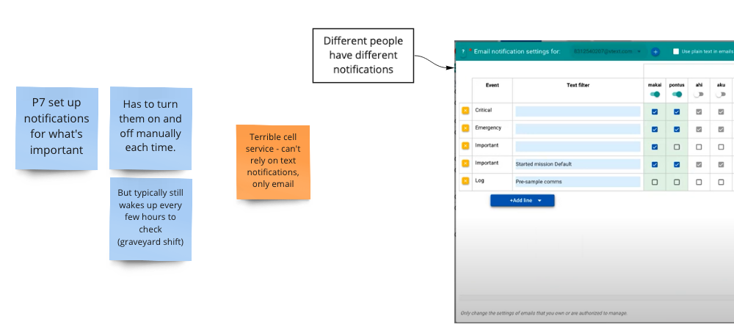
Theme: Relying on notifications

Slide 37
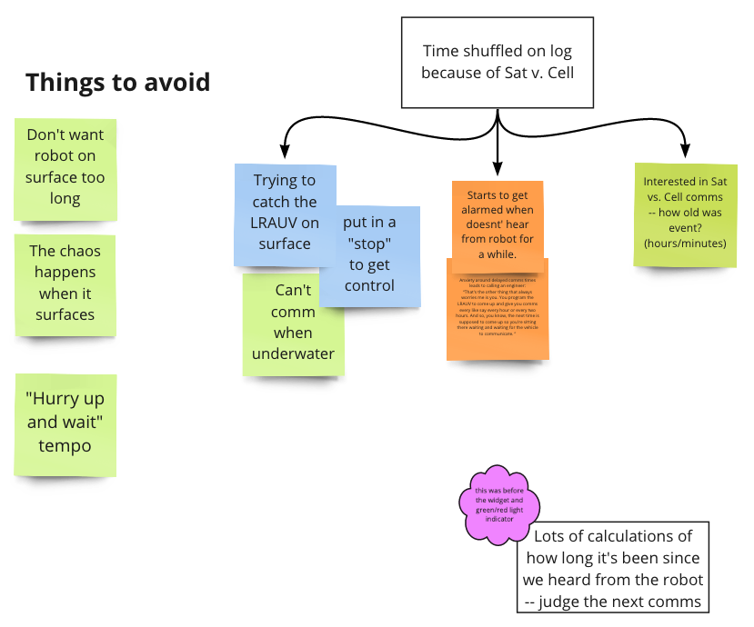
Theme: Stressing about when the vehicle surfaces

Slide 38
LRAUV Operator
User Needs
with more supporting quotes

Slide 39
1. Understand Vehicle State
Operators want a quick way to understand vehicle state to address issues and next steps.
The log can sometimes be a little bit tedious, because there's just so much that you have to scroll through ... if a sensor reports something down. It could be buried. ... you'd have to keep scrolling up and down to see what the latest new message is, not by time, but by when it was received. And that's one of the things that I kind of find a bit irritating.
So, what does ‘Invalid EZ Servo response; /0@4456’ mean, I wonder if I need to do something about that... my biggest pet peeve is all these cryptic messages coming... I don't know what I'm supposed to do.”
Most operators think that whenever one of those yellow fault [Invalid EZ Servo response; /0@4456] messages pop up that the vehicle is going to explode. They are thinking, “Why would I be seeing an error if it’s not important?”

Slide 40
2. Smooth Handoffs
Operators want a clearer understanding of past, present and future LRAUV actions during shift changes.
Interpreting a watch summary:
Here is what [previous operator] gave, as the synopsis. But its not clear from this what leg we are on or what the waypoint setting should be… and [previous operator] wasn't sure either.”
Starting a new shift:
I look back in Slack first, just to see what the conversation is, and then I really rely on what was done and what needs to be done from the previous watch stander… then I go on Dash to specifically look at the vehicle state and then the specific mission and things like that that are being run so I know what I have to do next.
Contrary to what was going on yesterday, I see what's going on pretty quickly [today]

Slide 41
3. Build Confidence
Operators want to alleviate the stress of administering commands or mission requests.
I guess my biggest concern is, these cryptic messages that come up and and wondering... is this something that I need to be concerned about?
It's safer for the vehicle to be under because there's less chance of it to be run over by something… The other problem is that... you have more of a risk of being sent being blown away.
...getting down pretty deep in terms of parsing the individual commands, they get split up and sometimes it's a little confusing to make sure that the commands have been received.

Slide 42
4. Collaborate Effectively
Operators want efficient group consensus during deployments.
There are so many different ways to communicate that it can be difficult to figure out what is going on. Some people use notes on the dash, some use specific slack channels, some use slack direct messaging, etc.
I don't always remember [different slack channels]… it would be easier if it were just pretty much all in one place.
…[Slack] has been a Godsend but also an opening to make changes on the fly a lot…
Some people like to “chat” using the notes, which I feel clutters the event-log in many ways.

