Slide 1


Final concepts
MBARI
12-10-2020

Slide 2
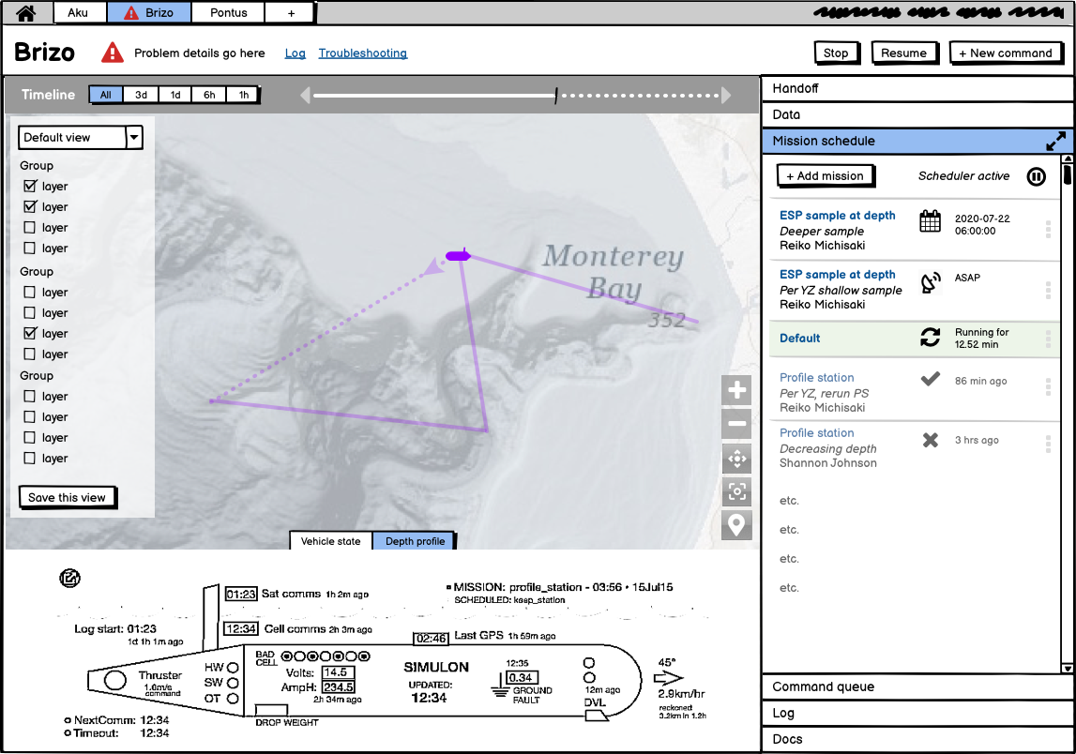
Vehicle main page

Slide 3
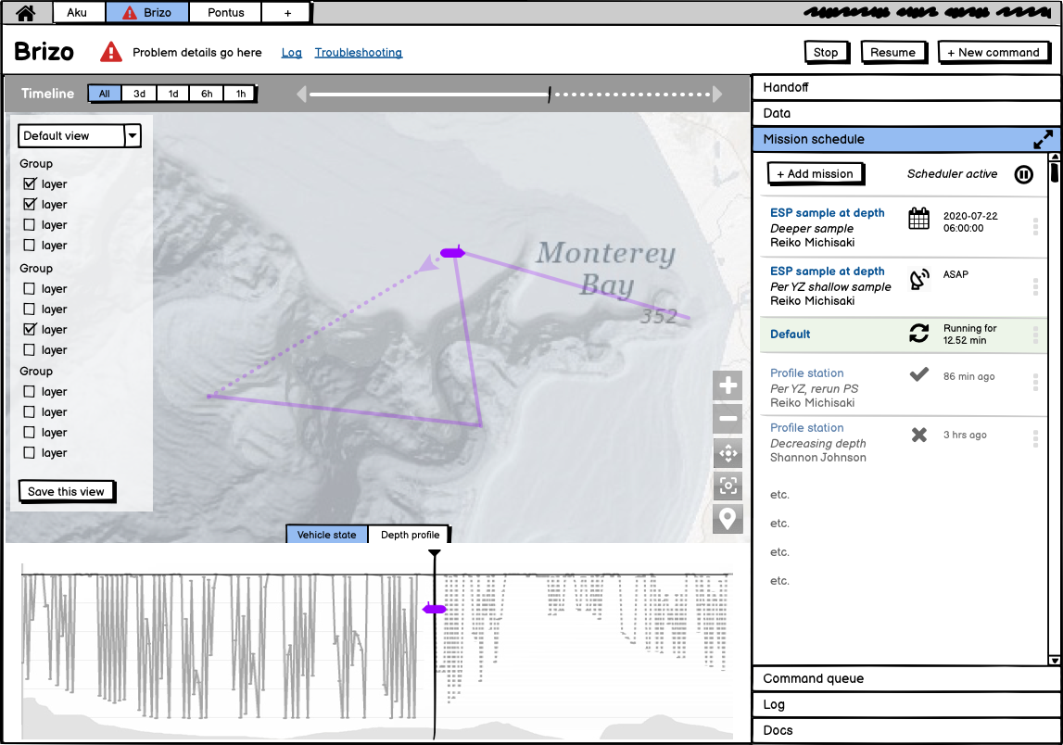
Vehicle main page - Depth view

Slide 4
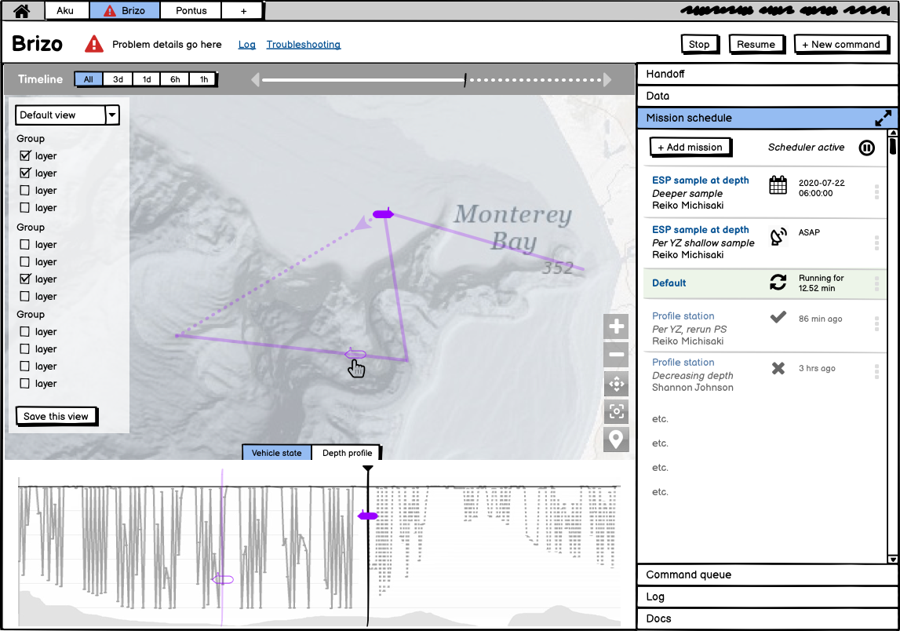
Vehicle main page - Hover

Slide 5
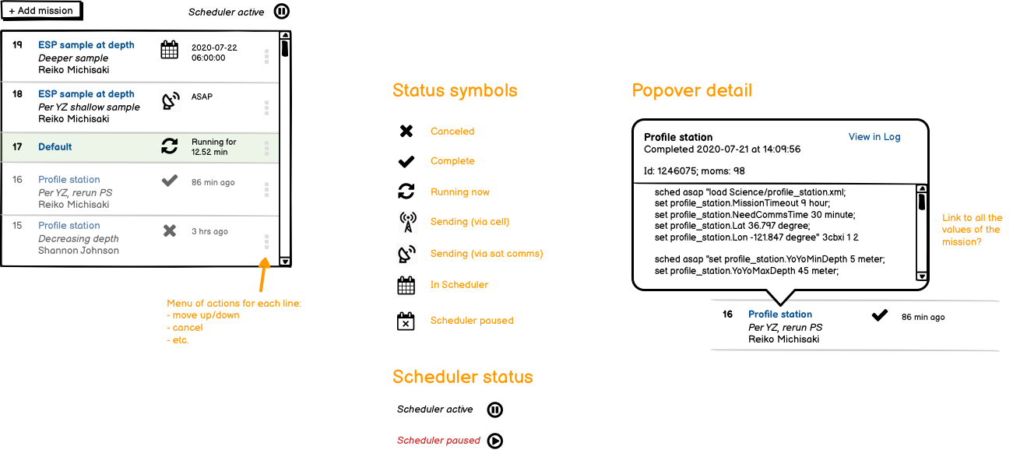
Mission schedule details

Slide 6
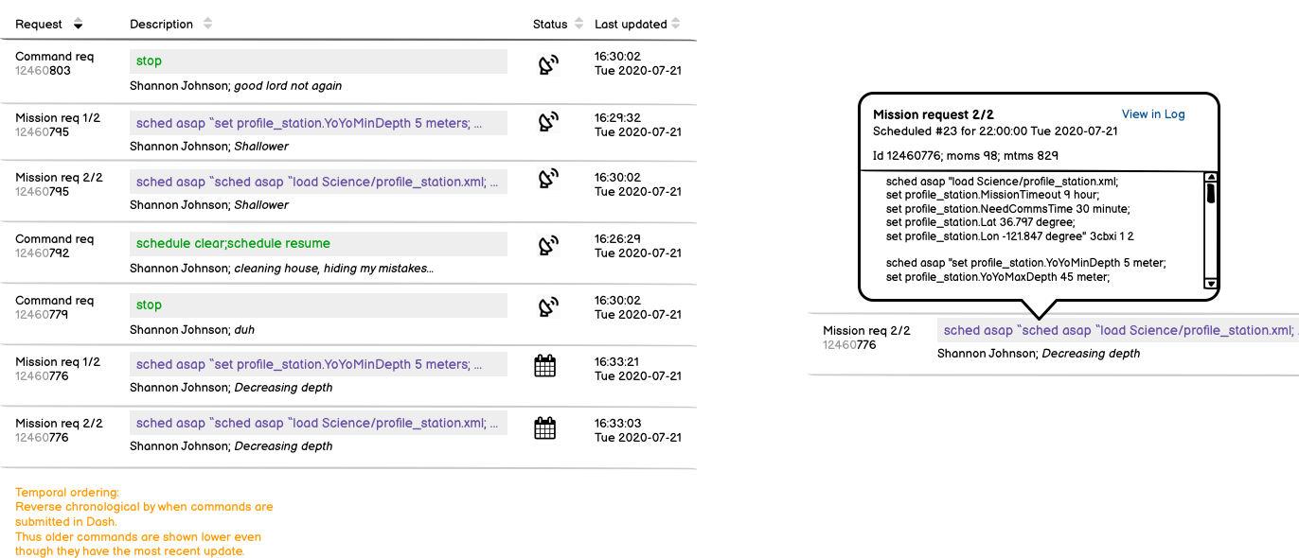
Command Queue

Slide 7
Next steps
These concepts are very rough, and there are many more levels of detail to work out.
Team should gather user feedback on iterations as often as possible.
Gather user feedback on these concepts
Refine sketches, including:
  Sketch out additional elements (handoff, log, data, etc.)
  Work out flows between elements
  Refine details of data representations
  Further explore map-centered interactions (science data, hovers, timeline)
  Iterative user feedback

