Slide 1


Concepts round 1
MBARI

Slide 2


Agenda
Recap design goals & brainstorm
Review concepts
Select a direction
Explore details
Next steps
Notes:
Use sentence case for all slide titles (besides the first slide)
Use Semi Bold about 24pt for any anchoring slides, like this content

Slide 3
Recap

Slide 4
User needs
Understand vehicle state
Operators want a quick way to understand vehicle state to address issues and next steps.
Hand off smoothly
Operators want a clearer understanding of past, present and future LRAUV actions during shift changes.
Build confidence
Operators would operate more effectively under less stressful, uncertain conditions.
Collaborate effectively
Operators want efficient communication and group decision-making during deployments.

Slide 5
Who are we designing for?
 | Engineers | PICs | Scientists
Expertise with system | Very high | Moderate | Low
Level of detail needed | All the detail | What’s urgent | Very little
Interested in science data? | Not really | Maybe | Yes!
Attitude | Could I please just get some sleep? | I don’t want to break anything! | Call me when the data’s ready

Slide 6
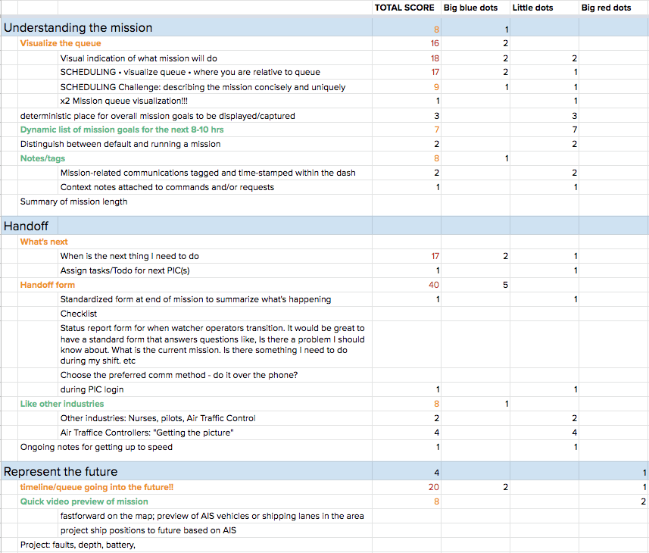
Brainstorm summary
Complete spreadsheet

Slide 7
Brainstorm: top ideas
Understanding the mission
Visualize the queue
Dynamic list of mission goals for the next 8-10 hrs
Notes/tags
  Mission-related communications tagged and time-stamped within the dash
  Context notes attached to commands and/or requests
Handoff
What’s the next thing to do
Handoff form/checklist
  Look at other industries, like nursing, air traffic control
Represent the future
Timeline/queue going into the future
Quick video preview of mission
Science data
Scientists can dynamically tune/preview data resolution vs. mission work
Onboard QA checks for science data
Build confidence
Knowledge base

Slide 8
Brainstorm: top ideas
Map + timeline together
Interactive timeline
Including timeline (past + future) for full deployment
Map
Waypoint ETA on timeline + light up on map
Collaboration/communication
Area for discussion v. what is decided
Command status
List of commands/missions issued with status (sent/received/acted upon)
Prioritize
Automatically determine what is important
Miscellaneous
Intro video

Slide 9
Brainstorm: other areas
Build confidence
Links to cheat sheet/knowledge base
Troubleshooting
Resolved vs. live issues
Timing of comms/commands
Help users understand actual order vs. comms order
Searching & filtering
“prefab” filters for common use cases or user probiles

Slide 10
Concepts:
Map sketches

Slide 11
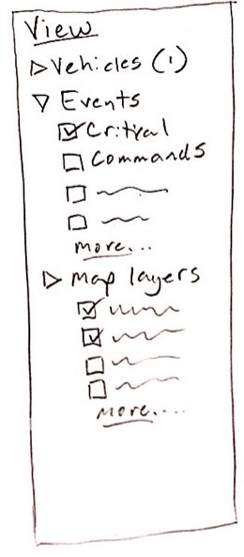
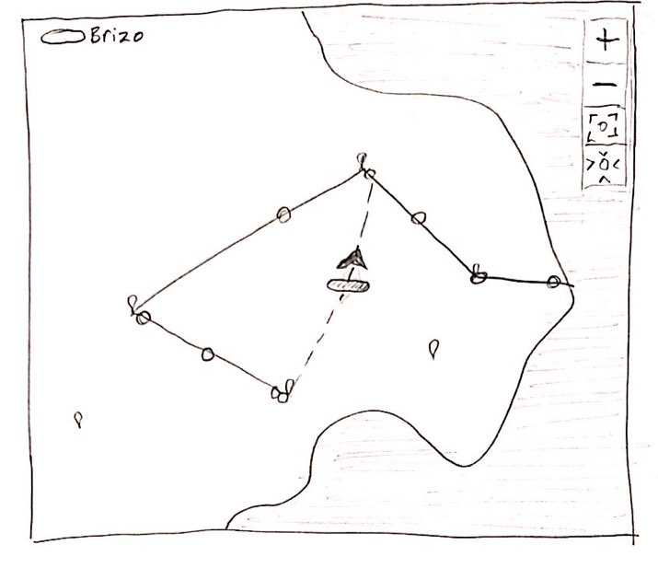
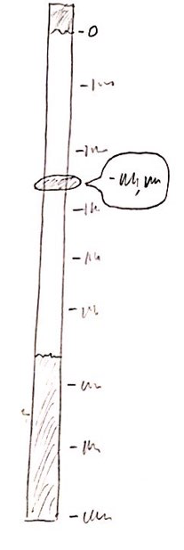
Map
Layers
Map with events overlaid, future direction
Depth

Slide 12
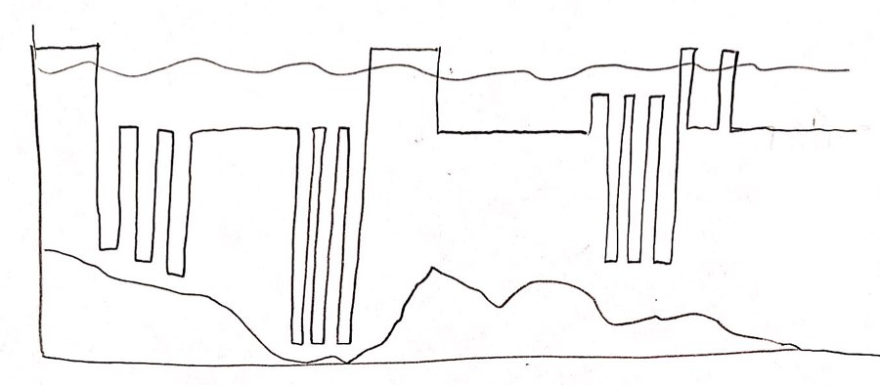

Map
Depth profile over time
Playhead
Play back and Play forward (for map and depth)

Slide 13
Concepts:
Layouts

Slide 14
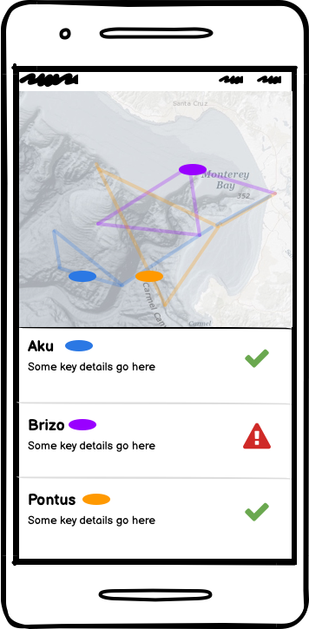
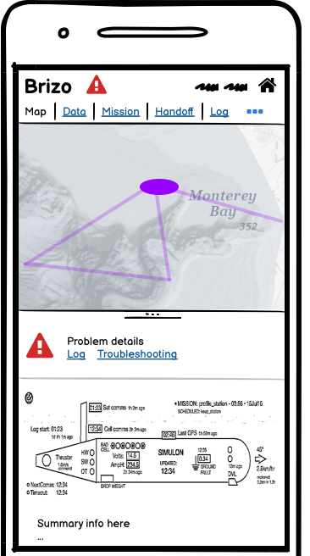
Mobile
Overview
Specific Vehicle

Slide 15
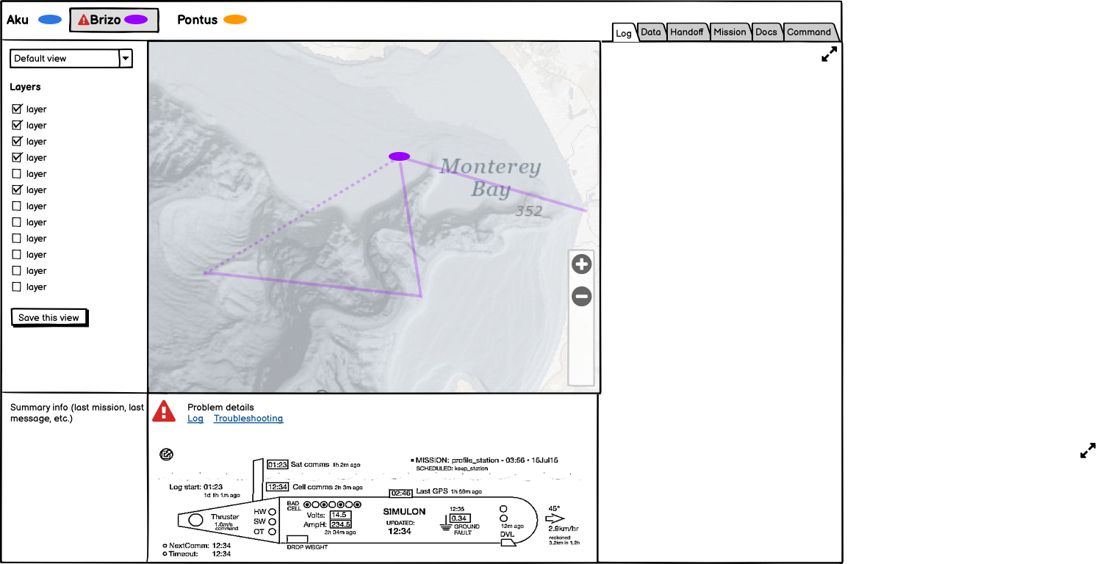
Direction A
Map primary

Slide 16
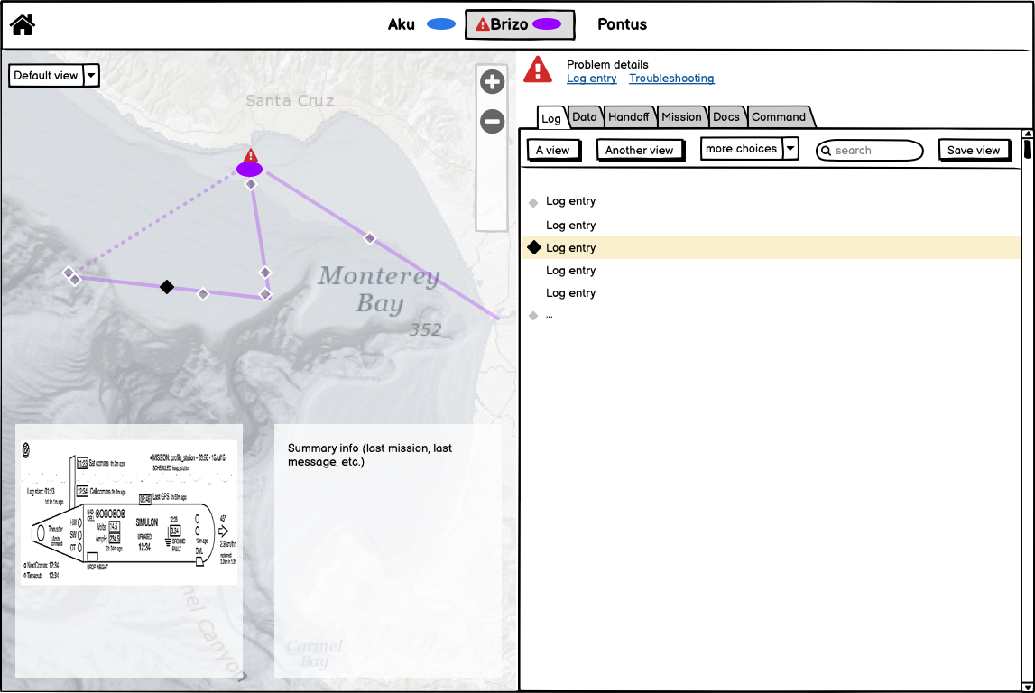
Direction B
Equal division

Slide 17
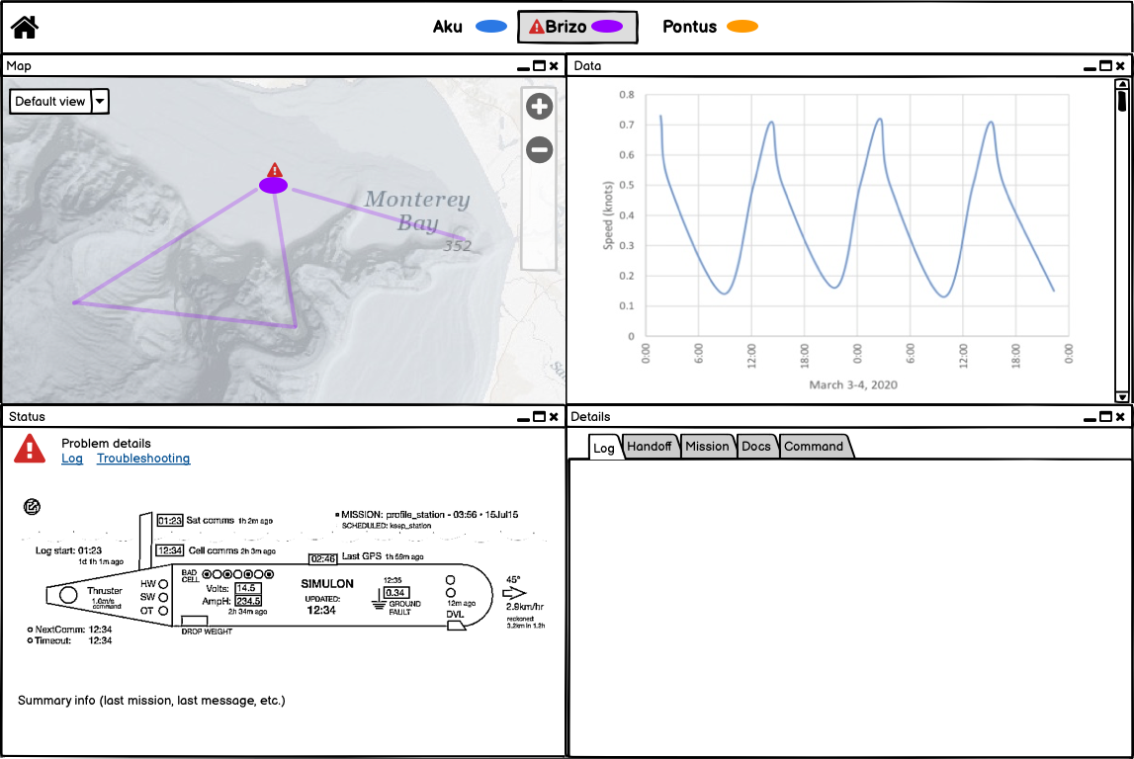
Direction C
4-square

Slide 18
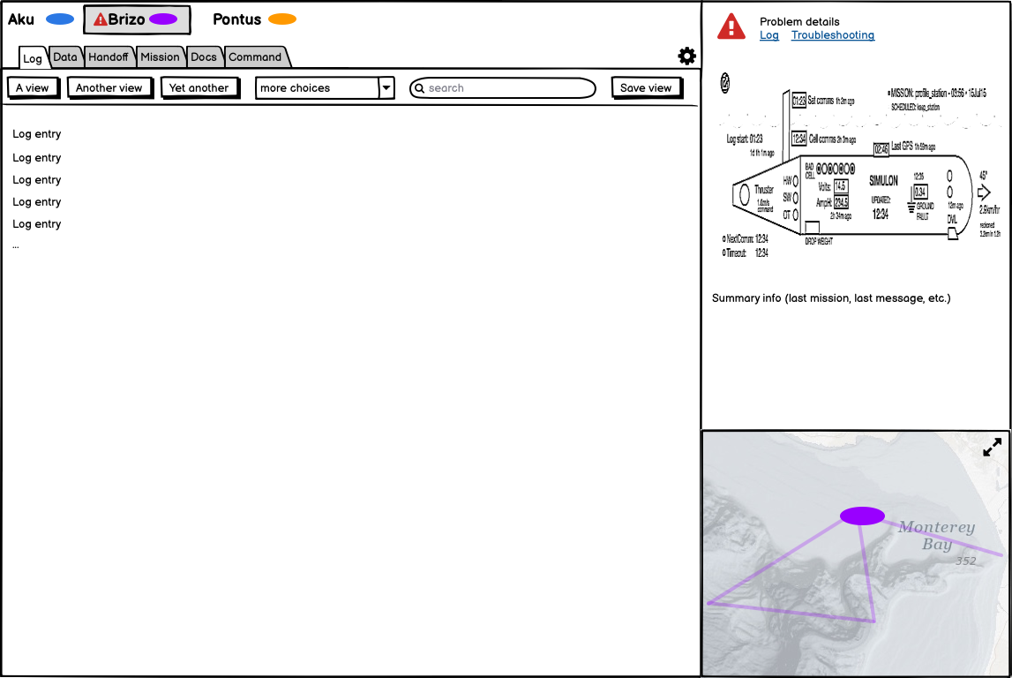
Direction D
Log primary

Slide 19
Which direction should we pursue?

Slide 20
Evaluating the directions
Which layout will best meet the needs of our target user type?
Which layout will best meet the needs of all user types?
What about the map + timeline + depth profile concepts? Should we include these in next round of concept work?

Slide 21
Let’s dig into some details

Slide 22
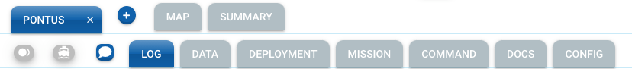
Information Architecture
Summary
(all selected vehicles)
Existing
New
One vehicle
Map
Vehicle status
Data
(science & other)
Mission description
Commands
Handover
Log
Command Queue
Docs
Deployments
Config

Slide 23
Information Architecture

Slide 24
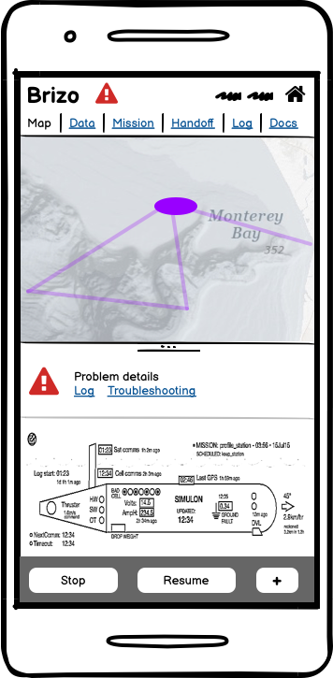
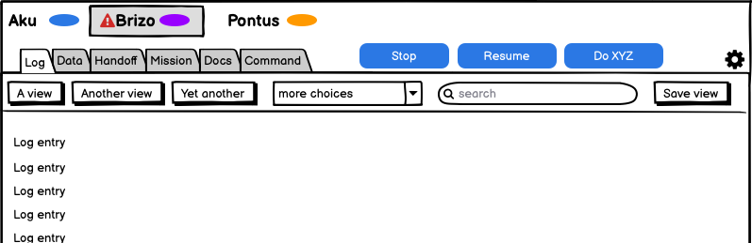
Common commands

Slide 25
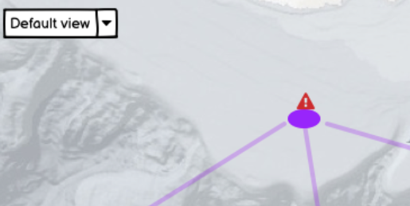
Views & filters
Map views
Log views

Slide 26
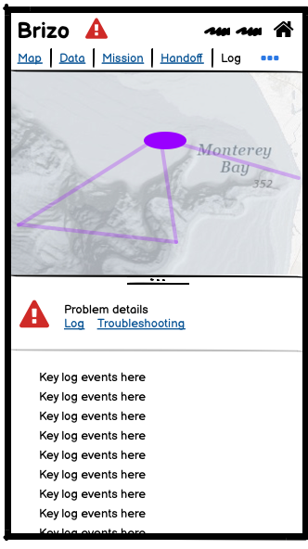
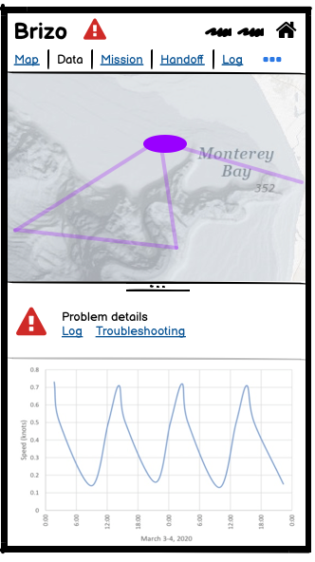
Mobile: Vehicle Option B
Different tabs as default
Commands here
Condensed log - key events only
Data

Slide 27
Next steps

Slide 28
Next steps
One more round of design: where to focus?
Schedule 2 more meetings
  Design review Dec. 3 or 4
  Wrap up around Dec 9

