Slide 1


Concepts round 2
MBARI

Slide 2
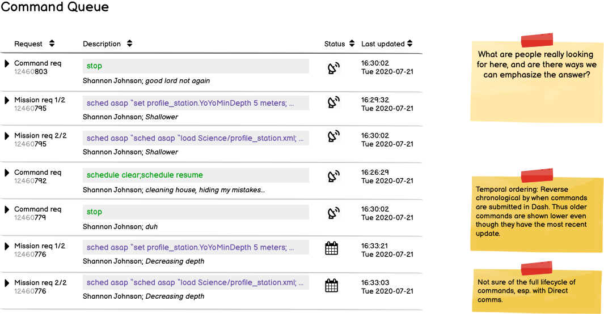
Command Queue

Slide 3
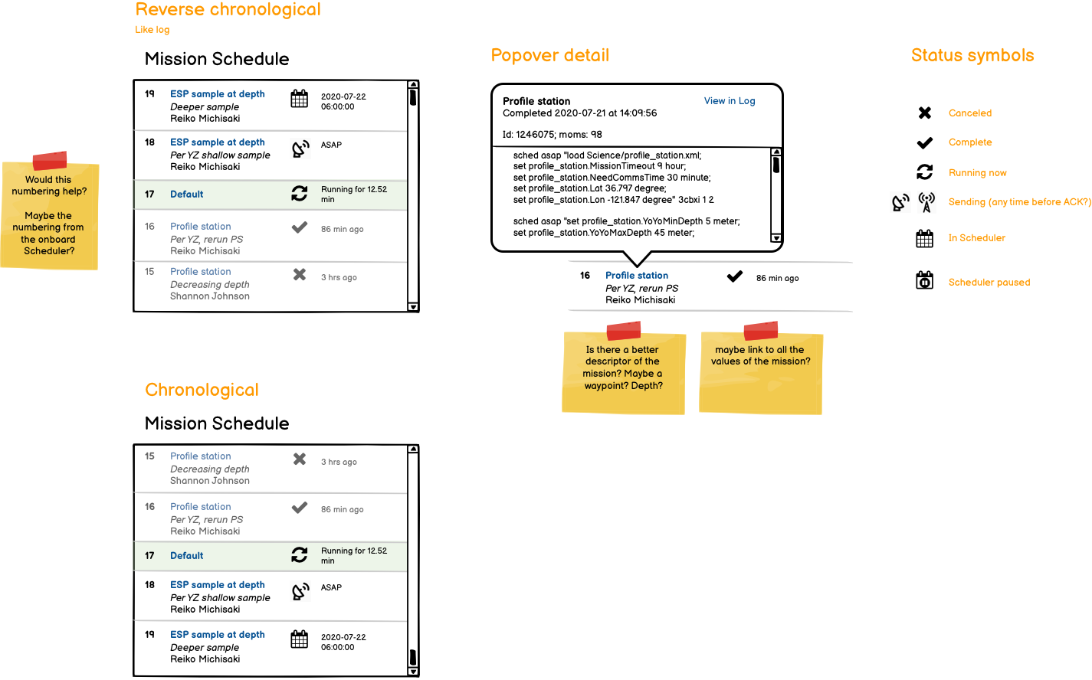
Mission schedule

Slide 4
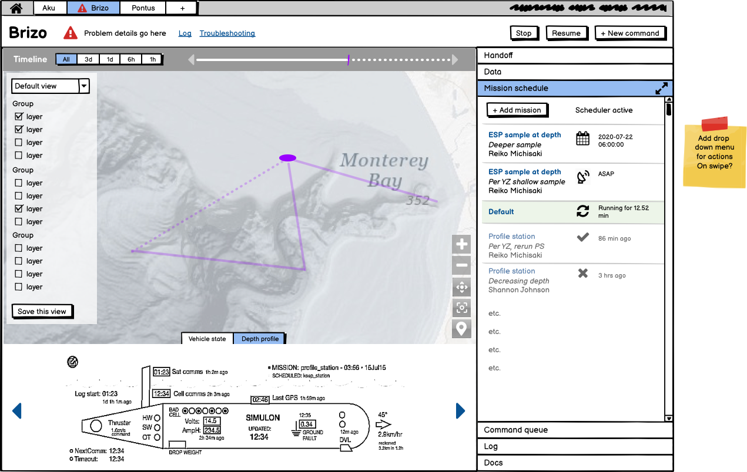
Vehicle main page

Slide 5
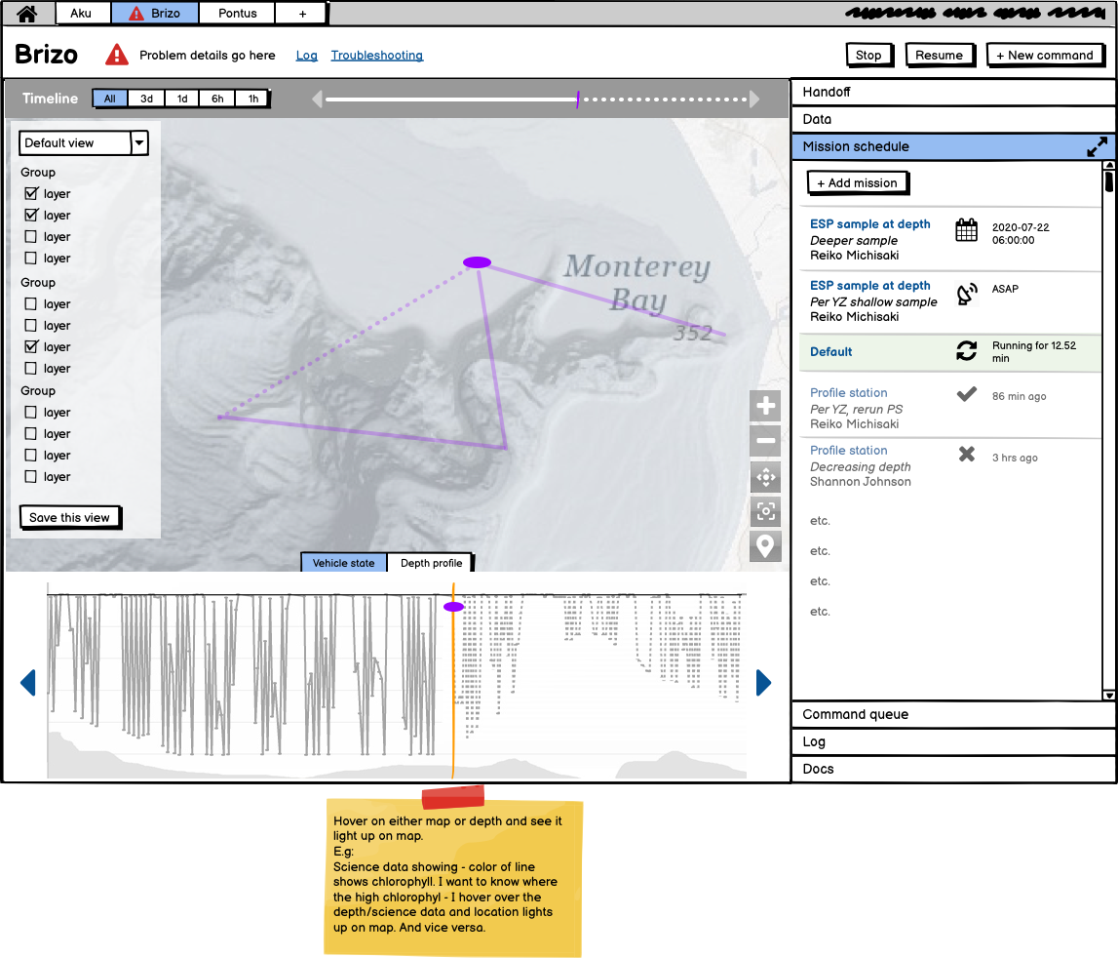
Main page with depth

Slide 6
Next steps
Add your comments by 6 pm Friday, 12/4
Wrap-up meeting Tuesday, 12/8 at 1 pm PT

