Slide 1


Kickoff
MBARI

Slide 2


Agenda
Introductions
Project definition
UX design process
Questions for MBARI
Pre-mortem
Software walkthrough
Notes:
Use sentence case for all slide titles (besides the first slide)
Use Semi Bold about 24pt for any anchoring slides, like this content

Slide 3
Project definition
Overview | Create a UI design direction for LRAUV software that better support the needs of science team end-users. This conceptual design work will then inform more detailed design work and design specifications in subsequent phases of the project.
Discovery | Review existing research, brainstorming workshop
Initial design | 2-3 conceptual directions (pencil UI sketches or rough storyboards) with 1-2 use cases each. MBARI will select a direction to pursue.
Design refinement | Concept sketches and/or storyboards for 3 different use cases, based on chosen design direction.
Timeframe | 4-8 weeks

Slide 4
UX design process

Slide 5
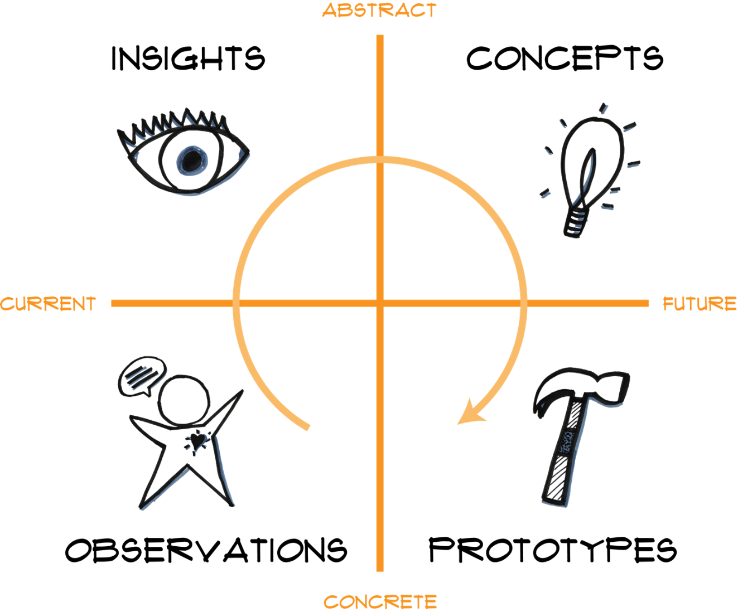

Slide 6
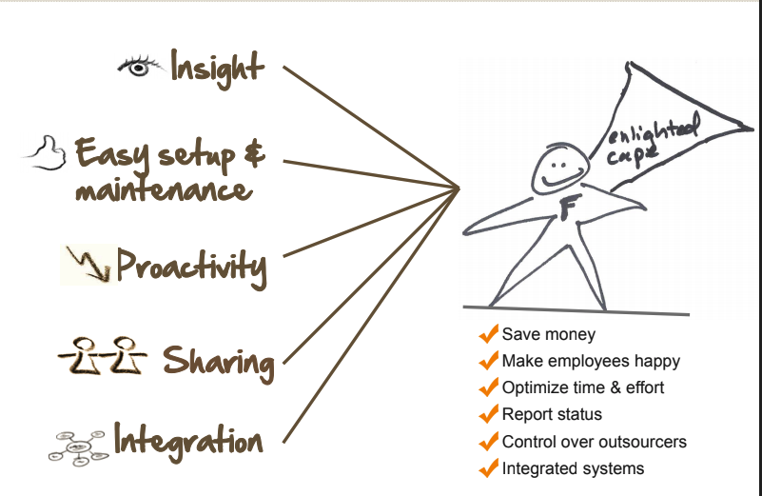
Insights from user research

Slide 7
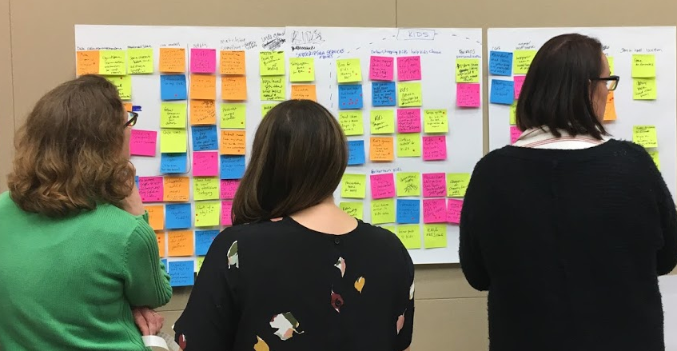
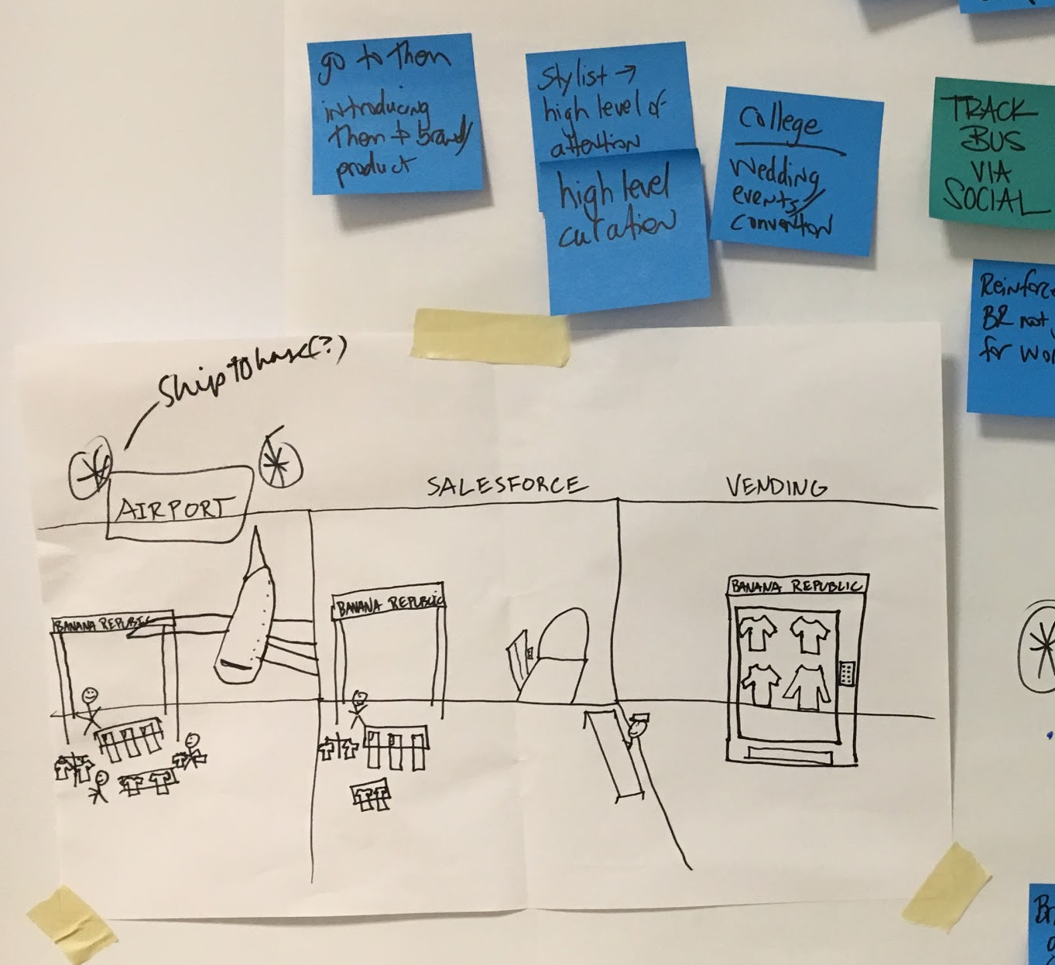
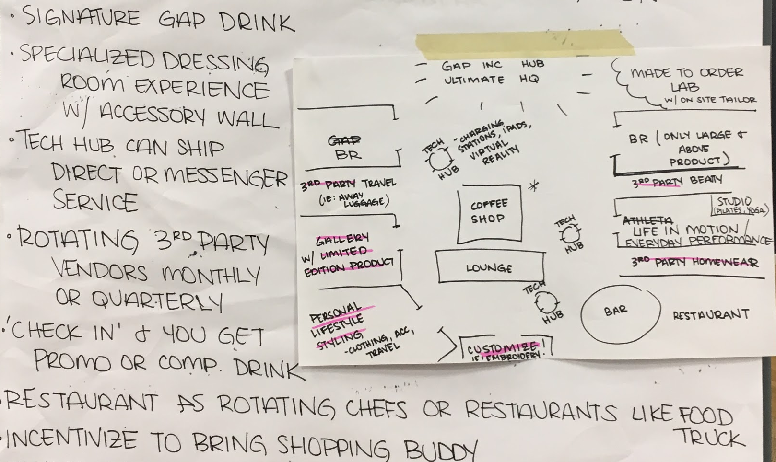
Concepts: Brainstorming

Slide 8
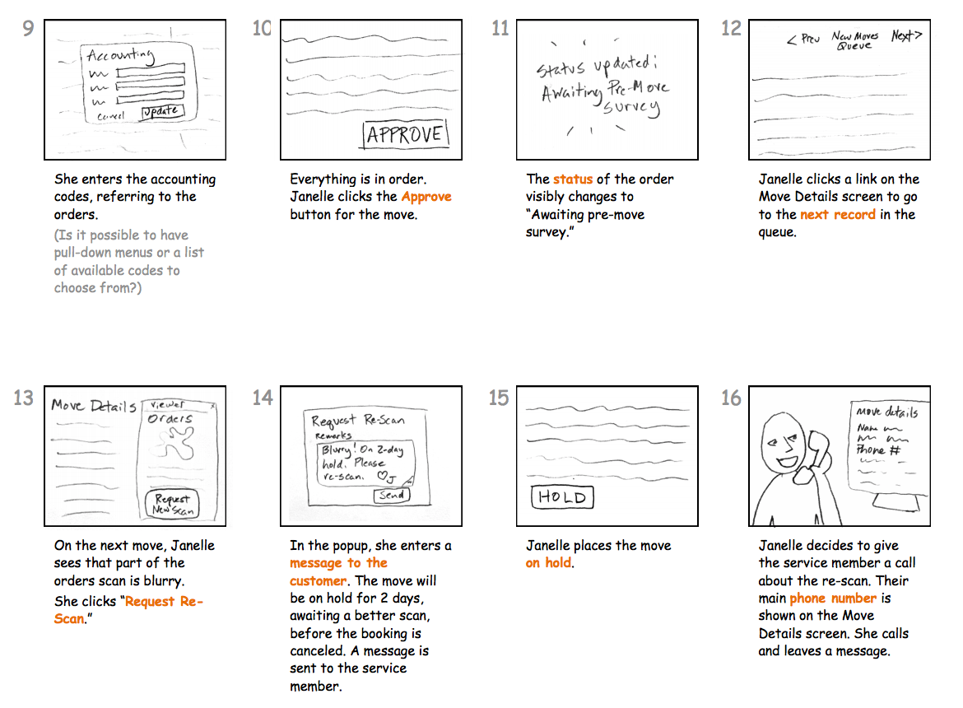
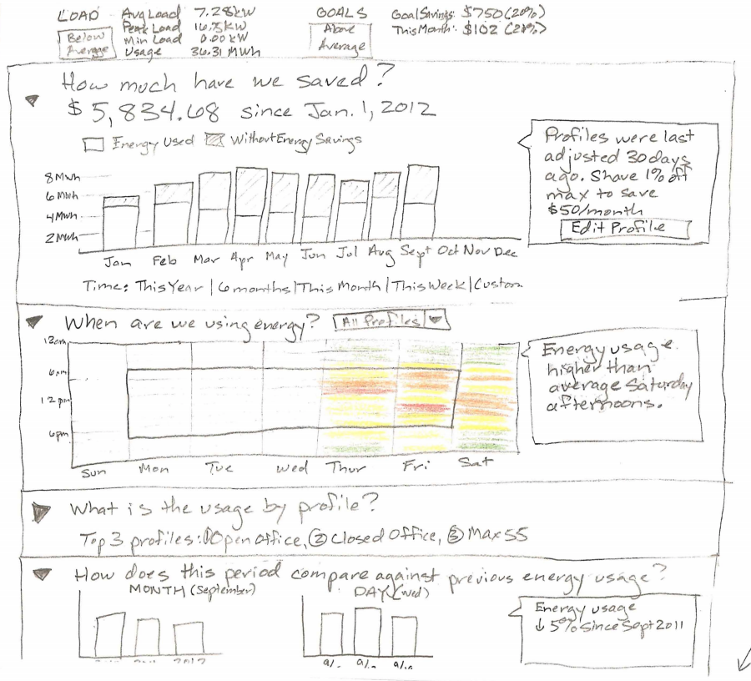
Concepts: Preliminary sketches

Slide 9
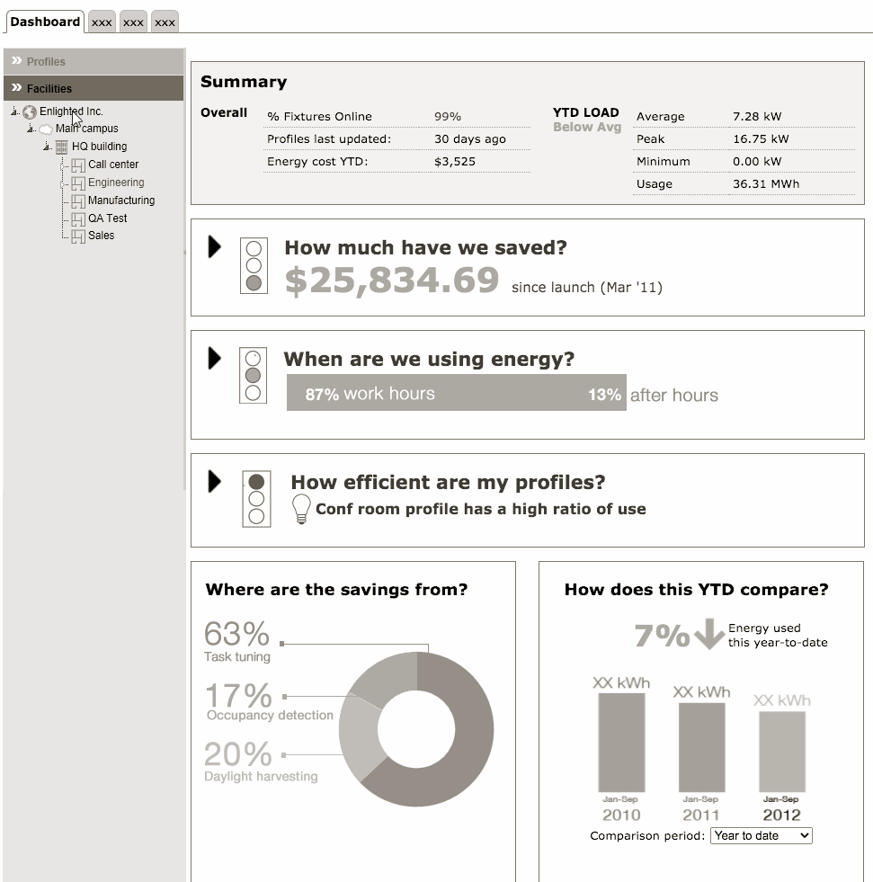
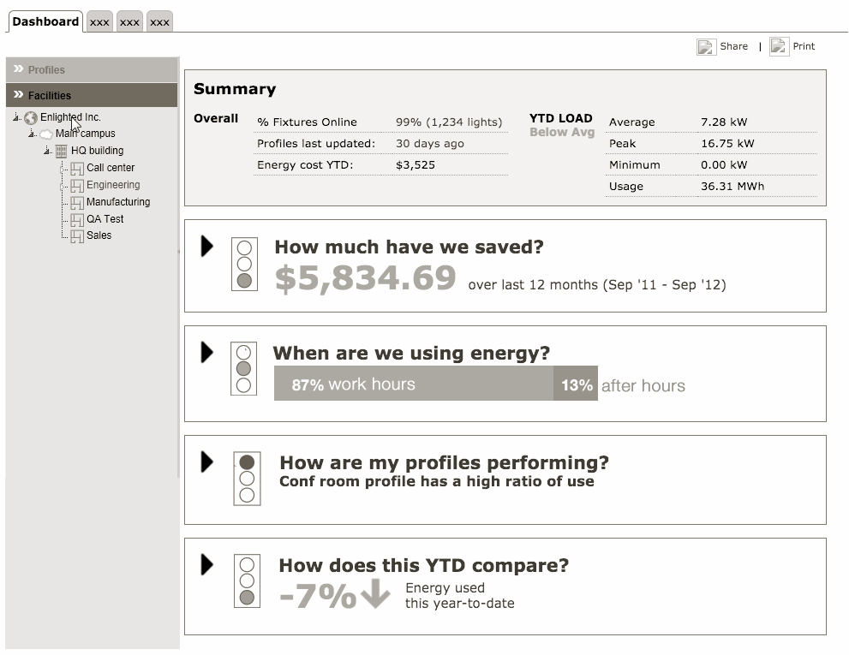
Prototype

Slide 10
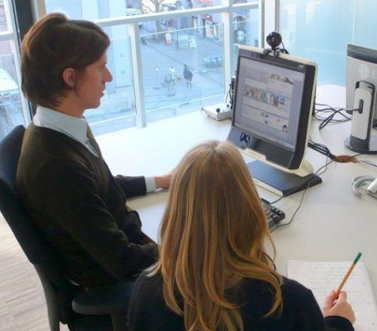
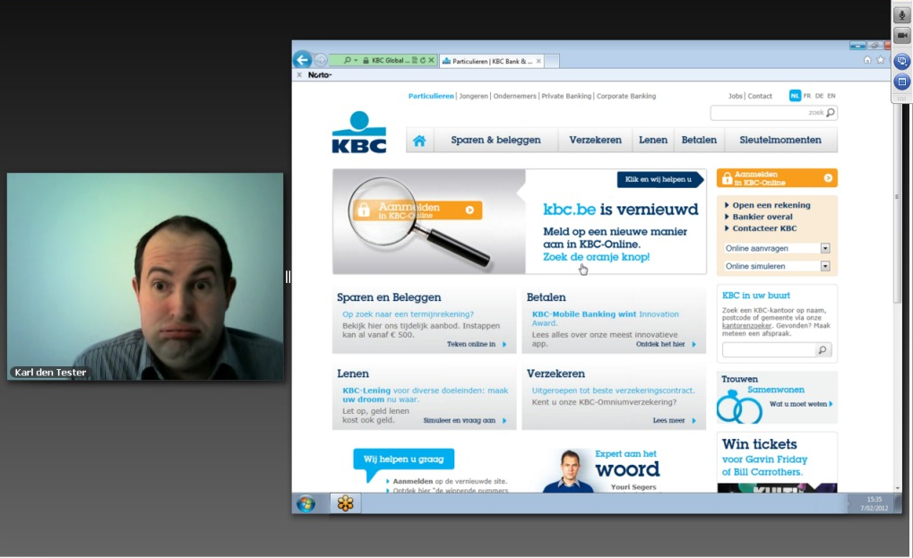
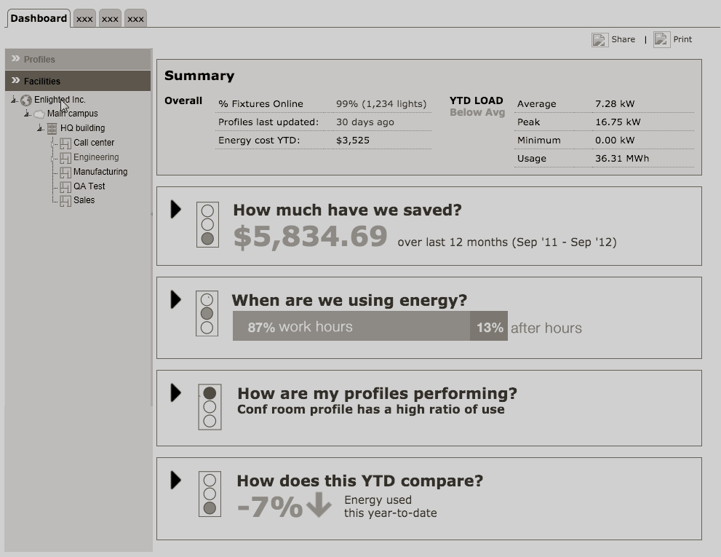
Observe

Slide 12
Questions

Slide 13
Questions for MBARI
Which users should we focus on?
What workflows and tasks are most important to support?
What situations are most important to solve for?
What are key design goals?

Slide 14
Pre-mortem exercise
I like, I wish, What if

Slide 15
Software walkthrough

