Slide 1


Phase 2 Handoff
MBARI Dash

Slide 2


Agenda
Design evolution
Walkthrough and discussion
Next steps
Notes:
Use sentence case for all slide titles (besides the first slide)
Use Semi Bold about 24pt for any anchoring slides, like this content

Slide 3
Project definition
Overview | Sliced Bread Design worked with MBARI in Phase 1 of this project to create an effective user interface for managing their LRAUV. SBD will continue Phase 2 by building on and creating concept sketches, testing with users, and implementing and maintaining the front-end.
Discovery and definition | Review existing designs, updates from MBARI, create Product Requirements Document.
Design development | Add detail to existing designs from Phase 1. Create additional designs for screens and workflows that weren’t covered in Phase 1.
User testing and design refinement | 2 rounds of user testing, to evaluate updated screens and new designs with 3-4 users each round. Analyze results and make relevant changes to designs.
Timeframe | 8-10 weeks for design phase

Slide 4
Design evolution

Slide 5
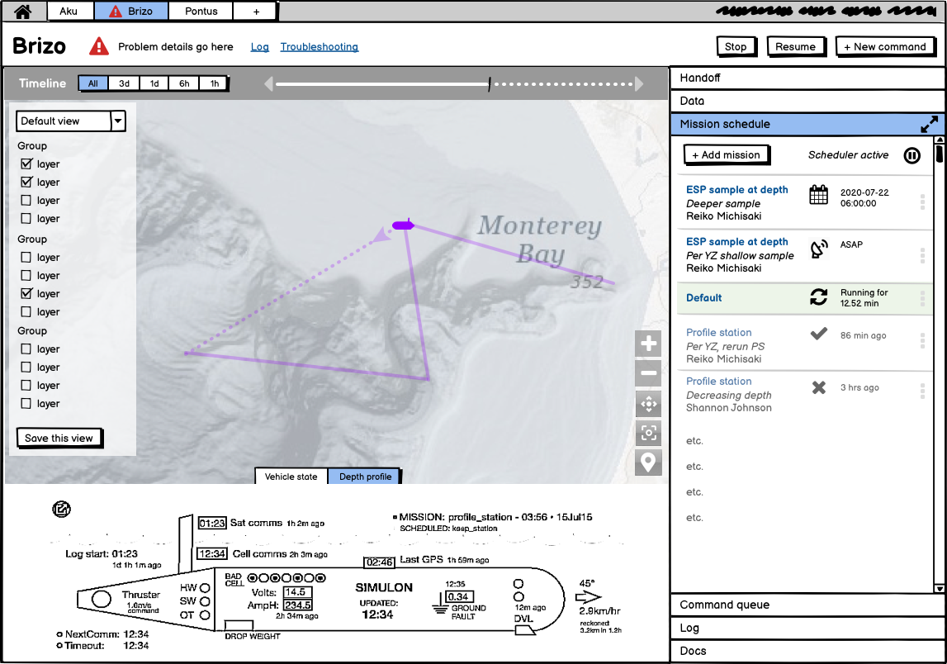
Timeline
MBARI concepts deck

Slide 6
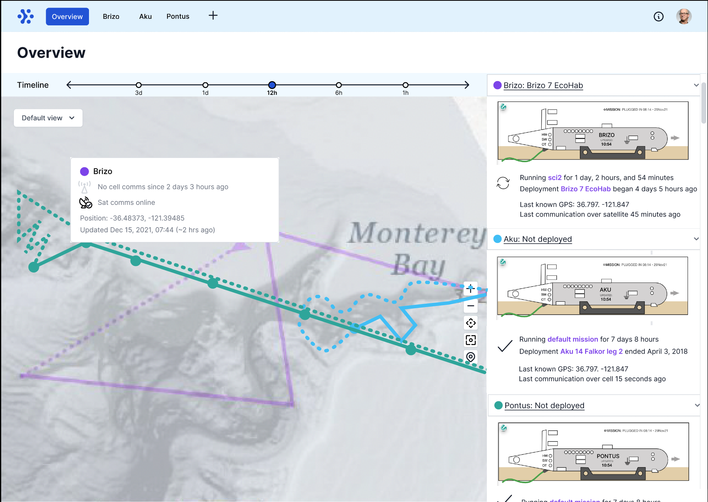
Round 1 user feedback
On call/on watch is usually global vs. LRAUV-specific
Packets of transferring data isn’t that useful to see
Calling out consistent safety and comms parameters would be helpful
Recently used missions and commands are what people want to see first
Getting estimates for depth along a projected route would be helpful in setting other parameters
Stopping the scheduler is not the same as stopping the LRAUV
Having to build a command is still intimidating
Round 1 designs · Clickable prototype

Slide 7
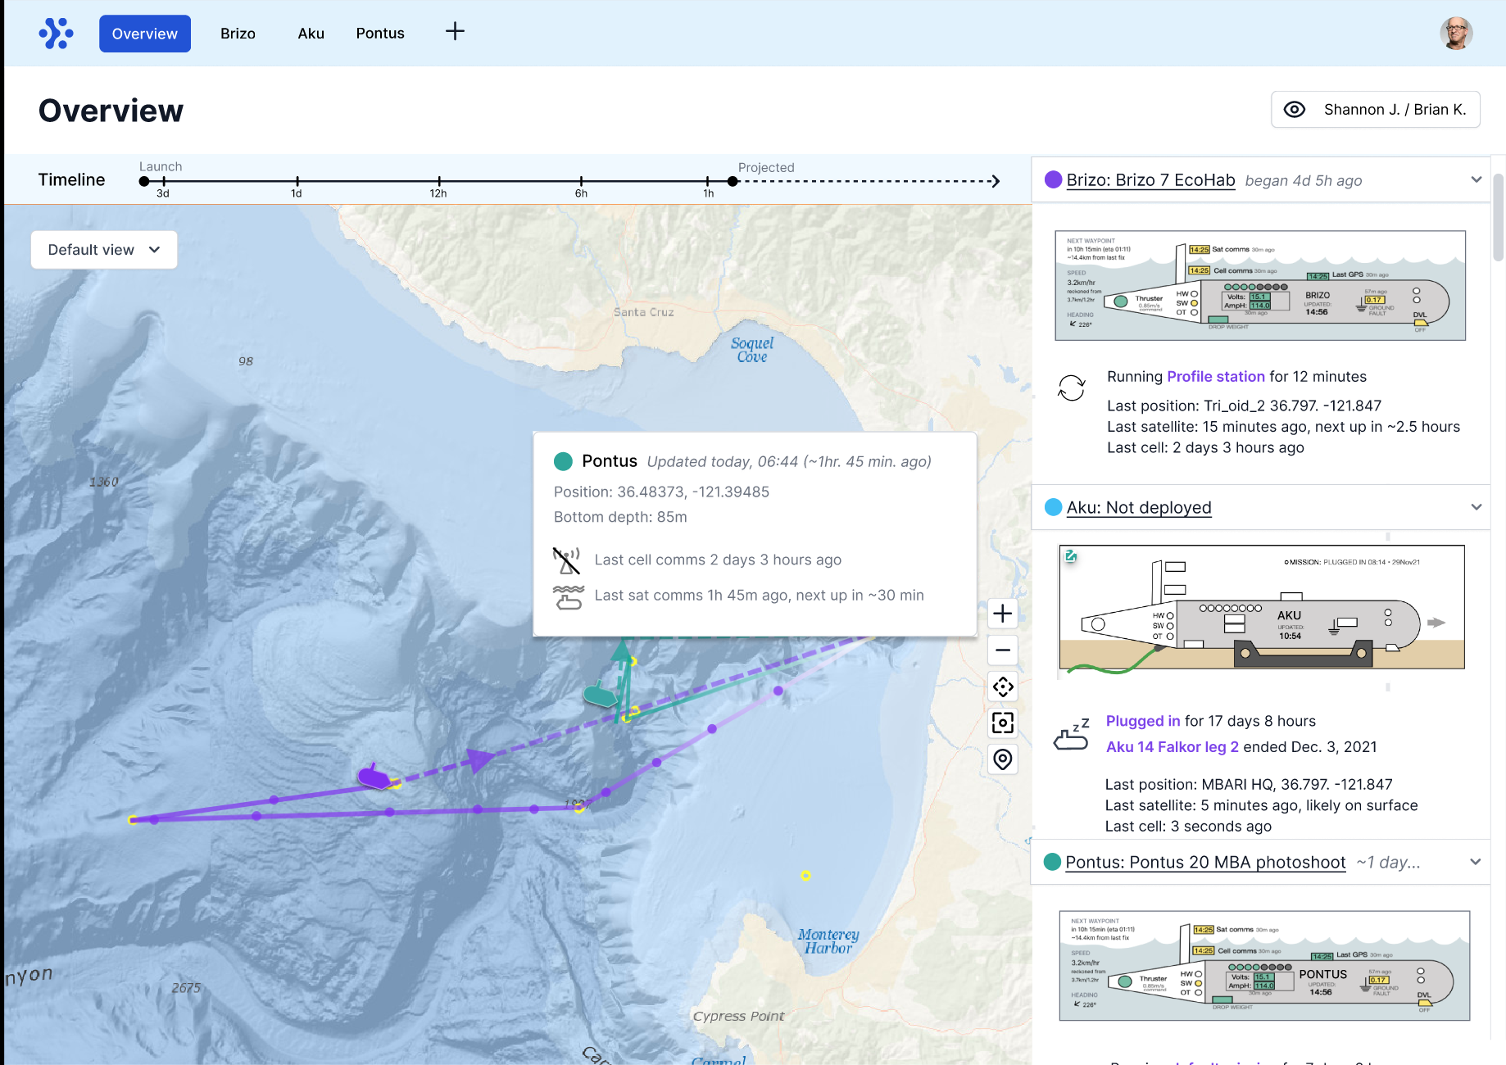
Timeline
Round 2 user feedback
“Mission schedule” does not actually exist
Deployment timings are set in the moment, rather than after the fact
Schedule layout still confusing in terms of current/future/past
Sat/cell/surface indicators confusing and don’t “pop” enough - they really want to know when cell is available
Can’t review mission details when it’s stuck in comms queue but not yet scheduled
Depth estimates while planning a mission are great; maybe they should be more prominent
Round 2 → Final designs · Prototype

Slide 8
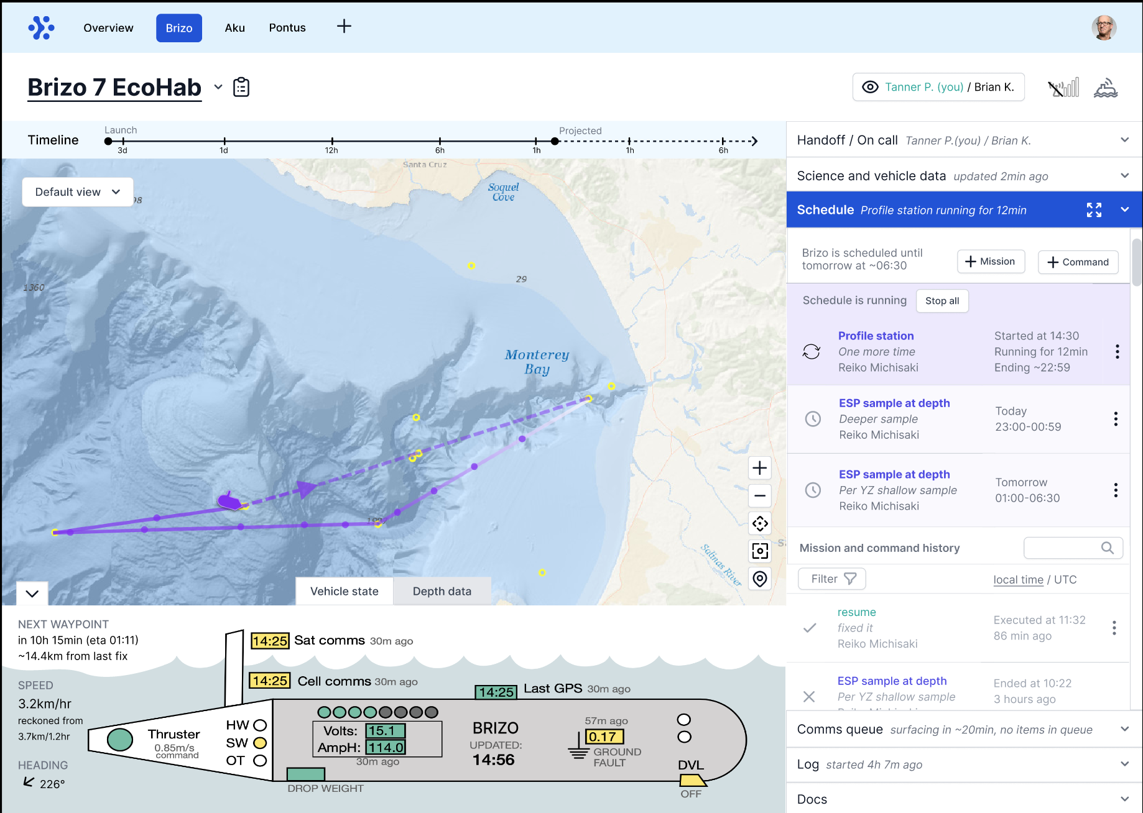
Round 2/Final designs
Clickable prototype

Slide 9

Thanks!
To Brian, Ben, and Steve for answering many questions along the way
To prototype testing volunteers: Tanner, Chris, Monique, John, Bill, Erik, and Jim

Slide 10
Appendix

Slide 11
Project timeline
Nov |  |  |  | Dec |  |  |  | Jan |  |  |  | Feb - May |  |  |  | June - Nov
Background, PRD, visual design
Recruiting round 1
Recruiting round 2
Design round 1
User testing(1)
Design round 2
User testing (2)
User testing (2)
Handoff
Handoff
Progress check-in
Maintenance
Holiday break
1 week

Slide 12
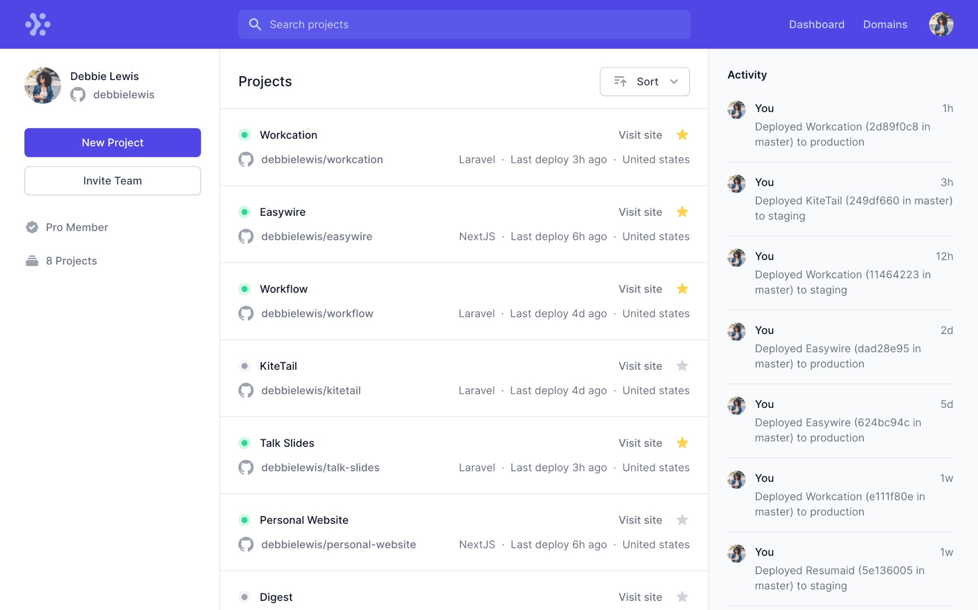
Tailwind UI

Slide 13
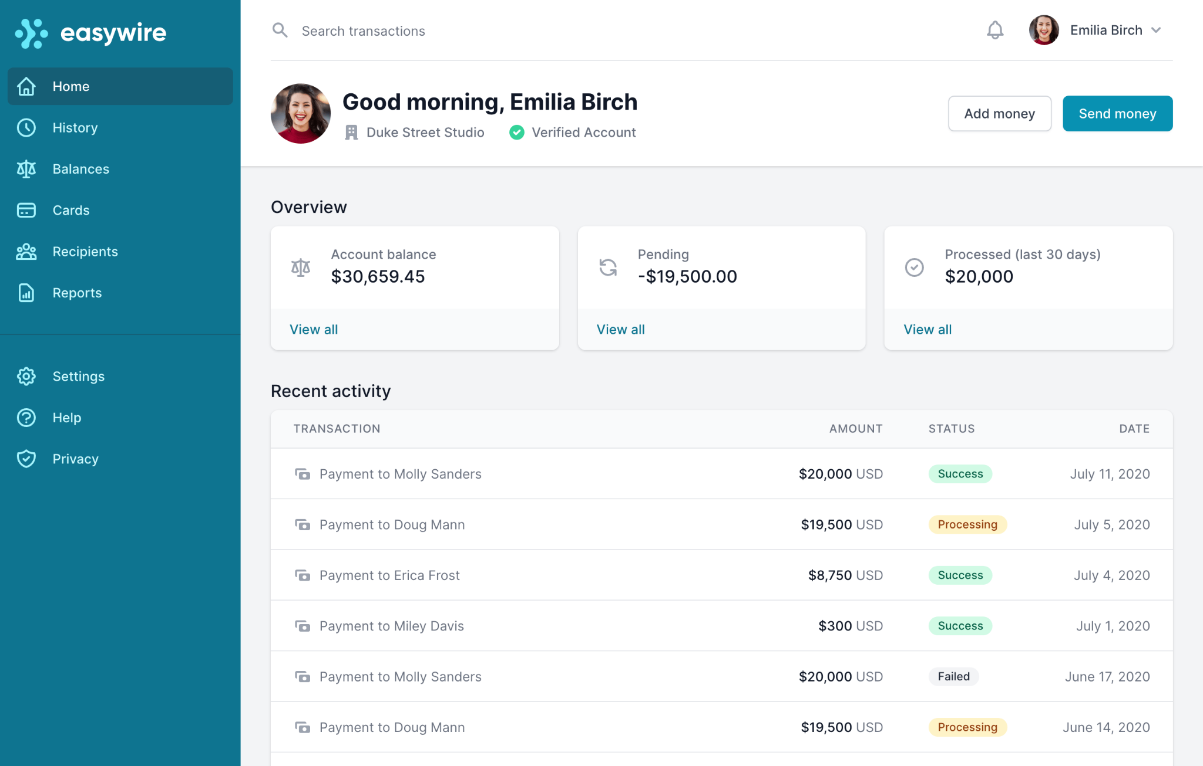
Tailwind UI

