Slide 1
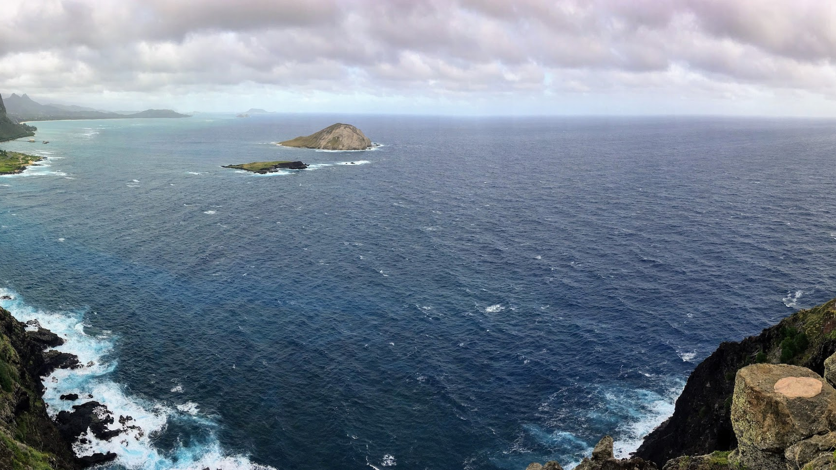


Project Proposal:
User-centered design for
operating autonomous systems
Notes:
Brian starts here at 1:30pm

Slide 2
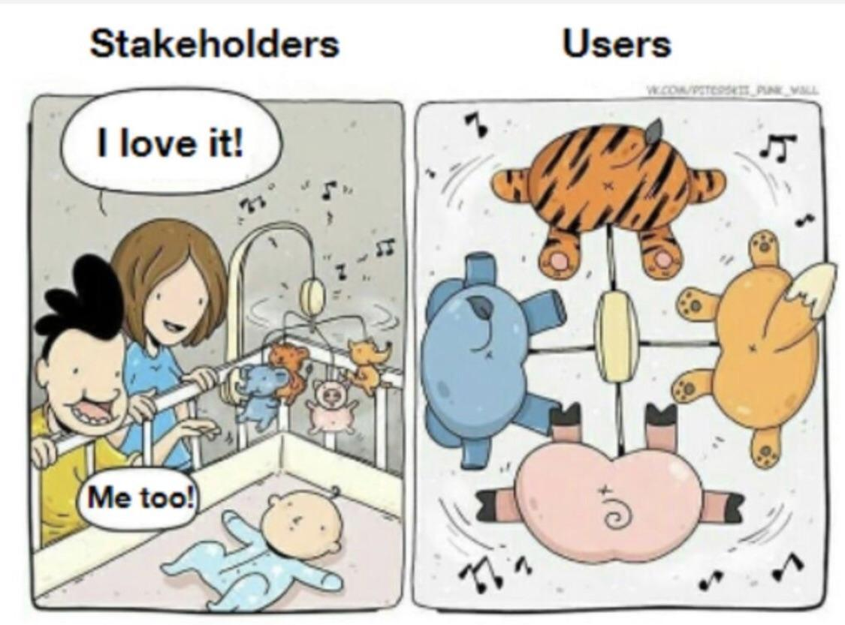
Challenge: Enabling science teams to operate LRAUVs
without distracting them from their work or asking them to be Engineers

Slide 3
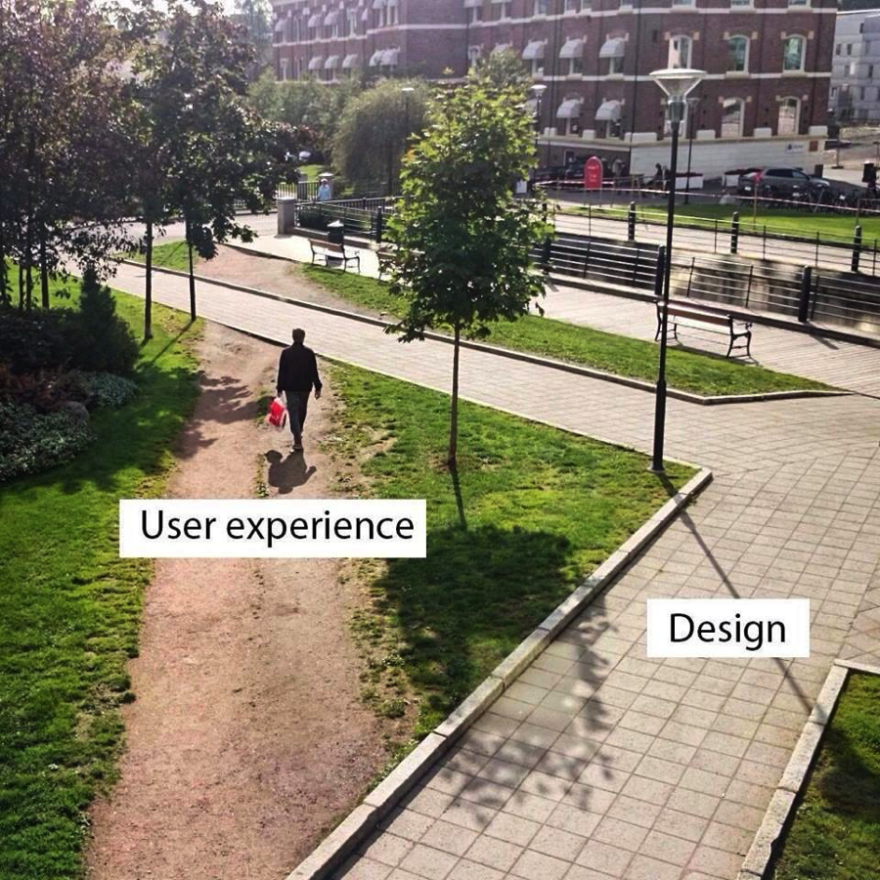
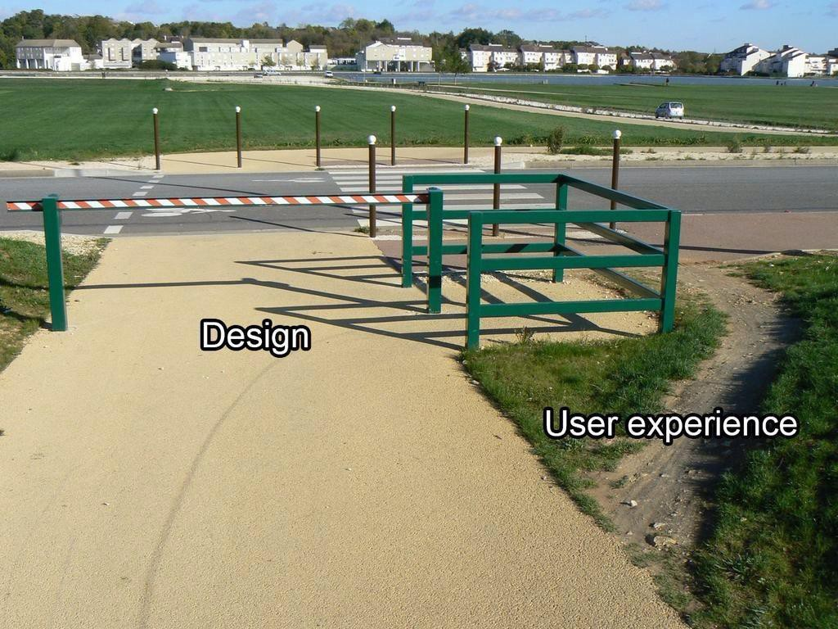
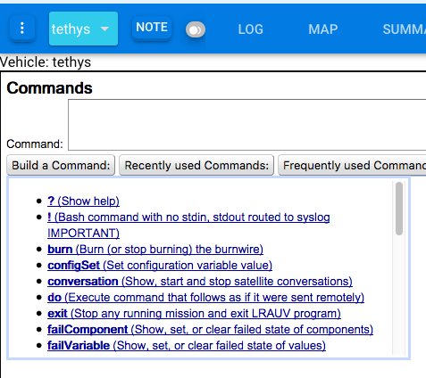
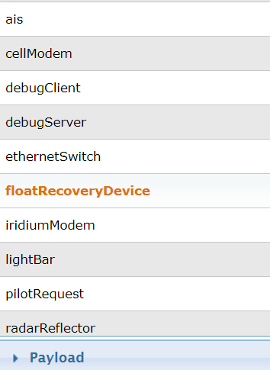
Notes:
Images source: https://medium.com/@VicTheSlowMo/whats-missing-from-that-ux-path-analogy-6cf1c68ea049

Slide 4
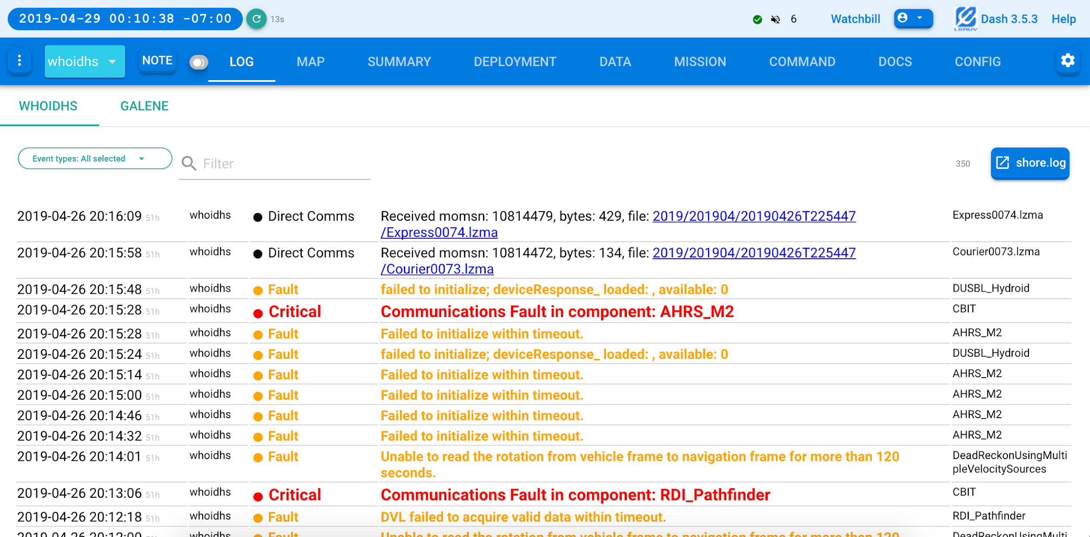
Approach: Learn from end-user teams, using our LRAUVs

Slide 5
Proposal: Improve LRAUV User Interface Tools
by using User Experience (UX) research methods to inform their design
01
Prioritize science teams’ most important use cases
Identify the most critical and most frequent use cases for LRAUV vehicle state monitoring and mission planning amongst science teams
02
Learn from current uses of LRAUVs
Observe and interview science teams, who are using the new LRAUVs and Dash3 so that we can identify strengths, pain points, and opportunities
03
Make design recommendations
Leverage the UX data to conduct an interdisciplinary workshop with Engineering team and a professional designer to pursue new design directions for LRAUV state monitoring and mission planning use cases
Notes:
Leila starts here

Slide 6
User Experience Research
provides insight into more holistically and systematically addressing design issues
?
What do end-users actually do with our systems and UIs?
End-users perceptions and attitudes matter. Their performance and behaviors matter, too.
We study both what people say and what people do in order to understand both.
Which design is better
- this one or that one?
What happens when we can’t make up our minds about which design to use?
We run controlled experiments to see which performs better for our end-users.
?
?
Will this design work for others outside of MBARI?
While we will focus on MBARI scientists and operators as our primary end-users, we can also expand our studies to include broader user groups beyond MBARI, if needed.
How much confidence will we have in our design decisions?
Isn’t it just a matter of subjective taste?
No, we can observe and measure performance, user experience, etc. quantitatively and qualitatively.
?

Slide 7
User Experience Research
uses both exploratory and evaluative hypothesis testing methods to provide data-driven design recommendations
Contextual Inquiry
We begin with studying the end-user (science and operations team members), observing their use of the systems and interviewing them about their experiences
User Studies
When there are difficult design decisions to make, we can run controlled psychology-style experiments to test performance differences between different versions of the UI
Surveys
When we need to check our hypotheses with broader populations of end-users (e.g., scientists at other institutions), we design and run online studies and/or surveys with broader samples
Quantitative Data Analysis
When possible, we run statistical analyses of quantitative data so that we can test our hypotheses with the rigor of full psychology experiments (e.g., NASA TLX)

Slide 8
Timeline: Proposed One-Year Study
An initial exploration of adopting user experience (UX) research methods for AUV user interfaces
Conduct observations and interviews with MBARI science teams, who use LRAUVs such as Tethys
2 mo
Conduct design workshop with MBARI Engineering team, using the data from observing science teams
5 mo
Contextual Inquiry
Analyze Data
Conduct Design Workshop
Produce UI Design Recommendations
4 mo
Analyze the qualitative data from contextual inquiry with science teams
1 mo
Iteratively design, user test, and improve upon the design of the top three most critical use cases for monitoring LRAUV state and mission planning

Slide 9
Deliverables
will be produced through each of the four phases of this project
Deliverable 1:
Raw Data Sets
Deliverable 3:
Design Ideas
Contextual Inquiry
Analyze Data
Conduct Design Workshop
Produce UI Design Recommendations
Deliverable 2:
Prioritized User Needs
and Issues
Deliverable 4:
Low Fidelity UI Design Storyboards and Prototypes
Notes:
TRR

Slide 10
Estimated Costs and Benefits
Science and Ops Team Time
Becoming User-Centered
Up to 8 hours of interview and user study time with each of the science and operation team members, who are willing to participate in this study
By adopting UX research methods, this project will capture and prioritize the perspectives and mental models of science and operations teams to form design priorities and guide user interface development
Engineering Team Time
Holistic Design
Monthly 1-hour project meetings with UCSC team and participation in a 1-day ideation workshop
Rather than play whack-a-mole with fix-it tickets, we will work toward more holistic design changes to make LRAUV operations more user-friendly
Money
Smoother, Efficient LRAUV Missions
Up to $18K to support a freelance designer to sketch storyboards and low fidelity prototype
for user feedback and engineering design review
Overall, we aim to decrease the cognitive load for science and operations teams and to decrease the total time spent using the LRAUV user interfaces so that scientists can focus on doing science

Slide 11

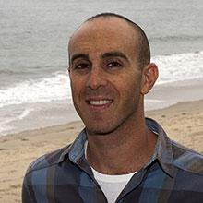
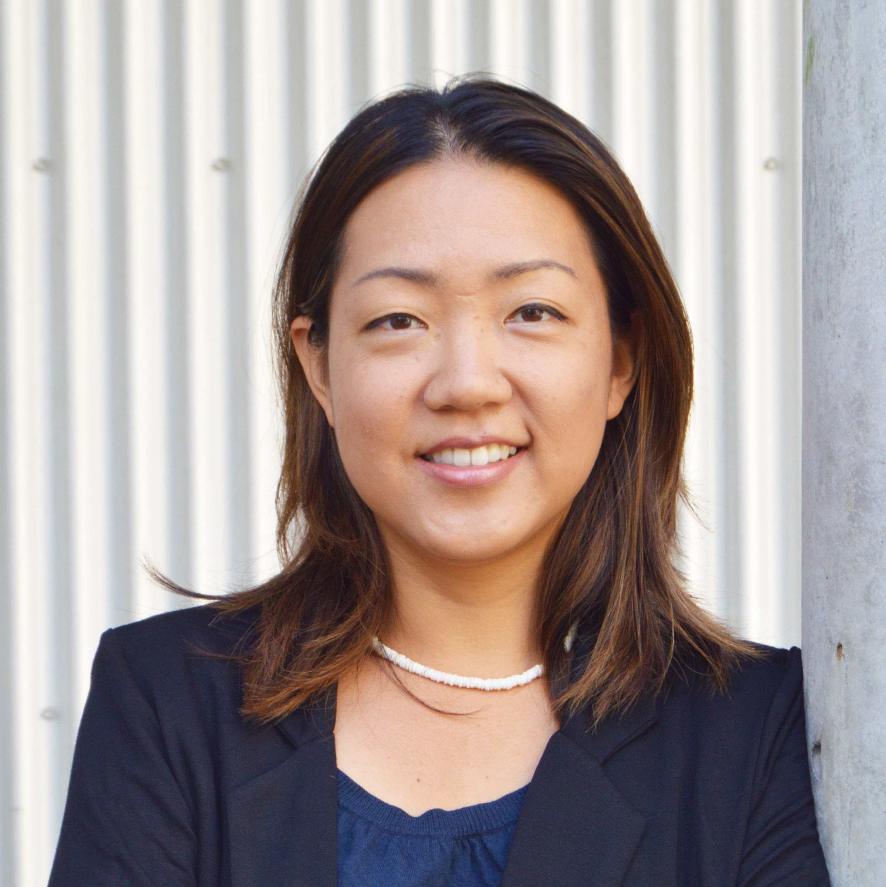
LRAUV UX Research Project Team
1 UCSC PhD student for 10 weeks of research (1 quarter)
Brian Kieft
MBARI
Ben Yair Raanan
MBARI
Leila Takayama
UC Santa Cruz
+ Technical University Munich (TUM) Fellow with paid support for
3 years of a PhD student to develop multi-AUV user interfaces
PI and Project Manager
LRAUV Engineering Team
Lead Engineer
LRAUV Engineering Team
Associate Professor of Computational Media
Human-Robot Interaction
Notes:
Mention labor for engineering teams

Slide 12
This is just the beginning
This initial study can be used to develop our expertise in UX research methods
to improve MBARI’s science, operations, and engineering effectiveness
2019
Year 1
Vehicle state and mission planning UI design study with LRAUVs
Year 2
2020
Develop prototype of new vehicle state and mission planning UIs for use with LRAUVs
2021
Year 3
User test and iterate upon the design of the vehicle state and mission planning UIs for LRAUVs
Year 4
2022
Improve the data collection planning and process for scientists using LRAUVs
2023
Years 5+
Extend the vehicle state, mission planning, and data collection design to include other vehicles, e.g., gliders
Extend the UIs for multi-vehicle coordination across heterogeneous fleets of AUVs and gliders
Notes:
Brian starts here

Slide 13
Mahalo

