Slide 1
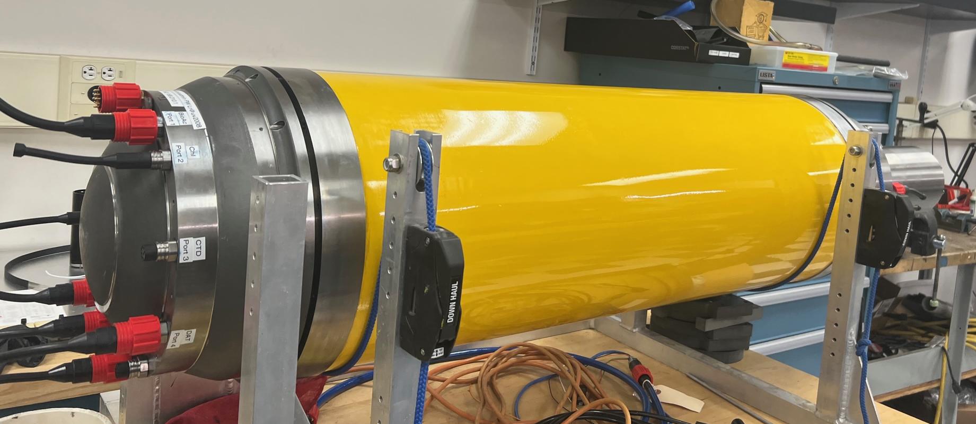
Mesopelagic LRAUV
2024 Proposal Abstract #902010
Presentation Outline:
Project Goals
Current State
Proposed Timeline
Resource Estimate
Core LRAUV Development Team: Brett Hobson, Brian Kieft, Quinn Shemet
Notes:
I’d like to start my talk today with the title. For robots to operate in the open ocean, they must have a long range to get there be very reliable so they get back with endurance of weeks to months, at least. To study Ecology, these robots need be equiped to observe the entire ecosystem: from microbes to whales. Historically, ocean scientists worked in the open ocean aboard large research vessels, for a week or two, once a year or so. The ship may have gone back out there with a different crew of scientists with a different set of questions and tools and only rarely was there an expedition to try to observe a complete ecosystem over timescales relevant to those ecosystems. My colleagues and I at MBARI, with funding from the Packard Foundation, are trying to develop new technology to make it much easier to observe open ocean ecosystems.
In my presentation today I’m going to start with an introduction to the open ocean environment to hopefully show why an improved understanding of this massive environment is vitally important to us all. From there, I’m going to review some of the tools ocean scientists use to study the ecology and then get to the topic I’m most familiar with: The development of platforms to carry these tools. I’ll then present a case study experiment we performed and end with our development plans for the future.

Slide 2
Project Goals
Extend the operational depth envelope of the LRAUV from 300 to 1500 meters.
  This is important because many animals migrate and live below 300m
  300-1500m is an important zone to study carbon export to the seafloor
  Bioacoustics, Chiton and Planktivore are ready to go
Enables persistent operation using AUV-Docking from the MARS cabled observatory
Enables the exploration of Sur Ridge and other deep reefs

Slide 3
Current State
Significantly behind schedule
  Defective hull tubes – 1 of 3 is usable
  Defective titanium end-bell casting – were able to use
  PI has been distracted, LE is overloaded and out of the office, MT/AE is over subscribed
Finally ready for pressure testing
  Only have one hull, so no failure testing
  Fully instrumented with strain gauges and DAQ
  Fill with golf balls and carefully monitor strain – abort test if abnormal
  Jon, Aaron and possibly Brett will take the hull down to the Navy facility at Point Hueneme within a few weeks
“Cross-deck” components after pressure test, though not everything is ready

Slide 4
Revised Timeline
  3rd qtr ‘23
  4th qtr ‘23
  1st qtr ‘24
  2nd qtr ‘24
  3rd qtr ‘24
  4th qtr ‘24
Pressure Test
Machine shop parts
Welding
Build Sub-assemblys
Design and build DVL housing
Final Assembly
Fabricated new flow hull shells
Integration and testing
Offshore Testing

Slide 5
2024 Resource Estimate
A significant cost over run for the titanium endbells drained 2022 expense budget and we only requested $2500 for 2023
Will be requesting discretionary funds
  Pressure test ~ $5k
  Flow hull shells – ~$10k
  Externally printed parts (better material)
  Raw material for the machine shop. ~$2k
Optional expenses this year or next year
  $10k for a new propeller
  $20k for full titanium upgrade – required before long missions at MARS
400 hours of shared engineering (Jon, Aaron, and 200 hours of MT/ET.

