Slide 1
902101 LRAUV Technology Development and Fleet Operations
What’s the fundamental problem, question, or issue you are addressing?
- This is a project to extend the depth rating of one of MBARI’s LRAUVs from 300 to 1500 meters to gain access to the poorly studied Mesopelagic zone.
Why is it important/why should anyone care?
-There are uncertainties in rates of carbon sequestration in the deep ocean that have profound effects on our understanding of the global carbon cycle. Understanding the variability of carbon transport through the Mesopelagic zone is a critical component in the models used to predict how much carbon the ocean can absorb.
-

Slide 2
What are we doing about it/what’s MBARI’s unique contribution?
- The new Mesopelagic LRAUV with the AyeRIS imaging system aims to accurately measure the distribution and rates of carbon sinking through the mesopelagic zone. A bio-acoustic imaging system is also being developed image the water column hundreds of meters above and below the vehicle to characterize zooplankton and fish distribution.
What are your project plans for next year (2023)?
- During 2023 we plan to complete the construction and begin testing the new 1500m depth rated LRAUV we’ve named Opah.

Slide 3
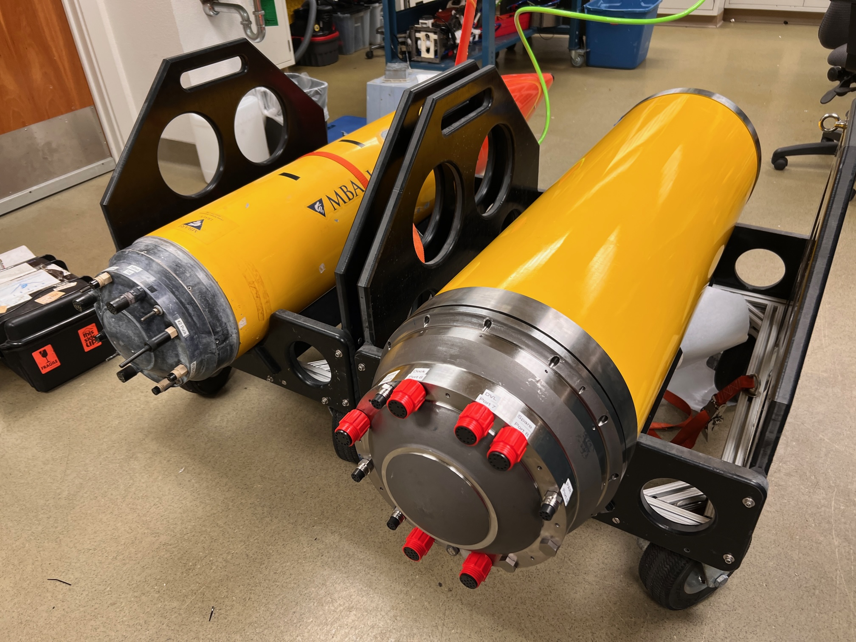
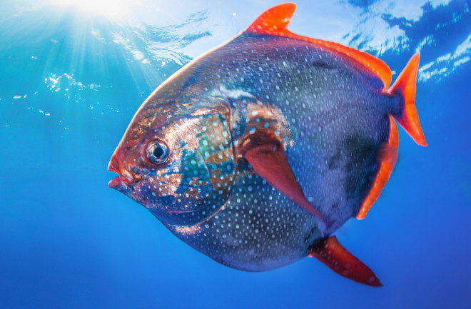
902101 LRAUV Technology Development and Fleet Operations
Notes:
Figure 1: The original LRAUV Tethys next to her new 1500 meter depth rated sister named Opah
Figure 2: Image of Opah fish, a beautiful mesopelagic explorer.

