Slide 1
Directions
Answer the questions on the following slides with this guidance:
limit text to bullets that are easy to read (i.e., use large font)
be concise
assume you're audience is the "informed general public”
Additional details can be added in the notes section, if needed.

Slide 2
9021010 Mesopelagic LRAUV
What’s the fundamental problem, question, or issue you are addressing?
- Extend the autonomous ocean observing capability of MBARI’s LRAUVs down into the mesopelagic zone.
Why is it important/why should anyone care?
The re-mineralization zone between 200 and 1000 meters deep is an important part of the biological carbon pump. A 1500m depth rated LRAUV, along with the Chiton 3D plankton imaging system will allow direct observation of sinking detritus in and below the remineralization zone. These data are necessary to accurately estimate carbon export to the seafloor, which is vital for future climate models.

Slide 3
What are we doing about it/what’s MBARI’s unique contribution?
-We have designed, built and now tested a pressure hull upgrade for MBARI’s LRAUVs. During 2024 we will begin offshore testing of the new 1500 meter depth rated Mesopelagic LRAUV.
What are your project plans for next year (2024)?
-Finish construction and field test the Mesopelagic LRAUV

Slide 4
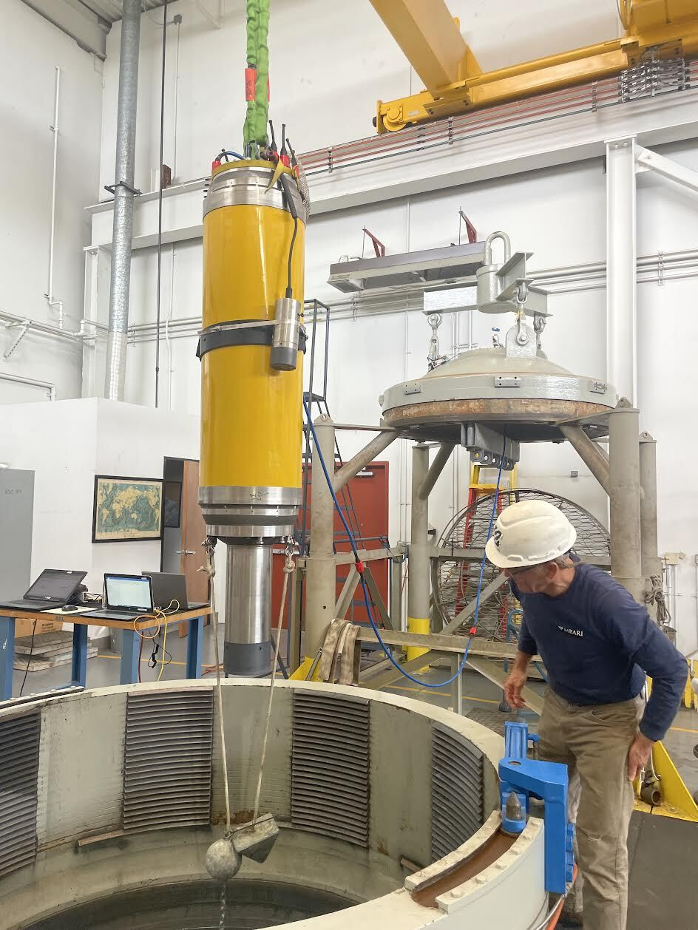
902010 Mesopelegic LRAUV
Mesopelagic LRAUV being lowered into one of the Navy’s high pressure test chambers. Special ballasting and acoustic range measurements allowed direct measurement of pressure related buoyancy changes.

