Slide 1
902101 LRAUV Development
What’s the fundamental problem, question, or issue you are addressing?
Extend the autonomous ocean observing capability of MBARI’s LRAUVs down into the mesopelagic zone.
Why is it important/why should anyone care?
The re-mineralization zone between 200 and 1000 meters deep is an important part of the biological carbon pump. A 1500m depth rated LRAUV, along with the Chiton 3D plankton imaging system will allow direct observation of sinking detritus in and below the re-mineralization zone. These data are necessary to accurately estimate carbon export to the seafloor, which is vital for future climate models.

Slide 2
902101 LRAUV Development
What are we doing about it/what’s MBARI’s unique contribution?
-MBARI has developed their LRAUV and continues to refine the system and develop new payloads that extend the observational capabilities to new realms of ocean science.
What are your project plans for next year (2025)?
- Continue to improve the AUV docking station to support science operations with the Chiton Camera and eDNA sampler.
- Begin ocean testing of the new LRAUV hovering module.
- Add Passive Acoustic Monitoring (PAM) capabilities
- Support the technology export to Saab

Slide 3
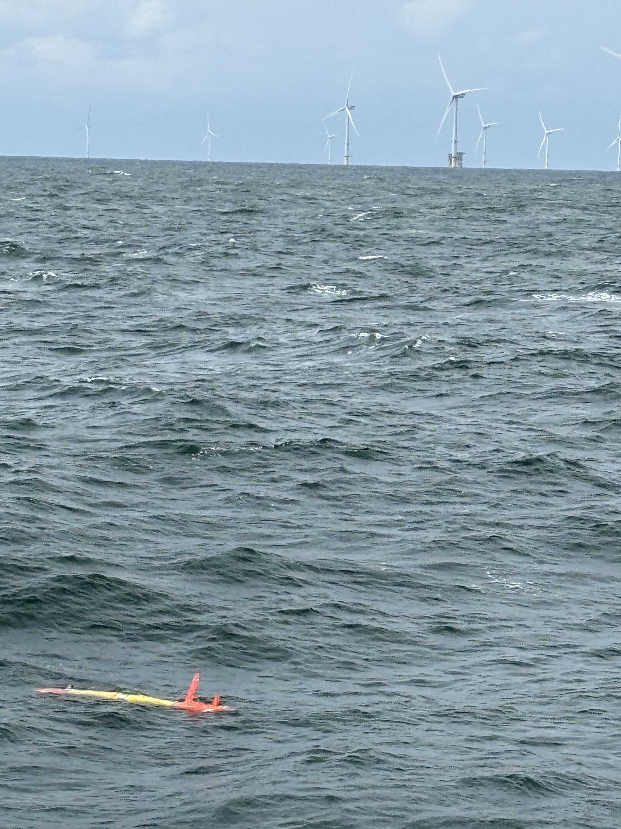
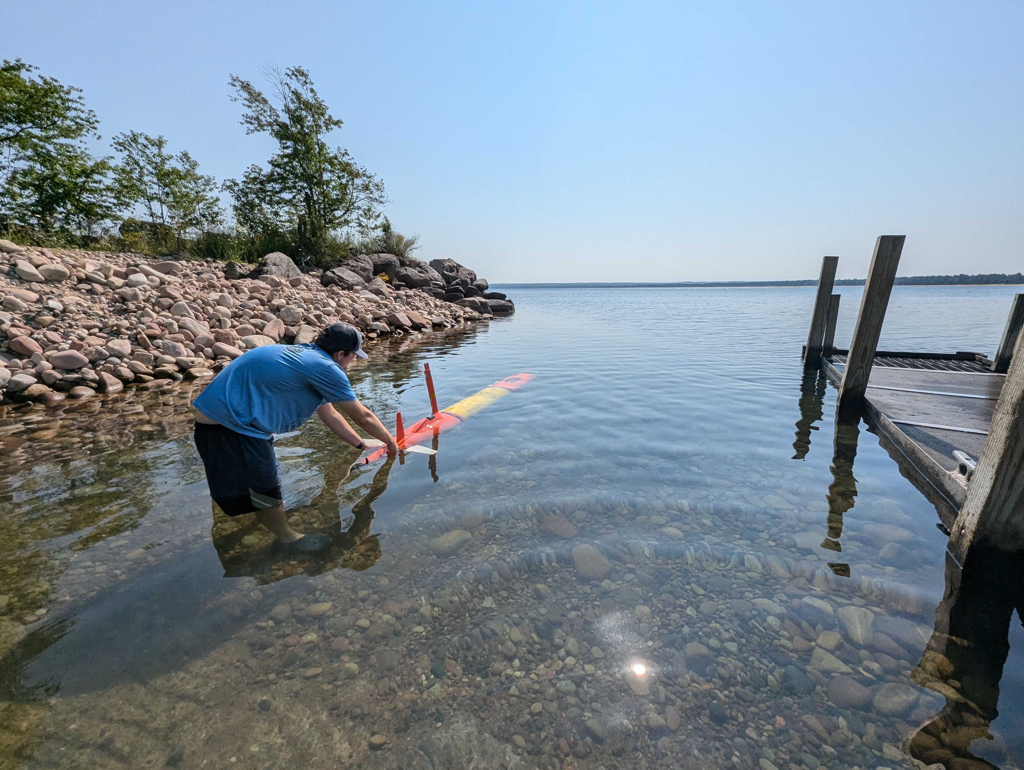
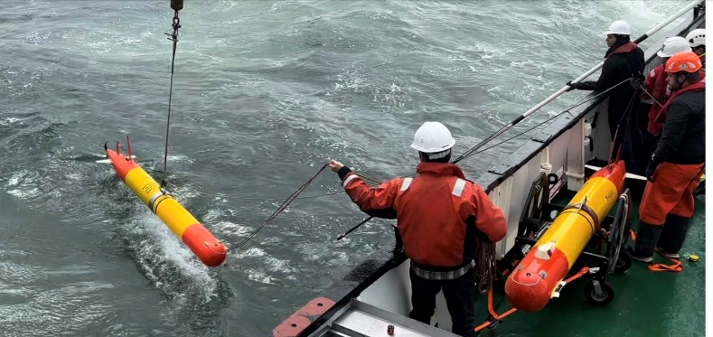
Insert name of project here (e.g. – 901023 Continental Margins)
Please add one or two images or a simple graph here or insert into the previous slide.
Restrictive government oversight of Un-crewed vehicles in Denmark required a large ship to deploy LRAUVs at a offshore wind farm
USGS Technician launching a LRAUV into Lake Huron for a 10 day deployment.

