Slide 1
902010 Mesopelagic LRUUV
What’s the fundamental problem, question, or issue you are addressing?
We are developing a 1500 meter depth rated version of MBARI’s Long Range Autonomous Underwater Vehicle (LRAUV)
This new vehicle will be able to carry a bio-acoustic sonar and the EyeRIS plankton imaging system.

Slide 2
902010 Mesopelagic LRUUV
Why is it important/why should anyone care?
The largest migration on earth occurs every day as animals that hide in the dark depths during the day migrate to the surface to feed at night. We are developing Mesopelagic LRAUV to follow these animals throughout their migration.
The Mesopelagic LRAUV will also be able to measure the amount of sinking detritus, or carbon, exporting from the surface layers to the deep sea using the EyeRIS imaging system.

Slide 3
902010 Mesopelagic LRUUV
What are we doing about it/what’s MBARI’s unique contribution?
This is a project to upgrade an existing LRAUV with a high pressure housing to increase the depth rating from 300 to 1500 meters.
We are leveraging a previous carbon fiber pressure hull development project to build a new hull that maintains neutral buoyancy throughout its depth range.

Slide 4
902010 Mesopelagic LRUUV
What are your project plans for next year (2022)?
Build one 1500m depth rated pressure hull and a few components.
Migrate vehicle systems from an existing LRAUV into this new pressure hull
Perform pressure tests, tank tests and open-water tests

Slide 5
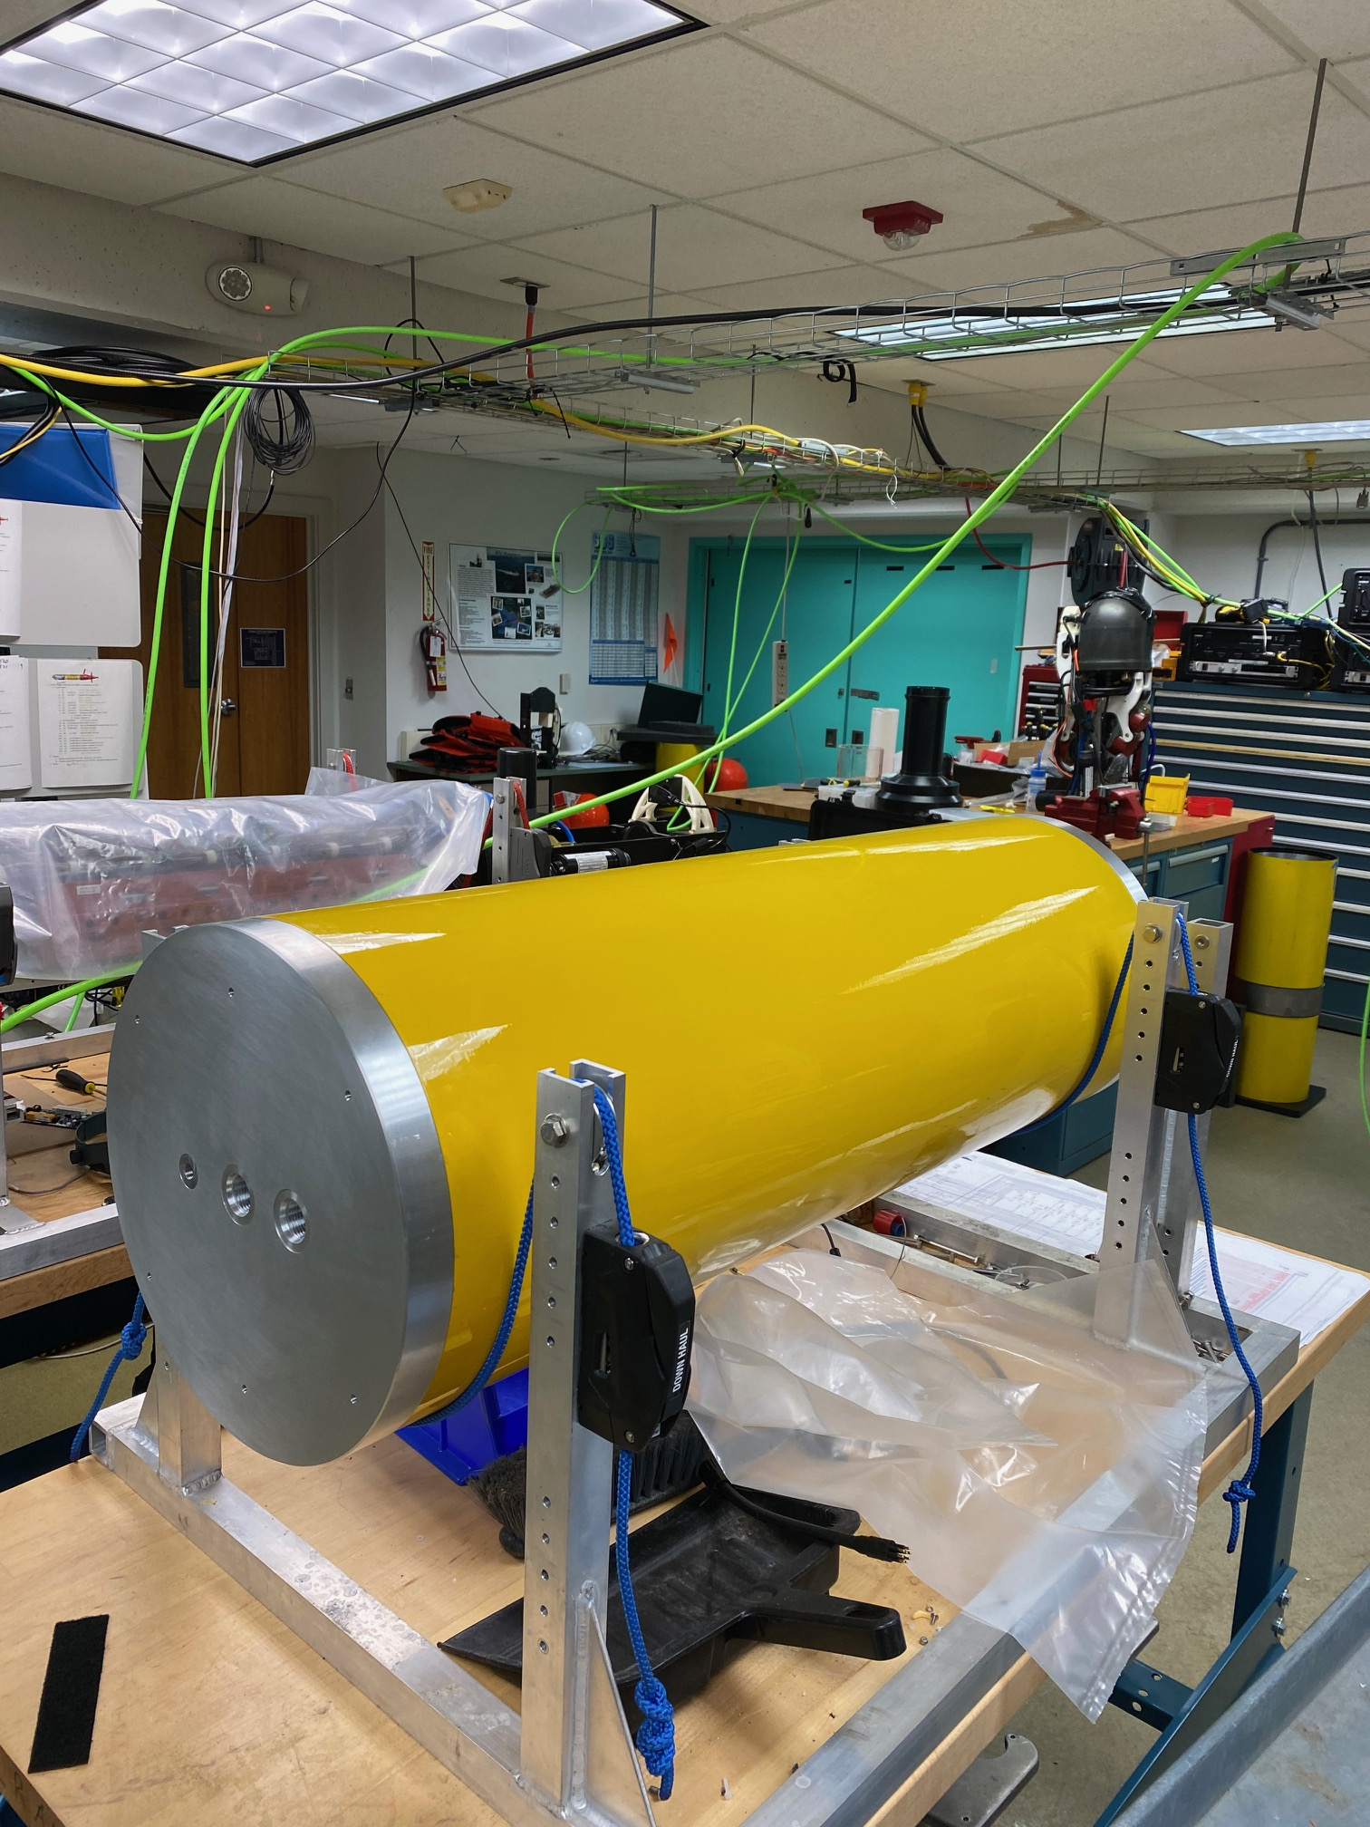
902010 Mesopelagic LRUUV
New 1500 meter rated pressure hull with testing endcaps for the Mesopelagic LRAUV
The outside diameter increased from 30 cm (12”) to 36 cm (14.5”)

