Slide 1
MesoPelagic LRAUV
Investigating the addition of acoustic emission monitoring systems to our current hydrostatic pressure testing

Slide 2
Background Information
Materials
  Epoxy/carbon fiber laminate
    ~55 degree wind angle
    Lamina thickness ~0.01225”
    Wound around a 13” mandrel
    Wall thickness ~0.695”
  Carbon fiber tube with bonded titanium rings and cast titanium end-bells
    This hull will be proof tested
    One hull with this configuration
  Carbon fiber tube with aluminum end-caps
    Hull for cycling and destructive testing
    Two hulls in the configuration

Slide 3
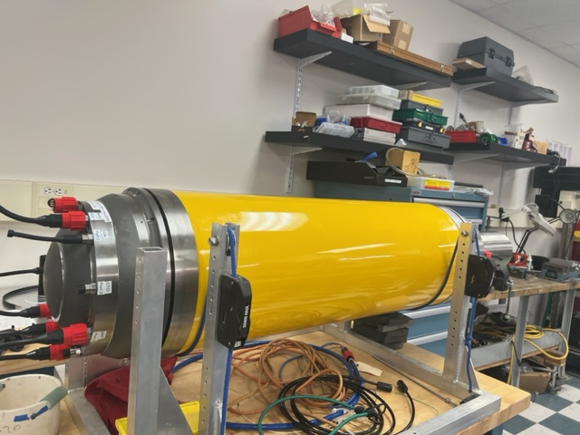
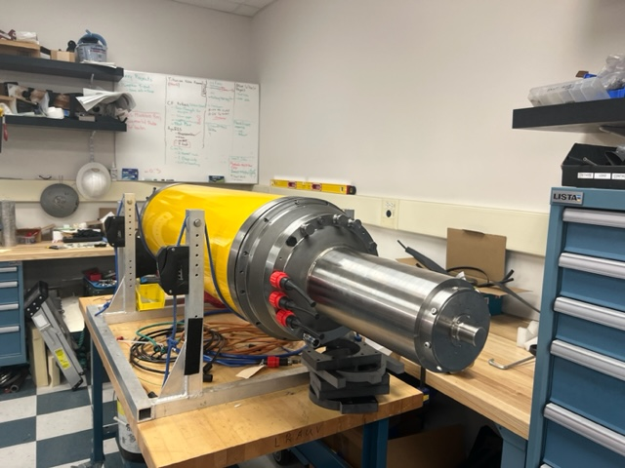
Carbon fiber tube with bonded titanium rings and cast titanium end-bells

Slide 4
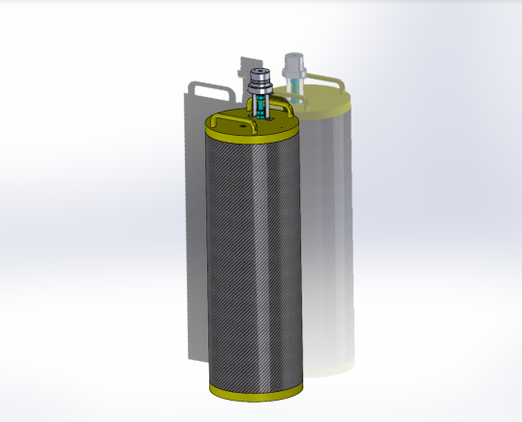
Carbon fiber tube with aluminum end-caps
Hull to be cycle tested and
ultimately pressurized to failure.
Hull will be filled with water to minimize shock wave.

Slide 5
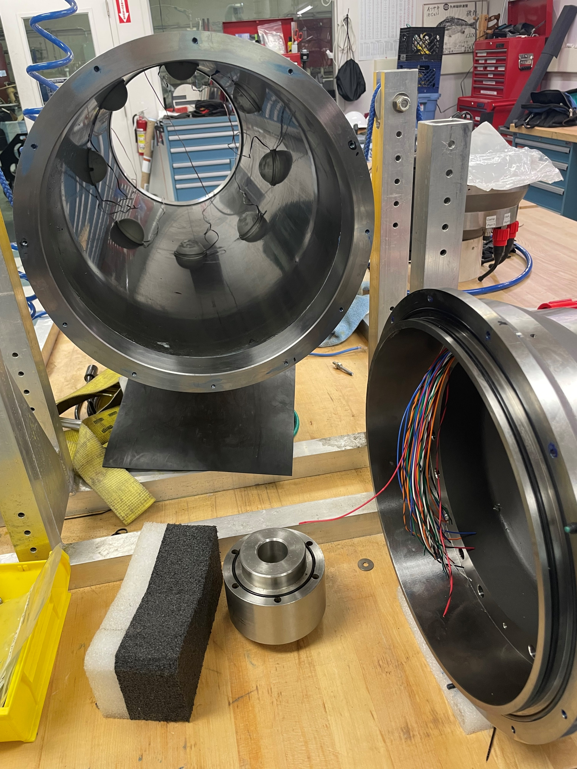
Previous Testing of MesoPelagic LRAUV
Fitted two of the hulls with strain gauges
Pressure tested hull fitted with strain gauges
Monitored strain during the test
Tested hull to 2000 psi

Slide 6
What can we expect out of the AE sensors/equipment?
Determine if the tubes stabilize at working depth after cycling(Will fiber breakage quiet down?)
Check for consistency between tubes/hulls()
Help determine “knockdown” value for the tubes theoretical critical buckling/first ply failure pressure
Determine safety factor for the current CF tube configuration
Types of sensors needed to run the different test procedures(Wet/Dry)
What equipment is needed
Will we get ample warning with the AE system to stop the test and depressurize?
Is AE better than our current testing set up(i.e. Looking for the “knee” or converging values with inverse of strain)
What is this equipment going to cost?

Slide 7
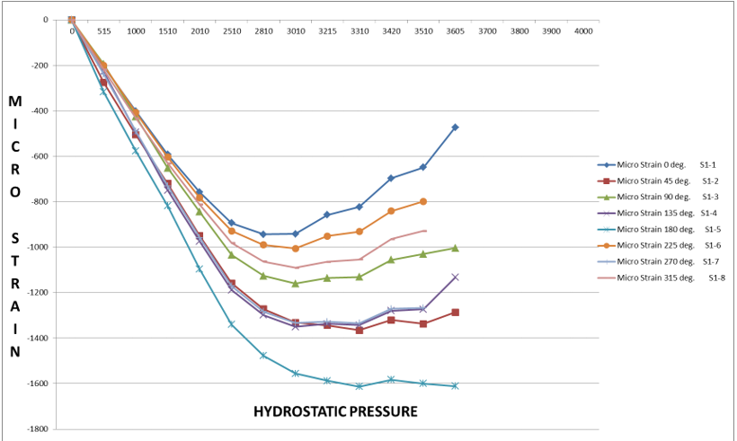
Results from previous strain gauged CF tubes

Slide 8
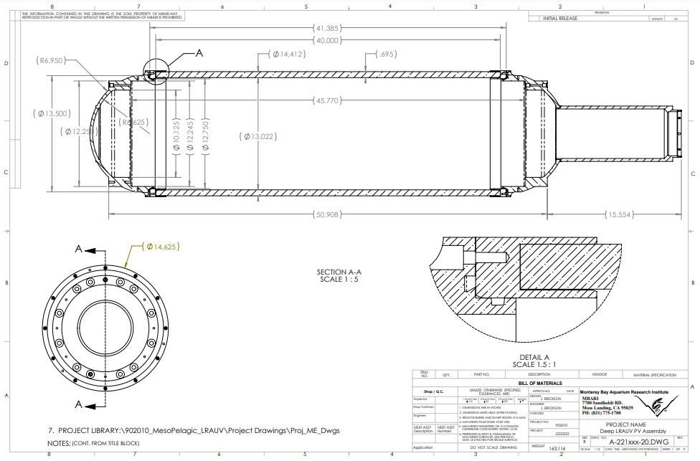
As built hull dimensions

Slide 9
Questions?
What is your experience testing COPV’s
Fatigue Testing with COPV’s
Destructive testing
Recommendations?
Could be a noisy testing environment-will this effect our results?
Bonding Sensors
What adhesive to use?
How many?
Where?

