Slide 1
Project Update 2020
MBARI Telepresence 2020 Rapid Response Revision B

Slide 2
Goals of MBARI Telepresence in 2020
COVID-19 Restrictions reduces labor force at-sea.
Enforces new offshore paradigms for maximum productivity.
Telepresence can enable non-physical contributions.
Opportunity for expanded outreach after 2020.
Resulting System
100% Remotely managed/Maintained solution.
Deployable within 1 month of funding.
Supporting 2 ships simultaneously.
No satellite equipment upgrades allowed.
Fits inside a 4mbps ⬆️ and 1mbps ⬇️ VSAT connection.
Latencies required to support remote ROV science direction.

Slide 3
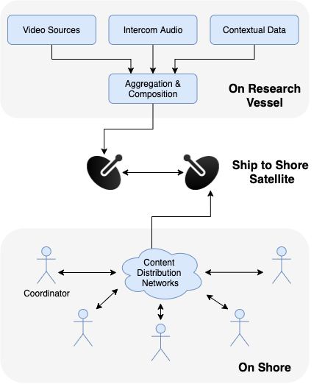
The State of Telepresence Capabilities
Video/Audio are assembled by a broadcaster computer in the ROV control room, leveraging OBS.
Single stream off-vessel, selectable onshore.
Webex Events are the content distribution
Audio is patched from the ship Telex system
  Not always enabled (contact ship science)
Screengrabs are available via web from around the control room.
Notes:
Due to the immediate nature of this problem, we were approved to conduct some experiements on the Western Flyer to prove feasibillity of using existing systems for the requirements we had defined.
We secured an upgraded service plan from the provider, and set about testing a proxy system on the ship.
We were please to find that the system was more than capable of sustaining telepresence activities, with stable connections all day, and tests lasting as long as 30 minutes without any significant dropouts.
Also, we tested a number of services, evaluating quality across 6 users and latencies to each one.

Slide 4
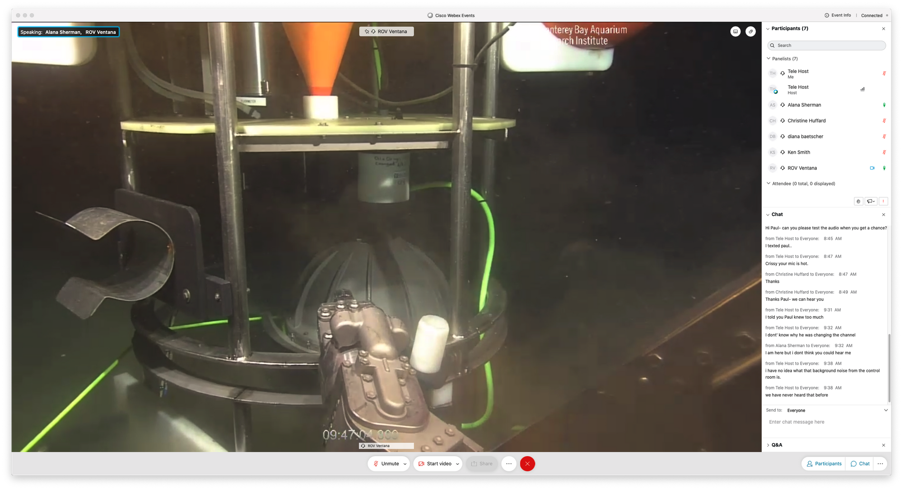
Webex Events
Chosen teleconferencing for reliability and granular participant management. (No Zoom Bombing)
Can split participants between Panelists and Audience Roles.
All participants have to register, links are sent daily for security.
Self-recovering
Low-latency
720p Video, variable bit rate.
MARS observatory servicing of an sediment trap for Ken Smith

Slide 5
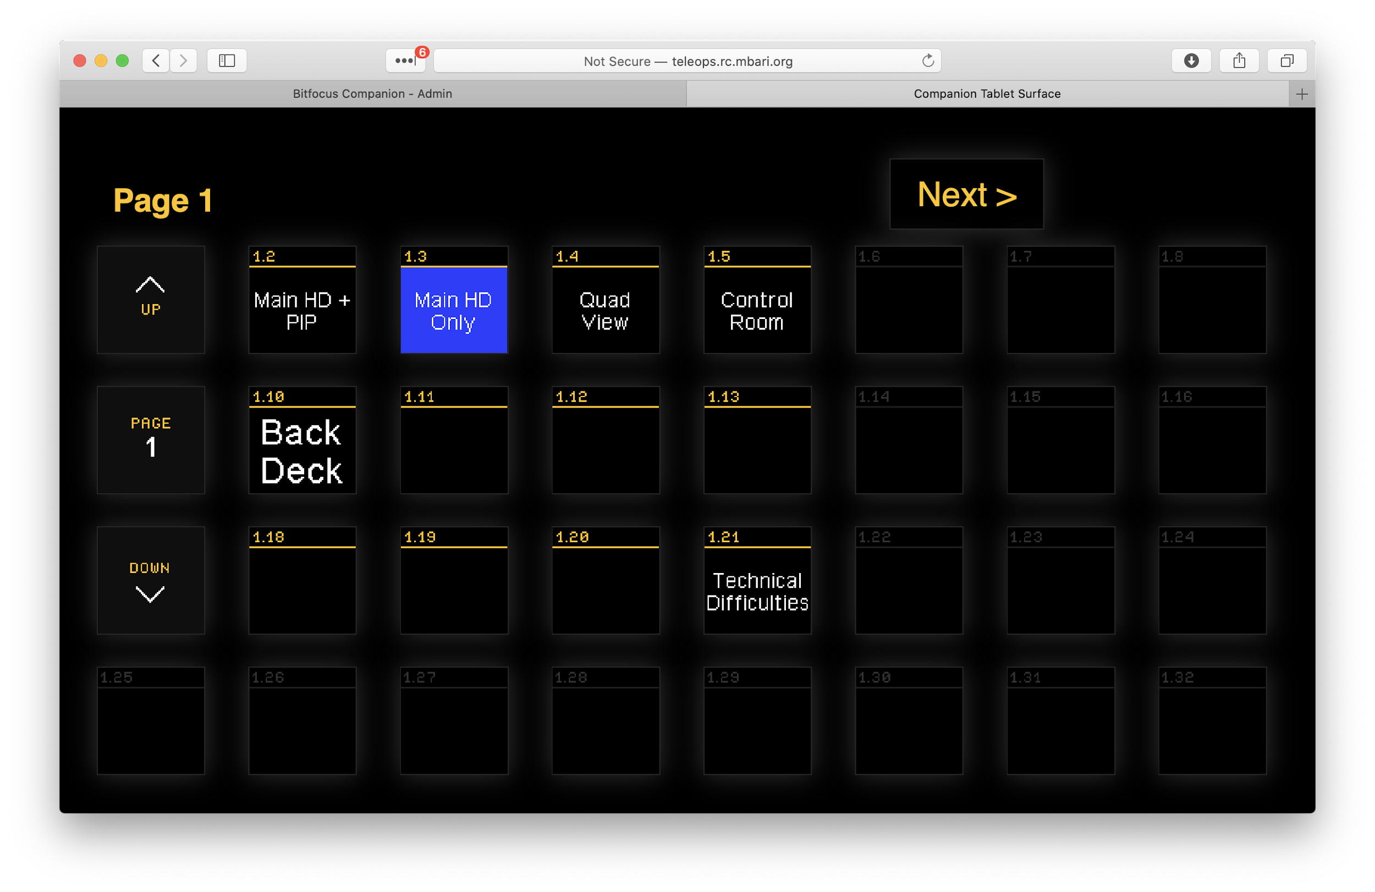
Video Feed Control
Web interface
Mirrors buttons in control room
Changes for all parties

Slide 6
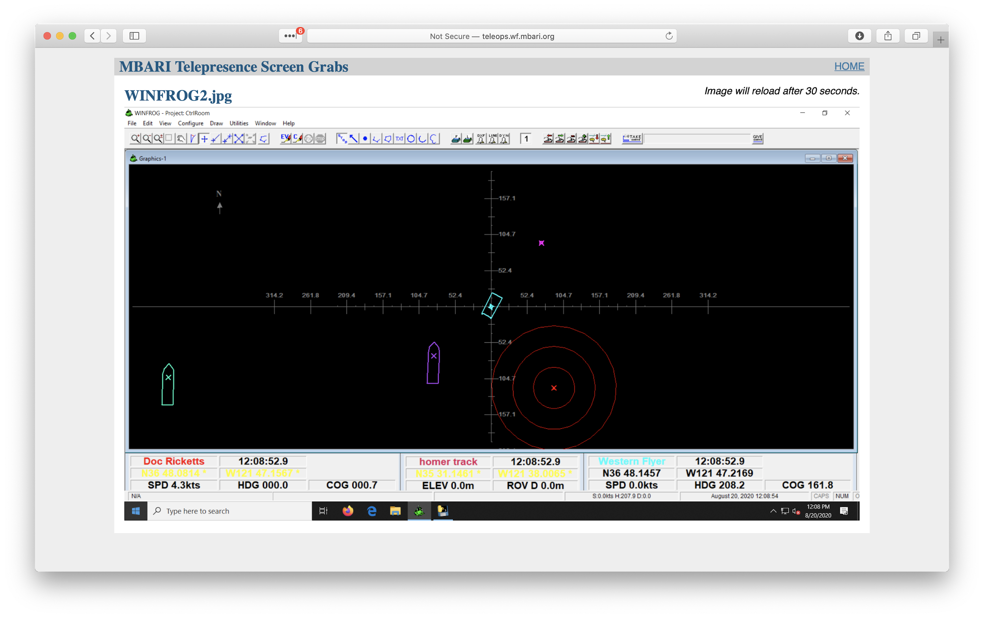
Contextual Data
A webpage is updated every 30-seconds with framegrabs of key PCs running in the control room.
  Winfrog (Navigation)
  Sonardyne (USBL Tracking and Navigation)
  Scanning Sonar
  Multibeam Sonar
  CTD

Slide 7
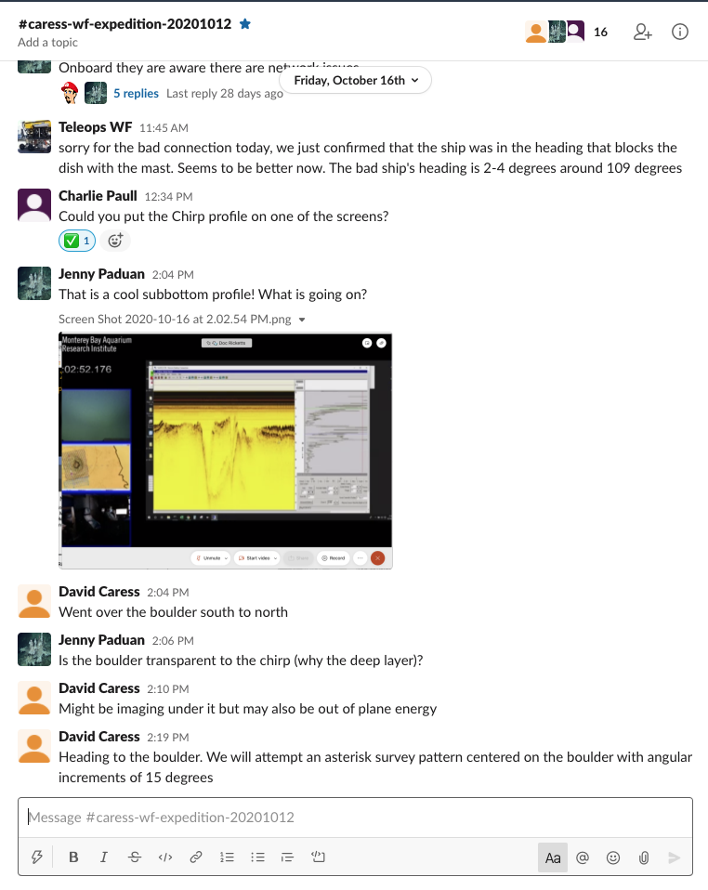
Annotation
VARS can be run onshore, contributing to the shore database:
  Latencies must be low
  Frames will be saved post-expedition when the video is back at the lab
  Only one contributor at a time.
Webex Meetings has a chat window
  Can be periodically exported by anyone to text file
  Texts are locally time and user tags
Slack has been a key tool for collaboration on our cruises, and can include non-MBARI participants easily.
  Slack conversations are difficult to export, they do not replace VARS.

Slide 8
2020 Activities Summary
Development:
Working system built in short order, meeting flexibility, space, data and cost restrictions.
Latencies are < 2 seconds on VSAT and < 500ms on Microwave
Memoryless system by design.
100% Shore managed, with boat troubleshooting support.
Science:
10 Supported days on the R/V Rachel Carson using microwave for 5 PI’s
4 Expeditions on the R/V Western Flyer leveraging telepresence for:
  Biology (Benthic & Midwater)
  Geology
  Hydrography
  Engineering Support
  Television footage remote direction
Extending MBARI’s reach to USGS, BBC, NOAA NMS, and many university collaborations.

Slide 9
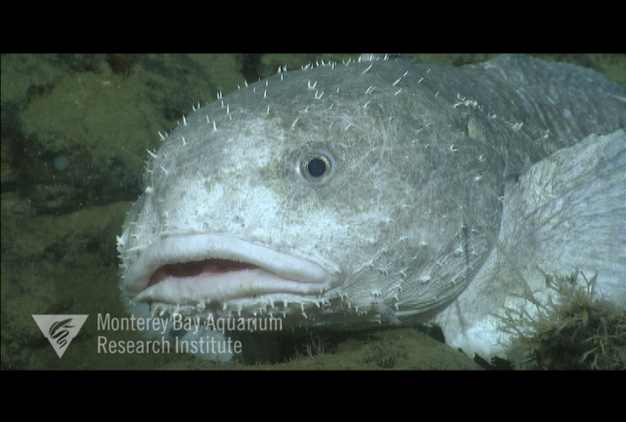
Pacific Northwest Expedition (PI Charles Paull)

Slide 10
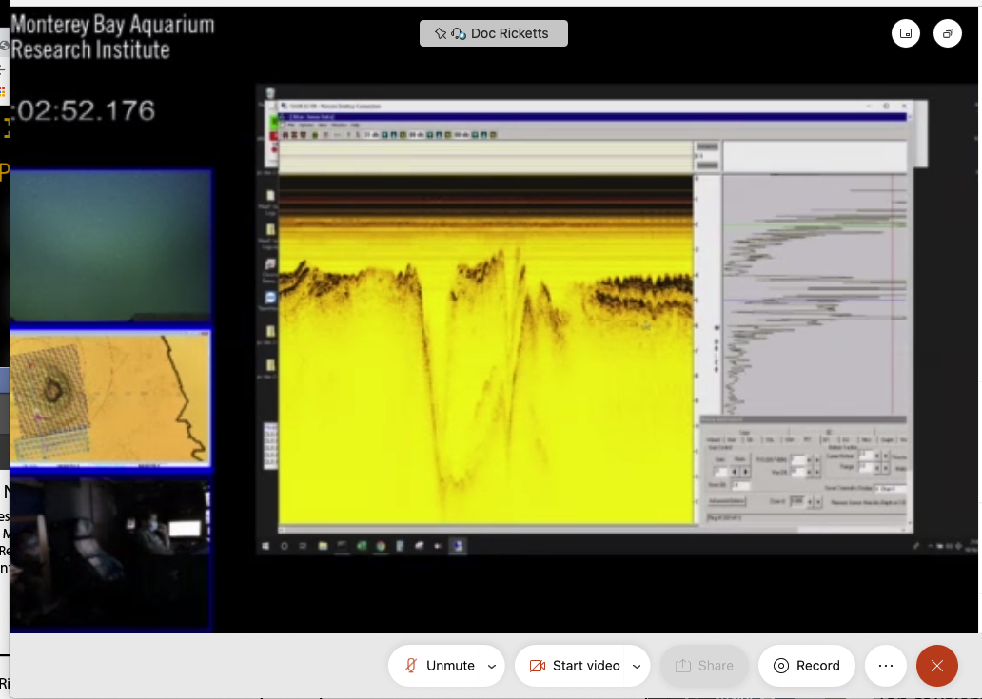
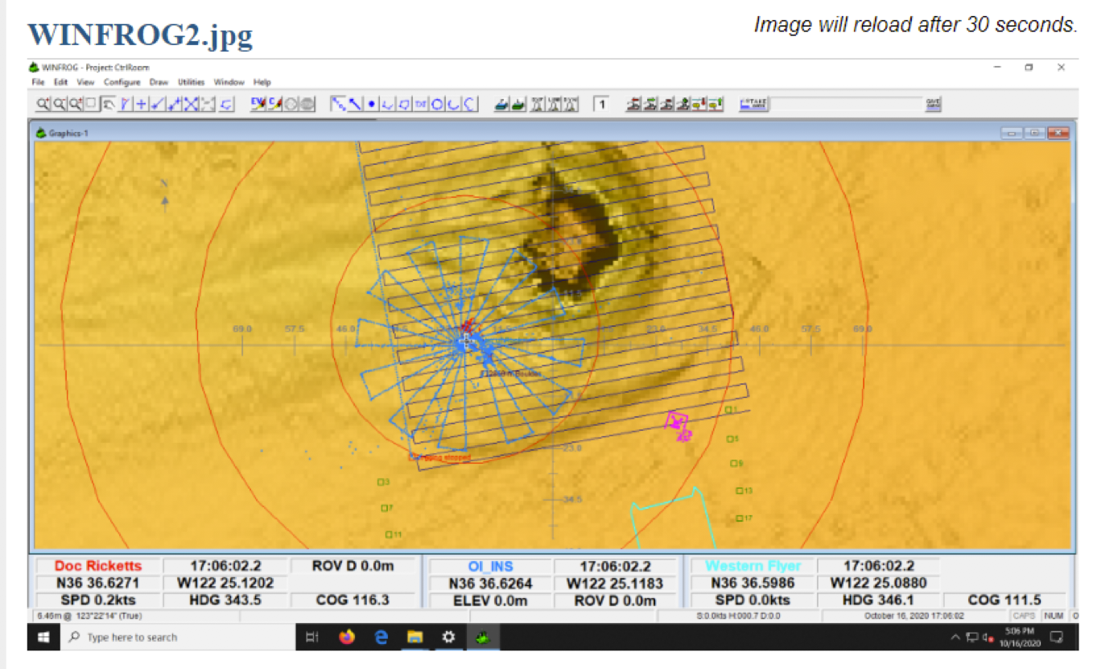
Low Altitude Surveys (PI David Caress

Slide 11
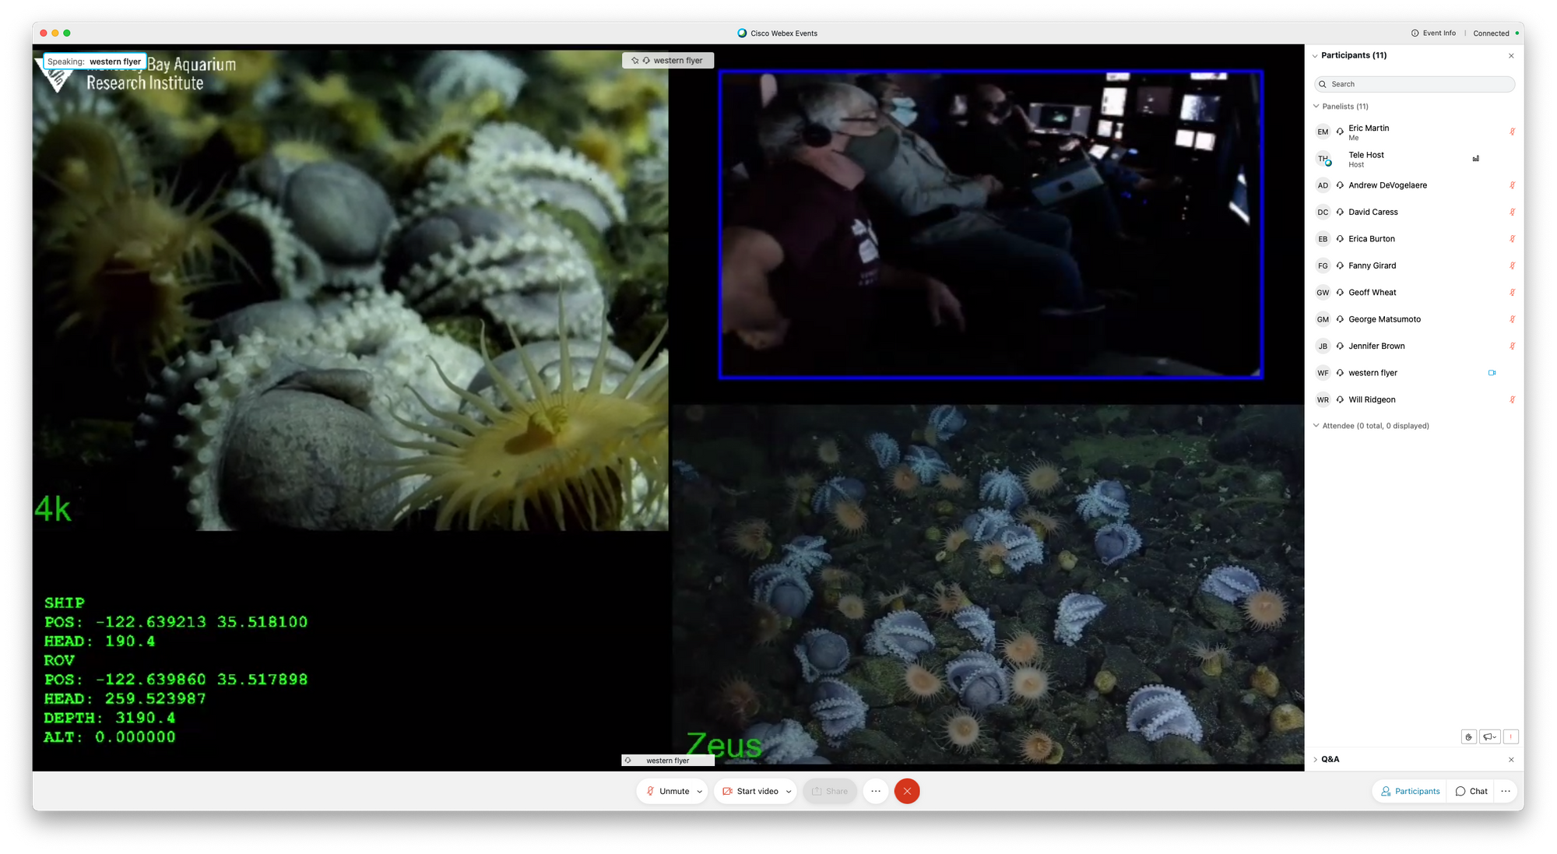
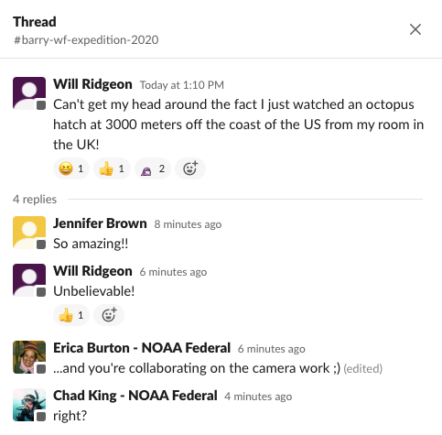
Benthic Biology at Octopus Garden (PI James Barry)

Slide 12
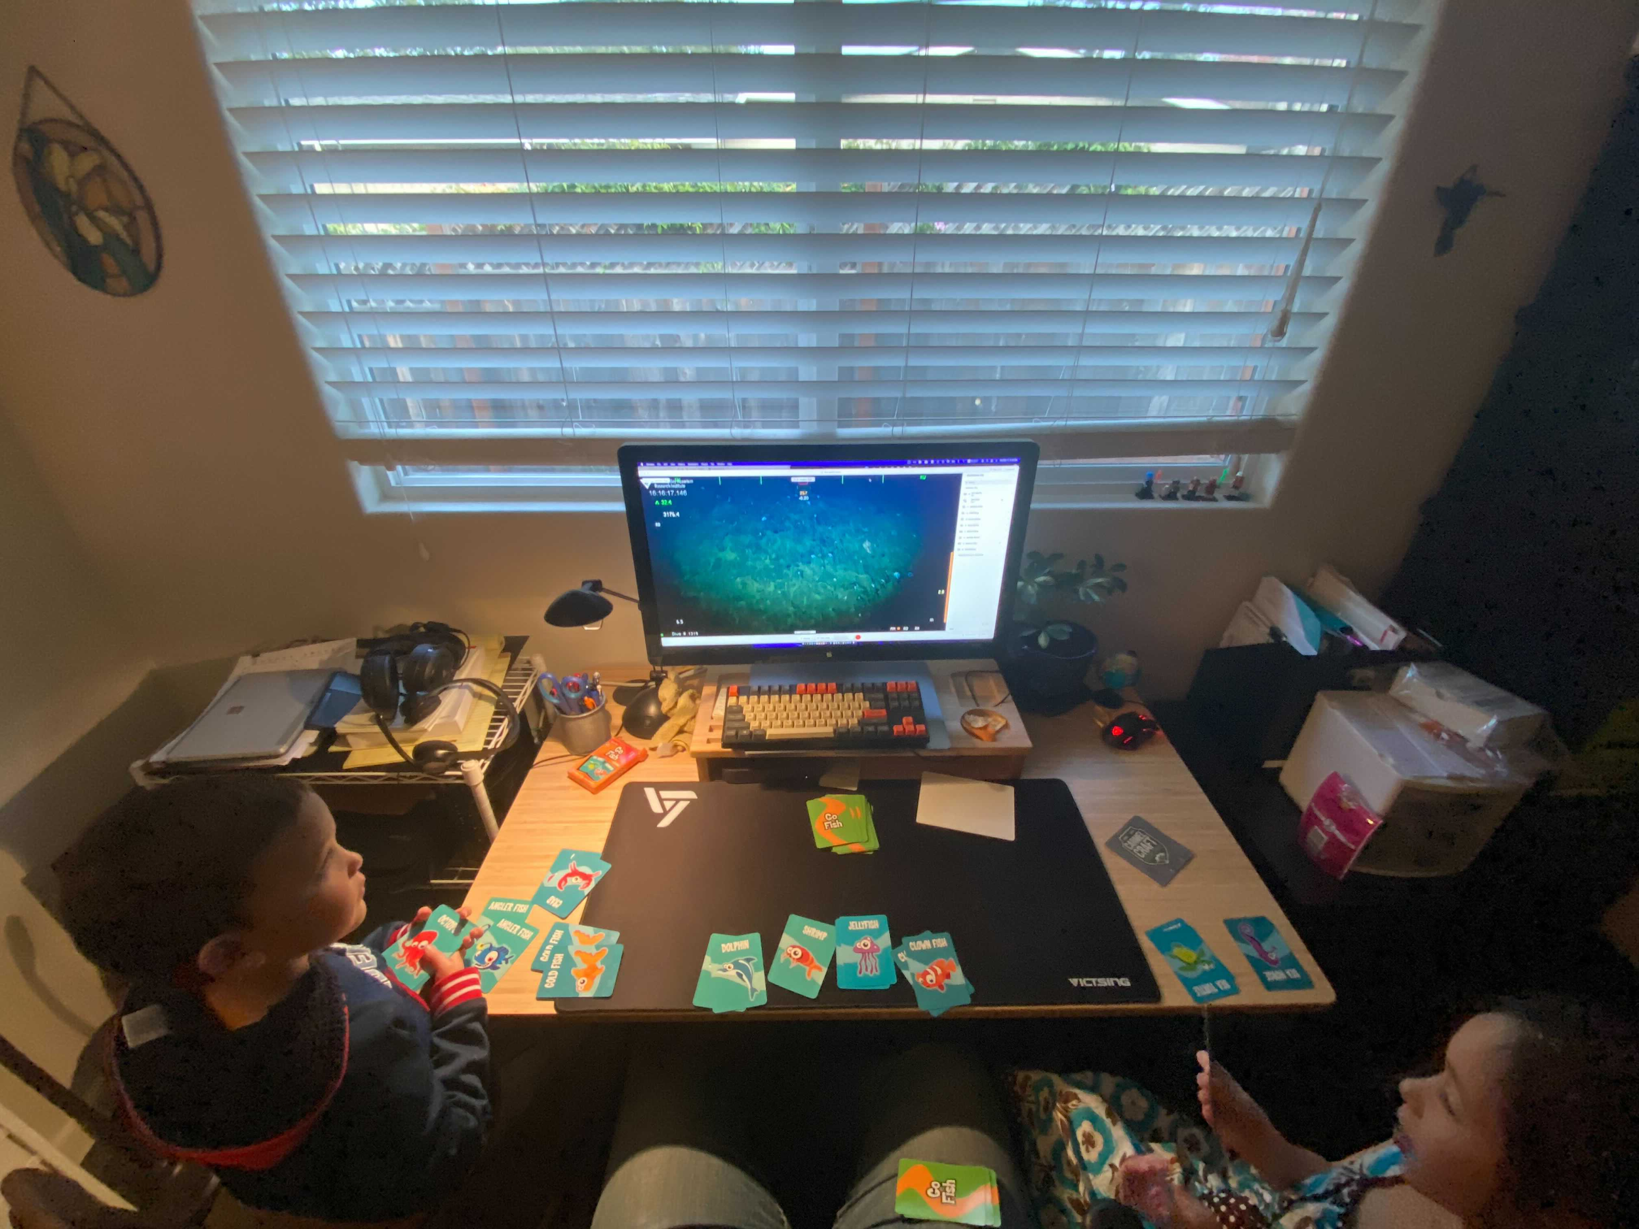
2021 Goals
https://files.slack.com/files-pri/T04FF62JY-F01G918C143/image_from_ios.jpg
Refinement of the 2020 rapid response
Multi-contributor expansion of VARS
Situational awareness software development
Monthly outreach experiences

Slide 13
Fin

Slide 14
Roles & Responsibilities
Vessel Panelist
🚢
Host
👩‍✈️
Panelist
🧑‍🔬
Audience
🙋‍♀️
On vessel
Connects Webex from Vessel
Telex Audio Control
Troubleshooting
Other ship responsibilities
On Shore
Controls Video Feed
Hosts Webex
Concentrates ship requests
Elevates Audience
On Shore
Watches video
Audio to Boat director/observers
Chat annotation
Other annotation
On Shore
Watches video
Listen Only
Chat annotation
Other annotation

Slide 15
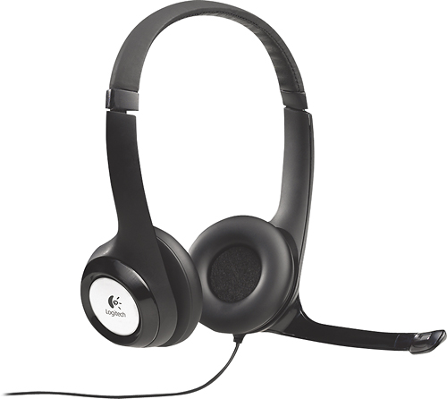
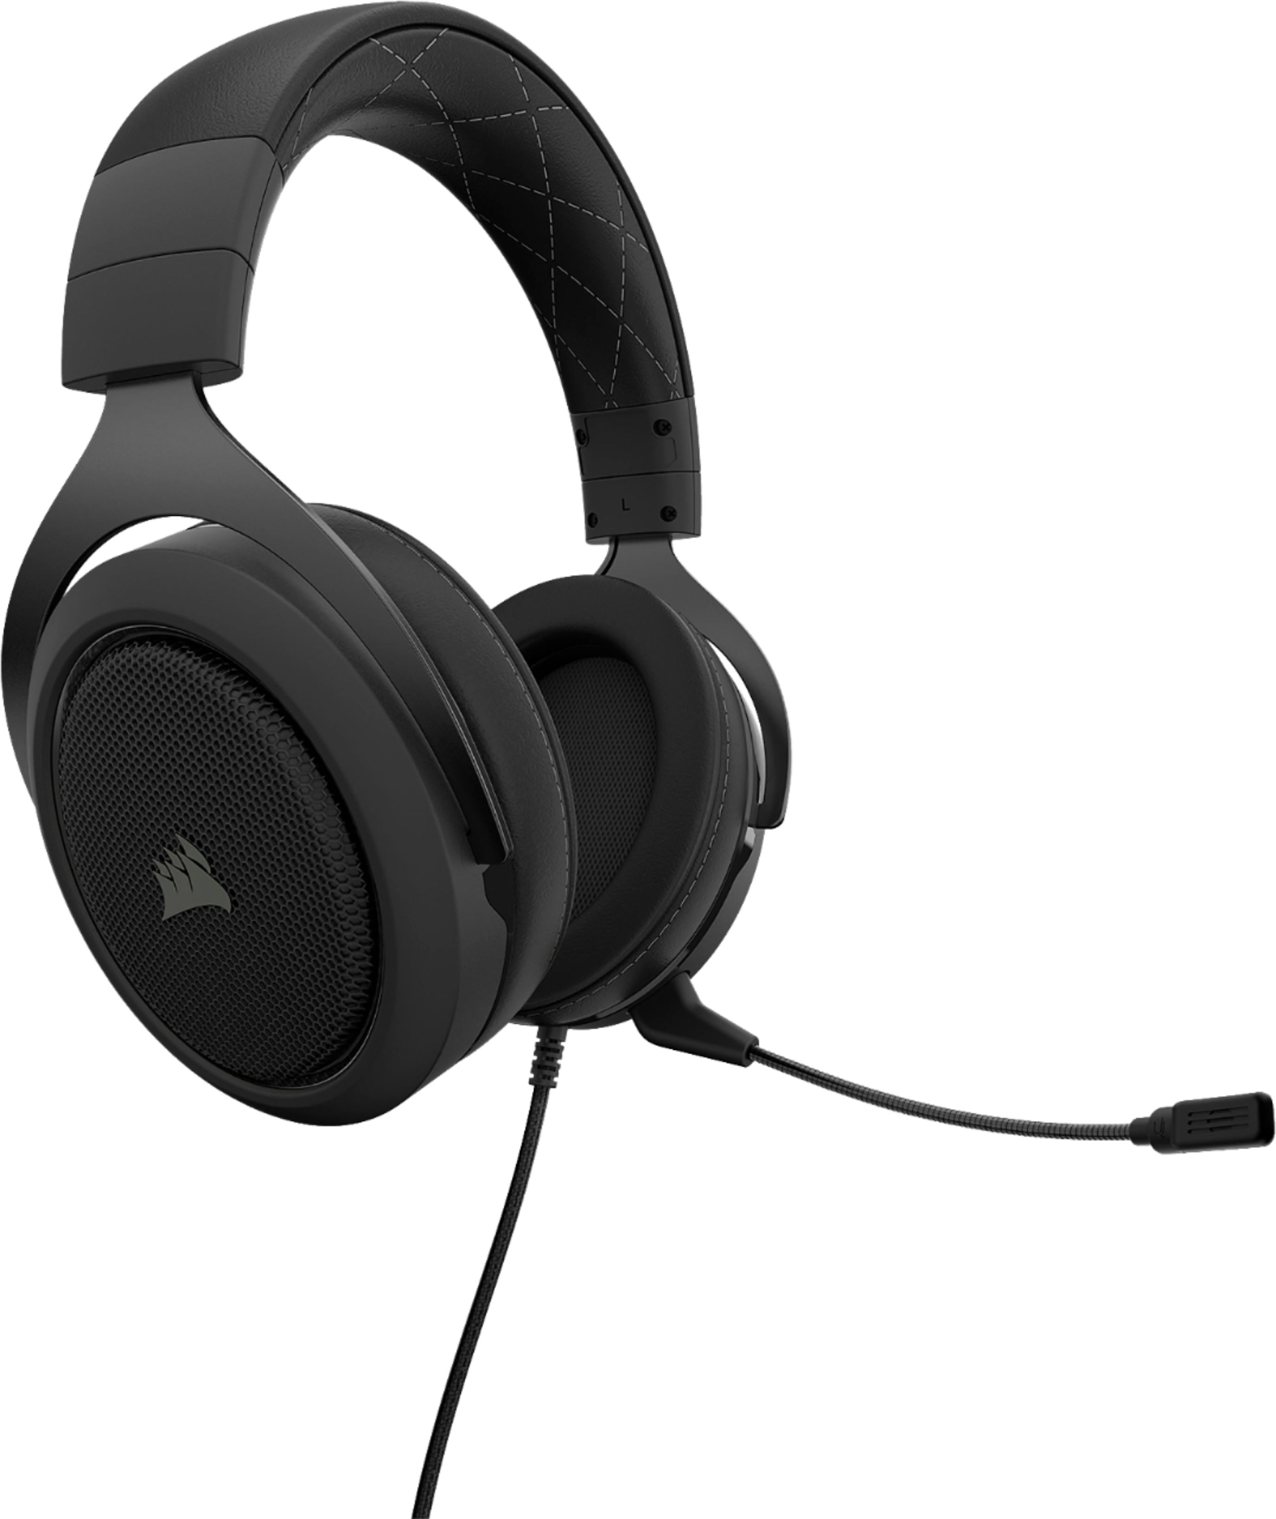
Etiquette and Best Practices
Follow the same rules as in the control room.
Request Telex isolation prior to a lengthy discussion
The whole ship may hear you otherwise.
Be conscious of ship operations.
Get a good headset, to avoid echoes:
  Logitech H390 (on ear)
  Corsair HS60 (over ear)
  We have some available for loan
Use a wired network connection
Use the webex application (test early)
Test your connection to MBARI
Use Split-tunnel VPN

Slide 16
Novel Operational Timeline
Pre-dive a webex event is started by a host on shore
The ship broadcast PC (teleops.wf.mbari.org) connects as a panelist
Shore based clients connect to the event as panelists or audience
The host can control what is displayed on the video stream for everyone.
The host can choose who can speak to the boat
All clients have access to the chat.

Slide 17
Failover Planning
The VSAT is reliable but many factors can affect connection:
  Technical issues
  Weather
  Atmospheric conditions
  Space oddities
  Latitude
Make sure you have a plan to move critical roles onto the boat in the event of connectivity issues both for VSAT and home issues.

Slide 18
Specific Software Access
Every group needs some special access unique to their science
Computer video available
Audio Feeds available
Some limited VNC remote desktop available

Slide 19
Audio Paradigms
Fully Open to Telex Intercom:
  Fully bi-directional conversations
  Pros: Allows for best emplacement
  Cons: Does not isolate bridge communications
Half Open to Telex (Current):
  Shore talks to the intercom
  Shore can only hear 1 dedicated microphone in control room.
  Pro: Provides some isolation (shore cannot hear telex)
  Con: Shore does not know when to talk and cut in, are unaware of ship/rov issues.
Multi-channel or Matrix systems:
  Multi-channel is possible on Rachel Carson, not on Flyer (upgradable)
  Matrix is the most flexible, but also most complex.

Slide 20
What’s next?
Please provide feature requests to emartin@mbari.org
We are working with IS to provide some access to things behind MBARI’s firewall and reduce ship bandwidth.
You can use these systems off dive-time to conference with people on shore.
A request from ITD to do some public streaming has been made.

Slide 21
Privacy Policies
MBARI must protect our IP and privacy of our working groups.
All parties would like to know who they are speaking to, and who is listening.
A full R&R document is under development, will be approved in December
For now:
  Do not invite party members that are not approved (in progress)
  Do not go public on the internet without approval (in progress)

