Slide 1
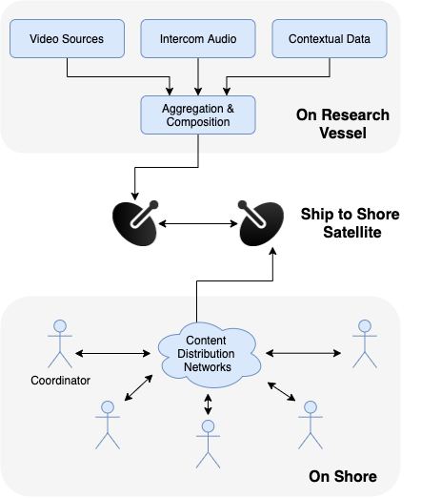
902100 Telepresence on MBARI Research Vessels
COVID-19 and a changing world are reducing the at-sea workforce, potentially limiting productivity.
Telepresence enables on-shore
  Observation
  Decision Making
  Annotation
  Technical Support
  Outreach and Engagement

Slide 2
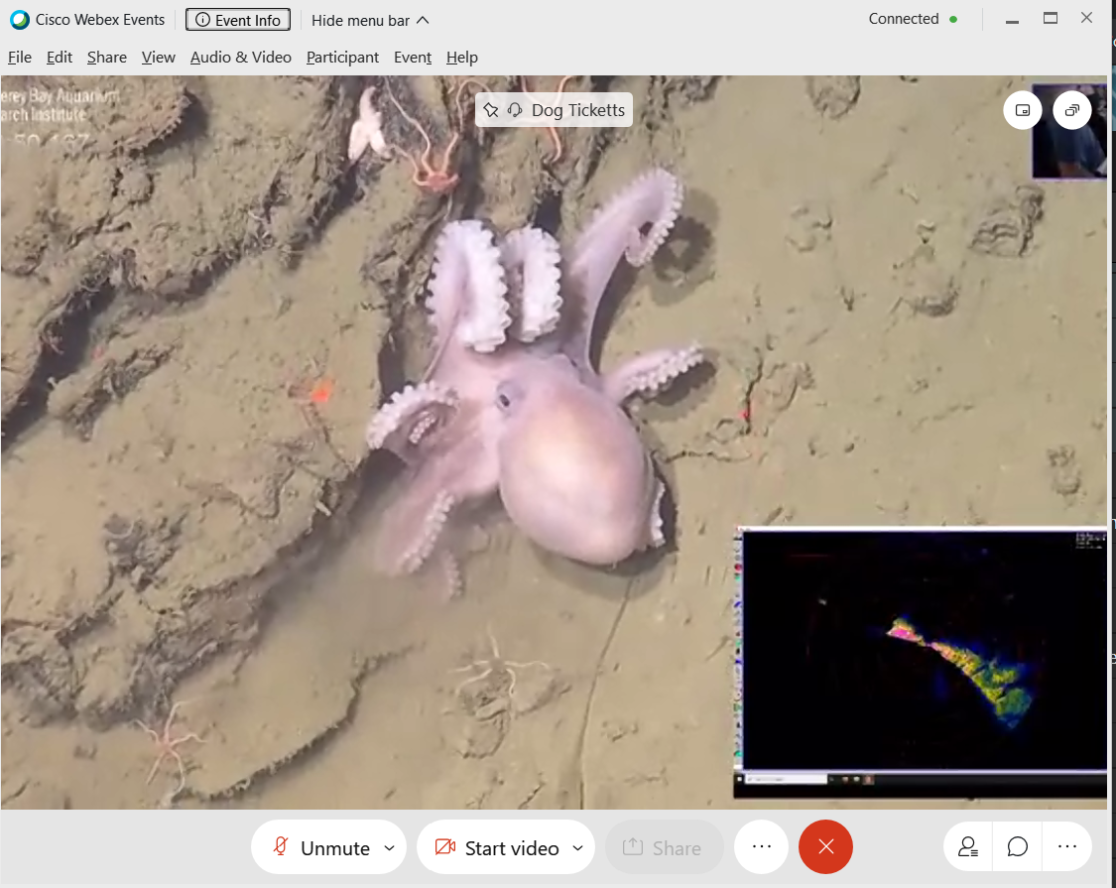
902100 Telepresence on MBARI Research Vessels
Development of a solution that fits within conventional ship satellite communication systems has the potential to enable the broader oceanographic community facing the same limitations.
2021 Efforts:
Refinement of the 2020 rapid response
Multi-contributor expansion of VARS
Integrated contextual awareness tools
Monthly outreach experiences
Telepresence view of 2020 NW Paull Expedition -- Jason Addison (USGS)

