Slide 1
Telepresence on MBARI Research Vessels
MBARI Project 902100
2021 Proposal - Abstract Presentation
Notes:
Good morning
Expanding telepresence capabilities on MBARI Research Vessels

Slide 2
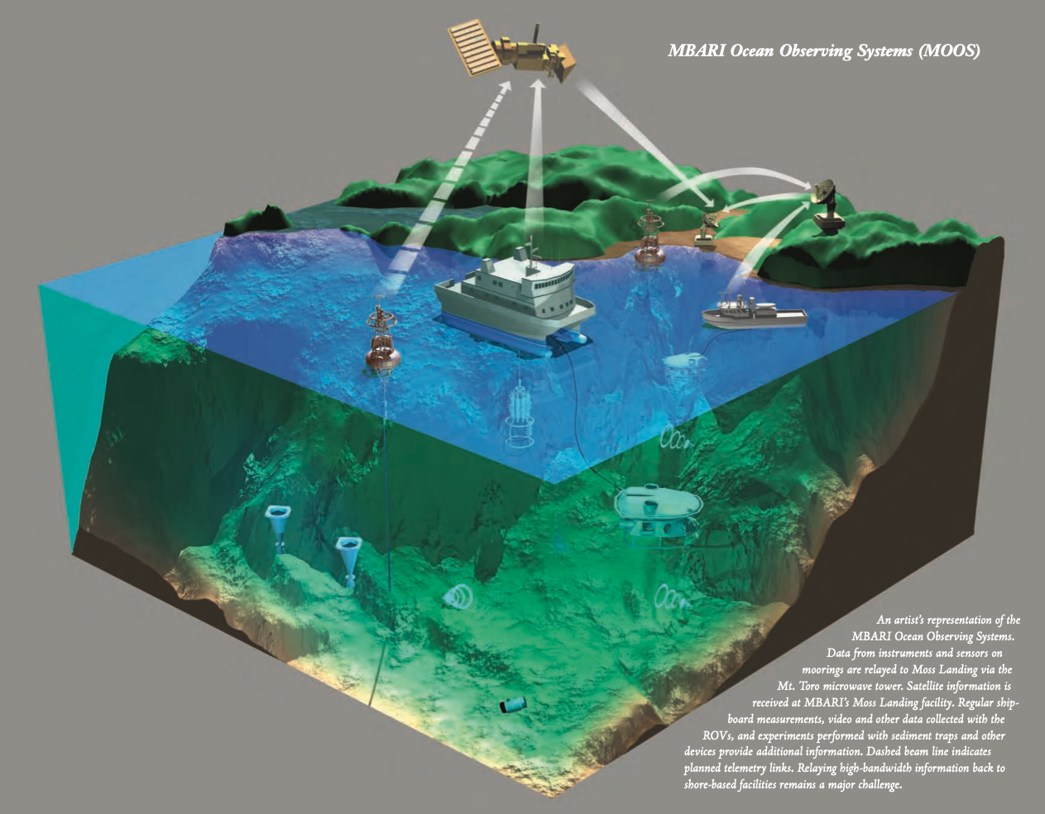
Telepresence at MBARI Revisited
History:
1991 - Early microwave demo as part of the first Macon expedition.
1993 - Installation of the microwave system on Mt. Toro.
1999 - Start of live link sessions with MBA
Today - the Microwave system is still a critical system for the Rachel Carson, esp. for MARS operations.
MBARI’s First Decade: A Retrospective | MBARI. https://www.mbari.org/the-first-decade/

Slide 3



A New Need
COVID-19 Restrictions reduces labor force at-sea.
Enforces new offshore paradigms for maximum productivity.
Telepresence can enable non-physical contributions.
Opportunity for expanded outreach.
Other R/V Operations are facing similar issues.
Notes:
COVID-19 Restrictions for seagoing participation will restrict access for both MBARI employees and collaborators, and reduce science workforce sizes.
Either science goals must be similarly scaled down or new techniques adopted to preserve effectiveness of operations.
Telepresence can help by allowing for remote science direction, annotation, and collaborator contribution.
Presents an opportunity to expand outreach from our platforms as an added value proposition.
Other R/V Operations are facing the same issues:
Schmidt Ocean Institute & ROV Subastian
Ocean Exploration Trust & ROV Hercules
NSF/UNOLS & ROV Jason

Slide 4
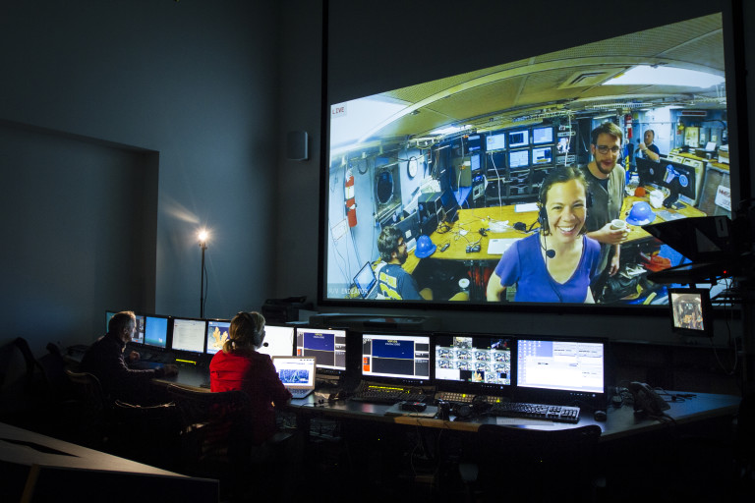
Science User Goals
Effective ROV dive participation must facilitate:
Observation
Discussion
Decision making
Annotation
Situational Awareness
Technical Support
An effective solution must include:
ROV Video at HD720 quality and low latency (< 10s).
Audio for control room decision making
Latent communication for annotation and non-mission-critical discussion.
Contextual data presentation, i.e. attitude, location.
More information available in the requirements doc: https://bit.ly/3f5Xz9U
The URI Innerspace Center, https://innerspacecenter.org
Notes:
If we expect a scientist to sit at home and take part in these dives we must facilitate
Make observations so they can
Parrticipate in Discussions that lead to
Real time decision making
And have the ability to annotate what’s happening, with some
Contextual understanding and in some cases provide
Technical support
With that in mind, we carried out discussions with current telepresence users in a variety of groups to help set these requirements
Video from the main camera and control room
Bi directional audio
Some form of communication that isn’t immediate, like a chat client that can also serve for textual annotation
On top of this, we believe a rich layer of decimated vehicle data will help complete the picture.

Slide 5
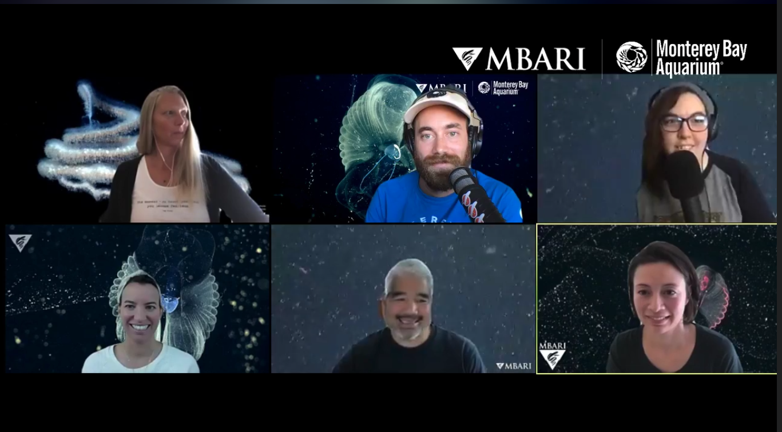
Telepresence Outreach Goals
A. Bring the excitement and joy of discovery in the deep-sea to a larger audience.
B. Share MBARI research and knowledge with the general public
C. Bring greater awareness about the deep-sea to the general public
More information available in the outreach memo: https://bit.ly/2AOaeQ7
Notes:
Aquarium has been using canned footage
During the pandemic, it has expanded their online live presence
Deepsea 2021 exhibit
Current Livestreams, accelerated by the shutdown, have been getting over 50,000 views on Facebook and Youtube
With MBARI outreach experts' interpretation (i.e. George, me, and perhaps video lab), along with the scientists at sea and the commentary of the MBA social team, we have the potential to do this livestream in a very different way from what other platforms like Nautilus and Okeanos are doing.

Slide 6
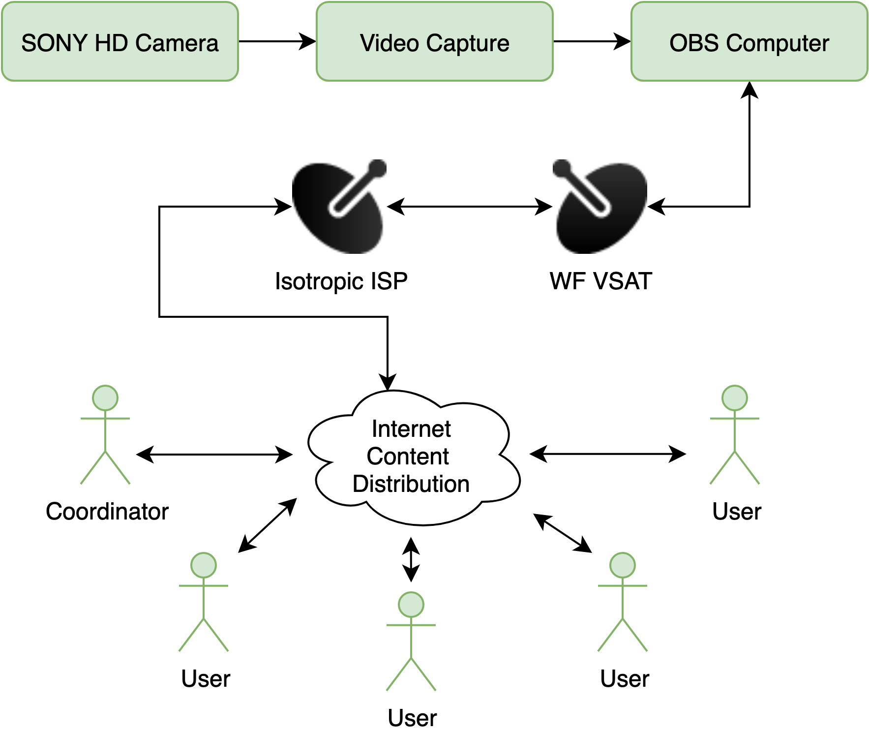
The State of Telepresence Capabilities
In May 2020, a scoping study was conducted to determine system readiness of ship-to-shore telecommunications for the added loads of telepresence. The key results are:
The Flyer VSAT will work (proven)
  Tested 5/29/20
  6 simultaneous users
  Low latencies were possible
  1080p30 H.264 capable.
The Carson is capable (unproven)
Costs can be optimized for “as-needed” use.
More information available in the report brief: https://bit.ly/3dWRVqR
Notes:
Due to the immediate nature of this problem, we were approved to conduct some experiements on the Western Flyer to prove feasibillity of using existing systems for the requirements we had defined.
We secured an upgraded service plan from the provider, and set about testing a proxy system on the ship.
We were please to find that the system was more than capable of sustaining telepresence activities, with stable connections all day, and tests lasting as long as 30 minutes without any significant dropouts.
Also, we tested a number of services, evaluating quality across 6 users and latencies to each one.

Slide 7
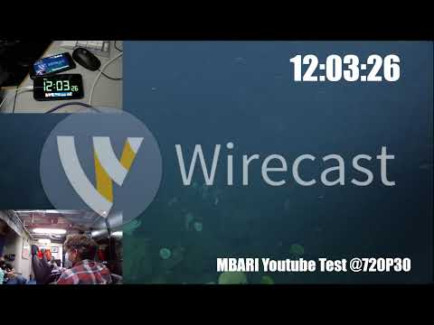
Notes:
Here is an example of one of our livestreams:
As you can see, we have been able to
compile a variety of video sources,
generate textual overlay as a means to
Measure latencies, which for some services, like
zoom and google meet were 1-3s
While higher quality, constant bitrate streams seemed to have 30s delays
We have more investigations to do on this front.

Slide 8
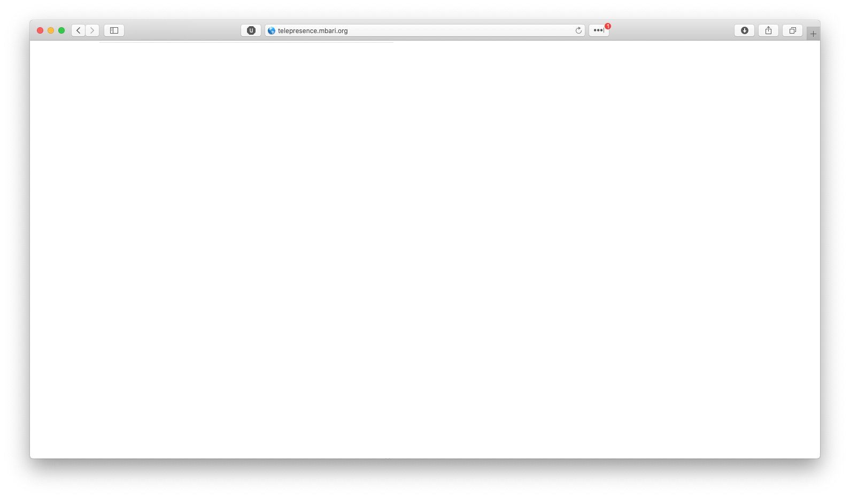

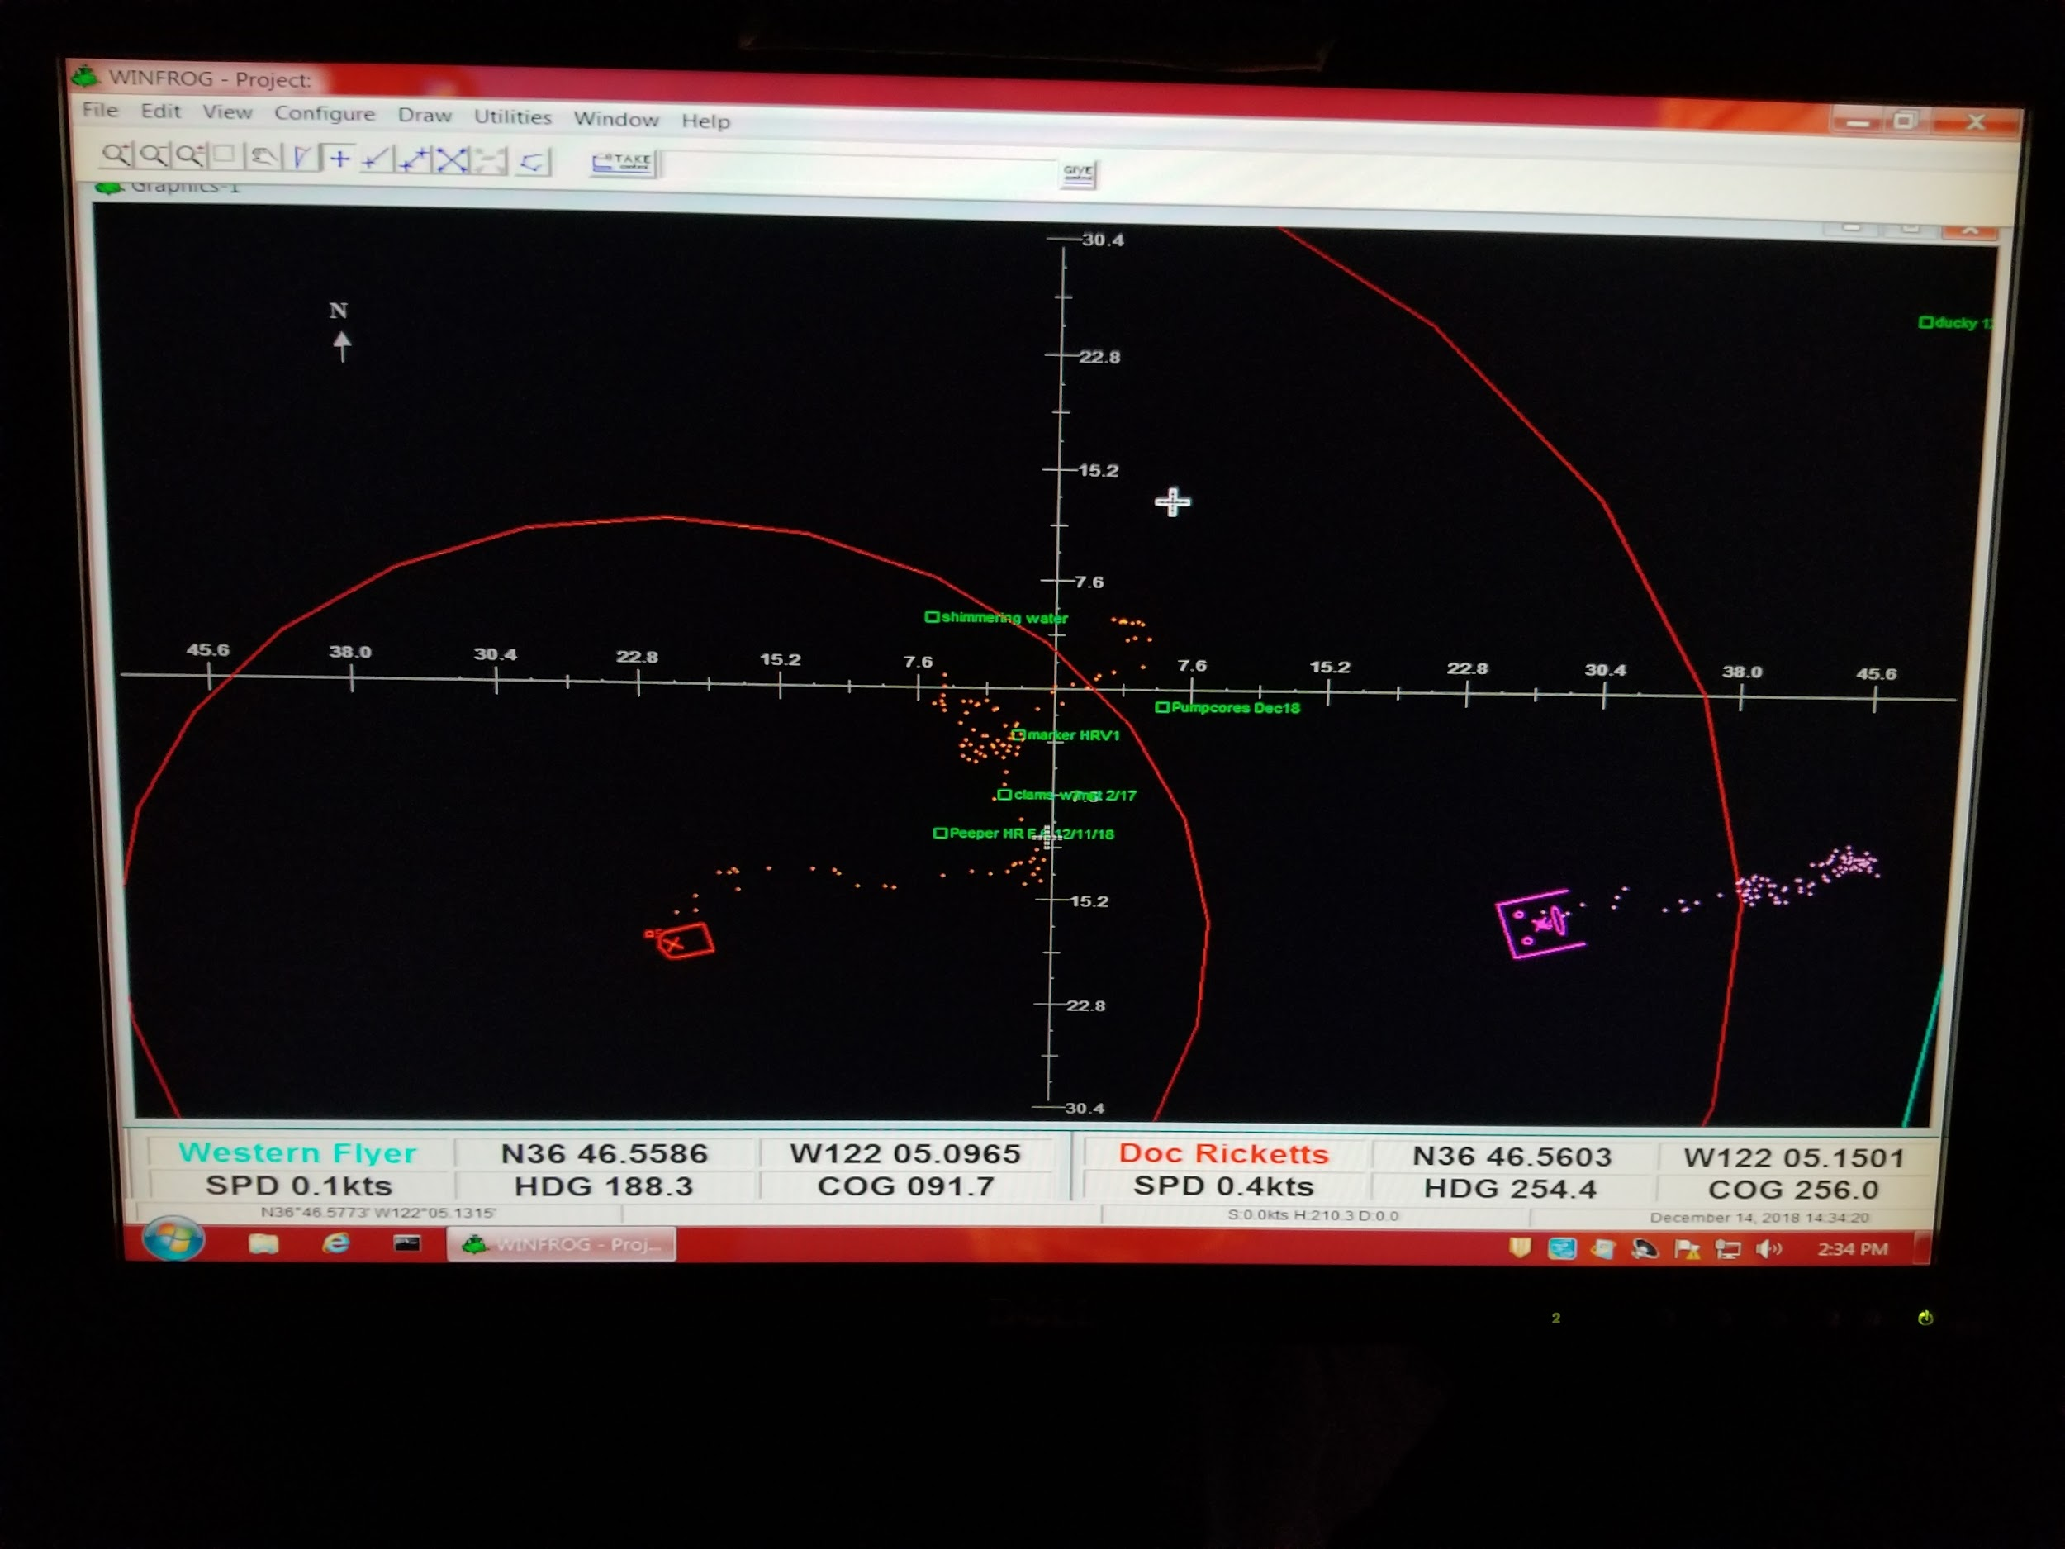
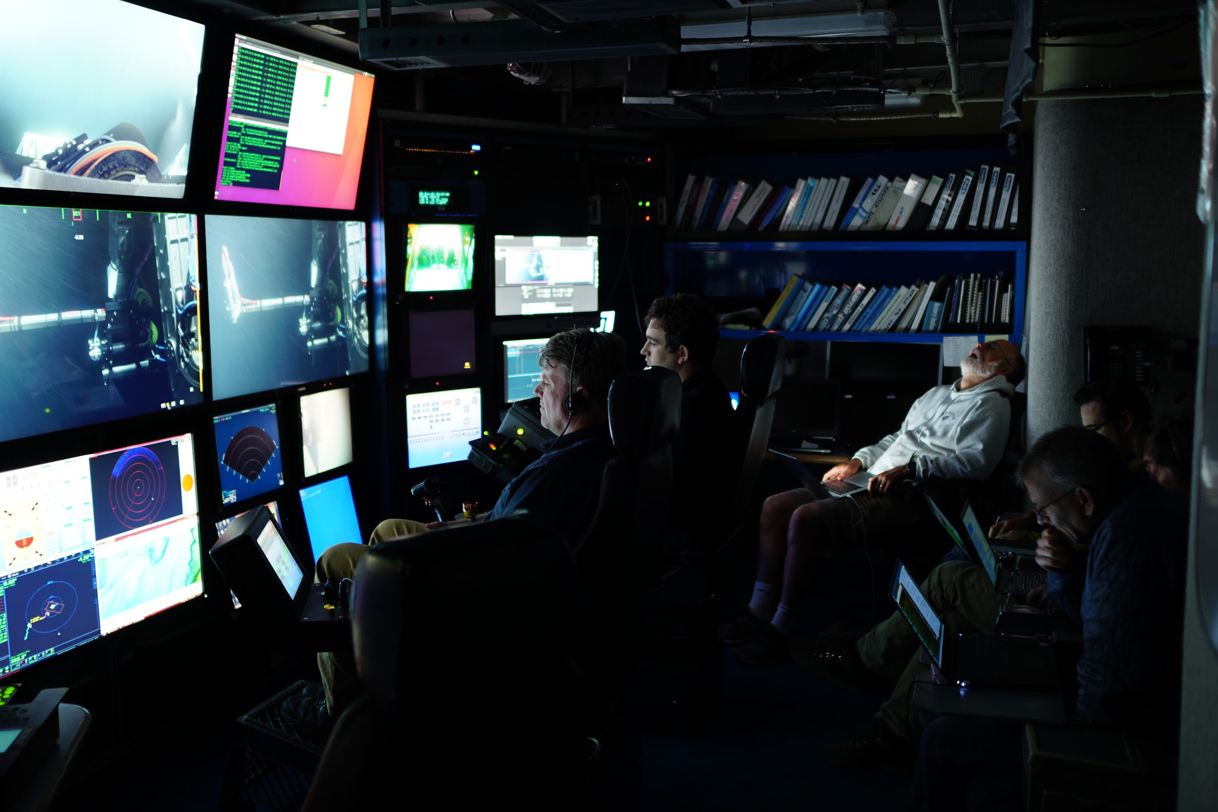
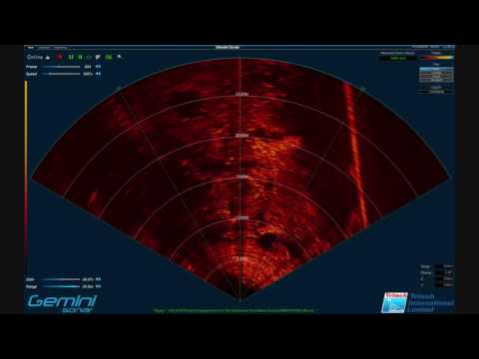
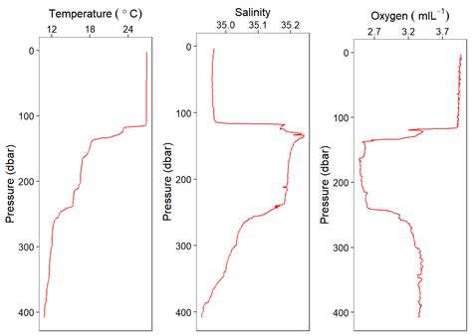
Web Hosted Telepresence Mock-up With Separate Data Pathway
TIME (UTC): 23:42:42
DIVE #: DR4242
Navigation
SONAR
CTDO
.
CONTROL
CHAT
Kakani (18:02:01 UTC): Capture it! We need one at this depth and location.
Notes:
Here is a mock up of the current concept design for a web hosted telepresence solution:
Here is video, with our small control room video in picture
Relevent contextual information is grouped on the right, and
Bottom is a chat dialog, but you can believe Kakani is also
Shouting in the audio to grab this thing to her intern who’s in the chief sci
Seat, while our engineers are face down in their laptops

Slide 9
Technical Deliverables (Year 1)
A rack-mounted “turn-key” system:
  Ancillary integration
  Assembles video and data sources
  Transmits to shore locations
  Combination of PC and broadcast equipment
Operators:
  Science personnel on ship, similar to VARS
  Precruise training
Pilot Obligations:
  Ensuring video & data integrity
Fixed shore-side targets
  Either hosted at MBARI or through cloud services
Notes:
A rack-mount “turn-key” system integrated as non-critical and ancillary to existing control room components. This will assemble video and data sources and broadcast over the shore link.
This system will be operated by science personnel on ship, with video and data feeds maintained eventually by ROV pilots.
Dedicated shore-side systems or agile cloud-based solution for content distribution and hosting.

Slide 10
Outreach Objectives (Year 2)
1-hour live streams through social media once per month.
ITD Coordinated and hosted, with an interactive comment/answer
Follow up with attendees to evaluate the success of the program.
Notes:
A. Deliver a one-hour live stream over social media at least once a month.
B. The live stream feed will be coordinated by ITD and include both the ability to respond to comments and provide an abbreviated audio summary of what is going on during the one-hour dive segment
C. Follow up with those attending with occasional surveys to evaluate the success of the livestream

Slide 11
Future Use
Transition system into an asset allocated during cruise planning.
Clear user training protocols.
Data Storage restricted to outreach archival.
Notes:
At the end of the project, we expect the system to transition the system in to as an asset allocated as part of cruise planning done during normal proposal cycles to enable appropriate budgeting and shore support.
Data storage needs will be likely restricted to archiving outreach activities.

Slide 12
Project Team
Kakani Katija
David Caress
Eric Martin
Ben Erwin
Heidi Cullen
George Matsumoto
Susan Von Thun

Slide 13
Questions

Slide 14
Supplemental Slides

Slide 15
Streaming Tests Latency Results
Stream Target | Video Quality | Average Latency (s)
uri innerspace center | 720p30 | 35.5
wowza cloud | 1080p30 | 23.7
microsoft streams | 720p30 | 27.7
facebook | 1080p30 | 22.5
youtube | 720p30 | 26.3
zoom | 480p30 | 1.5
google meet | 720p30 | 1.5

Slide 16
Budget
Function | Potential Item | Cost ($)
Video/Audio Ingestion | Blackmagic Web Presenter or Decklink Duo 2 | $1,000
Video Adapters/Cabling |  | $500
Audio Interface Components | Audiocom WM1000 for line tap | $1,000
Audio Adapters/Cabling |  | $500
Broadcast PC | NUC 9 Extreme with RTX2070 | $3,300
Chat Server | Skype/Zoom/XMPP | $0
Professional Broadcaster Software | Wirecast | $700
Cloud Restreaming | Wowza | $2,400
WF Satellite Service (Outreach/year) | Isotropic | $13,200
WF Satellite Service (per week of use) | Isotropic | $5,600
 | Total: | $28,200
Notes:
Service rates are subject to change dependent on use
These are additional charges on existing satellite service budgets

Slide 17
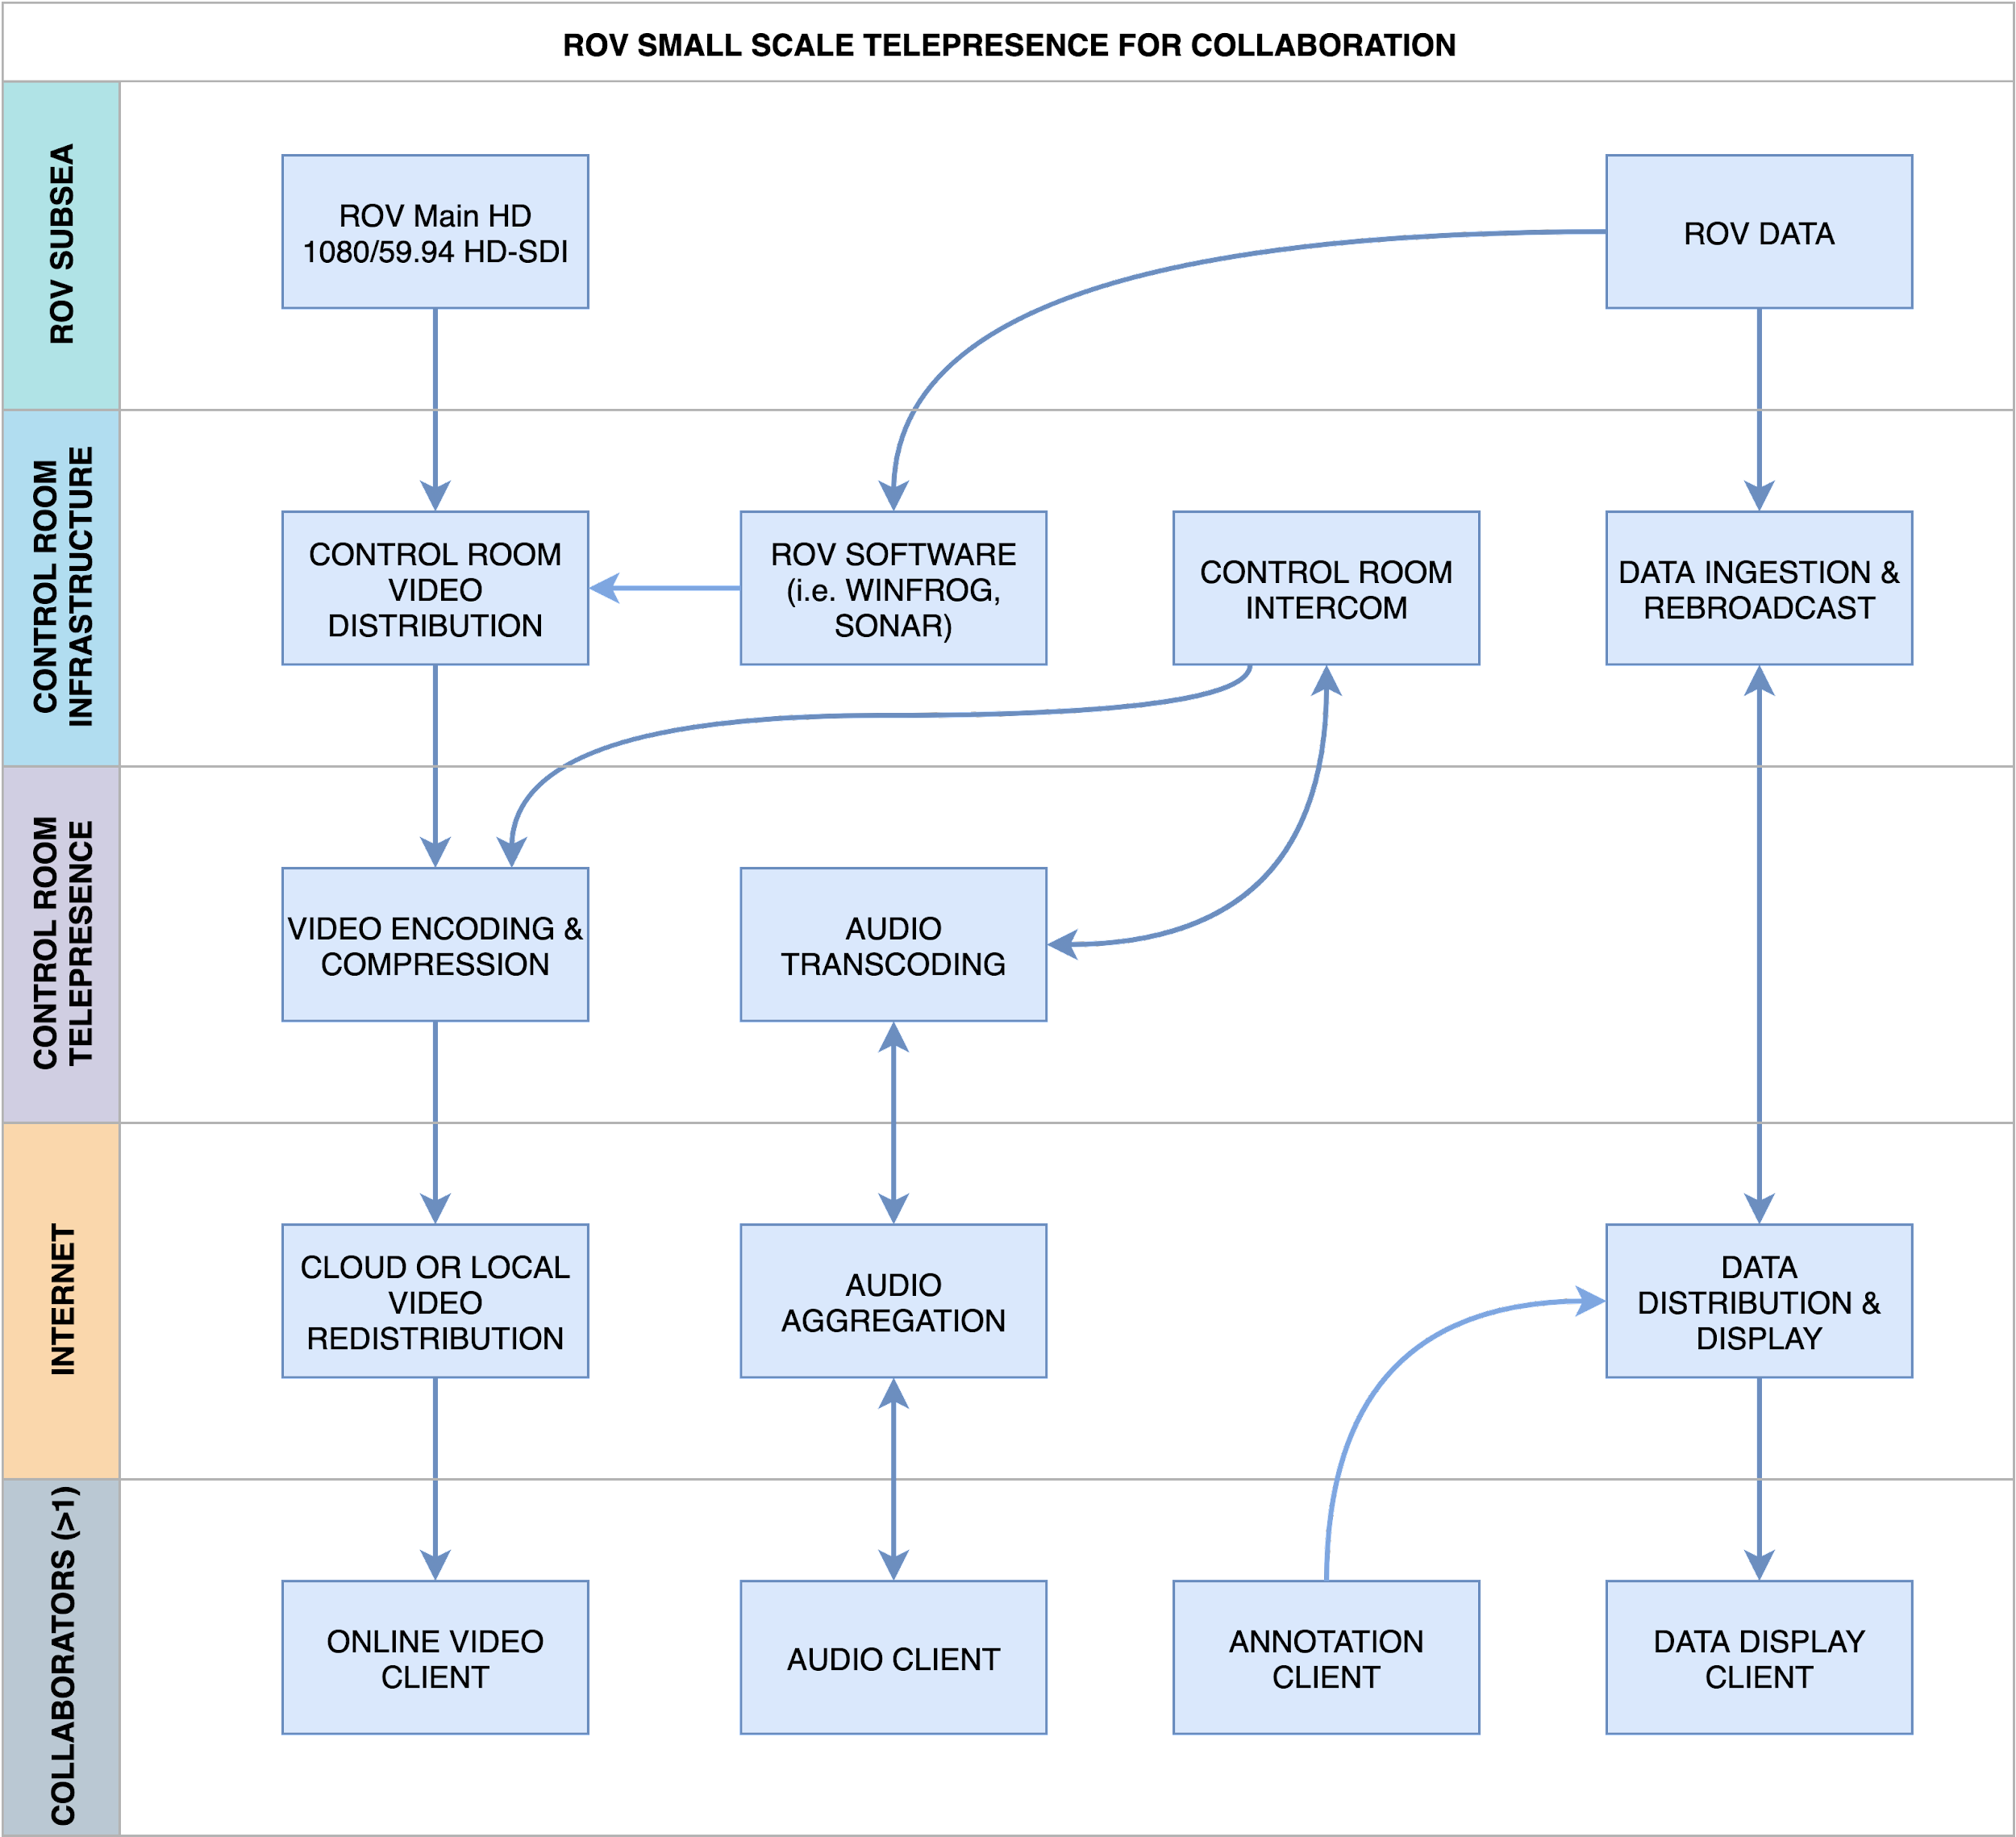
Data Pathways

Slide 18
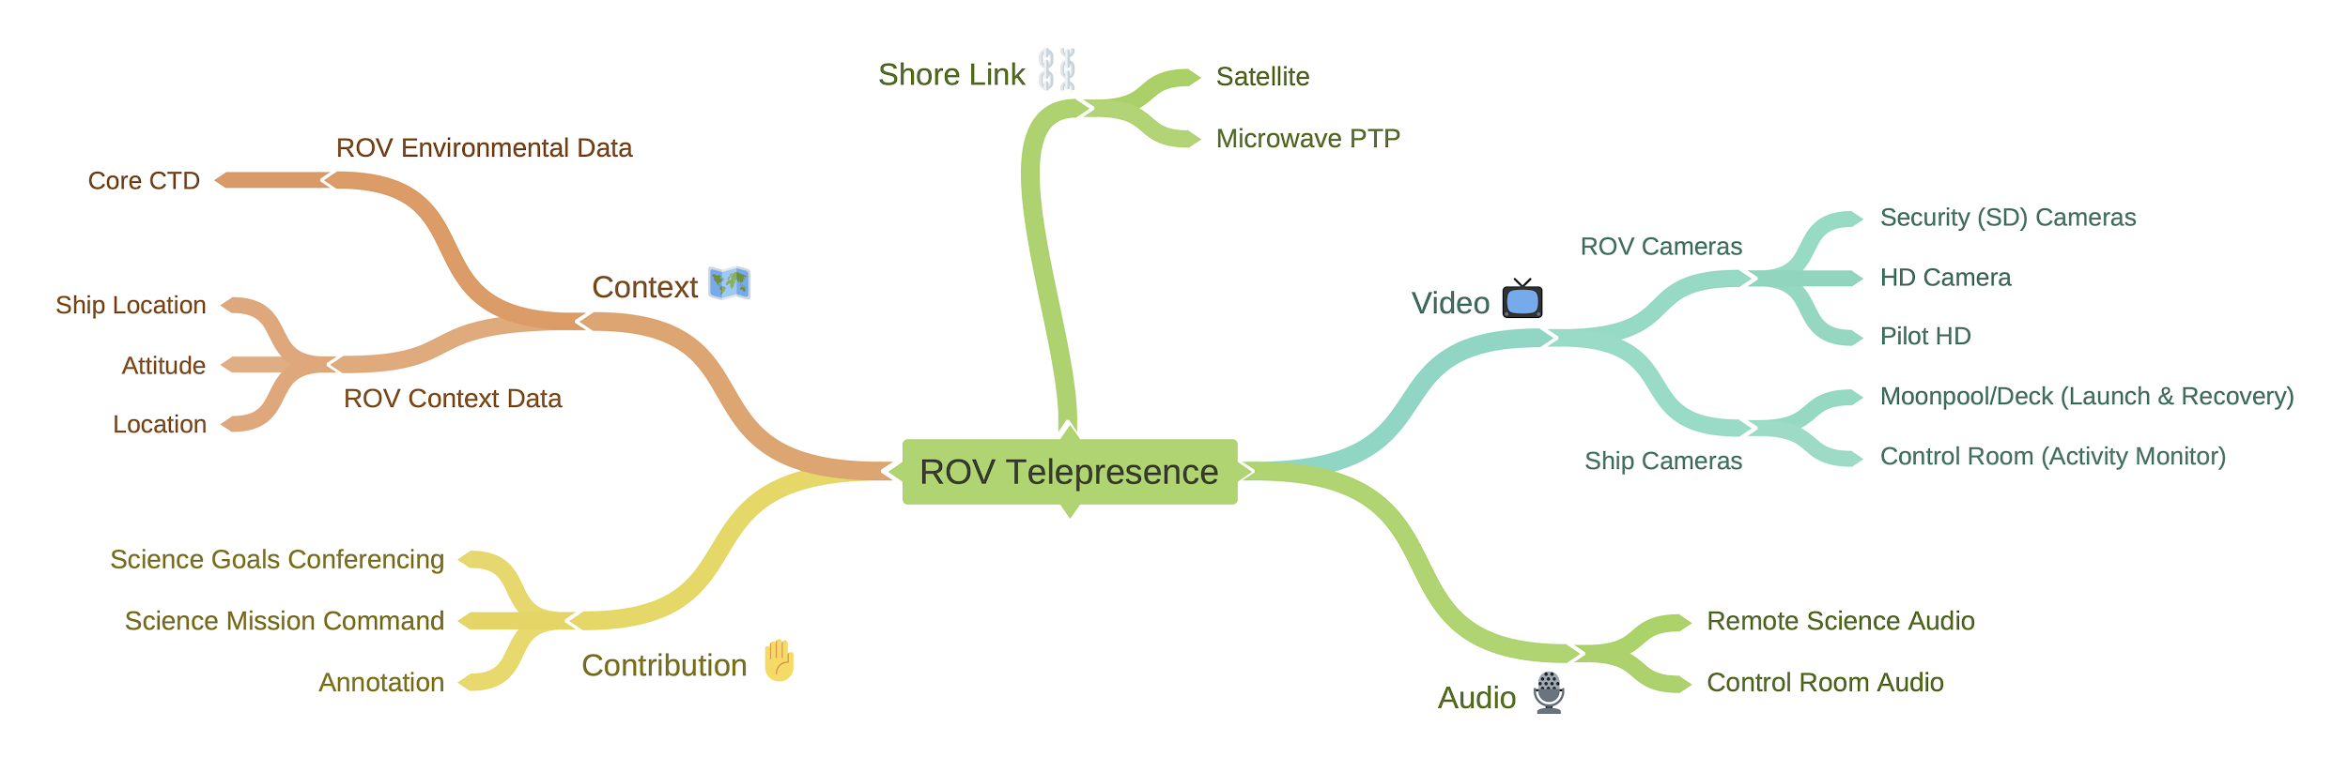
Basic Telepresence Features

Slide 19
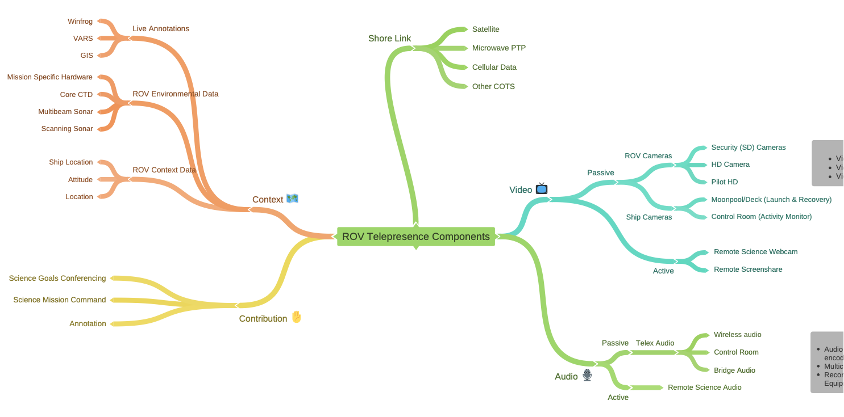
The Grand Challenge

Slide 20
Video Only Solution Using OBS
TIME (UTC): 23:42:42
DIVE #: DR4242
Ship
LAT: 121°N42.42
LON: 36°W42.42
ROV
LAT: 121°N42.42
LON: 36°W42.42
DEPTH: 4000.1 m
HDG: 42.1
ROLL: -1.42
PITCH: -10.2
COND: 42
TEMP: 3.42
O2: 10.0
CONTROL
Notes:
Video only solutiont

Slide 21


