Slide 1
902012 Telepresence for MBARI Research Vessels
What’s the fundamental problem, question, or issue you are addressing?
How do we expand the ability of collaborators to make meaningful contributions to MBARI’s offshore research expeditions?

Slide 2
902012 Telepresence for MBARI Research Vessels
Why is it important/why should anyone care?
COVID-19 continues to impact MBARI operations, and collaborators still need access to ongoing offshore research.
Telepresence has enabled expansion in collaborator contributions for MBARI’s offshore research.
A live connection to MBARI’s vessels can be a powerful tool for communicating with the public.

Slide 3
902012 Telepresence for MBARI Research Vessels
What are we doing about it/what’s MBARI’s unique contribution?
MBARI has compact satellite systems, and developing a small solution can enable similar research vessels.
Telepresence enabled expeditions continue to help our PIs engage a broader audience.

Slide 4
902012 Telepresence for MBARI Research Vessels
What are your project plans for next year (2022)?
Delivery of a new unified interface for telepresence users.
Transition telepresence from development to general use.
Conduct user studies to inform future proposals for the new R/V David Packard

Slide 5
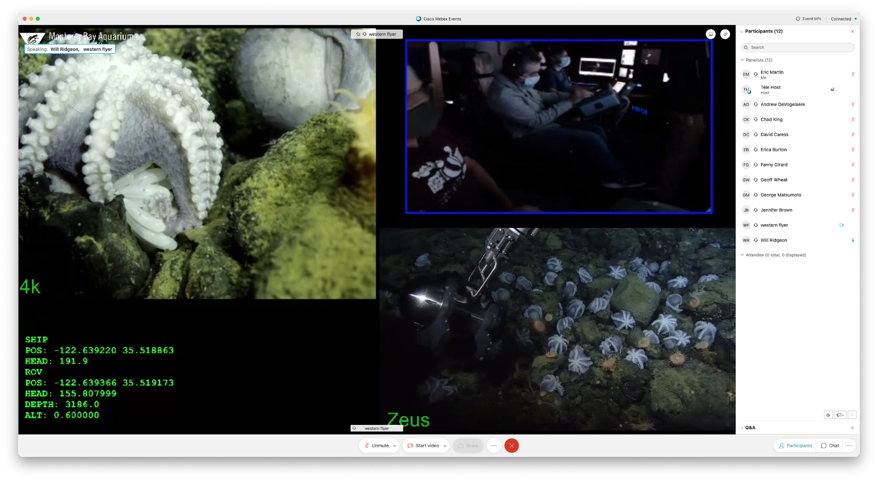
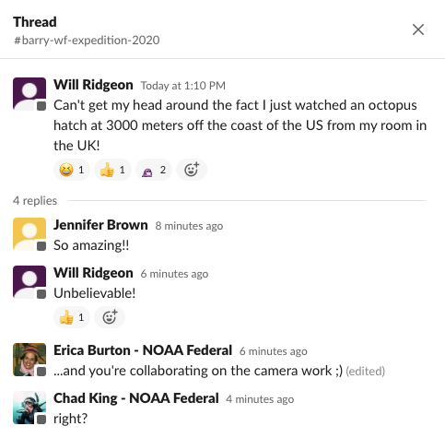
902012 Telepresence for MBARI Research Vessels
Telepresence enables moments like the one shown here, collaborative work, across disciplines, and connects MBARI research to anyone with access to the internet.

