Slide 1
Telepresence Onboarding and Orientation
MBARI Telepresence 2021 Revision C

Slide 2
Goals of MBARI Telepresence Prototype
COVID-19 Restrictions reduces labor force at-sea.
Enforces new offshore paradigms for maximum productivity.
Telepresence can enable non-physical contributions.
Opportunity for expanded outreach
Other R/V Operations are facing similar issues.

Slide 3
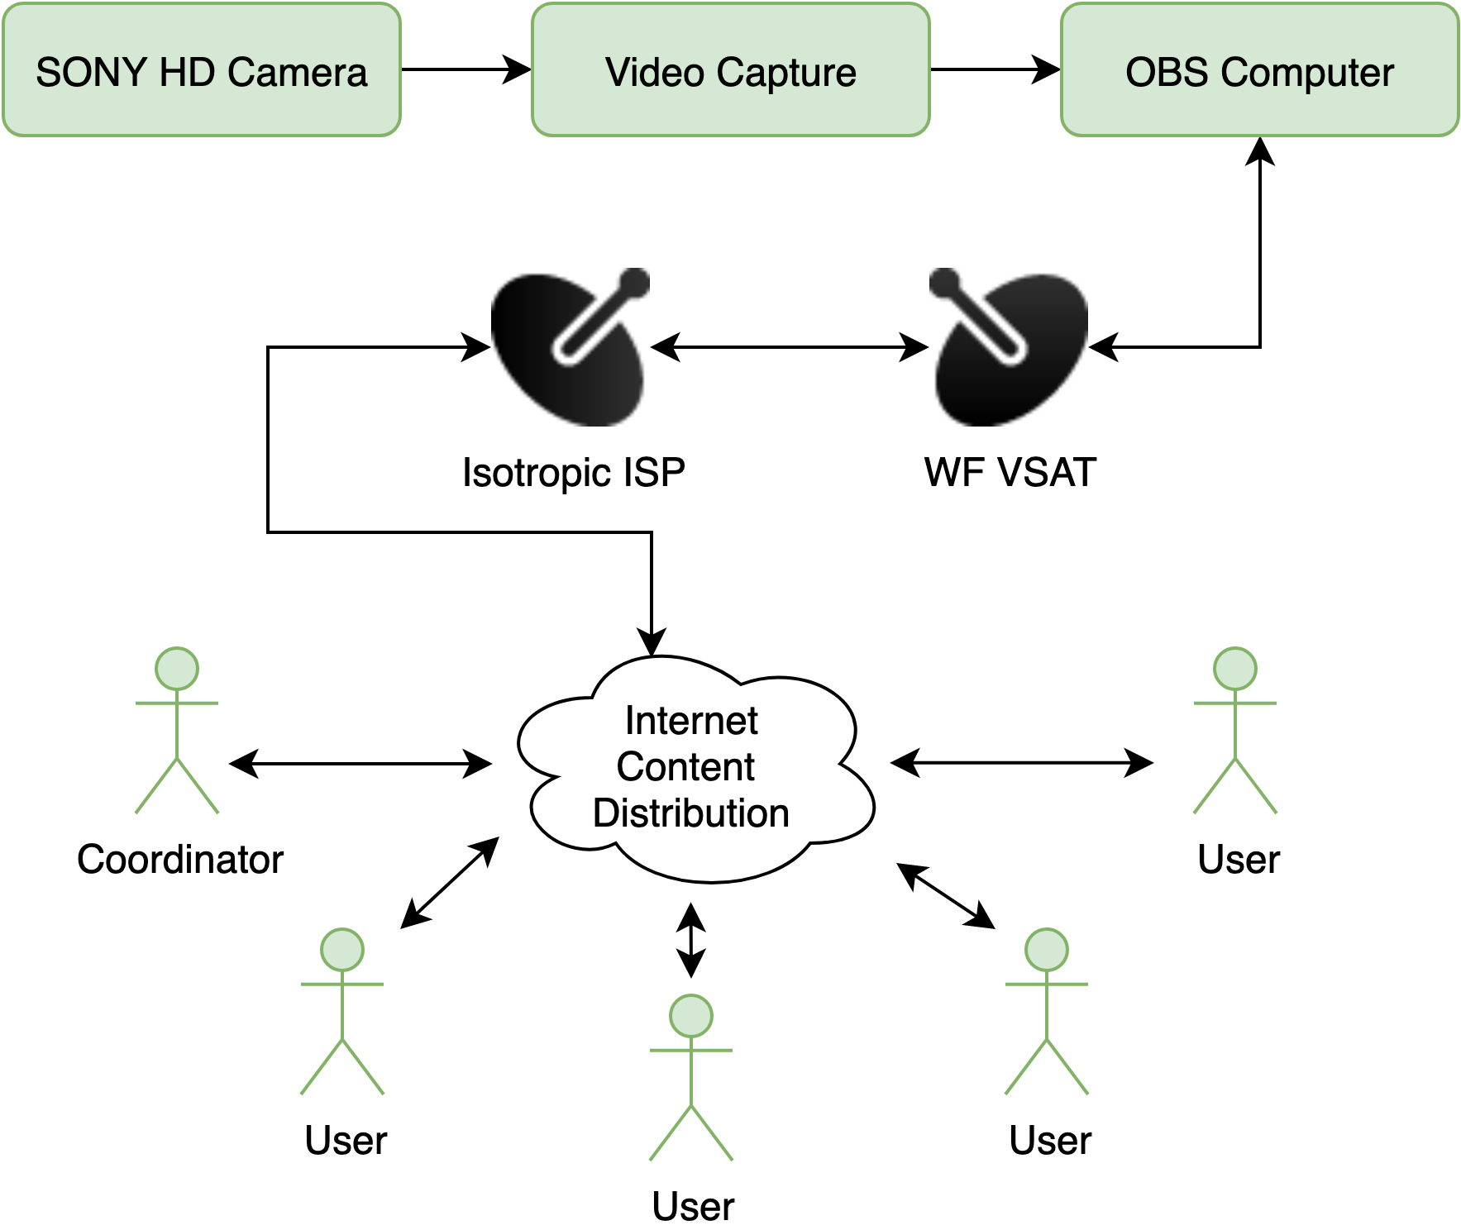
The State of Telepresence Capabilities
Video/Audio are assembled by a broadcaster computer in the ROV control room.
Webex Events are the content distribution
Audio is patched from the ship Telex system
  Not always enabled (contact ship science)
Other data and screens are available to MBARI VPN members.
Notes:
Due to the immediate nature of this problem, we were approved to conduct some experiements on the Western Flyer to prove feasibillity of using existing systems for the requirements we had defined.
We secured an upgraded service plan from the provider, and set about testing a proxy system on the ship.
We were please to find that the system was more than capable of sustaining telepresence activities, with stable connections all day, and tests lasting as long as 30 minutes without any significant dropouts.
Also, we tested a number of services, evaluating quality across 6 users and latencies to each one.

Slide 4
Roles & Responsibilities
Vessel Panelist
🚢
Host
👩‍✈️
Panelist
🧑‍🔬
Audience
🙋‍♀️
On vessel
Connects Webex from Vessel
Telex Audio Control
Troubleshooting
Other ship responsibilities
On Shore
Controls Video Feed
Hosts Webex
Concentrates ship requests
Elevates Audience
On Shore
Watches video
Audio to Boat director/observers
Chat annotation
Other annotation
On Shore
Watches video
Listen Only
Chat annotation
Other annotation

Slide 5
Webex Events
Chosen teleconferencing for reliability and granular participant management. (No Zoom Bombing)
Can split participants between Panelists and Audience Roles:
  Panelists
    can talk on audio to each other and to the boat
    can chat with each other and audience
    can see the video (and share video, though that should be restricted use only)
  Audience
    Can see the video
    Cannot Talk
    Can chat with Panelists
    Can be elevated to panelist by the host
All participants have to register, links are sent daily for security.
Make sure to enter with your video and audio turned off.

Slide 6
Novel Operational Timeline
Pre-dive a webex event is started by a host on shore
The ship broadcast PC (teleops.[wf/rc].mbari.org) connects as a panelist
Shore based clients connect to the event as panelists or audience
The host can control what is displayed on the video stream for everyone.
The host can choose who can speak to the boat
All clients have access to the chat.

Slide 7
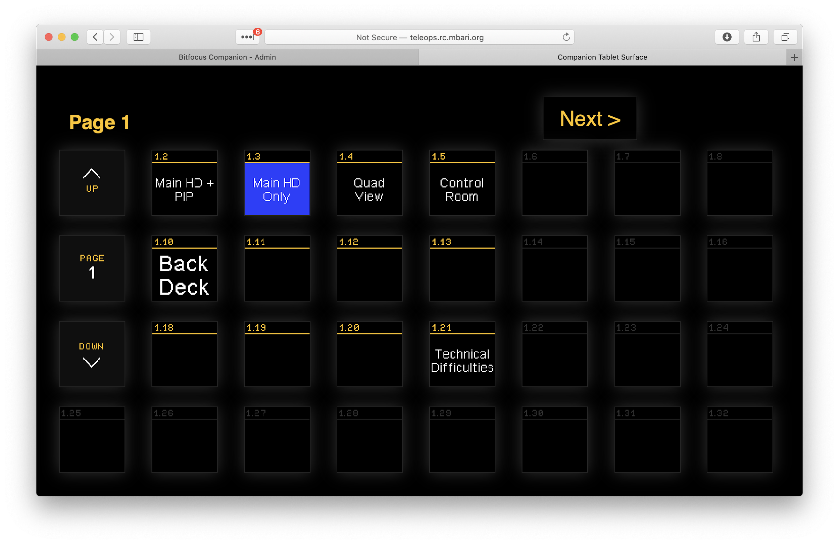
Video Feed Control
Web interface
Mirrors buttons in control room
Changes for all parties
Should only be used by lead offshore members
http://teleops.[rc/wf].mbari.org:8000/tablet.html
Notes:
http://teleops.rc.mbari.org:8000/tablet2.html

Slide 8
Audio Paradigms
Fully Open to Telex Intercom:
  Fully bi-directional conversations
  Pros: Allows for best emplacement
  Cons: Does not isolate bridge communications
Half Open to Telex (Current):
  Shore talks to the intercom
  Shore can only hear 1 dedicated microphone in control room.
  Pro: Provides some isolation (shore cannot hear telex)
  Con: Shore does not know when to talk and cut in, are unaware of ship/rov issues.
Multi-channel or Matrix systems:
  Multi-channel is possible on Rachel Carson, not on Flyer (upgradable)
  Matrix is the most flexible, but also most complex.

Slide 9
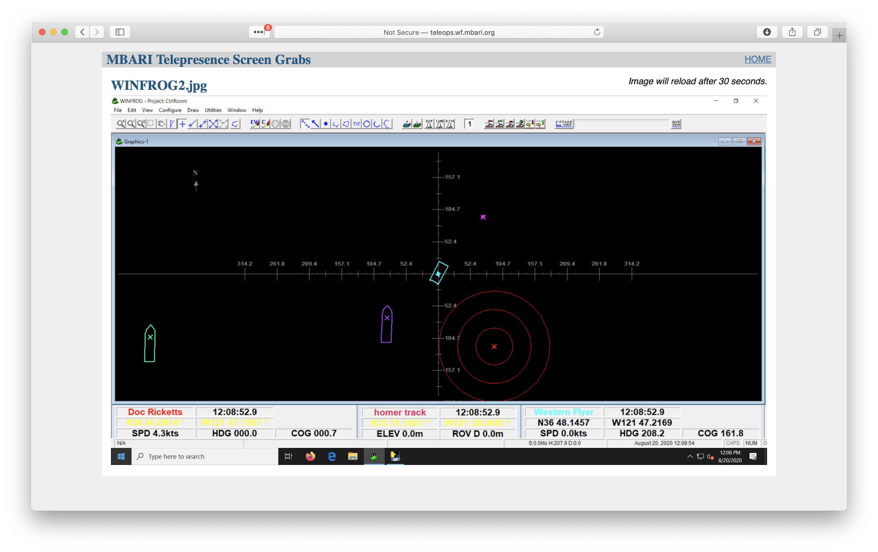
Contextual Data
A webpage is updated every 30-seconds with framegrabs of key PCs running in the control room.
  Winfrog (Navigation)
  Sonardyne (USBL Tracking and Navigation)
  Scanning Sonar
  Multibeam Sonar
  CTD
  More?
Currently only available to members with VPN access to MBARI’s network
http://teleops.wf.mbari.org:80

Slide 10
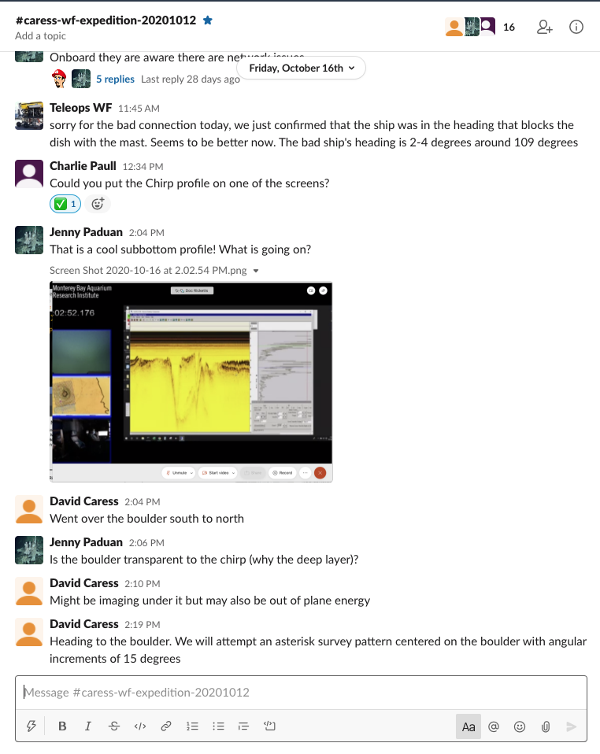
Annotation
VARS can be run onshore, contributing to the shore database:
  Latencies must be low
  Frames will be saved post-expedition when the video is back at the lab
  Only one contributor at a time.
Webex Meetings has a chat window
  Can be periodically exported by anyone to text file
  Texts are locally time and user tags
Slack has been a key tool for collaboration on our cruises, and can include non-MBARI participants easily.
  Slack conversations are difficult to export, they do not replace VARS.

Slide 11
Privacy Policies
MBARI must protect our IP and privacy of our working groups.
All parties would like to know who they are speaking to, and who is listening.
A full policy document can be found here [link]
Important Rules:
Only enable your microphone if you are talking to other participants and disable your personal computer camera.
Be aware that latencies exist due to satellite and microwave communications. Wait for a quiet period in the control room before interrupting.
Do not carry on audio discussions with the ship during critical safety operations such as launch/recovery.
No audio/video recordings or restreaming of the feed are permitted without consent of the chief scientist aboard. This includes sharing this with large groups at your workplace.
Imagery is permitted (screengrabs) for documentation, but sharing on social media is allowed only with consent of the chief scientist.

Slide 12
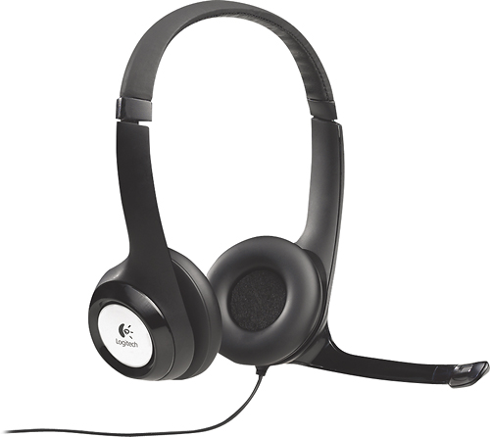
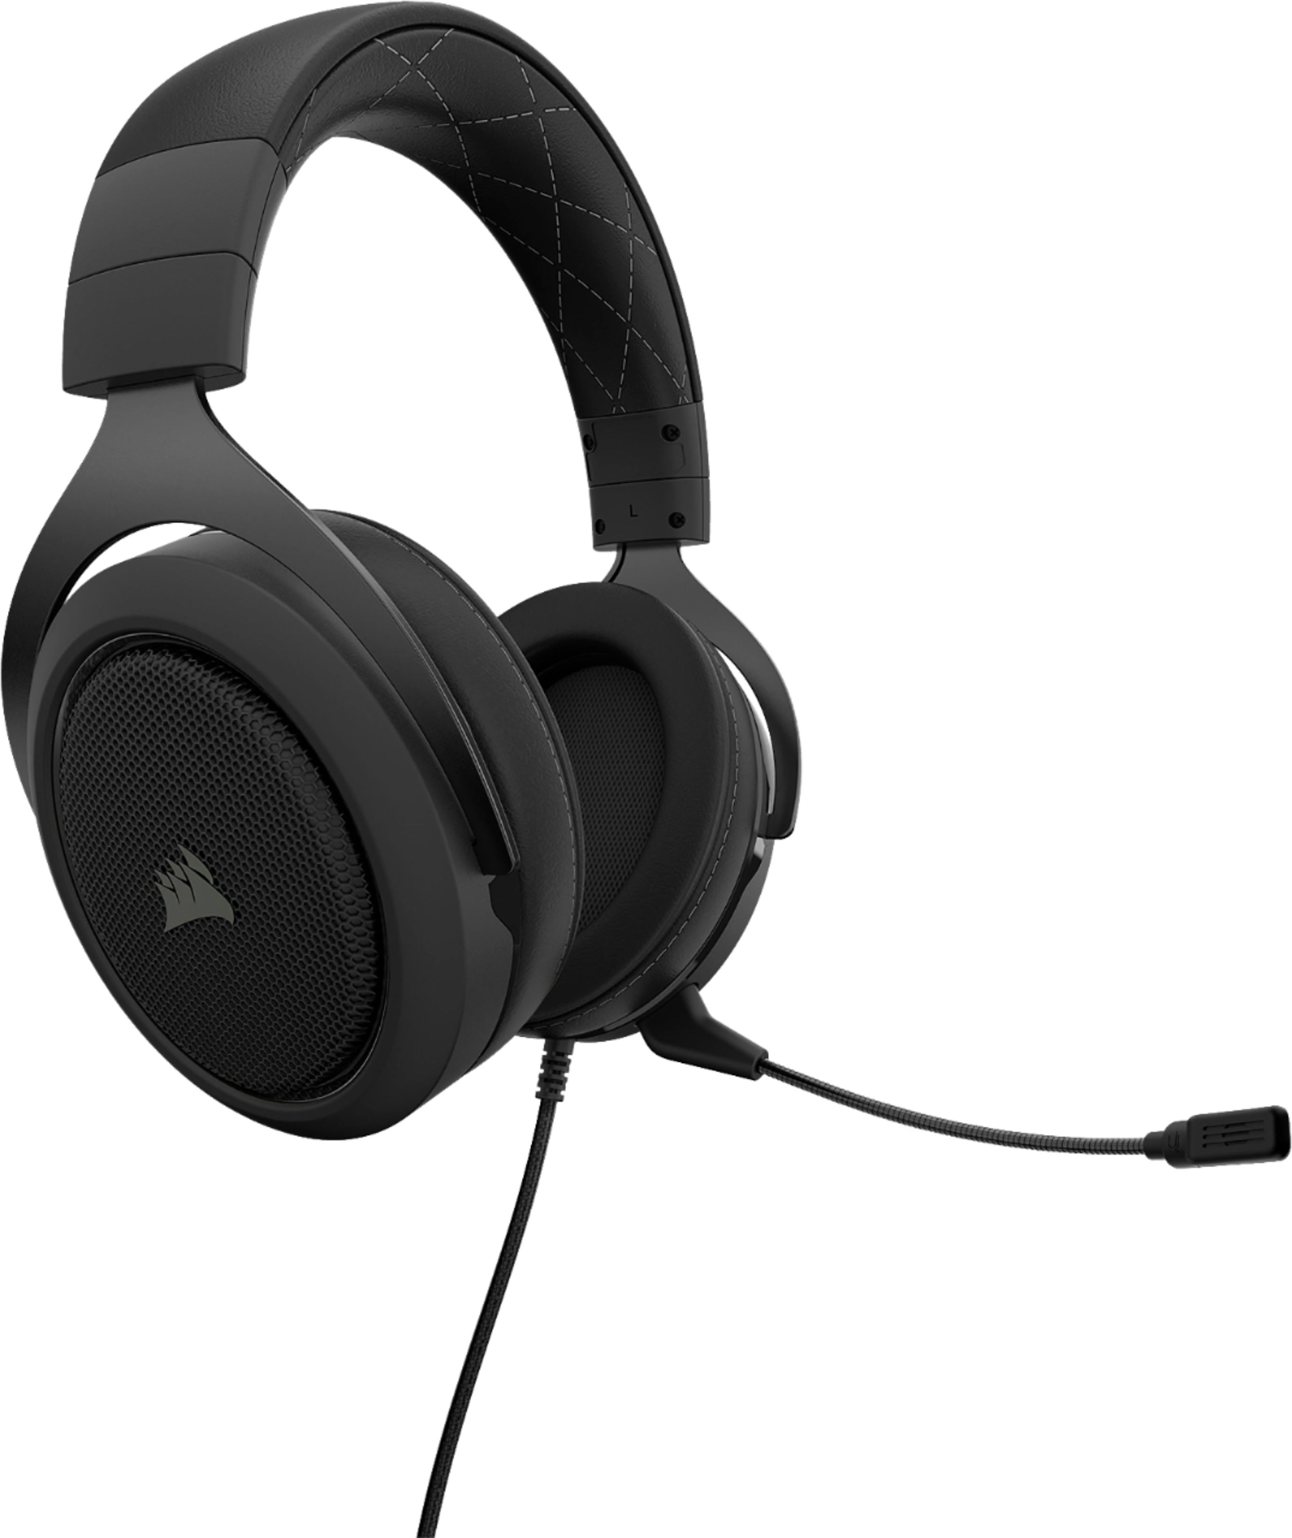
Etiquette and Best Practices
Follow the same rules as in the control room.
Request Telex isolation prior to a lengthy discussion
The whole ship may hear you otherwise.
Be conscious of ship operations.
Get a good headset, to avoid echoes:
  Logitech H390 (on ear)
  Corsair HS60 (over ear)
  We have some available for loan
Use a wired network connection
Use the webex application (test early)
Test your connection to MBARI
Use Split-tunnel VPN

Slide 13
Failover Planning
The VSAT is reliable but many factors can affect connection:
  Technical issues
  Weather
  Atmospheric conditions
  Space oddities
  Latitude
Make sure you have a plan to move critical roles onto the boat in the event of connectivity issues both for VSAT and home issues.

Slide 14
Specific Software Access
Every group needs some special access unique to their science
Computer video available
Audio Feeds available
Some limited VNC remote desktop available

Slide 15
What’s next?
Please provide feature requests to emartin@mbari.org
We are working with IS to provide some access to things behind MBARI’s firewall and reduce ship bandwidth.
You can use these systems off dive-time to conference with people on shore.

