Slide 1
902102 Multi-LRAUV Simulation Environment
Multi-LRAUV applications are a key component in MBARI field programs
CANON (Chavez) ESP (Birch and Scholin) Targeted Sampling (Zhang) Precision Control (Rock) | Acoustical Ocean Ecology (Benoit-Bird) Biodiversity & Biooptics (Haddock) EyeRIS (Katija and Roberts) soon Scalable Robotics (Troni)
We anticipate the demand and complexity of multi-LRAUV applications at MBARI will only increase in the future
How to scale?
How can we scale up multi-vehicle operations at MBARI?
How to go from LRAUV pair to a collaborative fleet?
How to develop?
How can we improve development for multi-vehicle applications?
How can we increase reliability and performance in the field?
How to export?
How can we make the LRAUV software more extensible?
How do we optimize our development efforts to support technology transfer?

Slide 2
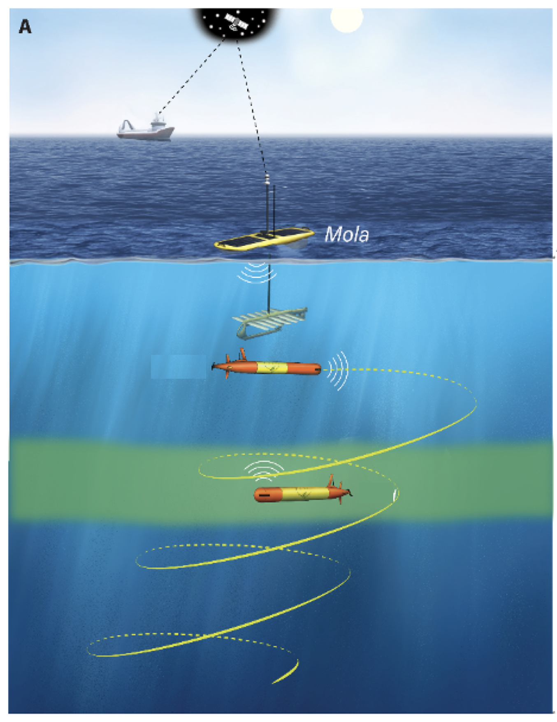
902102 Multi-LRAUV Simulation Environment
Targeted sampling within a Lagrangian reference
frame is inherently a multi-vehicle problem
Sampling vehicle tracks a feature of interest (and samples)
Sentinel vehicle vertically surveys neighboring waters to capture contextual data
Developing multi-vehicle capabilities for LRAUV rely heavily on testing in the field
(High overhead → slow development cycle times)
Practice in simulation can support rapid prototyping/testing of next-generation algorithms for multi-LRAUV apps
Developers can test new designs in the simulator prior to leaving the lab, then deploy the final product to the AUV for execution at sea
Figure: Zhang et al. (2021), A system of coordinated autonomous robots for Lagrangian studies of microbes in the oceanic deep chlorophyll maximum. Science Robotics

Slide 3

902102 Multi-LRAUV Simulation Environment
Alongside MBARI’s growing fleet of AUVs, developing tools for design and validation of new robotic applications will be crucial for scaling up autonomous operations and advancing the ocean research they enable
We are partnered with a team of robotics and simulation experts at Open Robotics to develop advanced simulation tools using open-source software (ROS/Gazebo Ignition)

Slide 4
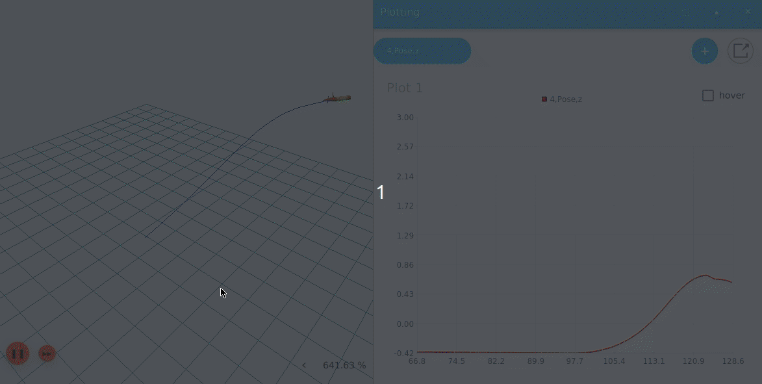
902102 Multi-LRAUV Simulation Environment
We are creating a simulated environment and vehicle models to support rapid prototyping and testing of next-gen algorithms and control software for multi-AUV apps under controlled and reproducible settings
Simulation of LRAUV embedded in the Ignition simulation environment. The simulator supports faster than real-time execution and live data visualization such as the vehicle’s trajectory (left) and depth (right).
Animation by Mabel Zhang, Open Robotics

Slide 5
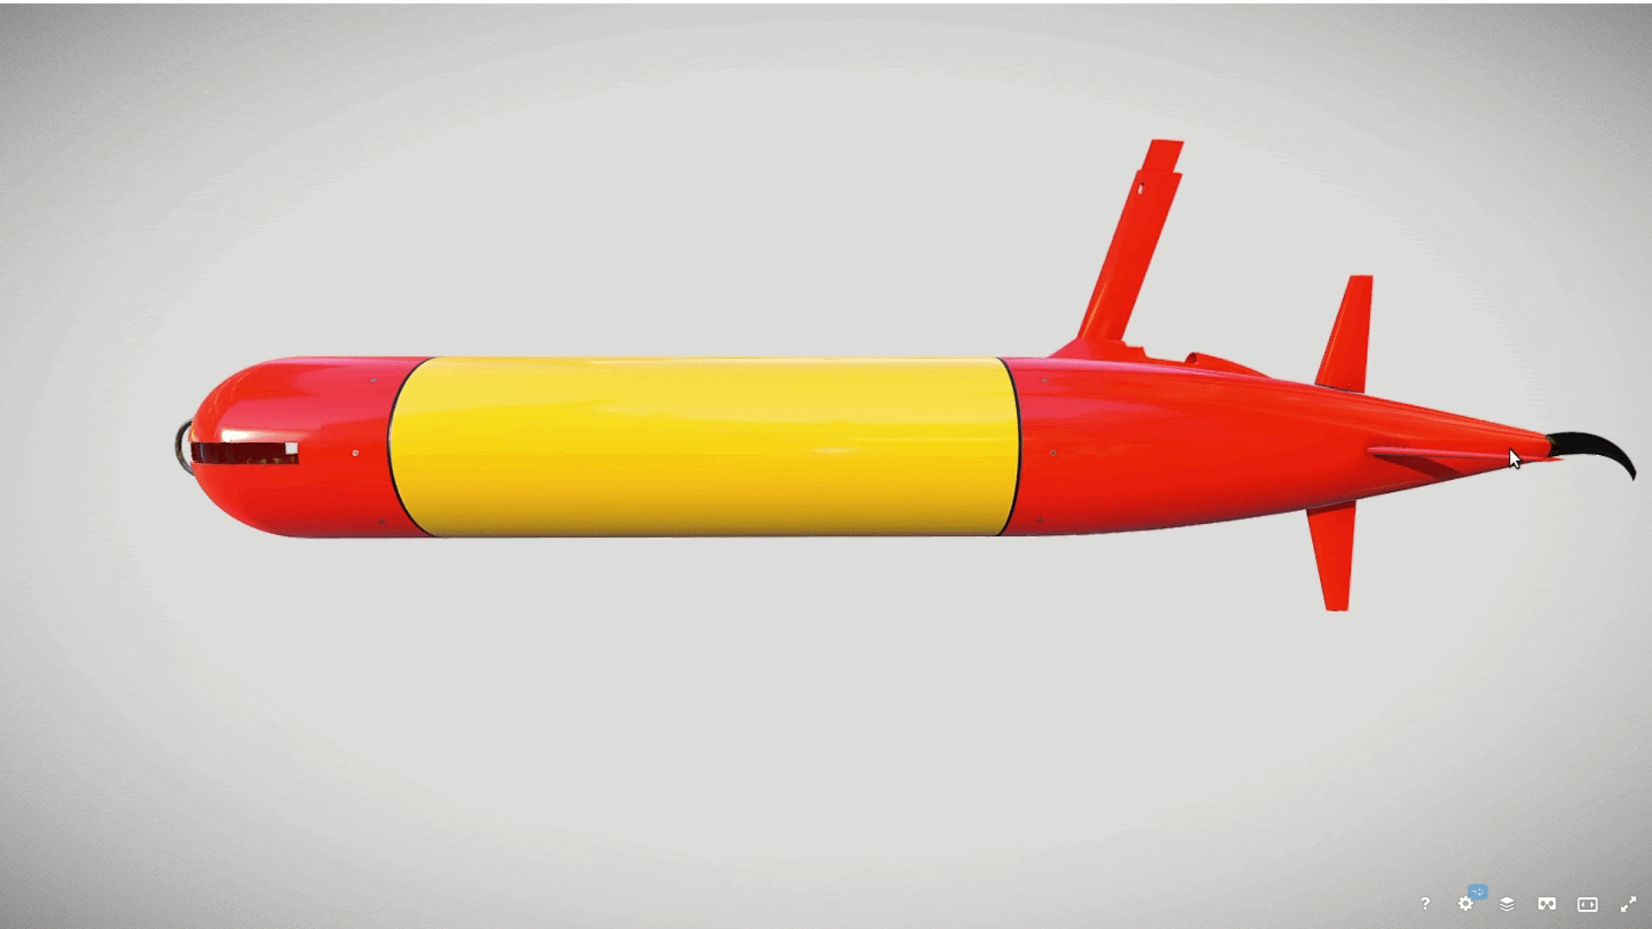
902102 Multi-LRAUV Simulation Environment
In 2021 we:
Delivered a simulated water-column environment with a 3D vehicle model of LRAUV
The simulated LRAUV is controlled by the same software that runs onboard during field operations and can run x130 faster than real-time
Sim environment includes oceanographic and biological water properties such as temperature, salinity, and chlorophyll
In 2022 we will:
Add bathometry maps and DVL plugin for vehicle navigation dev
Add simulation plugins for water sampler and battery
Add ocean surface dynamics (waves, winds)
Export: open-source the simulation package and make publicly available
3D rendering of the LRAUV vehicle model embedded in the Ignition simulation environment
Figure by Carlos Agüero, Open Robotics

