Slide 1


Multi-LRAUV simulation environment
Milestone #1
March 2020

Slide 2
Main goal and milestone #1 tasks
Develop a multi-LRAUV simulation environment
Basic 3D LRAUV vehicle model
Basic water column environment
Vehicle plugins
API and LRAUV software stack integration

Slide 3
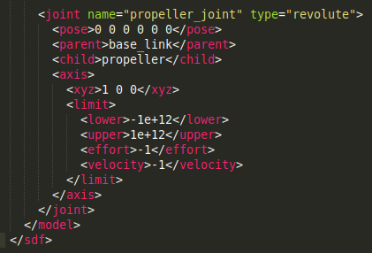
Basic 3D LRAUV vehicle model
Based on the MBARI Tethys CAD file -> Simplified mesh
Create SDF file describing the kinematics and dynamics
Notes:
Kinematric structure of the model as well as dynamics properties
Links: Chassis, propeller, rudder and elevator
Joints: Glue two different links together and add constraints

Slide 4
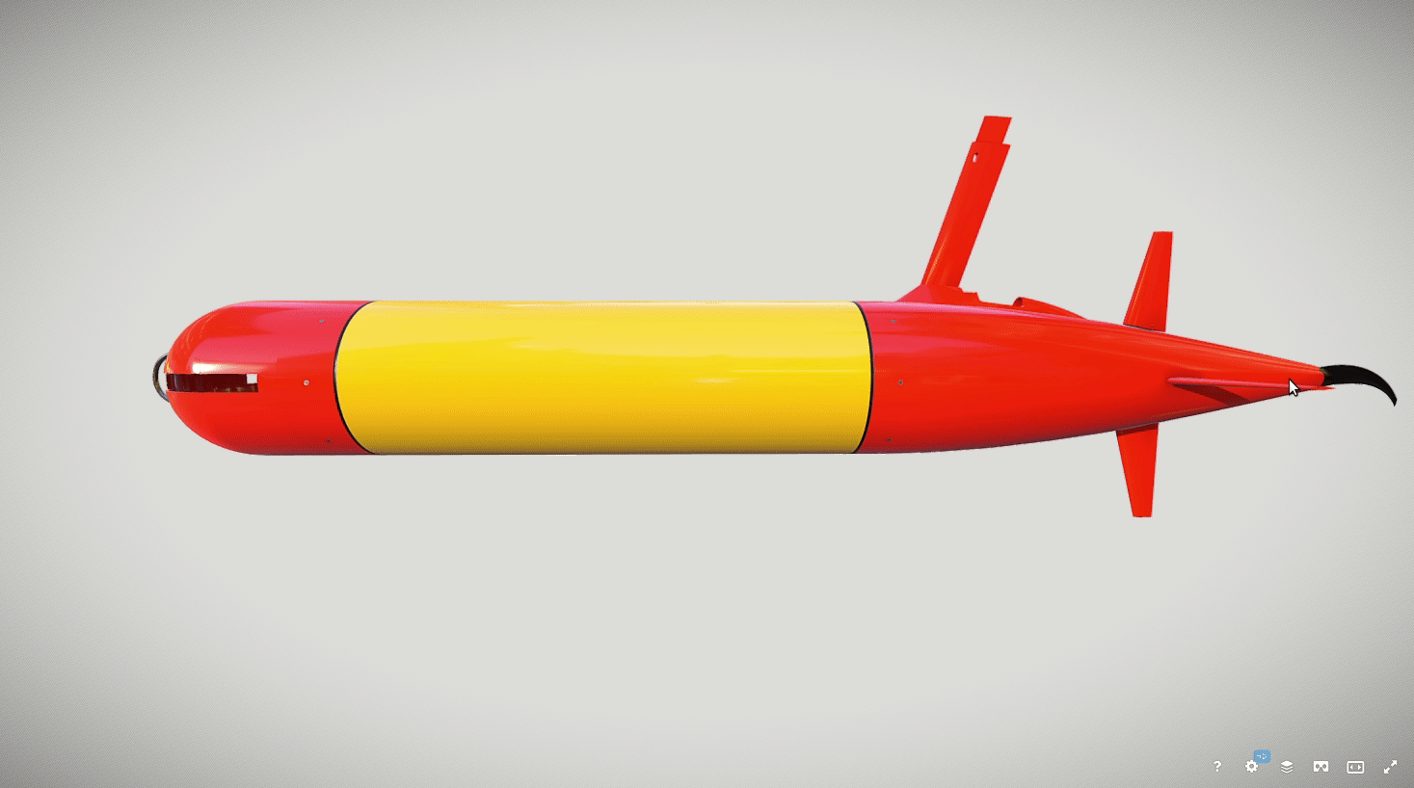
Basic 3D LRAUV vehicle model
Split the original mesh: main vehicle, horizonals fin, vertical fin and propeller
Associate a mesh and texture to each link
Modified tail cone version

Slide 5
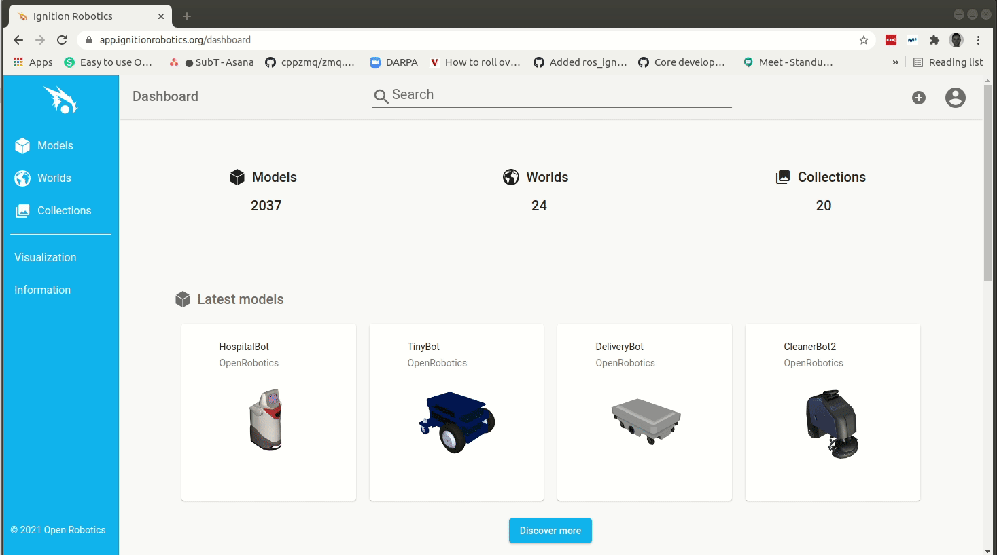
Basic 3D LRAUV vehicle model
Tethys is available at Fuel

Slide 6
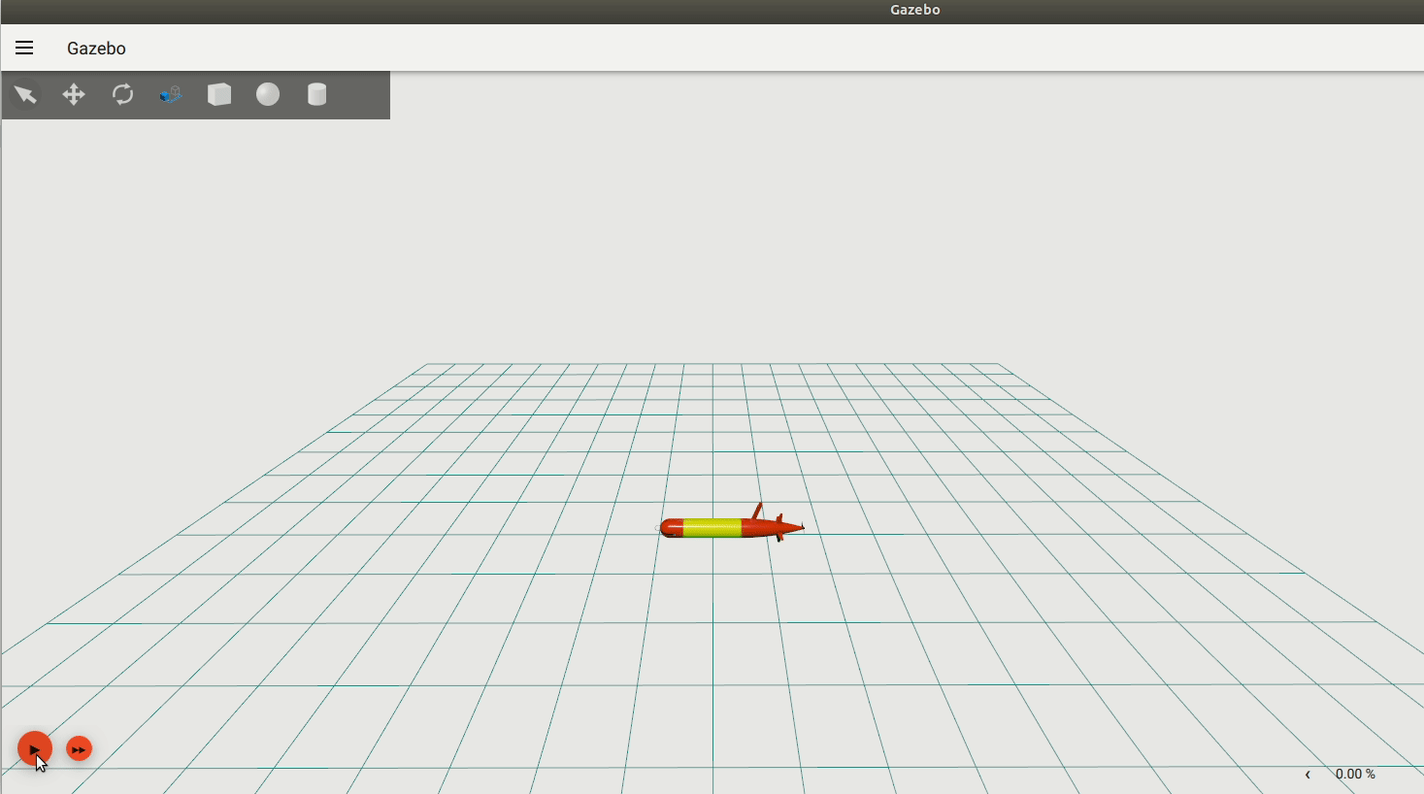
Basic water column environment ⚓
Environment without buoyancy

Slide 7
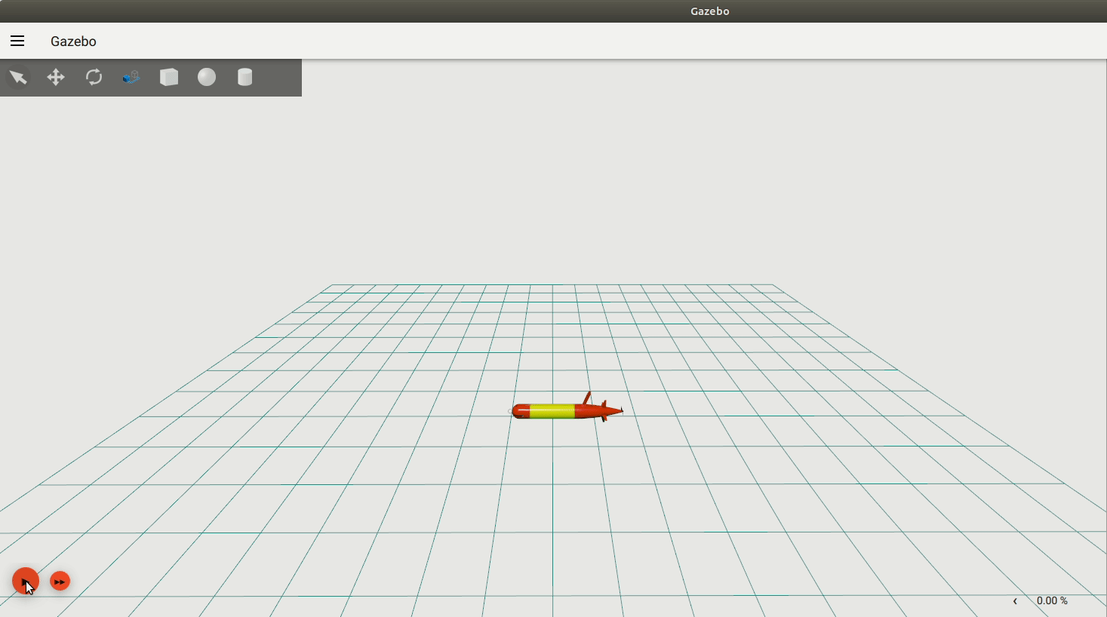
Basic water column environment 🐟
⬆️ Buoyancy plugin
Set fluid density (1000 kg/m³)
Set density of the object placed in the water
≈ Volume of the object
≈ Object collision mesh
Notes:
Ignition Gazebo as a collection of components: Physics, sensor generation, rendering, GUI,...
Plugins allow to customize simulations, for example, adding custom forces

Slide 8
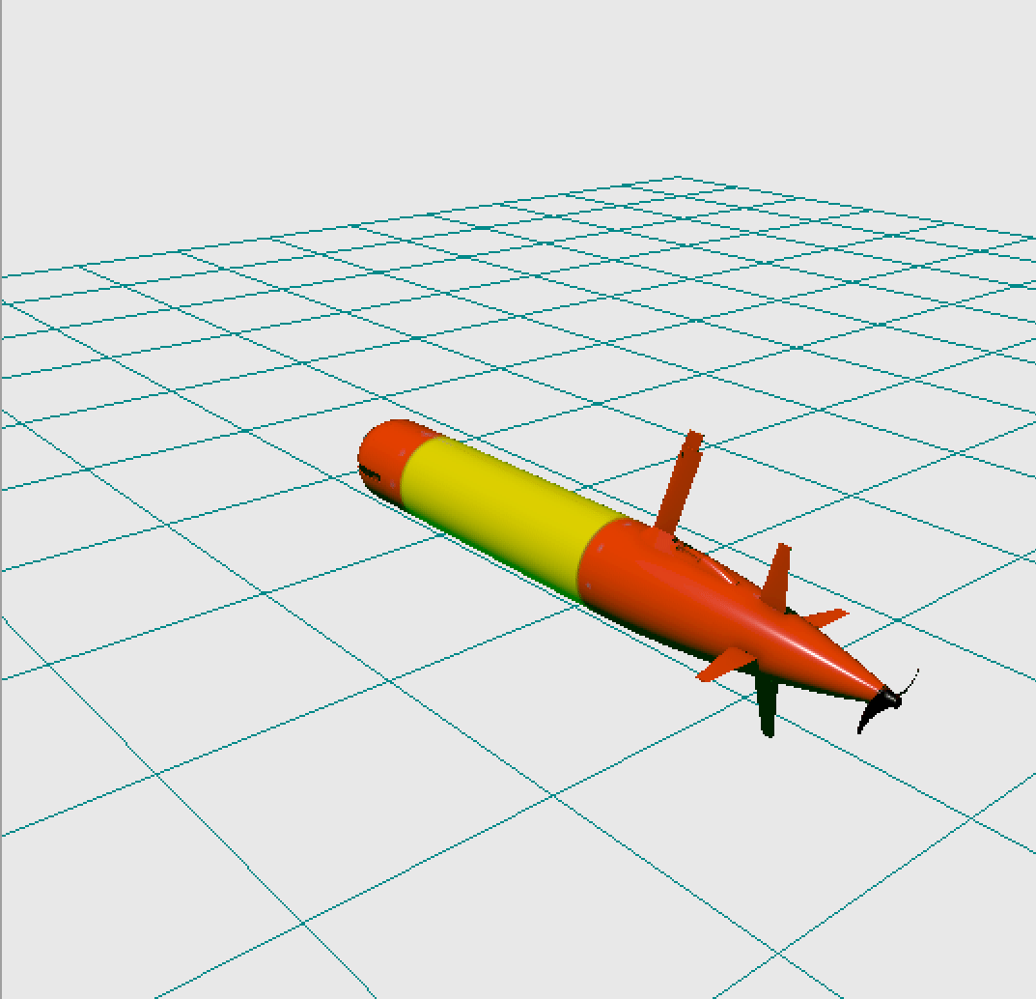
Vehicle plugins - Thruster
Notes:
Contributes with a force in the direction of the movement

Slide 9
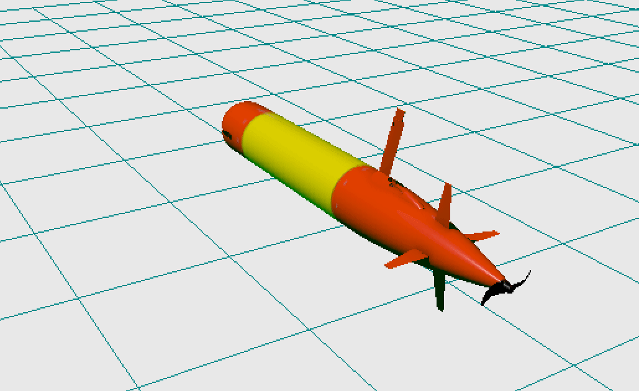
Vehicle plugins - Rudder / Elevator
Notes:
It doesn’t contribute with forces, it just moves the fins.

Slide 10
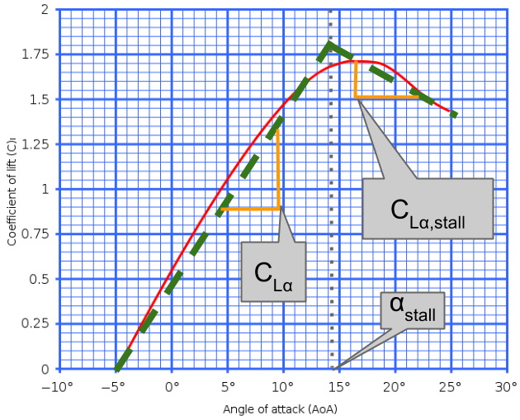
Vehicle plugins - Lift/Drag
Notes:
Contributes with lift and drag at each fin center of mass
Slope

Slide 11
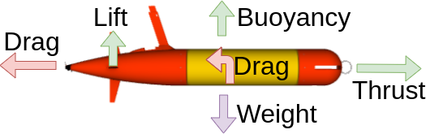
Vehicle plugins - Hydrodynamics
Notes:
Counteract the movement from the thrust and the rotation generated by the fins
Based on Fossen’s equations
Compute three terms: Added mass, drag and coriolis based on multiple parameters that are passed to the plugin
These parameters have been provided by MBARI

Slide 12
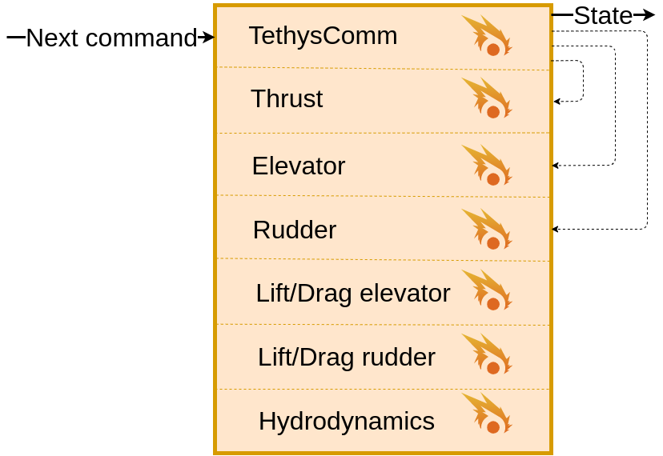
Vehicle plugins - TethysComm
Notes:
Diagram represents all running plugins in Tethys
TethysComm represents the public plugin
Input: The next command (coming from the MVA code)
Applies that command.
Produces the state and send it back to the MVA code.

Slide 13
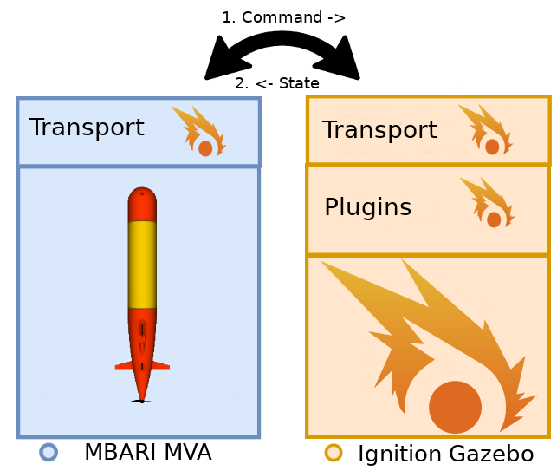
Simulation API
Message passing interface
Propeller, rudder, elevator
Command message
State message
Notes:
Contract between the simulation and the code controlling each robot

Slide 14


LRAUV integration
Ignition World Statistics (time)
Ignition time is published every simulation iteration - “heartbeat”
SimDaemon: ExternalSim
Ignition: ExternalSimIgnition
One control iteration:
Wait for control loop to elapse, 400 ms in sim time
Set LRAUV clock to latest Ignition time
Command
Wait for state
State
(not shown: once per plugin iteration)
Write state to Slate
Notes:
In case asked:
World Stats is published every simulation iteration, default 1 ms.
State is published every plugin iteration, which is slower, but still more frequent than commands from LRAUV, in RTF 1.
For simplicity, the diagram only shows 1 State message. The reality is that you might have multiple State messages during the 400 ms wait. In addition, the Wait period between Command and State can be longer or shorter, depending on dt.

Slide 15
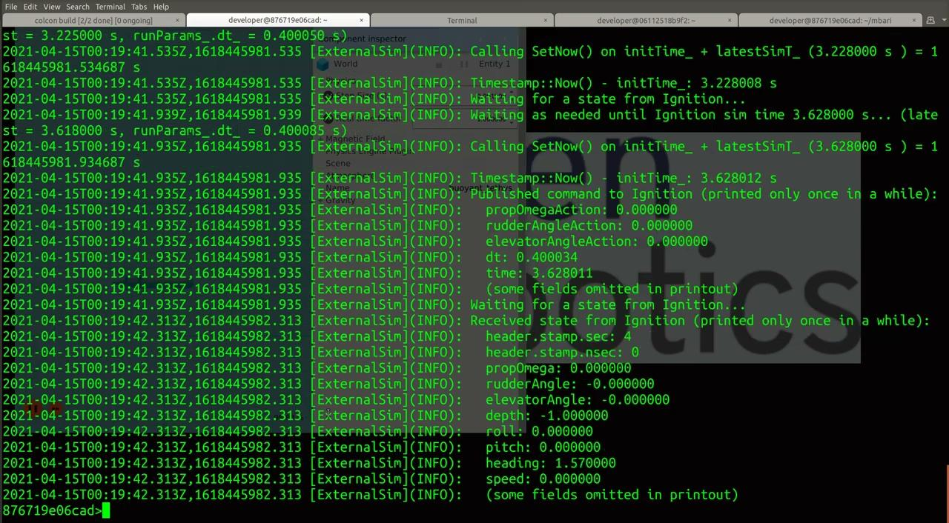
Integrated simulation in real time
maintain control HorizontalControl.rudderAngleAction -0.2 radian
maintain control SpeedControl.propOmegaAction 300 rpm
Notes:
If video doesn’t play (error 5) in Chrome, enable third-party cookies (click on the eye on the right end of the address bar, click Allow cookies)

Slide 16
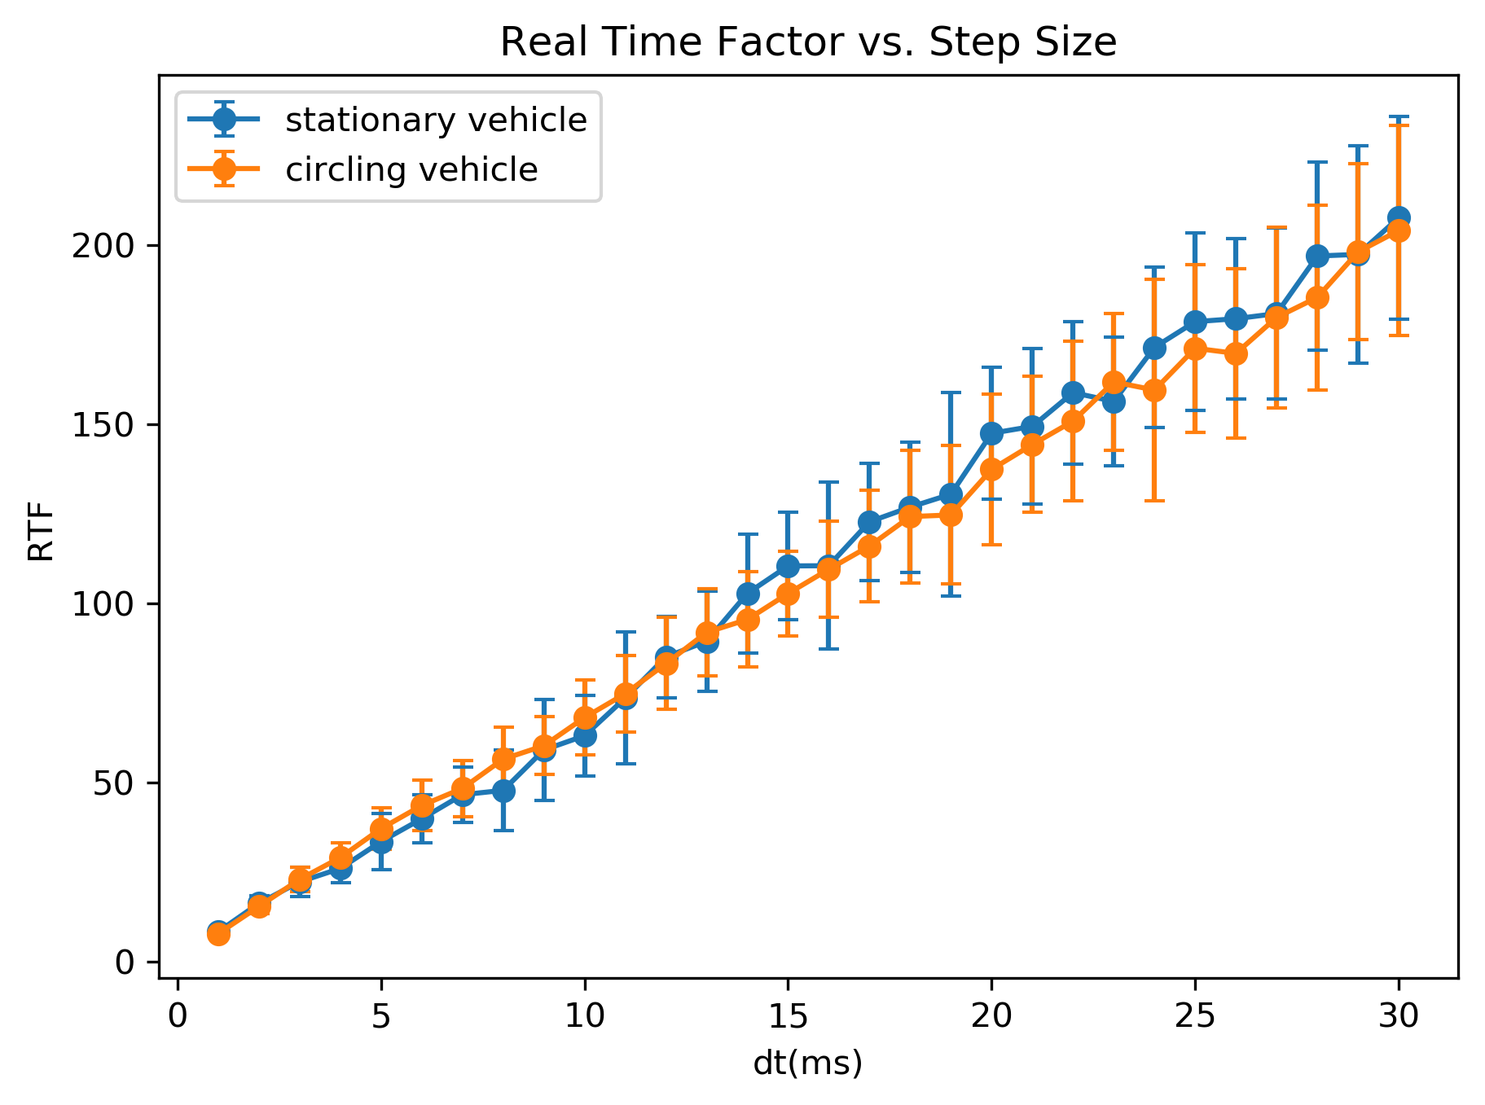
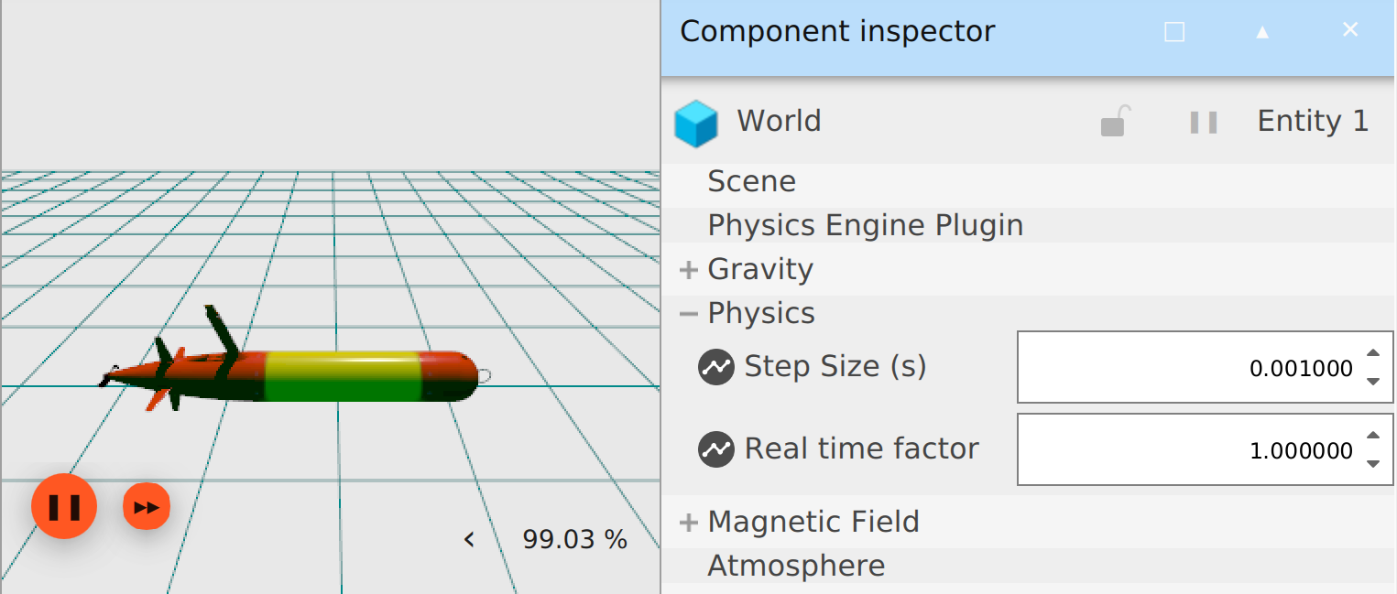
Faster-than-real-time Ignition performance
Set in Ignition or SDF
  Real time factor: 0 (AFAP)
  Step size (duration per iteration)
No change in LRAUV setup from RTF 1
100x FTRT
Notes:
Plot is Ignition only, no integration. This is expected to be faster and dependent on the machine.
Future work: Controller instability is expected when too fast

Slide 17
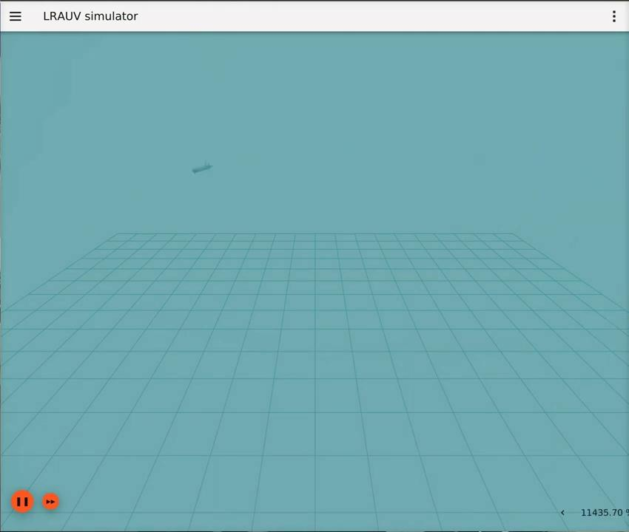
100 times faster than real time, Ignition only
Set in SDF:
RTF: 0 (AFAP)
Step: 0.02 ms
… or, not so fast, look out?
Notes:
If video doesn’t play (error 5) in Chrome, enable third-party cookies (click on the eye on the right end of the address bar, click Allow cookies)

Slide 18
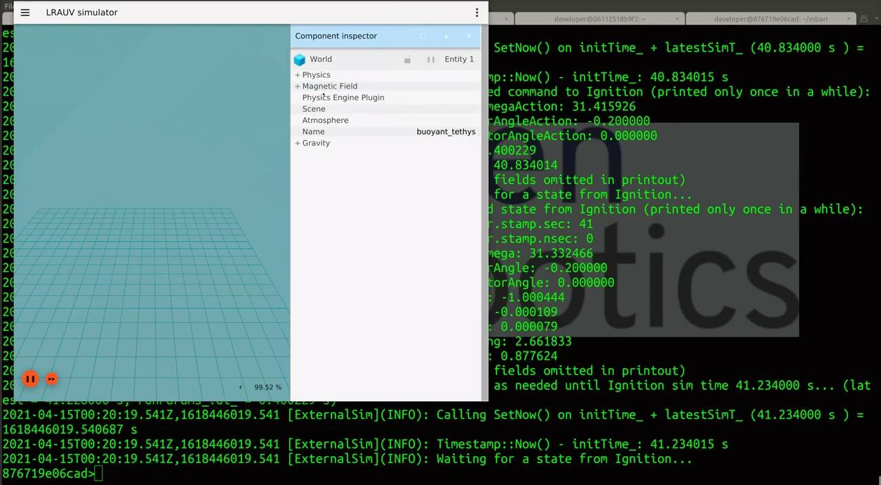
100 times faster than real time, integrated
Notes:
If video doesn’t play (error 5) in Chrome, enable third-party cookies (click on the eye on the right end of the address bar, click Allow cookies)

Slide 19
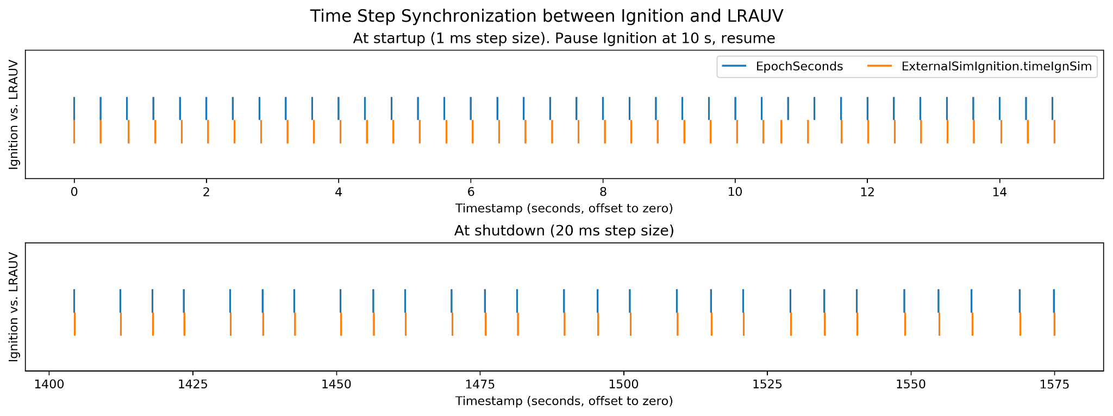
A 1500-second run with various step sizes
Time step test
Pause test
Time step test
Notes:
Main point: Stays synchronized after pause and time step changes.
To field questions:
Vehicle is moving after 20 s.
Dynamic step size change requires some time to stabilize.
Resuming a pause takes a little extra time to come back. No State messages are published when paused, so LRAUV code waits for a while.

Slide 20
Thanks!

Slide 21
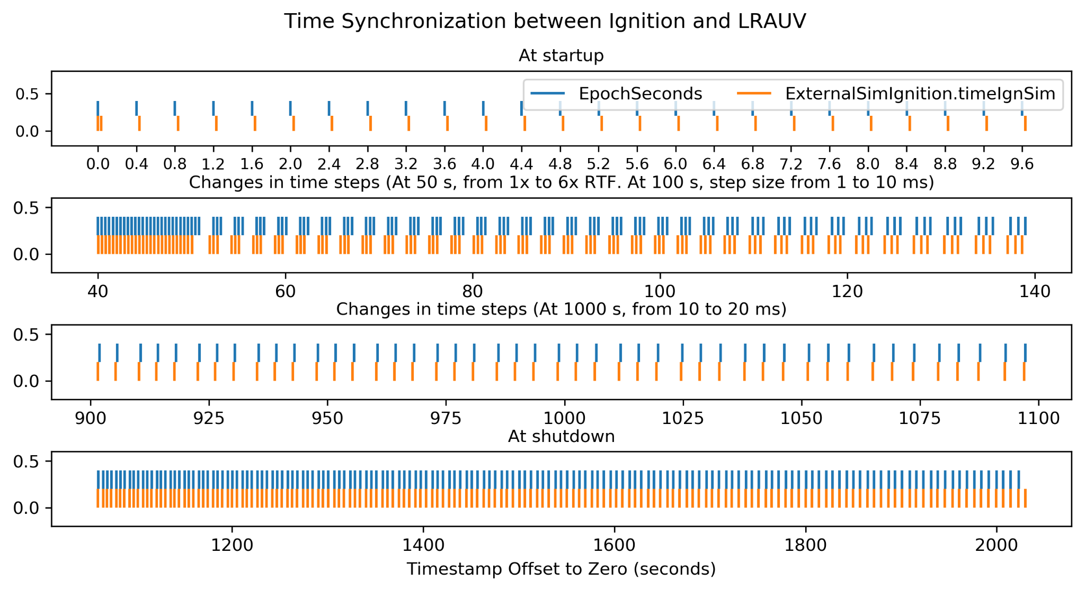
Notes:
Backup slide in case people ask about dynamic change to time step

