Slide 1
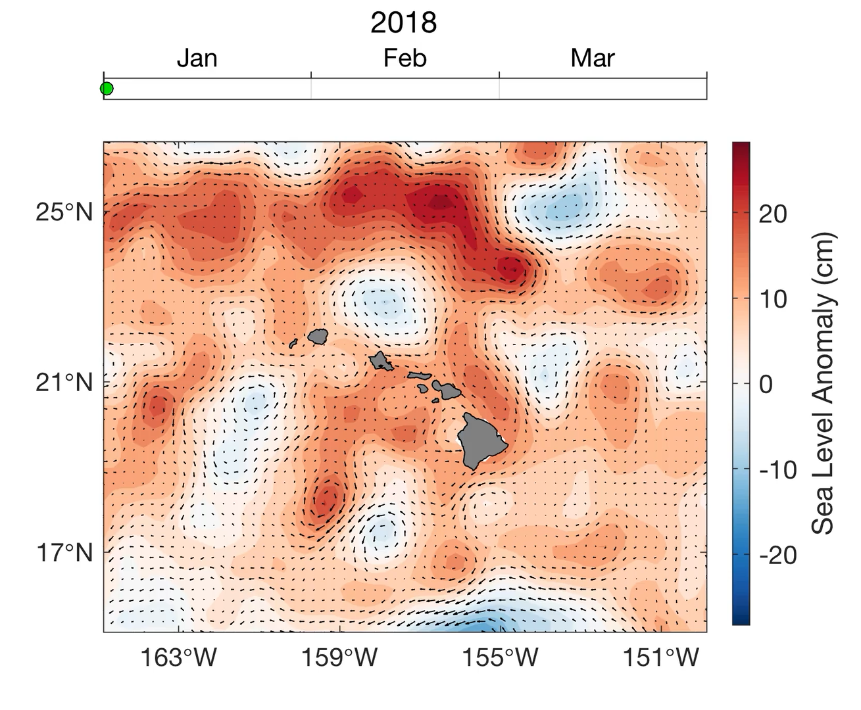
AUTONOMOUS VEHICLES for EDDY EXPLORATION

Slide 2
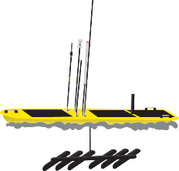
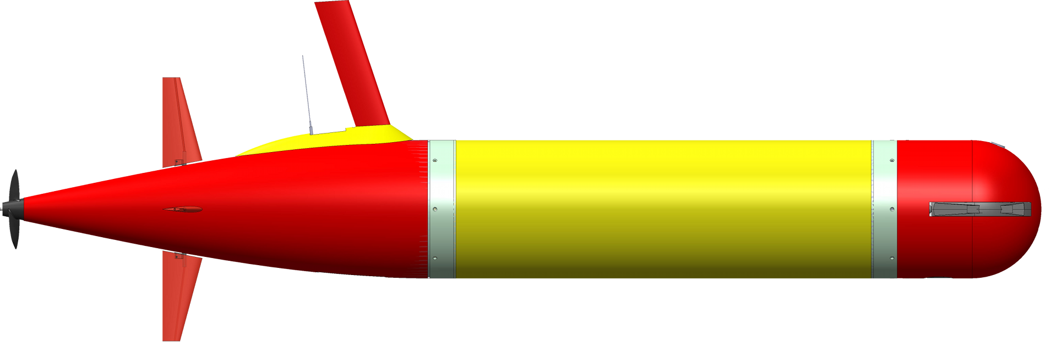
The Behaviors
Aku: drift within layer and SAMPLE
Wave Glider: stay with Aku
Opah: spiral around Aku for contextual measurements
Opah
Aku (with 3G-ESP)

Slide 3
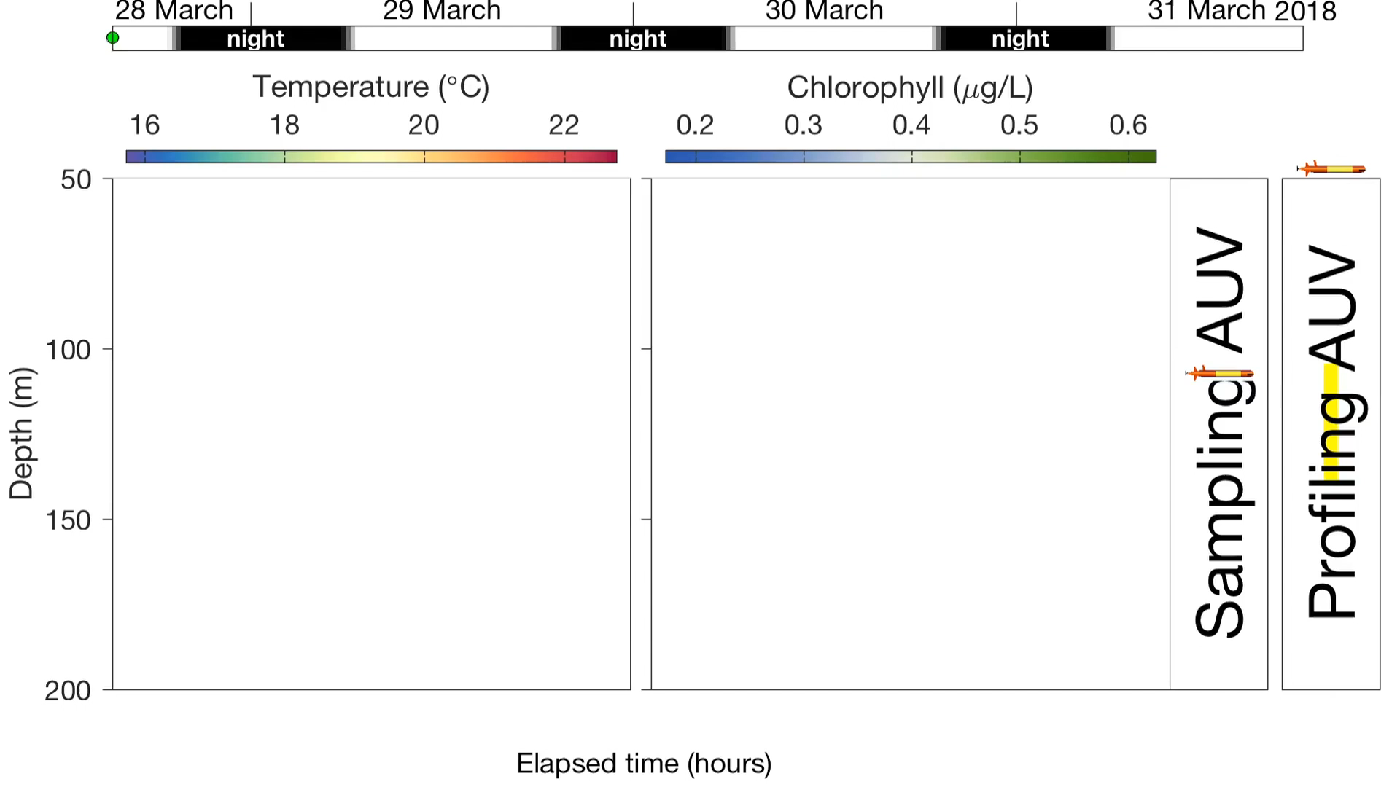
Drift without surfacing

Slide 4
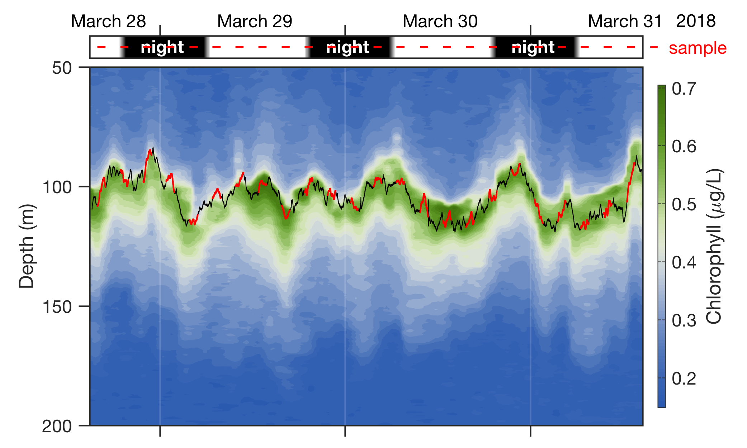
Drift without surfacing

