Slide 1



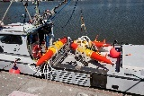

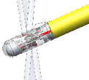

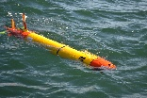

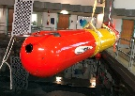

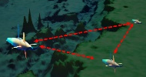
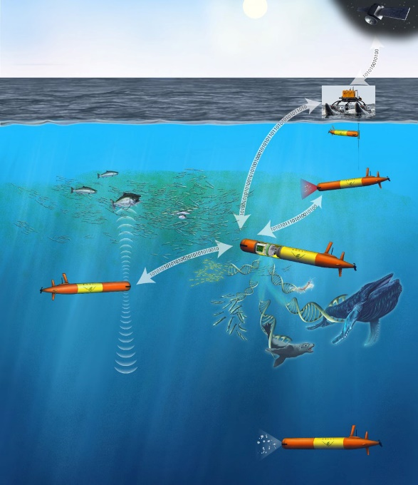






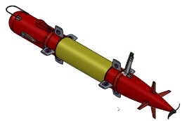

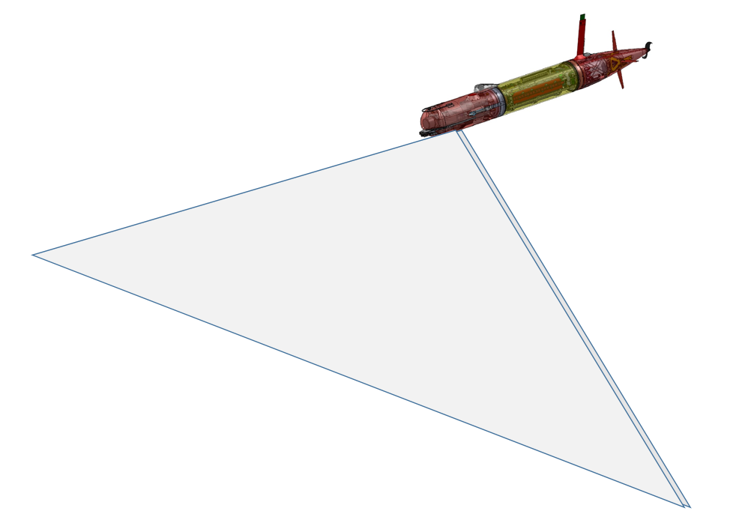

Biological Oceanography CANON, Sipper Sampler
Targeted Sampling
Multi-vehicle Opps
Bio-acoustics
Zooplankton
LRAUV
Development Roadmap
2009
---
2020
HABS & Microbes
3G ESP, MiVEGAS
Zooplankton Biodiversity
Bioluminescence
Terrain Relative Nav
Low Altitude Control
2021-2024
Autonomy – Smart Sampling
  Machine Learning
  Open Source Algorithms
  Backseat Computing
  Target Following
  ESP, Bio-acc, Biolum processing
Persistence
  Tow-out/back
  Bluewater recovery/recharge
  WEC Docking, NG Neobium
Multi-vehicle
  Collaboration,
  ROS/Gazebo Simulation
Deep Vehicle
Mapping
Low-altitude Imaging
2025 - 2029
Find, follow and sample hot spots, anywhere, for months on end
Map and image in complex terrain down to 1500m
Watch a legion of new users around the world extend MBARI’s success with their own LRAUV applications and discoveries
?

Slide 2
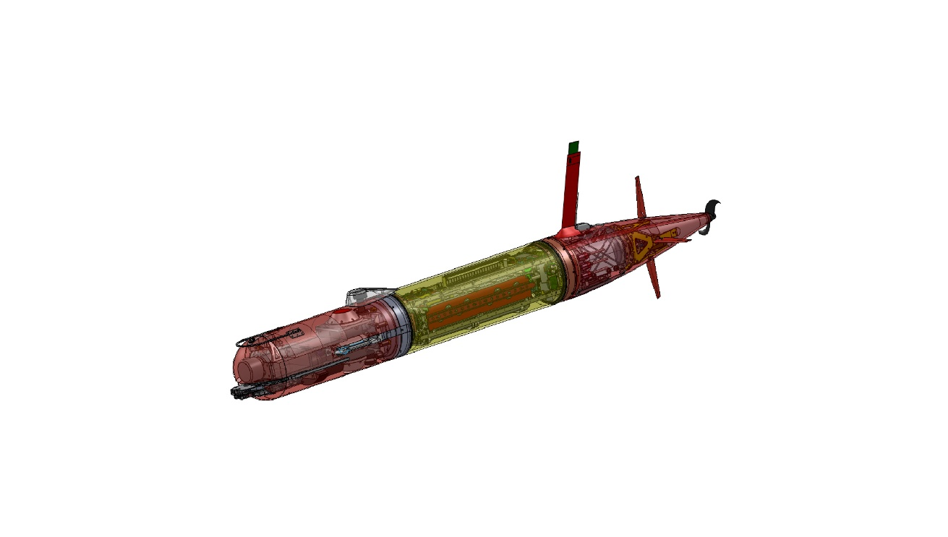

Slide 3
