Slide 1
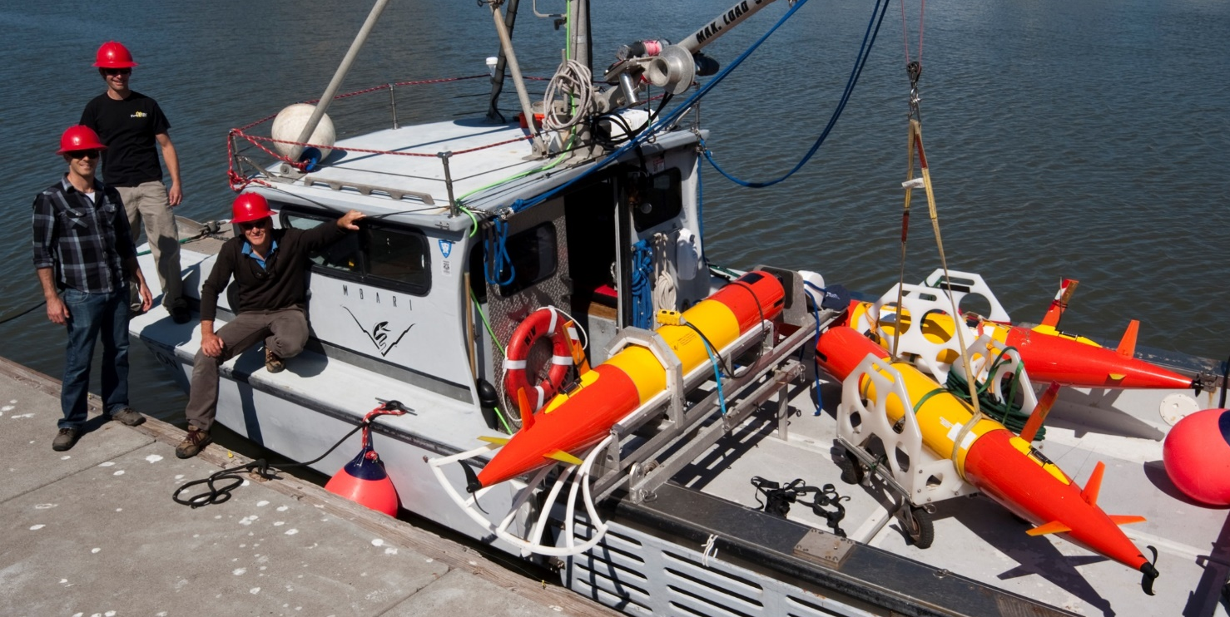
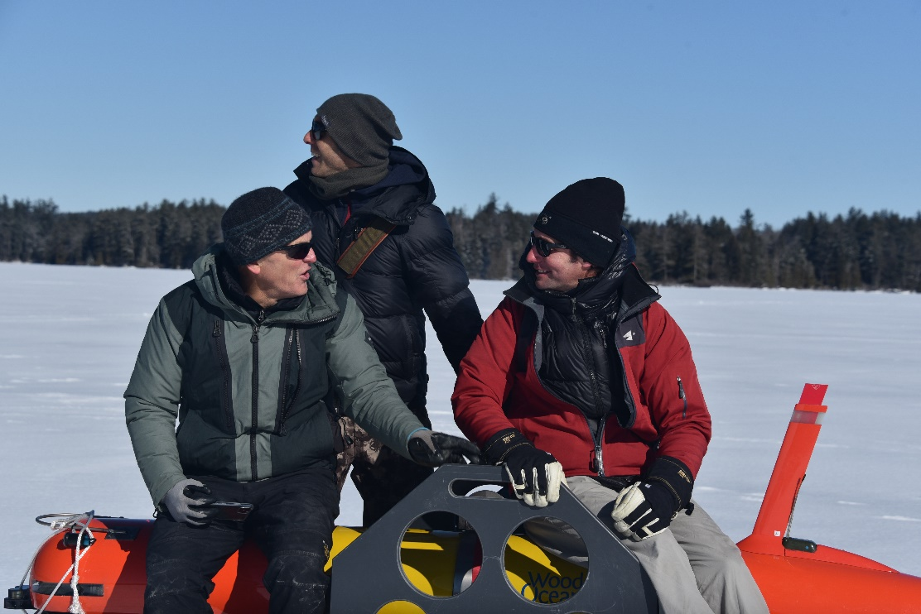
902101 LRAUV Technology Development
and Fleet Operations
Brett Hobson, Brian Kieft and Ben Raanan
“The B-Team”

Slide 2
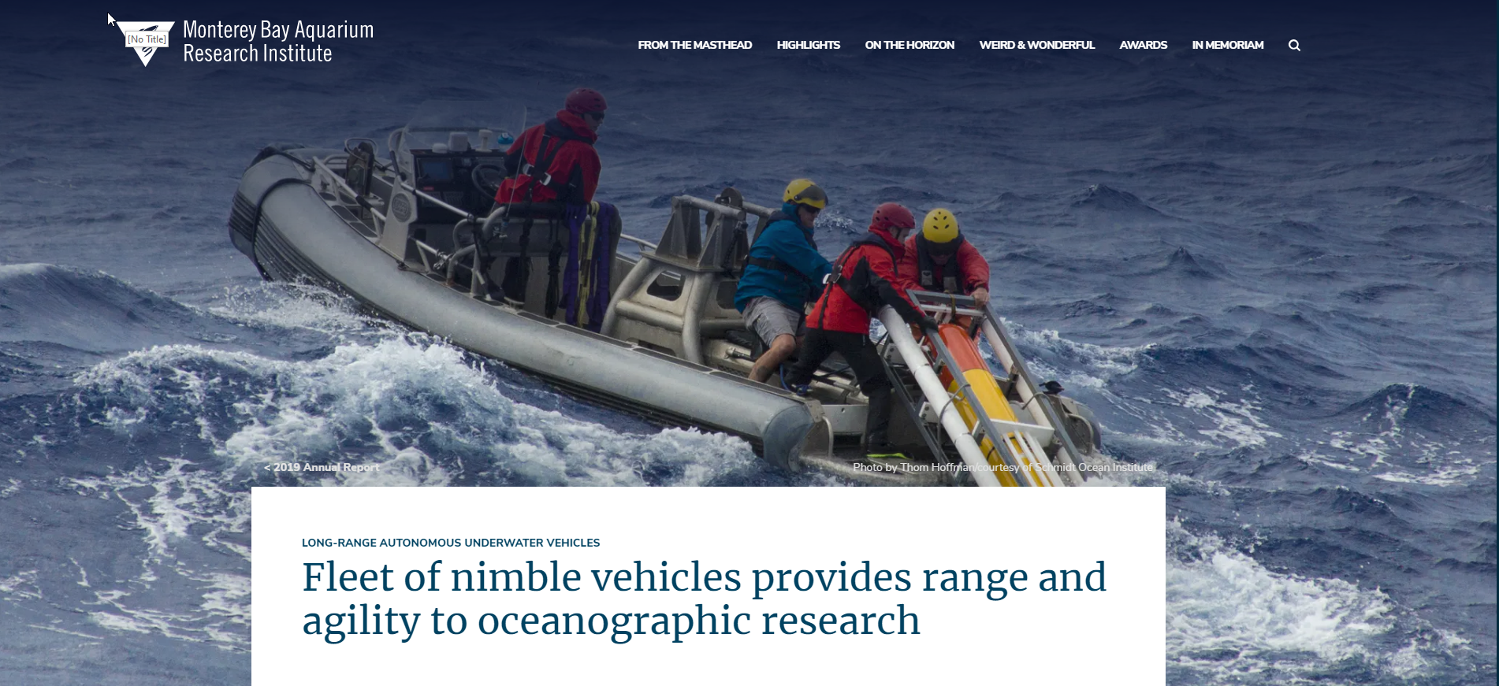



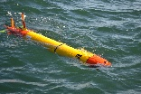

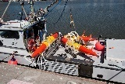

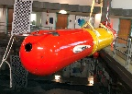

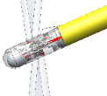

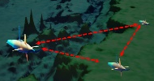
Recent History
2019 Annual Report
Good backstory for why we developed the LRAUV
Biological Oceanography CANON, Sipper Sampler
HABS & Microbes
3G ESP, MiVEGAS
Targeted Sampling
Multi-vehicle Opps
2009
---
2020
LRAUV
Early Adopters
Zooplankton Biodiversity
Bioluminescence
Bio-acoustics
Zooplankton
Terrain Relative Nav
Low Altitude Control

Slide 3
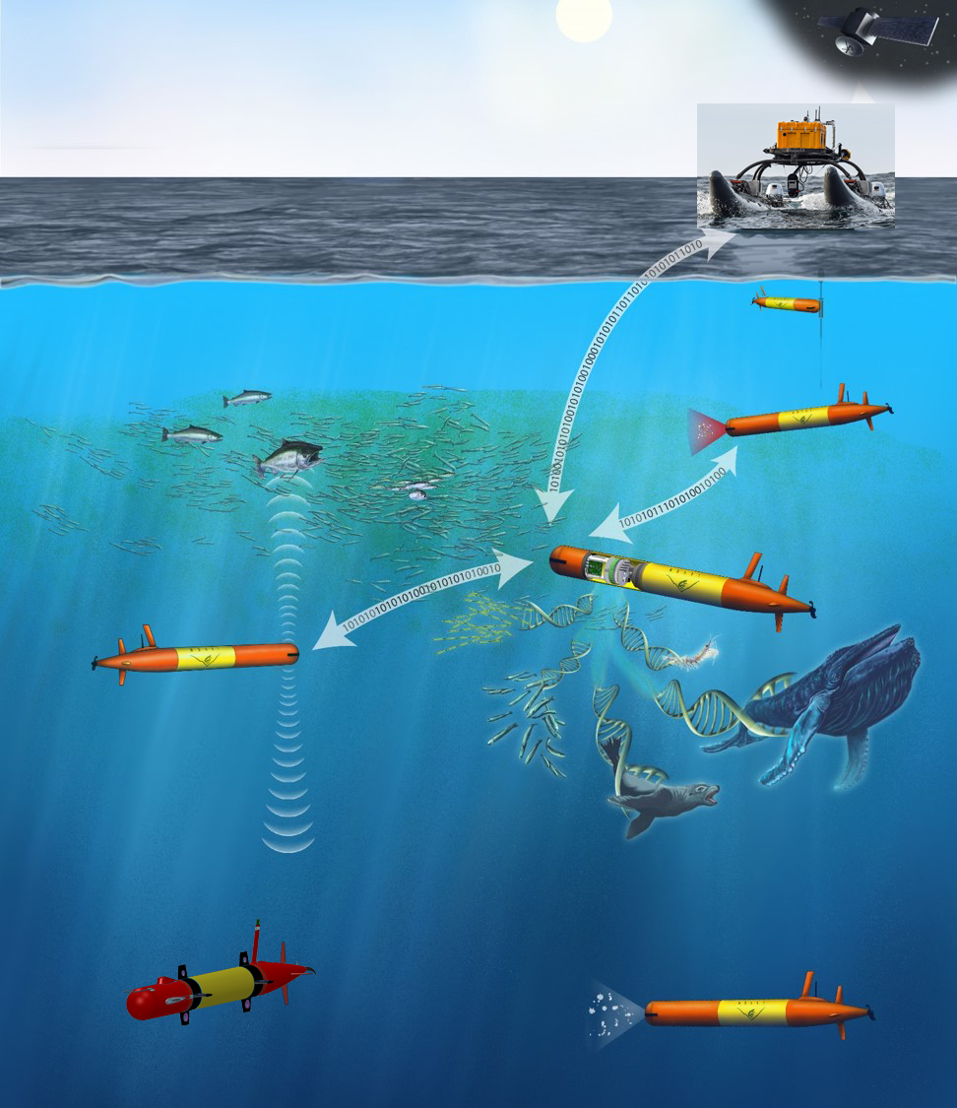
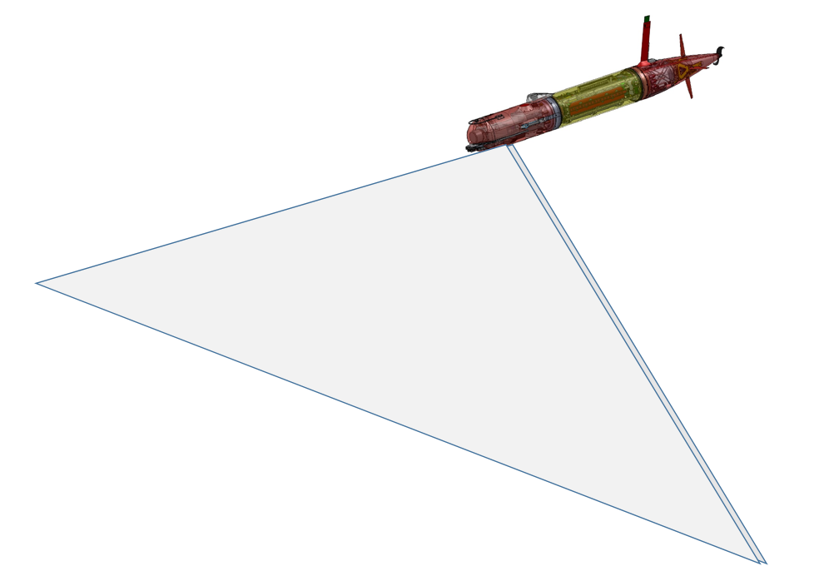
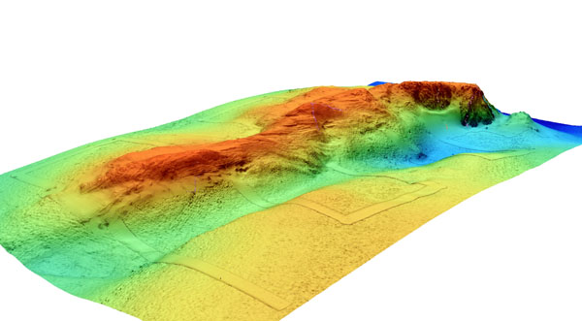
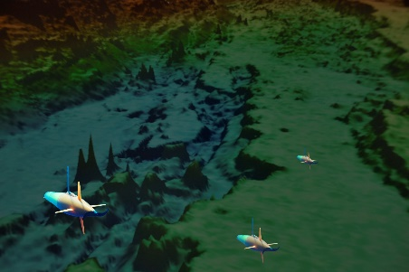
Where Do We Think We’re Heading?
2025 - 2029
Find, follow and sample hot spots, anywhere, for months on end
Enable true autonomy aboard individual and groups of vehicles to answer our questions and solve any ew problems along the way
Map and image in complex terrain down to 1500m
Watch a legion of new users around the world extend MBARI’s success with their own LRAUV applications and discoveries

Slide 4
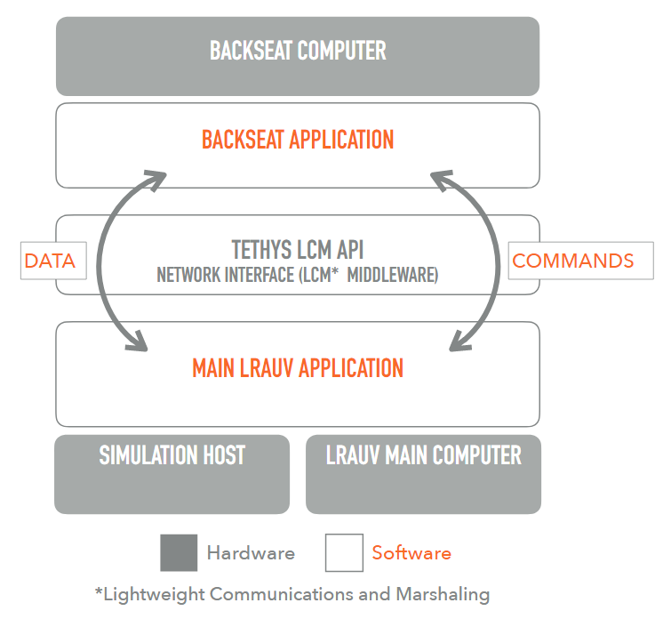
What should we be working on to get there?
Autonomy – Smart Sampling
Multi-Vehicle Collaborations
Persistence
Deep Vehicle
Seafloor Mapping and Low-Altitude Imaging
Autonomy and Smart Sampling
  Most new, custom software developed off-board AUV – Backseat Computer
  Processor and computer language agnositic
  Open source
  Test-able, especially if ROS simulator is available
  Targeted Sampling, adaptive path planning, high power
  See Ben’s Multi-LRAUV Simulation Environment presentation
Current and Planned Backseat Computer Applications:
1. Plankton Proxies: Process sensor data to look for patterns proven to be associated with taxa. Will soon re-direct AUVs for samping/imaging
2. TRN: Process DVL range data to determine position relative to the terrain and updated AUV navigation
3. Targeted Sampling: processes sensor data from multiple AUVs that are shared over acoustic communication and then send new waypoints to all the AUVs in the group
4. ESP HABS: Processes raw SPR data to obtain toxin concentration that can be used for targeted sampling
5. Bio-acoustics: Process images from sonar payload to identify areas of interest that can be shared with nearby AUVs for imaging, eDNA sampling, microscopic imaging
6. JPL collaboration: Monitor navigation uncertainty and override mission with waypoints to get home when the uncertainty exceeds a threashold
7. Mapping: Run the high-power mapping and navigation payload, exchanging mission parameters, sonar and logging settings from AUV and sharing INS navigation with AUV
8. Hovering: Run the high-rate control and high-power thrusters based on position data from machine vision cameras imaging targets of interest

Slide 5
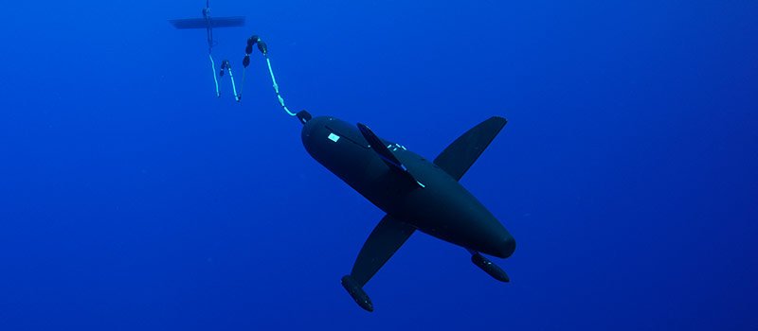
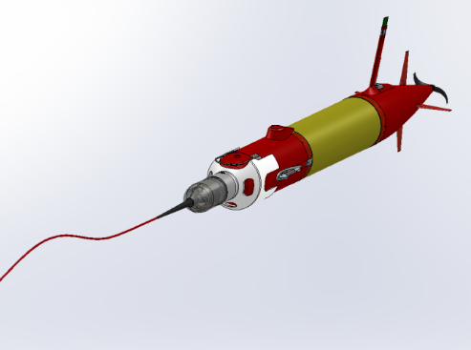
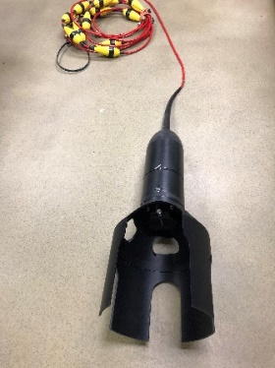
What should we be working on to get there? (2/3 )
2. Multi-Vehicle Collaborations
  Yanwu’s smart front following and Patch Tracking
  AUV mission re-direct based on consensus
  Rock’s distributed TRN navigation
  Formation flying
3. Persistence
  AUV Docking
  Tow out – Tow in
  Un-Crewed Surface Vessel Launch and Recovery (USV/LARS)

Slide 6
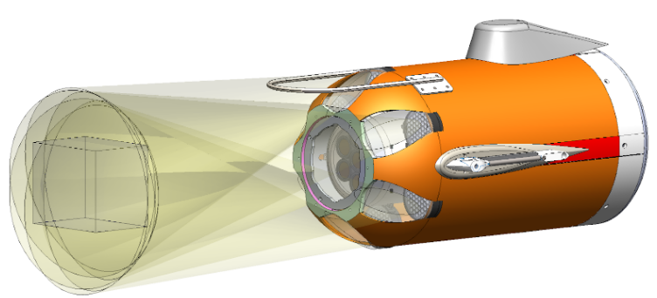
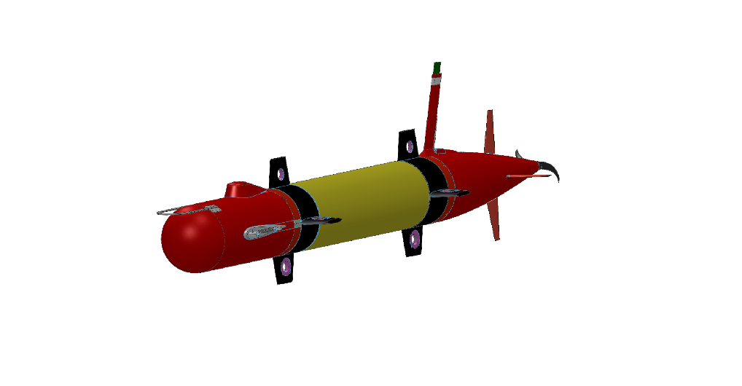
What should we be working on to get there? (3/3 )
4. Deep Vehicle - Biodiversity, community composition, and biological carbon pump function:
  EyeRIS imaging of particles and plankton
  Bioacoustic imaging of plankton and nekton
  Access to seafloor sites such as Sur Ridge
5. Seafloor Mapping and Low-Altitude Imaging
  Multibeam mapping vehicle upgrade at WHOI with funding from DHS/Coast Guard
  Uses MB System, a Norbit high resolution multibeam, and INS
  2020 work at MBARI to integrate a forward-look obstacle avoidance sonar for reactive bottom following and Terrain Relative Navigation (TRN)
  Use TRN for feed-forward control of bottom following
  Work with EyeRIS team to develop a seafloor imaging version
  Develop an add-on hovering module for very low altitude, high resolution imaging

Slide 7








Not Everyone at MBARI uses the LRAUV
Yet

Slide 9
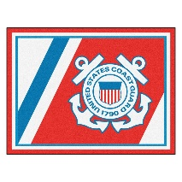





?
?

Slide 10
2021 Proposal
Option A, Super Optimistic:
  2+ FTEs to work on Smart Sampling, Docking, Deep Vehicle, Imaging, USV+LARS, Hovering Module, Operations Support
Option B, Realistic:
  1 FTE-ish, Smart Sampling, Tow-out-in, Docking, Deep Vehicle Design, EyeRIS, Operations Support
Option C, Bare Bones:
  1 FTE, Same as B, but with minimal expenses
Optinon D, Shelter in Place:
  ½ FTE, Smart Sampling and as much design work as possible with operations support

