Slide 1
902106 Niobicon AUV docking
What’s the fundamental problem, question, or issue you are addressing?
MBARI replies heavily on AUVs, but their endurance is severely limited by their battery capacity.
Remote AUV charging is a very challenging problem that MBARI and other groups have attempted to solve with limited success.

Slide 2
902106 Niobicon AUV docking
Why is it important/why should anyone care?
Remote AUV charging could allow months-long deployment of the AUVs, to perform time series and event response missions.
Not having to recover the AUV on a regular basis to recharge its batteries will save time and money

Slide 3
902106 Niobicon AUV docking
What are we doing about it/what’s MBARI’s unique contribution?
We are developing a docking station for the LRAUV to allow remote battery charging and data transfer.
The AUV docking will rely of Niobicon, a technology patented by Northrop Grumman that allows electrical connections in water, without insulation.
MBARI is uniquely positioned to tackle this problem, thanks to our fleet of AUVs and experience with AUV docking.

Slide 4
902106 Niobicon AUV docking
What are your project plans for next year (2022)?
In 2022, we will make improvements to the Niobicon power-transfer device that we have been developing.
In collaboration with WHOI, we will design and build a buoy-supported dock and deploy it for 6 months in Monterey Bay. Solar energy will be harvested on the buoy and transferred to an AUV dock on the seafloor.
The dock will be used to support scientific surveys.

Slide 5
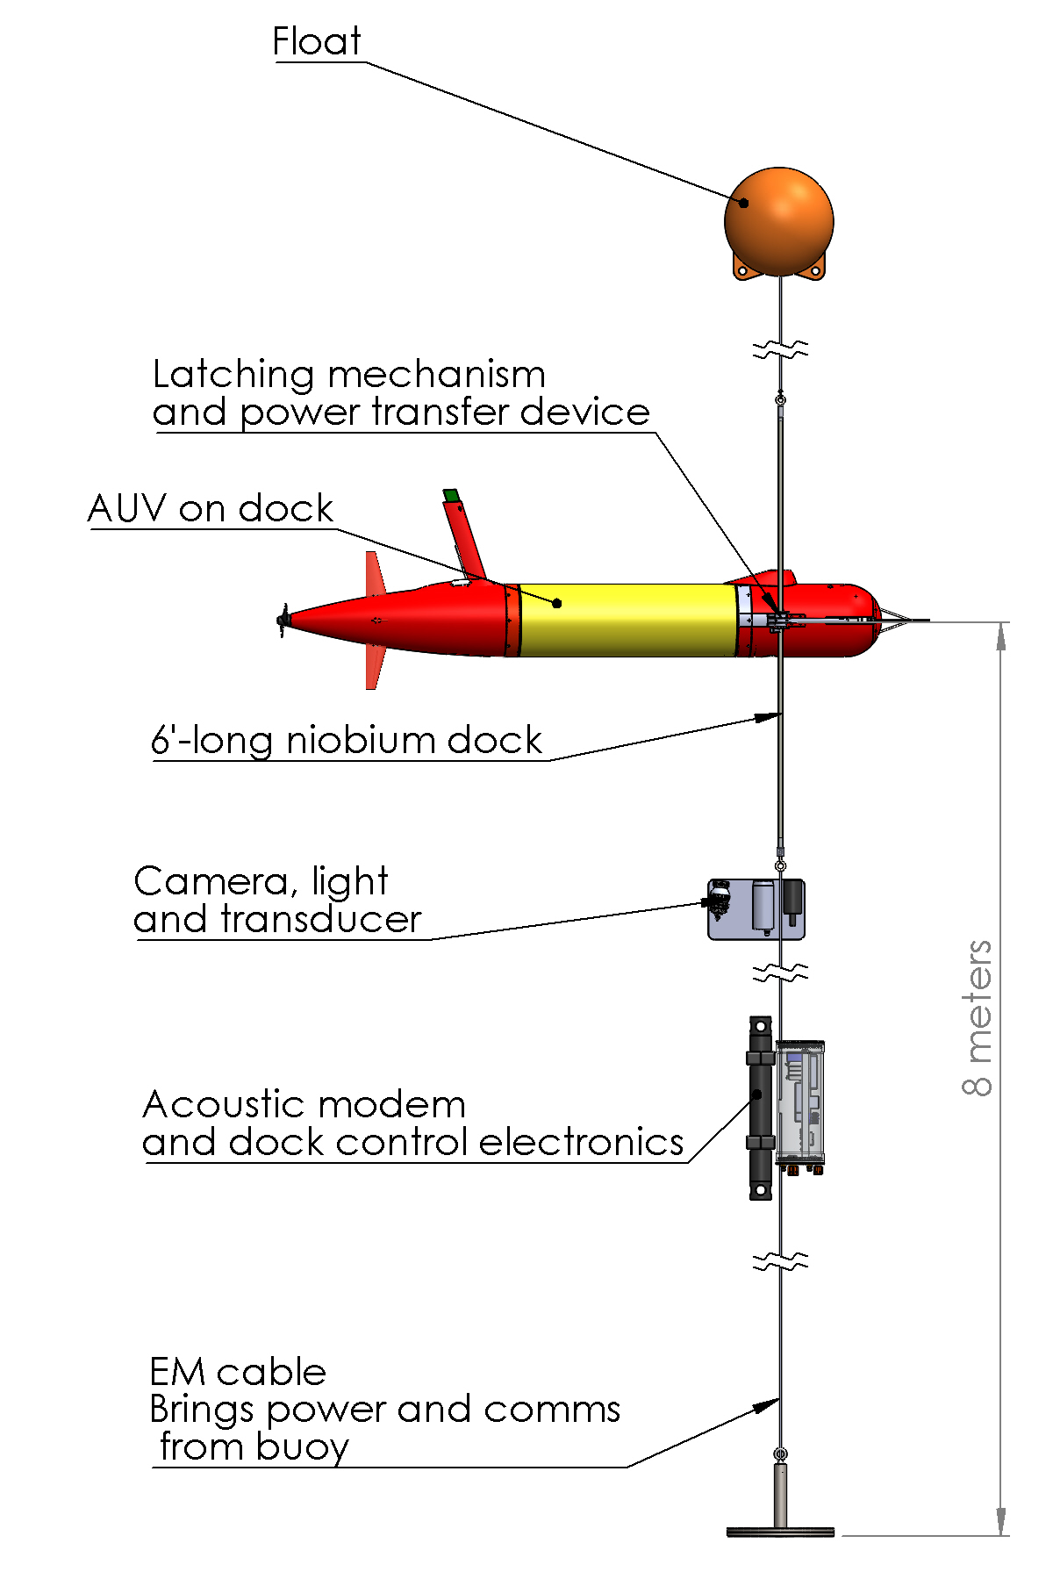
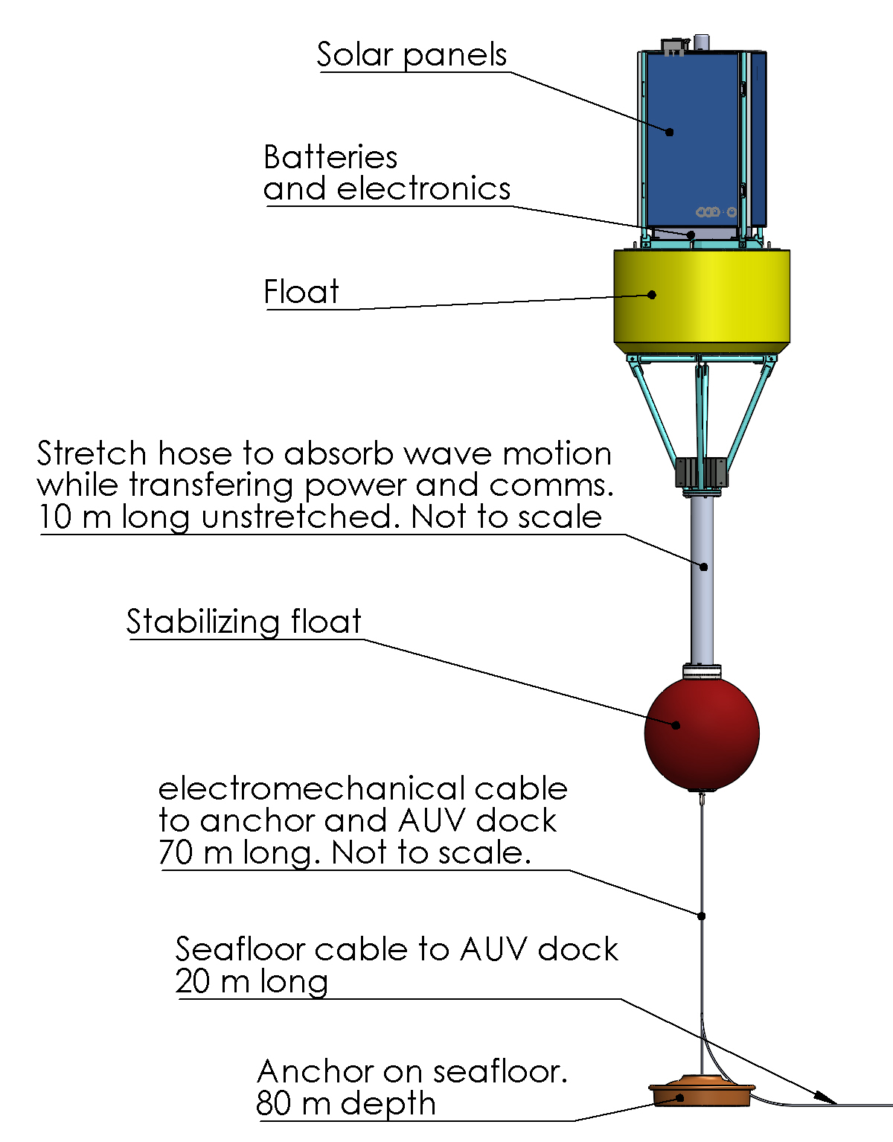
902106 Niobicon AUV docking
A solar harvesting buoy will bring power and data to the seafloor mounted AUV dock

